Slide 1
Overdose Prevention and Response
Tiffaney Nielson and Ashley Borlick
Human Services Program Coordinators
Division of Care and Treatment Services

Slide 2
Purpose
This course is designed for people interested in learning about the unpredictable drug supply, as well as overdose prevention strategies to support health care for injection drug use, including how to use naloxone and how to teach others to use naloxone.

Slide 3
Agenda
Drug overview
Overdose
Overdose epidemic
Health care for injection drug use
Overdose prevention
Opioid overdose reversal medications
Overdose signs
Overdose response
Laws and procedures
Overdose prevention tips
Tailoring the training
Resources

Slide 4
Section A
Drug Overview

Slide 5
Opioids
An opioid is any drug that contains opium (or its derivative).
Opioids can be:
Natural or synthetic.
Prescription medications or illegal drugs.
Pills, capsules, powder, dermal patches, or liquid.
Swallowed, smoked, snorted, or injected.

Slide 6
Opioids
Opioids:
Manage pain, suppress coughs, and treat opioid use disorder.
Cause feelings of euphoria, contentment, and/or detachment.
Have effects lasting from 3 to 24 hours.
Can suppress a person’s ability to breathe when taken in large amounts.

Slide 7
Opioids in the Brain
Opioids bind to and activate receptors in the brain, triggering the release of dopamine—a neurotransmitter linked to learning, pleasure, and reward.
Notes:
Our bodies produce substances that are very similar to opioids; these are known as endogenous opioids or endorphins. Exogenous opioids, such as heroin and methadone, bind to the same receptors as endogenous opioids, which explains their powerful effect on human beings.
Opioids release an excess of dopamine into the body. Dopamine is a neurotransmitter (brain chemical) involved with learning, motivation, pleasure, and reward. Opioids change the amount and sensitivity of dopamine receptors and can make people feel euphoric; in addition, opioids can suppress pain and reduce anxiety. Eventually, users require an opioid to continuously occupy the opioid receptor in the brain, or they develop withdrawal symptoms.

Slide 8
Opioids in the Brain
Opioid
Opioid fits exactly on receptor
Opioid receptor in brain

Slide 9
Opioids: Tolerance
Over time opioid use changes both the amount and sensitivity of dopamine receptors causing users to need a continuous supply of opioids to feel “normal.”
Notes:
Our bodies produce substances that are very similar to opioids; these are known as endogenous opioids or endorphins. Exogenous opioids, such as heroin and methadone, bind to the same receptors as endogenous opioids, which explains their powerful effect on human beings.
Opioids release an excess of dopamine into the body. Dopamine is a neurotransmitter (brain chemical) involved with learning, motivation, pleasure, and reward. Opioids change the amount and sensitivity of dopamine receptors and can make people feel euphoric; in addition, opioids can suppress pain and reduce anxiety. Eventually, users require an opioid to continuously occupy the opioid receptor in the brain, or they develop withdrawal symptoms.

Slide 10
Examples of Prescription Opioids
Generic Name | Brand Name
Oxycodone | Oxycontin®, Percocet®, Roxicodone®
Oxymorphone | Opana®
Hydrocodone | Vicodin®, Lorcet®, Zohydro®, Zortab®
Hydromorphone | Dilaudid®
Morphine
Meperidene | Demerol®
Codeine | Tylenol® 3 & 4
Buprenorphine | Suboxone®, Subutex®, Zubsolv®
Methadone
Fentanyl | Duragesic®

Slide 11
Opioids: Fentanyl
Fentanyl is a synthetic opioid 50x stronger than heroin and 80-100x stronger than morphine.
Pharmaceutical fentanyl has been used in clinical settings since 1968 during surgery and for pain management.
Illegally produced fentanyl comes in a powder that can be injected, smoked, or snorted.
Illegally produced fentanyl has been mixed into heroin, meth, cocaine, and pills.

Slide 12
Opioids: Fentanyl
You cannot smell, taste, or see fentanyl.
Fentanyl can be detected by using a fentanyl test strip.
You cannot overdose by simply touching fentanyl.
Notes:
1. Fentanyl must be introduced into the bloodstream or mucus membrane. Dermal fentanyl patches for pain management are a different formulation than what is used to “cut illicit substances. 2. Licit and illicit drug use is a part of our world and people will continue using drugs, FTS is a supportive manner to empower people at risk of a fentanyl ingestion and does not enable drug use. 3. Fentanyl in the drug supply is no longer limited to opioids only. 4. In an overdose situation Narcan and naloxone will work on fentanyl.

Slide 13
Opioids Side Effects
Slowed physical activity
Constriction of pupils
Flushing of the face and neck
Nausea
Slowed breathing
Notes:
1. Fentanyl must be introduced into the bloodstream or mucus membrane to experience effects. Dermal fentanyl patches for pain management are a different formulation than what is used to “cut illicit substances. 2. Licit and illicit drug use is a part of our world and people will continue using drugs, FTS is a supportive manner to empower people at risk of a fentanyl ingestion and does not enable drug use. 3. Fentanyl in the drug supply is no longer limited to opioids only. 4. In an overdose situation Narcan and naloxone will work on fentanyl.

Slide 14
Xylazine
Xylazine is a veterinary tranquilizer not approved for human use.

Slide 15
Xylazine
Xylazine is not an opioid.
Xylazine is not detectable by taste or smell.
Xylazine can be detected with a xylazine test strip.
Xylazine is primarily being mixed with other drugs during the final stages of the drug trafficking process.
Xylazine is often found in combination with fentanyl because it may extend the effects of fentanyl.
Notes:
1.)Along with sedative effects, Xylazine also has pain relieving and muscle relaxant properties.
2.)Xylazine was first synthesized by Bayer in the 60’s and then approved as an animal medicine by the FDA in 1972. Studies in humans found to have serious side effects like the occurrence of very low blood pressure (severe hypotension) and severe central nervous system depressants effects. Xylazine (Tranq Dope): Effects, Addiction & Treatment - Drugs.com
3.)Phenothiazines fall into the group of first generation antipsychotic medications.
5.)Xylazine is not an opioid and is almost never seen by itself. Xylazine is commonly added to drugs containing fentanyl. Narcan and rescue breaths are important responses to suspected Xylazine overdoses!

Slide 16
Xylazine Side Effects
Sedation
Difficulty breathing
Dangerously low blood pressure
Slowed heart rate
Wounds that easily become infected
Severe withdrawal symptoms
Death
Notes:
Signs of Xylazine effects/overdose:
Extreme sedation/drowsiness, inability to respond, low blood pressure, slow heart rate, decreased or very slow breathing, dry mouth.
Wounds can develop for individuals who don’t inject and can form outside of injection site for those who do inject. Missed shots can increase the severity of wounds.
Identifying suspected xylazine wounds is an important proactive in reducing the changes of necrosis and further complications to infections.
Susceptible to violence due to the inability to move from sedation.
Some may experience intensified withdrawal symptoms of other drugs.

Slide 17
Stimulants
Stimulants are drugs that induce temporary improvement in either mental or physical functions or both.
Examples of prescribed stimulants: amphetamines, ephedrine, caffeine, nicotine.
Examples of illicit stimulants: cocaine, crack cocaine, methamphetamine.

Slide 18
Stimulants
Stimulants cause a state of euphoria, optimism, and general felling of well-being.
Notes:
Stimulant modes of administration: Oral, Snort, Smoke, and Inject.

Slide 19
Stimulants Side Effects
Arousal
Dizziness
Headache
Heart failure
Hyperactive reflex
Increased blood pressure
Increased heart rate
Insomnia
Irritability
Tremor
Upset stomach
Weakness

Slide 20
Section B
Overdose

Slide 21
Drug Overdose
Overdose happens when a toxic amount of a drug, or combination of drugs overwhelms the body.
Mixing drugs increases the risk of an overdose.
Notes:
Too many substances in the body. Overwhelming the receptors and they cannot work properly
Can also happen when you mix substances together. You never know how they will react in the body

Slide 22
Opioid Overdose
The brain has many receptors for opioids. An overdose occurs when too much of an opioid fits in too many receptors slowing and then stopping a person’s ability to breathe.
Notes:
Too many substances in the body. Overwhelming the receptors and they cannot work properly
Can also happen when you mix substances together. You never know how they will react in the body

Slide 23
Section C
Overdose Epidemic

Slide 24
Wisconsin Drug Overdose Deaths
Notes:
Drug overdose deaths (not just opioids)

Slide 25
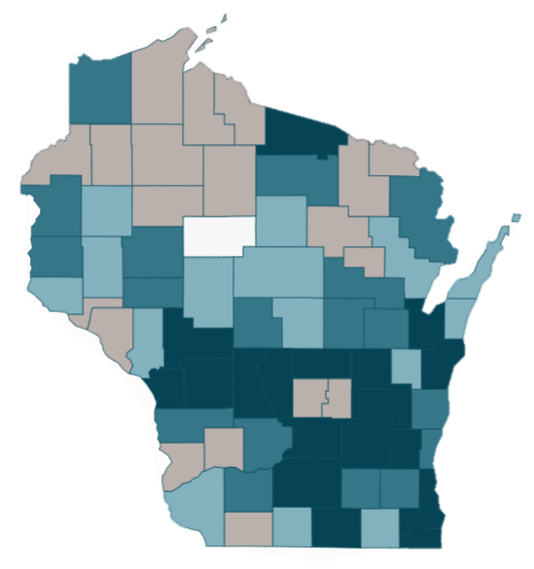
2023 Opioid Deaths by County
County rank fewest
24.0
statewide rate per 100,000 of all opioid deaths
1 to 18
19 to 36
37 to 54
55 to 72
No rank available
Source: Dose of Reality: Opioid Deaths by County Dashboard | Wisconsin Department of Health Services
Notes:
Dose of Reality: Opioid Deaths by County Dashboard | Wisconsin Department of Health Services
MILWAUKEE DANE ROCK BROWN KENOSHA RACINE WASHINGTON WINNEBAGO OUTAGAMIE SHEBOYGAN

Slide 26
Fueled by Fentanyl
In 2023, synthetic opioids, primarily fentanyl, were identified in 92 percent of opioid overdose deaths and 74 percent of all drug overdose deaths.
Provisional data shows the number of fentanyl overdose deaths in Wisconsin grew by 101 percent from 2019 (651) to 2023 (1,307)

Slide 27
Waves of Overdose Epidemic
First wave (started in the mid to late 1990s)
Medical societies and pharmaceutical companies made claims that the risk of opioid use disorder related to prescription opioids was very low.
Communities where opioids were readily available and prescribed liberally were the first places to experience increased opioid use disorder and diversion.
Notes:
First:
Pharmaceutical companies played a significant role in the overprescribing of opioids during the first opioid overdose wave. Marketing efforts that launched campaigns to use OxyContin beyond cancer pain, bonuses that to incentivize reps, and messaging to prescribers that by increasing the dose, pain relief and quality of life will significantly improve. Oxycontin will solve the “pain epidemic”.
81 million opioid painkillers were delivered to Cabell County in West Virginia, which has fewer than 100,000 residents.

Slide 28
Waves of Overdose Epidemic
Second wave (started around 2010)
Consciousness around the overprescribing of opioids led to the limiting of opioid prescriptions.
Heroin became the top alternative to prescription opioids.
Notes:
Second:
*Overprescribing fear spread and the new restrictions on prescribing opioids resulted in people who were dependent on prescription opioids transitioning to using diverted or illicit opioids.
*There is there is no denial that prescription opioids can be misused and diverted. However, this knee jerk reaction to limit and cut people off from their prescriptions has a direct correlation to the sharp increase in opioid overdose deaths. Without the potency and quality assurance being regulated by a manufacturer, people who were using opioids loss their safety net to make informed decisions on their use of opioids.
*The shift to diverted and illicit drugs like heroin led to additional drug user health problems. Heroin is commonly injected, which puts people who use drugs at risk for injection-related diseases like HIV/AIDS, hepatitis B and C, skin infections, bloodstream infections, and infections of the heart.

Slide 29
Waves of Overdose Epidemic
Third wave (started around 2013)
Overdose deaths during this time mostly resulted from the use of synthetic opioids, like illegally made fentanyl.
From 2011 to 2016, African Americans had the highest increase in synthetic opioid overdose death rates.
Notes:
Third: Saw an increase in overdose deaths in African Americans

Slide 30
Waves of Overdose Epidemic
Fourth wave (started around 2020)
An unpredictable drug supply and the use of multiple substances at one time, including cocaine and methamphetamine, as well as lingering challenges from the COVID-19 pandemic related to accessing treatment and recovery supports due to agency staffing shortages are among the factors identified in overdoses.
There were an estimated 100,306 drug overdose deaths in the United States during 12-month period ending in April 2021.
Notes:
Fourth: Covid-19 resulted in a ripple effect that limited access to treatment, basic healthcare, overdose prevention services, and housing stability. Communities of color that have long-standing systemic health inequities have felt the greatest impact from the barriers that resulted from the Covid-19 restrictions. After restrictions started to lift, staffing shortages, vicarious trauma, and burnout resulted in a reduction in services and safety nets.

Slide 31
Unpredictable Drug Supply
Fentanyl is mixed into non-opioid substances.
Other substances mixed with opioids including xylazine and benzodiazepines can complicate overdose reversal.
People using stimulants (examples: methamphetamines, cocaine/crack cocaine) impacted more than other populations because of a lack of effective overdose prevention strategies for stimulants and no overdose reversal medications for stimulants.
Notes:
Adulterated drug supply.

Slide 32
Wisconsin
Stimulant-Involved Deaths
2014
2015
2016
2017
2018
2019
2020
2021
2022
2023
2024
Notes:
ALL STIMULANTS- no current reversal agent/antidote on the market (can still use Naloxone if there is fentanyl in the supply)
Psychoactive drugs that induce temporary improvement in either mental or physical functions or both. Effects include alertness, wakefulness, and locomotion.
Examples of prescribed stimulants: amphetamines, ephedrine, caffeine, nicotine.
Examples of illicit stimulants: cocaine, crack cocaine, methamphetamine.

Slide 33
Section D
Health Care for Injection Drug Use

Slide 34
What is stigma?
Stigma is a social process linked to power and control, which leads to creating stereotypes and assigning labels to those that are considered to deviate from the norm or to behave badly.
Notes:
*share stories about stigma and overdose*
Parents giving kids Narcan to carry in their backpack at school

Slide 35
What is stigma?
Stigma creates the social conditions that make people who use drugs believe they are not deserving of being treated with dignity and respect, perpetuating feelings of fear and isolation.

Slide 36
What does stigma look like?
Stigma limits a person’s ability to access services they need because they feel unworthy.
Stigma creates barriers while receiving services because people feel unwelcome or judged by program staff.

Slide 37
Use People First Language
A person is a person first, and a behavior is something that can change – terms like “drug addict” or “user” imply someone is “something” instead of someone.
Notes:
We use language, images, and often stereotypes to quickly add meaning to situations. This is an ingrained human behavior which allows us to quickly process information and make decisions. If we were in a jungle looking through the bushes and saw a yellow field with black spots, we would likely think “cheetah” and have a fight or flight response rather than thinking “person in a polka-dot shirt” resulting in a different action.
To underline this point, have your audience think of a “Bachelor”. Ask them if the image they have in their head of a bachelor includes the Pope. While the Pope is a man who is not and has never been married – a bachelor - he is not likely fitting into the image most people have in their heads when they think of this word. Language elicits images and stereotypes in people’s brain in order to quickly process information.
This is true for the language we use when referring to people with substance use disorders. The language we use as trainers should be person-centered and non-stigmatizing whenever possible. Just because some one in recovery refers to themselves as an “addict” or a “junkie” does not mean you should. As a trainer it is your job to model appropriate language in order to reduce stigma and change the dialogue around people with substance use disorders.

Slide 38
Use People First Language
Stigma is a barrier to care, and people want to feel comfortable when accessing services or talking to providers.
People are more than their drug use.

Slide 39
Model Respectful Language
Avoid | Use Instead
Substance abuser Addict Junkie | Person with a substance use disorder, person who uses drugs
“Dirty” (person/syringe) | Positive urinalysis, used syringe
“Clean” (person/syringe) | Negative urinalysis, unused syringe, substance free
Substance abuse | Substance use, substance misuse, non-medical use, risky use
Notes:
*in person- ask what language we should be using*

Slide 40
Section E
Overdose Prevention

Slide 41
Overdose Prevention
Overdose prevention is an evidence-based approach at reducing overdose deaths.
Source: Center for Disease Control and Prevention, 2025

Slide 42
Overdose Prevention Goals
Aim to attain any positive change. Minimize the negative effects of drug use for people who use drugs, their families, and the community.
Empower people who use drugs to keep themselves as safe as possible.

Slide 43
Principles of Overdose Prevention
Accepts that legal and illegal drug use is part of our environment.
Understands that drug use is on a spectrum and some methods of using drugs are safer than others.
Establishes well-being and quality of life as the standard for successful interventions.
People who use(d) drugs are involved when programs and policies are being created.

Slide 44
Principles of Overdose Prevention
People who use drugs are the primary agents and experts at reducing the risks associated with their drug use.
Services must be noncoercive and non-judgmental.
Drug-related risks are impacted by the realities of poverty, class, racism, social isolation, trauma, discrimination, and other social inequalities.
Reducing the risks of drug use does not ignore the reality and tragedy associated with substance use.

Slide 45
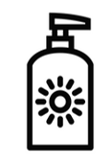




Examples of Other Prevention Strategies
Sun
screen
Seat
belts
Speed
limits
Cigarette
filters
Recycling
Notes:
You can mention safe consumption sites (bars). How many people participate in that?

Slide 46
Section F
Opioid Overdose Reversal Medications

Slide 47
Naloxone
Naloxone is a medicine that reverses an opioid overdose by
blocking the effects of opioids on the brain.
Notes:
**NARCAN is not the only brand of nasal overdose reversal medication, however, for the naloxone direct program, this is a picture of the supply we hand out**

Slide 48
Naloxone and the Brain
Naloxone
Opioid
Naloxone
Opioid receptor in brain

Slide 49
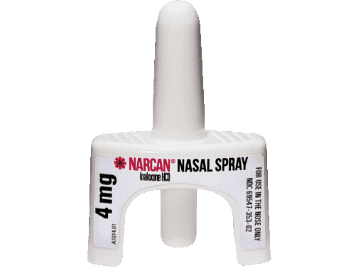
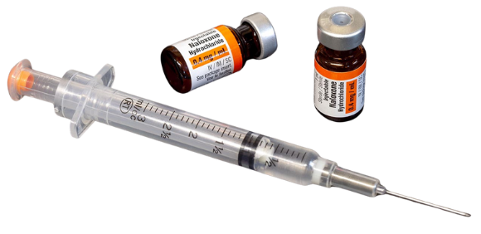
Naloxone
Intramuscular/IM Intranasal/nasal

Slide 50
Naloxone
Only effective in reversing opioid overdoses
No effect on someone who hasn’t taken opioids
No significant side effects
No potential for misuse or getting high

Slide 51
Naloxone
Wears off in 30‐90 minutes
Safe for children, pregnant women, and pets

Slide 52
Naloxone Storage (All Forms)
Store in original package at room temperature (60°- 80°) away from light sources, like sunlight.
Notes:
Do not allow naloxone to freeze or attempt to use if it does freeze. If the naloxone is cloudy, it may be an indication that it is no longer usable.
Keep naloxone in a safe place away from children and pets, but easy to access in case of emergency.

Slide 53
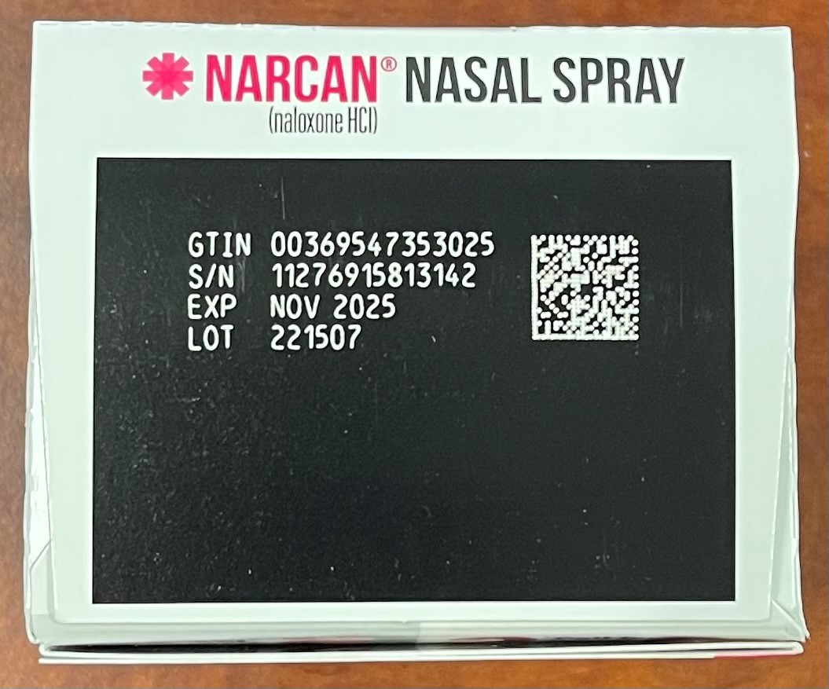
Naloxone Shelf-Life
Find the expiration date for NARCAN® on top of the box
Notes:
4 years from manufacturing date- depends on when you receive the Narcan. Always refer to the date on the top of the box

Slide 54
Naloxone Shelf-Life
Consider donating naloxone near its expiration date that may go unused to P.U.L.S.E, Wisconsin’s alliance of people who experience using drugs.
Notes:
4 years from manufacturing date- depends on when you receive the Narcan. Always refer to the date on the top of the box
P.U.L.S.E: Promoting, Understanding, Lifting, Stigma, and Empowerment
P.U.L.S.E. represents a dynamic alliance of individuals who have experience using drugs. Additionally, P.U.L.S.E includes advocates and supporters for drug-using communities.
https://www.people4pulse.org/; people4pulse@gmail.com

Slide 55
Naloxone Disposal
Intramuscular naloxone
Dispose needle as medical sharps in a rigid container
Nasal naloxone
Dispose device in any trash container

Slide 56
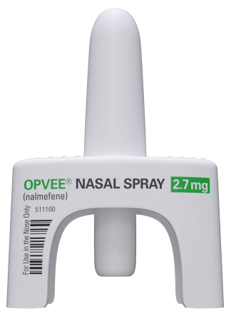
Nalmefene
Nalmefene is a medicine that reverses an opioid overdose by blocking the effects of opioids on the brain like naloxone, but it stays in the body longer.
Notes:
Currently, a prescription only medication. Opvee stays in the body longer
Nalmefene was FDA approved for IM in 1995. It was removed from the market in 2008 for commercial reasons. Because it was already approved for use via injection, the nasal product did not require new clinical data.
**Lower dose, sometimes people use to much…etc, compassionate overdose webinar-Europe***
Why people do not support Nalmefene? UNC article (source below)
The marketing of high-dose naloxone is a historical and global anomaly. The average dose of naloxone per reversal did not change during the fentanyl era.
Severe Withdrawal Increases Risk for Repeated Overdose. Legit question: If saving a life is what's important, can't they just put up with withdrawal? We just learned about this. Severe withdrawal can lead to immediate and repeated re-dosing with dope. In the weeks that follow, negative withdrawal experiences may lead to using drugs alone. Both of these outcomes increase the chance of a subsequent overdose!
Nalmefene nasal spray has never been tested in the real-world. How can you trust an overdose reversal drug that wasn't even tested with people who use drugs!?
Stick with what is proven: There is no urgency to switch to untested medications.
https://opioiddatalab.ghost.io/october-2024-newsletter/?ref=unc-street-drug-analysis-lab-newsletter

Slide 57
Nalmefene and High-Dose Naloxone
These options may cause severe precipitated withdrawal symptoms, including acute respiratory distress syndrome, severe agitation, irregular heartbeat, and stress cardiomyopathy.
Notes:
Cardiomyopathy- disease that affects the heart muscle, making it difficult to pump blood and can lead to heart failure
All opioid reversal medications cause precipitated withdrawal symptoms. Precipitated withdrawal symptoms range in severity from mild dysphoria or gastrointestinal upset to life-threatening conditions.
Nalmefene is a long-acting overdose reversal medication. Kloxxado and Zimhi are examples of high dose naloxone. Evidence shows more risks with nalmefene and high-dose naloxone than standard dose naloxone, as there is higher likelihood of severity of symptomology and elongated duration of the precipitated withdrawal.
Currently, there is no evidence to demonstrate nalmefene (non-naloxone) or high-dose naloxone is more effective than 4mg naloxone.

Slide 58
Break: 10 minutes

Slide 59
Section G
Overdose Signs

Slide 60
Being “High” vs. Overdosing
It can be hard to tell if someone is very “high” or overdosing.
If they are very “high,” you may notice:
Their pupils contracting and appearing small.
Their muscles are slacking and droopy.
Them “nodding out.”
They may scratch their skin a lot.
Their speech may be slurred.
They will respond to outside stimuli like loud noise or a light shake.
Notes:
It can be really difficult to tell when someone is overdosing or just really high. These signs and symptoms are for someone who is very high

Slide 61
Helping a “High” Person
If the person is still conscious, help them walk them around, keep them awake, and monitor their breathing.
Notes:
You don’t want someone to overdose, so make sure you do not leave that person alone in case they do overdose. Also have naloxone ready

Slide 62
Signs of an Opioid Overdose
Unresponsiveness or unconsciousness
Slowed or stopped breathing
Snoring or rattling sounds
Cold or clammy skin
Discolored lips or fingernails

Slide 63
Signs of an Opioid Overdose
If someone is making unfamiliar sounds while “sleeping,” it is worth trying to wake them up. Many people think a person is snoring, when in fact the person is overdosing.

Slide 64
Take Action
It is rare for someone to die immediately from an overdose. People survive because someone was there to respond.

Slide 65
Section H
Overdose Response

Slide 66
Responding to an Opioid Overdose
Assess
Stimulate
Call 911
Give naloxone
Start rescue breathing
Put person in recovery position
Stay with the person until emergency medical services arrives
Notes:
These are not steps. They can be done in different orders

Slide 67
Assess
Check to see if the person is displaying any signs of an opioid overdose:
Unresponsiveness or unconsciousness
Slowed or stopped breathing
Snoring or rattling sounds
Cold or clammy skin
Discolored lips or fingernails

Slide 68
Stimulate
Verbal
Try to get them up by saying:
Their name.
something they don’t like. "I'm going to call 911.”
"I'm going to give you naloxone."
Physical
Make a fist and rub your knuckles firmly up and down their sternum.
Pinch the back of their arm.

Slide 69
Call 911
Share your exact location (street address, location in building, etc.).
Share if the person is unresponsive.
Share if the person has slowed or stopped breathing.
Follow the directions of the 911 operator.

Slide 70
Call 911
Emergency medical help is needed because:
The situation may not be an opioid overdose.
Naloxone is only temporary.
Notes:
At a minimum, if you suspect someone is overdosing, call 911.
A Good response to an overdose is to call 911 to ensure proper medical attention is provided and administer naloxone.
A Better response to an overdose is to call 911, administer naloxone, and provide chest compressions.
The Best response to an overdose is to call 911, administer naloxone, and administer rescue breathing and/or CPR.
Calling 911 is especially important with the rise in fentanyl. As was mentioned, it is extremely potent and as a result, it may take several doses of naloxone in order to reverse the overdose effects.
Naloxone is only temporary; it is like pushing the pause button on a remote control. It will eventually wear off, and if there are still large amounts of opioids in the system, the person can fall back into an overdose.
The 911 dispatcher can also talk you through caring for the patient including providing rescue breaths and administering naloxone (if available) until EMS arrives.

Slide 71
Call 911
When emergency medical help arrives, tell them:
What you know about what drugs the person may have been taking.
If/when naloxone was administered and how much was given.

Slide 72
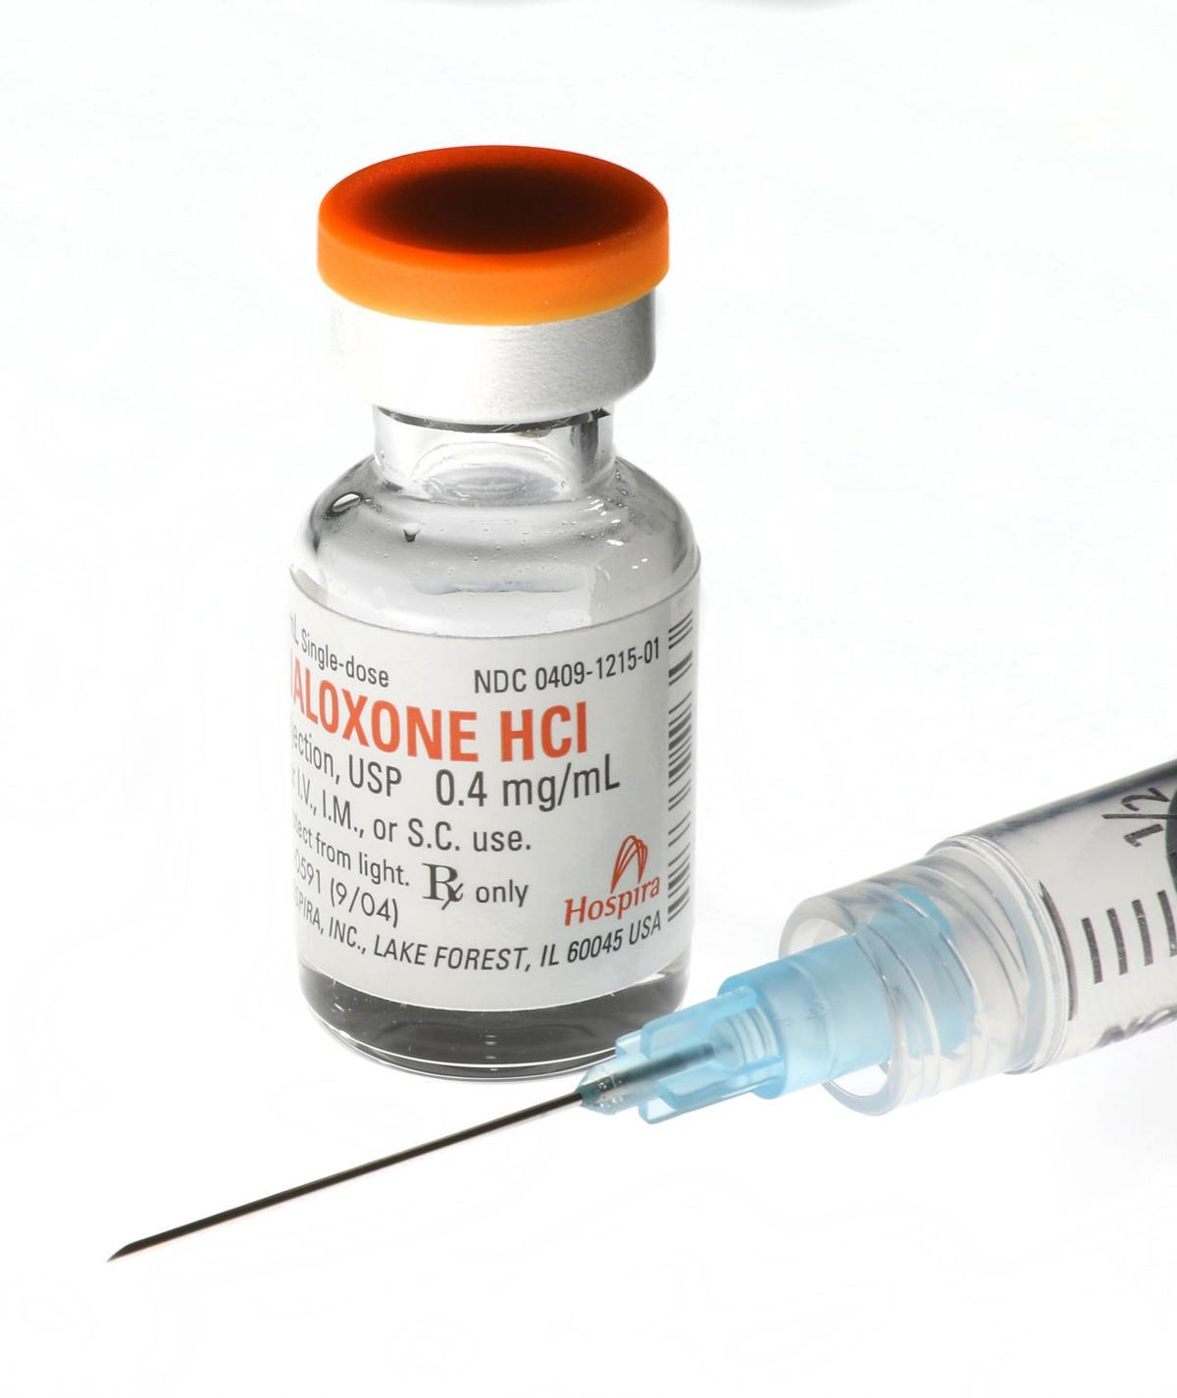
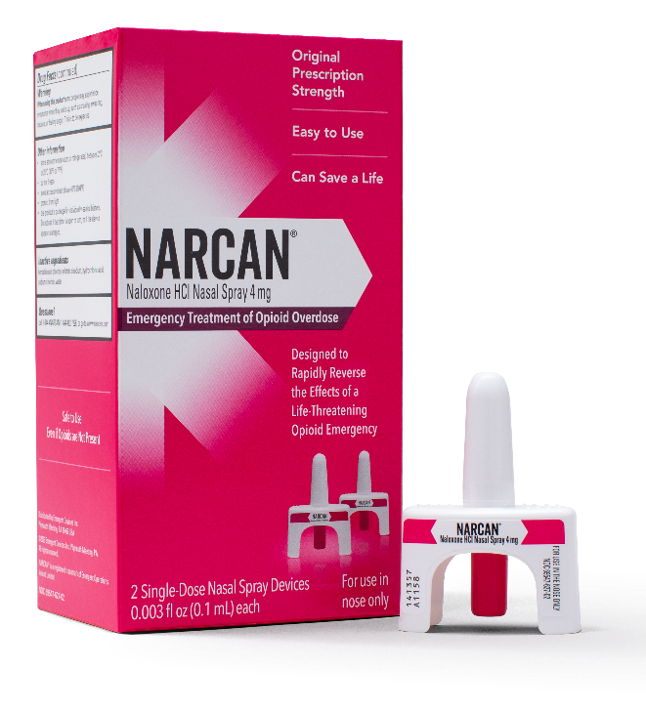
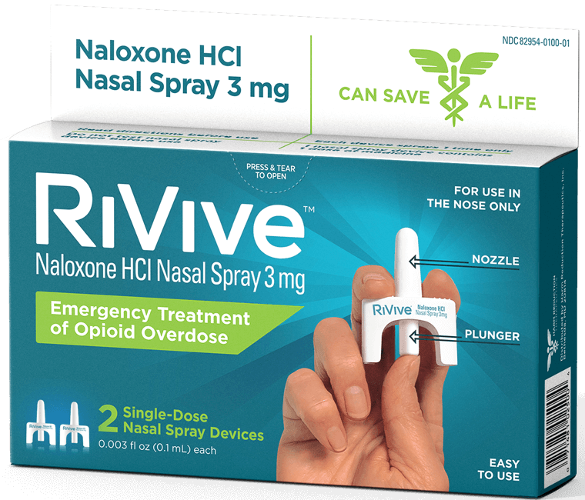
Give Naloxone
Notes:
IM (vial and syringe)
RiVive (3 mg naloxone) (generic version of NARCAN)
NARCAN (4 mg naloxone)

Slide 73
Naloxone Nasal Spray
Do rescue breathing for a few quick breaths if the person is not breathing.
Remove nasal spray from box. Peel back tab with circle to open.
Hold nasal spray with your thumb on the bottom of the plunger and your first and middle fingers on either side of the nozzle.
Notes:
The box of nasal spray includes instructions. There are also instructions in each individual dose of nasal spray.

Slide 74
Naloxone Nasal Spray
Tilt person’s head back and support their neck. Make sure there is nothing in their airway.
Gently insert tip of nozzle into a nostril until your fingers touch the nose.
Press the plunger firmly to release the dose of naloxone.
Notes:
It is not uncommon for some of the naloxone or mucus to run out of the nose when administering it.
With some other forms of naloxone it was necessary to “prime the injection” before administering it. This is NOT the case with nasal Narcan®. Once you push the plunger naloxone will be administered – just like an atomizer nasal spray that you might use for allergies.

Slide 75
IM Naloxone (Injectable)
Do rescue breathing for a few quick breaths if the person is not breathing.
Pop off the flip‐top of the naloxone vial.
Insert the needle into the vial and draw up 1cc of naloxone into the syringe (whole vial).
Inject needle straight into muscle (through clothes, if necessary), then push in plunger.

Slide 76
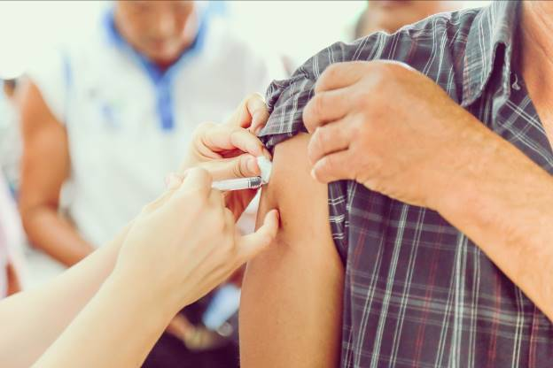
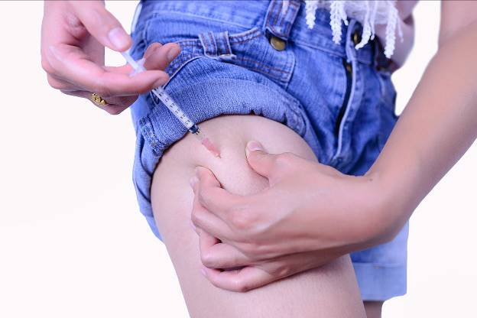
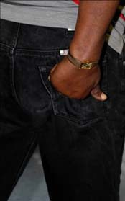
IM Naloxone (Injectable)
Where to inject naloxone:
Thigh
Buttocks
(upper outer quadrant)
Shoulder
Do not inject naloxone into the person’s heart, chest, or back.
Notes:
To inject into the upper arm, place the needle about three fingers down from the top of the shoulder.

Slide 77
IM Naloxone Common Questions
Will it take longer to administer IM naloxone?
What if it makes me uncomfortable to use needles?
What if I do it wrong?
Notes:
Answers:
No. The amount of time it takes to administer is roughly the same as Nasal. The only difference is you are using a needle and inserting that into a muscle vs using a nasal device.
2. Practice using the needle. Work on changing your mind set- needles can be scary, but you are potentially saving someone’s life.
3. Naloxone is never going to hurt someone. Instructions reference how and where to administer Naloxone.

Slide 78
Multiple Naloxone Doses
Multiple naloxone doses may be needed. If there is no response after 2-3 minutes, give a second dose. Provide rescue breathing between doses or until the person’s breathing is restored.
Notes:
People always want to know how many doses is "normal." There is no normal amount. An individual has given someone 1 dose and they are up and someone else gave 4 doses before they are up. Depends on the person, their body, what they took, etc.

Slide 79
Rescue Breathing
Rescue breathing is the quickest way to get oxygen into a person’s body.
“Hand-only” CPR guidelines work for cardiac arrest, not overdoses.
Notes:
You may have heard that recent CPR guidelines recommend “hands-only CPR,” or only chest compressions instead of rescue breathing and chest compressions. These guidelines are for layperson response to cardiac arrest, and NOT overdose. It is still recommended that you perform rescue breathing for an overdose, where the primary issue is respiratory depression, and not cardiac arrest.
With an overdose your heart rate slows gradually over time, meaning you have less oxygen in your system by the time you are unconscious. Meaning you need to get oxygen flowing as fast as possible because permanent brain damage can occur as a result of lack of oxygen in as little as 4 minutes (rescue breathing). In a heart attack, you heart stops at that moment meaning you still have a lot of oxygen in your system, so getting the heart pumping again is most important (chest compression)
**This is why Rescue breathing is so important** We need to get the oxygen flowing again.
We have always suggested that people can use whatever they have available to create a make-shift breathing shield, like using a t-shirt (as long as it’s thin enough to breathe through). I’ve even heard of people grabbing a piece of paper and poking a whole through it to breathe through.

Slide 80
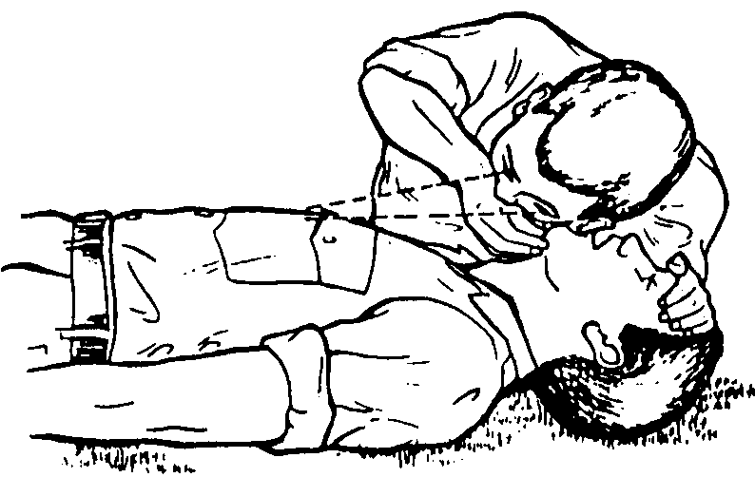
Rescue Breathing
Look, listen, and feel for breathing.
Start rescue breathing right away, if breaths are shallow or short, or the person is not breathing.
Notes:
Slow breathing for an adult is approximately less than one breath every five seconds. Time is very important when an unconscious person is not breathing. Permanent brain damage begins after only 4 minutes without oxygen, and death can occur as soon as 4 to 6 minutes later.

Slide 81
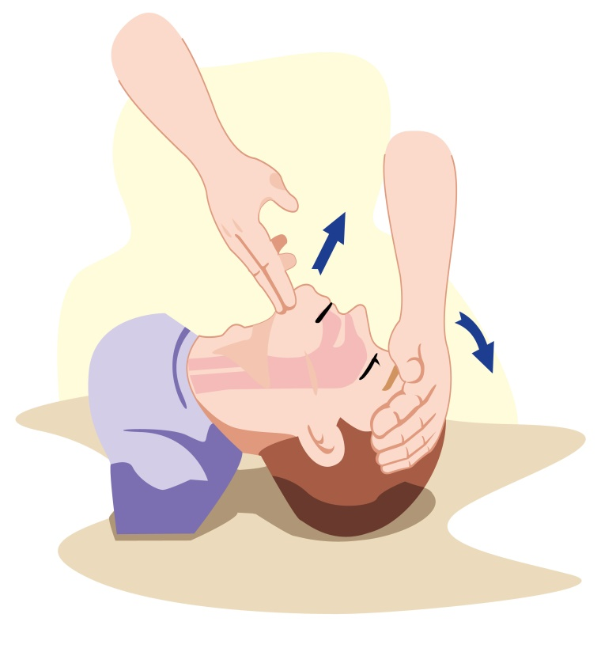
Rescue Breathing Instructions
Place the person on their back.
Tilt the chin to open the airway.
Check to see if there is anything in their mouth blocking their airway (gum, syringe cap, etc.) and remove anything you find.
Notes:
The most common item found in an overdose patient’s mouth is the cap from the needle they used to inject themselves.

Slide 82
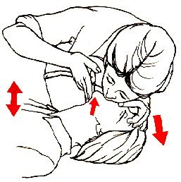
Rescue Breathing Instructions
Pinch the person’s nose closed.
Cover the person’s mouth with your mouth. Blow 2 regular breaths (about 1 second each).
Make sure you see their chest rise. If their chest is not rising, tilt their head more and make sure their nose is plugged.
Continue breathing: Give 1 breath every 5 seconds.

Slide 83
Rescue Breathing
If you don’t have naloxone, continue rescue breathing until emergency medical help arrives. If there’s more than one person present, take turns rescue breathing – it can be exhausting.

Slide 84
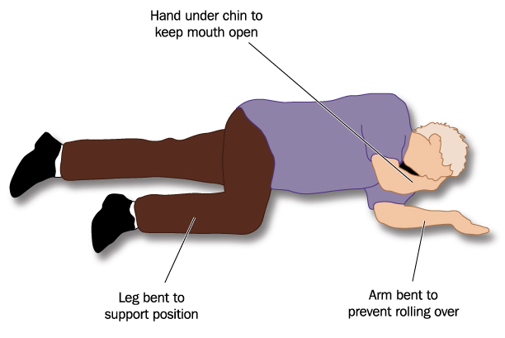
Recovery Position
Put person in recovery position if you must leave them, even briefly.
This keeps the airway clear and prevents choking or aspiration if vomiting occurs.

Slide 85
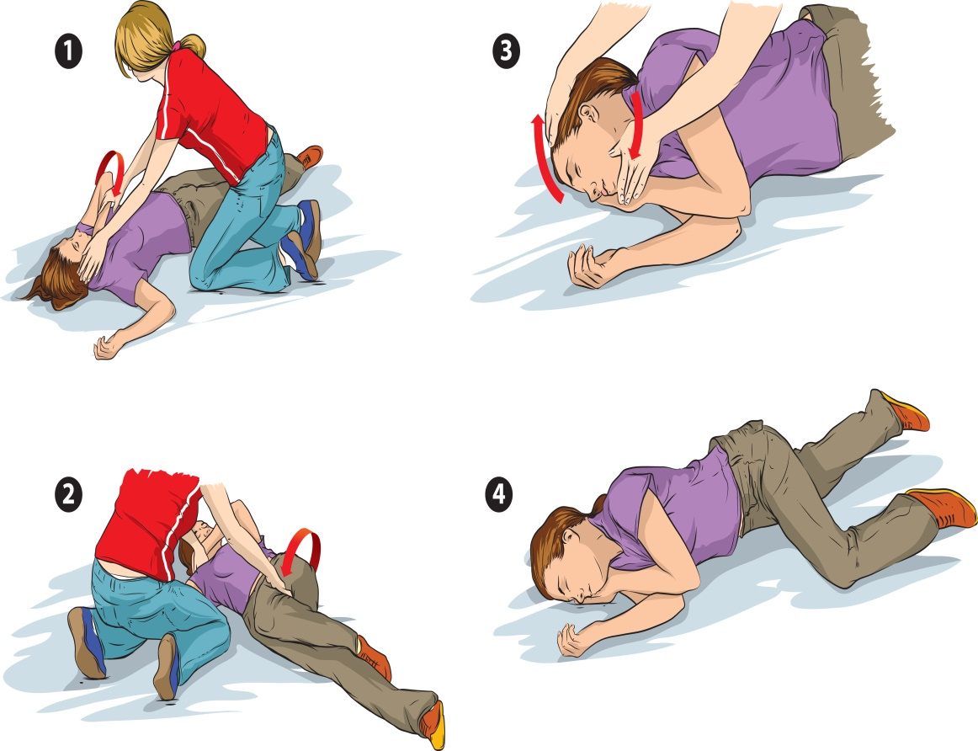
Recovery Position
Face and body turned to the left side
Hand supports head
Bent knee supports body

Slide 86
Care for the Person
After receiving naloxone, a person may:
Feel physically ill
Feel withdrawal symptoms (unpleasant but not life‐threatening)
Become agitated and upset
Overdose again
Notes:
Feel withdrawal symptoms- not life threatening
They may want to use drugs again. It's very important that they do not use drugs until the Naloxone wears off (30-90 minutes) so that an overdose does not reoccur
A person who has overdosed should be monitored for at least 2 hours, or more to ensure overdose symptoms do not return.

Slide 87
Care for the Person
Place the person in the recovery position if they start breathing.
Get the person to a hospital if they can’t walk and/or talk after waking up.
Notes:
As naloxone wears off, the opioid high can return, this includes the chance of the overdose
If the person cannot walk and/or talk well after waking up, then it is very important that they are taken to the hospital. (loss of oxygen/brain damage)
If 911 is not called (we do not recommend), stay with the person for at least 2 hours in case they go back into an overdose (if they do, administer Narcan immediately)
e returning.

Slide 88
Compassionate Response
Treat the person with dignity and respect
Explain in a calm, clear voice that you believe the person overdosed and you gave naloxone
  “You are safe.”
  “I’m here to help you.”
  “EMS is on their way.”
Ask them if they have someone they would like you to contact (family, peer support, “sponsors,” etc.)
Leave naloxone with them, if possible.

Slide 89
Compassionate Response
“A compassionate overdose response is looking at the entire person. It’s not that moment of reviving them. It’s also what happens afterward.”
- Panel member from the Compassionate Overdose Summit

Slide 90
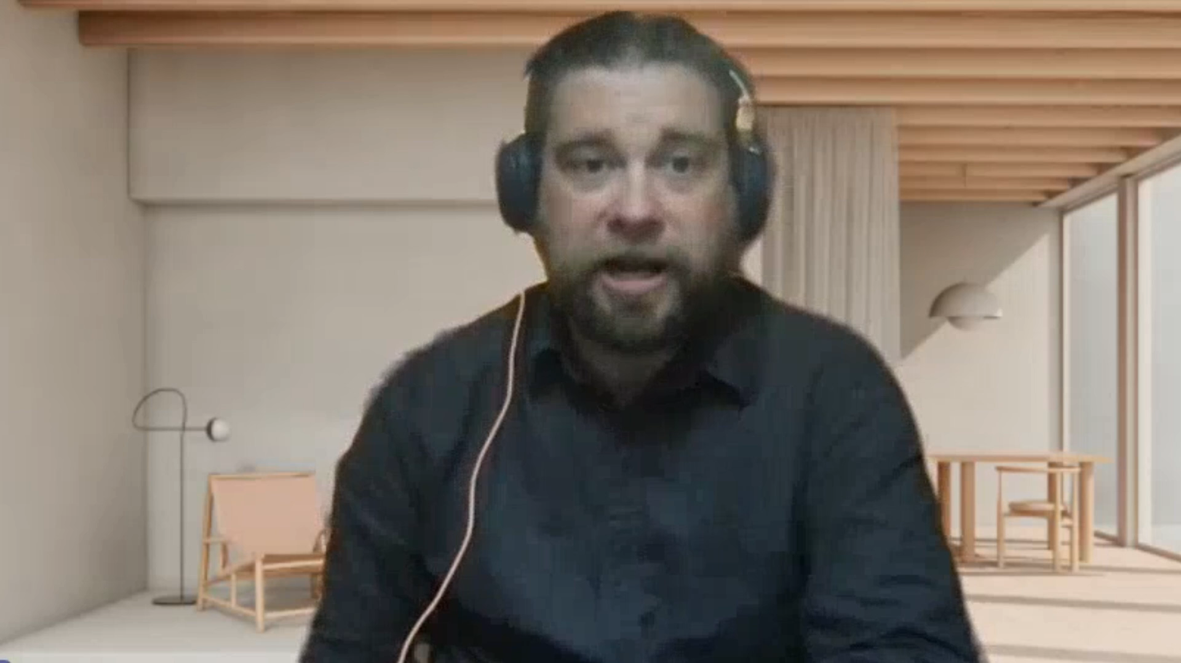
P.U.L.S.E Testimonial

Slide 91
Section I
Laws and Procedures

Slide 92
Carrying Naloxone
State law allows anyone to give naloxone.
Administer naloxone in accordance with training procedures.
Make a good faith effort to get emergency medical help for a person experiencing an opioid overdose.
Notes:
State law allows you to carry naloxone and administer it. Similar to how you cannot be held liable for cracking someone’s ribs when administering CPR, you cannot be held liable for a good faith attempt to help someone by administering naloxone.
State Statute 450.11 Prescription drugs & Devices:
(1i) Opioid antagonists
(b) Possession, dispensing, and delivery
450.11(1i)(b)1.1 Any person may possess an opioid antagonist
450.11(1i)(b)2.a.a. Subject to subd. 2.b-d: any person may deliver or dispense an opioid antagonist.

Slide 93
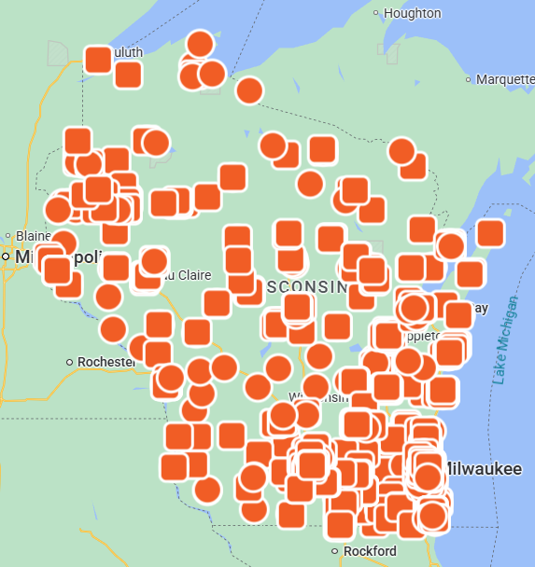
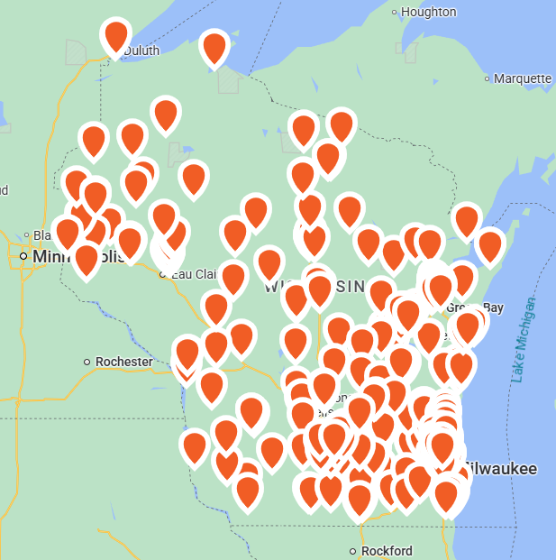
Naloxone Availability
Pharmacies offering naloxone for purchase under a standing order
Naloxone is available for free or for purchase at hundreds of locations in Wisconsin.
Map of locations on the DHS website:
https://www.dhs.wisconsin.gov/aoda/naloxone.htm
Free naloxone
Notes:
NEXT Distro: Vital Strategies partnered with Bad River to expand the tribe’s overdose prevention program, as well as offer the mail-order service. The tribe is receiving around $340,000 each year for their efforts. That has helped finance staff to support people using drugs, as well as provide supplies and safe spaces. Indigenous people are dying at more than twice the rate in the state
Article about it: https://www.wpr.org/health/new-program-bad-river-tribe-free-opioid-reversal-drugs-through-mail-naloxone-gwayakobimaadiziwin

Slide 94
Good Samaritan Laws
Good samaritan laws are meant to encourage people to:
Call 911 for help when someone overdoses.
Give naloxone as soon as possible.
Notes:
Just because the law is written with the intent to create limited immunity in certain situations, people may still be sued and therefore incur fees and expenses.
Please make sure to consult your own legal counsel for a more complete understanding of the law and how it may be applied to individual circumstances.

Slide 95
Good Samaritan Laws
2013 Wisconsin Acts 194 and 200
A person who helps someone who is overdosing is immune from criminal prosecution unless they are on probation or parole for:
Possession of a controlled substance.
Possession or use of drug paraphernalia.
Wis. Stat. § 961.573, Wis. Stat. § 961.41(3g), Wis. Stat. § 441.18(3), and Wis. Stat. § 448.037(3)
Notes:
If you call 911, you, the caller are immune from criminal prosecution.
You are not protected by the Good Samaritan Law if you have a warrant out for your arrest or you are on probation or parole.
This protection is not provided to the person who overdosed.

Slide 96
Section J
Overdose Prevention Tips
Notes:
*in person they can write down prevention tips and share with large group*

Slide 97
Activity
Write down five prevention tips and share with large group

Slide 98
Tip #1
Do not share prescription drugs with others.
Notes:
Why? You never know how its going to react in our body.

Slide 99
Tip #2
Do not use opioids alone.
Notes:
Why? Because no one is there to administer Naloxone if needed

Slide 100
Tip #3
If you have not used opioids in a few days, your tolerance will be lower and your risk for overdose greater. Use fewer opioids than you normally would.

Slide 101
Tip #4
Start slow, know your dose.

Slide 102
Tip #5
Always keep naloxone on hand. Tell others where it is.

Slide 103
Section K
Tailoring the Training

Slide 104
Important Content
Signs and symptoms of opioid overdose
How to respond to an overdose, including:
  Calling 911.
  Giving naloxone.
  Providing rescue breathing.
  Caring for someone after giving naloxone.
Notes:
Let audience know that the core curriculum is section E-H, but they can take out whatever
While some information included in the core curriculum should be included in every group training, there is some information that you can remove depending on your audience, the type of training you are providing, or the length of time you have to offer the training. For example, the complete slide deck includes educating the audience on how to administer four forms of naloxone. If you know your audience will only have access to nasal Narcan®, then you can remove the slides on the other formulations.
Prior to offering a training, you should download the most recent version of the Naloxone Administration Training slide deck at: https://www.dhs.wisconsin.gov/opioids/narcan-direct.htm. The DHS may make updates to the curriculum as new information becomes available.

Slide 105
Types of Trainings
One-on-one/“quick”: A session of up to 10-minutes for one or two people.
Classroom: A session that runs about an hour for a large group.
Virtual: A session of 10 to 30 minutes online for one or multiple people.
Notes:
Start with what people know: ask questions and add or correct info as needed (e.g., “What are some signs of an opioid overdose?”)
Naloxone handouts are available from the Wisconsin Department of Health Services. They can be accessed at: https://www.dhs.wisconsin.gov/opioids/narcan-direct.htm
Consider conducting pre/post-tests when conducting trainings to gauge an understanding of how effective the training is and whether participants are showing an increase in the required knowledge.

Slide 106
One-on-One In-Person Trainings
Considerations
Is the space for the training appropriate?
How will you provide interpreters?
Teaching tips
Ask participants what they know
Provide a handout with key information and resources
Track the number of people trained
Notes:
Start with what people know: ask questions and add or correct info as needed (e.g., “What are some signs of an opioid overdose?”)
Naloxone handouts are available from the Wisconsin Department of Health Services. They can be accessed at: https://www.dhs.wisconsin.gov/opioids/narcan-direct.htm

Slide 107
Classroom-Style Trainings
Considerations
Is the location and time convenient for people?
Is the space large enough for the audience and activities?
How will you provide interpreters?
Teaching tips
Use a handout with key information and resources
Use a mannequin to demonstrate rescue breathing
Use naloxone test/practice kits
Engage participants (ask questions, have them answer)
Track the number of people in attendance
Notes:
When holding classroom-style trainings be mindful of the number of people you train in one session. Some people may learn better in smaller groups (6-12 people). If holding a training for a larger group, plan to have another trainer present to help with demonstrations and to answer questions.

Slide 108
Virtual Trainings
Considerations:
How will you distribute naloxone and related resources to those you train?
How will you provide interpreters?
Teaching tips:
Incorporate a video on how to administer naloxone
Engage participants (ask questions, have them respond)
Use breakout rooms
Track the number of people in attendance
Notes:
When holding virtual trainings consider how you will distribute naloxone and other resources such as education materials or wallet cards to those you have trained. Can they pick it up at your agency, will you mail it to them, will you deliver it to their home?
Consider using a video on how to administer naloxone like DHS naloxone training video: https://www.youtube.com/watch?v=XH2mkQC3-fc&feature=youtu.be

Slide 109
Tailoring to the Audience
When planning your training:
Consider what the audience may already know.
Consider what will likely be new to them.
Consider asking the audience what concerns they have before the session begins.
Notes:
Consider other partners who may be helpful to have at your training. For example, if you are training a group of law enforcement officers, it might be helpful to have a law enforcement partner who you have worked with before at the training to address concerns or questions that are specific to the field.

Slide 110
All Audiences
Naloxone training and information on the drug overdose epidemic may bring up painful memories or difficult emotions.
Ensure the training is a safe space.
Be sensitive and respectful of participants.
Model respectful language.
Prepare based on educated guesses, but don’t make assumptions about individuals.

Slide 111
Section L
Resources

Slide 112
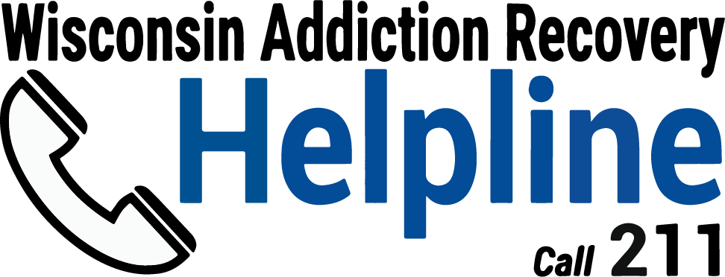
Wisconsin Addiction
Recovery Helpline
addictionhelpwi.org
Notes:
When some one overdoses, they may be more willing to seek help. They can provide information on referrals, treatment, and recovery options. Know what resources are available locally.

Slide 113
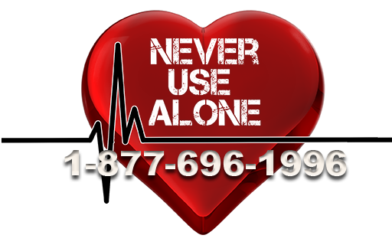
Never Use Alone
People who are using drugs are connected to a trained operator who can call for help in case of overdose.
https://neverusealone.com/
877-696-1996
Notes:
They recently updated their number. The old number still works, but they would like everyone to start transitioning to the new number.

Slide 114
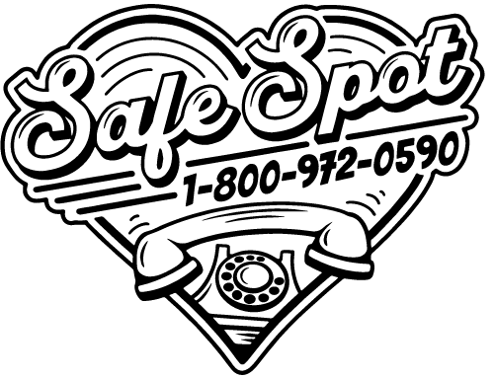
SafeSpot
People who are using drugs are connected o a trained operator who can call for help in case of overdose.
https://safe-spot.me/
800-972-0590

Slide 115
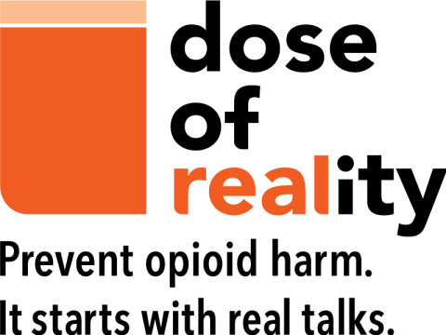
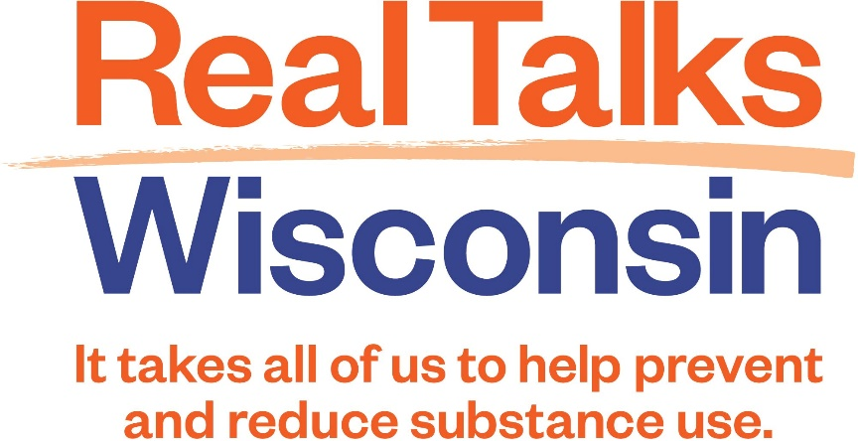
Wisconsin Initiatives
doseofrealitywi.gov
realtalkswi.org

Slide 116
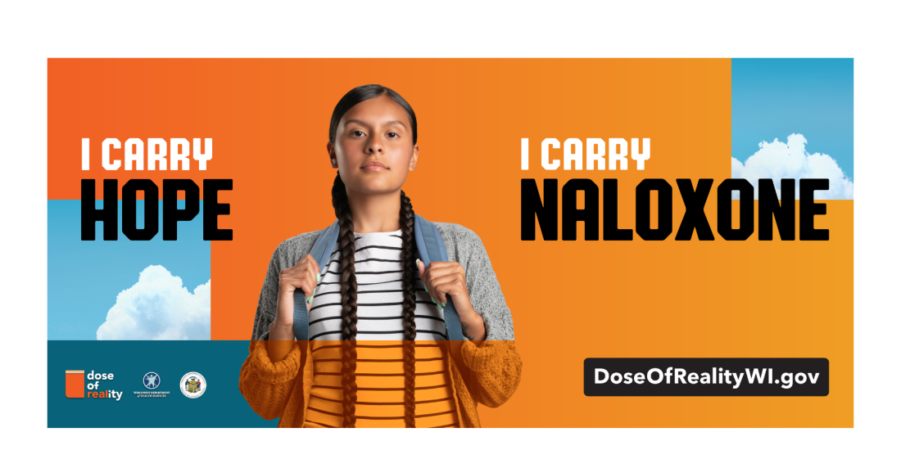
“I Carry Hope, I Carry Naloxone”
Promote naloxone use with materials on the DHS website
https://www.dhs.wisconsin.gov/opioids/partner-resources.htm#naloxone-promotion

Slide 117
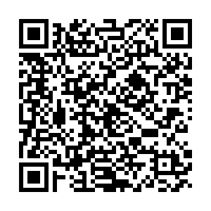
DHS Drug Checking Technologies Training-of-Trainers Trainings
Presented virtually.
Occurs monthly from 10 a.m. to 12 p.m.
  December 16, 2025
Scan QR code to sign up for a session.

Slide 118
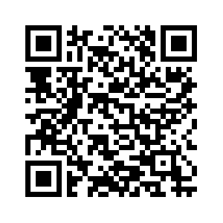
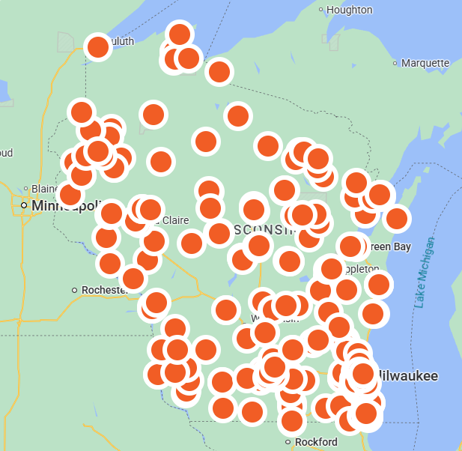
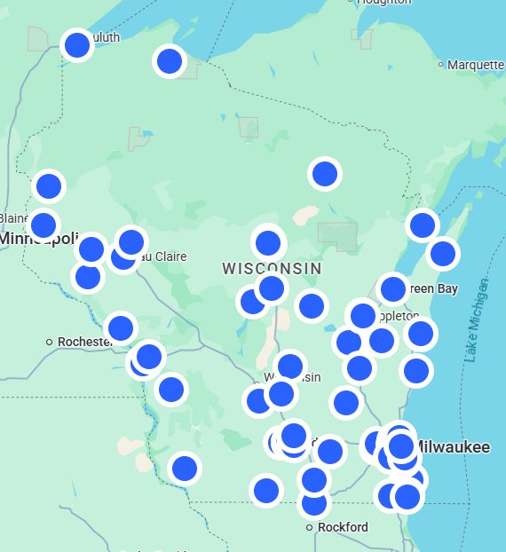
Test Strip Availability
Fentanyl Test Strips
Xylazine Test Strips

Slide 119
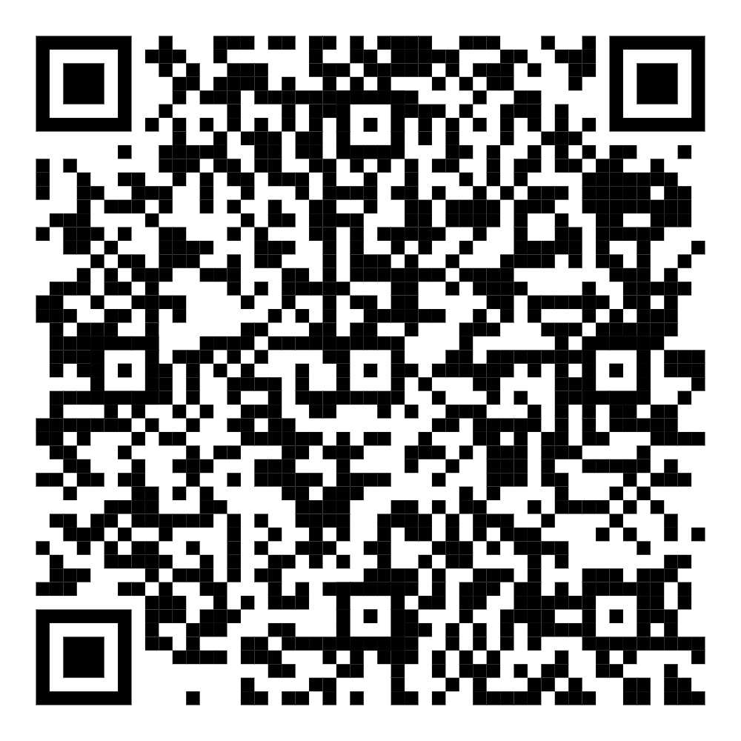
Thank you!
Share your feedback on this course!
Scan the QR code or follow the link in the chat
and complete the short survey.
Notes:
QR code for evaluation of this presentation. We want to hear your feedback so please take a few minutes!
Drop the survey link in the chat for folks:
https://survey.alchemer.com/s3/8099260/Naloxone-Direct-Training-Survey

Slide 120
Contact Information
Tiffaney Nielson
Human Services Program Coordinator
tiffaneym.nielson@dhs.wisconsin.gov
Ashley Borlick
Human Services Program Coordinator
ashley.borlick@dhs.wisconsin.gov

