Slide 1
Skilled Nursing Facilities
Testing Initiative
14 May 2020

Slide 2
Purpose and Goals
Nursing home and ICF/IID residents are at higher risk of dying from Covid-19 than the general population
Keep residents and workers safe
Voluntary, with consent, by the staff person or the resident (or the resident’s representative)
Asymptomatic testing is voluntary and the decision to be tested is solely at the discretion of the individual staff member, resident or the resident’s representative

Slide 3
Priorities
ICAR and CMS Assessment status
Facility readiness and capacity
Outreach to local health departments and facilities
Staggering facilities within the same jurisdiction
Includes CCRC

Slide 4
Process
Phone contact to discuss facility-specific questions
Notify staff, residents, families and/or guardians about availability of testing through this initiative, get information and opportunity to ask questions
Those who are interested in participating must consent to be tested
Order free testing supplies; allow 4 business days; let us know about urgent requests

Slide 5
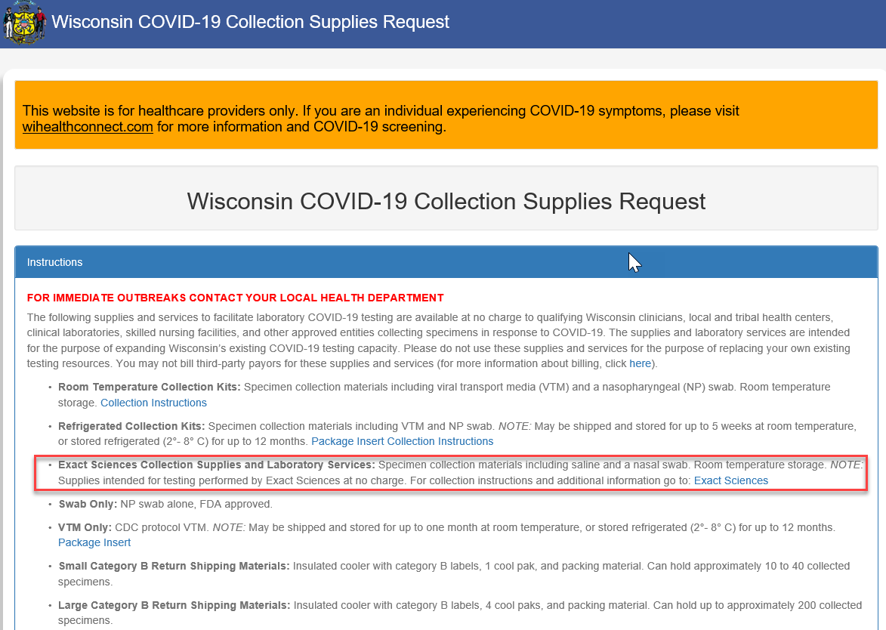
Process: Ordering Supplies

Slide 6
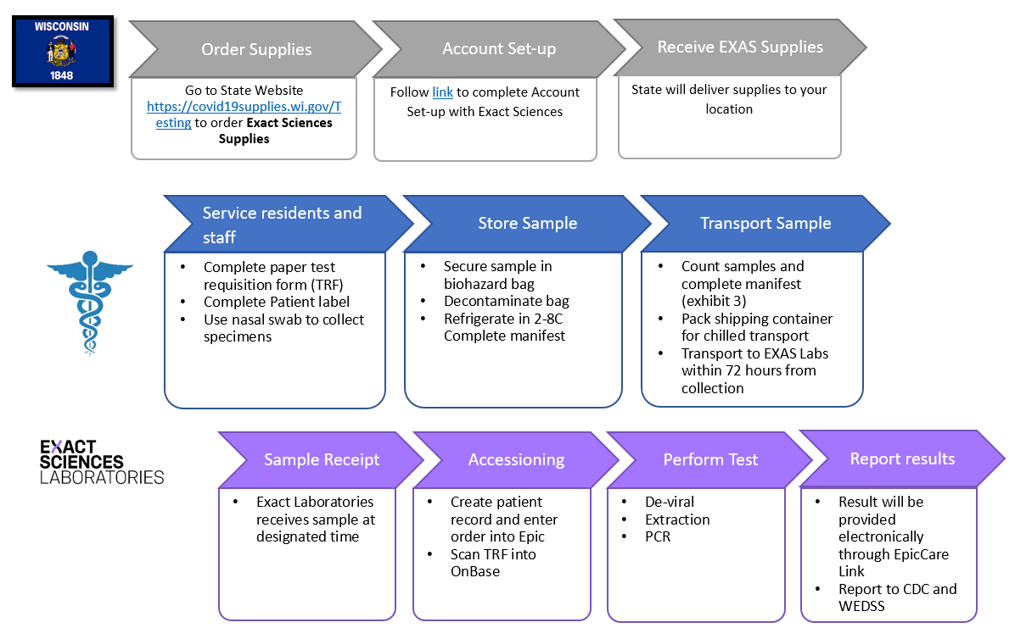
Process: Testing

Slide 7
Process: Exact Sciences
Nasal swab
Training video https://bit.ly/EXASCovidTest
  Includes: Completing the necessary paperwork to collecting the specimen and delivering the specimen to Exact Sciences
Transport specimen: Ship or Courier to Exact Sciences
  Ship: 650 Forward Drive, Dock 14, Madison, WI 53711
  Gold Cross Couriers

Slide 8
Process: Gold Cross Courier
Notify Gold Cross Dispatch 715-839-9989 by noon.
  for same day pickup.
  Samples must be ready for pickup when the courier arrives.
  Close time, contact name, phone number, and destination lab (Exact Sciences).
Delivered next day: 7 days/week @ 6am and 8am.
Package samples according to Exact Sciences guidelines. All packaging must be labeled. Courier will not accept samples that are not packaged and labeled correctly.
  From: [Your Facility Name]
  To: Exact Sciences

Slide 9
PPE
For specimen collection
Guidance to protect health care workers and patients at facilities that provide care to patients with COVID-19 found at https://www.dhs.wisconsin.gov/covid-19/ppe.htm
Requesting PPE: Work with current vendors to procure PPE to facilitate testing
  If you need assistance procuring PPE, work with your county emergency manager to submit a request for assistance

Slide 10
Results
Receiving test results
Communicating test results
Guidance for Outbreaks
Guidance for positive workers (asymptomatic and symptomatic)
Retesting Approach from CDC/BCD
Individuals who refuse testing

Slide 11
Staffing
Facilities are encouraged revise emergency staffing plans to include:
  If your facility is part of a corporation temporally assign staff to work in the impacted facility
  Increase shifts from 8 to 12 hours
  Contact your local emergency manager to submit a WEAVR request
  Contract with staffing agencies and/or area hospitals and clinics for caregiving and professional services

Slide 12
Health Care Worker (HCW) Return to Work
Symptom-based strategy: exclude from work until:
  At least 3 days (72 hours) have passed since recovery defined as resolution of fever without the use of fever-reducing medications and improvement in respiratory symptoms (e.g., cough, shortness of breath); and,
  At least 10 days have passed since symptoms first appeared

Slide 13
HCW Return to Work
Test-based strategy: exclude from work until:
  Resolution of fever without the use of fever-reducing medications and
  Improvement in respiratory symptoms (e.g., cough, shortness of breath), and
  Negative results of an FDA Emergency Use Authorized COVID-19 molecular assay for detection of SARS-CoV-2 RNA from at least two consecutive respiratory specimens collected ≥24 hours apart (total of two negative specimens)

Slide 14
HCW Return to Work-Asymptomatic
Time-based strategy: Exclude from work until:
  10 days have passed since the date of their first positive COVID-19 diagnostic test assuming they have not subsequently developed symptoms since their positive test
  If they develop symptoms, then the symptom-based or test-based strategy should be used
Test-based strategy may also be used for asymptomatic workers

Slide 15
Retesting of NH Residents
Retest any resident who develops symptoms consistent with COVID-19
Retest all residents who previously tested negative at some frequency shortly (e.g., 3 days), and then weekly to detect those with newly developed infection; consider continuing retesting until PPSs do not identify new cases
If retesting capacity is limited, retest residents who frequently leave the facility for dialysis or other services and those with known exposure to infected residents (such as roommates) or HCP

Slide 16
Retesting of NH Staff
Retest any HCP who develop symptoms consistent with COVID-19
Consider retesting HCP at some frequency based on community prevalence of infections (e.g., once a week)
If retesting capacity is limited, consider retesting HCP who are known to work at other healthcare facilities with cases of COVID-19

Slide 17
Retesting of Positive
Staff and Residents
Only if the facility has chosen a test-based strategy over the symptom-based or time-based strategy to inform release from isolation or return to work are retests of positives needed
Both the test-based and symptom-based strategies are considered equal by CDC it this time
There have been reports of prolonged detection of RNA without direct correlation to viral culture

Slide 18
Requesting Help
We realize that most facilities want to do this testing on their own
Facilities are encouraged to explore local resources that may be available:
  Local Health Department (LHD)
  Other health care providers including local hospitals and clinics
  Community paramedics, local EMS or fire department staff
  Corporate-owned facilities may be able to implement a joint testing program with their sister facilities
If other local resources are unable to assist, facilities can receive support from the WI National Guard (WING)
  Localities should work with their county emergency manager to submit a request for WING assistance

Slide 19
Reminder
Guidance for all long-term care facilities, assisted living facilities, and facilities serving people with developmental disabilities in Wisconsin caring for patients who are elderly and/or have chronic medical conditions that place them at higher risk of developing severe complications from COVID-19 can be found at
https://www.dhs.wisconsin.gov/covid-19/ltc.htm

