Slide 1
Step by Step
Testing Process
14 May 2020

Slide 2
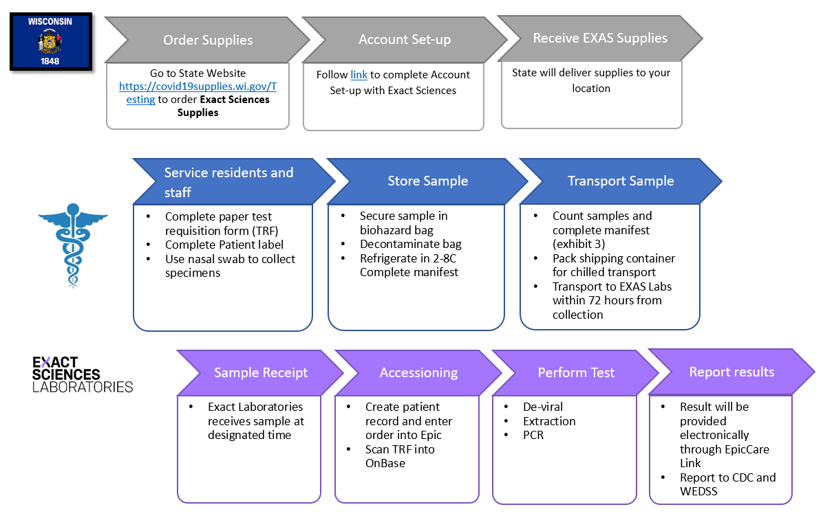
Process: Testing
Outreach & Supplies
Patient Care
Results

Slide 3
Phase 1: Outreach & Supplies
Exact Sciences account managers will reach out to SNFs by the end of the week (5/15)
Notify staff, residents, and the families and/or guardians of residents about the availability of testing
Provide an opportunity to answer questions
Those who are interested in participating must consent to be tested
Inform SNF about how to request supplies

Slide 4
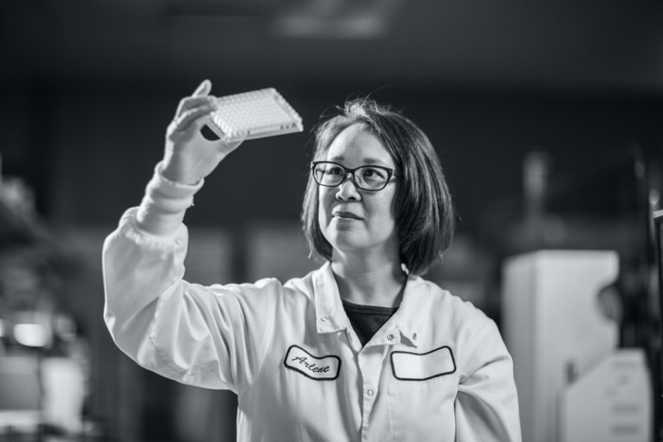

Phase 1: Outreach & Supplies
Order supplies from https://covid19supplies.wi.gov/Testing
Supplies provided at no cost
Select Exact Sciences supplies if testing is performed by Exact Sciences
Exact Sciences account managers can provide guidance through website
Allow 4 days to process requests
Notes:
In order to test, supplies to perform specimen collection must be requested by the SNF. These supplies can be requested by going to https://covid19supplies.wi.gov/Testing and filling out the requested fields. Supplies that are requested this way will be provided at no cost.
While this step is owned by the Wisconsin DHS, Exact Sciences account managers can assist with this process,

Slide 5
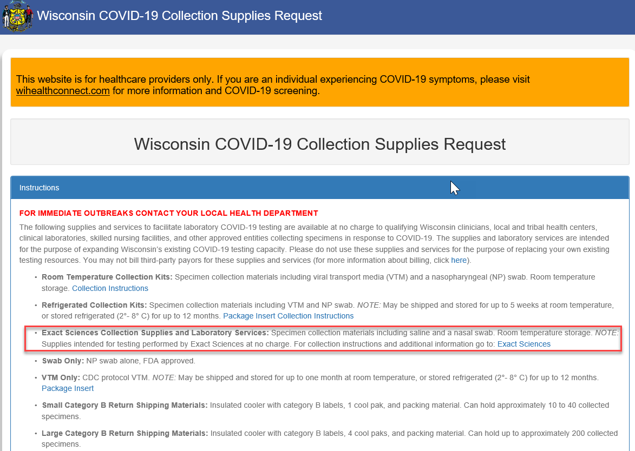
Phase 1: Outreach & Supplies

Slide 6
Phase 2: Patient Care
Engage with Exact Sciences to prepare for testing in 3 steps:
1. Account creation
2. Complete virtual training
3. Collect Samples
All setup and detailed instructions are available here: https://bit.ly/EXASCovidTest
If a provider is unavailable to issue orders, standing medical order by Dr. Westergaard should be used

Slide 7
Phase 2: Patient Care
Notify Gold Cross Dispatch 715-839-9989 by noon for same-day pickup
Samples must be ready for pickup when the courier arrives.
Refrigerate specimens if received by Exact within 72 hours
Freeze specimens at < -70 degrees C if received by Exact longer than 72 hours from time of collection
Close time, contact name, phone number, and destination lab (Exact Sciences).
Package samples according to Exact Sciences guidelines.
All packaging must be labeled.
Courier will not accept samples that are not packaged and labeled correctly.
To: Exact Sciences
650 Forward Drive, Dock 14
Madison, WI 53711
Delivered next day
Delivery available 7 days a week at 6AM and 8AM
Notes:
Transport specimen: Ship or Courier to Exact Sciences
Ship: 650 Forward Drive, Dock 14, Madison, WI 53711
Gold Cross Couriers

Slide 8
Phase 3: Results
Tests will be resulted by Exact Sciences within 48 hours of receiving specimens
Results will by:
  EpicCare Link portal (digital results)
  Paper fax
Fax is not recommended as large result volumes can overwhelm SNF fax machines
Communication preference is indicated by the SNF during order entry
Recommended

