Slide 1
Welcome to the Chronic Disease Prevention Partner call!
We will begin shortly at 9:05 a.m.
In the meantime, we ask that you include your name, organization, and your favorite Disney character in the chat so we can get to know each other better! ☺
September 28, 2022

Slide 2
Diabetes Initiatives to Address Equity
Marilyn Hodgson
Quality Initiatives Coordinator
Pam Geis
Health Promotion Specialist
Lena Swander
Epidemiologist
Division of Public Health, Chronic Disease Prevention Program

Slide 3
Presentation Outline
Diabetes Update
Building the Bridge for Reimbursement
Bright Spot Initiative: Populations of Focus
Diabetes Prevention and Promotional Materials

Slide 4
Diabetes Update
Marilyn Hodgson, RN, CDCES
Quality Initiatives Coordinator
marilyn.hodgson@dhs.wisconsin.gov
Division of Public Health, Bureau of Community Health Promotion,
Chronic Disease Prevention Program
Notes:
Presenter Notes
Introduce self.
This part of the presentation will highlight the:
Diabetes Action Plan published in July 2022.
Current diabetes management and prevention efforts at DHS.
COVID-impacts on diabetes prevention, care and management,
And opportunities for you to provide feedback about the future of our programming and efforts.

Slide 5
Wisconsin Diabetes Action Plan
Report to the Legislature

Slide 6
Wisconsin Diabetes Action Plan
Diabetes Care and Prevention Action Program Act, Wis. Stat. § 255.085 enacted March 3, 2020
Includes the development and implementation of an action plan and a providing a report to the legislature

Slide 7
Wisconsin Diabetes Action Plan
Requires the Department of Health Services (DHS), in consultation with the Department of Employee Trust Funds, to develop and implement an action plan to:
Reduce the incidence of diabetes.
Improve diabetes care.
Control diabetes-associated complications.
Notes:
Presenter Notes
DHS may also consult with Department of Public Instruction (DPI) and the Department of Corrections (DOC) in developing this plan.

Slide 8
Wisconsin Diabetes Action Plan
Wisconsin Diabetes Action Plan: Report to the State Legislature
P-03154 (07/2022)
Notes:
Presenter Notes
DHS published the very first Wisconsin Diabetes Action Plan: Report to the State Legislature in July 2022 as a result of the enacted legislation.
There are some limitations to this report as much of the data was captured prior to the onset of the COVID-19 pandemic. That said, it still provides a lot of valuable information to readers about recent diabetes trends, as well as programmatic efforts led by WI DHS and the Division of Public Health in recent years.
We’ll look at some of those programmatic efforts in our next section.

Slide 9
Diabetes Prevention and Management Efforts

Slide 10
Diabetes Prevention and Management Efforts
Prediabetes awareness
National Diabetes Prevention Program
Diabetes self-management education and support
Pharmacist engagement
Personal continuous glucose monitors
Community Health Workers

Slide 11
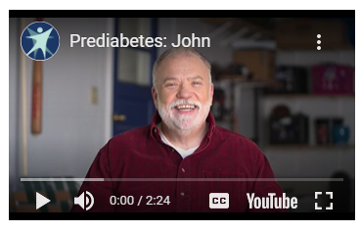
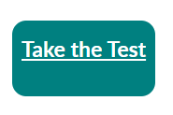
Prediabetes Awareness
Social media, print, radio, ad campaign
Call to action: preventdiabeteswi.org
Awareness materials available in Spanish and Hmong
Notes:
Presenter Notes
The Department of Health Services launched a multifaceted prediabetes awareness campaign in June 2020 with a call to action for people to learn more and take the type 2 diabetes risk test at preventdiabeteswi.org.
There are a lot of public materials, but also promotional materials for community organizations, employers, and health care providers to get involved. You can find all these materials at preventdiabeteswi.org.
Materials are also available in Spanish and Hmong translations.

Slide 12
National Diabetes Prevention Program
46 Centers for Disease Control and Prevention-recognized National Diabetes Prevention Program suppliers
Notes:
Presenter Notes
National Diabetes Prevention Program—or National DPP—was created in 2010 to address the increasing burden of prediabetes and type 2 diabetes in the United States. This national effort created partnerships between public and private organizations to offer evidence-based, cost-effective interventions that help prevent type 2 diabetes in communities across the United States.
One key feature of the National DPP is the CDC-recognized lifestyle change program, a research-based program focusing on healthy eating and physical activity which showed that people with prediabetes who take part in a structured lifestyle change program can cut their risk of developing type 2 diabetes by 58% (71% for people over 60 years old).
On the left side of the screen is a map of Centers for Disease Control and Prevention-recognized National Diabetes Prevention Program suppliers providing in-person in Wisconsin so you can get a sense of where recognized-suppliers are located in our state.
Wisconsin has 46 recognized National DPP suppliers.

Slide 13
National Diabetes Prevention Program

Slide 14
National Diabetes Prevention Program

Slide 15
Diabetes Self-Management Education and Support
53 Association of Diabetes Care and Education Specialists (ADCES)-accredited and American Diabetes Association (ADA)-recognized programs
Notes:
Presenter Notes
Diabetes Self-Management Education and Support (DSMES) is highly effective in improving health and diabetes management skills, but less than 7% of eligible patients participate within the first year of diagnosis. Health care providers like you are the best way to increase DSMES access.
Referring patients to DSMES can also help you meet follow-up care guidelines. Your patients will work with a certified diabetes care and education specialist. This licensed health care professional will provide training, counseling, and follow-up activities for your patients that support your plan of care.
On the left side of the screen is a map of ADCES-accredited and ADA-recognized DSMES locations in Wisconsin, so you can get a sense of where recognized-suppliers are located in our state.
Wisconsin has 53 recognized programs with about 200 locations statewide.

Slide 16
Diabetes Self-Management Education and Support
Annual encounters at accredited/recognized programs
Encounters at ADA/ADCES Programs
ADA/ADCES
Programs

Slide 17
Pharmacist Engagement
Wisconsin Pharmacy Quality Collaborative accredited pharmacies
Medication therapy management
Pharmacy-based accredited and recognized DSMES programs
Notes:
Presenter Notes
The Wisconsin Pharmacy Quality Collaborative (WPQC) is a network of accredited pharmacies throughout the state that are committed to higher standards of medication management, patient education, quality assurance and patient safety. WPQC-certified pharmacists provide medication therapy management (MTM) services such as comprehensive medication reviews to patients.
DHS has partnered with the Pharmacy Society of Wisconsin and their WPQC accredited pharmacy network to increase the number of MTM services delivered, with an intentional focus on patients with diabetes in recent years. We’re also working to increase the number of pharmacy-based accredited/recognized DSMES programs in Wisconsin.

Slide 18
Personal Continuous Glucose Monitors (CGM)
The Wisconsin Diabetes Advisory Group distributed a Personal CGM Survey to member organizations.
Survey findings available online at dhs.wisconsin.gov/diabetes/dag
Findings were shared within DHS to improve programming.
Notes:
Presenter Notes
The Wisconsin Diabetes Advisory Group (DAG) distributed a Personal Continuous Glucose Monitoring Survey to:
Document Wisconsin’s heath system and clinic approaches to personal CGM for patients with diabetes.
Document clinician barriers to personal CGM use for patients who could benefit.
Use the results to address identified barriers in Wisconsin.
https://www.dhs.wisconsin.gov/publications/p03161.pdf

Slide 19
Personal Continuous Glucose Monitors (CGM)
Division of Medicaid and Division of Public Health focus on personal CGM coverage expansion
Available ForwardHealth Provider Trainings
Diabetic Continuous Glucose Monitors
Submitting a Prior Authorization for CGM Devices on the ForwardHealth Portal

Slide 20
Community Health Workers
Community Health Worker defined:
A frontline public health worker who is a trusted member of and/or has an unusually close understanding of the community served. This trusting relationship enables the worker to serve as a liaison/link/ intermediary between health/social services and the community to facilitate access to services and improve the quality and cultural competence of service delivery.
American Public Health Association, 2021
Support to CHW workforce as part of care team
Community-clinical linkages
Reaching vulnerable populations

Slide 21
COVID-19 Impacts

Slide 22
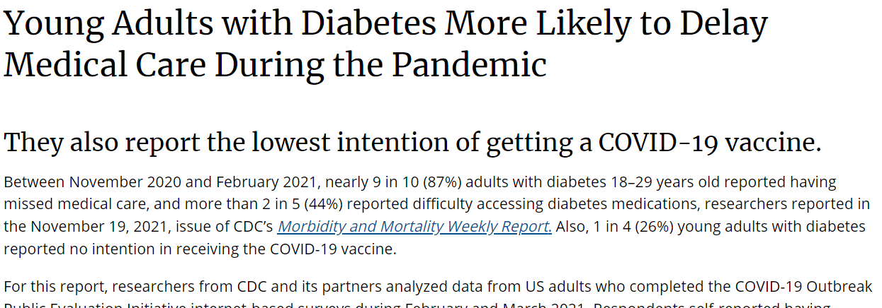
COVID-19 Impacts
Decrease in regular medical service usage
Diabetes and hospitalization for severe COVID-19 complications
Early evidence for increased risk of diabetes diagnosis following COVID-19 infection
Notes:
Presenter Notes
We are still learning about the magnitude and severity with which the COVID-19 pandemic affected diabetes prevention, care and management. Here are a few highlights from early peer reviewed literature:
There is evidence that people with diabetes were less likely to use regular medical services they needed to manage their condition throughout the pandemic. In particularly, young adults (ages 18-29) reported large disruptions in access to and use of medical care, including difficulty getting their diabetes medication.
Several studies have also suggested that adults and youth face an increased risk of diabetes diagnosis after contracting COVID-19. In one study, patients younger than 18 years old with COVID-19 were up to 2.5 times more likely to be diagnosed with diabetes in the months after infection than those without COVID-19 and those who had other respiratory infections before the pandemic.
Finally, it’s been well documented that patients with diabetes as an underlying medical condition faced higher risk of experiencing severe complications from COVID-19 infection. Among patients hospitalized with severe COVID-19 complications, nearly 40% had diabetes as an underlying medical condition.

Slide 23
Next Steps and Feedback Opportunities

Slide 24
Next Steps
Division of Public Health Chronic Disease Prevention Program’s current federal funding ends in 2023
Preparing for next iteration of federal funding forecasted opportunities
CDC-RFA-DP23-2320: A Strategic Approach to Advancing Health Equity for Priority Populations with or at Risk for Diabetes
Next Diabetes Action Plan report to the legislature due January 2023

Slide 25
Feedback Opportunities
Take our survey at www.surveygizmo.com/s3/7030522/Diabetes-Action-Plan-Survey
Spanish and Hmong translated surveys coming soon and will be posted to https://www.dhs.wisconsin.gov/disease/chronic-disease.htm.
Email dhschronicdiseaseprevention@dhs.wisconsin.gov with the subject line: “Diabetes Action Plan and Program Feedback”.
Notes:
Presenter Notes
We want to hear from you about where your care and management challenges are for patients with diabetes and prediabetes, how you feel we can improve our statewide programming focus areas and initiatives.
There are two options we’re recommending you use to get in touch with us and provide your feedback.
First is a survey we’re administering for the Diabetes Action Plan 2023 development. This same survey will be translated into Spanish and Hmong and posted to our program website.
The second is emailing the Chronic Disease Prevention Program staff at dhschronicdiseaseprevention@dhs.wisconsin.gov. It will help us a lot if you include the subject line “Diabetes Action Plan and Program Feedback” when you do.

Slide 26
Building the Bridge for Reimbursement
Pam Geis
National Diabetes Prevention Program State Quality Specialist
geis.pamela@gmail.com
Division of Public Health, Bureau of Community Health Promotion,
Chronic Disease Prevention Program
Notes:
Presenter Notes
Introduce self.

Slide 27
Wisconsin’s Lifestyle and Prevention Benefits Network
National Diabetes Prevention Program

Slide 28
Thoughtful Approach
Sustainability of National Diabetes Prevention Program (National DPP)
Partnership with National DPP suppliers
Notes:
Sustainability of National DPP
We have worked strategically to create a sustainable environment for the National DPP
We believe infrastructure building is as critical as reimbursement to ensure sustainability of the National DPP.
We only fund infrastructure building activities such as creation of screening-testing-referral processes, reimbursement connections and partnerships, marketing, and addressing barriers to participation and retention. We do NOT fund for program delivery.
Partnership with National DPP CDC recognized programs
We work with all of our National DPP CDC recognized programs, including those we do not contract with for 1815 or 1817 work.
This approach allows for the potential of all National DPP CDC recognized programs to thrive, not just those we contract with to achieve 1815 or 1817 outcome measures.

Slide 29
Convening Benefits Network Partners
Diabetes Prevention State Engagement Meeting (StEM)
National DPP Insurer Community of Practice
Notes:
Diabetes Prevention State Engagement Meeting (StEM)
In October 2017 we held our Diabetes Prevention State Engagement Meeting, or StEM, with the support of NACDD.
We’ve had a 25+ year relationship with health plans in our state through a Chronic Disease Quality Improvement Project and many of the health plans participated in the StEM.
As part of the Diabetes Prevention Action Plan developed during the StEM, health plans asked to begin meeting for discussion around referral and reimbursement for National DPP.
National DPP Insurer Community of Practice
In fall 2018, WI DHS staff began contacting Wisconsin health plans to gauge interest in developing a Wisconsin National DPP Community of Practice, or CoP.
In January 2019, five health plans committed to the CoP to learn more about the National DPP, explore becoming referral sources and, ultimately, payers.
All five participating health plans are Wisconsin-based health plans that have service areas ranging from statewide to large regional areas. Their insurance lines cover commercial, Medicaid, Medicare, Medicare Advantage, and Marketplace.
During 2019, CoP members learned about strong evidence supporting the National DPP, the program’s structure, different delivery modes, and available tools in the National DPP Coverage Toolkit to help them learn more about providing coverage for the program. They also learned about the Medicare DPP and its value-based payment structure, which went into effect in April 2018.

Slide 30
Building the Benefits Network
Opportunity to solve administrative burden problem
Finding the “bridge”
Notes:
Opportunity to Solve the Administrative Burden Problem
In January 2020, CoP members concluded National DPP referrals and reimbursement from commercial health plans would require individual contracts with each of Wisconsin’s 39 existing National DPP CDC recognized programs. This administrative burden proved a significant barrier they could not overcome.
After a bit of conversation and some out-of-the-box thinking, one representative suggested we consider creating a network, similar to a management services organization (MSO) concept. This would allow payers to put one contract in place for use of all National DPP CDC recognized programs in Wisconsin.
Finding the Bridge
Wisconsin needed a platform to host the benefits network and create a “bridge” for connecting programs and payers.
We connected with Welld Health in February 2020 and began meeting with Cassandra Stish, Welld Health’s Chief Customer Officer, to learn more about Welld Health’s platform.
Welld Health is a HIPAA-compliant electronic health record (EHR) for community-based organizations. Welld Health has Fast Healthcare Interoperability Resources (FHIR) capability and can interface with any EHR platform in the nation to exchange data. The platform has three major components: program and data management, secure referral capability, and a claims engine.
Our “aha” moment came after we sat through the first demo of the platform. We realized the Welld Health platform could help facilitate commercial coverage by serving as the basis for the benefits network, navigate the complex world of value-based payments, and provide programs with an easy-to-use environment for managing program data and referrals.

Slide 31
Lifestyle and Prevention Benefits Network
National DPP suppliers ➔ Welld Health ⬅ Payers
Developing contract language
Onboarding National DPP suppliers
Notes:
Programs ➔ Welld Health ⬅ Payers
Welld Health agreed to partner with WI DHS in May 2020 to build a self-sustaining benefits network called the Wisconsin Lifestyle and Prevention Benefits Network.
While language already existed for Welld Health to contract with National DPP CDC recognized programs, Welld Health needed to create language for a contract between Welld Health and the payers.
Developing Contract Language
Our staff, Welld Health, and members of the Wisconsin National DPP Insurer CoP collaborated during the next year to develop that contract language.
This turned out to be a complex part of the development, with a lot of back and forth. CoP members generously participated in the process and even involved their legal departments to provide input.
Payer contracting language is complete and several health plans are now reviewing for consideration of coverage.
Onboarding National DPP Suppliers
At the same time payer contract development was happening, our team was working to onboard Wisconsin’s National DPP CDC recognized programs to the platform.
We are supporting the National DPP CDC recognized programs’ costs to use the Welld Health platform for the first year or two, or until commercial coverage begins, whichever comes first.

Slide 32
How it works: Payments
One platform. One contract. One Invoice.
Health Plans
Reimburse for Proven Outcomes
Cost Savings
Issue
Payment on
Claims to Welld
$
Welld Health
TPA & Clearinghouse
Create/Transmit Claims
$
Generate Remittance/ reconciliation files & processes payouts
$
Continues Growing the Network
Network Suppliers
Deliver Services
$
Provide billable services to plan members
Receive payouts from Welld for services
Pays Welld processing fees
Realize
Sustainability & Reach More Members
Republished with permission from Welld Health, LLC - 2020.
Notes:
How It Works: Payments
Here is a visual of the network. There is one platform, one contract, one invoice.
Health plans or employers agree to cover the National DPP by signing one contract for the use of all Wisconsin National DPP CDC recognized programs using the network.
National DPP supplier claims flow through Welld Health as third-party administrator, or TPA. Health plans or employers issue a payment on claims to Welld Health. Welld Health generates remittance/reconciliation files and processes payouts to National DPP CDC recognized programs.
Health plans and employers have the option to cover additional evidence-based health intervention programs that are offered by CDC recognized programs, for example Blood Pressure Self-Monitoring, Diabetes Self-Management Education and Support or DSMES, Stanford-developed programs, and others.

Slide 33
Next Steps
Hire consultant
Health plans and influencers crosswalk
Develop supporting materials
Schedule meetings and secure contracts
Notes:
Hiring of Consultant
We have hired someone to work with us to help secure contracts for the benefits network.
He is a physician, well respected in the population health world in our state, and most recently served as the Chief Medical Officer for a Wisconsin-based health plan.
He understands the importance and impact of National DPP, speaks the insurance world language, and knows how to position the ask in a way that will make leadership listen.
Crosswalk of Health Plans and Influencers
Along with our partners, we have documented the state-based and national health plans with which we have connections.
We’ve created a document with the contacts, what we know of them (for instance if they are members of our Diabetes Advisory Group or the Chronic Disease Quality Improvement Project), and what influencers we know that are connected to them.
For influencers, we are looking at responses to the Employer Market Assessment Survey we did in collaboration with NACDD, as well as board members and corporate wellness clients of the YMCA of Metropolitan Milwaukee, who is working with us to help secure coverage.
Development of Supporting Materials
We’re working on developing “sales pitch” materials for our consultant to use as he reaches out to the health plans.
We are not reinventing the wheel. We received much of the content through our participation in NACDD’s Employer Learning Collaborative. But, we are relying on our consultant’s guidance to narrow down the information and focus on what is important to health leadership.
Scheduling Meetings and Securing Contracts
Securing contracts = the end game!

Slide 34
Bigger Vision
Blanket coverage of National DPP
Hyper-local statewide network
Reimbursement for other evidence-based community health programming
“Nothing happens unless first we dream.” ~ Carl Sandburg
Notes:
Blanket Coverage of National DPP
In my happy bubble employers will not need to “opt in” to the offering, health plans cover automatically for the membership because it will improve their population’s overall health.
Hyper-local Statewide Network
Suppliers across the state deliver the program in real-time through hyper-local in-person and distance learning delivery options.
Lifestyle coaches who live and work in the same community as participants facilitate the program.
These local coaches can connect a health plan’s members to local resources that resolve barriers to participation and retention as they arise.
Reimbursement for Other Evidence-based Community Health Programming
There is a reason why we strategically named our network the “Lifestyle and Prevention Benefits Network.” Welld Health’s platform can manage much more than just National DPP and already does for community organizations such as local YMCAs.
We hope that sometime in the not-too-distant future, health plans will reimburse for other evidence-based community programs to improve their overall population’s health like DSMES, the Stanford-developed Diabetes Self-Management Program (DSMP) and Chronic Disease Self-Management Program (CDSMP), blood pressure self-monitoring programs, falls prevention programs, the Livestrong cancer survivor program, and more.
And, the providers of those programs will join the Lifestyle and Prevention Benefits Network to make it happen.

Slide 35
Bright Spot Initiative: Populations of Focus
Lena Swander
Epidemiologist
lena.swander@dhs.wisconsin.gov
Division of Public Health, Bureau of Community Health Promotion,
Chronic Disease Prevention Program
Notes:
Hi all, my name is Lena Swander and I’m an epidemiologist with the Chronic Disease Prevention Program. I’m going to share a little bit about one of our program’s latest grants awarded by the National Association of Chronic Disease Directors, called the Bright Spot Initiative. Next slide.

Slide 36
Bright Spot Initiative
Increase National Diabetes Prevention Program (National DPP) enrollment through strategic partnerships
Prioritize populations of focus
Notes:
The Bright Spot Initiative focuses on increasing enrollment in the National Diabetes Prevention Program with a priority on populations of focus. Next slide.

Slide 37
Bright Spot Initiative
Increase National Diabetes Prevention Program (National DPP) enrollment through strategic partnerships
Prioritize populations of focus
Notes:
I’m going to share a little bit more about how we conceptualized the populations of focus.

Slide 38
Approach
Recruit National DPP suppliers
Identify populations disproportionately impacted by obesity, prediabetes, type 2 diabetes
Investigate community composition
Tailor populations of focus

Slide 39
Recruit National DPP suppliers
10 potential suppliers
15 counties
39

Slide 40
Identify populations disproportionately impacted
Race/Ethnicity
Sex
Age
Income
Education

Slide 41
Identify populations disproportionately impacted
Race/Ethnicity: American Indian/Alaskan Native,
Asian, Black, Hispanic
Sex: Male
Age: 35-64 and 65+
Income: Household income < $64,000
Education: Completed Grade 12 or GED or less
Notes:
Race/Ethnicity: American Indian/Alaskan Native, Asian, Black, Hispanic
Sex: Male
Ages: 35-64 younger adults…65+ also under consideration because of the large MDPP push.
Income: household income under $64,000
Education: completed Grade 12 or GED or less

Slide 42
Identify populations disproportionately impacted
Race/Ethnicity: American Indian/Alaskan Native,
Asian, Black, Hispanic
Sex: Male
Age: 35-64 and 65+
Income: Household income < $64,000
Education: Completed Grade 12 or GED or less
Where do these characteristics intersect in the immediate service areas?

Slide 43
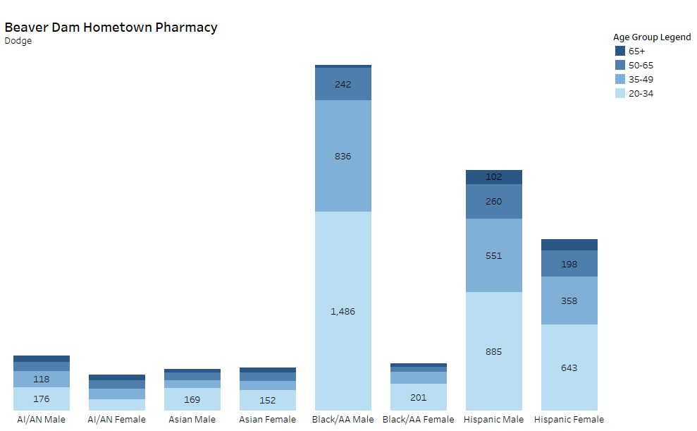
Investigate community composition
Demographic Estimates Dodge County example
Age Group Legend
65+
50-65
35-49
20-34
AI/AN
Male
AI/AN
Female
Asian Male
Asian Female
Black/
AA Male
Black/
AA Female
Hispanic Male
Hispanic Female
Notes:
This bar graph visualizes total population estimates for American Indians/Alaskan Natives (AI/AN), Asians, Blacks, or African Americans (AA), and Hispanics by sex and age groups for select Wisconsin counties in an immediate service area for an example National DPP supplier using U.S. Census Bureau’s Population Division 2019 estimates. These estimates are published at the county level. We want suppliers to focus recruitment efforts on populations at disproportionately impacted with sufficient representation, for example Black males, ages 20-49, in their immediate service area counties.
CDPP created reference bar graphs for all participating Bright Spot National DPP suppliers we’ll be sharing in a follow up email after this call. You can explore your immediate service area’s demographic estimates as a Tableau Dashboard at: NACDD Bright Spot: Populations of Focus Demographics, Demographic Estimates by County. This bar graph will also be shared as a static PDF, and the data behind it as a table in an Excel file.

Slide 44
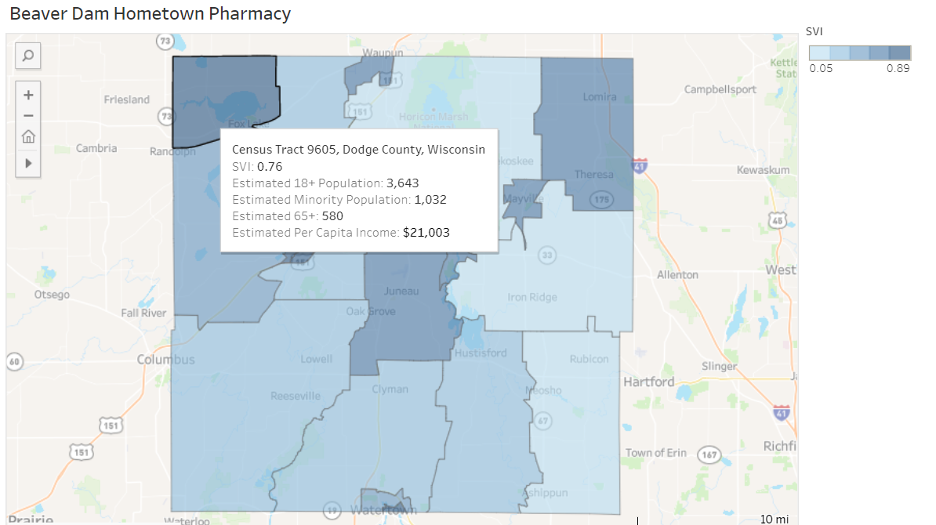
Investigate community composition
Social Vulnerability Index (SVI) and Census Tract Population Estimates
Dodge County example
SVI Legend
0.05
0.89

Slide 45
Tailor populations of focus
Supplier | American Indian/Alaskan Native | Asian | Black | Hispanic/Latino
1 |  |  |  | 
2 |  |  |  | 
3 |  |  |  | 
4 |  |  |  | 
5 |  |  |  | 
6 |  |  |  | 
7 |  |  |  | 
8 |  |  |  | 
9 |  |  |  | 
10 |  |  |  | 
Notes:
This is a summary table of populations who are at disproportionate risk of developing type 2 diabetes, and your community composition findings. Suppliers should focus on recruiting male participants who are Black/AA, Asian, American Indian/Alaskan Native, or of Hispanic ethnicity, of low SES, and between the ages of 20-49.
Note: Black/AA, Asian, AI/AN, and those of Hispanic ethnicity have populations that skew younger (younger populations make up a greater proportion of their population base when compared to Whites). This holds for every supplier service area we investigated.

Slide 46
How Partners Can Help
Investigate your community’s social vulnerability index (SVI) at svi.cdc.gov/map.html.
Know the National DPP suppliers in your community (dhs.wisconsin.gov/prediabetes/control.htm).
Prioritize prediabetes and National DPP awareness promotion for populations of focus.
Use our Diabetes Prevention Promotional Materials.

Slide 47
Diabetes Prevention Promotional Materials
Pam Geis
Health Promotion Specialist
geis.pamela@gmail.com
Division of Public Health, Bureau of Community Health Promotion,
Chronic Disease Prevention Program

Slide 48
November is Diabetes Awareness Month
Turn-key promotional
materials
Increase awareness of
prediabetes
Increase awareness of National DPP
dhs.wisconsin.gov/prediabetes/promotional-resources.htm
Notes:
CDPP has many different communication resources available to help you increase awareness of prediabetes and the National DPP:
Photos
Flyers and posters
Newspaper and print ads
Sample press releases
Banners and web ads
Social media content
And more!
Resources marked “From DHS” were created here in Wisconsin using key informant interviews and focus groups.
More resources are added every year, so if you haven’t checked them out in a while, please do.
Feel free to take these resources, add your logo, and distribute widely. If you need assistance with adding your logo, please contact us.

Slide 49
Chronic Disease Prevention Program
dhschronicdiseaseprevention@dhs.wisconsin.gov
Marilyn Hodgson Pam Geis
Quality Initiatives Coordinator Health Promotions Coordinator
marilyn.hodgson@dhs.wisconsin.gov geis.pamela@gmail.com
Lena Swander
Epidemiologist
lena.swander@dhs.wisconsin.gov
Chronic Disease Prevention Program

