Slide 1
CDC Grant Opportunity Forecasts
Mary Pesik, Chronic Disease Prevention Program Director
Lexi Davis, Healthy Communities Coordinator
Anne Gargano Ahmed, Heart Health Coordinator
November 9, 2022
November 17, 2022
Chronic Disease Prevention Program
Notes:
Mary bookend (intro and closing)
Invitation to put questions in the chat, if we don’t get to the questions during will include in follow up communication

Slide 2
Agenda and Purpose
Introduce partner interest survey process
Share information about upcoming CDC grant opportunities
Provide overview of current and anticipated chronic disease prevention strategies and activities
Review timeline
Note: enter your questions in the chat during the call

Slide 3
Acronym Definitions
NOFO = Notice of Funding Opportunity
CVD = Cardiovascular Disease
CDPP = Chronic Disease Prevention Program
SDOH = Social Determinants of Health
NPAO = Nutrition, Physical Activity, and Obesity
CDC = Centers for Disease Control and Prevention

Slide 4
Request for Partner Interest
Notes:
Mary

Slide 5
Request for Partner Interest
Potential partnerships for the 2023 NOFOs
Online survey to provide brief detail on:
Organizational capacity
Strategy areas of interest
Implementation approach
Health equity capacity
Partnerships and collaboration
Requested funding
Note: We can not guarantee funded partnerships
Notes:
Are you interested in working with us on this grant?
We’re seeking out potential partnerships for the 2023 NOFOs. What does this process look like?

Slide 6
Requests for Partner Interest
Seeking diverse group of partners:
Community (e.g., Local/Tribal Health Departments, coalitions, community-based organizations)
Health systems (payers and providers)
Statewide organizations (e.g., professional organizations, non-profits, health advocacy groups)
Survey completed by: December 30, 2022
https://survey.alchemer.com/s3/7095146/CDPP-Partner-Request-for-Interest-Survey

Slide 7
Screen Views

Slide 8
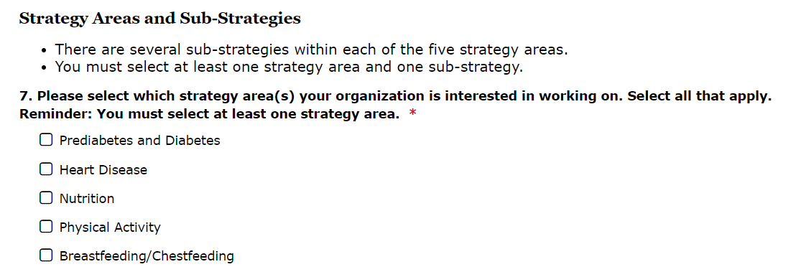
Screen Views

Slide 9
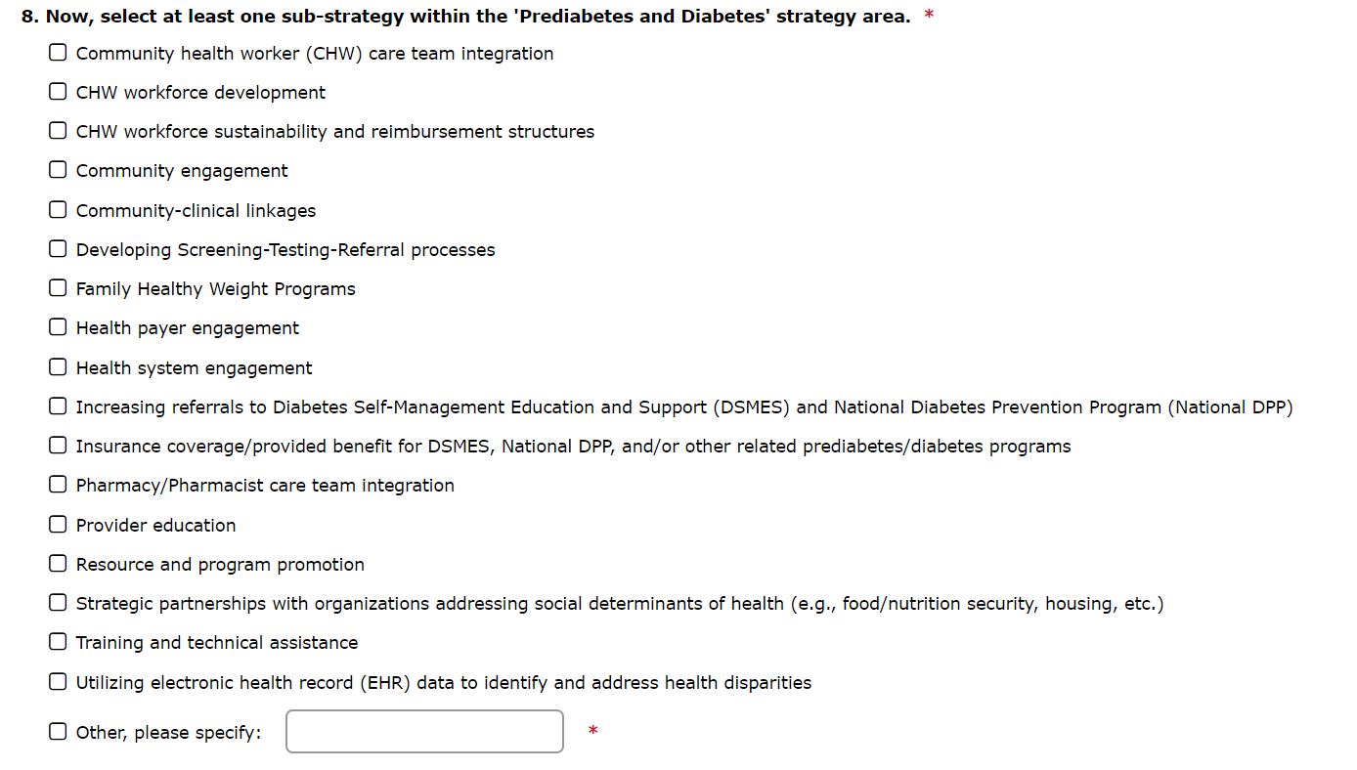
Screen Views

Slide 10
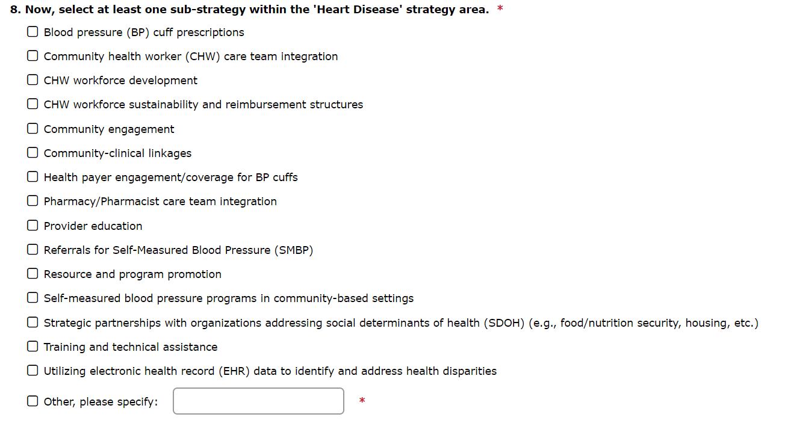
Screen Views

Slide 11
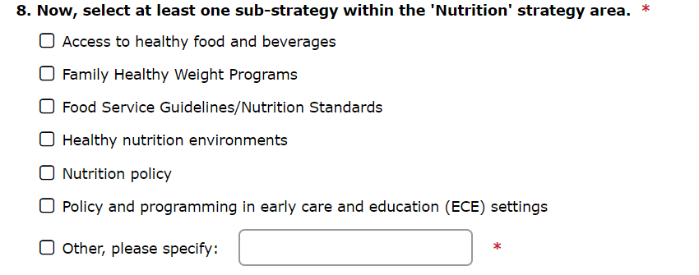
Screen Views

Slide 12
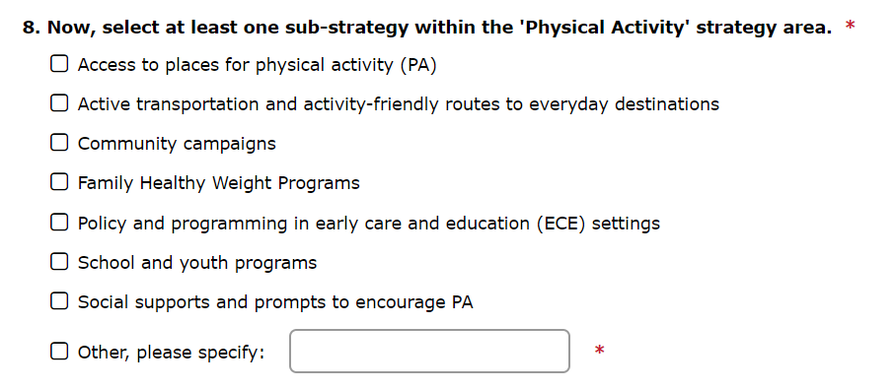
Screen Views

Slide 13
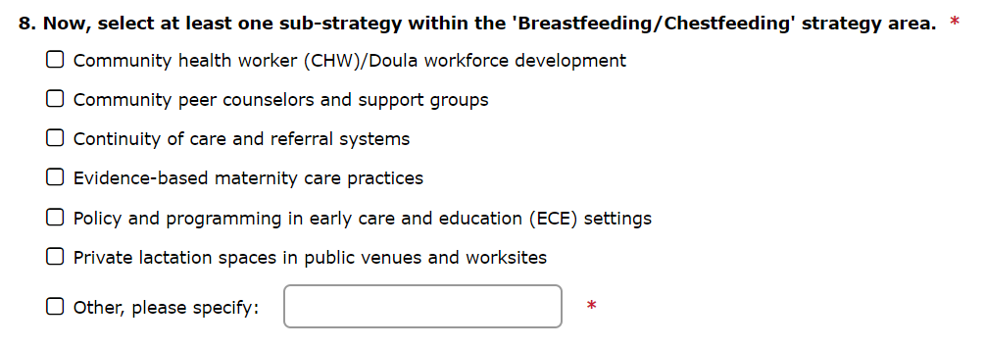
Screen Views

Slide 14
Screen Views

Slide 15
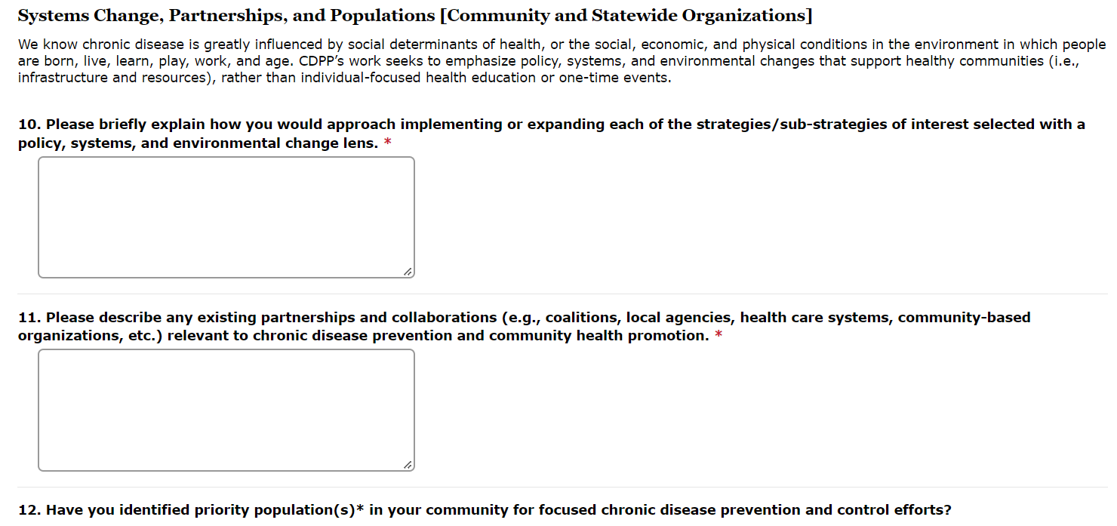
Screen Views

Slide 16
2023 CDC Notice of Funding Opportunities
Notes:
Mary

Slide 17
Anticipated 2023 Notice of Funding Opportunities
Grant | Funding range/year | Estimated Release Date/Start Date
2320: A Strategic Approach to Advancing Health Equity for Priority Populations with or at Risk for Diabetes | $850,000 - $1,250,000 (Competitive) | January 6, 2023/ June 30, 2023
2304: National Cardiovascular Health Program | $850,000 - $2,000,000 (Non-competitive) | January 15, 2023/ June 30, 2023
2305: Innovative Cardiovascular Health Program | $400,000 - $1,200,000 (Competitive) | February 11, 2023/ September 30, 2023
2312: State Physical Activity and Nutrition Program | $600,000 - $1,300,000 (Competitive) | January 12, 2023/ September 30, 2023
Notes:
All with an estimated release in Mid-January 2023. Due dates in Spring 2023

Slide 18
What do we know?
Estimated grant timelines
60-day turnaround from posting (45 days for DHS review)
High-level grant descriptions
Emphasis on health equity, social determinants of health (SDOH), and reaching priority populations
DHS requires a documented process to establish funded partnerships
Notes:
Grant forecasts were released in August 2022, from these we know estimated NOFO release dates in mid-January, and due dates 60 days from posting. Due to internal DHS review processes, we actually only have 45 days to complete grant writing.
The forecasts include high-level grant descriptions, but fall short of providing the required grant strategies. We do know that health equity will be central to the work, with forecast descriptions specifically calling out the social determinants of health and reaching priority populations (more on this in a moment)
Also different for this grant cycle is how DHS is required to document the process of establishing grantee partners. We will provide more detail on this process, including an interest survey, later in the webinar.

Slide 19
Priority Populations
From CDC NOFO Forecasts
“Those who have systematically experienced greater obstacles to health based on their racial or ethnic group; religion; socioeconomic status; gender; age; mental health; cognitive, sensory, or physical disability; sexual orientation or gender identity; geographic location; or other characteristics historically linked to discrimination or exclusion.”
Notes:
CDC defines priority populations as…Those who have systematically experienced greater obstacles to health based on their racial or ethnic group; religion; socioeconomic status; gender; age; mental health; cognitive, sensory, or physical disability; sexual orientation or gender identity; geographic location; or other characteristics historically linked to discrimination or exclusion.
Ultimately, strategies should be prioritized in communities and among populations that have experienced inequitable distribution of power and resources.
Potential grantees will be expected to identify priority populations, and tailor work to engage and reach those populations. This should be a data-informed approach. Rationale for selecting population(s) should consider various factors: disproportionate incidence, prevalence, or severity of diabetes disease burden and/or social vulnerability.

Slide 20
Priority Populations
Strategies should be prioritized in communities and among populations that have experienced inequitable distribution of power and resources
CDC may include guidance for determining populations
Incidence and prevalence
Social Vulnerability Index
Census data
Notes:
CDC defines priority populations as…Those who have systematically experienced greater obstacles to health based on their racial or ethnic group; religion; socioeconomic status; gender; age; mental health; cognitive, sensory, or physical disability; sexual orientation or gender identity; geographic location; or other characteristics historically linked to discrimination or exclusion.
Ultimately, strategies should be prioritized in communities and among populations that have experienced inequitable distribution of power and resources.
Potential grantees will be expected to identify priority populations, and tailor work to engage and reach those populations. This should be a data-informed approach. Rationale for selecting population(s) should consider various factors: disproportionate incidence, prevalence, or severity of diabetes disease burden and/or social vulnerability.

Slide 21
Key Outcomes
Decrease percent of individuals with uncontrolled diabetes (A1c >9%)
Increase percent of individuals with controlled high blood pressure (<140/90)
Increase percent of individuals with high blood cholesterol who are prescribed a statin
Increase opportunities for and access to safe physical activity
Notes:
Want to measure progress toward these goals and overall reach with priority populations in mind
Getting at PSE change outcomes- moving upstream

Slide 22
Increase availability and access to healthy nutrition environments
Increase settings with evidence-based maternity care practices
Decrease percent of individuals who are within the overweight and obese weight status
Notes:
Want to measure progress toward these goals and overall reach with priority populations in mind
Getting at PSE change outcomes- moving upstream

Slide 23
Cardiovascular Disease
Notes:
Now we’ll share more detail on each of the individual grant forecasts, and how they fit within our current work, starting with Cardiovascular Disease.

Slide 24
The National Cardiovascular Health Program (2304)
Previous iteration: 1815 Category B
Grant focus:
Implement and evaluate evidence-based strategies contributing to the prevention and management of CVD in populations at the highest risk.
Address social and economic factors to help health systems respond to social determinants present in their communities to offer those at risk of, or burdened with CVD, the best health outcomes possible.
Notes:
Heart disease and diabetes will be broken out into separate cooperative agreements this cycle, which is different from our current 1815 and 1817 grants. This means will we be writing separate applications for both.
The National Cardiovascular Health Program grant will focus on:
Implementing and evaluating evidence-based strategies contributing to the prevention and management of CVD in populations at the highest risk.
Addressing social and economic factors to help health systems respond to social determinants present in their communities to offer those at risk of, or burdened with CVD, the best health outcomes possible.
Again, we have limited detail on specific strategies, but expect similarities and alignment with current 1815 Category B strategies. We will expand on current grant efforts in a moment.

Slide 25
The Innovative Cardiovascular Health Program (2305)
Previous iteration: 1817 Category B
Grant focus:
Health system interventions to prevent, control, and manage high blood pressure and cholesterol
Improve continuity of care across health care settings
Maximize use of electronic health record data
Use technology to improve medication adherence
Notes:
Another funding opportunity is the Innovative Cardiovascular Health Program (2305). CDPP currently receives 1817 funding which is an innovative component with both Diabetes and Heart Disease strategies. Diabetes is not included in this upcoming round of “innovative” grant funding.
The focus of this grant includes innovation around:
Health system interventions aimed at preventing, controlling, and managing high blood pressure and high blood cholesterol
Supporting better continuity of care across health care settings
Maximal use of electronic health record data
Technological advances that improve medication adherence

Slide 26
Grant focus:
Integrate Community Health Workers
Support community and clinical links and partnerships
Develop partnerships to improve cardiovascular disease in priority populations
Address SDOH, stress/mental health, health inequity, and injustice
Notes:
Fully integrating community health workers, and other related interventions supporting community and clinical links and partnerships
Partnerships to improve the overall prevalence, detection, and control of hypertension and hypercholesterolemia in priority populations and address SDoH, stress/mental health, health inequity, and injustice

Slide 27
Current Grant Funded Efforts
Electronic Health Records/Health Information Technology
Team-based care
Pharmacist care team integration
Medication Therapy Management and Collaborative Practice Agreements
Community Health Worker integration
Self-measured blood pressure monitoring
Clinical and community-based settings
Hybrid cardiac rehab
Notes:
Work that we’ve been doing the last couple of years over both 1815/1817.
Current types of partners- trying to create comprehensive approach
Notes about areas of success (in reaching priority populations, etc), how to build off current, areas where CCL partnerships work well (SMBP); context for health department
While strategies with a clinical focus- tied back into community (example of CCL)
*Want to build partnership with those directly addressing SDOH
*What SDOH factors are impacting priority populations (why can’t access care, what other barriers, etc….)– considering these factors when planning programs, increasing locations into the community
SMBP examples: Free clinics, HHA

Slide 28
Resources
Million Hearts™ 2027 Priorities
The Surgeon General’s Call to Action to Control Hypertension Fact Sheets for Public Health Professionals and State and Local Governments
Set Your Heart on Health Toolkit: A toolkit for improving hypertension and cardiovascular outcomes
American Heart Association’s High Blood Pressure Resources
American Medical Association’s Checklists for Improving Blood Pressure Control
Notes:
While we won’t go into detail, we’ve compiled a list of resources related to cardiovascular strategies that may be helpful to review as a potential partner and establish if your organization’s skills and priorities are in alignment with our grant work.

Slide 29
Resources
The Community Guide, Community Preventive Services Task Force's Team-Based Care to Improve Blood Pressure Control
Pharmacy Society of Wisconsin's Wisconsin Pharmacy Quality Collaborative
National Association of Community Health Workers
Centers for Disease Control and Million Hearts™

Slide 30
Prediabetes and Diabetes

Slide 31
A Strategic Approach to Advancing Health Equity for Priority Populations with or at Risk for Diabetes (2320)
Previous iteration: 1815 Category A
Grant focus:
Prevent or delay onset of type 2 diabetes among adults and improve self-care practices, quality of care, and early detection of complications
Support implementation of evidence-based, family-centered childhood obesity interventions
Achieve statewide reach and reduce health disparities for priority populations
Implement evidence-based diabetes prevention and management strategies
Notes:
While we don’t have the all of the specific strategies, we know the diabetes grant will focus on:
Preventing or delaying onset of type 2 diabetes among adults with prediabetes and improve self-care practices, quality of care, and early detection of complications among people with diabetes
Supporting implementation of evidence-based, family-centered childhood obesity interventions as a type 2 diabetes risk reduction strategy
Achieving statewide reach and aim to reduce health disparities for priority populations
And we know we’ll have to select a minimum of 6 evidence-based diabetes prevention and management strategies from a provided menu; while we don’t know the exact list we do know we must include one or both of the following strategies
Strengthen self-care practices by improving equitable access, appropriateness, and/or feasibility of diabetes self-management education and support (DSMES) services.
Increase enrollment and retention of priority populations* in the National Diabetes Prevention Program (National DPP) lifestyle intervention by improving equitable access, appropriateness, and/or feasibility of the program.

Slide 32
Current Grant Funded Efforts
National Diabetes Prevention Program (National DPP)
Diabetes self-management education and support (DSMES)
Pharmacist and Community Health Worker integration into care teams
Notes:
The chronic disease prevention program has spent many years working on efforts to increase access to Type 2 Diabetes Prevention and Management Programs.
The National Diabetes Prevention Program is an evidence-based, year-long lifestyle change program introduced by the Centers for Disease Control and Prevention (CDC) for people who have prediabetes or are at risk for developing type 2 diabetes. CDPP provides statewide technical assistance and infrastructure support to health systems and organizations across the state working on the National DPP --from stages of program development to sustainable implementation.
Diabetes Self-Management and Education Support services help facilitate the knowledge, skills, and ability necessary for diabetes self-care and management on a sustained, ongoing basis. Our goal is to help patients with diabetes better manage their condition, resulting in increased use of primary and preventive services and lower use of acute, inpatient hospital services.
We know team-based care is a recommended approach for patients with type 2 diabetes, so important to this work is integration of pharmacists and community health workers into care teams. Pharmacies and pharmacists can play a key role in promoting medication management or Diabetes Self-Management and Education Support and helping people with diabetes achieve positive health outcomes. Another aspect is increasing training and utilization of CHWs in diabetes prevention and care coordination.

Slide 33
National Diabetes Prevention Program
Developing Screening-Testing-Referral processes
Increasing referrals and enrollment of priority populations
Insurer Community of Practice and Umbrella Hub Arrangement
Prediabetes and National DPP Campaign
Prediabetes risk test vanity URL www.diabetes.org/widhsrisktest
Notes:
Some specific examples of how we collaborate with partners on efforts to increase access to the National Diabetes Prevention Program includes: working with health systems and organizations on screening-testing-referral protocols to increase referrals; creation of DPP Umbrella Hub agreements to expand program delivery sites; make DPP a covered benefit by collaborating with Wisconsin-based health plans and other organizations and creating a Insurer Community of Practice; ongoing outreach and education of health care providers and the general public about prediabetes and the effectiveness of the National DPP to increase participant interest and enrollment;
We’re looking to expand and build off current successes into the next grant cycle to ensure access for underserved priority populations of focus across the state.

Slide 34
Diabetes Self-Management Education and Support (DSMES)
Increasing referrals to DSMES
Telehealth
Pharmacist care team integration
DSMES in pharmacy settings
Medication Therapy Management
Collaborative Practice Agreements
Community health worker diabetes education and referrals
Notes:
Our main Diabetes Self-Management Education and Support efforts include increasing availability of and access to these programs in both clinical and community settings. During COVID this has included a shift and increase in telehealth services.
Again, important to this work is a team-based care approach and integration of pharmacists and community health workers into care teams. This includes DSMES in pharmacy settings and referrals from pharmacists into DSMES, Medication Therapy Management services for diabetic patients on medication, collaborative practice agreements, and training and utilization of CHWs in diabetes prevention and care coordination.

Slide 35
Resources
CDC Diabetes Self-Management Education and Support (DSMES) Toolkit
American Diabetes Association-recognized and Association of Diabetes Care and Education Specialists-accredited DSMES Program Site Registry
CDC Interactive Diabetes Atlas: diabetes data by county to investigate local diabetes burden
The National Diabetes Prevention Program background and research
Notes:
While we won’t go into detail, we’ve compiled a list of resources related to prediabetes and diabetes strategies that may be helpful to review as a potential partner and establish if your organization’s skills and priorities are in alignment with our grant work.

Slide 36
Resources
American Medical Association/CDC Prevent Diabetes STAT toolkit to help health care teams screen, test and refer at risk patients to in-person or online diabetes prevention programs.
National DPP Resources for Engaging Health Care Providers
CDC National DPP Information for Health Care Professionals
CDPP Promotional Resources found on www.PreventDiabetesWI.org
National Association of Community Health Workers
CDC Job Aid: CHWs in Diabetes Management and Prevention
Notes:
While we won’t go into detail, we’ve compiled a list of resources related to prediabetes and diabetes strategies that may be helpful to review as a potential partner and establish if your organization’s skills and priorities are in alignment with our grant work.

Slide 37
Nutrition, Physical Activity, and Obesity (NPAO)

Slide 38
The State Physical Activity and Nutrition Program (2312)
Previous iteration: SPAN (1807) Note: CDPP does not have this funding.
Grant focus:
Support activities to implement evidence-based strategies and leverage resources from various stakeholders and sectors related to poor nutrition and physical inactivity.
Work with state and local partners to improve nutrition and access to safe physical activity, including breastfeeding, early care and education, and family healthy weight programs.
Notes:
The State Physical Activity and Nutrition Program grant is focused on supporting activities at the state and local governmental levels to implement evidence-based strategies and leverage resources from stakeholders and sectors (such as: agriculture, transportation, education, business, commerce, and housing) in their populations of focus related to poor nutrition and physical inactivity.
Recipients will be funded to work with state and local partners to improve nutrition and access to safe physical activity, including breastfeeding, early care and education, and family healthy weight programs.
This is a highly competitive grant, with only 16 expected awards. This is also the number of states currently funded.

Slide 39
Current Efforts
Partner engagement
Breastfeeding support in partnership with Maternal and Child Health and WIC programs
Nutrition security support in partnership with Wisconsin SNAP-Ed
Healthy Early
Wisconsin Physical Activity and Nutrition Road Map dissemination
Notes:
Historically, CDPP’s Nutrition, Physical Activity, and Obesity program complemented prediabetes, diabetes, and cardiovascular disease strategies, with a focus on policy, systems, and environmental change strategies to increase access and availability of healthy foods and safe physical activity opportunities. While CDPP did not receive the State Physical Activity and Nutrition funding in the last grant cycle, we’ve been working to build and maintain partnerships in these spaces.
We’ve remained active in breastfeeding work in partnership with our statewide Maternal and Child Health and Women, Infants, and Children (WIC) programs. This work includes focused strategies on supporting lactation in child care, worksites, and hospitals and supporting continuity of care for birthing families through local and state coordination of partners.
Since 2019 we have been coordinating with the Wisconsin Supplemental Nutrition Assistance Program – Education (SNAP-Ed). SNAP-Ed historically has focused more on working directly with SNAP eligible folks to encourage them to eat healthier foods. Education to individuals continues but efforts and resources are shifting to go beyond individual behavior to leverage community knowledge and power to create more equitable food systems that improve local access and control.
Our program also remains engaged in Healthy Early, a statewide, cross-sector partnership that works to create equitable opportunities for healthy eating and physical activity for Wisconsin kids and families. It’s currently going through a restructure to better center the voices of parents, caregivers, and early childhood providers.
Earlier in 2022 we published the Wisconsin Physical Activity Roadmap as a resource for communities. It serves as a starting point to understand key data, community needs, evidence-based strategies, and infrastructure needed to implement equitable physical activity and nutrition initiatives statewide; and will be an important guide as we apply for CDC SPAN funds.

Slide 40
Anticipated New Strategy
Family Healthy Weight Programs
Nutrition and physical activity skills and counseling
Family-centered design
Address SDOH context
Awareness of bias, stigma, and shame
Program delivery
>26 hours over 2-12 months
Setting: Clinical or Community
Various flexibility
Notes:
Family healthy weight programs are new focus in this round of State Physical Activity and Nutrition funding, and there is also alignment of this strategy with the new Diabetes grant.
Key components include nutrition and physical activity skills and counseling, incorporating a family-centered design.
We’re still learning more about program design, various models/curriculum and what they entail

Slide 41
Resources
Wisconsin Physical Activity and Nutrition Road Map
Early Care and Education Initiatives
Breastfeeding Initiatives
Active Community Initiatives
CDC Initiatives to Prevent or Manage Childhood Obesity in Healthcare
CDC State Physical Activity and Nutrition

Slide 42
2023 Notice of Funding Opportunities Summary
Grant | Funding range/year | Estimated Release Date/Start Date
2320: A Strategic Approach to Advancing Health Equity for Priority Populations with or at Risk for Diabetes | $850,000 - $1,250,000 (Competitive) | January 6, 2023/ June 30, 2023
2304: National Cardiovascular Health Program | $850,000 - $2,000,000 (Non-competitive) | January 15, 2023/ June 30, 2023
2305: Innovative Cardiovascular Health Program | $400,000 - $1,200,000 (Competitive) | February 11, 2023/ September 30, 2023
2312: State Physical Activity and Nutrition Program | $600,000 - $1,300,000 (Competitive) | January 12, 2023/ September 30, 2023
Notes:
All with an estimated release in Mid-January 2023. Due dates in Spring 2023

Slide 43
2023 Notice of Funding Opportunities Summary
Grant | Forecast links
2320: A Strategic Approach to Advancing Health Equity for Priority Populations with or at Risk for Diabetes | https://www.grants.gov/web/grants/view-opportunity.html?oppId=342950
2304: National Cardiovascular Health Program | https://www.grants.gov/web/grants/view-opportunity.html?oppId=342935
2305: Innovative Cardiovascular Health Program | https://www.grants.gov/web/grants/view-opportunity.html?oppId=342936
2312: State Physical Activity and Nutrition Program | https://www.grants.gov/web/grants/view-opportunity.html?oppId=342954
Notes:
All with an estimated release in Mid-January 2023.

Slide 44
Grant Implementation
Notes:
Now we want to provide a little more context around planning and implementation

Slide 45
CDC Required Grant Strategies
Desired Outcomes
Performance Measures (PMs) used to indicate progress
Example:
Improve access to, participation in, and coverage for the National DPP lifestyle change program for people with pre-diabetes, particularly in underserved areas.
Example:
Increased access to and coverage for the National DPP lifestyle change program for people with prediabetes
Increased community clinical links that facilitate referrals and provide support to enroll and retain participants in the National DPP lifestyle change program
Notes:
We do have parameters set by CDC where we’ll be working on specific strategies and working toward specific desired outcomes. We’ll also have predefined Performance Measures that will be used to measure progress toward achieving the desired outcomes.
These are examples from one of our current CDC grants—related to National DPP

Slide 46
CDC Required Grant Strategies
HOW?
Partner Roles
Desired Outcomes
Notes:
So we have the container we’re working within as it relates to specific strategies and desired outcomes, but we’ll need to fill in the gaps around HOW we achieve these outcomes. This is where our funded partners come into play- and this is the area where we have flexibility.
As we think about HOW?
We are looking at what we can do from a statewide approach
We can be creative and innovative in how we expand and scale up current work
We can be intentional about reaching priority populations
We can leverage local community assets and fit the work to local context
Key point here:
Working within grant parameters/container (broad prescriptive strategies, desired outcomes)
Where we have flexibility is how we do this work in WI– carry into roles (next slide)

Slide 47
Cross-Cutting Partner Roles
Use data to identify populations of focus
Develop strategic partnerships
Convene multi-sector partners
Facilitate community-clinical linkages
Align work with local context (priorities and needs)
Engage and incorporate populations of focus
Support and engage community-based organizations
Notes:
As we think more about how to reach desired outcomes---we will be prioritizing partnerships that demonstrate capacity in these areas.
These cross-cutting roles are things that need to happen regardless of the chronic program area or grant, and we want you to think about how these show up in the Public Health 3.0, Chief/Community health strategist role, and the Foundational Public Health Services.
We’re leading with priority populations, we have to be really intentional about this in order to make sure grant activities are appropriate and will move the needle toward addressing inequity
Want to build strategic partnership with those directly addressing SDOH. Despite the fact that the grants have very clinically oriented strategies, we’re able to identify what social and economic factors are impacting priority populations (and their access to care or other barriers) and consider these factors when planning programs, or bringing services outside of clinic walls and into the community.
Multi-sector partners- how can you work with a broad group of allies, really thinking about how community and non-health sectors have a voice and role.
Facilitating Community-clinical linkages-- these are connections between community and clinical sectors to improve population health. We want local health departments and community-based orgs to develop relationships with health systems and visa versa.
Fit grant strategies within local context (community health assessments and improvement plans), identify and build off existing community assets
Engage and incorporate populations of focus—really a first step of the work--can you start by hosting a community conversation with those groups?
Support and engage community-based organizations—who are the organizations interested in addressing chronic disease that could use more support? Who are the organizations that are a part of or represent priority populations?

Slide 48
Policy, Systems, and Environmental Change
Approaches that promote healthy behaviors and make physical activity and healthy eating easier and more accessible
Drive change at multiple levels (e.g., within an organization or health system, neighborhood, community, state)
Sustainable change, moves beyond one-time events or individual education
Notes:
We will also be prioritizing partnerships that help us address policy, systems, and environmental change. We’re ultimately looking for activities that will drive change beyond the individual level, impacting systems within organizations, or at the community setting; and activities that move beyond one-time events or individual education

Slide 49
Resources
CDC Community-Clinical Linkages Health Equity Guide
National Association of County and City Health Officials (NACCHO) Community Chief Health Strategist Competencies
Foundational Public Health Services Factsheet
NACCHO Public Health 3.0 Issue Brief
CDC Meaningful Community Engagement for Health and Equity
CDC Framework for Program Evaluation in Public Health

Slide 50
Timeline and Next Steps
Notes:
Mary

Slide 51
Complete the Interest Survey
https://survey.alchemer.com/s3/7095146/CDPP-Partner-Request-for-Interest-Survey
Complete by December 30, 2022
Note: the survey link, PDF and recording will be posted on the Chronic Disease Prevention Program website, https://www.dhs.wisconsin.gov/disease/chronic-disease.htm
Notes:
Note that a different survey is being sent to Local and Tribal Health Departments to identify NPAO, breastfeeding or similar coalitions. This is separate from the interest survey described today and we hope you will complete both, if appropriate.

Slide 52
After Interest Survey
CDPP will…
Review and summarize responses
Identify gaps
Additional outreach, if needed

Slide 53
After NOFO Released
Will contact those who expressed interest in specific strategy area(s)
Will be a rapid turn-around for information
Various partnership options
Funded partner
Collective action partner
DAG, Heart Health Alliance or healthTIDE member

Slide 54
After NOFO Released
Important considerations
Fit with NOFO guidance, strategies and performance measures, and available funding
Identification of populations of focus
Geographic distribution in state
Good standing with DHS requirements
Ability to participate in the planning process timeline

Slide 55
After NOFO Released
Anticipated application components:
Narrative
Detailed budget and work plan for year 1
Potential funded partners will be asked for a draft budget and work plan to help develop application
Letters of support or commitment
Supporting documents (organizational chart, staffing plan, resumes, position descriptions)

Slide 56
While We Wait…
Generally, it will be a few months before we know if awarded, amount of funding, and weaknesses to address
Often funding award is less than our request
CDPP will start fiscal paperwork for partners before funding award to be proactive
Technical review response within 30-60 days of award

Slide 57
What to Expect When Working with CDPP
Be part of cohesive, coordinated approach
Performance measure data monitoring
Regular check-ins and reporting
Orientation and annual meetings
Training, technical assistance, and resources
Peer learning and connections
Funding is on a reimbursement basis
Notes:
Not just “pass through” funds; cooperative agreement and work closely with CDPP

Slide 58
Allowable Costs
Allowable Costs | Unallowable Costs
Staff time (salary and fringe) | Direct clinical care
Mileage | Lobbying
Costs to implement the project | Costs not associated with project
Educational materials | Incentives*
Performance Measures/Evaluation* | Food*
Sub-contracts* | Equipment (>$5,000)*
Indirect <15% approved cost rate* | Construction
* These items will need discussion with CDPP
Notes:
This is not an inclusive list of allowable/unallowable costs
Items such as blood pressure cuffs are not allowable.

Slide 59
Chronic Disease Prevention Statewide Gathering
Monday, December 12 8:30am - 4:15pm
Glacier Canyon Conference Center, 45 Hillman Road, Wisconsin Dells, WI 53965
Register Here!
Notes:
Join us at Glacier Canyon on December 12 to brainstorm and strategize for our collective chronic disease prevention work. This will be a great opportunity to hear what others are doing in heart disease, diabetes, and NPAO work and see where your work fits in. If you have ideas that you want to flesh out or want to spark new ideas, we hope that that discussions at our gathering will do just that.

Slide 60
Contact Information
Send questions or comments to:
dhschronicdiseaseprevention@dhs.wisconsin.gov

Slide 61
Q & A
Please unmute to ask your question or type it into the chat box.

