Slide 1
Stroke in Wisconsin
Chronic Disease Partner Meeting
May 24, 2022

Slide 2
Objectives
Talk about Stroke
Projects within CDPU
Efforts being done
  Prevention and Promotion
  Stroke Systems of Care
  Post-Discharge and Secondary/Tertiary Prevention

Slide 3
Stroke Basics

Slide 4
What is a stroke?
Ischemic Stroke – Blood vessels in the brain become blocked (or narrowed). Reduces blood flow to the brain, causing brain cell death and leading to complications
Hemorrhagic Stroke – Blood vessel in the brain leaks or ruptures
Transient Ischemic Attack (TIA) – Called “ministroke”. Symptoms reflecting a stroke. Doesn’t cause damage but can be a precursor to a later stroke

Slide 5
Breakdown between stroke types is 87% ischemic and 13% hemorrhagic
Ischemic Stroke (two types)
  Thrombotic – Blood clot forms in artery directly supplying blood to the brain
  Embolic – Clot forms elsewhere in the body and travels to blood vessels to the brain

Slide 6
Stroke Statistics
Fifth leading cause of death in the United States
1 in 6 deaths from CVD is due to stroke
A stroke occurs every 40 seconds in the U.S.
Annually, nearly ~800,000 in the U.S. have a stroke and 610,000 are first (or new) strokes
Approximately 11,000 strokes per year in Wisconsin

Slide 7
Projects within Chronic Disease Prevention Unit

Slide 8

Wisconsin Coverdell Stroke Program
Wisconsin is 1 of 13 states funded by CDC to improve state stroke systems
Grant period: 2021-2024
Funded since 2012
Administered by Wisconsin Department of Health Services, Division of Public Health

Slide 9
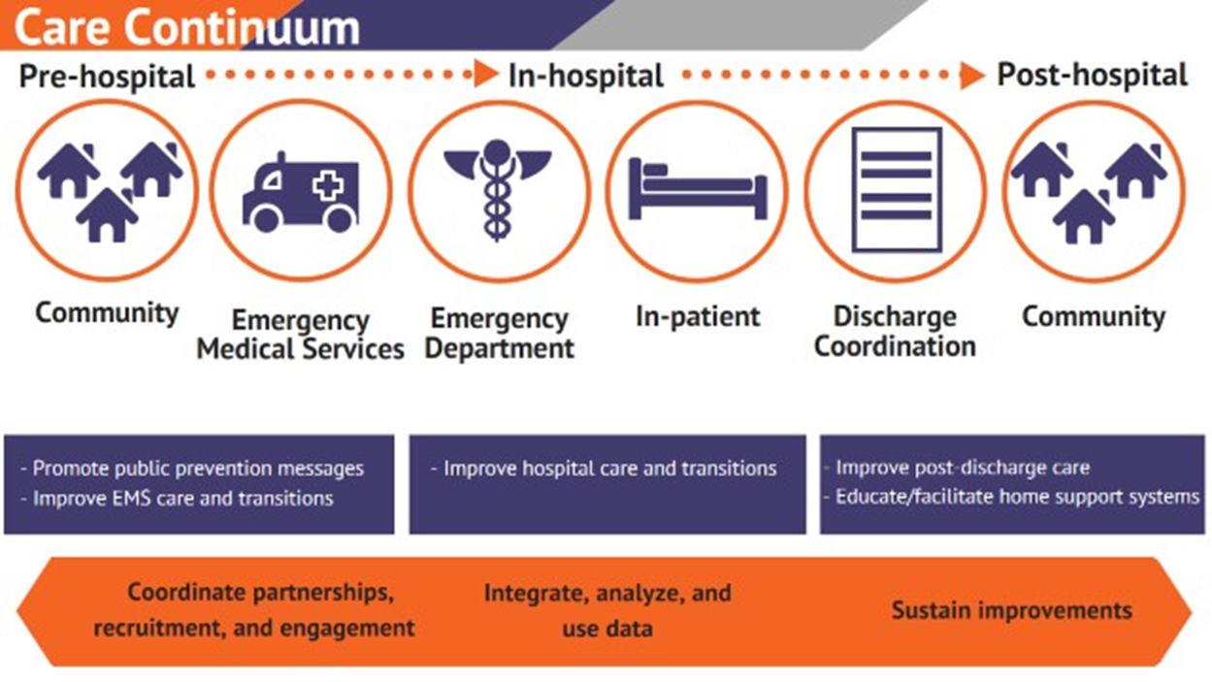
Wisconsin Coverdell Stroke Program

Slide 10

Short-term goals:
Increase public awareness and recognition of stroke symptoms and the importance of calling
9-1-1
Linking and monitoring data across transitions of care
Improving care coordination throughout the care continuum

Slide 11
Longer Term Goals:
Reduce the burden of stroke in Wisconsin
  Reduced mortality
  Improved outcomes for stroke survivors
  Reduced rates of subsequent strokes

Slide 12
Data
Health Equity
Community
Track and monitor clinical measures to improve data infrastructure across stroke systems of care
Implement a team-based approach to enhance quality of care for those at highest risk for stroke events and stroke patients across systems of care
Link community resources and clinical services that support those at highest risk for stroke events and stroke patients across systems of care

Slide 13
Health Disparities Grant (2103)
Funding provided to all states to address disparities, primarily those related to COVID-19
Activities across Wisconsin DHS
Including two stroke activities to address disparities

Slide 14
Health Disparities Grant (2103)
Mobile Integrated Health for COVID and Stroke
Rural Wisconsin COVID and Stroke Data Project

Slide 15
Stroke Prevention and Promotion

Slide 16

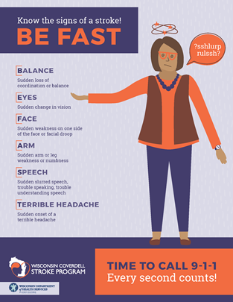
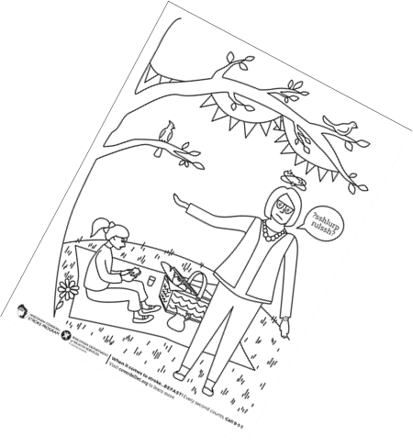
BE FAST BELLA
https://www.dhs.wisconsin.gov/coverdell/bella.htm

Slide 17
Stroke Systems of Care

Slide 19
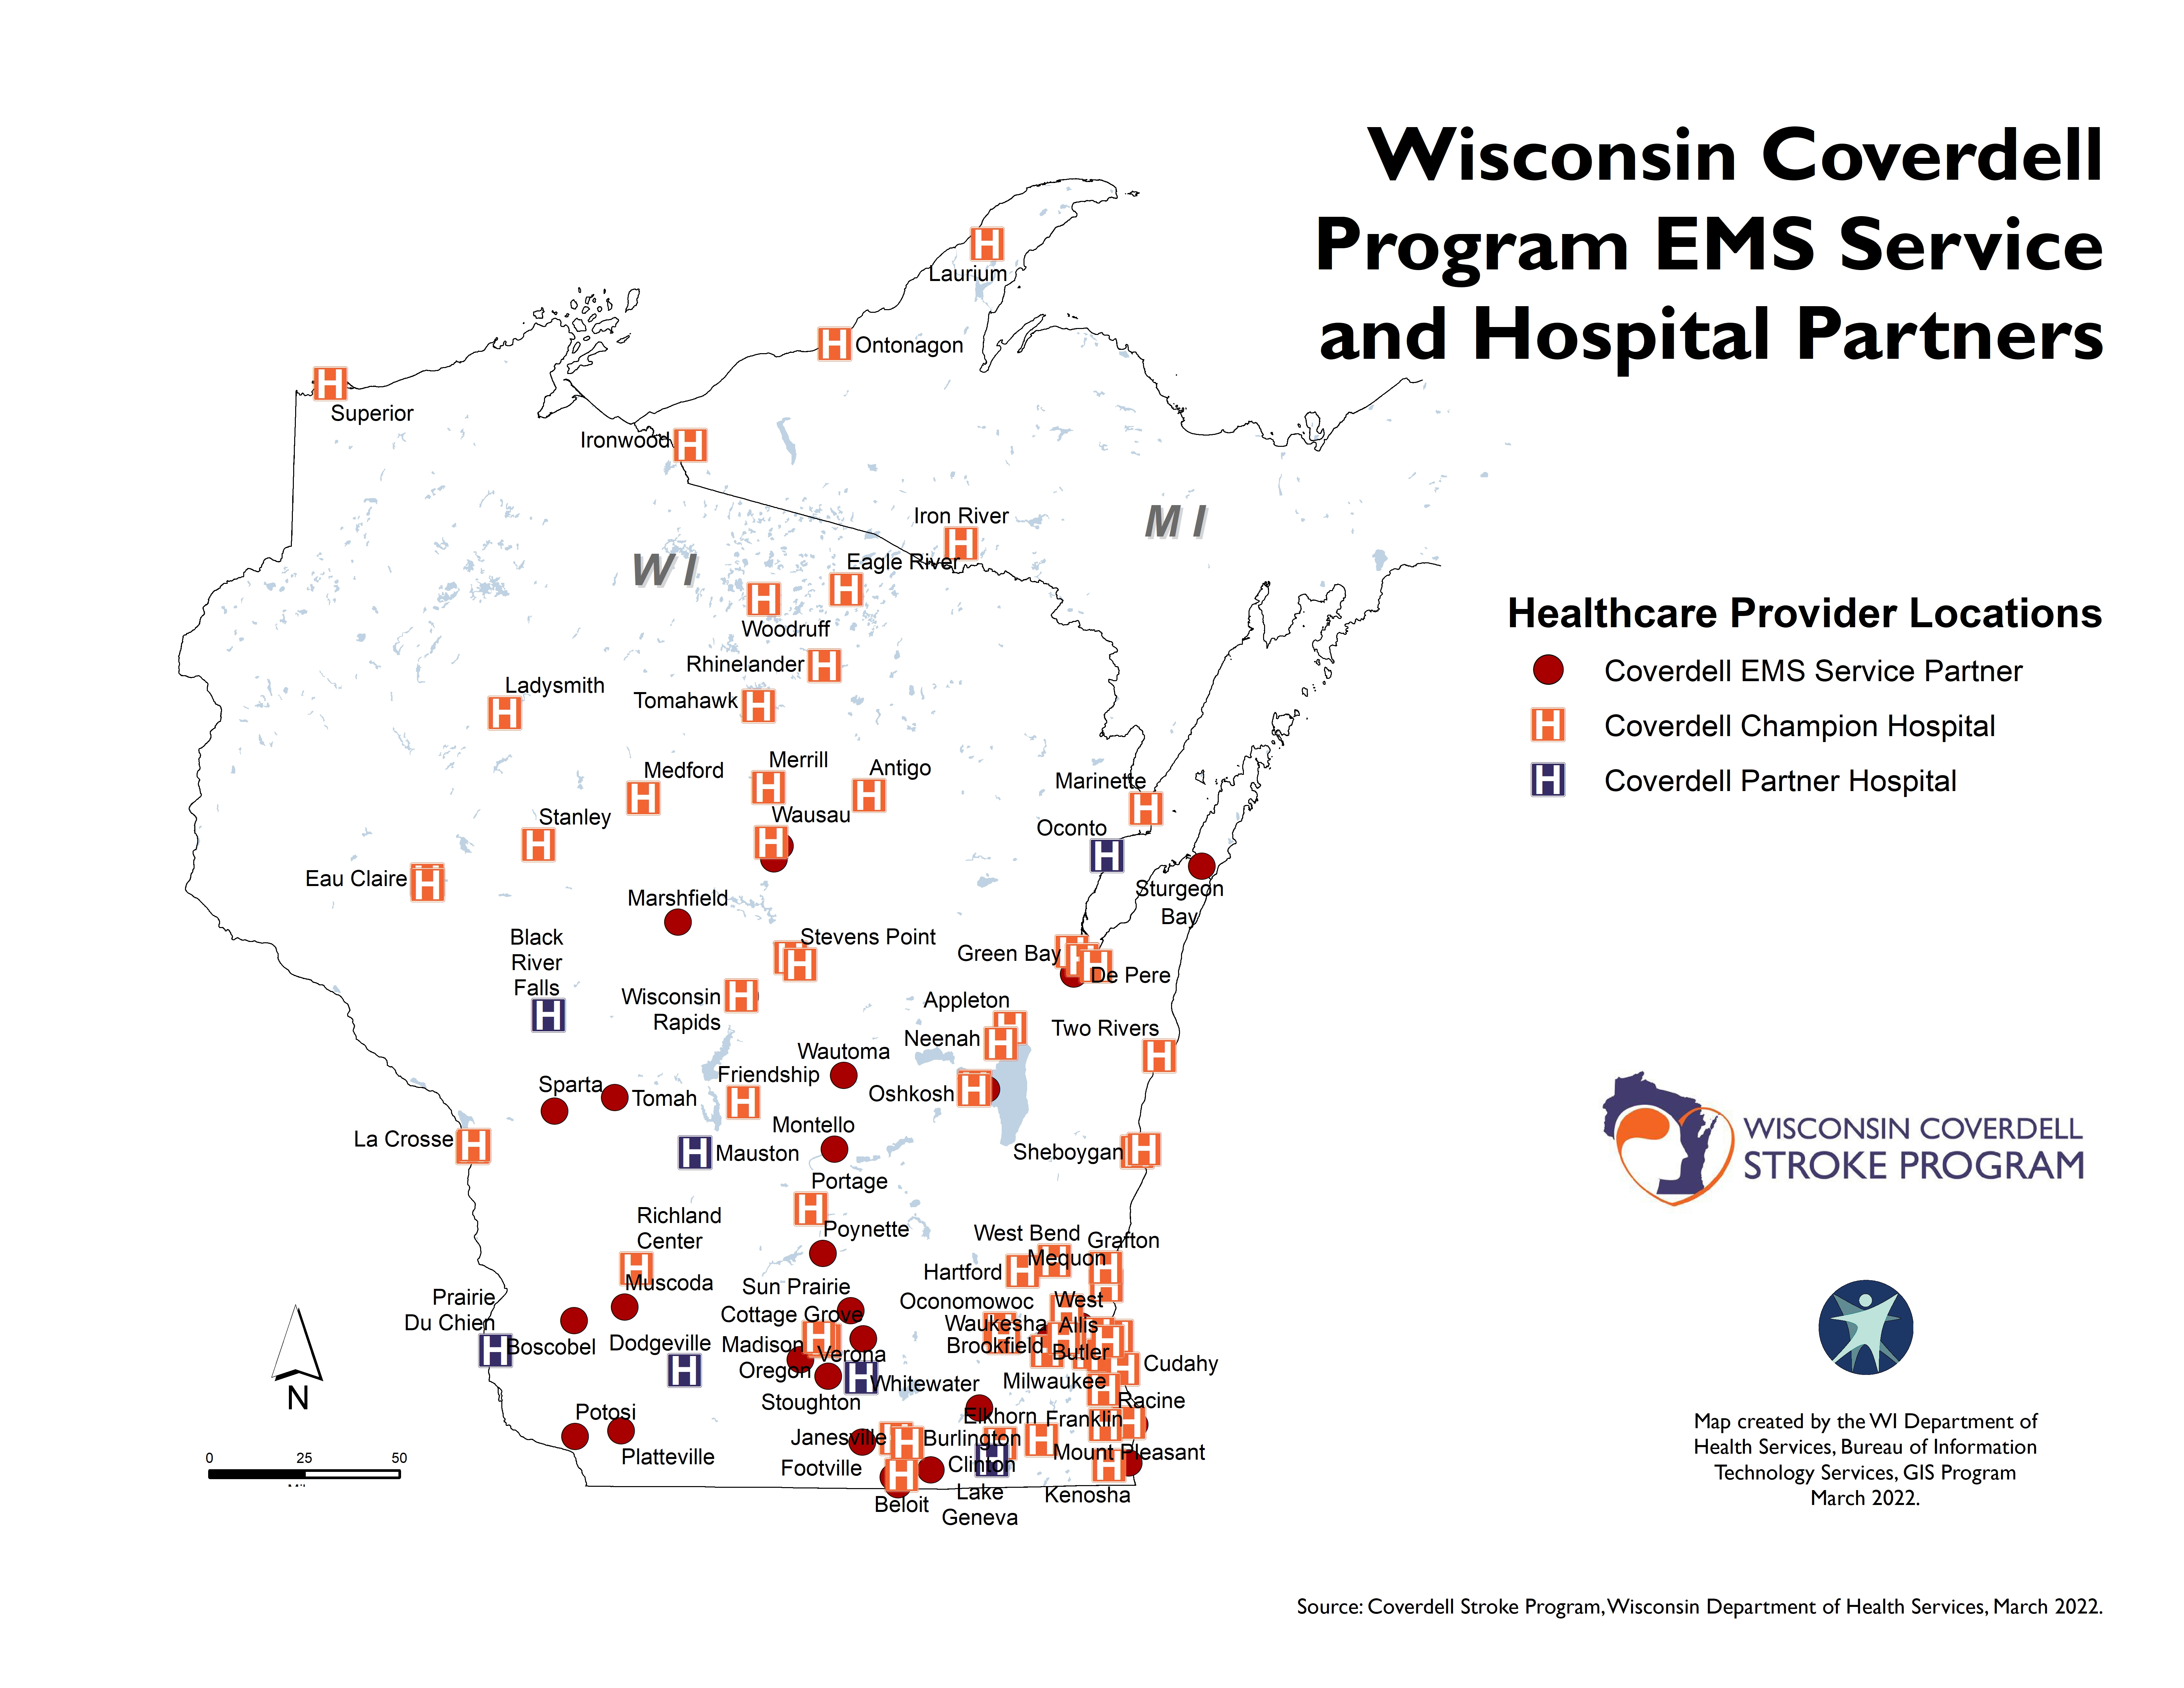
73 Hospitals
~80% of all Wisconsin stroke admissions
36 EMS Partners
Notes:
This map is an overlay of Coverdell EMS and hospital partners in Wisconsin. We’ll see that there are pockets in the state where we would want to focus our recruitment efforts, particularly in the northern and rural parts of the state. Next slide.
A handout will be provided (text smaller than 18 font size)

Slide 20
Data-Driven Quality Improvement
Stroke data collected through two sources
  EMS: Wisconsin Ambulance Run Data System (WARDS)
  Hospital: Get with the Guidelines ®
Data used to identify areas of weakness across continuum to drive quality improvement efforts

Slide 21
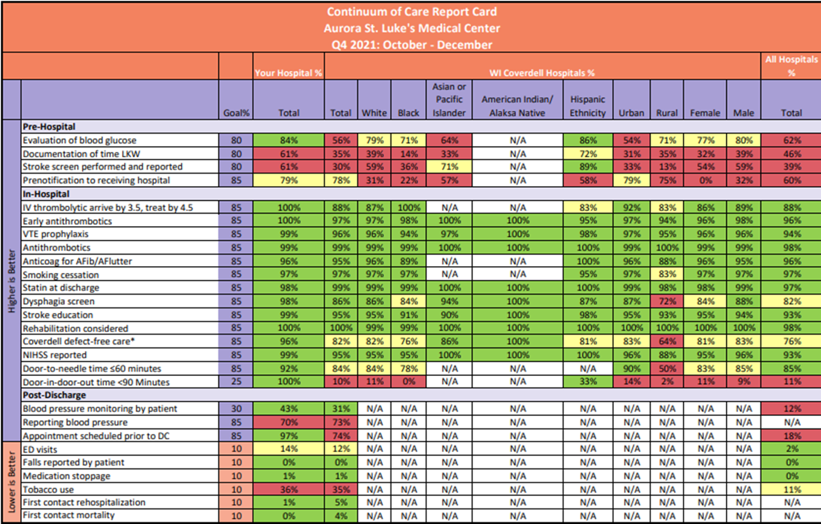
Report Card

Slide 22
Community of Practice
Bi-annual Wisconsin Stroke Coalition Meetings
Quarterly meetings
  Coverdell EMS
  Coverdell Learning Collaborative
  Stroke Coordinators of Wisconsin (SCOW)
Opportunities to share results and discuss resolutions

Slide 23
PDSA and other Projects
Telestroke Taskforce
Speed and Efficiency in Stroke Care
Tobacco Cessation
Hub-and-Spoke Map

Slide 24
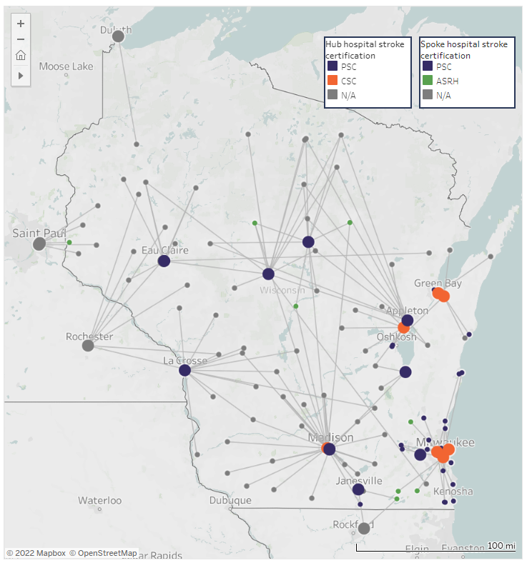
Wisconsin Stroke Transfer Map
Notes:
The last six months, the Coverdell program has been working on a new interactive map. We wanted to look at where stroke patients are being transferred to in Wisconsin. Dot Bluma, our Stroke Project Specialist, collected data from regional stroke coordinators. We asked hospitals where they were transferring stroke patients 25% or more of the time and put that data into two transfer maps. I’ll now share my screen. [SHARE SCREEN]
The maps sit on the Coverdell webpage. The bigger dots are the hub hospitals, where stroke patients are being transferred to. And the smaller dots are the spoke hospitals, where stroke patients transfer out of. You’ll also see different colored dots depicting the different stroke certifications, for example comprehensive stroke centers and acute stroke ready hospitals. When you hover over a transfer line, it’ll tell you which hospitals are involved in that exchange and also the distance and drive time from hospital to hospital.
The second map holds the same information but allows users to filter for specific hospitals. For example, if I was Froedtert and wanted to see our transfers, I can click on our hospital name to see which hospitals transfer their stroke transfers to us.
The maps need to undergo one more round of user-testing before we can share the link with everyone. We have hopes of adding more interactive maps to the Coverdell webpage and would also invite suggestions for new maps that our partners will find useful.
[STOP SHARING SCREEN]
Back to you, John.

Slide 25
Post-Discharge and Secondary/Tertiary Prevention

Slide 26
Mobile Integrated Health
Mobile Integrated Health (MIH) can have many forms
Work with stroke involves at-home visit by EMS within 30 days of discharge
Meet people where they are to understand non-clinical realities
Work ongoing in Milwaukee for past four years (Coverdell)
Expanding into five new communities across Wisconsin (Health Equity Grant)

Slide 27
Community-Based Work
Community Health Workers
Patient Navigators
Wisconsin Libraries
ADRCs

Slide 28
Looking Ahead

Slide 29
Increasing partnerships in rural communities
More “direct-to-consumer” health promotion
Ongoing PDSA projects

Slide 30
Take Home Message
Maximize awareness of BEFAST and the need to call 9-1-1
All people benefit from message
  Stroke patients
  Those around someone with symptoms

Slide 31
Thank you!
Questions?
John Bowser, PhD
john.bowser@dhs.wisconsin.gov
www.coverdellwi.org

