Slide 1
Leveraging Wisconsin’s Ambulance Run Data System to Monitor the Opioid Overdose Epidemic
Ashley Bergeron, MPH
Office of Preparedness and Emergency Health Care Wisconsin Division of Public Health June 12, 2018

Slide 2
Disclosure
Wisconsin was one of 12 initial states awarded the Center for Disease Control and Prevention (CDC) Enhanced State Opioid Overdose Surveillance (ESOOS) three-year grant in 2016.

Slide 3
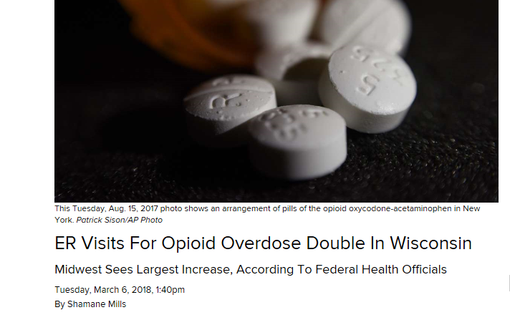
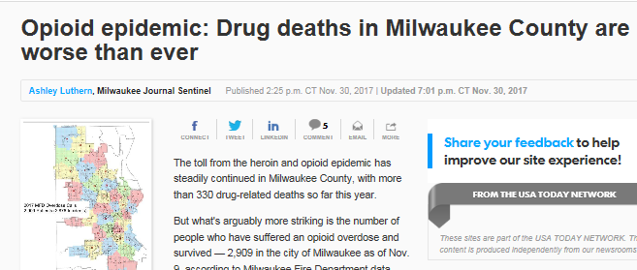
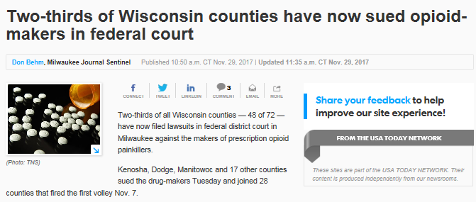
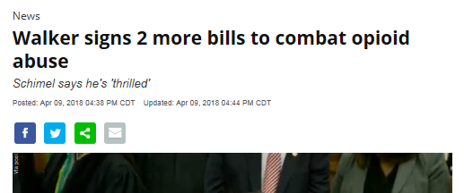
In the News

Slide 4
Background
The primary aim of this grant is to increase the timeliness of suspected nonfatal opioid overdoses using rapid surveillance data systems.

Slide 5
Wisconsin Ambulance Run Data System (WARDS)
Data submitted by emergency medical service (EMS) providers within seven days of incident
>90% services in Wisconsin submit
Rich data source with many variables

Slide 6
Indicators
Rate of nonfatal:
All drug overdoses
All opioid nonfatal overdoses
Heroin overdoses
Incidents with opioids and IV drug use

Slide 7
Methods: Develop Case Definition
Exclude nonemergency ambulance runs.
Exclude persons under age 11.
Determine variables of interest.
Determine key terms.
Determine key terms for false positives.

Slide 8
Variables of Interest
Type of service requested
Chief complaint
Secondary complaint
Incident narrative
Medications given
Additional fields for de-duplicating and linking: patient identifiers, date of incident

Slide 9
Key Terms
Use SAS regular expression analysis to find key terms, such as opioids, heroin, naloxone, and Narcan.
Exclude visits that indicate false positives, such as withdrawal and detox.

Slide 10
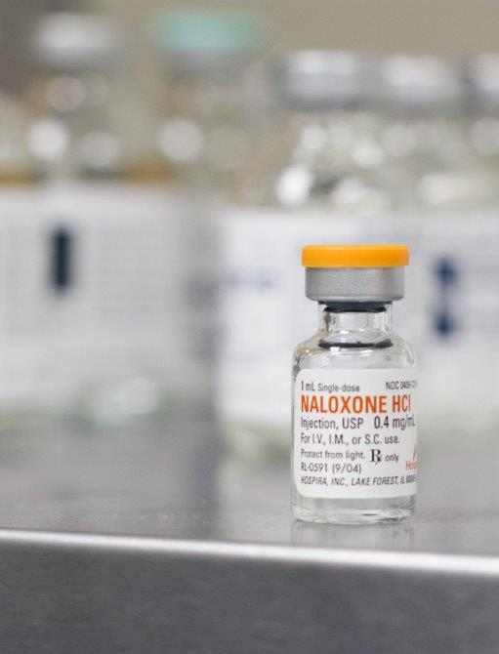
Final Definition
Created flags for overdose, opioid use, Naloxone administration
Created flags for false positives
Searched for flags in identified variables of interest

Slide 11
Flagged Opioid Overdose
“…was updated en route that it was a possible heroin overdose and that the patient did have a pulse…found the patient lying unresponsive on the bathroom floor. The patient had rapid and shallow respiration. There was drug paraphernalia present in the bathroom. The patient was administered 2mg of Naloxone…after approx. 1 minute the patient became responsive...”

Slide 12
Flagged False Positive
“…dispatched for a response to female patient withdrawing from heroin addiction…patient was ambulatory showing no signs of distress and walked into the ambulance without difficulty…she is a regular user of heroin for the last 4 years and has not used in the last two days…reported onset of nausea, vomiting, bilateral lower extremity leg pain.”

Slide 13
Final Definition
Overdose: drug abuse, use, poisoning, ingestion; substance abuse, use, poisoning, overdose
Opioid: opioid, Narcan, methadone, heroin, naloxone
Medications administered: Narcan, naloxone
False positive: withdrawal, detox, alcohol poisoning (only if no other poisoning reference)

Slide 14
Validation
Random sampling:
Sample records with and without flags.
Examine narratives.
Data linking:
Use hospitalizations as the gold standard.
Link to ambulance runs based on patient identifiers and date of event.

Slide 15
Results
From January 1, 2016, to December 31, 2017: 9,514 opioid overdose ambulance runs identified (1.2% total emergency runs)
Suspected opioid overdose runs:
Naloxone given at least once: 82%
Male: 62%
Large proportion of overdoses are persons 25–34 years of age

Slide 16
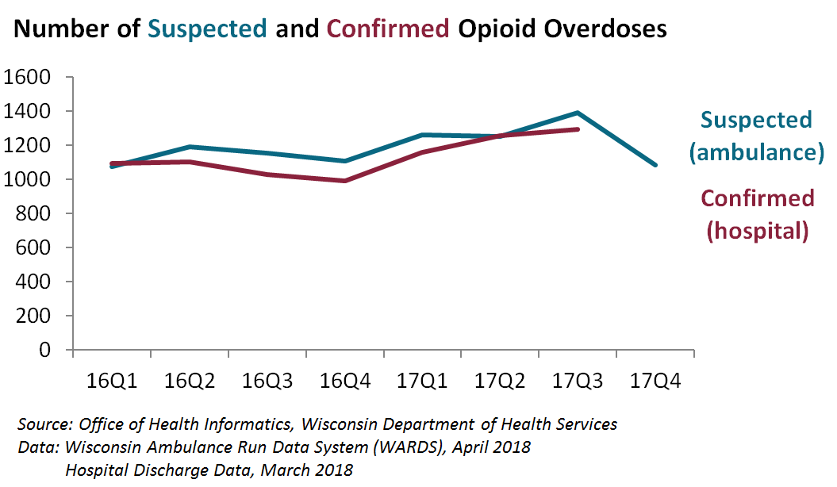

Slide 17
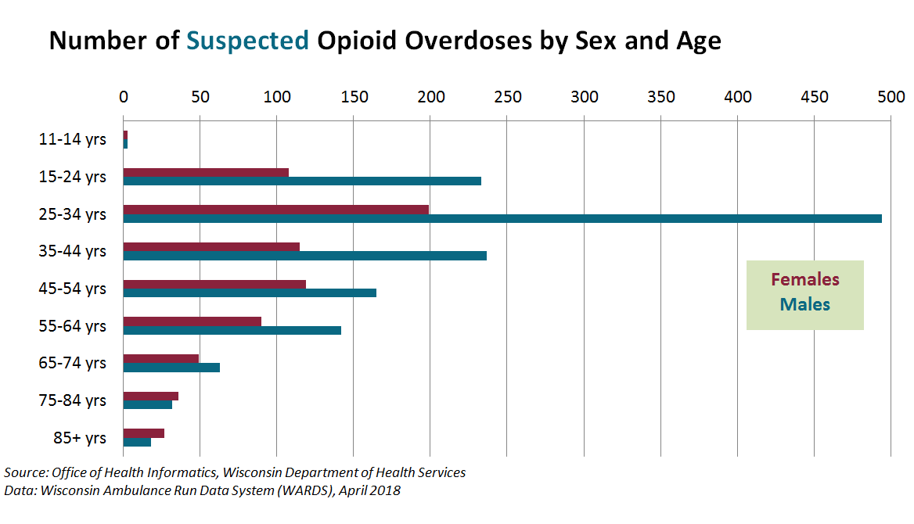

Slide 18
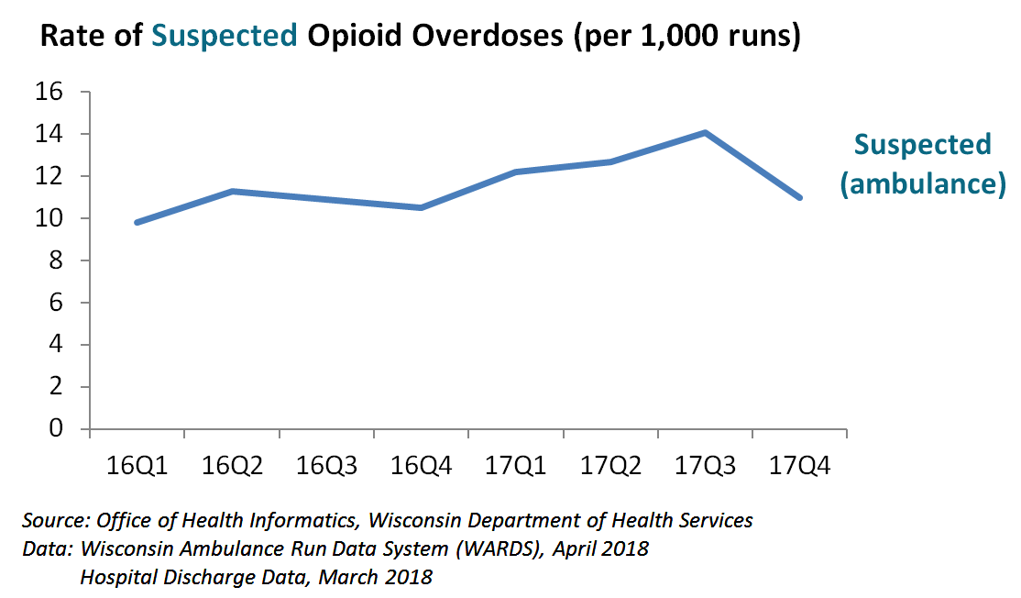

Slide 19
Exact Counts Versus Trends
Counts were used when examining validation and comparing to hospital data
Trend and percent change are more. appropriate because of the suspected nature of cases.
These overdoses are suspected because they have not been examined and confirmed by a clinician and then coded.

Slide 20
Results
Overall 24% increase in rate of opioid overdose ambulance runs from Q1 2016 to Q1 2017
16% increase in 2017 from Q1 to Q3
Rate decrease Quarter 4 each year

Slide 21
Conclusions
EMS data systems are useful to monitor the opioid overdose epidemic.
It is useful to examine trends instead of straight counts.
There is potential to use EMS data to monitor other health events if the case definitions are carefully created and validated.

Slide 22
Lessons Learned
Wisconsin's EMS data system was recently upgraded to the ImageTrend Elite version 3 database.
Coding combined two versions.
Data quality improvements are warranted.
Spelling variation, abbreviations
Random sample validation is critical.

Slide 23
Next Steps
Continue to monitor the epidemic and continuously evaluate the case definition.
Disseminate data reports to partners statewide.
Support prevention and response activities with useful information using rapid surveillance data.
Identify additional responses to leverage EMS data.

Slide 24
Acknowledgements
Wisconsin Department of Health Services:
Jennifer Broad
Milda Aksamitauskas
Ousmane Diallo
Gayatri Raol
Chuck Happel
CDC:
Justin Davis
Matthew Gladden
Alana Vivolo-Kantor

Slide 25
Questions?

