Slide 1


2024 Wisconsin EMS Scope of Practice Review
M. Riccardo Colella, DO, MPH, FACEP
Wisconsin State EMS Medical Director
April 2024
Notes:
Hello and welcome to the 2024 Wisconsin EMS Scope of Practice Review. I am Dr. Riccardo Colella, YOUR state EMS medical director.

Slide 2

Objective
At the conclusion of this presentation, the learner will:
Understand the required and optional skills designations.
Understand the changes from the 2023 Scope of Practice and the rationale behind the changes.
Notes:
Read the slide

Slide 3
Objective Continued
Identify which skills under the Emergency Medical Responder scope are considered an “advanced skill” and why documentation in the Wisconsin Ambulance Run Data System (WARDS) is important.
Understand EMS Provider agency requirements to update service operational plans.
Notes:
Wisconsin Ambulance Run Data System (WARDS)

Slide 4

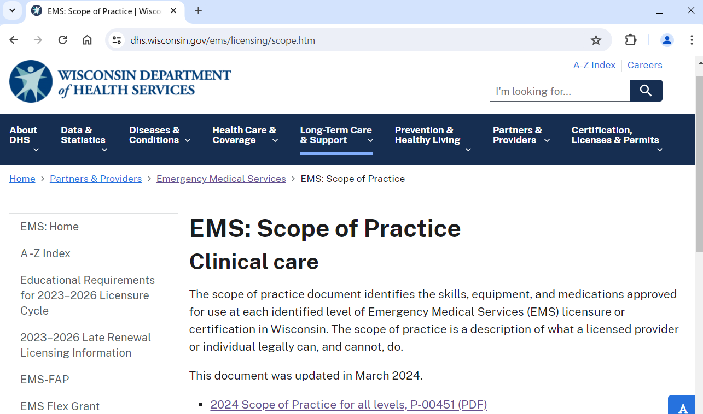
Visit the DHS EMS Page
https://www.dhs.wisconsin.gov/ems/licensing/scope.htm
2022
2024
Notes:
The Wisconsin scope of practice for each EMS professional provider level is reviewed annually in consultation with the Wisconsin EMS Advisory Board and the Physician Advisory Committee. The scope of practice becomes effective on March 31st of each year and is published and posted on the department website.
You will also find other valuable information and resources on the DHS homepage.

Slide 5

Wisconsin Admin. Code § DHS 110.12
Administrative Rule
DHS specifies the scope of practice for all EMS practitioners and responders.
Responders and practitioners may only perform skills, use equipment and administer medications within the scope of practice to which the individual is licensed, certified, or credentialed.
Notes:
DHS is identified by Administrative Rule DHS 110.12 to specify the Scope of Practice for EMS practitioners and responders.
Responders and practitioners may only perform skills, use equipment and administer medications within the scope of practice to which the individual is licensed, certified, or credentialed.
This process has been transparent and vetted through the PAC and EMS Board with input from the public in these venues.

Slide 6

“R” and “O”
All skills, equipment and medications designated with an “R” at a practice level are REQUIRED for that level; these core skills ensure equal access to EMS care across the state.
All “R” skills, equipment and medications must be submitted as part of the EMS Service Operational Plan and approved by DHS.
Continued next slide
Notes:
Read the slide

Slide 7

“R” and “O”
All skills, equipment and medications designated with an “O” at a practice level are optional advanced skills for that level based on the needs and resources of a community.
These optional skills must be submitted as part of the EMS Service Operational Plan and approved by DHS.
Continued next slide
Notes:
Read the slide

Slide 8

“R” and “O”
EMS Provider License Level | Required to submit patient care report to WARDS?
Emergency Medical Responder (EMR) | Only if Optional skills, equipment and medications (Advanced Skills) are used in caring for patients. Optional at EMR = Advanced Skills
Emergency Medical Technician (EMT) Advanced EMT EMT-Intermediate Paramedic | Yes, for all patient care reports including when any Required or Optional skills, equipment and medications are used.
Notes:
Questions often arise about the need to submit a patient care report to WARDS---the Wisconsin Ambulance Report Data System.
If the EMS entity is licensed as an emergency medical responder service provider, they are required to submit a patient care report to WARDS only if advanced skills are used in caring for the patient. Any “O” Optional skill is considered an advanced skill for the EMR provider and should be included in the patient care record for safety, quality and accountability. This requirement is codified in administrative rule (110.34.8).
For the EMT, AEMT, EMT-INT and PARA license levels, all patient care reports must be submitted to WARDS including any item listed on the scope of practice, whether a required skill or an optional skill.

Slide 9

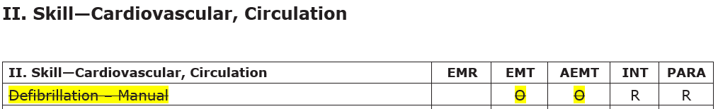
Part A: Scope of Practice for 911 EMS Practitioners or Emergency Medical Responders
Notes:
In an effort to continually align our Wisconsin EMS scope of practice with national educational end clinical practice guidelines, manual Defibrillation is removed as the skill for the EMT and aemt. The rationale for this removal is that manual Defibrillation requires an EMS professional to interpret a rhythm and subsequently manually defibrillate a patient. Further the advancements of the automatic external Defibrillation technology makes rhythm recognition and rapid Defibrillation easy and safe to do for providers that are not trained in rhythm recognition. This removal only impacts manual Defibrillation and has no change on the use of an automatic external defibrillator at these license levels.

Slide 10
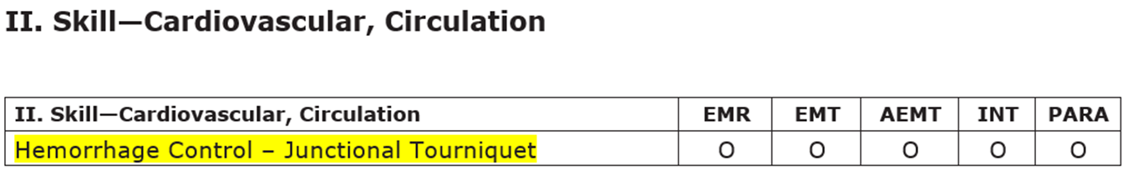
Part A: Scope of Practice for 911 EMS Practitioners or Emergency Medical Responders
Notes:
The use of a junctional tourniquet to help manage proximal bleeding is an optional skill for all EMS professional certification and license levels. The intent is to bring more resources to patients suffering from proximal life threatening bleeding.

Slide 11
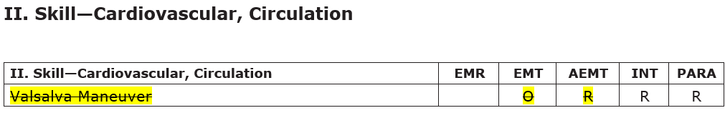
Part A: Scope of Practice for 911 EMS Practitioners or Emergency Medical Responders
Notes:
In an effort to continually align our Wisconsin EMS scope of practice with national educational end clinical practice guidelines, Valsalva maneuver is being removed as a skill for the EMT and aemt. The rationale for this removal is that performing the Valsalva maneuver requires an EMS professional to interpret an ECG rhythm and subsequently manually perform the Valsalva. Rhythm interpretation for an EMT and AEMT are not within national educational curriculum or national scopes of practice period

Slide 12
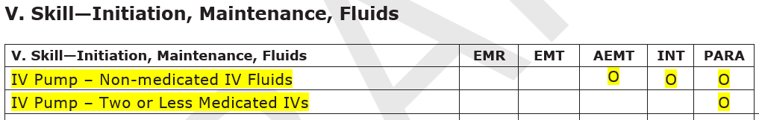
Part A: Scope of Practice for 911 EMS Practitioners or Emergency Medical Responders
Notes:
The 2024 Wisconsin EMS scope of practice allows for the use of IV pumps as an optional skill at the AEMT, intermediate and paramedic level for 911 us all other scope of practice routes of administration and medications are to be followed.

Slide 13
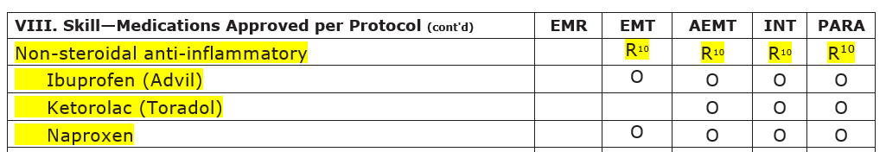
Part A: Scope of Practice for 911 EMS Practitioners or Emergency Medical Responders
Notes:
In addition to the alphabetical list of medications approved within the Wisconsin EMS scope of practice, we have categorized certain classes of medications that are commonly used for ease of reference and clarity. So for example you will see that non steroidal anti-inflammatory medications are required at all service levels from EMT a EMT intermediate and paramedic however there are options within that category of medications that can be chosen by an EMS service medical director for use at that agency.

Slide 14
Part A: 911 Scope of Practice Update Summary
Skill | Required or Optional | Certification or Licensure level
Defibrillation - Manual | Removal from EMT and AEMT | Still required skill only for INT and PARA
Hemorrhage Control – Junctional Tourniquet | Optional | EMR, EMT, AEMT, INT, PARA
Valsalva Maneuver | Removal from EMT and AEMT | Still required skill for INT and PARA
IV Pump | Optional | AEMT, INT and PARA
Medication Categories | Format change only | Format change only
Notes:
In summary, this table outlines the updates to the Part A 911 Scope of Practice. Please review these changes—especially for any required skill.

Slide 15
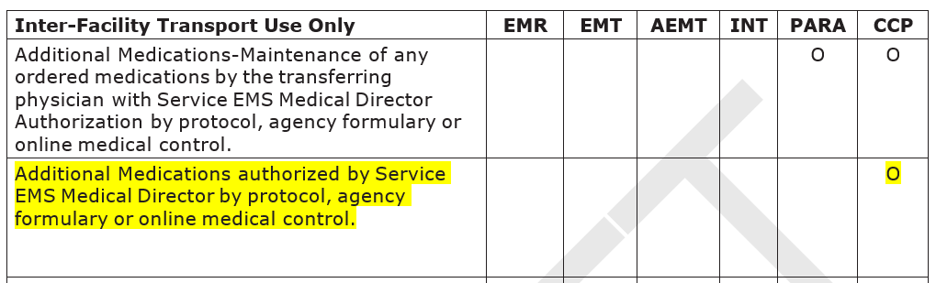
Part B: Additional Scope of Practice Items For Ambulance Service Providers Licensed to Provide Interfacility Transport
Notes:
Moving to the Part B portion of the EMS Scope of Practice for agencies licensed for interfacility transport.
With the 2024 scope of practice, we expanded the ability for service medical directors to increase the formulary for critical care paramedic level services. The new addition allows the service medical director for a critical care interfacility transport service to authorize additional medications by protocol agency formulary or online media control. The intent is to allow flexibility for service medical directors of critical care interfacility transport services to be able to better serve the needs of their communities. As a reminder, any additional medications at this level need to be included in the operational plan.

Slide 16
Part B: Interfacility Scope of Practice Update Summary
Skill | Required or Optional | Certification or Licensure level
Additional Medications authorized by Service EMS Medical Director by protocol, agency formulary or online medical control. | Optional | CCP (IFT only)
Notes:
In summary, this table outlines the updates to the Part B Interfacility Scope of Practice. Please review these required changes.

Slide 17
EMS Provider (Agencies)
Submit operational plan updates as required in Wis. Admin Code § DHS 110.35 (2) through e-licensing.
Service and Medical Directors attestation of skills, equipment and medications annually corresponding to the new scope of practice.
Ensure EMR capacity for documentation in WARDS.
Notes:
For EMS service directors and EMS medical directors, please ensure that agency EMS protocols are updated for the 2023 scope and that a list of the optional advanced skills and procedures intended for use are submitted to DHS as required in DHS 110.35.2.
DHS will make this reporting and attestation very easy for service and medical directors through the e-licensing platform.
For EMR agencies using optional advanced skills, please ensure a method to report to WARDS as required.

Slide 18
Contact Us
Phone: 608-266-1568
Email: dhsemssmail@dhs.wisconsin.gov
Website: dhs.wisconsin.gov/ems
Notes:
And finally, on behalf of the EMS Section, I want to say thank you for all you do for Wisconsin EMS
If you have any questions, please reach out to your regional coordinator or me through our contact information on the DHS website.

