Slide 1
EMS Flex Grant – Expense Reporting
EMS Flex Grant Staff
October 26, 2022
Expense Report and Documentation Webinar

Slide 2
Webinar Housekeeping Items
Meeting will not exceed 90 minutes.
Session is being recorded and uploaded to EMS Flex Grant Recipients | Wisconsin Department of Health Services
Participants are muted when entering the meeting.
EMS Flex Grant resource page contains the Flex Grant Expense Reports and other grant related information located at EMS Flex Grant Recipients | Wisconsin Department of Health Services
Please submit Flex Grant questions to: DHSFLEXGRANT@dhs.Wisconsin.gov

Slide 3
EMS Flex Grant
Webinar Agenda
Welcome and Grant Funding Overview (Amanda Bates)
Grant Overview: Eligible Expenses, Submitting Report and Required Documents (Mia Parker)
E-License Expense Report (Anthony Dare)
Closing with Questions and Answers

Slide 4
Expense Reports Important Details
Expense Reports must be submitted in E-Licensing by 11:59 p.m. on the due date
For items covered with the 1st payment, the due date is March 21, 2023
For items covered with the 2nd payment, the due date is September 23, 2023
EMS Services can submit reports prior to the due date along with proper documentation to trigger the 2nd payment
Issues with demonstrating proof of payment, such as delayed delivery and payment, must be supported with documentation and justification for review and approval.

Slide 5
Expense Reports Important Details
Funds must be fully expended by September 23, 2023.
If an extension to expend funds is needed, a written request must be submitted along with a justification and documentation demonstrating the need for an extension.
All requests for extensions will be reviewed and a written decision will be provided via email.
Report will be available under Service Applications in E-Licensing and listed as EMS Flex Grant Expense Report.

Slide 6
Acceptable Documentation
Document items paid for with Flex Grant funds with a receipt or invoice that details the item(s), cost, and date of purchase.
Upload in E-Licensing with the report.
Ensure all documentation is legible.
Ensure cost for items do not occur before the Notice of Award (September 20, 2022).
If the item costs more than what’s budgeted with Flex Grant funds, only list the amount of Flex Grant funds used for the purchase on the report.

Slide 7
Proof of Payment
If the receipt or invoice indicates a method of payment (for example, “paid with Visa ending in 1234”) and the amount, no other proof is needed.
If you have an invoice for an order, but the payment was provided later, please upload proof of payment.
Types of proof include cancelled checks, a bank statement or credit card receipt indicating the amount of the payment, date of payment, and who the payment was made to.
Proof of payment should correspond to the receipt or invoice amount.

Slide 8
Flex Grant Eligible Expenses (list is not exhaustive, ask if you have questions)
Supplies
Gloves, face masks, and shields
Gowns and bottles
Replacement of supplies used during the COVID-19 pandemic, such as:
Cot sheets and pillowcases
Blood pressure cuffs
Stethoscopes
Personal protective equipment
Respiratory isolation hoods
Laptops, portable radios, and cell phones

Slide 9
Flex Grant Eligible Expenses (list is not exhaustive, ask if you have questions)
Equipment
Cardiac monitors
IV pumps
Transport ventilators
No-touch thermometers
Capnography monitors
Portable ultrasound
CPR assist device
Mechanical Cot
Ambulance child restraint
Disinfectant fogger machine

Slide 10
Flex Grant Eligible Expenses
Emergency Response Vehicles
Vehicles such as ATVs, snowmobiles, winter EMS sleds, trucks (SUVs)
Ambulances including retro-fitting cabins
Training
Costs associated with providing training to staff with purchased equipment
Costs associated with advance scope of practice

Slide 11
Flex Grant Eligible Expenses
Staffing
Costs associated with helping to recruit new staff. This could be job advertisement posting costs, raising the rate of pay, or other incentives to attract new hires.
Costs associated with helping to retain existing staff, which may include increase in pay, bonuses, or uniform reimbursement or allowances.
The purchase of gift cards will be reviewed to establish eligibility.

Slide 12
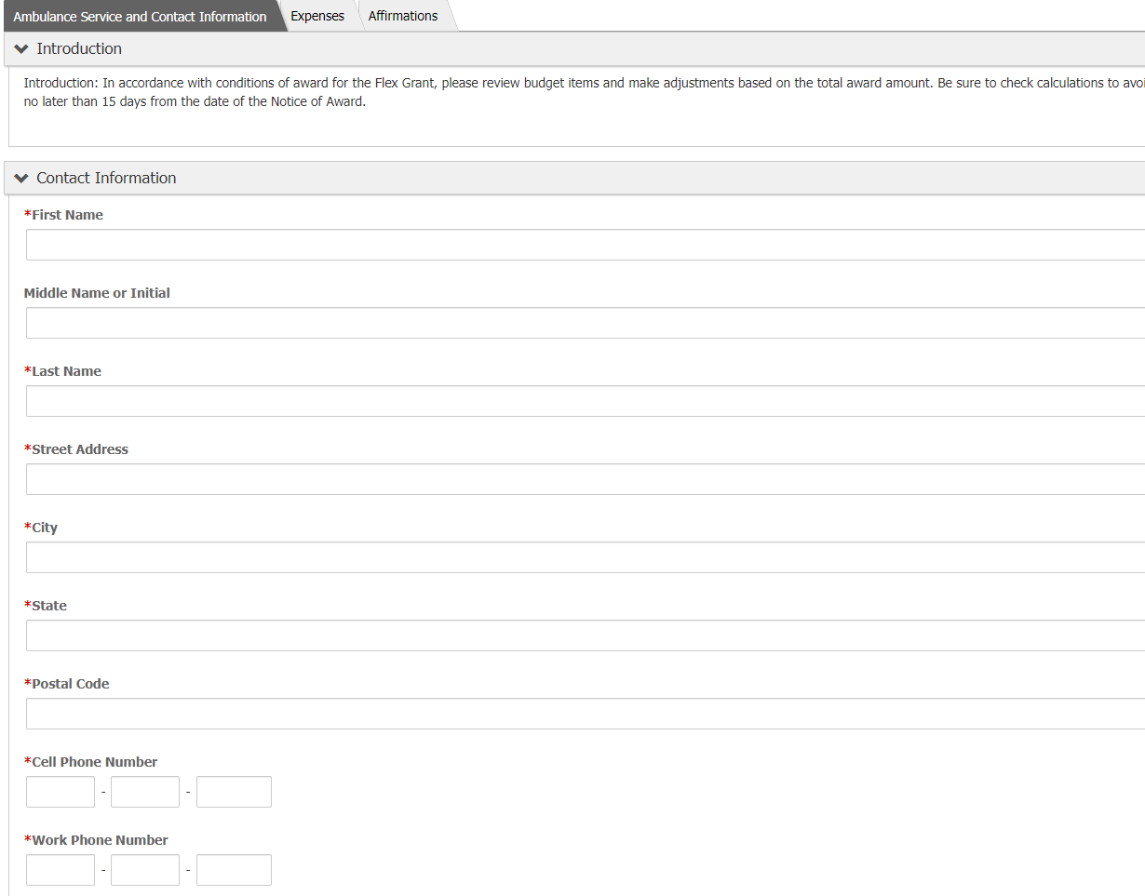
Flex Grant Expense Reports

Slide 13
Flex Grant Expense Report

Slide 14
Flex Grant Expense Report

Slide 15
Flex Grant Expense Report

