Slide 1
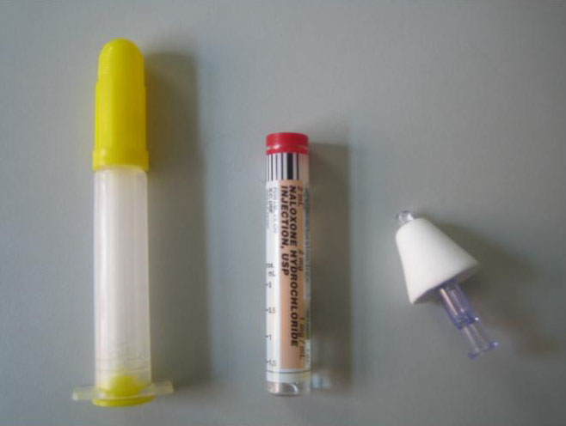
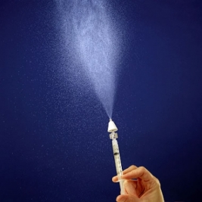
Naloxone Intranasal Administration in the Pre-hospital Setting – Basic Life Support (BLS) Pilot Program
A Joint Project of the Wisconsin EMS Advisory Board and the
Wisconsin EMS Office

Slide 2
Naloxone Pilot Project
Why is this project needed?
Increased number of narcotic overdoses.
Accessibility to Advanced Life Support (ALS) is not the same in all areas of Wisconsin.
Safety of EMS providers.

Slide 3
Decrease in Needles = Decreases in Risk
The Centers for Disease Control and Prevention (CDC) estimates 600,000 percutaneous injuries occur each year involving contaminated sharps in the United States.
Technological developments can increase protection.
Education and training are the keys to a positive resolution.

Slide 4
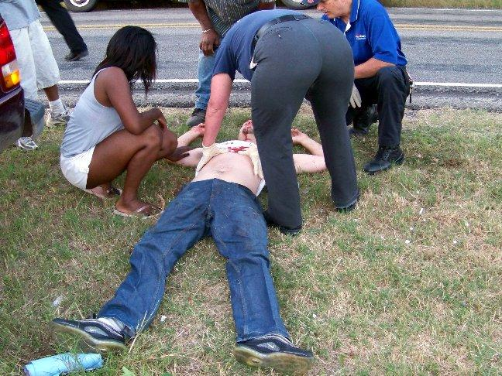
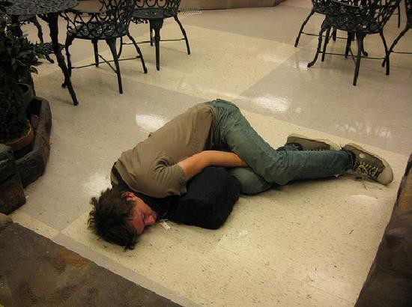
Communicable Disease Population
Not all infected people know they are infected.
EMS scenes can be high risk events due to patient and bystander behavior, as well as environmental aspects.

Slide 5
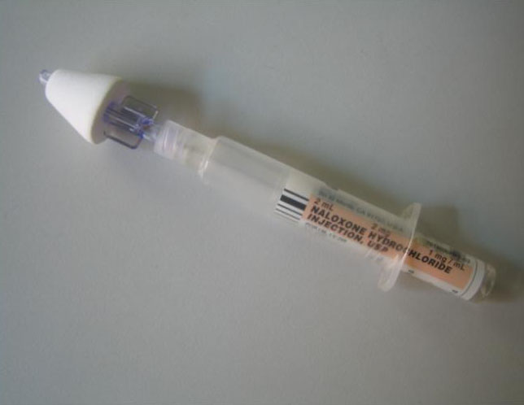
Intranasal Medication Administration
Intranasal medication administration offers a “Needleless” solution to drug delivery.

Slide 6
Intranasal Administration: Basic Concepts
The intranasal delivery route has several advantages:
It’s easy and convenient.
The nose is a very easy access point for medication delivery (even easier than the arm, especially in winter).
No shots are needed.
It is painless.
It eliminates any risk of a needle stick to you, the medical provider.

Slide 7
Naloxone (Narcan)
Pure opiate antagonist –reverses respiratory & central nervous system (CNS) depression
High lipid solubility so rapidly enters CNS
Roughly $10-$30 per 2 mg
Long shelf life: 18-24 months

Slide 8
Naloxone Complications
Patient withdrawal:
Agitation
Vomiting
Patient Combativeness
Rare: Less than 1% of the time
Seizures
Pulmonary edema
<1 % complicated by non-cardiogenic pulmonary edema – 95 % of cases occur at onset of OD
Arrhythmias

Slide 9
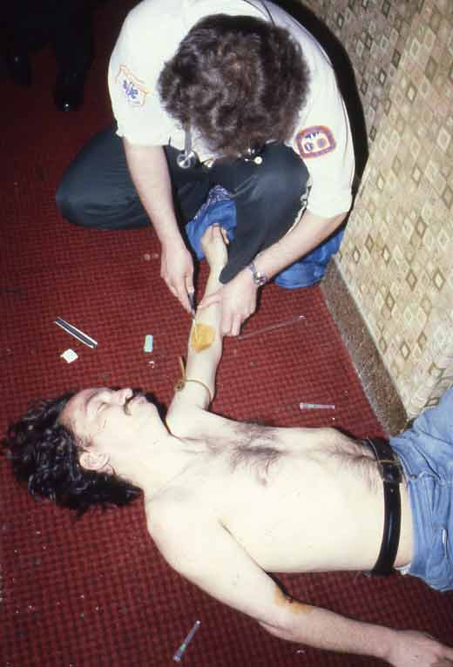
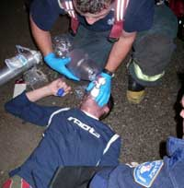
Patient Does Not Need to be Breathing for IN Administration

Slide 10
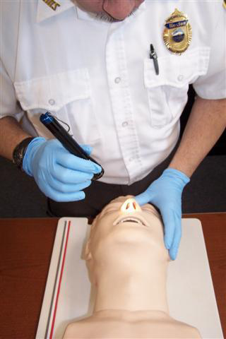
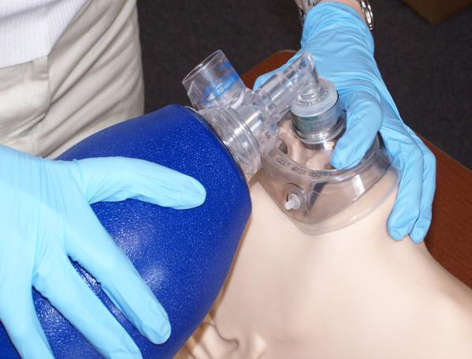
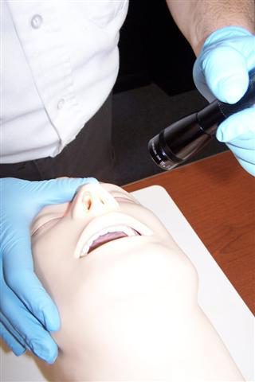
IN Administration

Slide 11
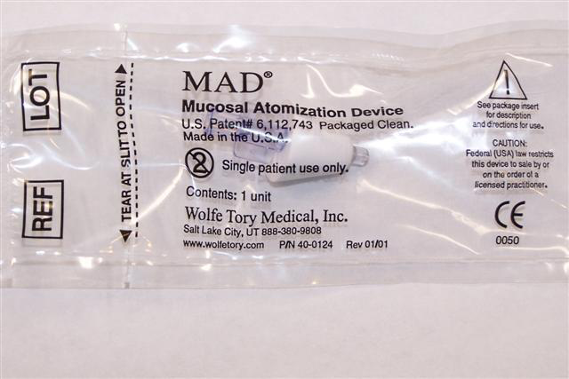
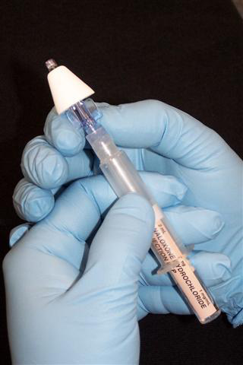
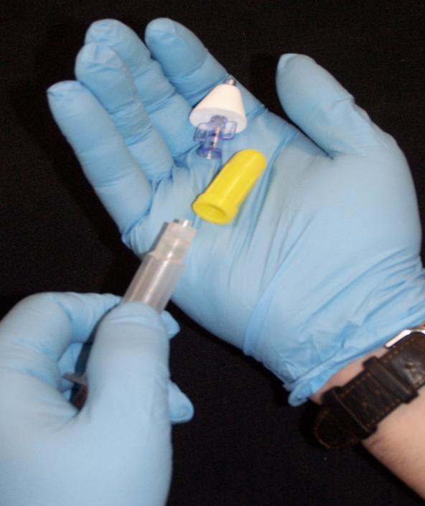

Slide 12
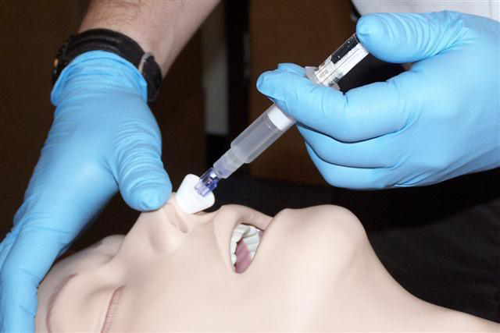
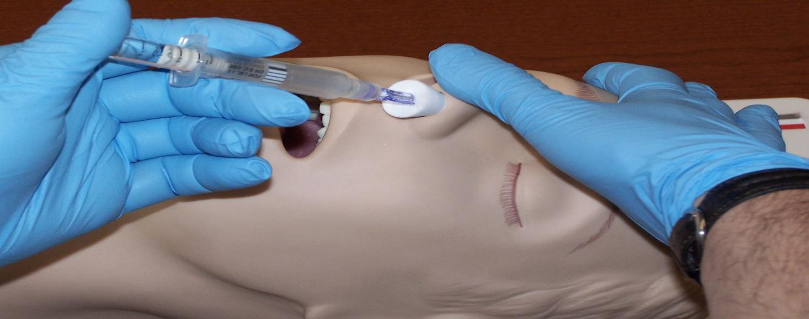
IN Administration

Slide 13
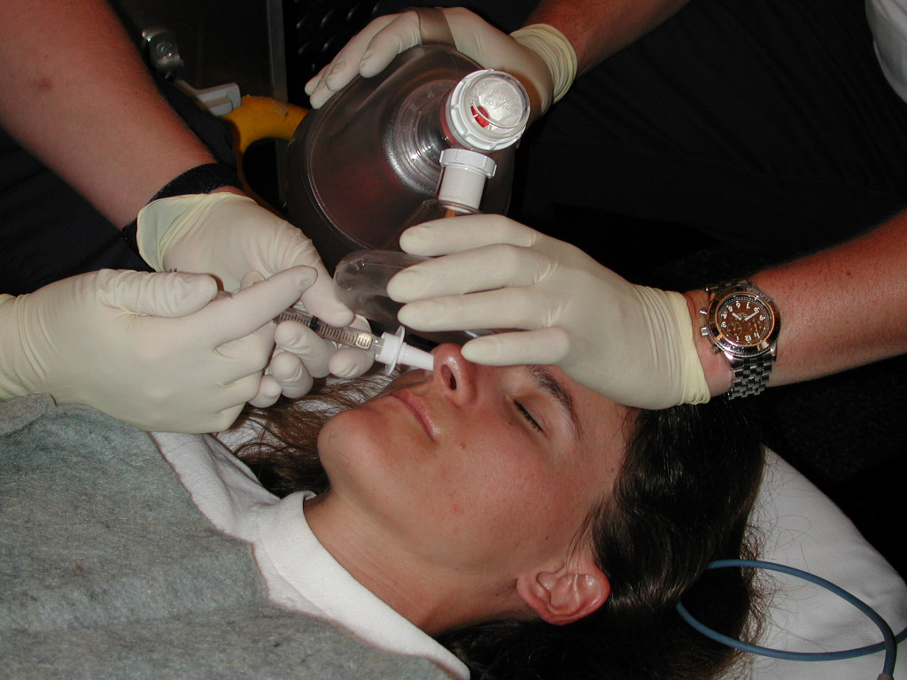
IN Administration

Slide 14
The Pilot IN Protocol
Suspected Opioid Overdose Protocol for BLS Providers
Inclusion Criteria:
Suspected narcotic or opiate overdose, with at least one of the following:
History of overdose provided by bystanders
Paraphernalia consistent with opiate/narcotic use
Medical history consistent with opiate/narcotic use
Respiratory depression with pinpoint pupils
Blood glucose level >60 mg/dl. If blood glucose < 60 mg/dl, treat low glucose first.
Patients age >8
Alteration of consciousness (defined as P or U on the AVPU scale)
Respiratory rate <8

Slide 15
The Pilot IN Protocol
Suspected Opioid Overdose Protocol for BLS Providers
Exclusion Criteria:
Documented allergy to naloxone
Alteration of consciousness or respiratory depression of presumed traumatic etiology
Epistaxis, nasal trauma or nasal mucosal abnormality for IN administration. Deviate to IM administration.

Slide 16
The Pilot IN Protocol
Suspected Opioid Overdose Protocol for BLS Providers
Procedure (based upon local packaging)
Ensure all BLS assessments and procedures are being adequately delivered.
Check blood glucose to assure a reading of greater than 60mg/dl.
Verify that inclusion and exclusion criteria support administration.

Slide 17
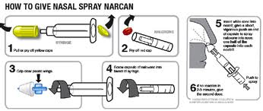
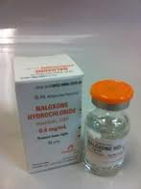
The Pilot IN Protocol
Suspected Opioid Overdose Protocol for BLS Providers
Procedure (cont.)
Pre-filled syringe
Un-package and remove prefilled syringe
Remove the pop-off caps and screw together
Withdraw 0.4 mg - 0.5 mg of the naloxone using the 1 cc luer lock syringe and needle
Remove needle from 1 cc luer lock syringe
Vial
Confirm the medication
Remove top from the naloxone and clean the rubber top with an alcohol pad
Draw equal amount of air into syringe as you want to administer
Inject air into vial and withdraw medication to appropriate amount
Remove needle from 1 cc syringe

Slide 18
The Pilot IN Protocol
Suspected Opioid Overdose Protocol for BLS Providers
Procedure (cont.)
Once medication is drawn into 1 cc syringe:
Attach mucosal atomizer device to the 1 cc luer lock syringe
Insert atomizer until flush with external nare
Depress plunger rapidly to ensure delivery of 0.4 mg - 0.5 mg of syringe contents
Remove syringe and atomizer from the patient’s nare
Dispose of syringe and atomizer in approved receptacle
Monitor patient respirations and mental status for signs of improvement and/or deterioration
If no improvement after five minutes and/or deterioration in the patient’s respiratory status is noted, repeat procedure using the other nare. This procedure can be continued until a max dose of
2 mg has been administered.

Slide 19
Understanding IN delivery: Definitions
First pass metabolism
Nose brain pathway
Lipophilicity
Bioavailability

Slide 20
First pass metabolism
Molecules absorbed through the stomach, including all oral medications, enter the “portal circulation” and are transported to the liver.
Liver enzymes then break down most of these drug molecules and only a small fraction enter the body’s circulation as active drug.
This process is called “First Pass Metabolism.”
Nasally delivered medications avoid the digestive system so do not suffer first pass metabolism.

Slide 21
Nose brain pathway
The olfactory mucosa (smelling area in nose) is in direct contact with the brain and cerebrospinal fluid (CSF).
Medications absorbed across the olfactory mucosa directly enter the CSF.
This area is termed the nose brain pathway and offers a rapid, direct route for drug delivery to the brain.
Olfactory mucosa, nerve
Brain
CSF
Highly vascular nasal mucosa

Slide 22
Lipophilicity
“Lipid Loving”
Cellular membranes are composed of layers of lipid material.
Drugs that are lipophilic are easily and rapidly absorbed across the mucous membranes.
Non-lipophilic molecules
Lipophilic molecules
Cell Membrane
Blood stream

Slide 23
Bioavailability
How much of the administered medication actually ends up in the blood stream?
IV medications are 100% bioavailable.
Most oral medications are about 5 to 10 percent bioavailable due to destruction in the GI tract and liver.
Nasal medications vary, but nasal Naloxone approaches
100 percent, the same as when given intravenously.

Slide 24
Bioavailability
Table demonstrating naloxone serum concentrations when given via IV and IN routes.
Note that IV and IN serum levels are identical after about two to three minutes.

Slide 25
Intranasal Medication Administration: Bioavailability
Not all drugs can be delivered via the nasal mucosa.
Factors affecting bioavailability:
Medication characteristics
Medication volume and concentration
Nasal mucosal characteristics
Delivery system characteristics
Mucosal surface area coverage
Medication particle size

Slide 26
Intranasal Medication Administration: Factors Affecting Bioavailability
Medication Characteristics:
Drug characteristics that affect bioavailability via the nasal mucosa include
Molecular size
Lipophilicity
pH
Drug concentration
Properties of the solution the drug is solubilized within

Slide 27
Intranasal Medication Administration: Factors Affecting Bioavailability
Volume and concentration
Too large a volume or too weak a concentration may lead to failure because the drug cannot be absorbed in high enough quantity to be effective.
Volumes over 1 ml per nostril are too large and may result in runoff out of the nostril.
1/3 to 1/2 ml per nare is ideal in an adult.

Slide 28
Intranasal Medication Administration: Factors Affecting Bioavailability
Nasal mucosal characteristics
If there is something wrong with the nasal mucosa, it may not absorb medications effectively.
Examples:
Vasoconstrictors, such as cocaine, prevent absorption.
Bloody nose, nasal congestion, mucous discharge all prevent mucosal contact of drug.
Destruction of nasal mucosa from surgery or past cocaine abuse – no mucosa to absorb the drug.

Slide 29
Intranasal Medication Administration: Factors Affecting Bioavailability
Delivery system characteristics:
Nasal mucosal surface area coverage:
Larger surface area delivery = higher bioavailability.
Particle size:
Particle size 10-50 microns adheres best to the nasal mucosa.
Smaller particles (nebulized) pass on to the lungs.
Larger particles form droplets and run-out of the nose.

Slide 30
Bioavailability and Particle size
Compared to drops, atomized medication results in:
Larger surface area of coverage.
Smaller liquid particle size, allowing thin layer to cover mucosa.
Less run-off out the nasal cavity.

Slide 31
Intranasal Medication Administration: Factors Affecting Bioavailability
Nasal drug delivery is convenient and easy, but it may not always be effective.
Nasal drug delivery cannot completely replace the need for injections.
Being aware of the limitations and using the correct equipment and drug concentrations will assist you in predicting times when nasal drug delivery may not be effective.

Slide 32
Intranasal (IN) Naloxone
Background
Absorption of IN naloxone is almost as fast as IV in both animal and human models:
Hussain, A.A., Mechanism of nasal absorption of drugs. Prog Clin Biol Res, 1989. 292: p. 261-272.
Loimer N., Hofmann P., Chaudhry H.R. (1994). Nasal administration of naloxone is as effective as the intravenous route in opiate addicts. The International Journal of the Addictions; 29:6.

Slide 33
Intranasal (IN) Naloxone
Atomized spray of medications show much better absorption via the IN route:
Bryant, M.L., et al., Comparison of the clearance of radiolabelled nose drops and nasal spray as mucosally delivered vaccine. Nucl Med Commun, 1999. 20(2): p. 171-4.
Daley-Yates, P.T. and R.C. Baker, Systemic bioavailability of fluticasone propionate administered as nasal drops and aqueous nasal spray formulations. Br J Clin Pharmacol, 2001. 51(1): p. 103-5

Slide 34
“Intranasal Administration of Naloxone by Paramedics”
Prospective clinical trial
Preliminary study February, 2001
Barton et al, Prehosp Emer Care 2002
http://www.ihra.net/files/2010/08/23/Barton_-_Intranasal_Administration_of_Naloxone.pdf
Final study completed
Barton et al, J Emerg Med 2005
Kelly et al, Med J Aust 2005 (a study in Australia)
https://www.mja.com.au/journal/2005/182/1/randomised-trial-intranasal-versus-intramuscular-naloxone-prehospital-treatment
Study design:
Required all patients to get an IV and IV naloxone (standard care) – however nasal naloxone was administered first and if the patient awoke prior to IV therapy they could stop.

Slide 35
Pre-hospital IN Naloxone
Results
43/52 (83%) = Responded to IN Naloxone
Median time to awaken from drug delivery = 3 min
Median time from first contact = 8 min
9/52 (17%) = Did not respond to IN Naloxone
Fourpatients noted to have “epistaxis,” “trauma,” or “septal abnormality”
Note: no one waited for them to respond. Once an IV was started they got IV naloxone, so some cases were given IV naloxone before the nasal drug could absorb.

Slide 36
Pre-hospital IN Naloxone
Conclusions
IN naloxone is effective:
83 % response in the field
Potentially higher if one waits a few minutes for its effect prior to giving IV naloxone
Inexpensive device
Syringe driven atomizer
May decrease pre-hospital blood exposures
29 % of patients did not need an IV in the field (woke up before one could be started)

Slide 37
Pre-hospital IN Naloxone
Take away lessons for nasal naloxone:
Dose and volume – higher concentration preferred so use 1 mg/ml IV solution.
Delivery – immediately on decision to treat, inject naloxone into nose with atomizer. Then begin standard care.
Successful awakening eliminates the need for any IV or further ALS care.
Awakening is gradual-patient doesn’t jump off the bed, but adequate respiratory efforts occur as fast or faster than IV naloxone due to no delays with IV start.
Not 100 percent effective- failures with IN naloxone need to be followed with IM naloxone.

Slide 38
What if initial intranasal Naloxone does not work?
Continue ABCs to support breathing and circulation.
Administer additional Naloxone per protocol.
Consider other causes for respiratory depression/coma AEIOU-TIPS.
 | AEIOU
A | Alcohol
E | Epilepsy
I | Infection
O | Overdose
U | Uremia
 | TIPS
T | Trauma
I | Insulin
P | Poisoning
S | Stroke

Slide 39
Give the Initial IN Dose Time to Work
0.5 mg can usually correct respiratory concerns in a large person.
Give the drug three to five minutes to work before additional doses are given.

Slide 40
Use of IM Administration
Use only when IN route is contraindicated.

Slide 41
Conclusions
Drugs can be given IN:
Rapid
Safe to patient and provider
Immediate access
Can be given to almost anyone
Exception = Nasal mucosal abnormalities

Slide 42
Conclusions
The purpose of this medication is NOT to wake someone up.
The purpose of this medication is to increase their spontaneous
respiratory effort.
Intranasal drug delivery is a “needleless” system.
Reduce bloodborne exposure risks:
HIV
Hepatitis B, C

Slide 43
Questions?
Dr Charles E. Cady, MD - State of Wisconsin Medical Director
cecady@mcw.edu
Frederick T. Hornby II – Training Coordinator, Wisconsin EMS Office
frederick.hornby@wisconsin.gov
Jerry Biggart - EMS Advisory Board Chair
axswngr@att.net
Mark Frederickson - EMS Advisory Board Vice Chair
mark@goldcross.org

Slide 44
Resources and References
www.intranasal.net
http://www.ihra.net/files/2010/08/23/Barton-Intranasal_Administration_of_Naloxone.pdf
https://www.mja.com.au/journal/2005/182/1/randomised-trial-intranasal-versus-intramuscular-naloxone-prehospital-treatment
Hussain, A.A., Mechanism of nasal absorption of drugs. Prog Clin Biol Res, 1989. 292: p. 261-272.
Loimer N., Hofmann P., Chaudhry H.R. (1994). Nasal administration of naloxone is as effective as the intravenous route in opiate addicts. The International Journal of the Addictions; 29:6.
Hussain, A.A., Mechanism of nasal absorption of drugs. Prog Clin Biol Res, 1989. 292: p. 261-272.
Bryant, M.L., et al., Comparison of the clearance of radiolabelled nose drops and nasal spray as mucosally delivered vaccine. Nucl Med Commun, 1999. 20(2): p. 171-4.
Daley-Yates, P.T. and R.C. Baker, Systemic bioavailability of fluticasone propionate administered as nasal drops and aqueous nasal spray formulations. Br J Clin Pharmacol, 2001. 51(1): p. 103-5

