Slide 1
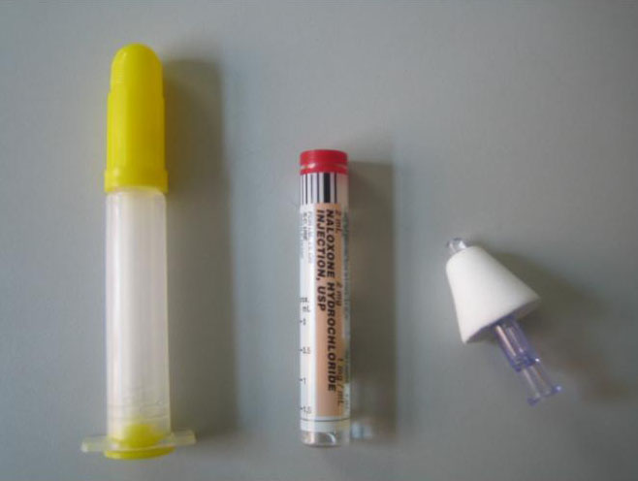
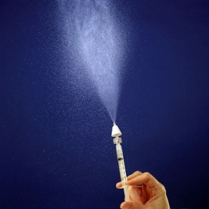
Naloxone Intranasal Administration in the Pre-hospital Setting –
First Responder Program
A Joint Project of the Wisconsin EMS Advisory Board and the
Wisconsin EMS Office

Slide 2
Decrease in Needles = Decreases in Risk
The Centers for Disease Control and Prevention (CDC) estimates 600,000 percutaneous injuries occur each year involving contaminated sharps in the United States.
Technological developments can increase protection.
Education and training are the keys to a positive resolution.

Slide 3
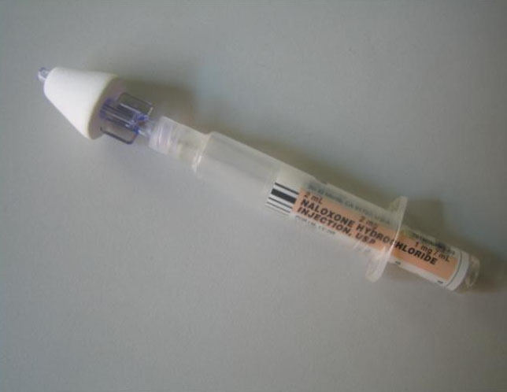
Intranasal Medication Administration
Intranasal medication administration offers a “Needleless” solution to drug delivery.

Slide 4
Intranasal Administration: Basic Concepts
The intranasal delivery route has several advantages:
  It’s easy and convenient.
  The nose is a very easy access point for medication delivery (even easier than the arm, especially in winter).
  No shots are needed.
  It is painless.
  It eliminates any risk of a needle stick to you, the medical provider.

Slide 5
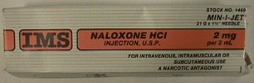
Naloxone (Narcan)
Pure opiate antagonist –reverses respiratory & central nervous system (CNS) depression
High lipid solubility so rapidly enters CNS
Roughly $10-$30 per 2 mg
Long shelf life: 18-24 months

Slide 6
Naloxone Complications
Patient withdrawal:
  Agitation
  Vomiting
Patient Combativeness
Rare: Less than 1% of the time
  Seizures
  Pulmonary edema
    <1 % complicated by non-cardiogenic pulmonary edema – 95 % of cases occur at onset of OD
  Arrhythmias

Slide 7
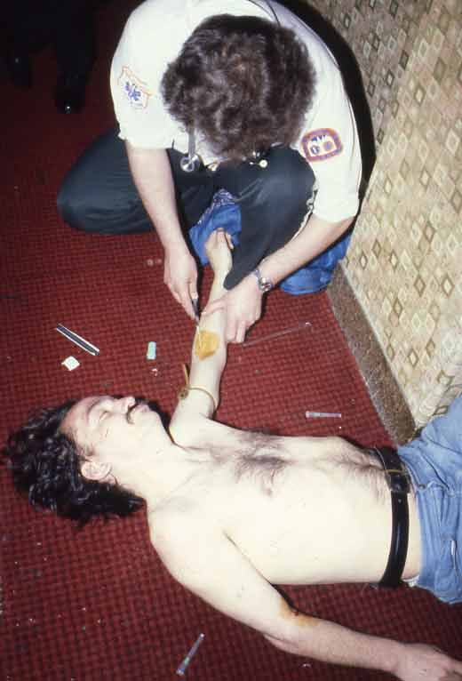
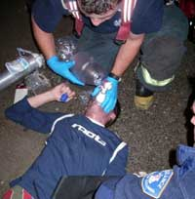
Patient Does Not Need to be Breathing for IN Administration

Slide 8
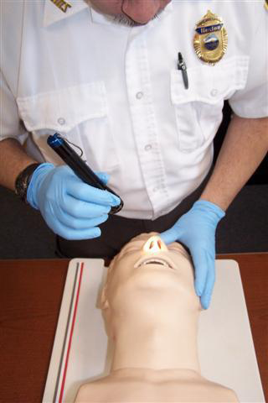
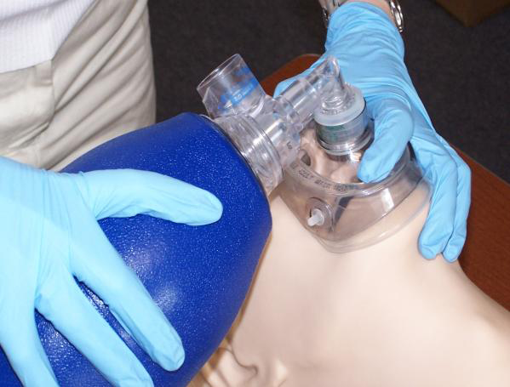
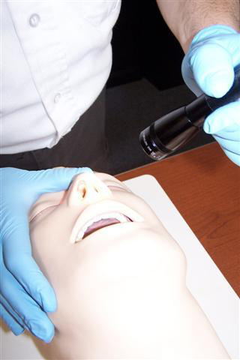
IN Administration

Slide 9
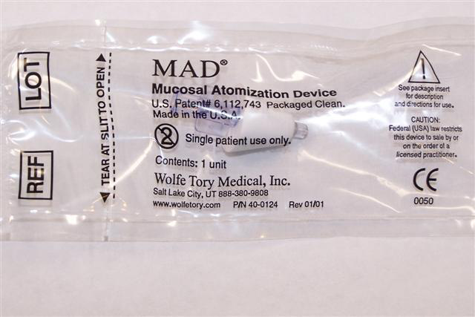
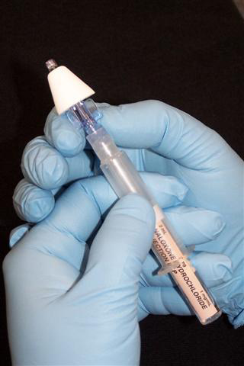
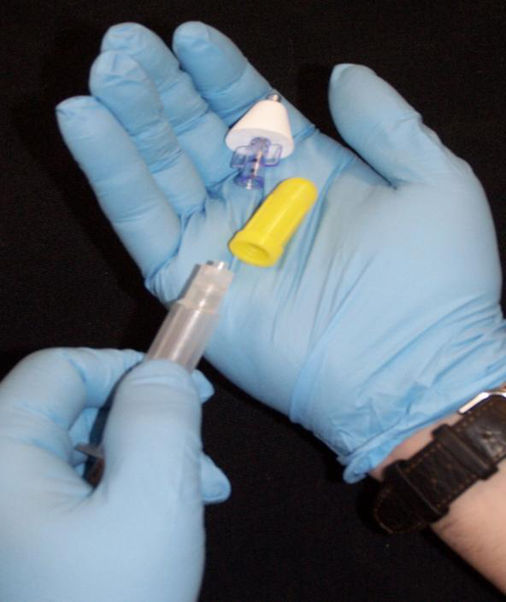

Slide 10
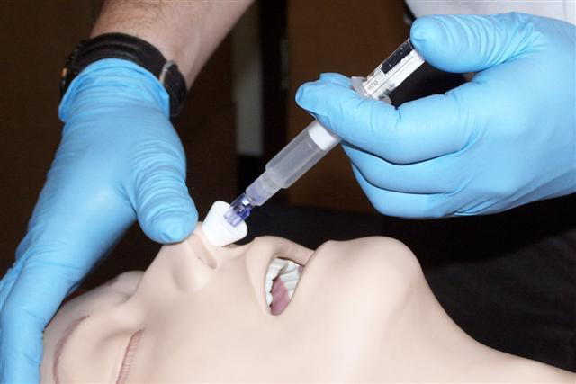
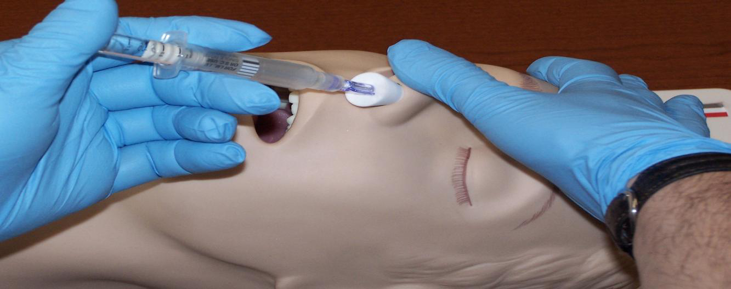
IN Administration

Slide 11
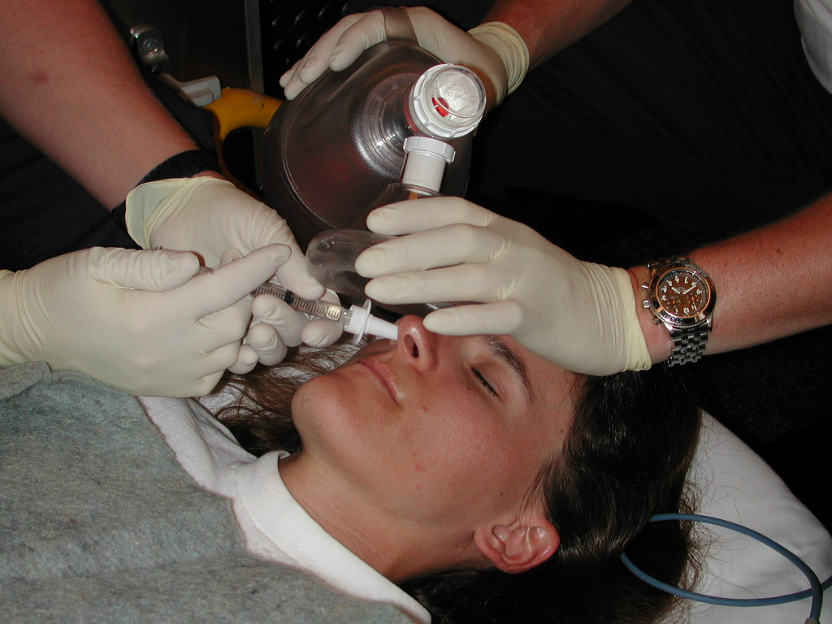
IN Administration

Slide 12
The Suggested IN Protocol
Suspected Opioid Overdose Protocol for BLS Providers
Inclusion Criteria:
  Suspected narcotic or opiate overdose, with at least one of the following:
    History of overdose provided by bystanders
    Paraphernalia consistent with opiate/narcotic use
    Medical history consistent with opiate/narcotic use
    Respiratory depression with pinpoint pupils
  Blood glucose level >60 mg/dl. If blood glucose < 60 mg/dl, treat low glucose first.
  Patients age >8
  Alteration of consciousness (defined as P or U on the AVPU scale)
  Respiratory rate <8

Slide 13
The Suggested IN Protocol
Suspected Opioid Overdose Protocol for BLS Providers
Exclusion Criteria:
  Documented allergy to naloxone
  Alteration of consciousness or respiratory depression of presumed traumatic etiology
  Epistaxis, nasal trauma or nasal mucosal abnormality for IN administration.

Slide 14
The Suggested IN Protocol
Suspected Opioid Overdose Protocol for BLS Providers
Procedure (based upon local packaging)
  Ensure all BLS assessments and procedures are being adequately delivered.
  Check blood glucose to assure a reading of greater than 60mg/dl.
  Verify that inclusion and exclusion criteria support administration.

Slide 15
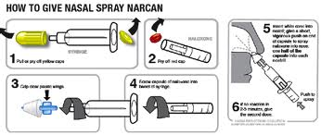
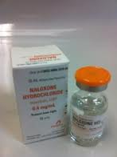
The Suggested IN Protocol
Suspected Opioid Overdose Protocol for BLS Providers
Procedure (cont.)
  Pre-filled syringe
    Un-package and remove prefilled syringe
    Remove the pop-off caps and screw together
    Withdraw 0.4 mg - 0.5 mg of the naloxone using the 1 cc luer lock syringe
    Remove needle from 1 cc luer lock syringe
  Vial
    Confirm the medication
    Remove top from the naloxone and clean the rubber top with an alcohol pad
    Draw equal amount of air into syringe as you want to administer
    Inject air into vial and withdraw medication to appropriate amount
    Remove needle from 1 cc syringe

Slide 16
The Pilot IN Protocol
Suspected Opioid Overdose Protocol for BLS Providers
Procedure (cont.)
  Once medication is drawn into 1 cc syringe:
    Attach mucosal atomizer device to the 1 cc luer lock syringe
    Insert atomizer until flush with external nare
    Depress plunger rapidly to ensure delivery of 0.4 mg - 0.5 mg of syringe contents
    Remove syringe and atomizer from the patient’s nare
    Dispose of syringe and atomizer in approved receptacle
    Monitor patient respirations and mental status for signs of improvement and/or deterioration
    If no improvement after five minutes and/or deterioration in the patient’s respiratory status is noted, repeat procedure using the other nare. This procedure can be continued until a max dose of
    2 mg has been administered.

Slide 17
Understanding IN delivery: Definitions
First pass metabolism
Nose brain pathway
Lipophilicity
Bioavailability

Slide 18
First pass metabolism
Molecules absorbed through the stomach, including all oral medications, enter the “portal circulation” and are transported to the liver.
Liver enzymes then break down most of these drug molecules and only a small fraction enter the body’s circulation as active drug.
This process is called “First Pass Metabolism.”
Nasally delivered medications avoid the digestive system so do not suffer first pass metabolism.

Slide 19
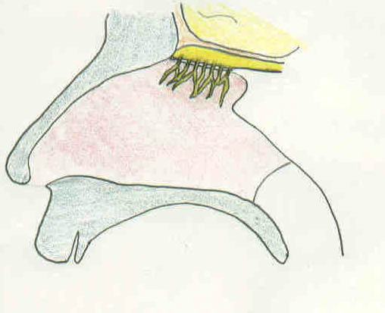
Nose brain pathway
The olfactory mucosa (smelling area in nose) is in direct contact with the brain and cerebrospinal fluid (CSF).
Medications absorbed across the olfactory mucosa directly enter the CSF.
This area is termed the nose brain pathway and offers a rapid, direct route for drug delivery to the brain.
Olfactory mucosa, nerve
Brain
CSF
Highly vascular nasal mucosa

Slide 20
Bioavailability
How much of the administered medication actually ends up in the blood stream?
    IV medications are 100% bioavailable.
    Most oral medications are about 5 to 10 percent bioavailable due to destruction in the GI tract and liver.
    Nasal medications vary, but nasal Naloxone approaches
    100 percent, the same as when given intravenously.

Slide 21
Intranasal Medication Administration
Not all drugs can be delivered via the nasal mucosa.
Factors affecting administration
  Medication characteristics
  Medication volume and concentration
  Nasal mucosal characteristics
  Delivery system characteristics
    Mucosal surface area coverage
    Medication particle size

Slide 22
Intranasal Medication Delivery
Medication Characteristics:
  Drug characteristics that affect effectiveness via the nasal mucosa include
    Molecular size
    pH
    Drug concentration
    Properties of the solution the drug is solubilized within

Slide 23
Intranasal Medication Administration: Factors Affecting Effectiveness
Volume and concentration
    Too large a volume or too weak a concentration may lead to failure because the drug cannot be absorbed in high enough quantity to be effective.
    Volumes over 1 ml per nostril are too large and may result in runoff out of the nostril.
      1/3 to 1/2 ml per nare is ideal in an adult.

Slide 24
Intranasal Medication Administration: Factors Affecting Effectiveness
Nasal mucosal characteristics
  If there is something wrong with the nasal mucosa, it may not absorb medications effectively.
  Examples:
    Vasoconstrictors, such as cocaine, prevent absorption.
    Bloody nose, nasal congestion, mucous discharge all prevent mucosal contact of drug.
    Destruction of nasal mucosa from surgery or past cocaine abuse – no mucosa to absorb the drug.

Slide 25
Intranasal Medication Administration: Factors Affecting Bioavailability
Delivery system characteristics:
  Nasal mucosal surface area coverage:
    Larger surface area delivery = higher amount absorbed.
  Particle size:
    Particle size 10-50 microns adheres best to the nasal mucosa.
      This is what the atomizer expells
    Smaller particles (nebulized) pass on to the lungs.
    Larger particles form droplets and run-out of the nose.

Slide 26
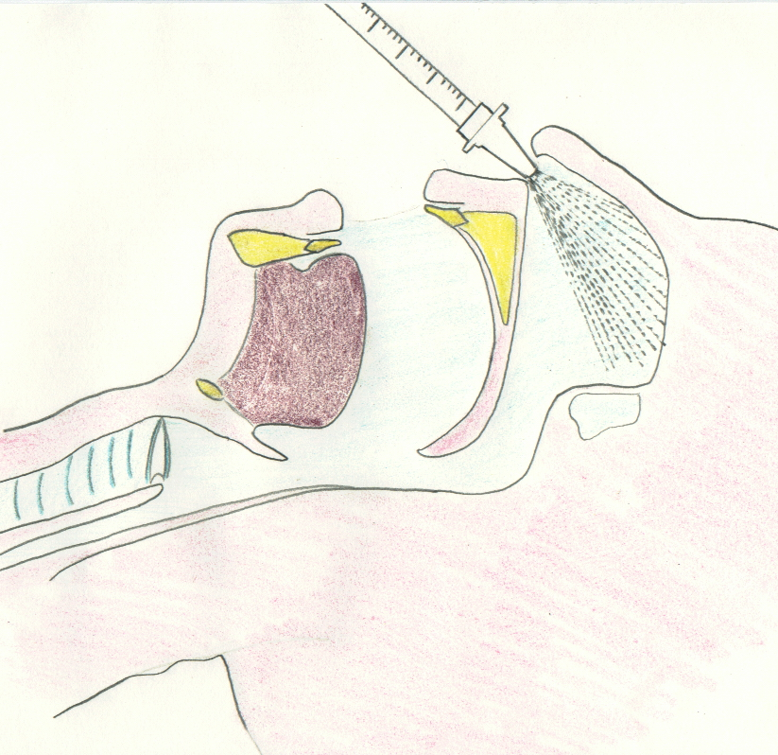
Particle Size
Compared to drops, atomized medication results in:
  Larger surface area of coverage.
  Smaller liquid particle size, allowing thin layer to cover mucosa.
  Less run-off out the nasal cavity.

Slide 27
Intranasal Medication Administration
  Nasal drug delivery is convenient and easy, but it may not always be effective.
  Nasal drug delivery cannot completely replace the need for injections.
  Being aware of the limitations and using the correct equipment and drug concentrations will assist you in predicting times when nasal drug delivery may not be effective.

Slide 28
Intranasal (IN) Naloxone
Background
  Absorption of IN naloxone is almost as fast as IV in both animal and human models:
    Hussain, A.A., Mechanism of nasal absorption of drugs. Prog Clin Biol Res, 1989. 292: p. 261-272.
    Loimer N., Hofmann P., Chaudhry H.R. (1994). Nasal administration of naloxone is as effective as the intravenous route in opiate addicts. The International Journal of the Addictions; 29:6.

Slide 29
Intranasal (IN) Naloxone
  Atomized spray of medications show much better absorption via the IN route:
    Bryant, M.L., et al., Comparison of the clearance of radiolabelled nose drops and nasal spray as mucosally delivered vaccine. Nucl Med Commun, 1999. 20(2): p. 171-4.
    Daley-Yates, P.T. and R.C. Baker, Systemic bioavailability of fluticasone propionate administered as nasal drops and aqueous nasal spray formulations. Br J Clin Pharmacol, 2001. 51(1): p. 103-5

Slide 30
“Intranasal Administration of
Naloxone by Paramedics”
Prospective clinical trial
Preliminary study February, 2001
    Barton et al, Prehosp Emer Care 2002
    http://www.ihra.net/files/2010/08/23/Barton_-_Intranasal_Administration_of_Naloxone.pdf
Final study completed
    Barton et al, J Emerg Med 2005
    Kelly et al, Med J Aust 2005 (a study in Australia)
    https://www.mja.com.au/journal/2005/182/1/randomised-trial-intranasal-versus-intramuscular-naloxone-prehospital-treatment
Study design:
    Required all patients to get an IV and IV naloxone (standard care) – however nasal naloxone was administered first and if the patient awoke prior to IV therapy they could stop.

Slide 31
Pre-hospital IN Naloxone
Results
  43/52 (83%) = Responded to IN Naloxone
    Median time to awaken from drug delivery = 3 min
    Median time from first contact = 8 min
  9/52 (17%) = Did not respond to IN Naloxone
    Fourpatients noted to have “epistaxis,” “trauma,” or “septal abnormality”
    Note: no one waited for them to respond. Once an IV was started they got IV naloxone, so some cases were given IV naloxone before the nasal drug could absorb.

Slide 32
Pre-hospital IN Naloxone
Conclusions
  IN naloxone is effective:
    83 % response in the field
    Potentially higher if one waits a few minutes for its effect prior to giving IV naloxone
  Inexpensive device
    Syringe driven atomizer
  May decrease pre-hospital blood exposures
    29 % of patients did not need an IV in the field (woke up before one could be started)

Slide 33
Pre-hospital IN Naloxone
Take away lessons for nasal naloxone:
  Dose and volume – higher concentration preferred so use 1 mg/ml IV solution.
  Delivery – immediately on decision to treat, inject naloxone into nose with atomizer. Then begin standard care.
  Successful awakening eliminates the need for any IV or further ALS care.
  Awakening is gradual-patient doesn’t jump off the bed, but adequate respiratory efforts occur as fast or faster than IV naloxone due to no delays with IV start.
  Not 100 percent effective all the time

Slide 34
What if initial intranasal Naloxone does not work?
Continue ABCs to support breathing and circulation.
Administer additional Naloxone per protocol.
Consider other causes for respiratory depression/coma AEIOU-TIPS.
 | AEIOU
A | Alcohol
E | Epilepsy
I | Infection
O | Overdose
U | Uremia
 | TIPS
T | Trauma
I | Insulin
P | Poisoning
S | Stroke

Slide 35
Give the Initial IN Dose Time to Work
0.5 mg can usually correct respiratory concerns in a large person.
Give the drug three to five minutes to work before additional doses are given.

Slide 36
Conclusions
Drugs can be given IN:
  Rapid
  Safe to patient and provider
  Immediate access
  Can be given to almost anyone
    Exception = Nasal mucosal abnormalities

Slide 37
Conclusions
The purpose of this medication is NOT to wake someone up.
The purpose of this medication is to increase their spontaneous
respiratory effort.
Intranasal drug delivery is a “needleless” system.
Reduce bloodborne exposure risks:
    HIV
    Hepatitis B, C

Slide 38
Questions?
Dr Charles E. Cady, MD - State of Wisconsin Medical Director
cecady@mcw.edu
Frederick T. Hornby II – Training Coordinator, Wisconsin EMS Office
frederick.hornby@wisconsin.gov
Jerry Biggart - EMS Advisory Board Chair
axswngr@att.net
Mark Frederickson - EMS Advisory Board Vice Chair
mark@goldcross.org

Slide 39
Resources and References
www.intranasal.net
    http://www.ihra.net/files/2010/08/23/Barton-Intranasal_Administration_of_Naloxone.pdf
    https://www.mja.com.au/journal/2005/182/1/randomised-trial-intranasal-versus-intramuscular-naloxone-prehospital-treatment
    Hussain, A.A., Mechanism of nasal absorption of drugs. Prog Clin Biol Res, 1989. 292: p. 261-272.
    Loimer N., Hofmann P., Chaudhry H.R. (1994). Nasal administration of naloxone is as effective as the intravenous route in opiate addicts. The International Journal of the Addictions; 29:6.
    Hussain, A.A., Mechanism of nasal absorption of drugs. Prog Clin Biol Res, 1989. 292: p. 261-272.
          Bryant, M.L., et al., Comparison of the clearance of radiolabelled nose drops and nasal spray as mucosally delivered vaccine. Nucl Med Commun, 1999. 20(2): p. 171-4.
          Daley-Yates, P.T. and R.C. Baker, Systemic bioavailability of fluticasone propionate administered as nasal drops and aqueous nasal spray formulations. Br J Clin Pharmacol, 2001. 51(1): p. 103-5

