Slide 1
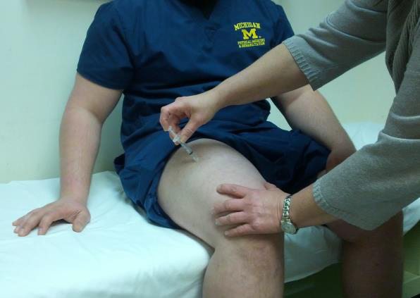
Anaphylaxis & IM Epinephrine Administration by the WI EMR
Advanced Skill
Requires Additional Training and Approval
WI DHS Office of Preparedness & Emergency Health Care

Slide 2
Learning Objectives:
With successful completion of this training module, the EMR will be able to describe and/or correctly demonstrate:
Expected baseline education for EMR:
Signs and Symptoms of Anaphylaxis
Epinephrine identification as a medication
The mechanism of action and effects of Epinephrine
Advanced skills MUST be recorded in WARDS report
Steps in Aseptic Technique
Preparation of Epinephrine for IM administration
Intramuscular administration of Epinephrine

Slide 3
Resources
WI EMS Allergy/Anaphylaxis treatment guideline or local protocol
Adult and Pediatric
Skills & Procedures Manual IM Injection Section
IM Injection video from WCTC; CD copy (edited) or internet access
https://www.youtube.com/watch?v=0SIG0N65yNY
Provided by WCTC as open EMS education
Epinephrine Check & Inject reference sheets as visual prompts
Skills testing check sheet or similar check sheet from local training program
EMR Advanced Skills form to update Op Plan

Slide 4

The earliest reported case of anaphylaxis can be traced to approximately 3300 BC, when the Egyptian King Menses died from a hymenoptera sting.
Hymenoptera are insects such as sawflies, wasps, bees, and ants
WI DHS Office of Preparedness & Emergency Health Care

Slide 5
Anaphylaxis Rosen's Emergency Medicine, Ed 2, Chapter 119
Anaphylaxis is derived from Greek
Ana = against
Phylax = guard or protect
meaning “against protection”
100,000 attacks per year in the U.S.
60,000 are first-time events
1000-1500 are fatal [1-1.5%]

Slide 6

Anaphylaxis Rosen's Emergency Medicine, Ed 2, Chapter 119
Primary triggers:
Foods
Egg, peanut, tree nut, milk, fruits, shellfish, shrimp, crustaceans
Medications
Antibiotics:
penicillins, cephalosporins, sulfonamides, nitrofurantoin, tetracycline, streptomycin
Insect stings
Hymenoptera venoms, fire ant stings
Natural rubber latex
In 1/3 of cases a trigger cannot be established

Slide 7
Anaphylaxis Rosen's Emergency Medicine, Ed 2, Chapter 119
Involvement of 2 systems after allergen exposure
Skin/Mucosa Rash or Swelling
Respiratory Distress
Hypotension
GI Upset/Cramps
Or Low SBP after exposure to allergen:
Age 1 month to 1 yr: <70 mmHg
Age 1-10 yrs: < (70 mmHg + [2 × age])
Age 11-17 yrs: < 90 mmHg
Adults: < 90 mmHg or more than 30% decr from baseline

Slide 8

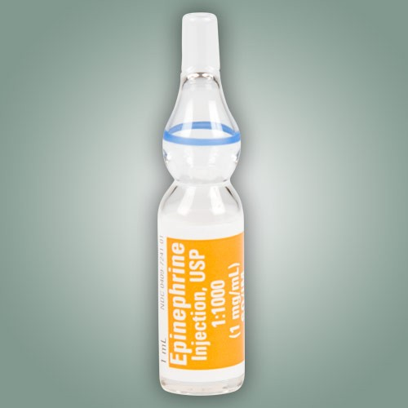
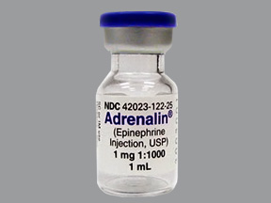
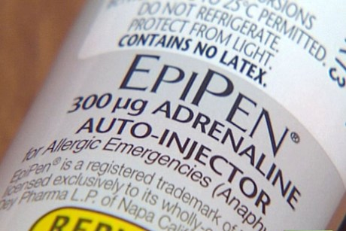
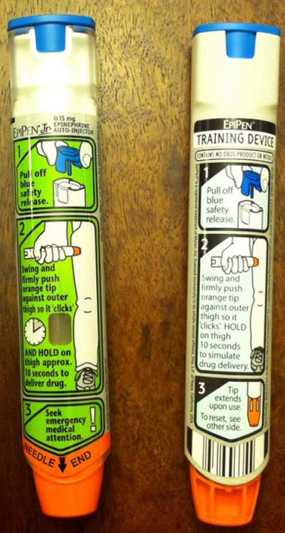
Anaphylaxis is treated with epinephrine
WI DHS Office of Preparedness & Emergency Health Care

Slide 9
Emphasis on Epi
Epinephrine for Anaphylaxis: Underutilized and Unavailable
Western J Emerg Med. 2015;16(3):385387
Anaphylaxis Requires Prompt Epinephrine Shot
Annals of Allergy, Asthma and Immunology Dec 2014
THE USE OF EPINEPHRINE FOR OUT-OF-HOSPITAL TREATMENT OF ANAPHYLAXIS: RESOURCE DOCUMENT FOR THE NATIONAL ASSOCIATION OF EMS PHYSICIANS POSITION STATEMENT
NAEMSP
Children with Food Allergies Should Carry Two Epinephrine Doses
Pediatrics 2009
Epinephrine: The Drug of Choice for Anaphylaxis
A Statement of the World Allergy Organization 2008

Slide 10
Key Terms
Anaphylaxis: life-threatening, hypersensitivity reaction of the immune system
Aseptic technique: procedure performed under sterile conditions
Asphyxia: suffocation as a result of blockage of the airway
Dyspnea: labored or difficult breathing
Epinephrine: hormone released from the adrenal glands that activates several tissues in the “fight-or-flight” response
Histamine: one of several chemical messages released from immune cells that promote inflammation as a defense mechanism
Intramuscular: medication route by injection into the belly of a muscle which encourages rapid transport in the bloodstream
Shock: severe reduction in blood pressure (by any cause) that results in inadequate blood flow (oxygen & glucose) to tissues

Slide 11
6 “Rights” of Medication Administration
Right patient
Right medication
Right dose
Right route
Right time
Right documentation

Slide 12
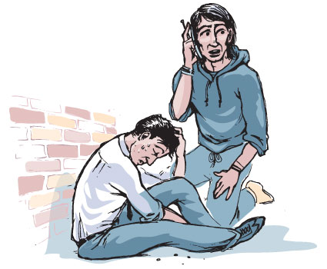
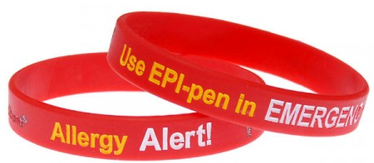
Half of the people with EpiPens do not know why or how to use them.
WI DHS Office of Preparedness & Emergency Health Care

Slide 13
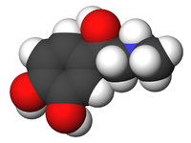
What is Epinephrine?
A synthetic form of the naturally occurring hormone Epinephrine
Released during “fight or flight” responses
Reflex stimulation of the adrenal gland
Sympathetic division of the autonomic nervous system
During “fight or flight” reactions, the airways _____________ .
(dilate or constrict)

Slide 14
The body’s stress response causes the normal release of epinephrine to maintain homeostasis during vigorous activity: “fight or flight”. These same actions of epinephrine counteract the bronchoconstriction and low blood pressure of anaphylaxis when administered by medical personnel.
Airway dilation
Blood flow to skeletal muscles increases
Pupils dilate
Blood sugar level increases
Blood pressure increases
Heart rate increases
Breathing rate increases
EPINEPHRINE

Slide 15
Epinephrine Underused in EMS
The Use of Epinephrine for Out-of-Hospital Treatment of Anaphylaxis
National Association of EMS Physicians Position Statement
Epinephrine for Anaphylaxis: Underutilized and Unavailable
Western J Emerg Med. 2015;16(3):385387.
Epinephrine Use Among EMS Providers Varies Widely By State
American College of Allergy, Asthma & Immunology 2009
Life-Saving Epinephrine Under Utilized by Paramedics
American College of Allergy, Asthma and Immunology 2008

Slide 16

Epinephrine Underused in EMS
There is NO contraindication for Epinephrine
for anaphylaxis or anaphylactic shock
This is the primary medication for allergic reaction & anaphylaxis in children

Slide 17
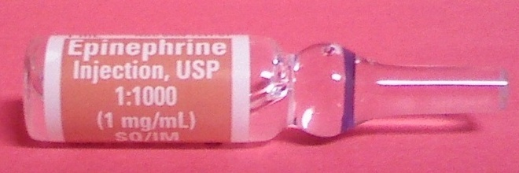
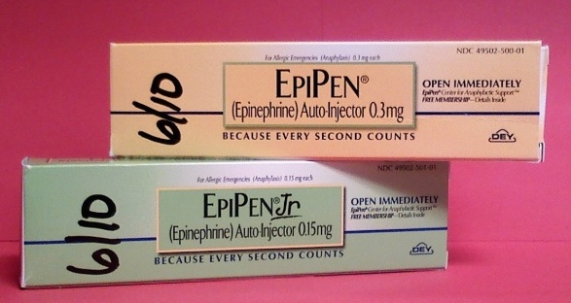
Examples of the Medication
Name of medication
Concentration (1:1,000 or 1mg/1ml)
Expiration date

Slide 18
Indications for Use
EMRs may administer Epinephrine for:
Anaphylaxis with Respiratory Distress
Anaphylactic shock
Dosage:
Adults - 0.30 mg of 1:1,000
Pediatrics - 0.15 mg of 1:2,000
Is this a different dose than when using the EpiPen?
>8yo
>30kg
(66 lbs)
<8yo
<30kg
(66 lbs)

Slide 19
Indications for Use
EMRs may administer Epinephrine for:
Anaphylaxis with Respiratory Distress
Anaphylactic shock
Dosage:
Adults - 0.30 mg of 1:1,000
Pediatrics - 0.15 mg of 1:2,000
Is this a different dose than when using the EpiPen?
>8yo
>30kg
(66 lbs)
<8yo
<30kg
(66 lbs)

Slide 20
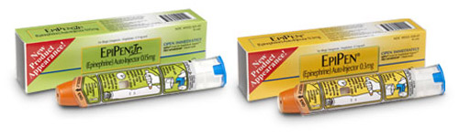
EpiPen Dosages
Pediatrics - 0.15 mg of 1:2,000
Adults - 0.30 mg of 1:1,000
The same dosage schedule is used in anaphylaxis, no matter the method of IM administration.

Slide 21
Anaphylaxis is an over-reaction of the Immune System
Sudden, severe allergic reaction involving the whole body (more than a local reaction, sting or rash)
Most common allergens:
Insect stings, Food, Medications, Latex
Skin responses with itching, hives & swelling
Vascular responses with tachycardia, hypotension, and hypoperfusion/shock
Tracheal and bronchial swelling may result in asphyxia
What respiratory signs would be typical of anaphylaxis?

Slide 22
Respiratory Signs & Symptoms
Shortness of breath
Swelling and/or spasm
Rapid and/or labored breathing, use of accessory muscles, prolonged expirations, hypoventilation, decreased lung sounds
Changes in the ability to speak
Hoarseness, stridor (upper airway), wheezing (lower airway), or other abnormal sounds of breathing

Slide 23

Action of Epinephrine
Relaxes smooth muscle in the airways
Counteracts histamine and other cytokines
Raises blood sugar level
Raises heart rate, blood pressure, and myocardial oxygen demand
For Intramuscular injection of Epinephrine
Onset of effect: 3-5 min
Duration of effect: 1-4 hours

Slide 24
Some Side Effects of Epinephrine will occur:
Palpitations
Tachycardia & dysrhythmias
Hypertension
Headache
Tremor, weakness
Skin signs: pallor, sweating
Nausea & vomiting
Nervousness & anxiety
Pain, redness at the injection site
Which vital signs are important to document before and after administering Epinephrine?

Slide 25
Document Vital Signs before and after treatment with Epinephrine
Because Epinephrine is expected to cause widespread changes in function, it is important to frequently monitor and document vital signs:
HR, RR, BP
Include general appearance, work of breathing, lung sounds, skin signs, and ability to speak

Slide 26
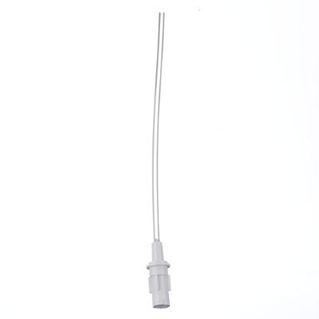
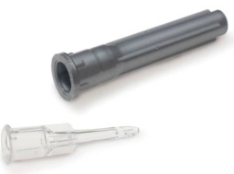
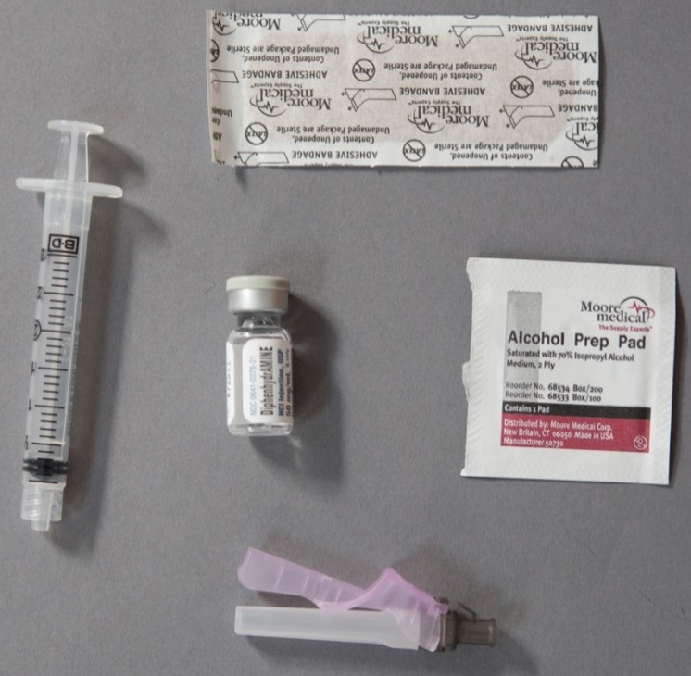
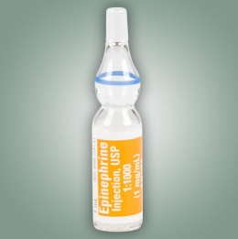
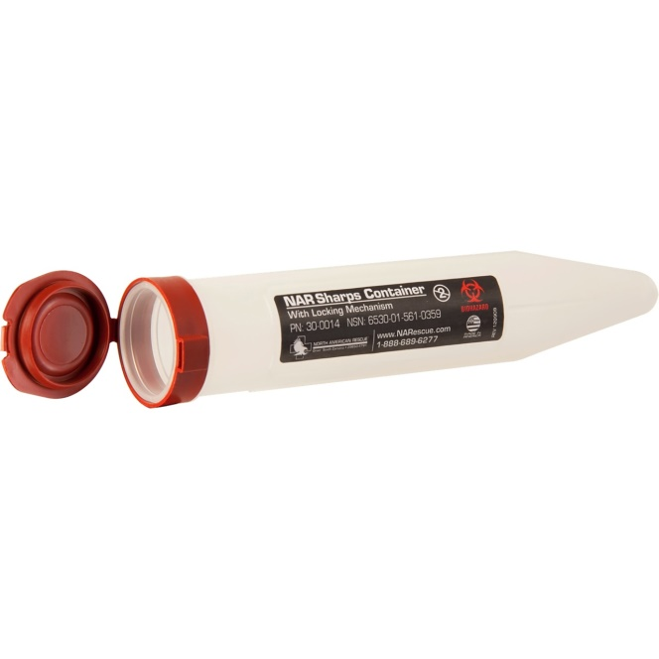
Techniques of Medication Administration
Equipment used for injections
Medication vial or ampoule
Transfer device
Filter needle/straw or blunt medication transfer device
1ml syringe
23 gauge 1.25 inch safety injection needle
Alcohol/Iodine wipe x2
1 for pt, 1 for vial/ampoule
Small gauze square
Adhesive bandage
Sharps disposal container

Slide 27
Techniques of Medication Administration
Equipment used for injections
Transfer device
Filter needle/straw for ampoule
Blunt transfer device for vial
1ml syringe; not larger
23 gauge 1.25 inch safety injection needle
Adequate for adults and peds
For safety, the devices are used on the medication container and the needle is only used on the patient

Slide 28
Preparing ampoules & vials
WI DHS Office of Preparedness & Emergency Health Care

Slide 29
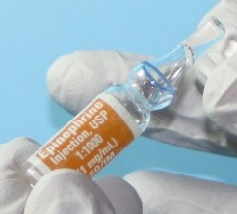
Ampoules and Vials
Store Epinephrine AWAY from light; leave it in its carton until ready to use. Also keep away from extreme heat and danger of freezing.
Ampoule
Vial
Self-sealing rubber top
top
scored neck

Slide 30
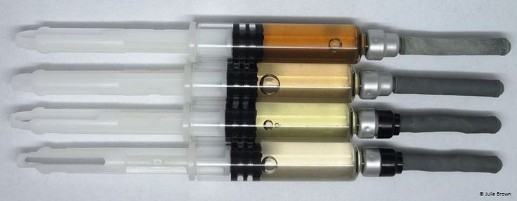
Epinephrine After Being Exposed To Sunlight for Various Times

Slide 31
Skills Section: Obtaining Medication from a Glass Ampoule

Slide 32
Confirm the Medication
Medication name
Dosage (1:1,000 or 1mg/1ml)
Expiration date
Not cloudy; no color or precipitate

Slide 33
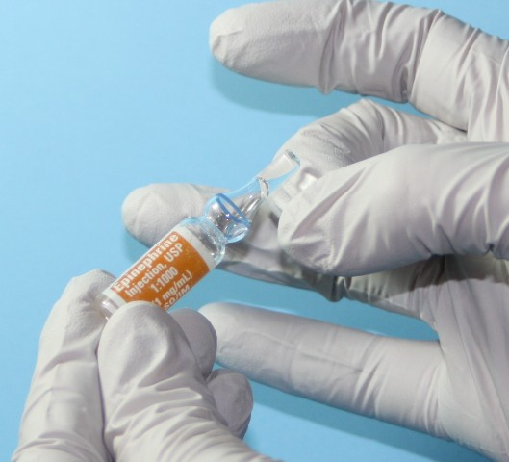
Hold the ampoule upright and tap its top to dislodge any trapped solution.

Slide 34
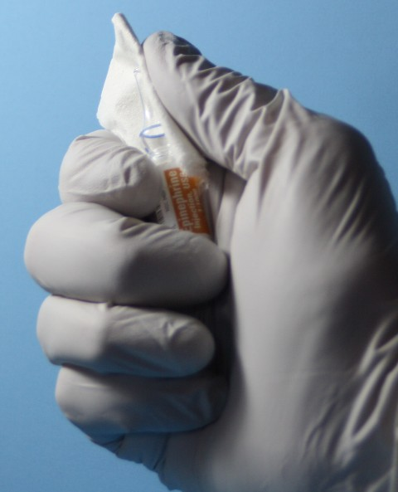
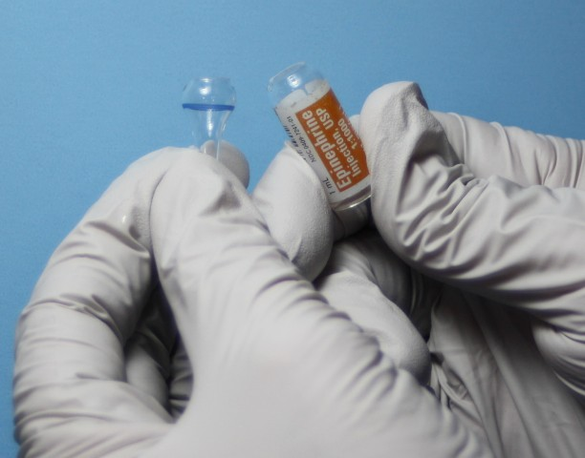
Use thumb to break along scored edge of neck. Place gauze or alcohol pad wrap around the neck to protect thumb.

Slide 35
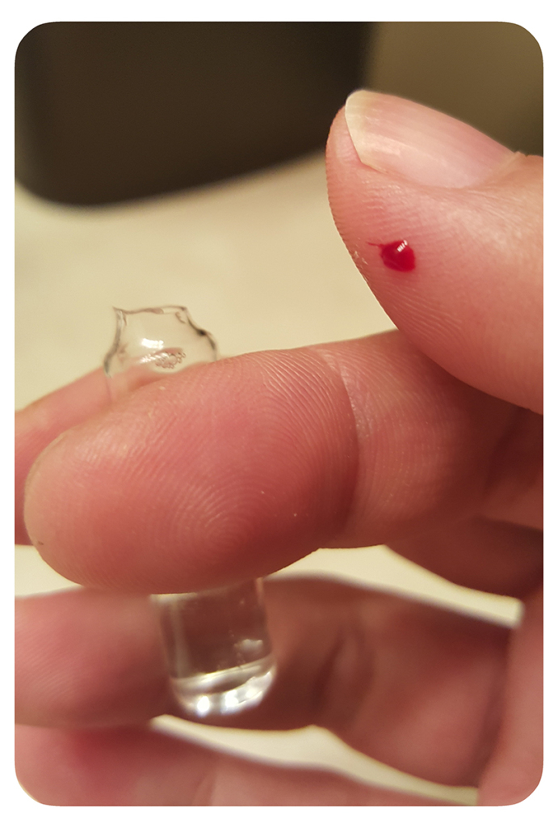
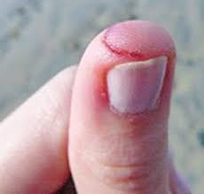
Use Caution When Breaking Glass Ampoule

Slide 36
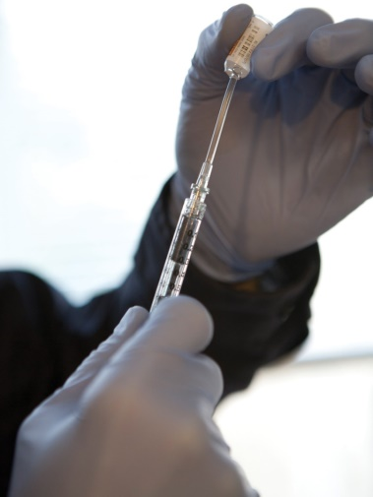
Techniques of Medication Administration
Drawing medication from ampoules
Hold upright between thumb and fingers
May invert to ensure all medication is in the lower section of the ampoule
Requires a filter needle/straw to retain glass fragments
Do not need to draw air into syringe or inject air into ampoule before drawing up medication, it is an open system.

Slide 37


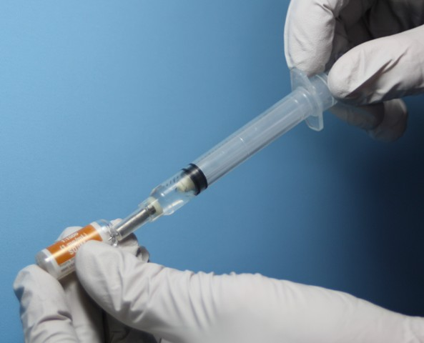
Tap-Wrap-Snap-Draw
Prep Epinephrine
1.
2.
3.

Slide 38

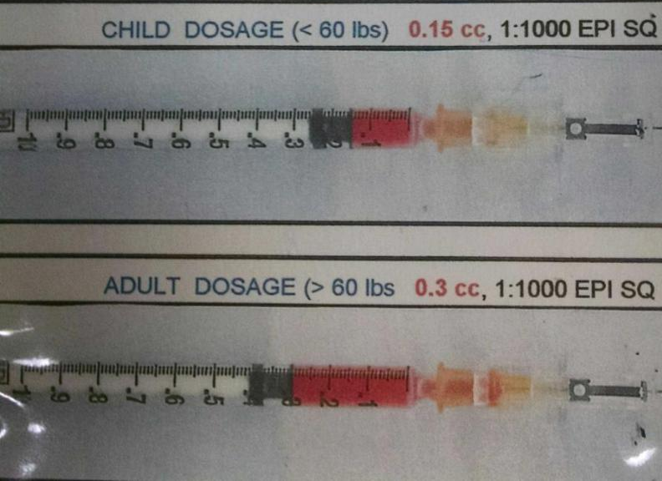
Draw Up The Medication
Using a syringe, insert the filter needle into the ampoule and
draw the plunger back until you reach the correct dosage
(PEDS = 0.15 ml or ADULT = 0.3ml)

Slide 39
Skills Section: Obtaining Medication from a Vial

Slide 40
Confirm the Medication
Medication name
Dosage (1:1,000 or 1mg/1ml)
Expiration date
Not cloudy; no color or precipitate

Slide 41
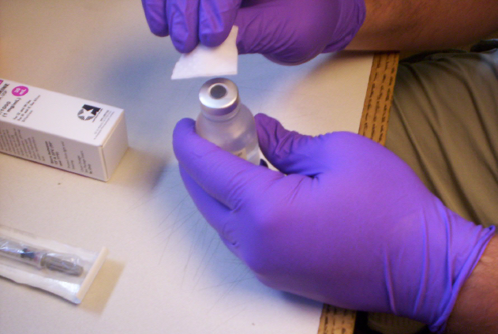
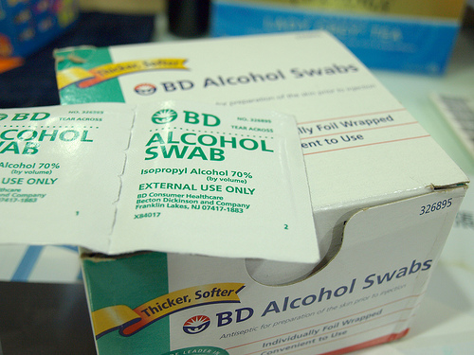
Clean the Vial’s Rubber Top

Slide 42
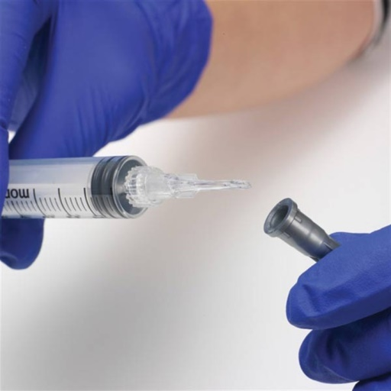

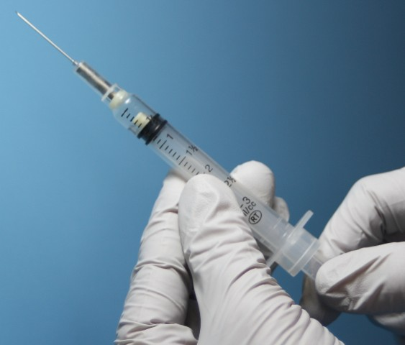
Prepare the syringe
With the needle cap on, pull back the plunger to the appropriate dosage.
You will inject the same volume of air into a vial as you withdraw the medicine.

Slide 43
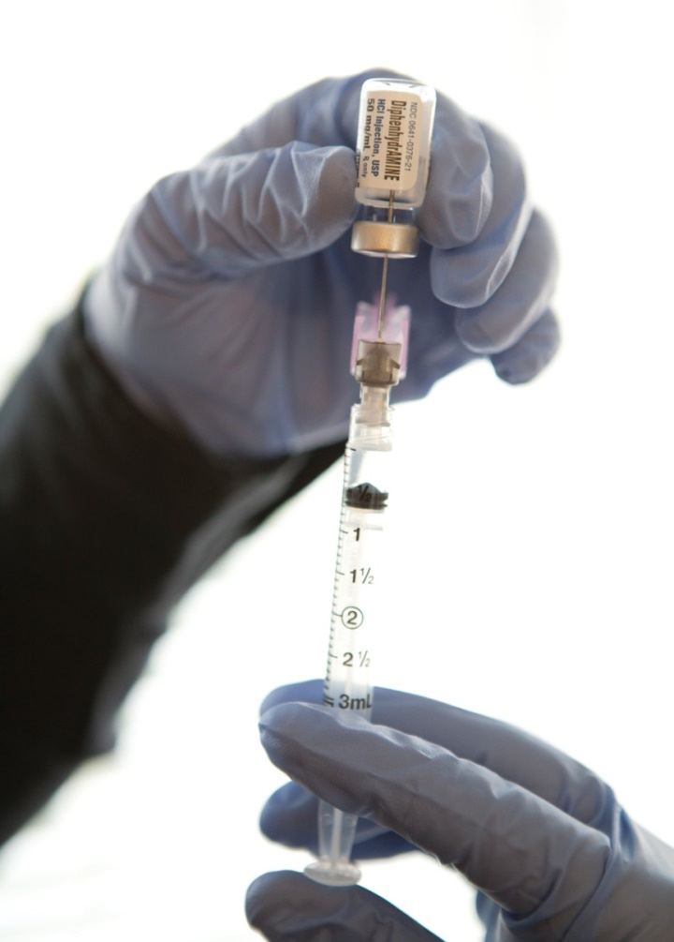
Inject Air and Withdraw Med
Insert transfer device through rubber stopper
Inject a volume of air slightly greater than the volume of medication to be withdrawn
Draw the medication from the vial

Slide 44

Draw Up The Medication
Using a syringe, insert the transfer device into the vial and
draw the plunger back until you reach the correct dosage
(PEDS = 0.15 ml or ADULT = 0.3ml)

Slide 45
Site Selection & Preparation
Intramuscular sites allow a drug to be injected into the belly of a muscle so that the blood vessels supplying that muscle distribute the medication to its site of action via the bloodstream.
First steps:
Prep the site with approved antiseptic by scrubbing vigorously and allowing to dry.
DO NOT TOUCH, BLOW ON OR FAN THE INJECTION SITE!
Align the needle above the injection site at a 90 degree angle to help insure IM administration of drug.
What PPE should be worn when preparing the medication and injection site?

Slide 46
Techniques of Medication Administration
EMS provider safety
Always use Standard Precautions
Gloves for standard precautions
Alcohol or povidone iodine swabs
Syringe of proper size with proper graduations
Needles or filter straws
Never recap contaminated needles
Dispose in biohazard container

Slide 47
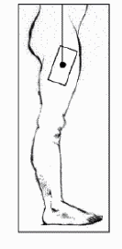
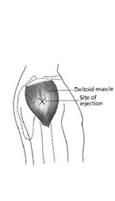
Intramuscular Injection Sites
Primary
Lateral thigh
Secondary
Deltoid
Where is the best IM injection site for infants and toddlers?

Slide 48
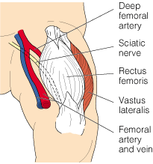
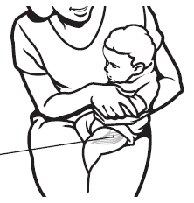
The Anterolateral Thigh is the Best Site for Infants & Toddlers
Good site for all ages, but especially under 3 years old
Far from major blood vessels & nerves
Insert needle at 90° angle ⬇

Slide 49
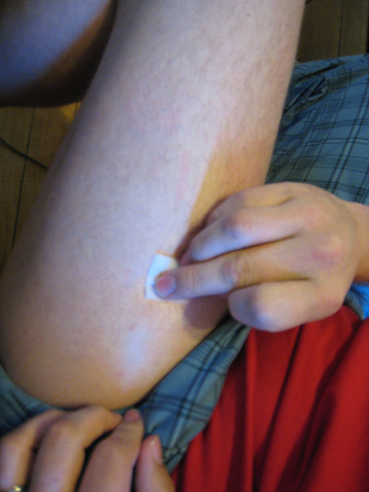
Prepare The Site
Scrub the skin vigorously with an alcohol/iodine wipe
Allow to air dry
Do not touch, blow on, or fan the injection site

Slide 50
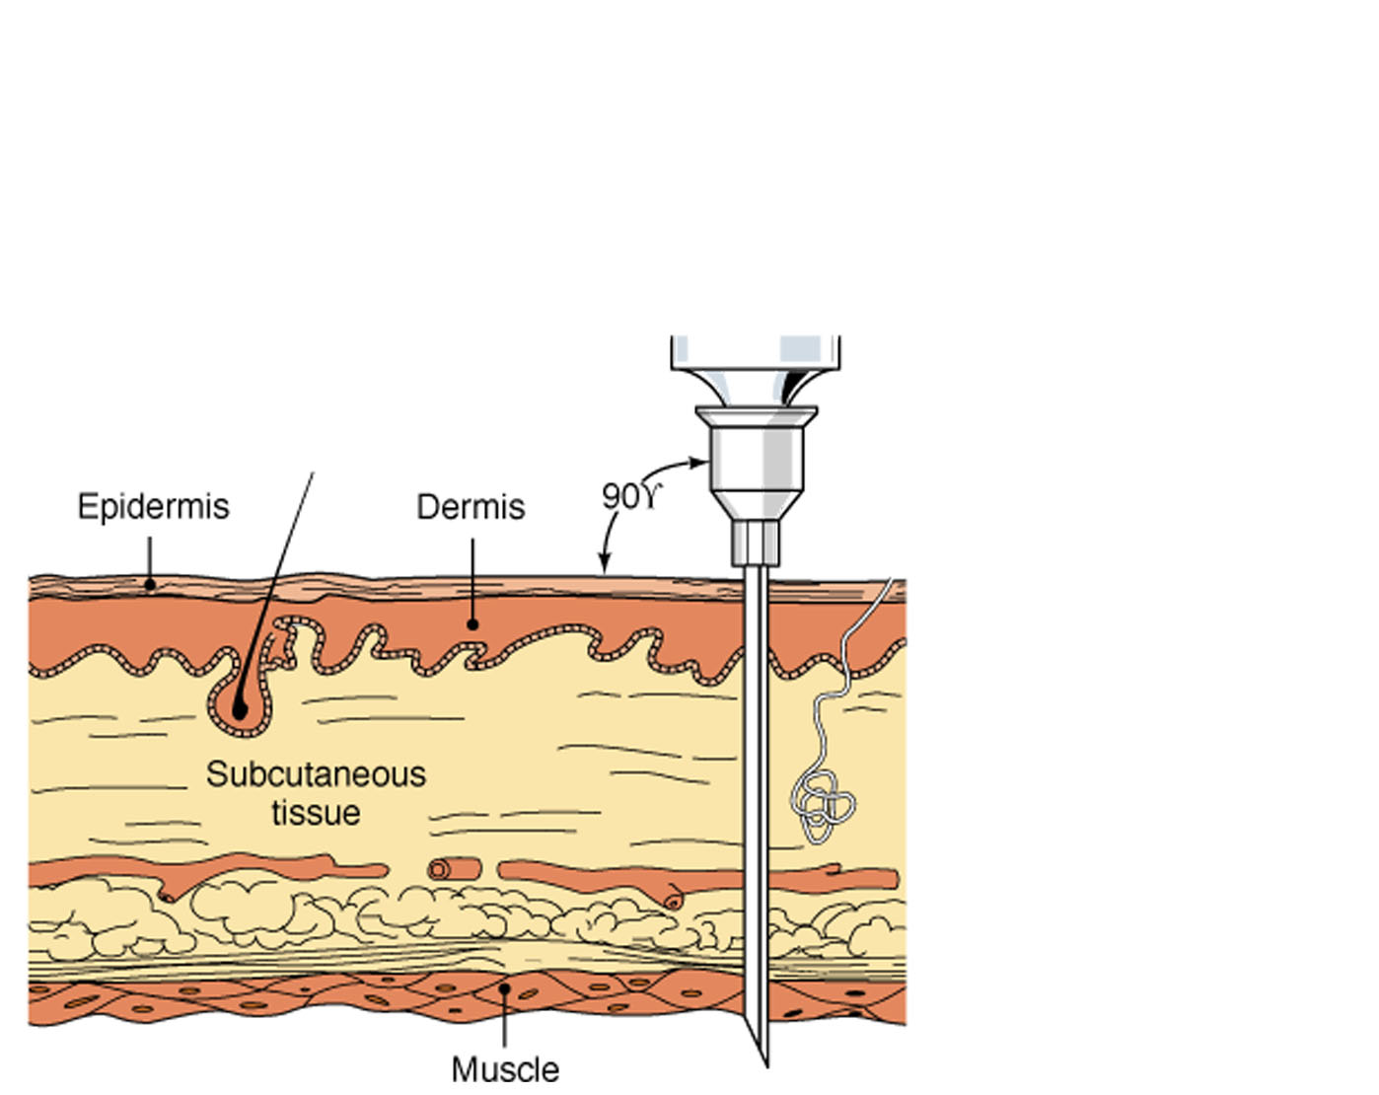
Intramuscular Injection
90º
How much longer will it take to treat anaphylaxis if Epinephrine is administered too shallowly (subcutaneous layer), rather than in muscle?

Slide 51
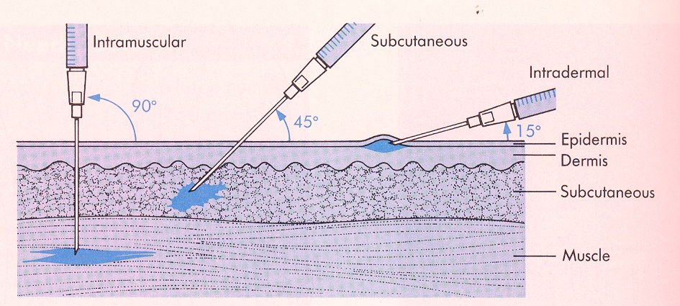
Be sure to inject Epinephrine into the muscle
It may take twice as long (up to 10 min) for Epinephrine to have the life-saving effect if not injected into the muscle.

Slide 52
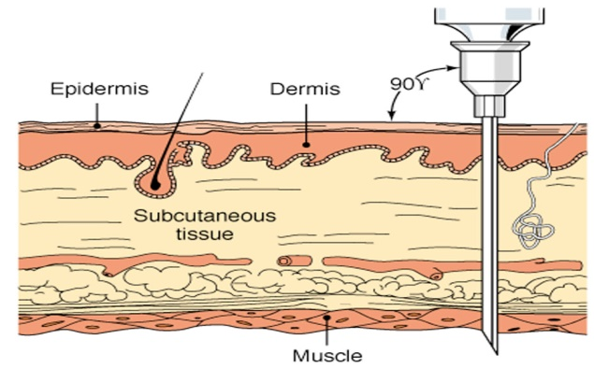
IM Injection Technique
IM Injection Depth [adult]
Lateral Thigh: 12mm = 0.5 inches
Deltoid: 13mm = 0.5 inches
Reinventing IM and Procedural Injections;
Practical Pain Management
Do NOT need to bury/hub the needle
Over 200lbs/100kg need deeper penetration

Slide 53
IM Injection Technique WI EMS Skills & Procedures Manual
Hold the syringe in dominant hand and remove the needle cover
Stabilize the injection site with your non-dominant hand using:
Pinch technique
Stretch technique (better for obese pts)
Holding the syringe like a dart, quickly but not forcefully, insert the needle into the injection site at a 90 degree angle until the proper depth is reached
Release the skin while continuing to hold the syringe in place with the dominant hand

Slide 54
IM Injection Technique WI EMS Skills & Procedures Manual
Grasp the plunger with one hand and the barrel of the device with the other. Pull back (aspirate) slightly on the plunger and wait 5 seconds.
If no blood aspirates into the syringe, proceed with the injection. Slowly depress the plunger to administer the injection. A slow, steady injection rate allows the muscle to distend gradually and accept the medication under minimal pressure.
Once the medication has been administered, wait 10 seconds, then withdraw the needle using appropriate safety features and/or activating the needle safety engineering device.

Slide 55
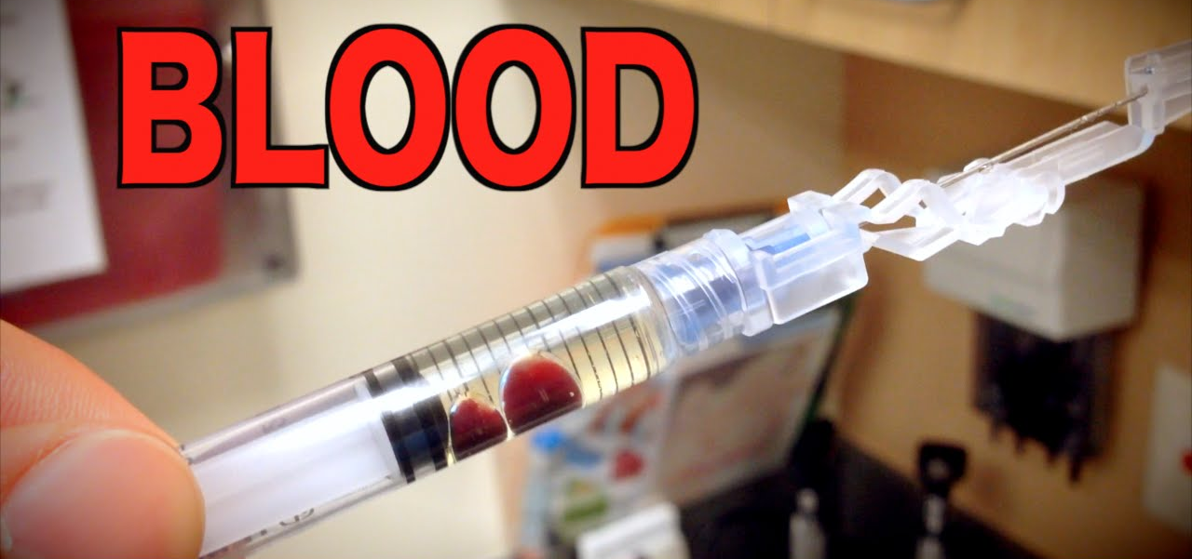
IM Injection Technique WI EMS Skills & Procedures Manual
If blood is present when aspirating, withdraw the needle and discard the medication.
Start over with new medication and a new site.

Slide 56
IM Injection Technique WI EMS Skills & Procedures Manual
Cover the injection site with an alcohol or gauze pad and apply gentle pressure to the area to help reduce pain and improve absorption.
Properly dispose of the syringe and needle assembly in an appropriate sharps container.
Place a bandage over the injection site.

Slide 57
Skills Section: Intramuscular Injection

Slide 58
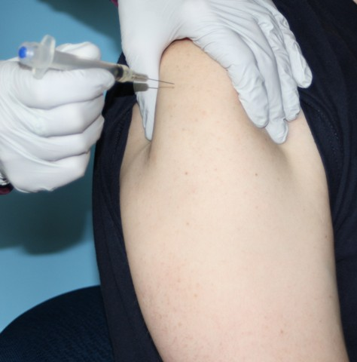
Insert The Needle at a 90-degree Angle
Broadly hold the muscle
Do not pinch the skin
Hold syringe like a dart
Insert the needle with a quick stab at a 90° angle to the skin surface

Slide 59
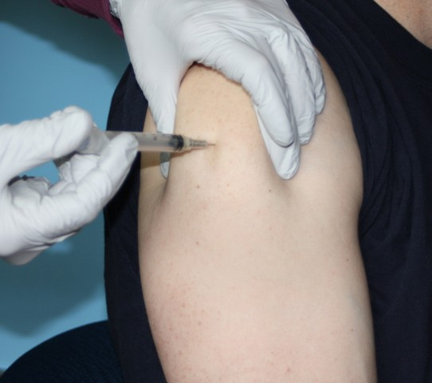
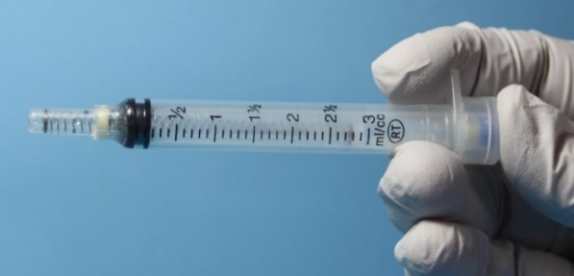
Deliver the Medication
Draw back the plunger to verify you are not in a blood vessel
If blood present, remove and prepare a new syringe.
Depress the plunger with a slow, steady motion until the syringe is empty
Remove syringe and needle, utilizing safety needle mechanism

Slide 60
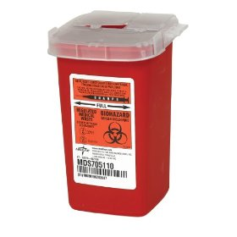
Needle Handling Precautions
Immediately dispose of used sharps in a sharps container.
NEVER recap needles

Slide 61
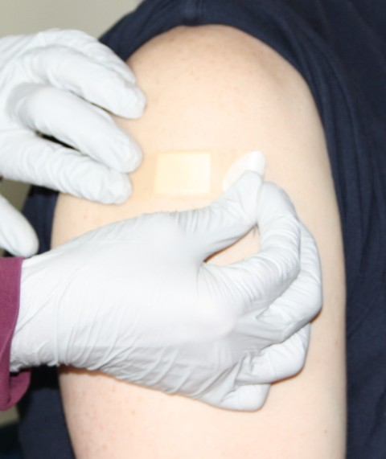
Secure, Massage & Cover Site
Massage with gauze or alcohol wipe to enhance absorption and comfort
Cover the puncture site
Reassess your patient
Prepare for transport

Slide 62

Reassess Patient
LOC
Appearance
Respiratory distress
VS
Change in symptoms

Slide 63
Treat & Document all information concerning the patient & medication:
ABC’s, LOC, oxygen therapy
Indication for medication administration
Vital signs, work of breathing, lung sounds, skin signs, ability to speak (how many words)
Medication, dosage, and delivery site
Response to the medication
Vital signs, work of breathing, lung sounds, skin signs, changes in ability to speak
Both positive and negative responses

Slide 64
Assessment of Patient Response
Document the patient’s response to treatment:
LOC, behavior, breathing effort, lung sounds, skin signs, vital signs, and changes in ability to speak
Document adverse effects, if any
How long does it take for the drug to take effect, and what do I do if the patient does not improve?

Slide 65
Ongoing Assessment
If no significant improvement within
10 minutes, consider second dose
Second dose may require consultation with online medical control
If unable to contact medical control or ambulance, it is recommended that an EMR may administer second dose if required
Thorough documentation is essential

Slide 66
Case example
WI DHS Office of Preparedness & Emergency Health Care

Slide 67
Case Example
You are called to the house of a 5 year‐old male with a chief complaint of “tongue itching”.
His father greets you and explains that approximately 30 minutes prior to arrival the patient ate an oatmeal raisin energy bar and within minutes of eating the bar he developed itching of his tongue and a sore throat. He then developed scattered hives, followed by an episode of vomiting.

Slide 68
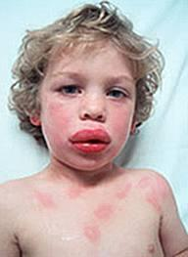
Case Example
Physical exam shows a diffuse red rash, facial swelling, rapid breathing, faint wheezing, and mild diffuse abdominal tenderness.
Vital signs are:
HR 124, RR 24, Pulse ox 94%, BP 64/34, Temp 37.1° C/98.8° F
During the examination his oxygen saturation dropped to 89% and his mental status began to decline…

Slide 69
Case Example
The child was immediately placed in the supine position
Oxygen administered via non‐rebreather mask
Epinephrine 0.15 mg administered into his left anterolateral thigh
Transporting ambulance arrives.

Slide 70
Case Example
Ambulance crew intervention:
An intravenous line was established
20 ml/kg bolus of 0.9% normal saline
Albuterol nebulizer treatment

Slide 71
Case Example
Within 15 minutes his rash began to improve and the wheezing was no longer heard.
Repeat VS: HR 96, RR 18, and a pulse oximetry reading of 97%, BP 110/59 mm Hg. His mental status returned to his baseline.
Previous VS: HR 124, RR 24, Pulse ox 94%, BP 64/34, Temp 37.1° C/98.8° F
He did not require any additional doses of epinephrine and was observed in the ED for approximately 5 hours.
He was discharged in good condition with an auto‐injector device and referral to an allergist.

Slide 72
Questions? Discussion?
WI DHS Office of Preparedness & Emergency Health Care

Slide 73
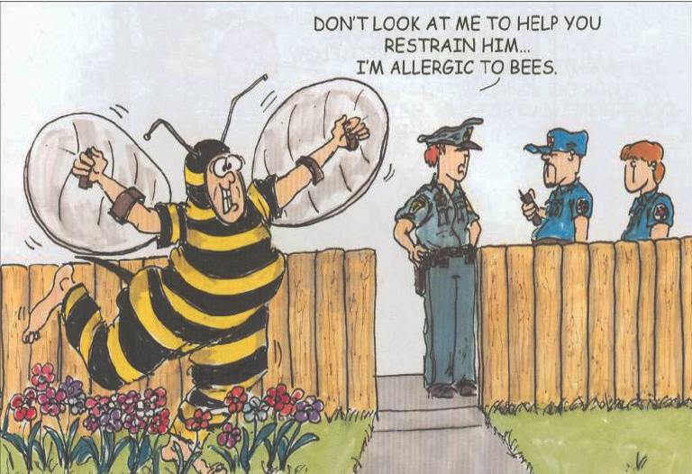
Questions?
Notes:
73

Slide 74
Release of training liability statement - pending
Example from S&P Manual
This manual is intended to provide examples of tried and proven techniques of caring for patients with the various injuries or illnesses that EMS personnel will encounter in the field. It does not provide the only method or technique that may be an acceptable approach in caring for an injury or illness. However, since the various certification examinations used within the state are based on the current edition of this document as well as the current edition of the National EMS Education Standards, the State of Wisconsin Scope of Practice, and the State of Wisconsin Curricula, this should be considered a companion to the curricula used for the education of EMS personnel. This is a consensus document, endorsed by the EMS Training Centers, the Office of Preparedness and Emergency Health Care in the Department of Health Services and the EMS Physician Advisory Committee for purposes of instruction

