Slide 1
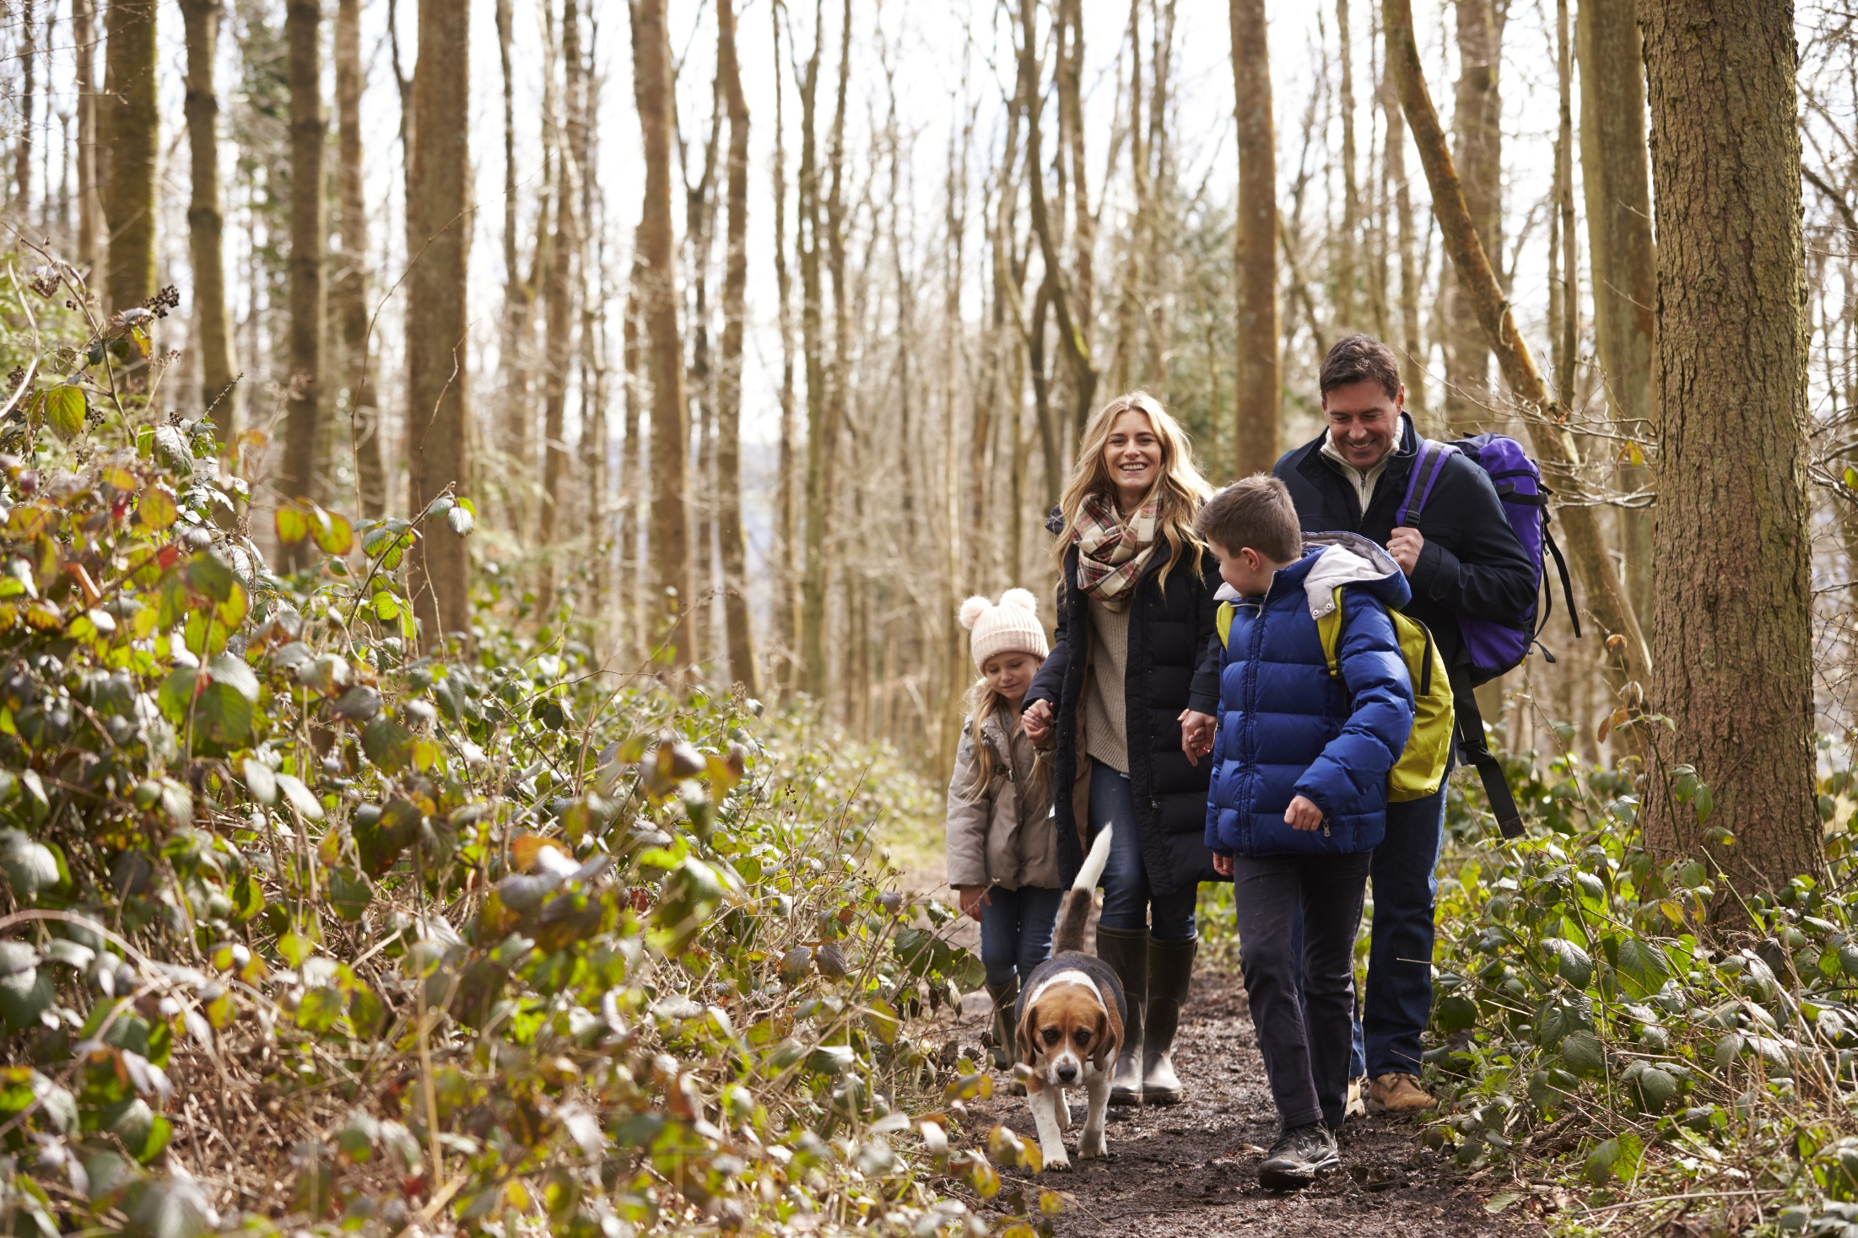
PUT YOUR LOGO IN THIS SPACE
TRACKING ENVIRONMENTAL HEALTH
2021 County Environmental Health Profiles
Presenter Name | Presenter Agency | Date
Notes:
Presenter notes:
These notes are provided as a guide. Feel free to make this your own. Add or remove slides as needed. If your audience doesn’t need the context about data, skip to slide 9.
During the presentation, all audience members should have a copy of your county’s dashboard (page 3 in your County Environmental Health Profile). If you need copies printed and sent to you, please email dhstracking@wi.gov so we can arrange to send them to you.
The full presentation should probably take about 15-20 minutes to deliver. With questions and discussion, it will probably take 30 minutes. Pare down or expound on your local efforts as needed. This is your presentation!
We have put text in italics that needs to be tailored to your community. Remember to update this text before you present. On this slide, delete the entire light blue circle and place your agency’s logo in this space.

Slide 2
Notes:
We use data to do a lot of things. Before you even left the house this morning, data helped you make several decisions:
(CLICK)
The time on the alarm clock told you it was time to get out of bed.
(CLICK)
You felt the temperature of the water in the shower and adjusted it accordingly.
(CLICK)
You maybe read the weather report and knew to pack an umbrella.

Slide 3
Notes:
We use data in public health in much the same way: to better understand the world around us, to solve problems, and to drive decision-making.

Slide 4
What if you kept your alarm clock in the basement, not next to your bed?
Notes:
The problem is that local environmental health data are often hard to find and interpret, making it a challenge for us to solve problems and make informed decisions. (CLICK)
Can you imagine if your alarm clock was located in your basement instead of right next to your bed?

Slide 5
What if you had to email the utility company to adjust your shower temperature?
Notes:
What if to change the temperature of the water in the shower you had to email a request to your utility company?

Slide 6
What if you had to consult five agencies to get a weather report?
Notes:
Imagine having to consult 4 or 5 agencies to get a simple weather report.
It sounds crazy, right? Unfortunately, this is the case for many environmental health datasets. Some datasets are hard to find, others require special permission to view, and most are just simply scattered across several agencies.

Slide 7
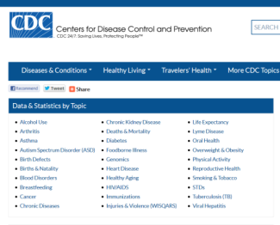
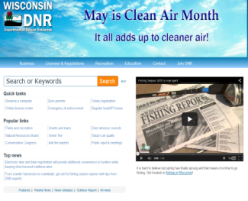
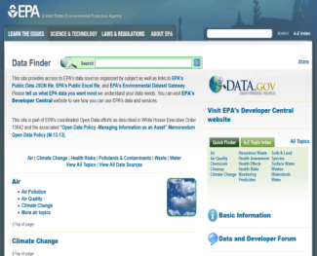
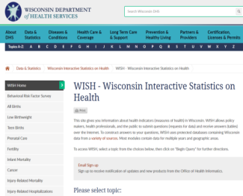
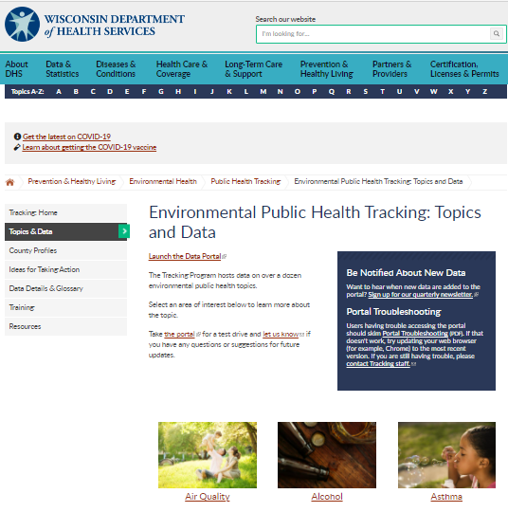
CDC
DNR
EPA
WISH
TRACKING
Notes:
Wisconsin Environmental Public Health Tracking Program makes it easier to find and use the data by pulling them from many sources into one web portal. (CLICK)
Presenter note: There is an animation here that pulls four sources into the bigger Tracking window.

Slide 8
TRACK.
Explore the data, compare counties, age groups, and years
ANALYZE.
Create charts, maps, and tables to visualize and interpret the data
ACT.
Use the data to target education, programming, and policies to address your community’s needs
Notes:
The Tracking Program was created to help make it easier to track (CLICK), analyze (CLICK), and act (CLICK) upon environmental health data.
Presenter note: Pause a minute here and give the audience some time to read the specifics under track, analyze, and act. It also gives you a chance to take a breath.

Slide 9
Notes:
The Tracking Program also puts out County Environmental Health Profiles. These profiles are updated every two years and just scratch the surface of what Tracking has available. Today we will be talking about how our county is doing with environmental health indicators. Let’s take a look inside.
Presenter note: Feel free to keep the screen shot of the profile as Milwaukee County, but you could instead add in a screen shot of your county’s profile.

Slide 10
Community health assessments
Community health improvement plans
Research
Media stories
Accreditation
Social media
Grant proposals
Education and outreach
Policy development
Notes:
In the profile, the first page after the cover highlights some potential uses of the data. As I go through our county’s data, be thinking about ways we can use the data in our communities. Here are a few examples.
Presenter note: Pause here for a few seconds to give the audience a chance to read the slide.

Slide 11
The dashboard is a snapshot of how Your County Name is doing on 12 environmental health indicators.
Notes:
First, let’s take a look at the dashboard, which is on the second page after the cover. The dashboard is a quick overview of everything included in the profile. You will notice there are some abbreviated data details on the back. We don’t expect everyone to read the full profile. The dashboard can be printed and shared with staff, stakeholders, and policymakers to give snapshot of how our county is doing on 12 environmental health indicators.
Notice the gold circle or green circle icon next to each measure. If our county’s rate or measure is above the state rate, it is the gold circle icon. If it’s below the state rate, it’s the green circle icon. Keep in mind that the icons don’t necessarily mean good and bad. In some cases the Wisconsin value might be quite low or very high; the comparison is only for a reference point.
Take a minute to review the dashboard in the profile. What sticks out to you? What questions do you have at this point?
Presenter note: Listen to what your audience has come up with so far. Answer questions the best you can. It’s completely okay to say, “I’m not sure, but I will check on that for you!” If you get any questions you can’t answer, send them our way (dhstracking@wi.gov).
Are you from a pretty small county? If so, you are probably used to getting reports with lots of suppressed values. Suppression often happens when there are so few cases that individuals might be identifiable or the rates are unstable (and not helpful for decision-making). The Tracking team tried to minimize suppression in smaller counties by aggregating more years. All of the details on years of data used are in the notes on page 4. This isn’t something you necessarily need to bring up with your audience, but if you get any questions, you have that background.
We have put text in italics that needs to be tailored to your community. Please change the text before you present.

Slide 12
HIGHLIGHTS FROM
OUR COUNTY
Notes:
Let’s talk about some highlights from Our County Name.
Presenter note: This is where your county data can really shine. Highlight 3-5 key data points from your profile. Start with something where you county is doing awesome. Is your asthma rate far below the state rate? Take this opportunity to highlight the things you have done to address asthma in your community. You might change the picture here to reflect the topics you plan to talk about.
If there is an indicator where your county measure is much higher than the state average, do you have any insights to share about why your measure might be higher? You will need to customize the next several slides. We have provided a skeleton that you are free to edit to highlight strengths and areas for improvement. Let us know if you need help presenting the data in a meaningful way (dhstracking@wi.gov).

Slide 13
Our carbon monoxide poisoning rate has decreased since 2010.
Rate of ER visits per 100,000 people
Wisconsin Average
Wisconsinville County
Notes:
Presenter note: This is an example of something Wisconsinville County might want to highlight. Add in a data point you want to highlight.
For all your data slides, summarize the key takeaway at the top. Your audience should understand at a glance what’s happening with the data. Try the takeaway test: show the slide to someone for a few seconds, then take it away. They should be able to give you the gist of what they just saw.
Right-click the chart and select “Edit Data” to update the chart with your county’s data.

Slide 14
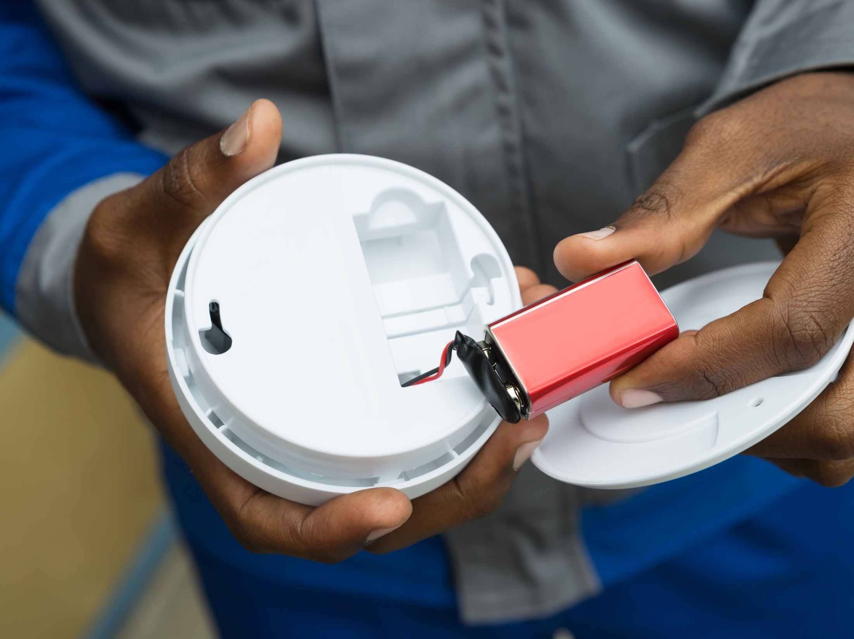
Notes:
Presenter note: Use this opportunity to talk about work done to improve this public health issue. For example, Wisconsinville County might discuss their strides to increase carbon monoxide detector use in homes or at ice arenas and indoor recreation facilities where gas-powered equipment is used. Talk about any key partnerships that helped make this happen. Use pictures that make sense with the topic you’re covering. If you need help with pictures, let us know (dhstracking@wi.gov).

Slide 15
Our Lyme disease rate is lower than the Wisconsin average.
Crude rate per 100,000 people
Wisconsin Average
Wisconsinville County
Notes:
Presenter note: In addition to covering the data, this is a great opportunity to explain how measures like this are environmental health issues. To learn more about how indicators in the profiles are linked to the environment, simply go to the topic area on our website and scroll down to the FAQs: https://www.dhs.wisconsin.gov/epht/data.htm.
To get exact numbers to create charts like this, you can get your data from our data portal (available through dhs.wisconsin.gov/epht).
Like with the previous slide, highlight success stories and things you are doing in your community to improve public health around this issue.
Right-click the chart and select “Edit Data” to update the chart with your county’s data.

Slide 16
I was worried about my daughter getting Lyme disease because we spend a lot of time hiking in the woods.
I’m so happy Wisconsinville Health Department offered this training on preventing tick bites and explained how to identify the signs and symptoms of Lyme disease.
Sofia Nelson
Mother of Natalie, age 4
WISCONSINVILLE, WI
Notes:
Presenter note: Use quotes and stories to make the data real. For example, on this slide, a county might highlight work they are doing to educate residents on tick bite prevention.
If your quotes are long and you plan to read them, simply put a few words then an ellipse and read the quote from your notes. Alternatively, display the whole quote but give the audience time to read it themselves.

Slide 17
Our projected number of future extreme heat days is higher than the Wisconsin average.
Number of days above 90°F
Wisconsinville County
Wisconsin Average
Notes:
Right-click the chart and select “Edit Data” to update the chart with your county’s data.

Slide 18
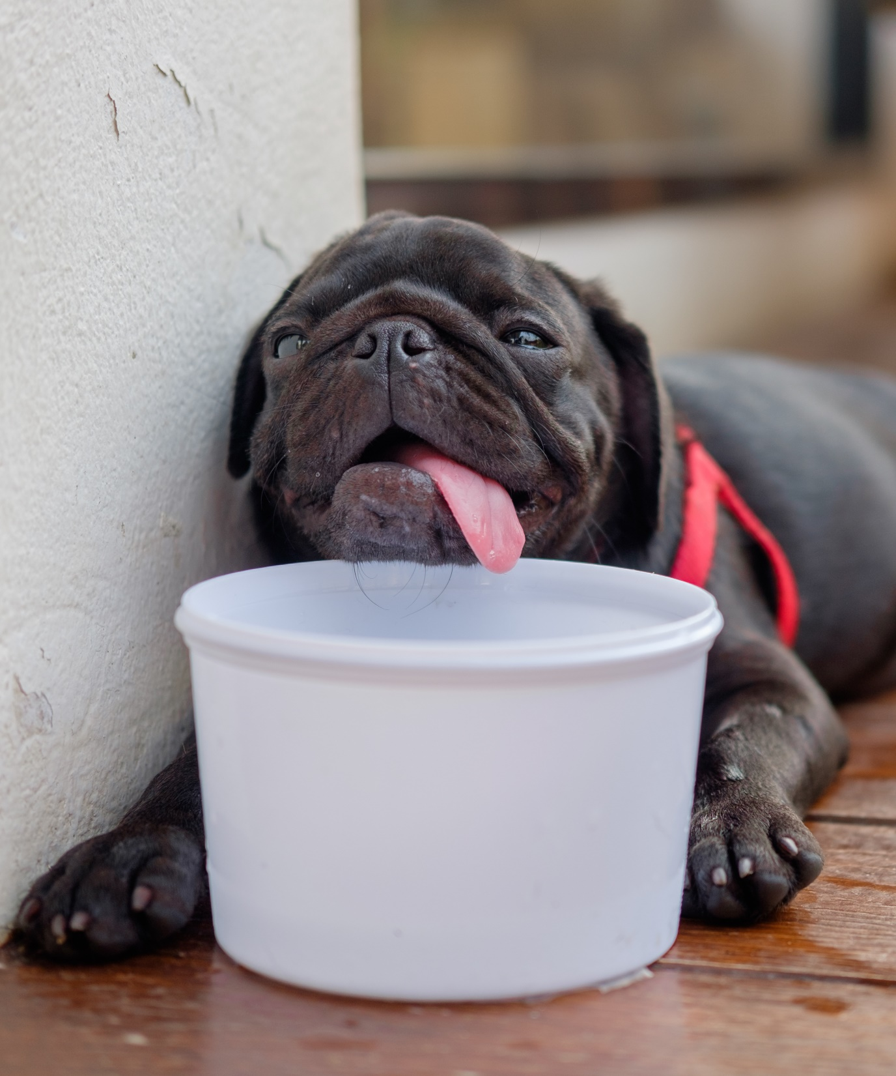
Plans for
Summer 2022
Notes:
Presenter note: If you have specific plans for addressing an issue, bring it up. For example, maybe Wisconsinville County is partnering with local churches and businesses to host more cooling centers next summer. Highlight those plans.

Slide 19
Our percent of motor vehicle fatalities involving cyclists or pedestrians is higher than the Wisconsin average.
Percent of fatal motor vehicle crashes involving cyclists or pedestrians
Wisconsinville County
Wisconsin Average
Room for improvement
Notes:
Right-click the chart and select “Edit Data” to update the chart with your county’s data.

Slide 20
Addressing motor vehicle fatalities in Wisconsinville County
Promoting active transportation options like safe routes to schools.
Encouraging drivers to share the road with cyclists and pedestrians.
Working with Parks and Rec to build and maintain sidewalks, bike lanes, and crosswalks.
Notes:
Presenter note: If you have specific plans for addressing an issue, bring it up. For example, maybe Wisconsinville County is actively promoting safe routes to schools programs, sharing the road with cyclists and pedestrians, and working with Parks and Rec to build and maintain bike and pedestrian infrastructure.

Slide 21
Notes:
You have heard a few data highlights from our County Environmental Health Profile and have also heard about our work in these areas. At this point, I want to hear from you!
Presenter note: At this point, you are transitioning to talk about potential solutions and partnerships. What do you want to ask of this group (for example, ideas for solutions, a seat at the table, an invitation for them to join your existing efforts, monetary support)? Insert more slides as needed.
The Tracking Program has fact sheets with strategies for each topic in the profiles. Visit dhs.wisconsin.gov/epht and click on the Profiles tab to get to them. Consider bringing some copies of this document to your presentation to get your audience thinking about solutions. You could lead a discussion about what strategies people are interested in or might be already doing.

Slide 22
PUT YOUR LOGO IN THIS SPACE
THANK YOU!
Presenter Name | Presenter Agency | Date
Notes:
Thank you so much for your attention and input! What questions do you have?
Presenter note: Update presenter name, agency and date. Also add in your logo.

