Slide 1
Public Health Law in Wisconsin
Western Region WALHDAB Meeting
Eau Claire, WI
March 6, 2013

Slide 2
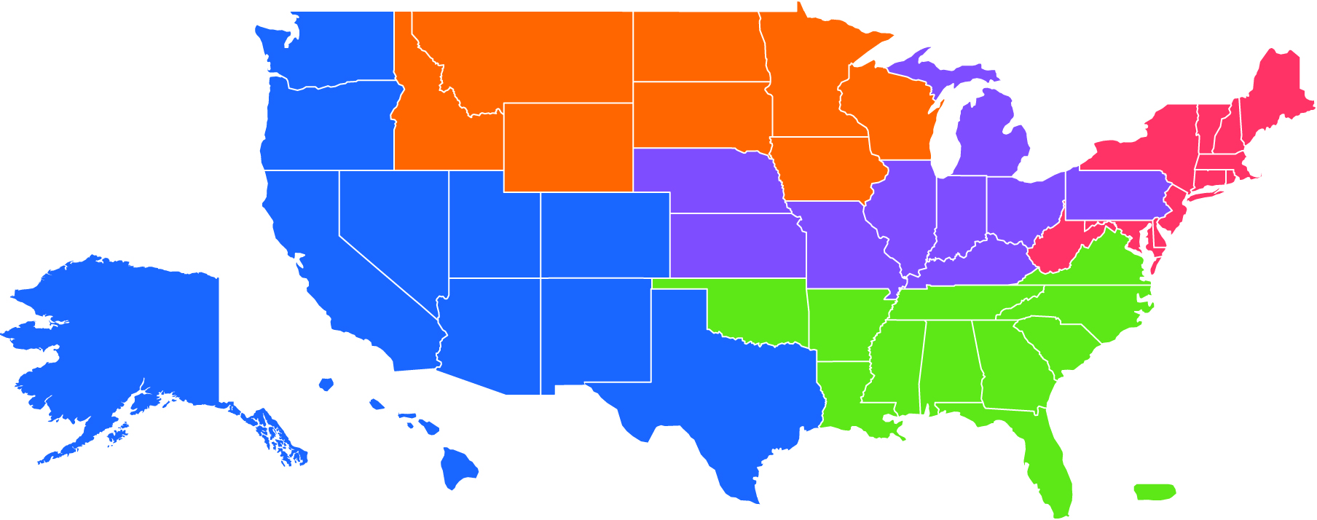
National Scope with Local Expertise
Provide support across the country
Divided into 5 Regions to provide local and state support
Contact your Region for assistance

Slide 3
Who can use the Network
Anyone committed to public health can join the Network:
Local, state, tribal and federal public health officials
Public health practitioners
Attorneys
Policy-makers
Advocates

Slide 4
Benefits of Joining
Get the latest information on public health law
Connect with others in the Network
Share your public health law knowledge and experiences
Get help developing, implementing and enforcing public health laws
Access legal assistance and resources

Slide 5
Legal Technical Assistance
Legal assistance can include:
Strategizing about potential legal options
Help finding experts, resources and tools
Support to develop, implement and enforce legislation, statutes or regulations
Technical assistance does not include providing legal advice or representation.

Slide 6
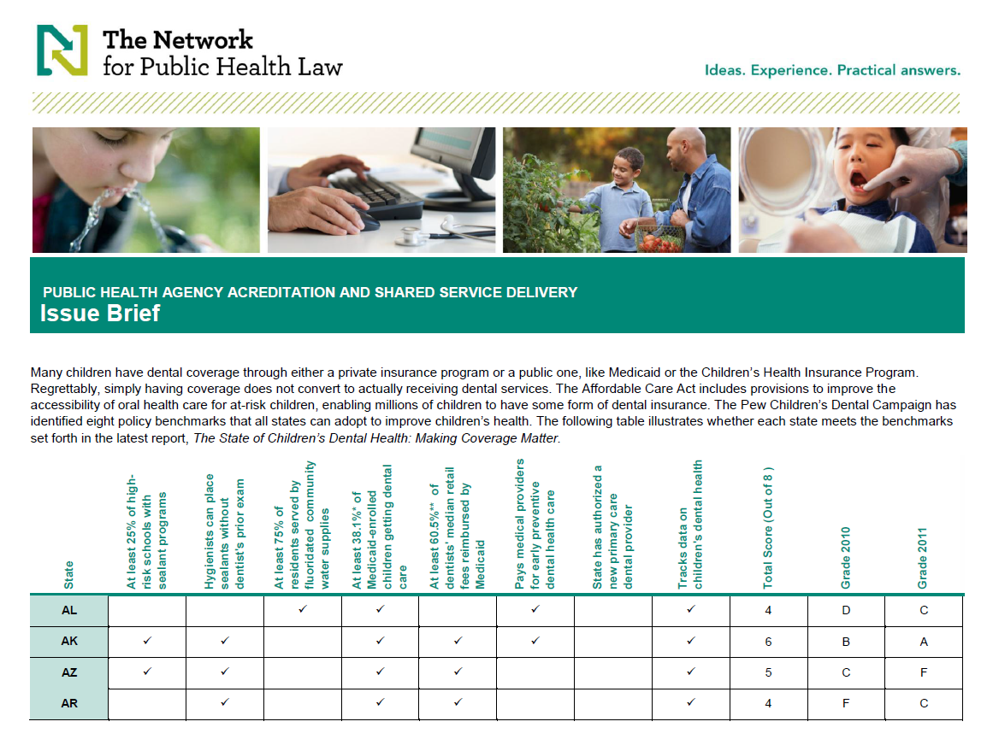
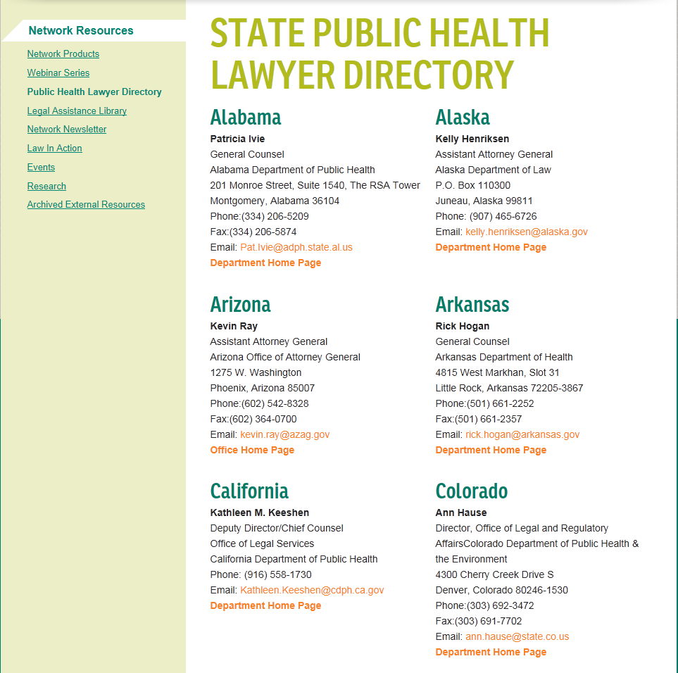
Access Helpful Resources
Network products, such as fact sheets, tables of state laws, legal briefs and more
Monthly webinar series
Public health lawyer directory
Library of legal assistance questions and answers
External resources
Network newsletters
Events

Slide 7
Public Health Topics
Working with experts around the country, the Network provides support on a variety of topics:
Cross-border public health
Emergency legal preparedness and response
Environmental public health
Food safety
Health reform
Health information data sharing
Injury prevention and safety
Obesity prevention
Public health agency accreditation and shared service delivery
Public health statutes and regulatory information
Tobacco control
Tribal public health law
And other topics

Slide 8
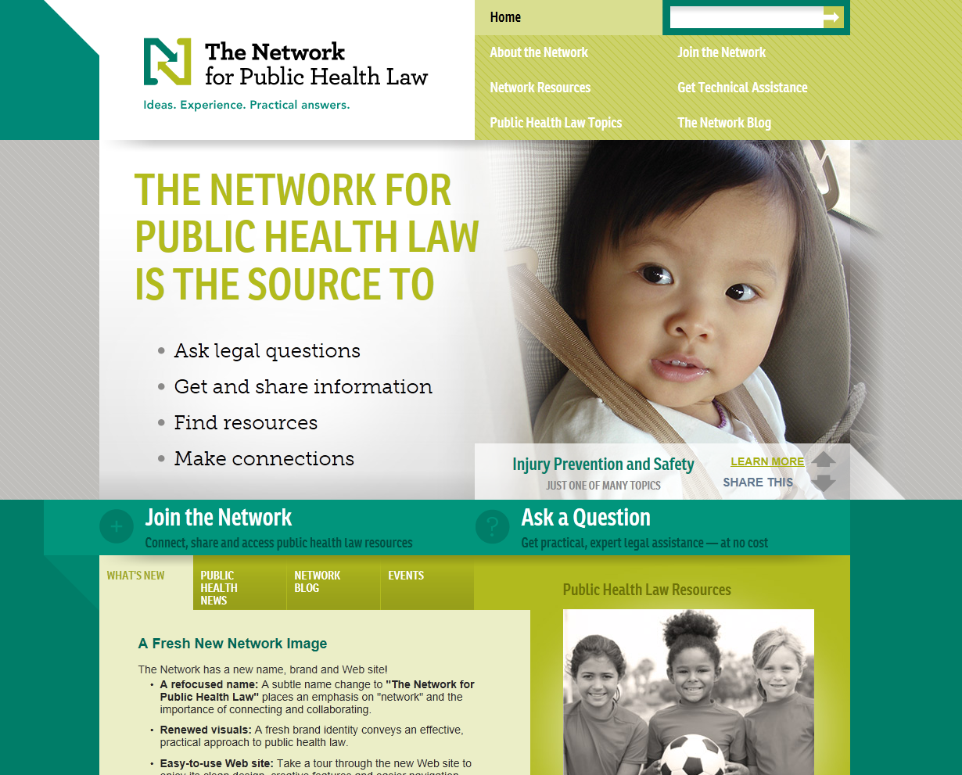
Contact the Network
Visit www.networkforphl.org
Call your Region
Office hours from 9 a.m. to 5 p.m. in the respective time zone of the region’s main office
Expect a first response within 72 business hours

Slide 9
New Network Wisconsin Resource (in progress)
Overview of Chapters 250-257
Categorized by:
Management
Rules and Policies
Investigations
Enforcement
Information Collection, Analysis & Dissemination
Programs/Grants

Slide 10
General Powers
Broad Powers derive from State ex rel Nowotny v. City of Milwaukee (1909)
“A health officer who is expected to accomplish any results must necessarily possess large powers and be endowed with the right to take summary action, which at times must trench closely upon despotic rule. The public health cannot wait upon the slow processes of legislative body or the leisurely deliberation of court…”

Slide 11
General Powers
The broad power affirmed in Nowotny is codified in our statutes today
Department has power to do “what is reasonable and necessary for the prevention and suppression of disease” [250.04(1)]
Department “may authorize and implement all emergency measures necessary to control communicable disease” [252.02(6)]
Local health officers “may do what is reasonable and necessary for the prevention and suppression of disease” [252.03(2)]
Local health officers “shall promptly take all measures necessary to prevent, suppress and control communicable diseases. . .” [252.03(1)]

Slide 12
General Legal Authority
Broad powers must be balanced against individuals’ rights
the right to be free from restrictions is overcome only when the exercise of governmental power is necessary
choose least restrictive measure that will assure public’s health
least restrictive measure will depend upon the threat to the public’s health

Slide 13
Interpreting Laws
Courts do it all the time
So do lawyers, and in doing so, they assess risks

Slide 14
Working With Legal Counsel
Build your relationship
Educate your attorney about your work and challenges
Anticipate legal issues
Contact your attorney as soon as possible
Be candid

Slide 15
Communicable Disease – Isolation & Quarantine
Shall immediately investigate and cause examinations to be made as necessary upon appearance of a CD [Wis. Stat. 252.03(1);252.06(3)]
Shall order additional tests if:
Dispute regarding disease determination, or
Potential public health significance, or
More testing will aid investigation
[Wis. Stat. 252.05(9)]
May isolate a patient and order quarantine of contacts [Wis. Stat. 252.06(1); DHS 145.05, .06]
May direct owners of property and animals to act to prevent transmission of CD [DHS 145.06(6)]

Slide 16
Isolation and Quarantine
May isolate a patient and order quarantine of contacts as may be necessary and if consistent with HFS 145, Wis. Adm. Code [252.06(1)]
Any communicable disease listed in Appendix A of HFS 145
Any other infectious disease which the chief medical officer deems a threat to the public [HFS 145.06(1)]

Slide 17
Isolation and Quarantine
Isolation = separation of persons who have a specific infectious illness from those who are healthy and the restriction of their movement to stop the spread of that illness
Quarantine = separation and restriction of movement of persons who, while not yet ill, have been exposed to an infectious agent and therefore may become infectious
[From CDC website]

Slide 18
Is Isolation/Quarantine Appropriate?
If a person is known to have, or is suspected of having, a contagious medical condition that poses a threat, the Department or local health officer may issue one or more of the seven directives listed in HFS 145.06(4)
The chosen directives must fit the particular communicable disease and the behaviors presented

Slide 19
Isolation and Quarantine
Seven possible directives:
Participate in education or counseling
Participate in treatment
Undergo tests and exams to identify, monitor and evaluate disease
Notify or appear before local health official to verify status, testing or direct observation of treatment
Stop conduct or employment that is a threat to others
Reside part-time or full-time in an isolated or segregated setting
Be placed in an appropriate institutional treatment facility until noninfectious

Slide 20
Isolation and Quarantine
A court order is not necessary if a person voluntarily complies with a directive
If a person fails to comply, the official who issued the directive may petition a court to order compliance [HFS 145.06(5)]

Slide 21
Isolation and Quarantine
Work with Corporation Counsel to draft a petition that includes facts to establish:
The person was given the directive in writing;
The directive included the reasons for giving the directive and the evidence supporting those reasons;
The person has had the opportunity to seek counsel; and
The directive is the least restrictive that would serve to correct the situation and protect the public

Slide 22
Isolation and Quarantine
The reasons for the directive must be proved by clear and convincing evidence:
That the person has, or is suspected of having, a communicable disease;
That the communicable disease is either listed in Appendix A or is deemed to be a communicable disease by the State’s CMO;
That the person exhibited one of the six behaviors;
That the person, if only suspected of having a contagious condition, exhibited one of the six behaviors and one of the three criteria.

Slide 23
Isolation and Quarantine
TB cases differ:
Use this same process for an order:
to undergo a medical evaluation;
to receive directly observed therapy;
for home isolation
Different process to confine in a facility
72 hours and then a hearing
May confine in jail for TB; unlikely for other communicable diseases

Slide 24
Isolation and Quarantine
Property and animals/environs:
If property or animals present a threat of transmitting an Appendix A or CMO-deemed communicable disease, may direct the person who owns or controls the property or animals to do what is reasonable and necessary to abate the threat of transmission. [HFS 145.06(6)]

Slide 25
Isolation and Quarantine
Contact with person isolated/quarantined:
If necessary, may forbid direct contact with the person by anyone other than:
Local health officer and representative
Attending physicians and nurses
Clergy
Immediate family
Those with special permit from local health officer [252.06(4)(a)]
During a Governor-declared public health emergency, only the public health authority determines who may enter isolation or quarantine premises [252.06(4)(b)1.]
Anyone who enters may also be subject to isolation or quarantine [252.06(4)(b)3.]

Slide 26
Environmental Health
Wisconsin Statutes Chapter 254
Toxic substances
Radiation protection
Recreational sanitation
Animal-borne and vector-borne disease
Human health hazards
Lodging and food protection
Tobacco products to minors

Slide 27
Environmental Health
Agent Status
Chapter 254 gives local health powers and duties
In addition, the department may designate local health to carry out the department’s functions under Chapter 254
Duties and powers of department delegated through written memorandum of agreement

Slide 28
Human Health Hazard – What is it?
Sec. 254.01(2): a substance, activity or condition that is known to have the potential to cause acute or chronic illness or death if exposure….is not abated.
There are no court decisions regarding the definition
It is a scientific-medical question to be decided by the health officer

Slide 29
Human Health Hazard - Inspection
Determine whether Hazard exists by consent to enter premise or via special inspection warrant except in case of emergency
Sec. 66.0119(2) authorizes a warrant to inspect “personal or real properties which are not public buildings…or portions of public buildings…not open to the public…upon showing consent has been refused.

Slide 30
Human Health Hazard – Abatement & Costs
If hazard exists, send registered mail with return receipt requested notifying owner and occupant, and ordering abatement/removal within 30 days
If no abatement/removal in the manner approved by local health, then local health may enter premises and abate/ remove the Hazard or contract to have it abated/removed
Recover the cost of abatement/removal from:
Owner of the premises
Person causing or permitting the HHH
Special tax? Not an option for county health departments

Slide 31
School Immunization Reporting
DHS 144.07(4)(a): The school shall report to the local health department the degree of compliance with s. 252.04, Stats., and this chapter
DHS 144.08(2): By November 15 of each year, each local health department shall report to the department statistical information concerning the degree of compliance with s. 252.04, Stats., of students within its service area

Slide 32
Open Records & Confidentiality Laws
State law regarding confidentiality
Patient health care records are confidential except to the extent they could be disclosed without consent under HIPAA Wis. Stat. s. 146.82(1)
A covered entity may redisclose information if it is a release that would be permitted under the statute
An entity that is not a covered entity may redisclose for the same purpose for which the information was received Wis. Stat. s. 146.82(5)

Slide 33
Open Records and Confidentiality Laws
Access to Health Information
All records concerning STDs are confidential and may not be divulged except as are necessary for the preservation of public health [Wis. Stat. 252.11(7)]
Results of an HIV test are confidential and may not be disclosed except to the state epidemiologist or designee for surveillance, investigation or control [Wis. Stat. 252.15(5)]

Slide 34
Dan Stier, Director
National Coordinating Center
The Network for Public Health Law
William Mitchell College of Law
St. Paul, Minnesota
DStier@networkforphl.org

