Slide 1
State Funding for Public Health
Office of Policy and Practice Alignment
Division of Public Health
October 2018
Protecting and promoting the health and safety of the people of Wisconsin

Slide 2
Goals for Presentation
Understand the State Biennial Budget Development Cycle
Understand funding sources for State Public Health Services
Understand the Community Aids Reporting System (CARS)

Slide 3
State Budget Cycle
Governor’s Vetoes on Budget Bill
Summer
Preparation and Submittal of Agency Budget Requests
April to September
The Budget Cycle
Review by DOA,
Preparation & Submittal of Governor’s Budget
September to February
Legislative Enactment of Budget Bill
Summer
Consideration of Executive Budget Bill by JFC
February through June
Notes:
The way in which the State funding is appropriated is through the state budget. Wisconsin has a biennial budget, which means that the budget typically describes how money will be spent July through June for a two-year period. The budget for 2017-19 was just passed and signed by the Governor.
Budget creation begins with state agencies submitting their budgets to the Dept. of Administration, which then combines the state agency budgets into the master budget request, which is then presented to the Governor. The Governor uses this budget request to develop a budget that is presented to the Legislature—first by the Joint Finance Committee, which includes several public hearings to get public input. The Joint Finance Committee then takes suggestions from the public, the Governor’s budget, and prepares its own version. This budget is reviewed by the Legislature (Assembly and Senate)—both houses need to agree on the budget, which can be challenging, before it can go back to the Governor for his approval. The Governor may make line-item vetoes (meaning he can cross out line items, change dollar amounts, etc.). The Legislature can override the vetoes, but it takes a 2/3rds majority.
The budget should be signed into law before spending begins; however, this does not always happen. Revenue and spending amounts are carried over from the previous year if a budget is not passed in time.

Slide 4
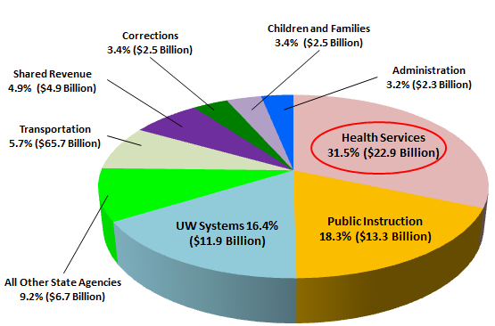
2015-17 Wisconsin Budget by State Agency ($72.7 Billion)
Protecting and promoting the health and safety of the people of Wisconsin
Notes:
Department of Health Services - 31.5% ($22.9 Billion)
Department of Public Instruction – 18.3% ($13.3 Billion)
UW System – 16.4% ($11.9 Billion)
Other State Agencies – 9.2% ($6.7 Billion)
Department of Transportation – 7.8% ($5.7 Billion)
Shared Revenue – 6.7% ($4.9 Billion)
Department of Corrections – 3.4% $2.5 Billion)
Department of Children and Families – 3.4% ($2.5 Billion)
Department of Administration – 3.2% $2.3 Billion)

Slide 5
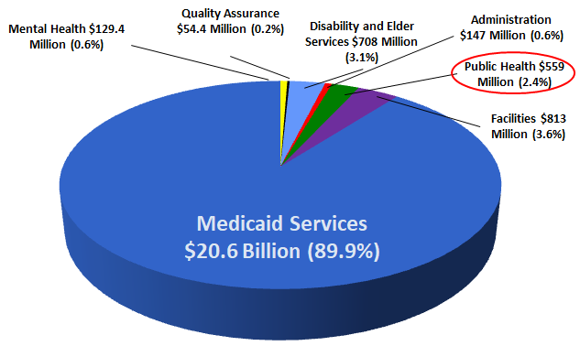
2015-17 DHS Budget by Division (Total Biennial Budget = $22.9 Billion)
Protecting and promoting the health and safety of the people of Wisconsin
Notes:
DHS
Medicaid Services 90%
Facilities 3.6%
Disability and Elder Services 3.1%
Public Health 2.4%
Administration 0.6%
Mental Health 0.6%
Quality Assurance 0.2%

Slide 6
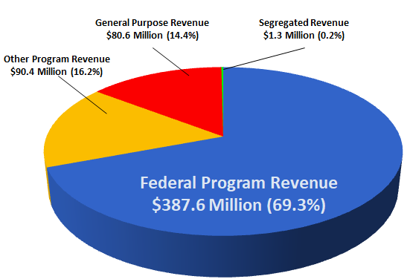
2015-17 DPH Budget by Source of Funds (Total Budget = $ 559.2 Million
Protecting and promoting the health and safety of the people of Wisconsin
Notes:
DPH
Receives funding from
Federal Government 70%
Other Programs 16%
General Purpose Revenue 14.4%
Segregated Program Revenue 0.2%

Slide 7
Program Revenue Fees Examples
Vital Records Fees
Radiation Protection
Congenital Disorders
Gifts and Granta
Protecting and promoting the health and safety of the people of Wisconsin
Notes:
Program Revenue is money that is collected by DHS for specific purposes, then is credited directly to an appropriation. Some examples of Program Revenue is licensing and certifying activities, and fees for vital records.

Slide 8
Segregated Program Revenue Examples
Funding from other State Agencies
Tribal Gaming Revenue
Protecting and promoting the health and safety of the people of Wisconsin
Notes:
Segregated Program Revenue is funding deposited into funds other than general revenue, and is used for specific purposes. For example, the Tribal Gaming Revenue that DHS receives helps to fund minority and tribal health grants. Segregated Program Revenue also includes transfers of funds from other agencies.

Slide 9
General Purpose Revenue Examples
State Operations
Earmarked for HIV/Aids
Workplace Wellness Grants
Lead Exposure and Poisoning Aids
Dispensaries and Drugs
Tobacco Use Control
Well Woman
Protecting and promoting the health and safety of the people of Wisconsin
Notes:
Fees collected
Put into the state general
Appropriated by the Legislature
Lead
Tobacco
Well Woman

Slide 10
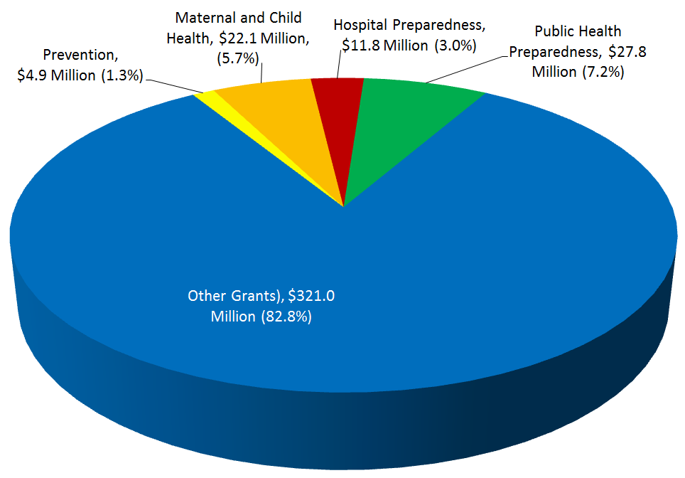
2015-17 DPH Federal Funding by Type of Grant ($387.6 Million)
Protecting and promoting the health and safety of the people of Wisconsin
Notes:
Other 83%
Immunization
Chronic Disease
Radon Information Centers
Woman, infants, and Children (WIC)
Title X Funding Reproductive Health
Public Health Preparedness 7.2%
Maternal and Child Health 5.7%
Hospital Preparedness 3.0%
Preventative Health and Health Services 1.3%

Slide 11
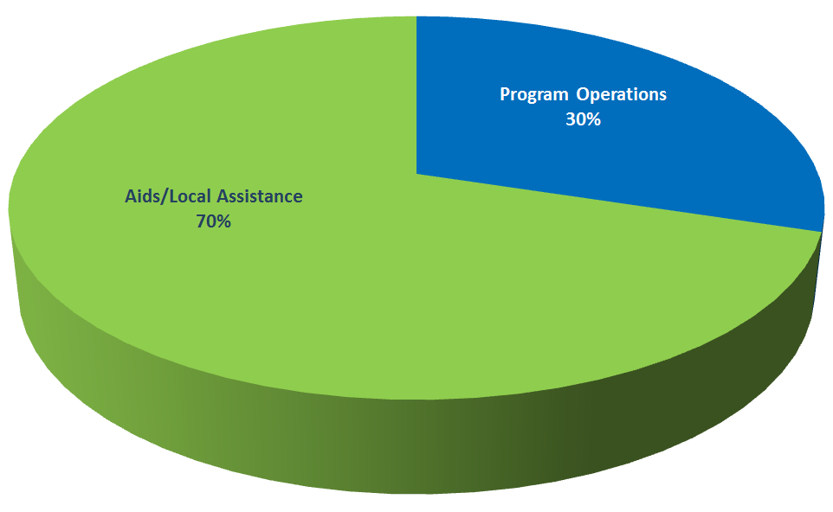
2015-17 DPH Budget by Program Operations & Aids/Local Assistance – Act 55 (Total Budget = $559.2 Million)
Protecting and promoting the health and safety of the people of Wisconsin

Slide 12
Community Aids Reporting System (CARS)
CARS is the system for processing contracts and reimbursing expenses for local agencies
The system records all expenditures from the county and non-county providers
Protecting and promoting the health and safety of the people of Wisconsin
Notes:
It calculates amounts due and adjustments back to the State. It also generates reports for providers, counties, and tribes under contract with the State.

Slide 13
How CARS Payments Work
The Payment Process Starts with Signed Contracts
DHS program units prepare and negotiate contracts
Program staff send signed contracts for entry into the CARS system
Protecting and promoting the health and safety of the people of Wisconsin
Notes:
DHS program units prepare and negotiate contracts with providers or local governments for services. Program staff send signed contracts to the CARS Unit for entry into the CARS system at least one month before the first payment to a provider.

Slide 14
Contract Information is Entered into the CARS System
Annually there are over 500 providers
With contracts totaling almost $1.2 Billion
Protecting and promoting the health and safety of the people of Wisconsin
Notes:
Annually there are over 500 providers with contracts totaling almost $1.2 Billion (500+ providers) into CARS annually. Most of these contracts are calendar year contracts.

Slide 15
Expenditure Reports Trigger Reimbursements
Providers report costs to the CARS Unit.
Reports are due one month after the end of the month for which the report is being submitted
Protecting and promoting the health and safety of the people of Wisconsin
Notes:
Providers must report costs incurred on signed expenditure reporting forms. The providers generally submit the forms to the CARS Unit. Reports are normally due one month after the end of the month for which the report is being submitted (e.g., January's report is due March 1st). The CARS Unit reviews, keys and proofs the information. Then CARS staff execute monthly payment processing computer jobs. After the payment processing jobs complete, the Bureau of Fiscal Services transmits payment data files to DOA to cut checks. DHS mails the checks to the providers.

Slide 16
Expenditure Reports Trigger Reimbursements
CARS staff execute monthly payments
The Bureau of Fiscal Services transmits payment data files to the Department of Administration (DOA) to cut checks. The Department of Health Services (DHS) mails the checks to the providers.
Protecting and promoting the health and safety of the people of Wisconsin
Notes:
Providers must report costs incurred on signed expenditure reporting forms. The providers generally submit the forms to the CARS Unit. Reports are normally due one month after the end of the month for which the report is being submitted (e.g., January's report is due March 1st). The CARS Unit reviews, keys and proofs the information. Then CARS staff execute monthly payment processing computer jobs. After the payment processing jobs complete, the Bureau of Fiscal Services transmits payment data files to DOA to cut checks. DHS mails the checks to the providers.

Slide 17
For More Information on CARS
https://www.dhs.wisconsin.gov/cars/cars-payments.htm
https://www.dhs.wisconsin.gov/cars/index.htm
Protecting and promoting the health and safety of the people of Wisconsin
Notes:
DHS program units prepare and negotiate contracts with providers or local governments for services. Program staff send signed contracts to the CARS Unit for entry into the CARS system at least one month before the first payment to a provider.

Slide 18
Questions
Protecting and promoting the health and safety of the people of Wisconsin

