Slide 1
Public Health 101 Series
Public Health 101:
History and Structure
Angela Nimsgern, MPH, CPH
WI DPH, Office of Policy and Practice Alignment, Northern Region
Note: This slide set is in the public domain and may be customized as needed by the user for informational or educational purposes. Permission from the Centers for Disease Control and Prevention is not required, but citation of the source is appreciated.
Notes:
<WELCOME learners to Introduction to Public Health and provide your background.>
Go to next slide.

Slide 2
Topics
Introduction to Public Health
1. Public Health Definition
2. History of Public Health
3. A Public Health Approach
4. Stakeholder Roles in Public Health
2
Notes:
SAY:
Today we will discuss several interrelated topics that, taken together, provide an introduction to public health.
<READ each topic on the slide.>
Go to next slide.

Slide 3
Learning Objectives
Define and describe the purpose of public health
Identify prominent events in the history of public health
Describe stakeholders in the field of public health
Describe the structure of public health
3
Notes:
SAY:
After this session, you will be able to
<READ each objective on the slide.>
GO to next slide.

Slide 4
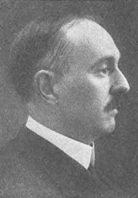
Public Health Defined
“The science and art of preventing disease, prolonging life, and promoting health through the organized efforts and informed choices of society, organizations, public and private communities, and individuals.”
—CEA Winslow
Photo: IF Fisher and EL Fisk
Winslow CEA. The untilled field of public health. Mod Med 1920;2:183–91.
4
Notes:
SAY:
Charles-Edward Armory Winslow a bacteriologist was a leading figure in the development of the modern study of public health. His definition of public health, developed almost a century ago, is as follows:
“Public health is the science and art of preventing disease, prolonging life and promoting health through the organized efforts and informed choices of society, organizations, public and private communities, and individuals.”
Note the influences at the broader, societal, and community levels as well as the individual levels. You will see examples of public health at each of these levels throughout this course.
GO to next slide.

Slide 5
The Mission of Public Health
“Fulfilling society’s interest in assuring conditions in which people can be healthy.”
—Institute of Medicine
“Public health aims to provide maximum benefit for the largest number of people.”
—World Health Organization
5
Notes:
SAY:
The Institute of Medicine states that the mission of public health is fulfilling society’s interest in assuring conditions in which people can be healthy.
Similarly, the World Health Organization stresses that public health aims to provide maximum benefit for the largest number of people.
Public health focuses on groups of people, rather than just an individual. At the core of public health lies the principle of social justice, providing people the right to be healthy and to live in conditions that will support their health.
GO to next slide.

Slide 6
The History of Public Health
6
Notes:
Topic 2
The History of Public Health
SAY:
Now, let’s review the history of public health. We will take a look at a few historical highlights through four lenses,
sanitation and environmental health,
pandemics,
disaster response and preparedness, and
prevention and policy.
GO to next slide.

Slide 7
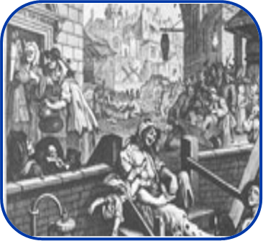
Sanitation and Environmental Health
500 BCE
1840s
1970
Greeks and Romans practice community sanitation measures
The Public Health Act of 1848 was established in the
United Kingdom
The Environmental Protection Agency was founded
7
Notes:
The first lens we look through encompasses the control of disease and promotion of health through sanitation to ensure a healthy environment. Here are three examples of how public health has worked to contain infectious disease through environmental measures.
Around 500 BCE, the ancient Greeks and Romans actively practiced community sanitation measures. (Built aqueducts to bring fresh water from the hills, pipelines to take sewage directly to the river.)
Approximately 2 millennia later, the Public Health Act of 1848 was established. It provided a central board of health and placed responsibilities for sanitation in the hands of boroughs.
Addressed all major PH issues, PH became the responsibility of local people and the ACTs approach remains revelent today.
In 1970, the Nixon Administration established the Environmental Protection Agency, which protects human health by safeguarding air, water, and land.

Slide 8
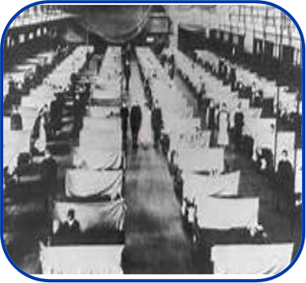
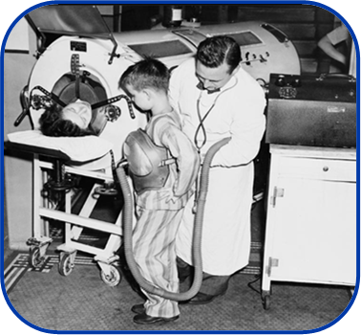
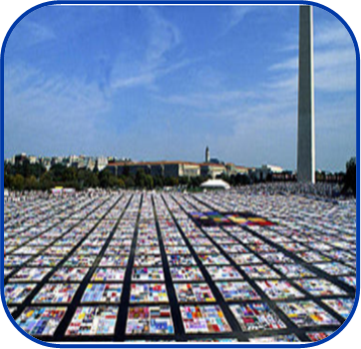
Pandemics
Influenza
Polio
HIV
500 million infected worldwide in 1918
Vaccine introduced in 1955; eradication initiative launched in 1988
34 million living with HIV worldwide; 20% decline in new infections since 2001
8
Notes:
SAY:
Next, we will explore pandemics. Pandemics are epidemics or outbreaks of disease that spread far and wide, affecting the populations of multiple continents.
Influenza, or the flu, has caused pandemics many times during both the distant past and recent history. Almost a century ago, the Spanish flu infected 500 million people across the world, including remote Pacific islands and the Arctic, killing 20 to 50 million persons. More recently, the “swine or H1N1” influenza pandemic in 2009 infected persons in 214 countries, causing almost 19,000 confirmed deaths and we continue to have cases of it each year since. Preparing for and controlling the effects of influenza will likely remain top priorities for public health.
Historically, polio was a common and highly feared disease that caused severe illness, including paralysis, and death among thousands of people each year. Thousands of people lined up to receive the polio vaccine after it was introduced in 1955. An initiative to eradicate polio was launched in 1988 because of outbreaks in more than 125 countries. Today, polio exists in only a few countries.
During the 1980s, human immunodeficiency virus, or HIV, emerged and spread rapidly across the globe. Public health has responded to this pandemic by developing new ways to diagnose and treat those who are infected. New infections of HIV are down 20% over the past 10 years, which is a sign that public health interventions are successful.
GO to next slide.

Slide 9
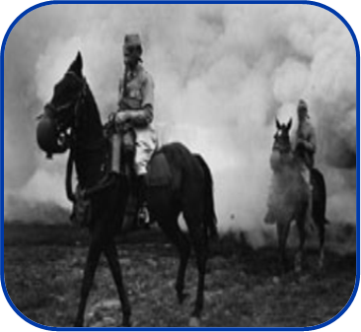
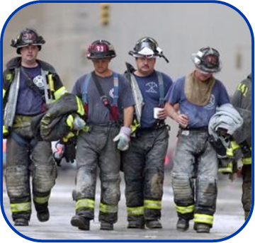
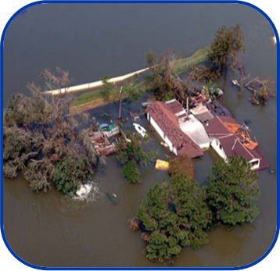
Preparedness for Disaster Response
Biologic Warfare
September 2001
Hurricane Katrina
Plague used as a weapon of war during the Siege of Kaffa
Public health surveillance conducted after the 9/11 attacks
Emergency services, public health surveillance, and disease treatment provided
9
Notes:
SAY:
The third area we’ll explore is public health’s role in preparedness and disaster response, both for natural disasters and human-made threats.
The use of biological warfare to infect people and animals goes back centuries. During the Siege of Kaffa in the 14th century AD, the attacking Tartar forces used plague as a weapon of war by hurling plague-infected corpses into the enemy’s city. Their actions started the first stage of the Black Death (or plague) among Europeans.
In the immediate wake of the terrorist attacks on September 11, 2001, public health workers were on the ground at the World Trade Center and the Pentagon, conducting surveillance to identify outbreaks of diseases or other possible health conditions resulting from the attacks. Public health workers closely monitored the health of first responders, city residents, and environmental conditions to detect health threats during the cleanup after the attack.
After Hurricane Katrina in 2005, public health workers and other disaster-relief agencies tirelessly provided emergency services. Teams were dispatched to conduct surveillance for illness and injury among people who evacuated to shelters and other places of refuge after the storm.
GO to next slide.

Slide 10
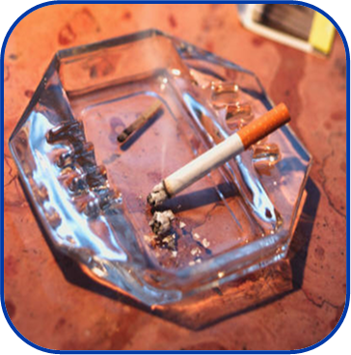
Prevention Through Policy
Book of Leviticus
Tobacco Laws
Obesity
The world’s first written health code
Laws banning smoking in public places
Food labeling and promotion of physical activity
10
Notes:
SAY:
The last lens we look through as we view public health history is prevention and policy. Public health works to protect and improve health, not just by responding to disease outbreaks or preparing for natural or human-made disasters, but also by implementing policies that support these efforts on a societal level.
As far back as 1500 BCE, Leviticus, the third book of the Hebrew Bible, is believed to be the first written health code in the world. The book deals with personal and community responsibilities and includes guidance regarding bodily cleanliness, sexual health behaviors, protection against contagious diseases, and isolation of lepers.
During 2000 to 2004, cigarette smoking was reported to be responsible for $193 billion dollars in annual health-related economic losses in the United States. Laws banning smoking in the workplace and other public places have been developed to encourage smokers to quit while protecting nonsmokers from the effects of second-hand smoke.
Finally, more than one-third of US adults and approximately 17% of children and adolescents aged 2 to 19 years are obese. Efforts to highlight fat, sugar, and salt content in foods through labeling regulations have been developed along with the promotion of physical activity in schools, workplaces, and neighborhoods. In New York City, the mayor and city council attempted to ban sodas larger than 16 ounces in an effort to combat the obesity epidemic.
GO to next slide.

Slide 11
A Public Health Approach
11
Notes:
Topic 3
A Public Health Approach
GO to next slide.

Slide 12
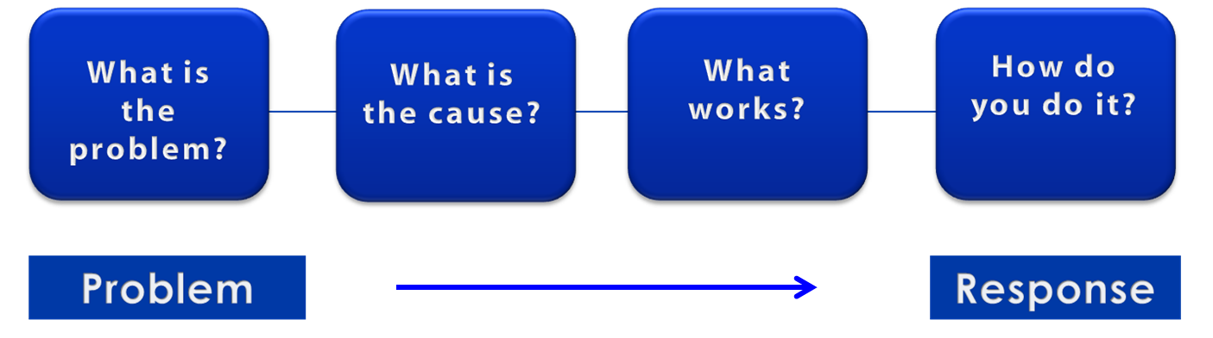
A Public Health Approach
Risk Factor Identification
Intervention
Evaluation
Surveillance
Implementation
12
Notes:
SAY:
Let’s talk about public health in a broader context. Public health problems are diverse and can include infectious diseases, chronic diseases, emergencies, injuries, environmental health problems, as well as other health threats.
Regardless of the topic, we take the same approach to a public health problem by following four general steps.
<CLICK for first arrow to appear.>
First, we ask “What is the problem?”
In public health, we identify the problem by using surveillance systems to monitor health events and behaviors occurring among a population.
After we’ve identified the problem, the next question is, “What is the cause of the problem?”
<CLICK to advance animation; first arrow will disappear, and second arrow will appear above Risk Factor Identification box.>
For example, are there factors that might make certain populations more susceptible to disease, such as something in the environment or certain behaviors that people are practicing?
<CLICK to advance animation; second arrow will disappear, and third arrow will appear above Intervention Evaluation box.>
Once we’ve identified the risk factors related to the problem, we ask, “What intervention works to address the problem?”
We look at what has worked in the past in addressing this same problem and if a proposed intervention makes sense with our affected population.
<CLICK to advance animation; third arrow will disappear, and fourth arrow will appear above Implementation box.>
In the last step, we ask, “How can we implement the intervention? Given the resources we have and what we know about the affected population, will this work?”
As we go through this course, you will see different examples of this public health approach at work.
GO to next slide.

Slide 13
A system of partnerships that includes, but is not limited to . . .
Media
Churches
Schools
Businesses
Philanthropy
Federal DHHS
State Health Departments
Local Health Departments
Tribal Health
Healthcare
Providers
Justice and Law
Enforcement
Environmental
Health
Community
Coalitions
Mental
Health
Transportation
Community
Services
Notes:
We can “chunk” the partners into these general categories.

Slide 14
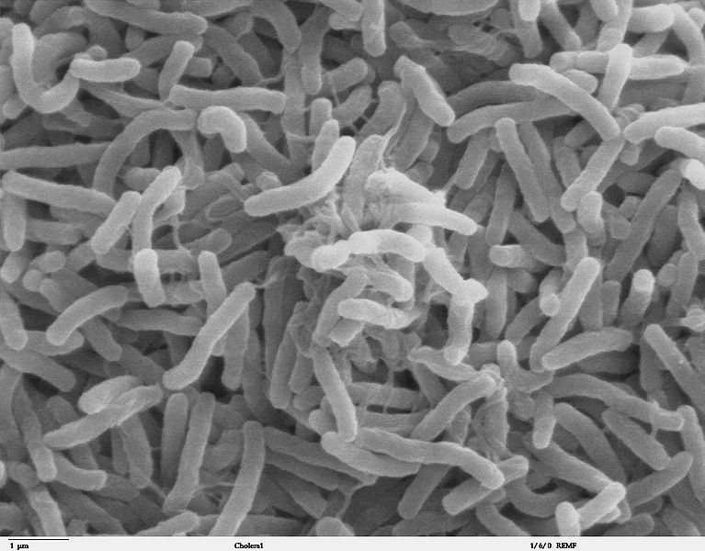
Cholera — A Public Health Approach
Cholera, a fatal intestinal disease, was rampant during the early 1800s in London, causing death to tens of thousands of people in the area. Cholera was commonly thought to be caused by bad air from rotting organic matter.
Photo: TJ Kirn, MJ Lafferty, CMP Sandoe, and R Taylor, Dartmouth Medical School
Notes:
SAY:
Let’s look at how the public health approach can be applied to an historical example of an infectious disease.
During the early 1800s in London, cholera, a fatal intestinal disease, was rampant, causing death to tens of thousands of people within hours of the first symptoms. At the time — which was before bacteria and viruses were recognized as the cause for many diseases — popular opinion held that cholera was caused by bad air coming from rotting organic matter.
GO to next slide.

Slide 15
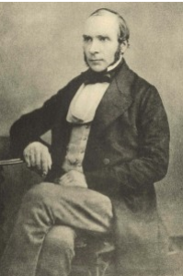
John Snow, Physician
John Snow is best known for his work tracing the source of the cholera outbreak and is considered the father of modern epidemiology.
Photo: London School of Hygiene and Tropical Medicine
Notes:
SAY:
John Snow, a British physician during that time, had a different opinion of cholera. He believed that the illness was spreading by way of a contaminated water supply because sewage was routinely dumped into the Thames River and cesspools near town wells. Because of his work tracing the source of the cholera outbreak, he is often considered the father of modern epidemiology. His research changed the way we look at disease.
GO to next slide.

Slide 16
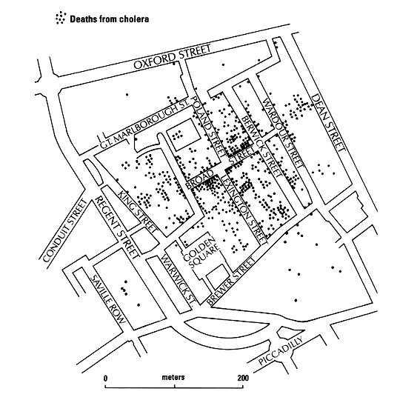
Epidemiology — What is the Problem?
Cluster of Cholera Cases, London — 1854
Image: The Geographical Journal
16
Notes:
SAY:
Now, let’s apply the public health approach to Snow’s research of the cholera outbreak.
What is the problem? Snow conducted public health surveillance by looking at where those with cholera lived in London. He saw that larger clusters of the cases were occurring in specific areas.
<CLICK for red circle to appear.>
SAY:
The red circle depicts the neighborhood in question, and the black dots represent the deaths from cholera. Notice the higher density of deaths around Broad Street.
Snow was assisted by a local clergyman, Reverend Henry Whitehead, in tracking down and interviewing cholera victims and their families and geographically mapping the outbreak. Their efforts highlight the benefits of linking scientific inquiry with engagement of community stakeholders and shared ownership for health.
GO to next slide.

Slide 17
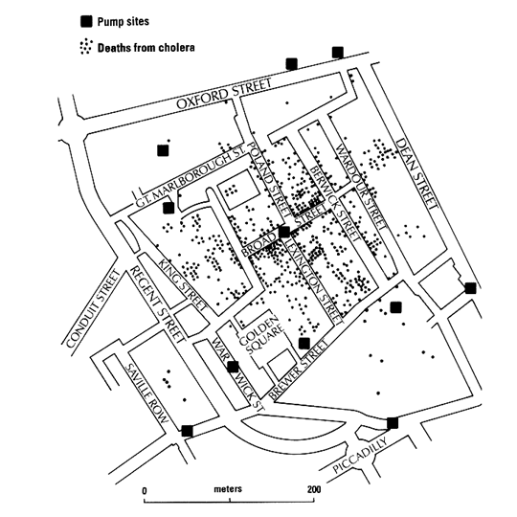
Risk Factor Identification — What Is the Cause?
Cluster of Cholera Cases and Pump Site Locations
Image: The Geographical Journal
Notes:
SAY:
Next he examined the data and tried to identify risk factors; that is, he tried to determine the cause of the deaths by using the pattern of where cases were occurring. This slide illustrates the location of the water pumps, which are indicated as black boxes.
On the basis of his previous work, Snow believed that water was a potential cholera source.
<CLICK for red boxes to appear.>
SAY:
The map reveals that the largest number of cholera cases occurred in areas near neighborhood water pumps. This observation prompted Snow to further research the distribution of water pumps in London. He identified where people who had cholera were drawing their water.
His findings indicated that clusters of cholera cases were more commonly located around certain pumps, particularly the Broad Street pump.
Through his research, Snow concluded that drawing water from the Broad Street pump was a primary risk factor for becoming ill with cholera.
GO to next slide.

Slide 18
Intervention Evaluation — What Works?
Through continuous research, Snow understood what interventions were required to
stop exposure to the contaminated water supply on a larger scale, and
stop exposure to the entire supply of contaminated water in the area
Notes:
SAY:
After identifying likely risk factors, the next step in the public health approach is evaluating potential interventions. What interventions will work? With the water supply from the Broad Street pump identified as the risk factor, Snow then worked to identify interventions to address the problem.
Through continuous research, Snow understood that the interventions required to control the cholera outbreak needed to
stop exposure to the contaminated water supply, and on a larger scale,
stop exposure to the entire supply of contaminated water in the area.
GO to next slide.

Slide 19
Implementation — How Do You Do It?
John Snow’s research convinced the British government that the source of cholera was water contaminated with sewage
Photo: Justin Cormack
Notes:
SAY:
Using the final step of the public health approach, Snow implemented the intervention by removing the handle from the Broad Street pump so no one could continue to draw water from the contaminated water supply.
After a long battle with the politicians and water companies, he finally convinced the British government that water contaminated with sewage was the source of cholera and other diseases, which resulted in the implementation of policies and laws for water sanitation.
GO to next slide.

Slide 20
Structure of Public Health in the United States
Office for State, Tribal, Local and Territorial Support
Centers for Disease Control and Prevention

Slide 21
Governmental Public Health
State and Local Health Departments
Retain the primary responsibility for health under the US Constitution
State and the District of Columbia Health Departments
51**
Tribal Health Departments
Local Health Departments
2,565*
Territorial Health Departments
8**
Accredited:
31 1 191 5
* Number based on 2010 National Profile of Local Health Departments (NACCHO, 2011)
** Numbers cited from ASTHO, Profile of State Public Health, Volume Two, 2011
Notes:
5 Territorial
Puerto Rico
Guam
US Virgin Islands
American Samoa
Commonwealth of the Northern Mariana Islands
3 Freely Associated States (sovereign)
Marshall Islands
Micronesia
Palau

Slide 22
Federal Public Health Roles and Responsibilities
Notes:
Let’s start our more detailed look with the federal public health system.

Slide 23
Federal Public Health Responsibilities
Ensure all levels of government have the capabilities to provide essential public health services
Act when health threats may span more than one state, a region, or the entire nation
Act where the solutions may be beyond the jurisdiction of individual states
Act to assist the states when they lack the expertise or resources to effectively respond in a public health emergency (e.g., a disaster, bioterrorism, or an emerging disease)
Facilitate the formulation of public health goals (in collaboration with state and local governments and other relevant stakeholders)
Source: Trust for America’s Health. Public Health Leadership Initiative: An Action Plan for Healthy People in Healthy Communities in the 21st Century. Washington, DC. 2006.
Notes:
[NOTE to Presenter: Pick one or two to discuss/elaborate; all are listed for completeness]
Ensure all levels of government have the capabilities to provide essential public health services
Act when health threats may span more than one state, a region, or the entire nation
Act where the solutions may be beyond the jurisdiction of individual states
Act to assist the states when they lack the expertise or resources to effectively respond in a public health emergency (e.g., a disaster, bioterrorism, or an emerging disease)
Facilitate the formulation of public health goals (in collaboration with state and local governments and other relevant stakeholders)

Slide 24
Other Roles of Federal Public Health
Federal government plays a crucial role in
Providing leadership, through regulatory powers, in setting health
Goals
Policies
Standards
Contributing operational and financial resources
Financing research and higher education
Supporting the development of scientific and technological tools needed to improve the effectiveness of public health infrastructure at all levels

Slide 25
State Health Departments Roles and Responsibilities

Slide 26
State Roles
Screening for diseases and conditions
Treatment for diseases
Technical assistance and training
State laboratory services
Epidemiology and surveillance
Notes:
Screening for diseases and conditions - Monitor state tobacco use (e.g., newborn screening, HIV/AIDS, TB, diabetes)
Treatment for diseases – establish QuitLine, MA coverage of nicotine replacement patches, and other supports(e.g., TB, STDs, HIV/AIDS, diabetes)
Technical Assistance and Training – toolkits for media and ordinances (e.g., emergency responders, hospitals, data management, policy development, local health departments)
State Laboratory Services – monitors for air quality (e.g., bioterrorism agents test, food-borne illness testing, influenza typing, environmental toxins, newborn screening)
Epidemiology and Surveillance (e.g., data collection and epidemiology on behavioral risk factors, communicable/infectious diseases, vital statistics, chronic diseases)

Slide 27
Local Health Departments Roles and Responsibilities

Slide 28
Six Required Services of Wisconsin LHDs:
Communicable disease surveillance, prevention and control
Generalized public health nursing program
Services to promote health
Services to prevent other diseases
Abatement or removal of human health hazards
Services to prevent the future incidence of occupational disease, environmental disease and human health hazard exposure
https://www.dhs.wisconsin.gov/lh-depts/lhdlevelrequirements.doc
Notes:
New Slide to add Local Roles and Responsibilities. From Level I, II, III Local Health Departments
(https://www.dhs.wisconsin.gov/lh-depts/lhdlevelrequirements.doc)

Slide 29
State and Local Health Department Governance Classification System
Mixed—Some local health departments are led by state government, and some are led by local government. No one arrangement predominates in the state.
State/Centralized—All local health departments are units of state government, which makes most fiscal decisions.
Shared—All local health departments are governed by both state and local authorities.
Local/Decentralized—Local health departments are units led by local governments, which make most fiscal decisions.
Source: ASTHO Profile of State Public Health, Volume Two, 2011
Notes:
There are several ways that local health departments function:

Slide 30
Wisconsin Local Governance
Constitutional Home Rule
Allows municipalities to determine their local affairs and government
Statutory Home Rule
Except as otherwise provided by law, management and control of the municipality's property, finances, highways, navigable waters, and the public services
Notes:
Add to explain home rule and local governance –
From DPH OPEHC slides.
Note that in WI we have county, city/municipal, city-county, multi county and multi municipal health departments

Slide 31
Public Health in American Indian and Alaska Native Tribes

Slide 32
Tribal Public Health
Tribal Health Department—a corporation or organization operated under the jurisdiction of a federally recognized tribe, or association of federally recognized tribes, and is funded by the tribe(s) and/or contract service(s) from the Indian Health Service (IHS).
Tribal Health Organizations—include Tribal Health Departments, Indian Health Service Units, Area Indian Health Boards and Urban Indian Health Centers (a much broader group, and relates to a variety of entities that might provide health services in a tribal setting).
Notes:
Tribal health:
There are organizations defined or recognized as tribal health departments, but then there is also a broader set of organizations or entities that provide services in a tribal setting.
Tribal Health Department—a health department, corporation or organization operated under the jurisdiction of a federally recognized tribe or association of federally recognized tribes, and funded by the tribe(s) and/or contract service(s) from the Indian Health Service.
Tribal Health Organization—Tribal Health Organizations include Tribal Health Departments, Indian Health Service Units, Area Indian Health Boards and Urban Indian Health Centers. (A much broader group that relates to a variety of entities that might provide health services in a tribal setting.)

Slide 33
QUESTIONS?
Notes:
GO to next slide.

Slide 34
Resources and Additional Reading
American public health Association (APHA). The Prevention and public health Fund: a critical investment in our nation’s physical and fiscal health. APHA Center for Health Policy Issue Brief. Washington, DC: APHA; 2012. http://www.apha.org/NR/rdonlyres/8FA13774-AA47-43F2-838B-1B0757D111C6/0/APHA_PrevFundBrief_June2012.pdf.
California Department of public health. TabaccoFreeCA. http://www.Tobaccofreeca.org.
Centers for Disease Control and Prevention. Key facts about seasonal flu vaccine. http://www.cdc.gov/flu/protect/keyfacts.htm.
Centers for Disease Control and Prevention. Overweight and obesity. http://www.cdc.gov/obesity/index.html.
Centers for Disease Control and Prevention. Social determinants of health. http://www.cdc.gov/socialdeterminants/FAQ.html.
Centers for Medicare and Medicaid Services. National health expenditure projections: 2008–2018. http://www.cms.gov/Research-Statistics-Data-and-Systems/Statistics-Trends-and-Reports/NationalHealthExpendData/downloads/proj2008.pdf.
Dean H. Introduction to public health, epidemiology, and surveillance. Presented at the CDC Science Ambassador Program, July 16, 2012.
Frieden, TR. Framework for public health action: the health impact pyramid. Am J public health 2010;100:590–5.
Kindig D, Stoddart G. What is population health? Am J public health. 2003;93:380–3.
Institute of Medicine. For the public’s health: investing in a healthier future. Washington, DC: National Academies Press; 2012.
Institute of Medicine. Primary care and public health: exploring integration to improve population health. Washington, DC: The National Academies Press; 2012.
34
Notes:
SAY:
The information from this course is based on these resources; I encourage you to take a look at them after this course.
GO to next slide.

Slide 35
Resources and Additional Reading
Institute of Medicine. The future of public health. Washington, DC: The National Academies Press; 1988.
Institute of Medicine. The future of the public's health in the 21st century. Washington, DC: The National Academies Press; 2002.
Institute of Medicine. Who will keep the public healthy? Workshop summary. Washington, DC: The National Academies Press; 2003.
Pearl R. Tobacco smoking and longevity. Science 1938;87:216–7.
Preamble to the Constitution of the World Health Organization as adopted by the International Health Conference, New York, June19–July 22, 1946.
Federal Communications Commission. Texting while driving. http://www.fcc.gov/guides/texting-while-driving.
UNAIDS. UNAIDS World AIDS Day Report, 2012. http://www.unaids.org/en/media/unaids/contentassets/ documents/epidemiology/2012/gr2012/JC2434_WorldAIDSday_results_en.pdf.
Skelton A. Introduction to public health science and practice.” Presented at the CDC Steven M. Teutsch Prevention Effectiveness Fellowship Orientation, August 15, 2012.
US Department of Health, Education, and Welfare. Smoking and health. Washington, DC: public health Service; 1964. http://profiles.nlm.nih.gov/ps/access/NNBBMQ.pdf.
Winslow CEA. The untilled field of public health. Mod Med 1920;2:183–91.
World Health Organization (WHO). World report on violence and health. Geneva: WHO; 2002. http://www.who.int/violence_injury_prevention/violence/world_report/en/.
35
Notes:
GO to next slide.

Slide 36
Disclaimers
Links provided in this course to nonfederal organizations are provided solely as a service to our users. These links do not constitute an endorsement of these organizations nor their programs by the Centers for Disease Control and Prevention (CDC) or the federal government, and none should be inferred. CDC is not responsible for the content contained at these sites.
Use of trade names and commercial sources is for identification only and does not imply endorsement by the Division of Scientific Education and Professional Development, Center for Surveillance, Epidemiology, and Laboratory Services, Centers for Disease Control and Prevention, the Public Health Service, or the U.S. Department of Health and Human Services.
The findings and conclusions in this course are those of the authors and do not necessarily represent the official position of the Centers for Disease Control and Prevention.
36
Notes:
Go to next slide.

Slide 37
For more information, please contact the Centers for Disease Control and Prevention
1600 Clifton Road NE, Atlanta, GA 30333
Telephone: 1-800-CDC-INFO (232-4636)/TTY: 1-888-232-6348
Visit: http://www.cdc.gov | Contact CDC at: 1-800-CDC-INFO or http://www.cdc.gov/info
The findings and conclusions in this course are those of the authors and do not necessarily represent the official position of the Centers for Disease Control and Prevention.
Center for Surveillance, Epidemiology, and Laboratory Services
Division of Scientific Education and Professional Development

