Slide 1
Public Health 101
Principles and Practices of Population-Based Services

Slide 2
Objectives
Population Health
Public Health Core Functions
Essential Services
Levels of Prevention
Levels of Public Health Intervention

Slide 3

What Is Population Health?
An approach to health that aims to improve the health of an entire human population

Slide 4
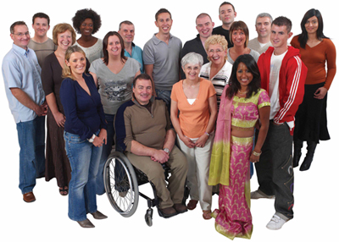
Who Is the Population?

Slide 5
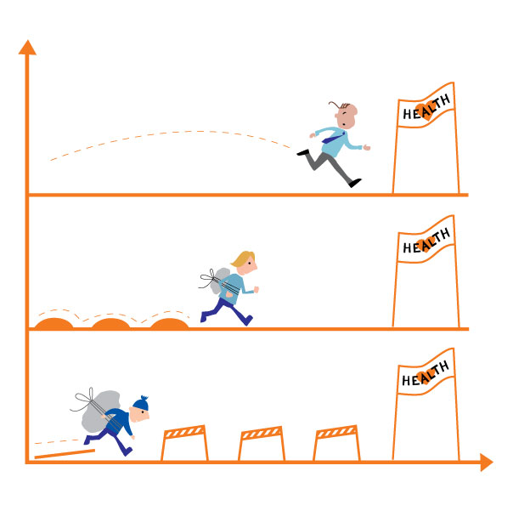
Population Health ≠ Distribution of Health

Slide 6
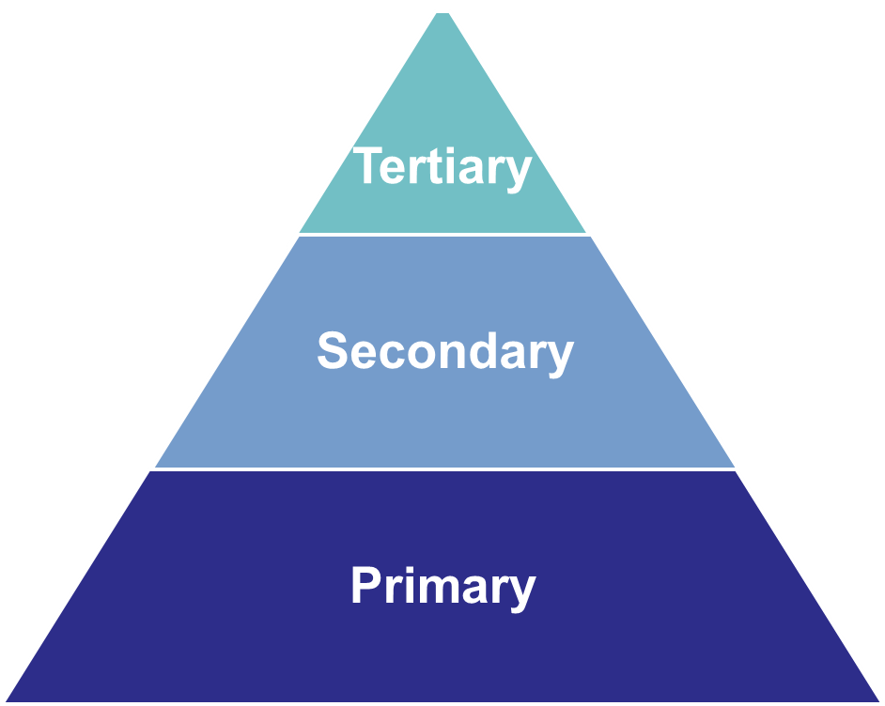
What is Prevention?

Slide 7
Primary Prevention
Designed to prevent a disease or condition from occurring in the first place
  Examples: immunization, physical activity to reduce risk of cardiovascular disease

Slide 8
Secondary Prevention
Identify a disease at its earliest stage so that prompt and appropriate management can be initiated.
  Example: A person gets a mammogram to detect breast cancer or gets screened for glaucoma.
Successful secondary prevention reduces the impact of the disease.

Slide 9
Tertiary Prevention
Reduce or minimize the consequences of a disease once it has developed.
  Example: most medical interventions
Eliminate, or at least delay, the onset of complications and disability due to the disease.

Slide 10
What Are Population-Based Interventions?
Aimed at disease prevention and health promotion
Affects an entire population or populations at risk
Targets underlying risks and environmental factors

Slide 11
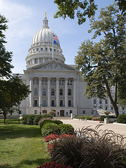





PUBLIC POLICY
National, state, local laws
COMMUNITY
Relationships among organizations
ORGANIZATIONAL
Organizations, social institutions
INTERPERSONAL
Family, friends, social networks
INDIVIDUAL
Attitudes, knowledge, skills

Slide 12



Population-Based Health
Level of intervention …
population at risk

Slide 13
Levels of Intervention
Systems
  Activities of organizations and government
Community
  Community or subgroups at risk
Individuals and families
  Individuals and families at risk

Slide 14
Level of Intervention: Systems
Requires action on a large scale to address a given problem
Creates change in organizations, policies, laws, and structures
Long-lasting way to impact individuals
Example: statewide smoke-free air law

Slide 15
Level of Intervention: Community
Focus on entire community or groups of people within the community
Forms partnerships within community organizations and groups
Changes community norms, attitudes, awareness, practices and behaviors
Example: social marketing campaign

Slide 16

Level of Intervention:
Individual and Family
Member of an at-risk population
Protect communities from threats to health posed by individuals
Changes knowledge, attitudes, skills, and behaviors
Example: promoting breastfeeding among families in the WIC Program
  Women, Infants and Children

Slide 17
Population-Based Interventions
Evidence-based
Best practices
Promising practices
Resource: What Works? Policies and Programs to Improve Wisconsin’s Health”
  http://WhatWorksForHealth.wisc.edu

Slide 18
Levels of Intervention Activity
Systems
  Activities of organizations and government
Community
  Community or subgroups at risk
Individuals and families
  Individuals and families at risk

Slide 19
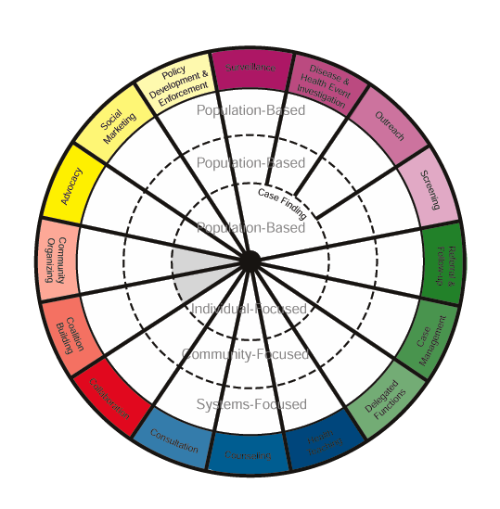
Public Health Interventions
Source: http://www.health.state.mn.us/divs/cfh/ophp/resources/docs/phinterventions_manual2001.pdf

Slide 20

What Do We Do?

Slide 21
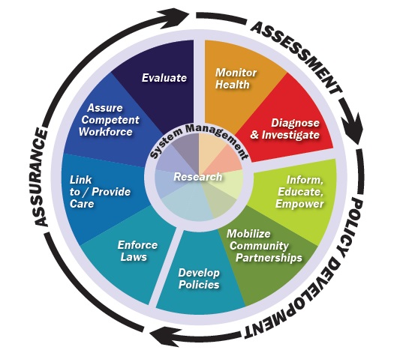
Core Functions and
10 Essential Public Health Services

Slide 22
Core Function 1: Assessment
Essential Service One: Monitor health status to identify and solve community health problems
Essential Service Two: Diagnose and investigate health problems and health hazards in the community.

Slide 23
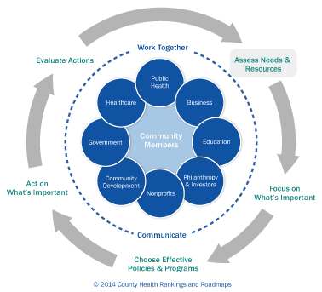
Core Function 1: Assessment

Slide 24

Healthiest Wisconsin 2020 Health Focus Areas
Nutrition and adequate, appropriate, and safe food
Alcohol and other drug abuse
Chronic disease prevention and management
Communicable disease prevention and control
Environmental and occupational health
Healthy growth and development
Injury and violence
Mental health
Oral health
Physical activity
Reproductive and sexual health
Tobacco use and exposure

Slide 25
Healthy Wisconsin Priorities
Alcohol
Nutrition and Physical Activity
Opioids
Suicide
Tobacco
Cross-cutting Issue - Adverse Childhood Experiences (ACEs) and Resilience
https://healthy.wisconsin.gov/
Notes:
With 2020 in sight, Healthy Wisconsin conducted a health assessment process that would lead to Wisconsin’s comprehensive state health improvement plan.
Led by a steering committee representing Wisconsin communities and leaders, we considered nearly two dozen health concerns before identifying five key health priorities for our state: alcohol, nutrition and physical activity, opioids, suicide and tobacco. We also recognized the need to build awareness around the effect ACEs can have on our health.
For more information on Healthy Wisconsin and to read the full state health assessment and improvement plan document, visit healthy.wisconsin.gov.

Slide 26
Core Function 2: Policy Development
Essential Service Three: Inform, educate, and empower people about health issues.
Essential Service Four: Mobilize community partnerships and action to identify and solve health problems.
Essential Service Five: Develop policies and plans that support individual and community health efforts.

Slide 27
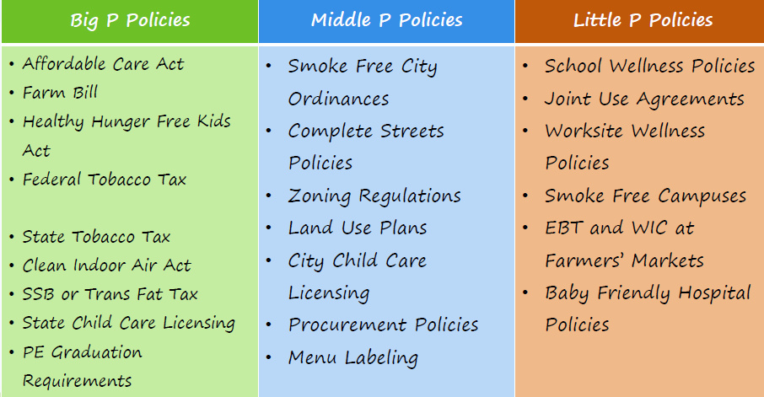
Policy Development:
Big “P” and Little “p”

Slide 28
Core Function 3: Assurance
Essential Service Six: Enforce laws and regulations that protect health and assure safety.
Essential Service Seven: Link people to needed personal health services and assure the provision of health care when otherwise unavailable.
Essential Service Eight: Assure competent public and personal health care workforce.
Essential Service Nine: Evaluate effectiveness, accessibility, and quality of personal and population-based health services.

Slide 29
Core Function 4: System Management
Essential Service Ten: Research new insights and innovative solutions to health problems.

Slide 30
National Public Health Performance Standards
Four concepts:
  Based on the 10 Essential Public Health Services.
  Focus on the overall public health system.
  Describe an optimal level of performance.
  Support a process of continuous quality improvement.

Slide 31
National Public Health Performance Standards
Focus on the “system”
More than just the public health agency
“Public health system”
  All public, private, and voluntary entities that contribute to public health in a given area.
  A network of entities with differing roles, relationships, and interactions.
  All entities contribute to the health and well-being of the community.

Slide 32
National Public Health
Performance Standards
Benefits
Improve organizational and community communication and collaboration.
Educate participants about public health and the interconnectedness of activities.
Strengthen the diverse network of partners within state and local public health systems.
Identify strengths and weaknesses to address in quality improvement efforts.
Provide a benchmark for public health practice improvements.
Notes:
With these benefits the standard are a tool to identify areas for improvement and strengthen partnership and ensuring strong systems

Slide 33
National Public Health
Performance Standards
How to use for performance improvement:
The NPHPS performance assessments can help people understand gaps between current performance and the optimal level of performance as described by the standards.
Results of the assessments should be incorporated into a broader planning process (a state health improvement process or a local board of health strategic planning process).

Slide 34
Public Health Accreditation Board (PHAB)
PHAB was formed as the non-profit entity to implement and oversee national public health department accreditation. Program development began in May 2007 with the incorporation of PHAB.

Slide 35
What Is Public Health Accreditation?
Measurement of health department performance against a set of nationally recognized, practice-focused, and evidence-based standards
Recognition of achievement of accreditation within a specific time frame by PHAB

Slide 36
What Is Required?
PHAB Standards and Measures, version 1.5
  12 domains
  32 standards and over 100 measures
  Required documentation for each measure
Specific prerequisite documents
  Community Health Assessment (CHA)
  Community Health Improvement Plan (CHIP)
  Strategic Plan
  Workforce Development Plan
  Public Health Emergency Operations Plan
  Quality Improvement Plan

Slide 37

What’s the Point?
Improve and protect health of public.
Measure performance through national system of common standards.
Drive continuous improvement.
Advance quality and performance of all health departments.
Demonstrate accountability.
Notes:
Give update on DPH accreditation

Slide 38
Local Health Department
Health Officer
Support Staff
Public Health Educator
Public Health Nurse
Registered Dietitian
Environmental Health
Other Public Health Staff

Slide 39

Welcome to Your New Role in Public Health!

Slide 40
Questions?
This presentation was supported by the Grant Number, B01 OT009070, funded by the Centers for Disease Control and Prevention (CDC). Its contents are solely the responsibility of the authors and do not necessarily represent the official views of the CDC or the Department of Health and Human Services.

