Slide 1
Public Health Emergency Preparedness Orientation
Joe Cordova
Public Health Emergency Preparedness Manager
Office of Preparedness and Emergency Health Care
October 10, 2018

Slide 2
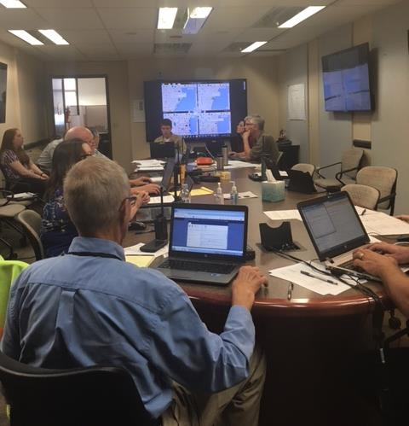
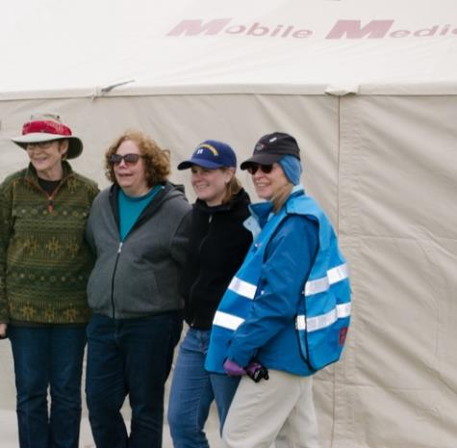
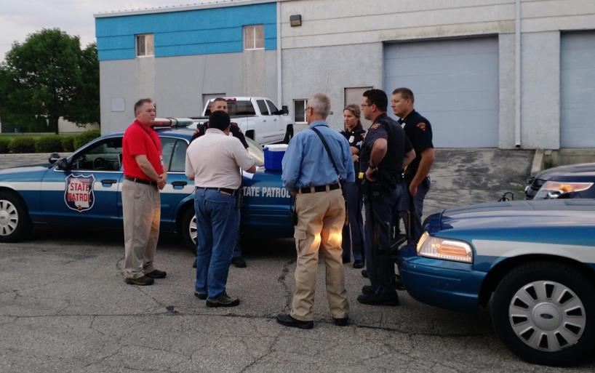
Office of Preparedness and Emergency Health Care (OPEHC)
Notes:
15 Staff
PHEP 10 FTE and 2 LTE
HPP 3 FTE

Slide 3
OPEHC and Public Health
Manage grants
Training and exercises
Provide technical assistance and planning
Maintain web-based systems
Respond
Staff Emergency Support Function 6 and 8 at the State Emergency Operations Center
Coordinate the Departments emergency response
Coordinate Division of Public Health’s On-Call teams

Slide 4
Wisconsin’s Preparedness Funding
2018 - 2019
$9,360,000
$3,560,000
Notes:
PHEP $7,100,000 to partners, remainder State staff, PH systems WEDSS, PCA, TRAIN, WebEOC

Slide 5
Technical Assistance and Planning
Preparedness Capabilities
Public Health 15
Healthcare 4
Emergency Operation Plan
Emergency Support Function 8 – Health and medical
Emergency Support Function 6 – Mass care, housing and human services
Some counties use annexes

Slide 6
Web-Based Systems
Partner Communications and Alerting – PCA Portal
Wisconsin Emergency Assistance Volunteer Registry - WEAVR
Incident management – WebEOC
Healthcare resource tracking – EMResources (WI-Trac)
Learning Management – TRAIN Wisconsin
Emergency Alerting – Rave Alert
Wisconsin Electronic Disease Surveillance System – WEDSS

Slide 7
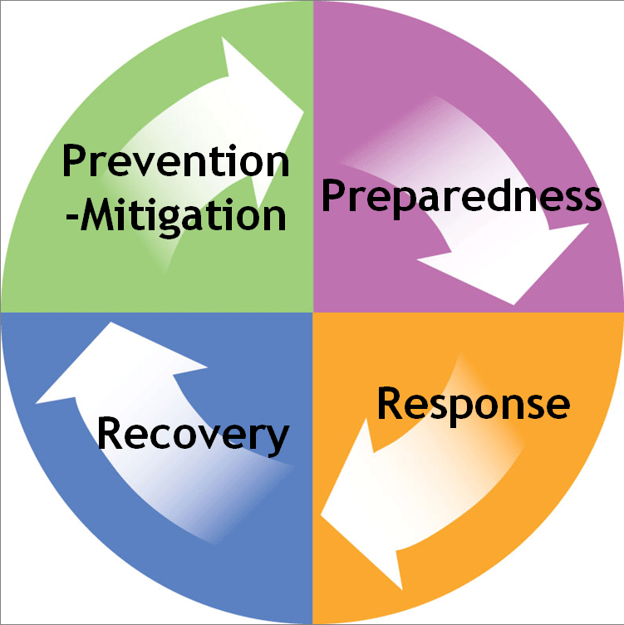
Preparedness Cycle
Prepare
Respond
Recover
Prevent/Mitigate

Slide 8
Prepare
Conduct a hazard vulnerability assessment
Develop a plan
Train staff
Incident Command System
Emergency response
Exercise plan

Slide 9
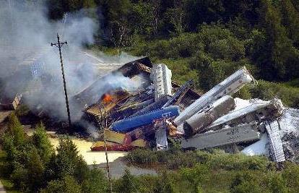
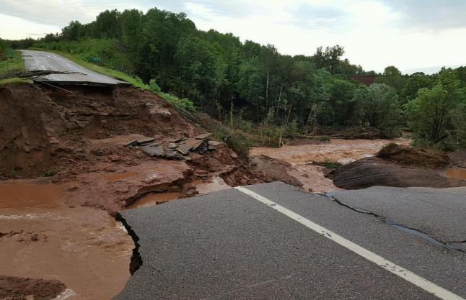
Potential Public Health Threats
Communicable disease outbreaks
Natural disasters
Radiological hazardous substance
Terrorism – Nuclear, biological and chemical

Slide 10
Hazard Vulnerability Assessment
Jurisdictional assessment of health risks and vulnerabilities
Threats drive planning and training
Top five threats in 2017
Cyber attack
Ice storm
Severe weather
Epidemic
Civic/sporting event

Slide 11
Incident Command System
Incident
Commander
Operations
Section
Planning
Section
Logistics
Section
Finance/
Administration
Section
Recommended Trainings
Online Training
ICS-100 and ICS-200
IS-700
Classroom Training
ICS-300 and ICS-400
IS-800
training.fema.gov

Slide 12
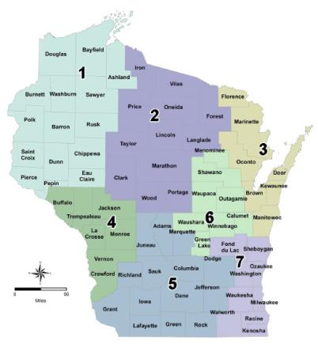
Healthcare Emergency Readiness Coalitions
Broaden scope of healthcare partnerships
Shift from planning to response and recovery
Regional medical coordination
Situational awareness of medical resources
Alerting and communication coordination
Bed availability counts and patient tracking
Surge capacity for disaster incidents

Slide 13
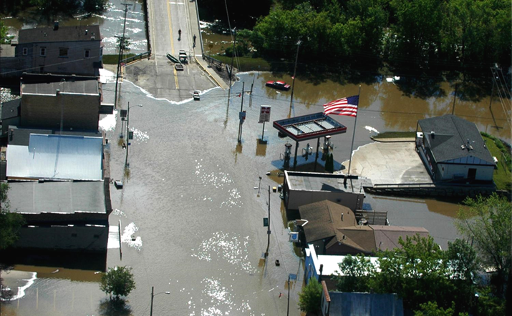
Response
Public Health Emergency Plan
Notification of staff
Develop an Incident Action Plan
Communicate
Internal
Partners
Public
Document

Slide 14
Recovery
Short term (days)
Recover staff, equipment, etc.
Establish surveillance protocols
Intermediate (weeks to months)
Continuity of care
Recovery planning
Long term (months to years)
Reestablish disrupted health care facilities
Assist with behavioral health

Slide 15
Prevention and Mitigation
Understand and meet the actual needs of the whole community
Engage and empower all parts of the community
Develop an after action report
Implement the improvement plan

Slide 16
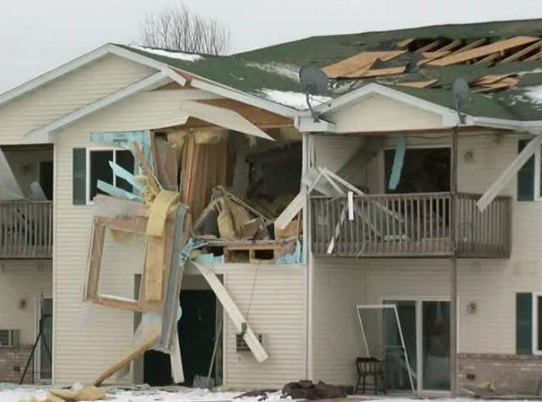
Public Health Workforce
Make a plan for yourself, family and pets
Plan to help your neighbor and community
Keep your contact information up to date
Get connected
Don’t be a victim
TMJ4

Slide 17
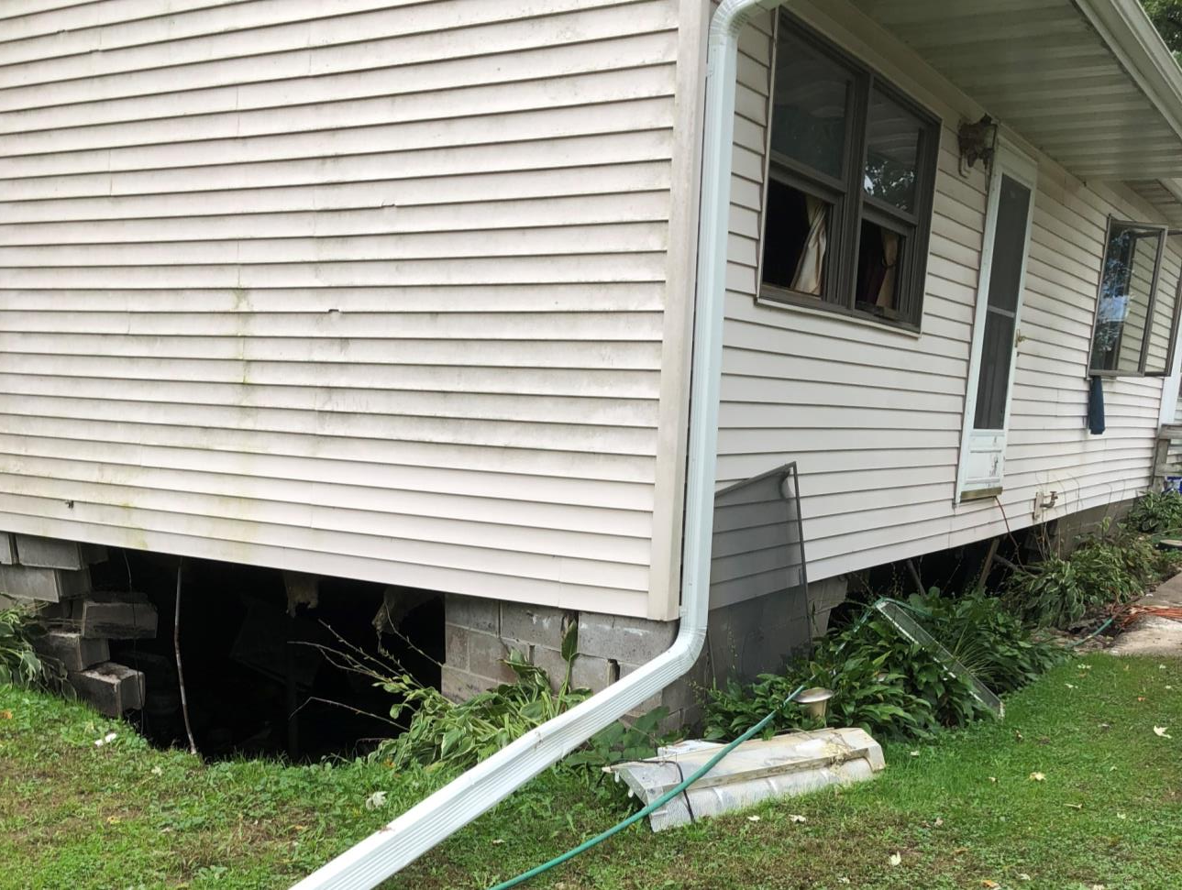

Slide 18
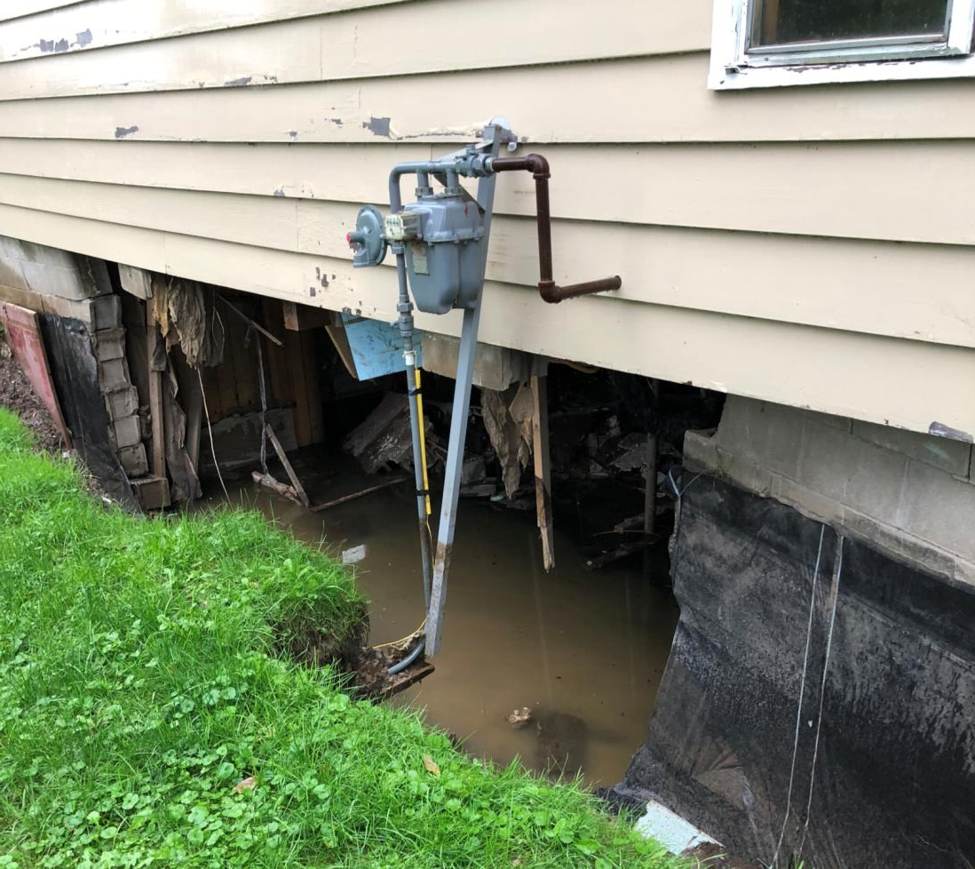

Slide 20
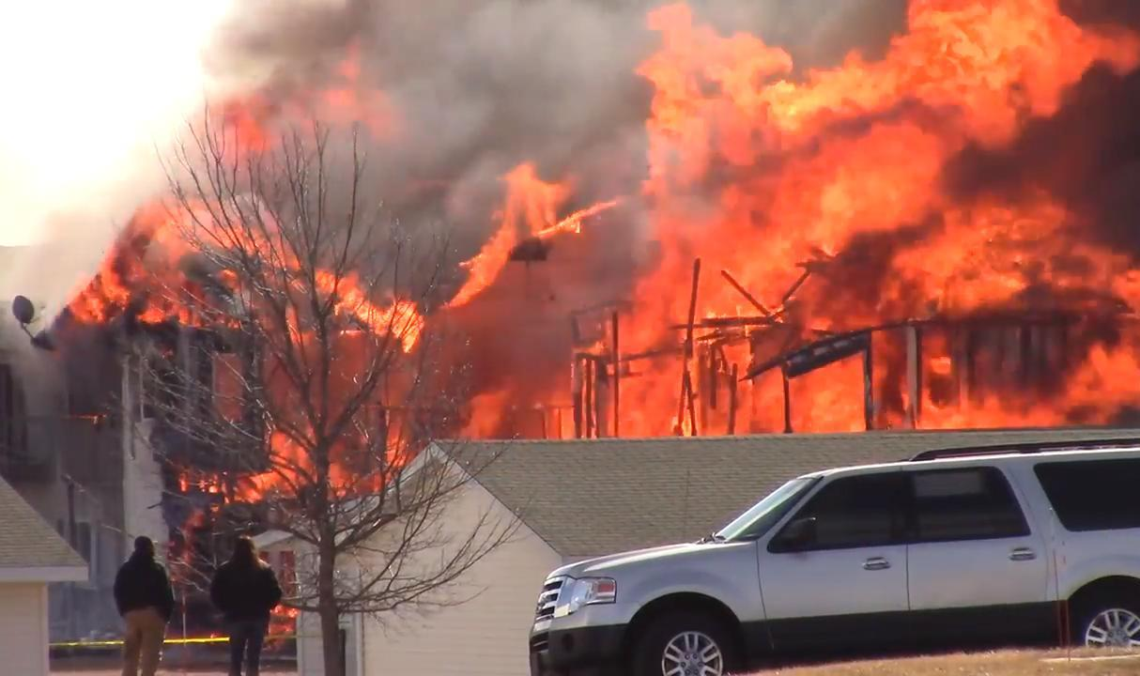

Slide 21
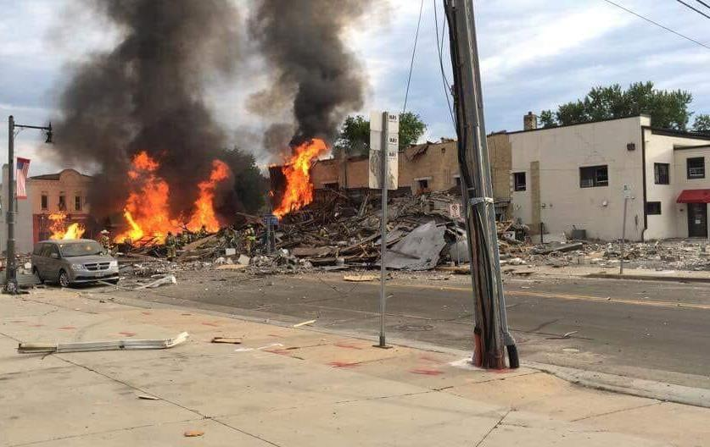

Slide 22
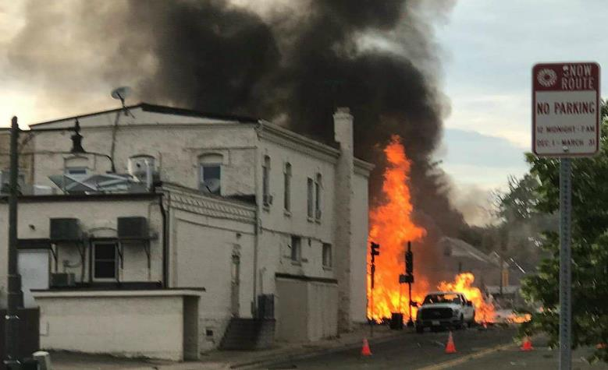

Slide 23
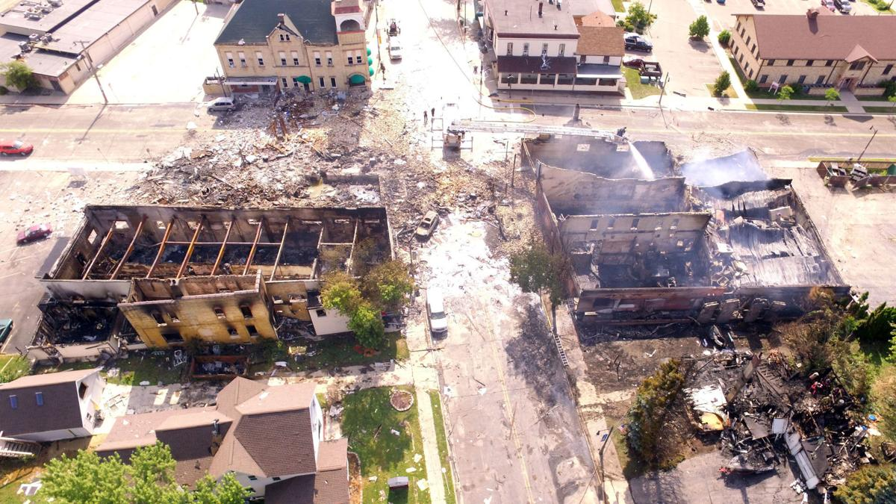

Slide 24
Partners Communications and Alerting (PCA) Portal
https://share.health.wisconsin.gov/ph/pca/default.aspx
Email: DHSPCAPortal@wisconsin.gov to request access

Slide 25
PHEP Q and A
Public Health Emergency Preparedness Question and Answer
Every other Tuesday at 10:00 a.m.
Opportunity to ask questions
Recorded and posted on the PCA Portal

Slide 26
For more information Joe Cordova
Joseph.cordova@wisconsin.gov
DHSResponse@wisconsin.gov

