Slide 1


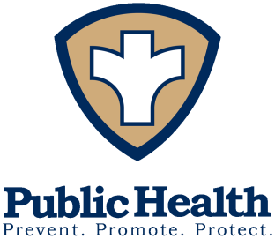
Public Health and You
Notes:
Script: I am delighted to be here with you today to talk about a subject that goes to the heart of what we all care about – keeping ourselves, our families, and our communities healthy. We all know that this country has a system of doctors and hospitals to take care of us when we get sick. What many people don’t know is that there also is a system that keeps us healthy. It works in ways that we aren’t usually aware of. It’s the public health system.

Slide 2
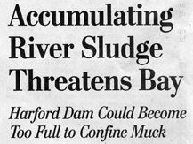


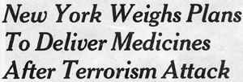
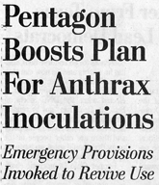
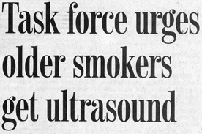

Public health is in the news everyday.
Notes:
Every day you see headlines about public health in the newspaper. But you probably don’t even recognize that the headlines reflect a public health system at work.

Slide 3



Public health protects you and keeps you and
your loved ones
safe and healthy.
Notes:
Public health protects you and keeps you and your loved ones safe and healthy. Every day. Day after day.

Slide 4
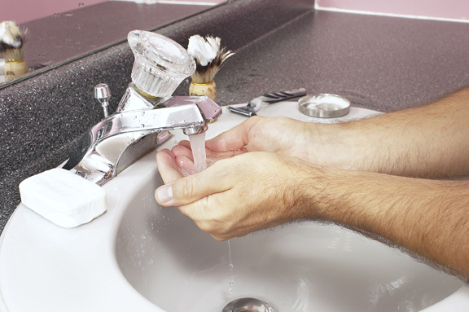
…modern sanitation was one of the greatest public health accomplishments of the late
19th and early 20th centuries.
Notes:
After you got up this morning, did you have a drink of water? Did you flush the toilet? It’s easy to laugh and take it for granted now, but modern sanitation was one of the greatest public health accomplishments of the late 19th and early? 20th centuries. Contamination of drinking water supplies by human waste is a cause of many deadly infectious diseases, including cholera, dysentery, typhoid fever. It remains a problem in undeveloped countries, and we all witnessed the great concern about disease when the December, 2004 tsunami wiped out sanitation systems in Sri Lanka and Indonesia.

Slide 5

Public health keeps entire populations healthy.
When it fails, entire populations suffer.
Notes:
The nation’s public health system continues to provide proper waste disposal and safe drinking water. These are prime examples of how public health, which takes care of entire communities, is different from personal health services, which take care of one person at a time. Public health works to keep entire populations healthy, and when it fails, entire populations suffer.

Slide 6

Fluoridation is a major public health accomplishment.
Notes:
After you first arose this morning,
did you brush and floss your teeth? Hopefully, you go to your dentist regularly and follow directions to keep your teeth and gums healthy. This is important personal health care. Public health also keeps your teeth healthy. Fluoridation of the public drinking water supply, which began in 1945, is a major public health accomplishment. It has resulted in a 40-70% reduction of tooth decay in children and a 40-60% reduction in tooth loss in adults. However, 40% of the U.S. population still live in areas without a fluoridated water supply.

Slide 7
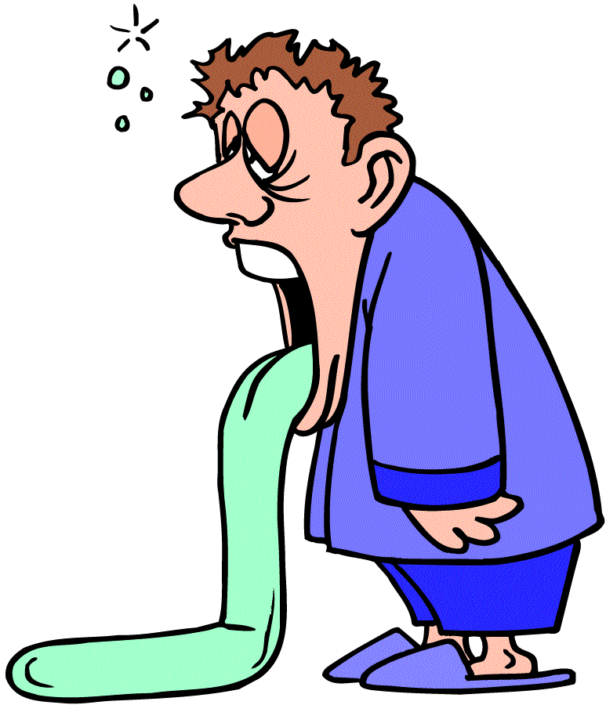
Public health keeps your food safe.
Notes:
After you dressed, did you stop for breakfast? Did you have orange juice, or perhaps scrambled eggs, or maybe a bagel with cream cheese?
The only reason you can be sure that your orange juice, eggs and cream cheese are not contaminated with bacteria that would make you sick is that public health regulates the safety of your food supply. We also teach and promote safe food handling practices that kill bacteria and help you and those who handle your food from contaminating it.

Slide 8

Public health tracks down the causes of disease outbreaks and stops them.
Notes:
Sometimes, despite everybody’s best efforts, outbreaks of disease caused by contaminated food occur. The public health system then does detective work to find the source of the contamination and to stop it. We apply the methods of epidemiology to learn what the sick people have in common and locate the source of the contamination. Then we make sure that all contaminated food is removed from the supply.

Slide 9

Folic acid supplementation is an important public health measure to prevent birth defects.
Notes:
Did you have cereal for breakfast? If you are a woman who might become pregnant, your cereal, fortified with folic acid, will help prevent some serious birth defects. Folic acid supplementation in things you eat every day, like cereal, is an important public health measure to prevent birth defects.

Slide 10
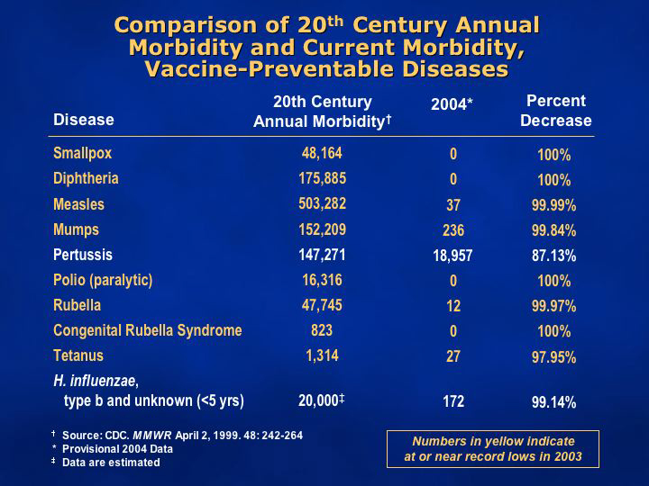
Notes:
After you had your safe, and hopefully healthy, breakfast, did you or your neighbors send children off to a day care center or school? It is the public health system that works to make sure that children are fully immunized, so that they cannot catch or transmit measles, whooping cough, diphtheria, polio, or other childhood diseases that are killers when they go to school or day care. We are all too young to remember a time early in the 20th century when tens of thousands of children died or were permanently disabled by these diseases. These days, the numbers of people who contract vaccine-preventable diseases are 95 to 100% fewer than before the vaccines were available.

Slide 11

Public health prevents childhood disease and death.
Notes:
Immunizations are a great public health success and we work vigilantly to make sure these wonderful statistics stay that way. It takes a continuous effort to make sure that all infants and school children get their shots. We monitor vaccination rates, actively seek out unimmunized children, and offer shots in our clinics. We cannot afford to stop, lest immunization rates once again decline.

Slide 12


Safety belts save more than 12,000 American lives annually.
(U.S. Department of Transportation, 2001)
Child safety seats reduce the risk of death by about 70% for infants and by about 55% for toddlers ages 1 to 4.
(Centers for Disease Control and Prevention, 2002)
Bicycle helmets reduce the risk of serious head injury by as much as 85%.
(CDC, 2002).
Notes:
Did you drive to work today? If so, did you buckle up your seatbelt? Motor vehicle safety is not just a transportation or law enforcement issue. It is also a public health issue. Public health works hard to promote the use of seatbelts, child safety seats, and motorcycle and bicycle helmets, all of which prevent deaths from injury.

Slide 13
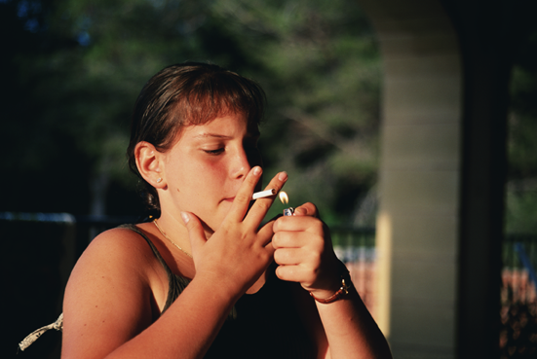
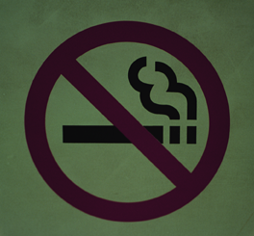
Public health reduces tobacco use.
Notes:
When you arrived at your office, it probably didn’t even cross your mind that no one is smoking. Decades of public health research and action have led to our knowledge that tobacco use kills and to many actions designed to reduce smoking, including clean indoor air regulations.

Slide 14

Public health keeps restaurant food safe.
Notes:
It’s lunch-time. Did you go out to eat? The public health system has established sanitation standards for restaurant kitchens and health departments inspect them. They close down restaurant kitchens that aren’t up to code. We can all be reasonably sure that our lunch won’t make us sick because of public health.

Slide 15

Reducing obesity and increasing physical activity are some of the greatest public health challenges for the 21st century.
Notes:
Are you planning to go to the gym after work? Good for you! Public health research has demonstrated the benefits of exercise and weight control in preventing the huge toll taken by heart disease, diabetes and stroke. The entire public health system is working to address the problems of obesity and physical inactivity. This is one of the great public health challenges for the 21st century.

Slide 16
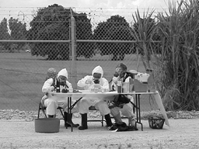
Public health works overtime to prepare for biological terrorism.
Notes:
Public health has also taken on another new role for the 21st century. You have all heard about the possibility that terrorists will use biological weapons. The public health system has been working overtime since 9/11 to prepare for such a horrific possibility. We are improving disease detection and communication, training our workers,and conducting exercises, much like the military, to test our readiness to respond.

Slide 17
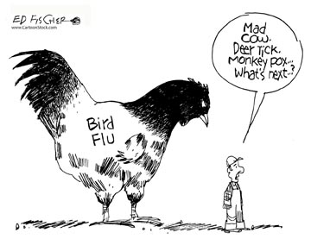
Public health
is preparing for whatever comes next.
Notes:
We all hope that an act of bioterrorism never occurs. Nonetheless, what we are spending today to prepare the public health system will not go to waste, even if biological weapons are never used against us. It does not really matter whether an outbreak of a dreadfully infectious disease is caused by the intentional release of anthrax spores, or whether it is caused by a new virus that mutated from the avian flu virus about which public health experts now worry. The public health response will be similar, and we will be ready.

Slide 18
What is the
‘public health system,’
anyhow?
Notes:
Your next question may be, “What is the ‘public health system’, anyhow?

Slide 19
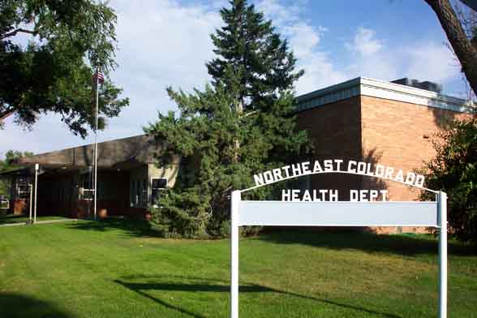
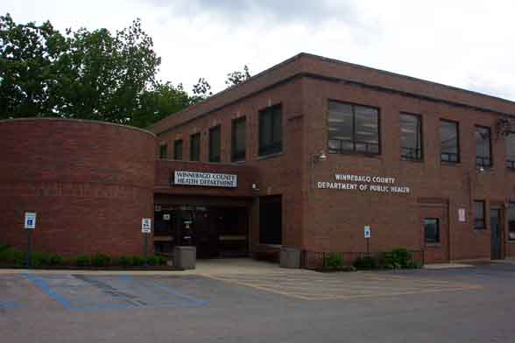
Government + Private Sector = Public Health System
Notes:
The public health system consists of government agencies and private entities. Federal agencies and state and local government agencies all work in partnership to provide leadership in preventing disease and promoting health in the entire nation, state by state and locality by locality. Governmental agencies have certain regulatory powers to protect people that no other entity has. But they can’t do it alone.

Slide 20


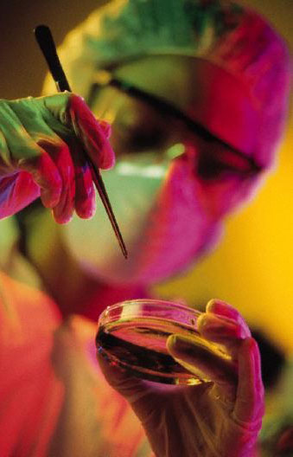

Many people and many organizations help keep communities healthy.
Notes:
In every community, hospitals, health centers, schools, doctors, nurses and dentists, clinical laboratories, businesses, and many others all have important roles in preventing disease and protecting the health of their communities.

Slide 21
Childhood Immunizations
Spend $1 = Save $27
Elderly Immunizations
Spend $1 = Save $2.21
Notes:
You’ve heard the old proverb, “An ounce of prevention is worth a pound of cure.” We know that public health measures don’t just save lives, they also save money. For instance, every single dollar spent for childhood immunizations for diphtheria, tetanus and pertussis (whooping cough) saves $27 in direct medical costs. Every dollar spent for immunizations of the elderly against influenza and pneumonia saves $2.21.

Slide 22
Public health will continue to protect you and your family, in ways you might not even notice.
Notes:
Every individual, every constituent, expects that the public health system will continue to protect him or her and his family. I have shown you the many ways that public health fulfills that mission, in ways so invisible that few people outside public health even notice.

Slide 23
Notes:
(User: insert your own concluding “take-away” remarks on this slide)

