Slide 2
Wisconsin State Laboratory of Hygiene Your Laboratory Partner in Public Health
WI Division of Public Health’s New Public Health Professionals Orientation

Slide 3
Objectives
The role of the State Lab of Hygiene’s partnership with WI DPH and LHDs
Functions of the State Lab of Hygiene
Introduction to the divisions of State Lab of Hygiene

Slide 4
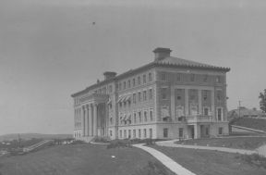
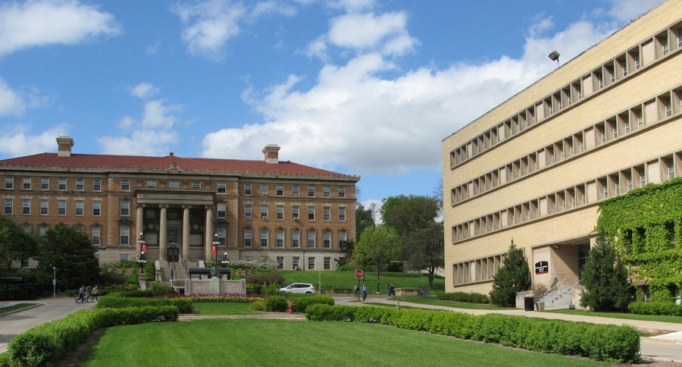
Beginnings…
1903 Laws of Wisconsin Chapter 344:
$1,500 appropriated annually to UW for establishment and maintenance of a hygienic laboratory in connection with existing bacteriological laboratories.
The WSLH’s first lab was in the basement of Agriculture Hall on the UW (now UW-Madison) campus. Photo courtesy of UW Archives
Ag Hall (left) and the WSLH Henry Mall facility (right) today.

Slide 5
WSLH in the Statutes: 36.25 (11)(a)
The laboratory of hygiene shall be attached to the University of Wisconsin-Madison … and shall provide complete laboratory services in the areas of…
water quality, air quality
public health and contagious diseases for appropriate state agencies...

Slide 6
WSLH in the Statutes:
Laboratory shall be operated to furnish a complete laboratory service to the Department of Health Services and the Department of Natural Resources …
… and make available to the (UW) System, the DHS and the DNR such facilities for teaching in the fields of public health and environmental protection as may be derived from such a laboratory.

Slide 7
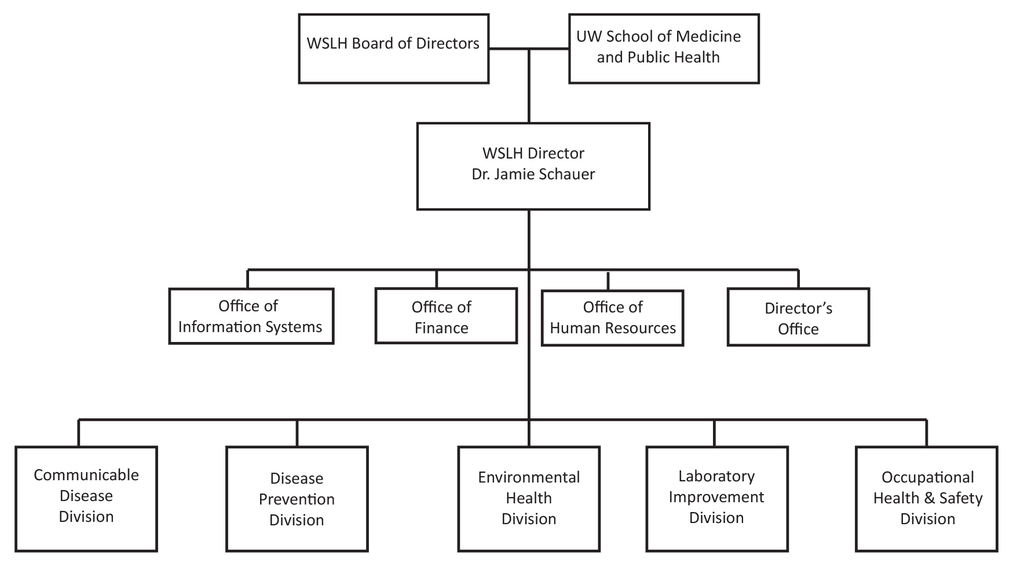
Organization

Slide 8
WSLH Staffing
The WSLH has more than 300 employees, including:
Faculty and academic staff
Laboratory scientists
Occupational health specialists
IT, business and administrative staff
Research assistants and postdoctoral fellows

Slide 9
What do we do?
Public Service:
Reference testing
Teaching
Research
Outreach
Program Services

Slide 10
State Lab Facilities

Slide 11
465 Henry Mall -- UW campus
Disease Prevention Division
Natl. Atmospheric Deposition Program (NADP) Program Office
Administration
2601 Agriculture Drive – Madison’s east side
Environmental Health Division (NADP CAL)
Occupational Health Division (WOHL)
Laboratory Improvement Division (WSLH Proficiency Testing)
Communicable Disease Division
2810 Walton Commons – Madison’s east side
IT
Occupational Health Division (BLS/OSHA Statistics, WisCon)

Slide 12
Communicable Disease Division
WSLH Clinical Customer Service:
800-862-1013
608-262-6386

Slide 13
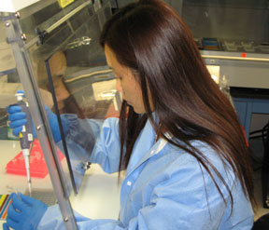
Communicable Disease Division
Provide a broad range of reference testing including:
Tuberculosis, rabies, pertussis, HIV, hepatitis, influenza, salmonella, measles, polio, sexually transmitted infections, legionella, Lyme disease, tularemia, diphtheria, anthrax, encephalitis...

Slide 14
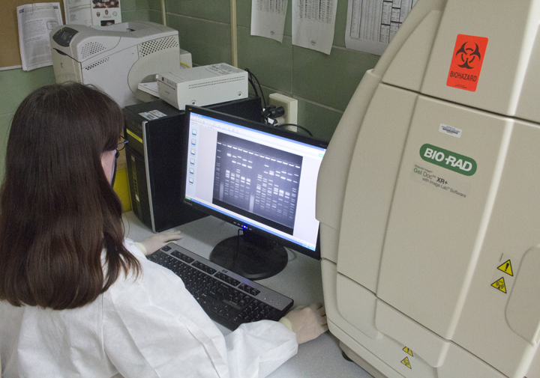
Communicable Disease Division
CDC LRN – Bioterrorism/Biological Emergency laboratory response and coordination
Outbreak Response
National Reference Centers - CDC
Lab Surveillance
Research, Education and Training- UW courses, APHL fellowships, UW-LAX rotations, WI Clinical Laboratory Network (WCLN)

Slide 15
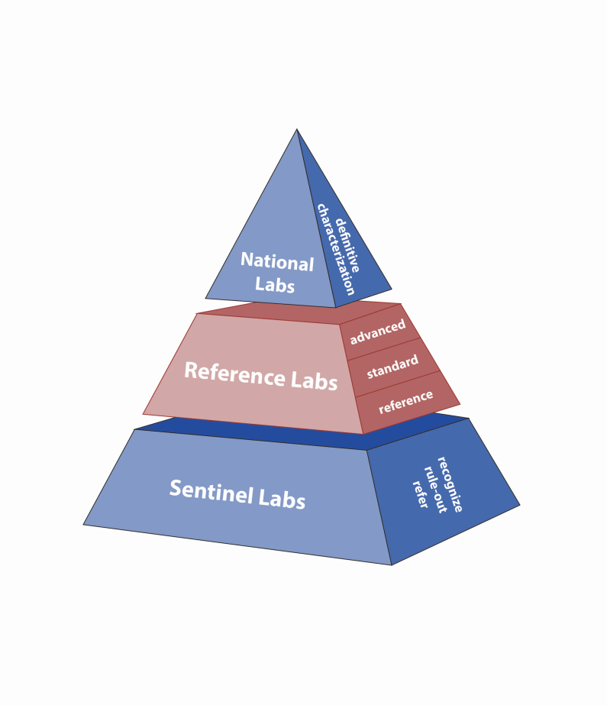
Laboratory Response Network(LRN)
A Model for Networking and Emergency Response
National Labs – CDC, USAMRIID (Army), NMRC (Navy)
Reference Labs - State & local PHLs, state agency labs
Sentinel Labs - Community clinical hospital labs
An integrated network of state & local public health, clinical, federal, military, & international laboratories to respond to bioterrorism, chemical terrorism and other public health emergencies.
MMWR Recommendations and Reports April 21, 2000 /Vol. 49 / No. RR-4

Slide 16
WCLN (WI Clinical Lab Network)
130+ clinical laboratories across WI – coordinated by WSLH
WCLN is subset of national Laboratory Response Network for bioterrorism/ emerging infectious diseases/other PH threats or emergencies.
WCLN members KEY to WSLH and DPH lab-based surveillance activities and outbreak response
Regional Meetings (PH encouraged to attend)
Training (teleconferences, workshops, exercises, etc.)
Listserv and Lab Messages
More info. on WCLN Web site --http://www.slh.wisc.edu/wcln-surveillance/

Slide 17
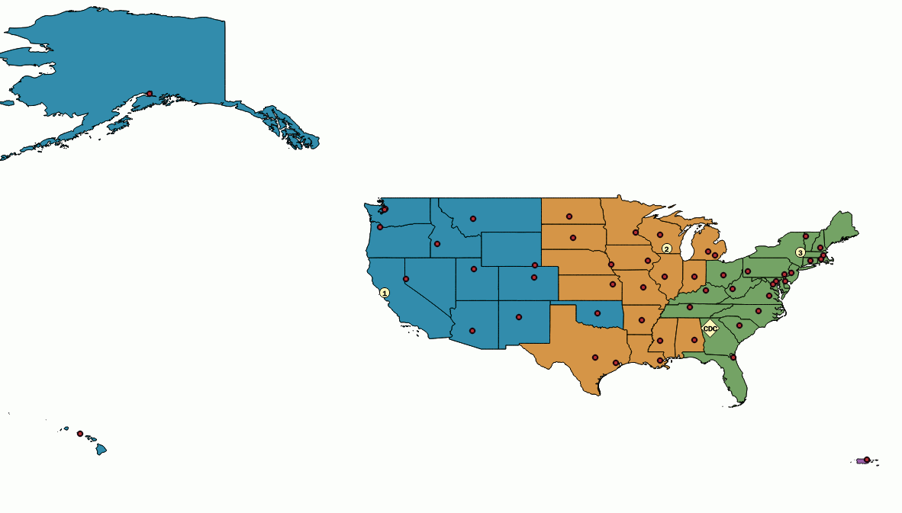
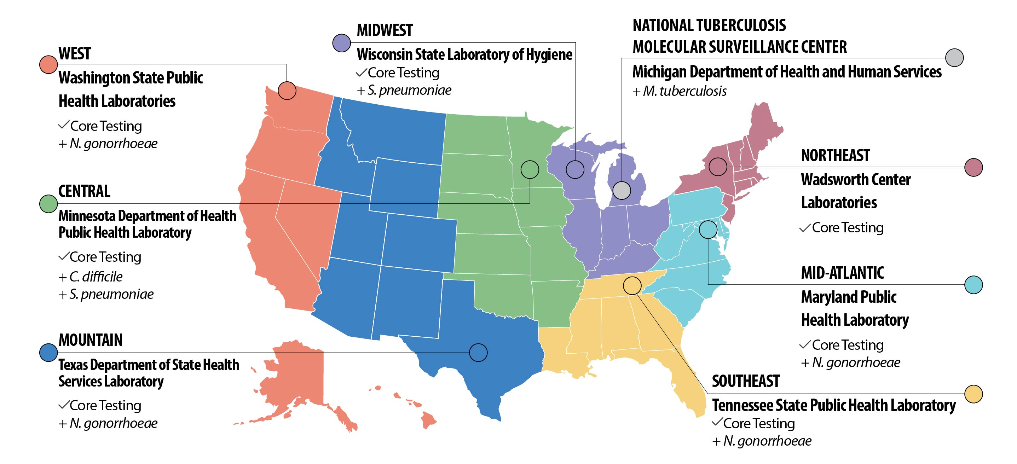
National Reference Centers A novel shared services model
To expand CDC capacity and provide diagnostic and reference testing capability and capacity to state and local PHLs nationwide and support laboratory-based surveillance and outbreak response.
NIRCs
The ARLN
Influenza virologic surveillance
Vaccine Preventable Diseases
Viral and bacterial
Provide PT program
CaliciNET
Norovirus surveillance
Antibiotic resistance surveillance and response

Slide 18
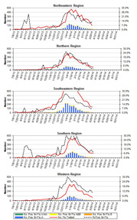
Lab-Based Disease Surveillance
Reports on WSLH web site
(http://www.slh.wisc.edu/wcln-surveillance/)
Bacteriology
Virology (influenza, RSV, other respiratory, rotavirus)
Mycobacteriology (TB)

Slide 19
Electronic/Web-based Lab Reporting
Laboratory reporting is a critical component of disease surveillance and outbreak response. Electronic reporting does NOT replace phone notifications if required.
Submitter Laboratory
WSLH
WEDSS (WI Electronic Disease Surveillance System)
Assign LOINC and SNOMED Codes (if necessary)
WLR: Secure login and password to enter laboratory results into template on WSLH web site. (Report <25 reportable diseases/month)
ELR: Extract reportable results from LIMS, create HL7 and transmit to WSLH. (Report >25 reportable diseases/month)
Case Management System
Transform, if necessary
Create HL7 Message
Securely Transmit through PHINMS

Slide 20
Disease Prevention Division
WSLH Clinical Customer Service:
800-862-1013
608-262-6386

Slide 21
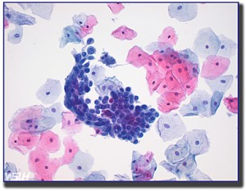
Disease Prevention Division
Cytology
Pap Test and HPV testing
Cytotechnology Certificate Program (affiliated with UW-Madison Genetics Department)
HCET collaborations

Slide 22
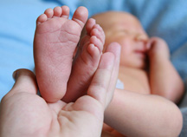
Disease Prevention Division
Newborn Screening
Testing ~65,000 Wisconsin newborns per year
Detection of 44 metabolic conditions that can lead to permanent disabilities and/or death if untreated
About 135 babies a year found to have one of the 44 disorders
Hearing and heart screening performed at hospital and reported on NBS submission cards
WI Newborn Screening Program administered by WI DHS and WSLH

Slide 23
Disease Prevention Division
Genetics
Cytogenetics and Molecular Genetics
Chromosomal analysis for genetic defects
Oncology, Prenatal, Postnatal
UW Teaching – medical genetics
ABMGG fellowships
UW Collaborative Genomics Core (UWCGC)
Biochemical Genetics
Diagnosis and monitoring of inborn errors of metabolism
ABMGG fellowship
Works closely with Newborn Screening Program and EHD Organic Chemistry

Slide 24
Environmental Health Division
Environmental Sciences and Toxicology Customer Service
800-442-4618
608-224-6202

Slide 25
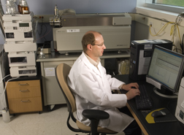
Environmental Health Division
Chemical Emergency Response
One of 10 CDC-designated Level 1 chemical emergency response labs in U.S.
Serve as a surge capacity lab for CDC
HazMat team coordination – equipment and testing

Slide 26
Environmental Health Division
Drinking Water Quality
Water microbiology for state and federal agencies
Public water supplies - Safe Drinking Water Act (SDWA) requirements
Private well owners – microbiology, fluoride, nitrate, lead, arsenic, radon
Microbial Source Tracking to determine source of contamination

Slide 27
Environmental Health Division
Pollution & Ecosystem Quality
Solid and hazardous waste - compliance and enforcement samples
Environmental Toxicology - testing water for toxic effluents using living organisms
Trace Elements Clean Lab – quantifying to the parts per billion and parts per trillion levels
Fish advisories -- Mercury

Slide 28
Environmental Health Division
Outdoor Air Quality
Research on measurement and characterization of emissions from air pollution sources
Ambient air monitoring for DNR attainment standards and health advisories
Natl. Atmospheric Deposition Program (NADP)

Slide 29
Environmental Health Division
Clinical Metals Toxicology
Childhood lead testing
National blood lead proficiency testing program
Reference testing for other metals in human samples

Slide 30
Environmental Health Division
Forensic Toxicology
Alcohol and drug analysis for law enforcement agencies in support of Wisconsin impaired driving laws
Court testimony on laboratory findings
Coroners - motor vehicle and other death investigations

Slide 31
Occupational Health Division
WI Occupational Health Lab (WOHL)
800-446-0404
WisCon – Onsite Safety and Health Consultation Program
800-947-0553
Bureau of Labor Statistics
608-221-6289

Slide 32
Occupational Health Division
Wisconsin Occupational Health Laboratory (WOHL) scientists offer comprehensive industrial hygiene analytical services to 46 state OSHA consultation programs, as well as businesses and industrial hygiene consultants nationwide.
WisCon On-Site Safety and Health Consultation Program industrial hygiene and safety consultants, engineers, and nurses provide free safety and health consultation and training services to small businesses throughout Wisconsin to help these employers provide safe and healthy workplaces for their employees and meet federal OSHA obligations and responsibilities.
Bureau of Labor Statistics/OSHA Statistics Unit analysts collect, analyze and publish workplace injury, illness and fatality data from Wisconsin employers to identify workplace hazards and problem areas, educate workers and employers about workplace safety issues, and evaluate the effectiveness of interventions.

Slide 33
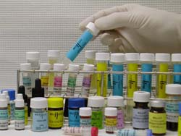
Laboratory Improvement Division
WSLH Proficiency Testing
Clinical labs – more than 3,000 in U.S. and internationally
Environmental labs – Wisconsin only
800-462-5261

Slide 34
24 Hour Emergency Hotline
You can contact the Wisconsin State Laboratory of Hygiene for emergencies 24/7 at
608-263-3280
(our emergency answering service).

Slide 35
State Lab of Hygiene Key Contacts
Jan Klawitter
WSLH Public Affairs Manager
(608) 265-2529
jan.klawitter@slh.wisc.edu

