Slide 1
Neighborhood Health Partnerships (NHP)
Program Overview
Lauren Bednarz & Korina Hendricks
DHS Chronic Disease Partner Call
10/25/2022

Slide 2
Contents
The challenge and opportunity
NHP program resources
How you can use NHP resources

Slide 3
The Challenge and Opportunity
Lauren Bednarz
3

Slide 4
The Challenge
Health is shaped by local conditions, due to:
most health data are only available at the county level, making it difficult for community organizations, health systems, government agencies, and researchers to:
but,
Social inequities
Identify and prioritize health improvement opportunities
Target disparities and inequities at the neighborhood level
Monitor the effectiveness of programs and interventions
Inequitable policies and practices
Impacts on environment and living conditions

Slide 5
The Opportunity
27 care measures identically coded across systems
example
Wellness | Prevention | Risk Factors | Heart Disease Care | Diabetes Care
Childhood vaccinations Adolescent vaccinations HPV vaccination Pneumonia vaccination Well Child Visit in first 15 months of life | Breast Cancer Screening Cervical Cancer Screening Chlamydia Screening in Women Colorectal Cancer Screening Depression Screening | Recommended Body Mass Index Blood Pressure Control | Blood Pressure Control Daily Aspirin Statin Use Tobacco-Free Optimal Control | Blood Pressure Control Blood Sugar Control Blood Sugar Testing Daily Aspirin eGFR Test Kidney Function Monitored Optimal Control Optimal Testing Tobacco-Free Statin Use
Neighborhood health data from electronic health records for ~3.75 million patients

Slide 6
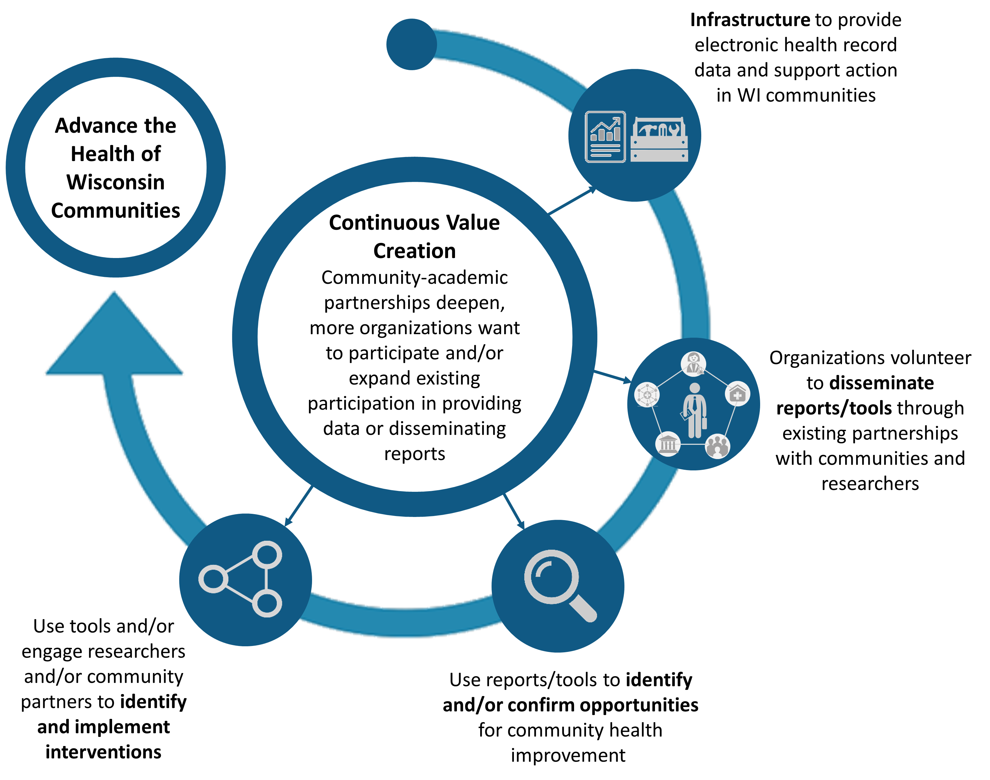
Our Goals
1. Build report infrastructure to provide local health data to communities and researchers
Advance the Health of Wisconsin Communities
Create continuous value as community-academic partnerships deepen and more organizations want to participate in providing data or disseminating reports
2. Disseminate reports through organizations who have existing partnerships with communities and/or researchers
4. Build tools to help encourage partnerships and support data to action
3. Provide resources to support the use of reports to identify or confirm opportunities for health improvement

Slide 7
NHP Program Resources
Korina Hendricks
7

Slide 8
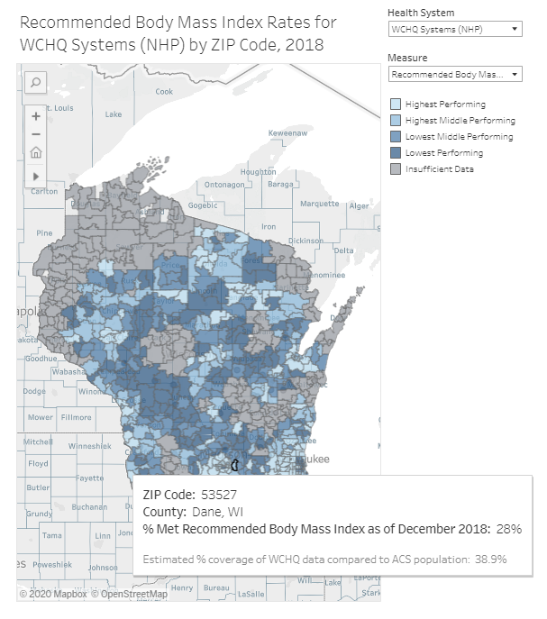
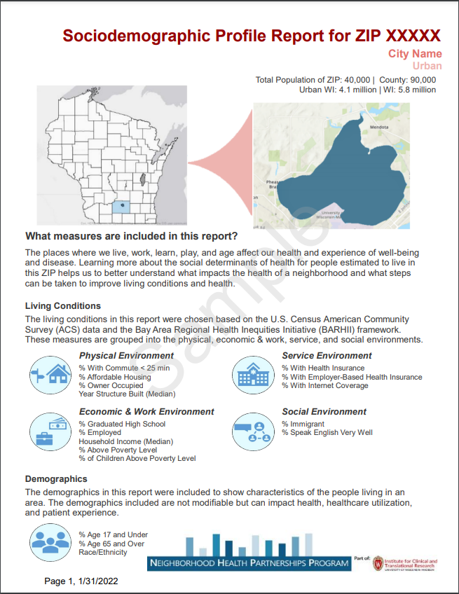
NHP Resources
Maps
Reports
Tools
2 Types
Action tools
Health Outcome and Care Reports using WCHQ data
Social Determinants of Health Reports using U.S. Census data
Partnerships tool
Maps for Navigators to help in selecting measures/ZIPs of interest
Policy tool

Slide 9
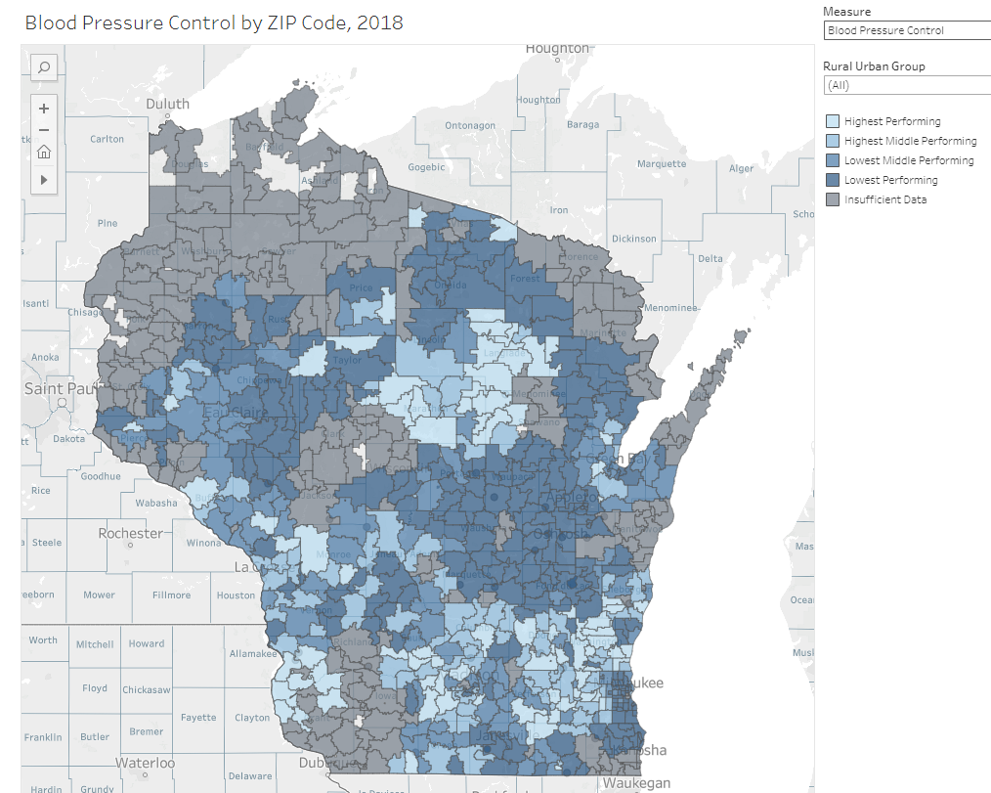
Map Demo
9
Notes:
Show audience mapping tool
Let them know they can work with a navigator (us included) to review and request map

Slide 10
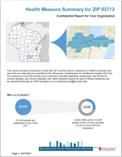
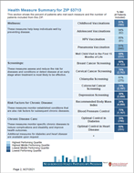
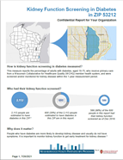
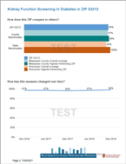
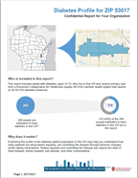
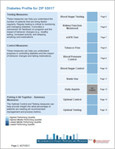
Health Outcome and Care Reports Available
Health Measure Summary Reports –
snapshot of a ZIP code's performance on most measures
Neighborhood Health Reports –
detailed info about a ZIP code's performance on one measure
Diabetes Profile Reports –
snapshot of a ZIP code's performance on all available diabetes measures and detailed info for each measure

Slide 11
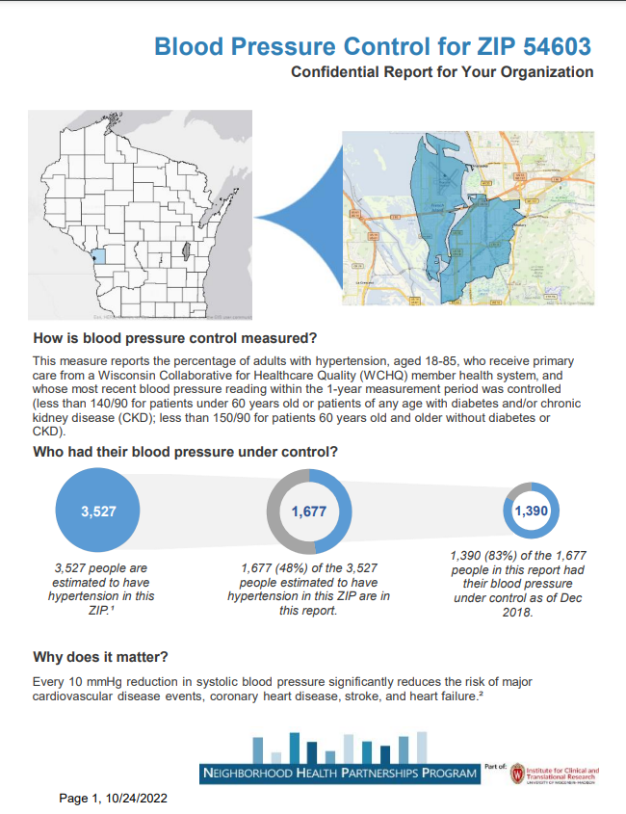
Example: Neighborhood Health Report
11
Notes:
Walk through an NHP report for either BPC or Diabetes A1c
Ask Lena is there is a specific county or ZIP we should pull a report for

Slide 12
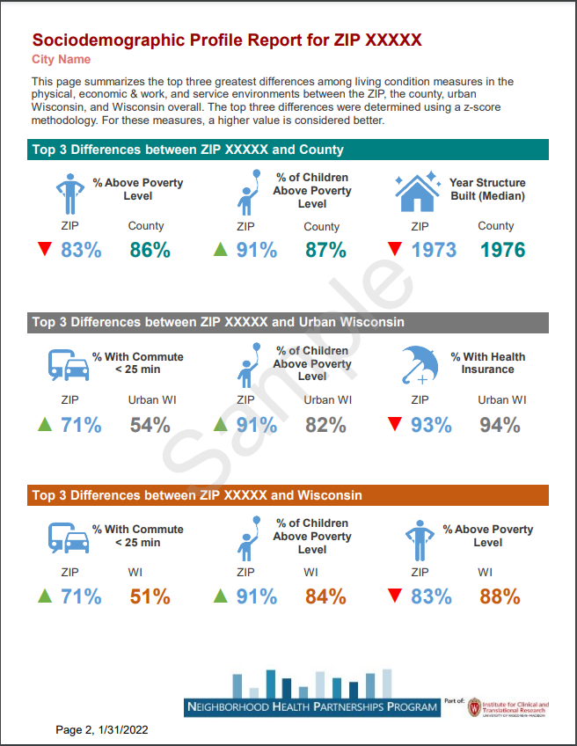
Social Determinants of Health Reports
Sociodemographic Profile Reports – Provide context on the social determinants of health for a ZIP code, comparing living conditions and demographics across ZIP, county, rural/urban and state geography levels
Use U.S. Census American Community Survey data ONLY
Measures included:
Demographics

Slide 13
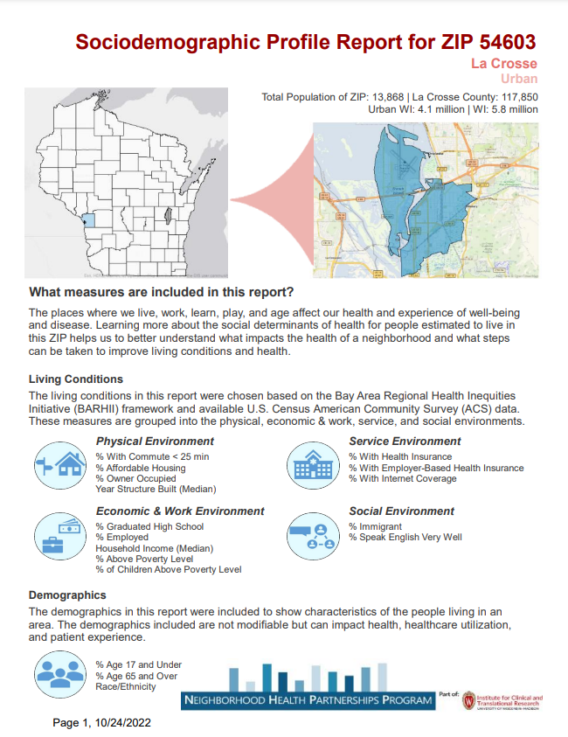
Example: Social Determinants of Health Report
13
Notes:
Same ZIP as we selected for NHP report

Slide 14
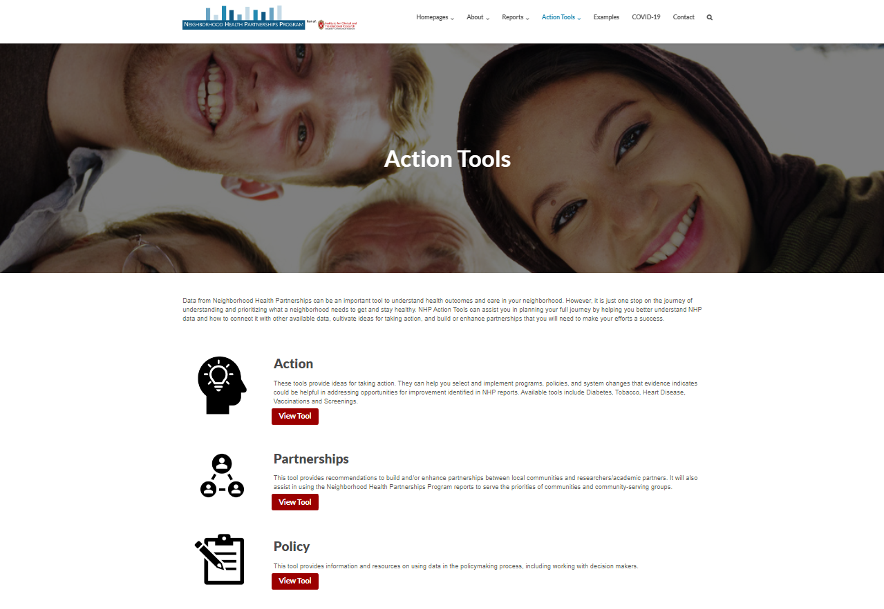
Tools
Action tools -
Ideas for taking action with evidence-informed strategies to improve health. (Available tools: vaccinations, screenings, tobacco use, diabetes, heart disease)
Partnerships tool -
Recommendations for building/enhancing partnerships and serving community priorities
Policy tool –
Information and resources on using data in the policymaking process
14

Slide 15
How you can use NHP resources
Lauren Bednarz
15

Slide 16
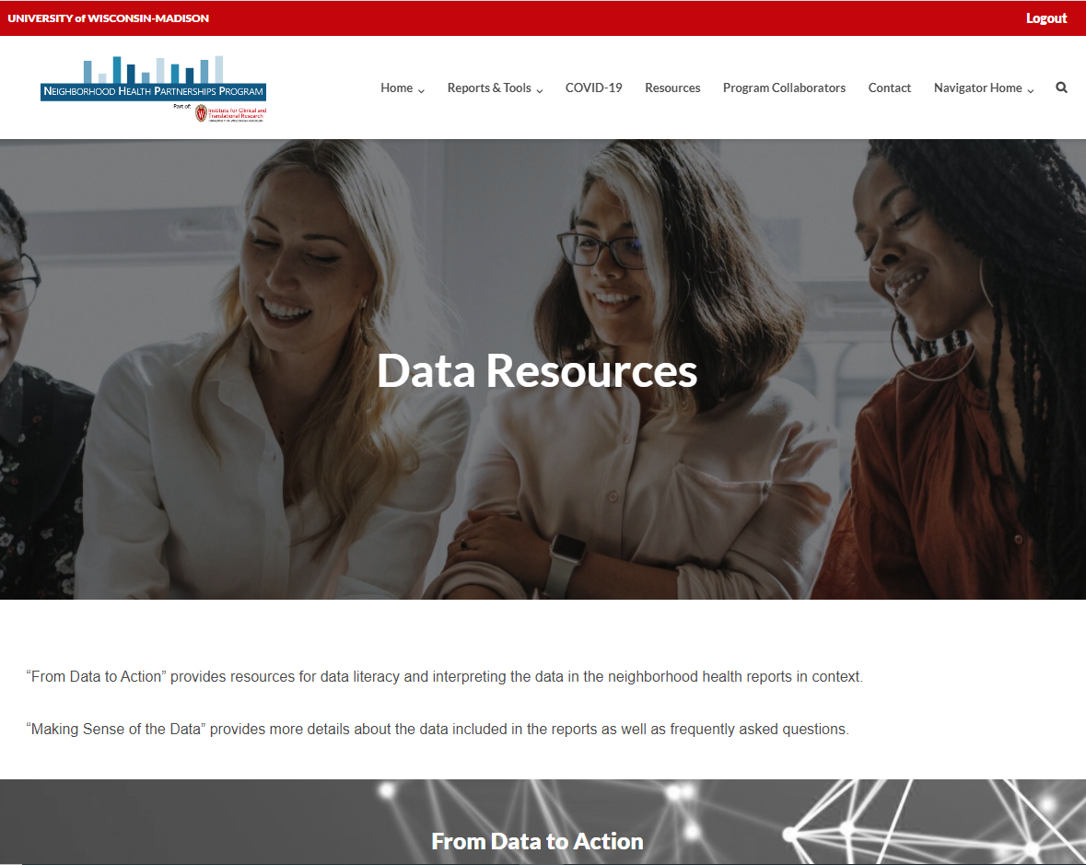
NHP request process, stakeholders, and uses
Uses
Health Systems
& Clinics
Identify & target disparities
Data
Direct services/ resources
example
Community Organizations
Strengthen grant applications
Reports
Establish new partnerships
Researchers
NHP
Navigators
Action
Develop new programs
State and Local Government
Organizations
Monitor & evaluate
Community Pharmacies
Prioritize focus areas
Tools

Slide 17
Examples of Report and Tool Use
Health Department:
Community health assessment
Local health departments have used NHP reports to learn more about the health of the communities they serve as part of their Community Health Assessment (CHA) and community health improvement planning processes.
Community coalition:
Identify communities with low cancer screening rates
A community coalition used NHP maps and reports to distribute colorectal cancer screening test kits in rural underserved areas. They could use our Partnerships tool to help build partnerships with researchers or other community-based organizations.
Pharmacists:
Implement additional programming for patients
A pharmacy resident used NHP reports to learn more about their patient population and implement a Diabetes Prevention Program in a community pharmacy. Pharmacy managers have used the reports to support other health projects at their sites.
More examples of NHP report and tool use available at https://nhp.wisc.edu/examples/

Slide 18
See an opportunity, but need custom data?
One-time requests
May be able to produce on a case-by-case basis
Limited by some small sample sizes
Schedule consultation by emailing nhp@hip.wisc.edu
Ongoing requests
Will require additional funding, can be written into grants
Schedule consultation by emailing nhp@hip.wisc.edu

Slide 19
Next Steps
Thank you for allowing us to share today!
To request a report, visit www.nhp.wisc.edu/reports to complete the request form.
To view the maps or discuss the data further, connect with NHP Navigators Lena Swander and Shelby Vadjunec at dhschronicdiseaseprevention@dhs.wisconsin.gov
For technical questions or custom requests, email us at nhp@hip.wisc.edu

Slide 20
NHP Sponsors and Partners

Slide 21
Discussion
Do you see potential for using these data / reports in your work?
Do you have feedback that could make the program even more powerful to you in your work?

Slide 22
Questions

