Slide 1
Feeding Wisconsin
Together, we are Leading the way Forward Toward a Healthy and Hunger-Free Wisconsin

Slide 2
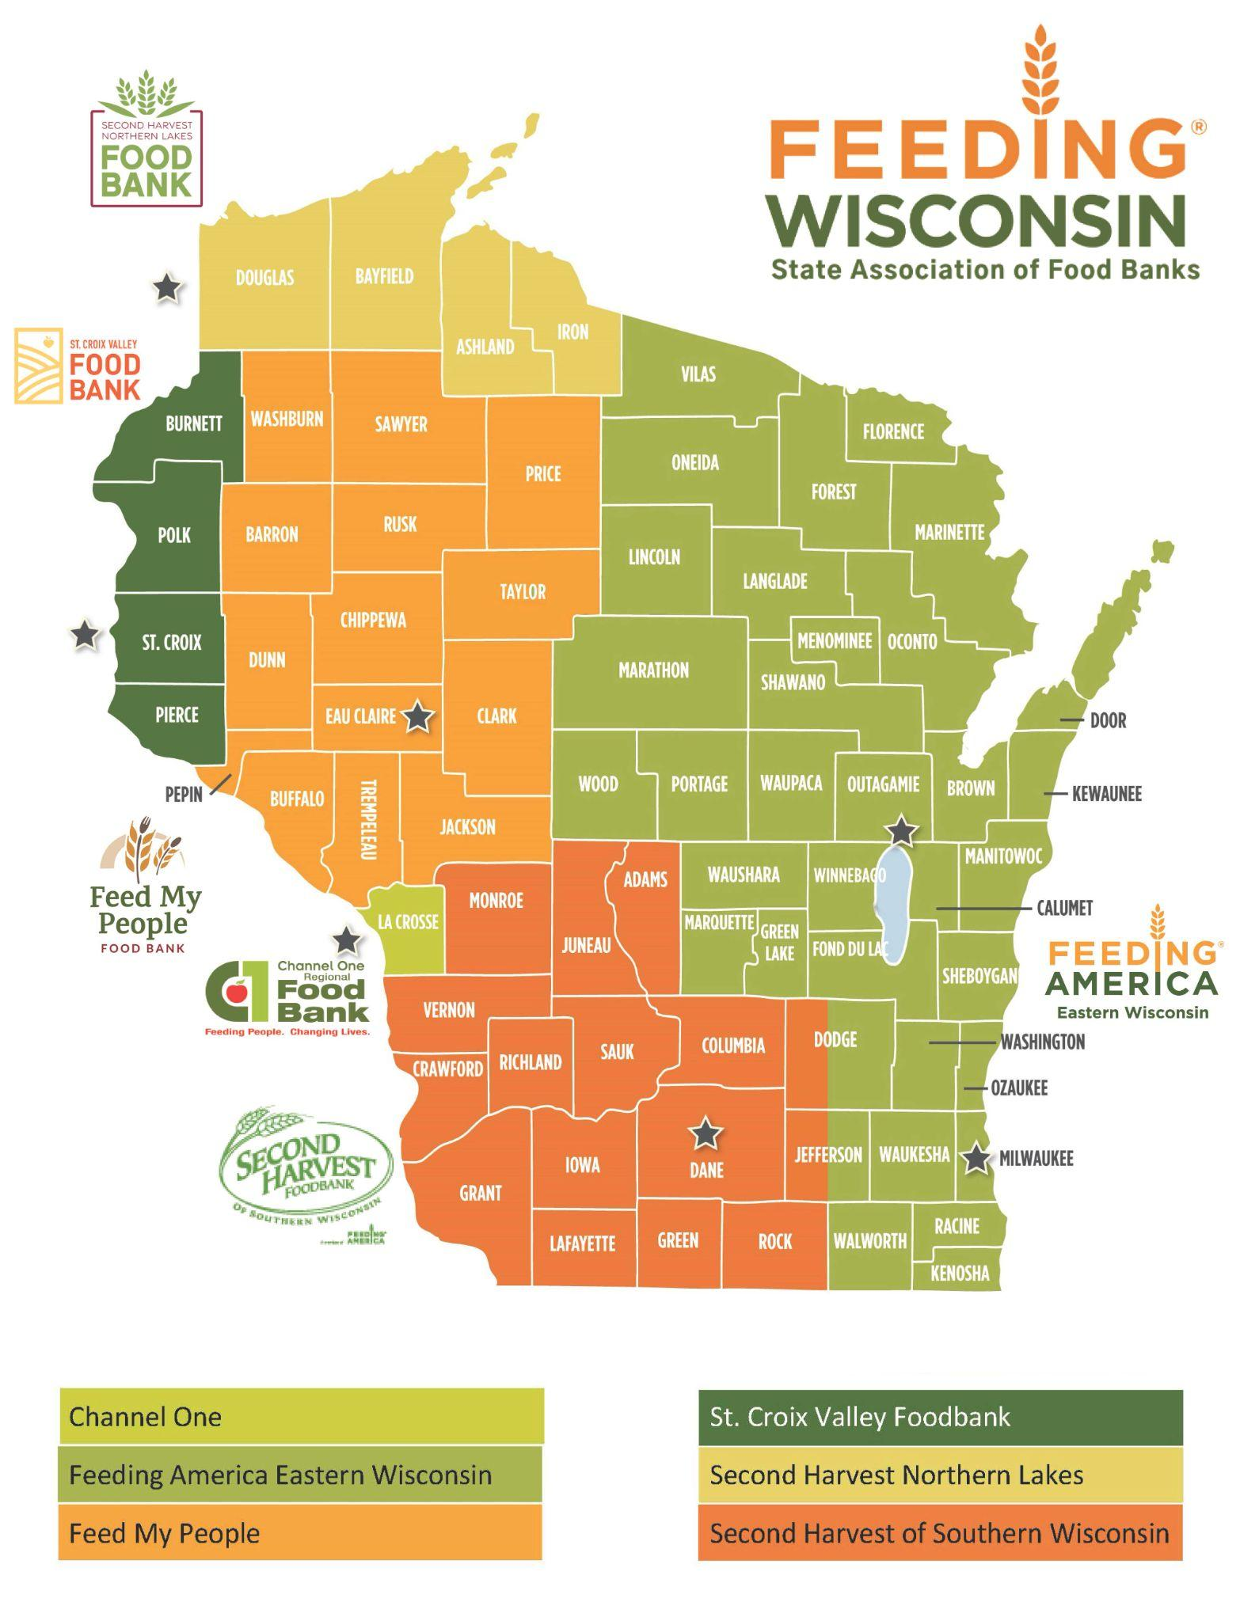
Together, we are Feeding Wisconsin
6
Large scale food sourcing, warehousing, distribution, fundraising, communications, regional programs and partnerships, and technical assistance
PARTICIPATING FOOD BANKS
1
State and federal policy and advocacy, coordinated statewide research, programs, partnerships, food and fund development, and communications.
STATE OFFICE
1K
Direct client distribution, local food and fund development, program, partnerships, and awareness raising
LOCAL FOOD PROGRAMS
86M
POUNDS OF FOOD PROVIDED TO WISCONSINITES IN ALL 72 COUNTIES IN FY2021

Slide 3
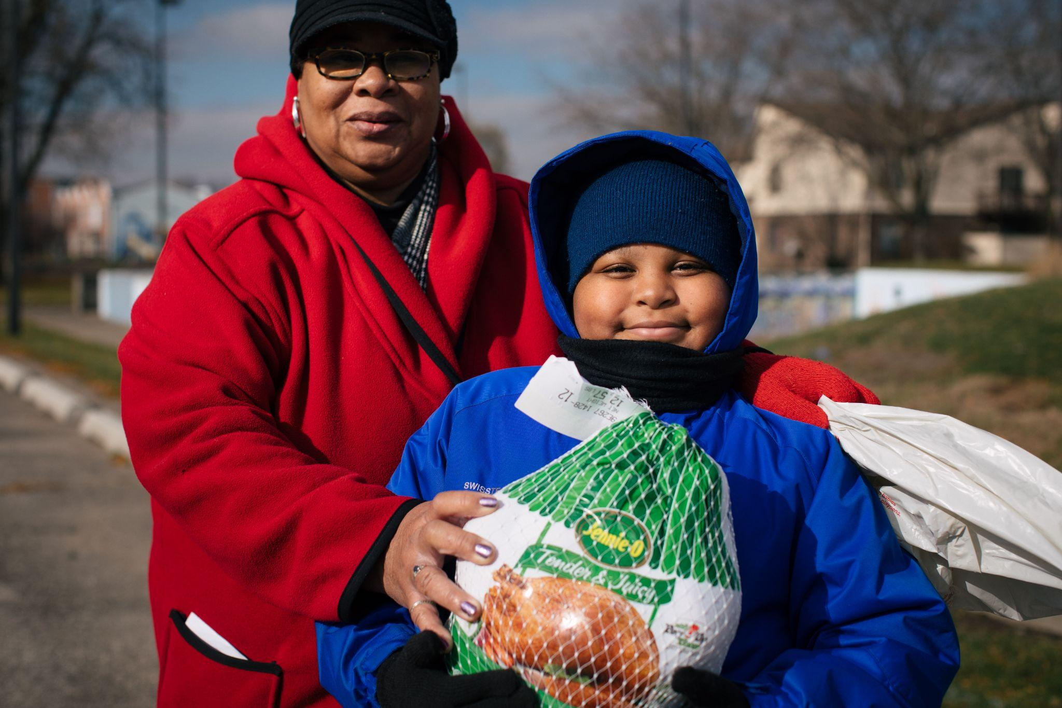
Our Vision is a Healthy and Hunger-Free Wisconsin
Our mission is help our food banks, stakeholders, and partners end hunger, improve health, and strengthen communities
About Us One Pager

Slide 4
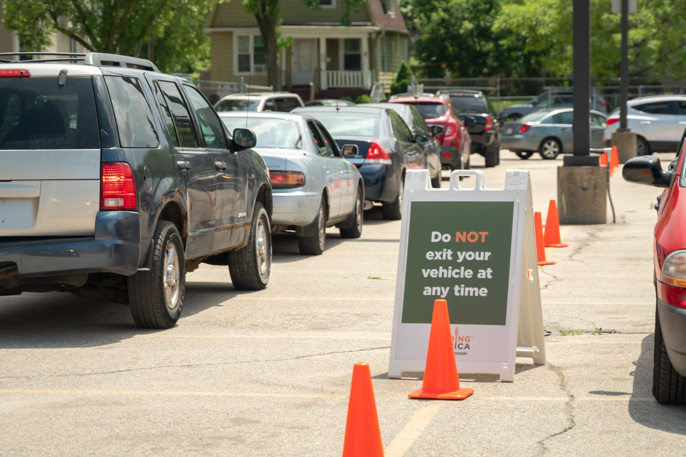
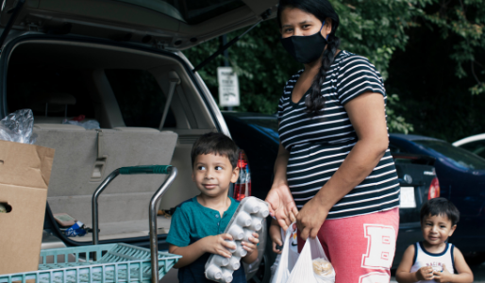
With Great Challenge,
Comes Great Opportunity
and also Responsibility
Notes:
Before the pandemic, food insecurity levels were the lowest they had been in 20 years, yet 515,930 Wisconsinites experienced hunger.
Feeding America estimates that in CY2021, 605,650 Wisconsinites or 10.4% will experience food insecurity. This includes 204,600 (or 16.2%) Wisconsin children. The USDA recently reported that households with children were 1 twice as likely to experience food insecurity as households without children.2 About 40% of those coming through our pantries and mobile distribution lines have never relied on the emergency food network before.3
Food pantries that were once considered a resource for temporary food assistance have become a part of many households’ coping strategies to put food on the table.
COVID was the perfect storm - increased need for food resources, dramatic supply disruptions, and limited volunteers and food donations - Food banks moved from procuring about 80 of food from donations to 40 percent… meaning went from purchasing 20% of the food distributed to 60% at the peak of the pandemic.
With this, many of our food banks are putting their values behind those dollars as they look to not only source product at scale to meet the demand, but support our local economies–Wisconsin products, sourcing from BIPOC and disadvantaged producers…
Our food banks are considering both how we can purchase to promote a more equitable food system and how we can purchase the right food for the right folks–how can we source the foods that people want to be eating—meeting nutritional, dietary, and cultural needs–feeding body and social selves.

Slide 5
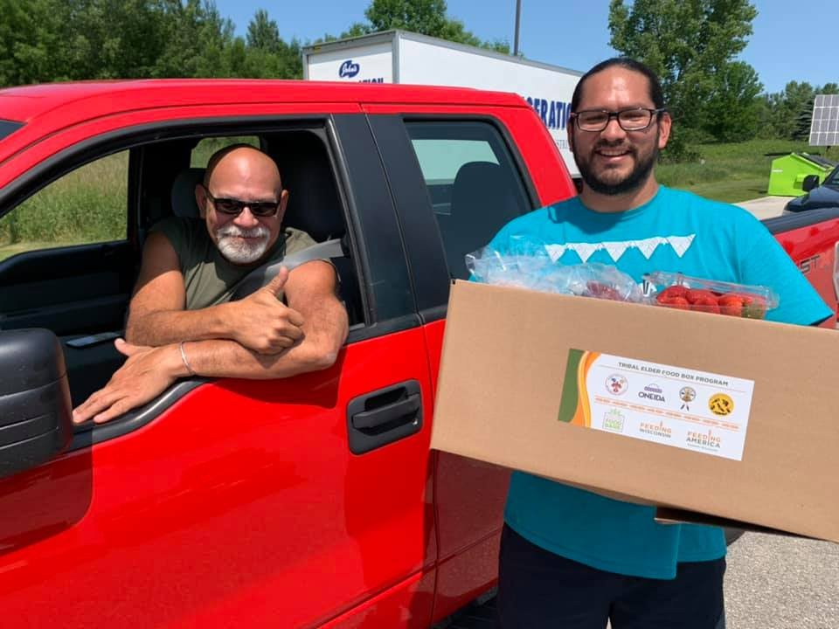
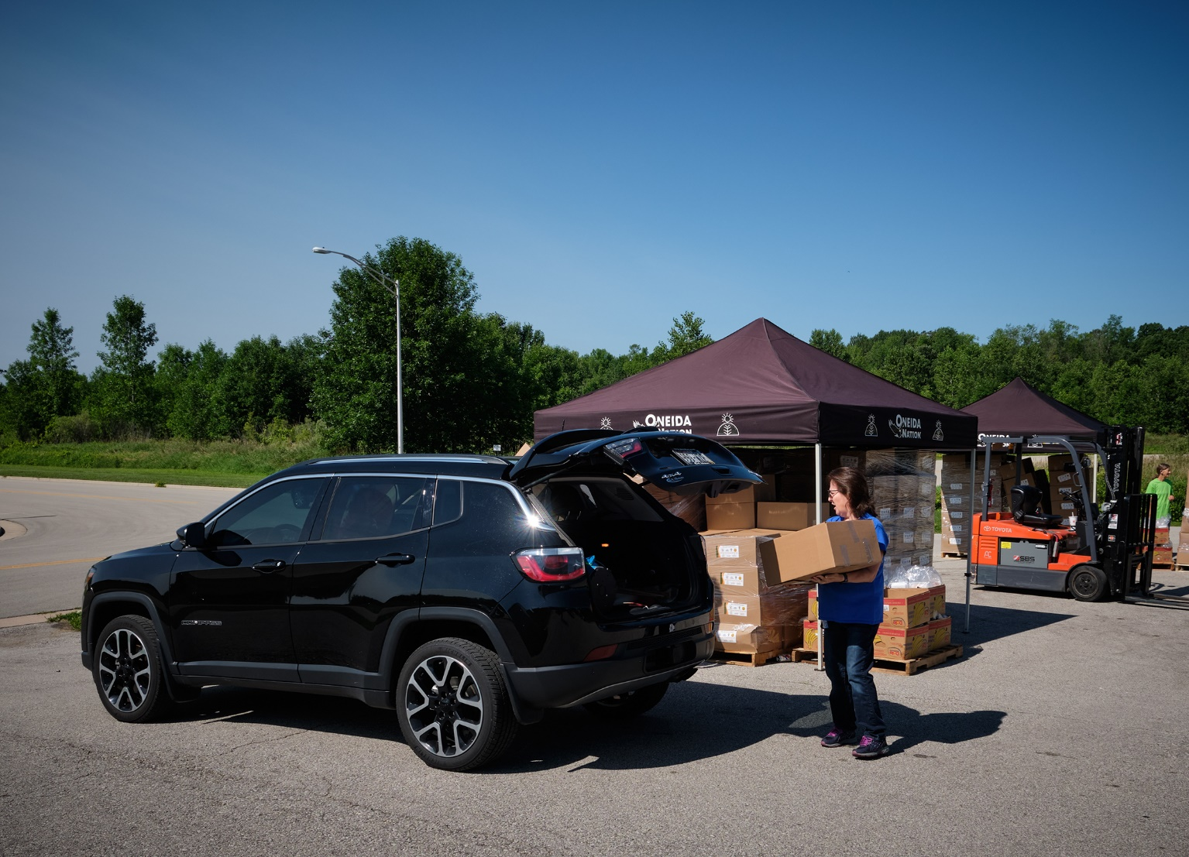
Tribal Elder Food Box Program
Learn More: https://feedingwi.org/programs/
tribalfoodsecurity/

Slide 6
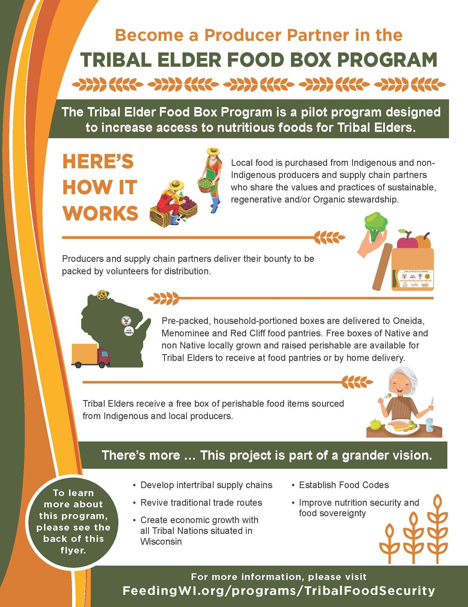

Slide 7
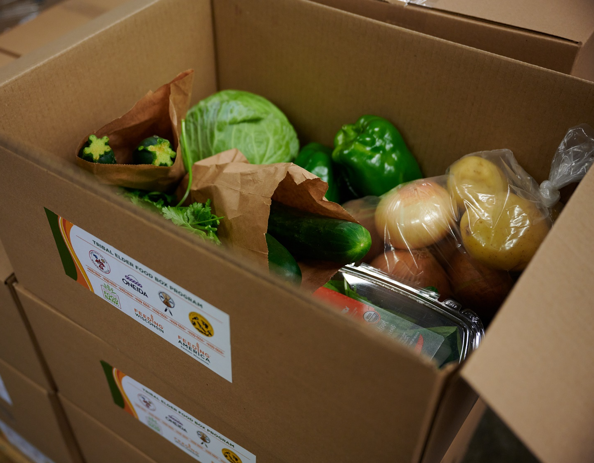
Tribal Elder Food Box Program Pilot
The 2021 Pilot funded through $427,800 Feeding America National Regional Agri Food Distribution grant
Tribal Elder Boxes were distributed to elders of seven Tribal Nations
900 boxes of fresh produce and proteins distributed at each distribution
12 distributions every other week between June – Dec
Product sourced from Tribal and local producers. In 2021, 41% of product purchased for the boxes was purchased from Indigenous producers.
Seasonal produce included: Onions, Potatoes, squash, tomatoes, strawberries, blueberries, lettuce, cabbages, beets, blackberries, cucumbers, herbs, apples, sweet corn, garlic, melons, carrots, winter squash, pumpkin, etc.
Proteins included: Beef, Fish, Buffalo, Pork, Elk, Chicken, and Eggs
Notes:
Feeding Wisconsin and food bank partners worked directly with Tribal partners to make important decisions around purchasing, aggregation and repack logistics, and distribution. Food preferences were informed by Tribal Elders themselves.
Produce
192,000 pounds of produce in total
Seasonal produce included: Onions, Potatoes, squash, tomatoes, strawberries, blueberries, lettuce, cabbages, beets, blackberries, cucumbers, herbs, apples, sweet corn, garlic, melons, carrots, winter squash, pumpkin, etc.)
Protein
21,000 pounds of protein in total
Included: Beef, Fish, Buffalo, Pork, Elk, Chicken, and Eggs

Slide 8
Tribal Elder Food Box Recipient Quotes
“Receiving this food from other nations [Tribal producers] was appreciated and made me (as an elder) feel like I was being looked after and loved. It made me feel happy.”
“I am on a fixed income. The food helped reduce my grocery expenses. This allowed me to pay other household expenses. The food boxes definitely had an impact on my monthly budget.”
“Excellent! This is a GREAT program! Thank you - Waewaemen! Getting your food box made a huge positive difference for my family & me.”
“Some of the protein items such as whitefish and bison are not available at the grocery store where I do my shopping. The food boxes provided healthy food I would not have access to otherwise. It also added more fresh vegetables to my diet.”

Slide 9
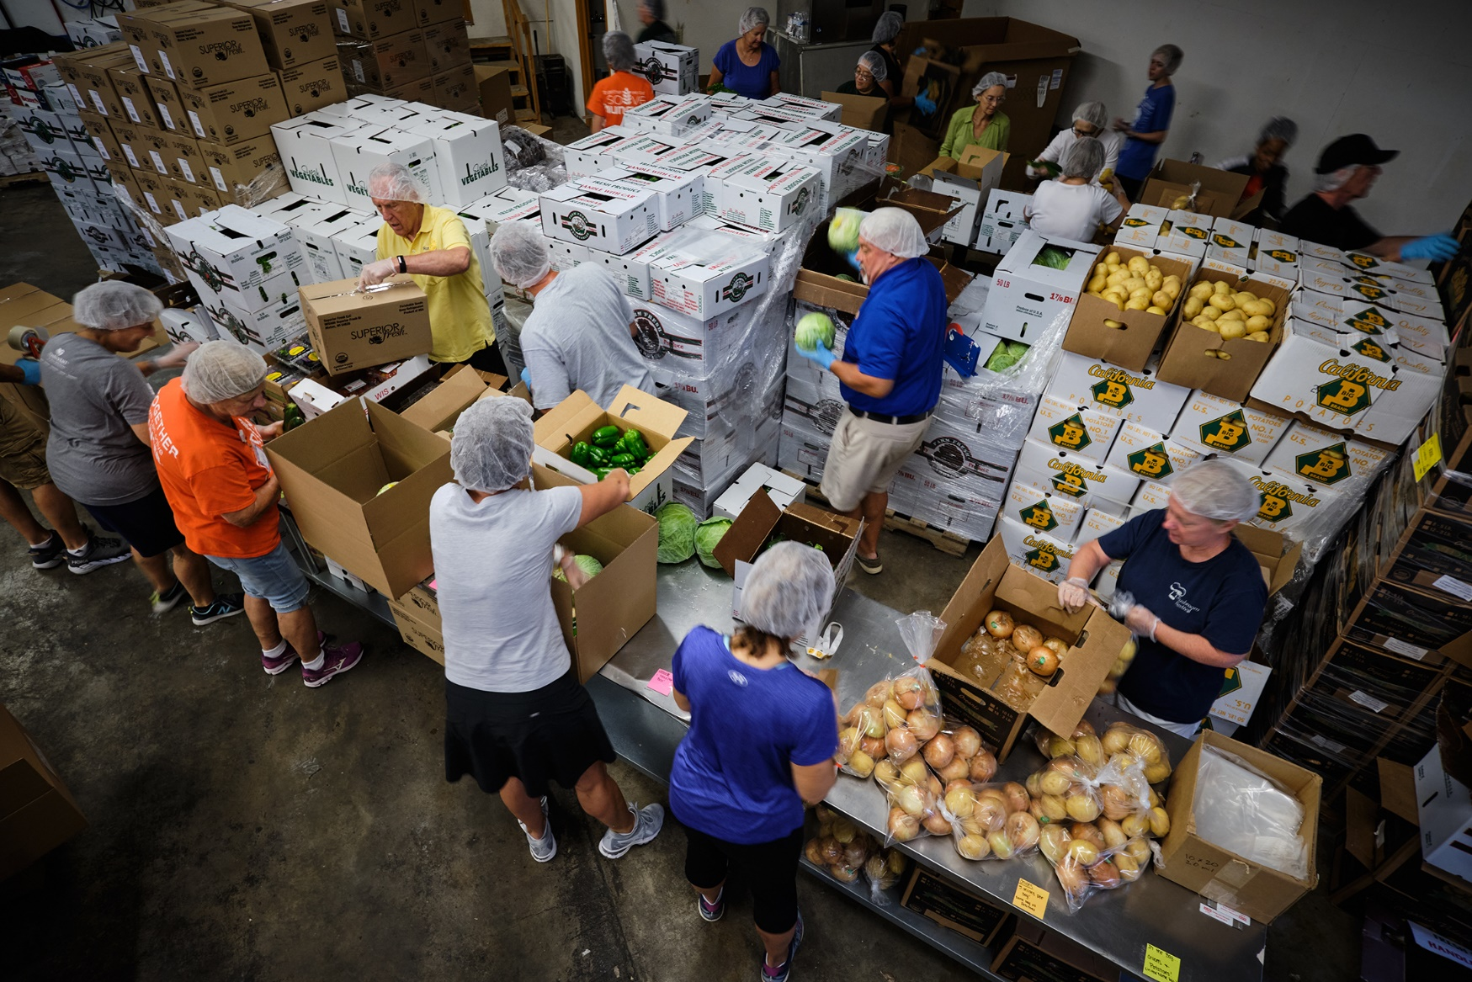
Tribal Elder Food Box - 2022 Season
The 2022 Program will be funded through
$1M of American Rescue Plan Act funds via a DATCP grant awarded to Feeding Wisconsin
$200,000 from a Feeding America National Regional Agri Food Distribution grant
1400-1800 boxes of a variety of food products (proteins, produce, non-perishables, etc.) will be distributed 1-2 times a month to an expanded number of Tribal Nations for Tribal Elders
16 distributions between May – December
Product will be sourced from Tribal and local producers
Notes:
Most appreciated seasonal variety that was included - enjoyed lettuce, apples, sweet corn, watermelon, proteins, and non-perishables (maple syrup and wild rice)
Additional produce requested - berries, more fruit (fresh and frozen), herbs (cilantro, parsely, bergamont, mint, rosehips, juniper berries), cranberries
More meat - especially buffalo
More non-perishables - wild rice, beans, honey, maple syrup, white corn flour, hominy, teas, canned meats and other canned foods
Other ideas: nuts (black walnuts), cheese, breads, mushrooms (fresh or dehydrated), diabetic friendly foods

Slide 10
Registration to launch this week
https://feedingwi.org/programs/conferences/2022_summit.php

Slide 11
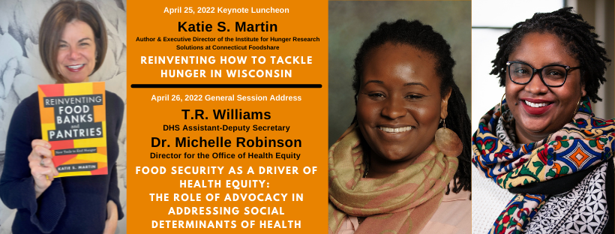

Slide 12
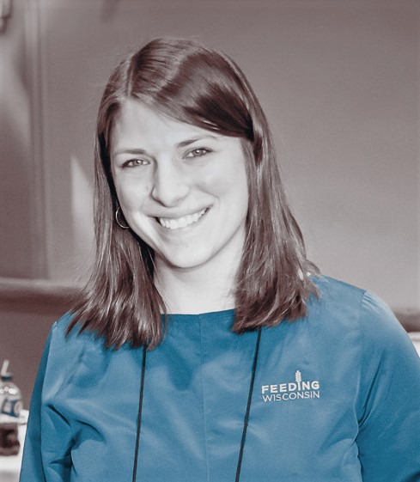
Stephanie Jung Dorfman Executive Director Feeding Wisconsin sdorfman@feedingwi.org 608-960-4517

