Slide 1
Kristie Egge, MPH |Wood County Health Department

Slide 2
Learning Objectives
Understand health equity related definitions
Understand how health equity connects with public health
Learn about available resources

Slide 3
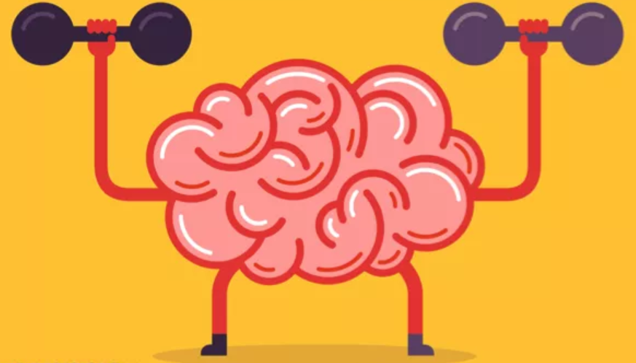
Activity
Notes:
Definition Matching

Slide 4
Health Disparity
Health Inequity
A population-based difference in health outcomes (e.g., women have more breast cancer than men).
By itself, disparity does not address the chain of events that produces it.
- MN Dept. of Health, 2015
A health disparity based on unfair, socially-determined circumstances (e.g. American Indians have higher rates of diabetes due to the disruption of their way of life and replacement of traditional foods with unhealthy commodity foods). Because health inequities are socially determined, change is possible.
- MN Dept. of Health, 2015
Health Equity
When “every person has the opportunity to achieve their full capabilities and potential for health and well-being”.
-NACCHO, 2015, Sen, 2004
A fair, just distribution of the social resources and social opportunities needed to achieve well-being.
-ASTHO, 2000
Notes:
What is health equity?

Slide 5
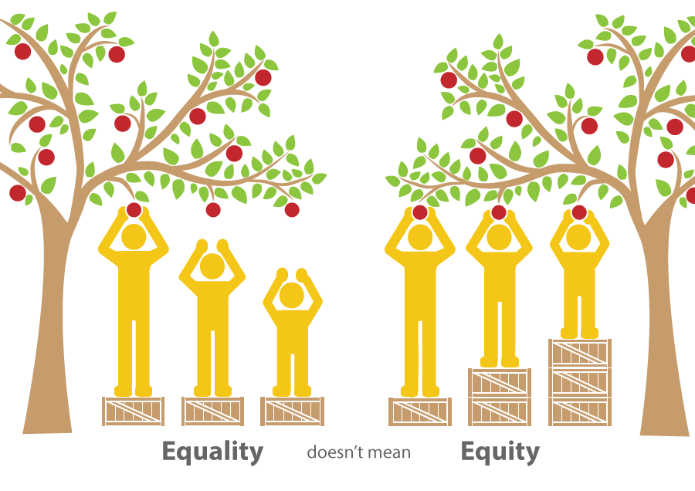

Slide 6
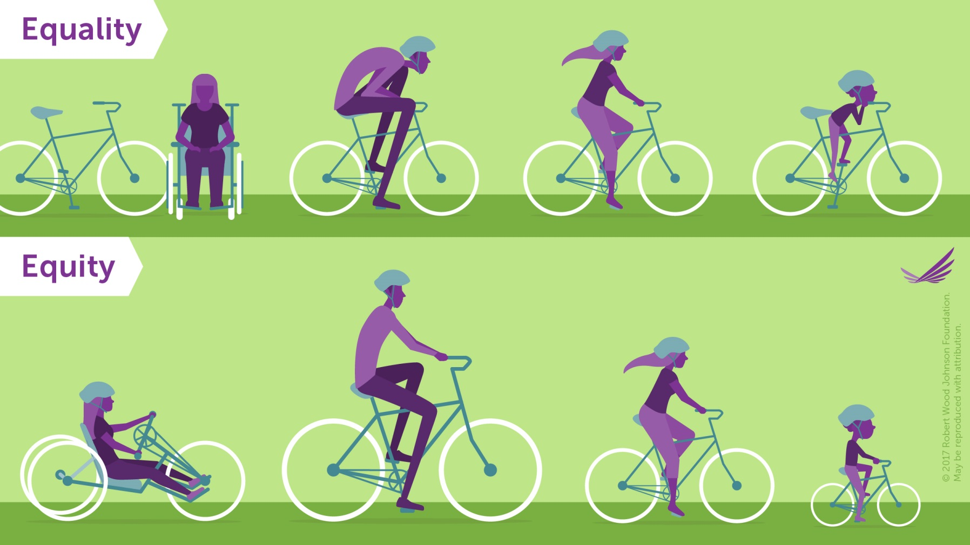

Slide 7
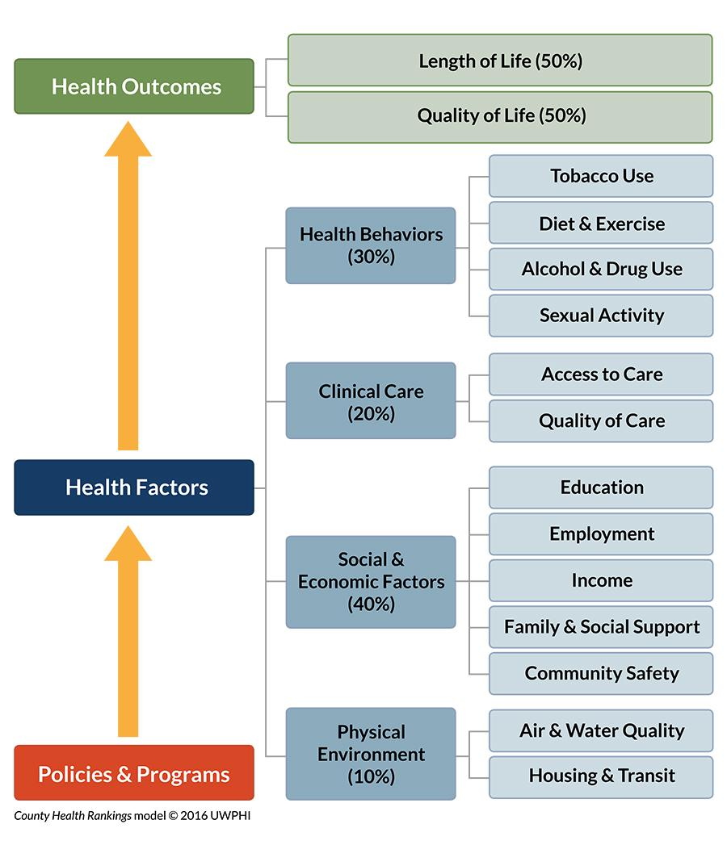
Why Focus on Health Equity?
Addressing Inequity Requires Closing Gaps in Social Determinants
Notes:
Kristie will present this slide and discuss changing demographics in re: DPI data
Accreditation
Business as usual = same outcomes
Sustainability
Limited resources
Business as usual = same outcomes
Sustainability
Limited resources

Slide 8
A Tale of Two Zip Codes
Notes:
Kristie will present this slide and discuss changing demographics in re: DPI data

Slide 9
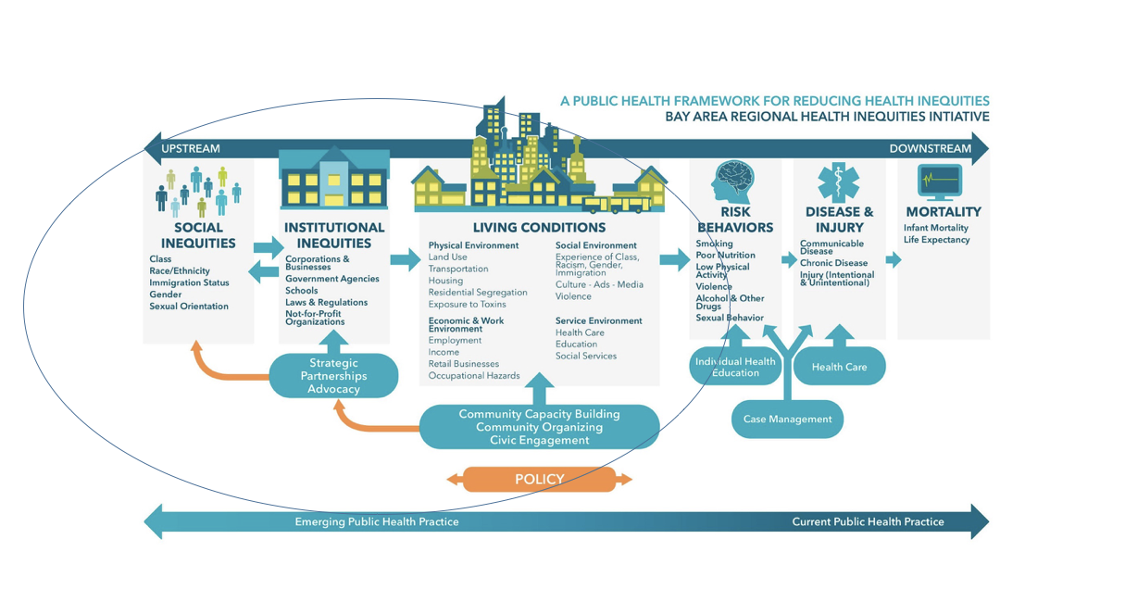
Public Health Framework

Slide 10
History of the Suburbs
Notes:
Kristie will present this slide and discuss changing demographics in re: DPI data

Slide 11
Why Race Matters
Racial inequities persist in every system; Health, Education, Criminal Justice, Employment, and so on.
When you look within other dimensions of identity — income, gender, sexuality, education, ability, age, citizenship, and geography — there are inequities based on race.
Advancing health equity requires addressing all areas of marginalization and understanding the interconnected nature of oppression.
Pulled from Human Impact Partners Health Equity Guide

Slide 12
Reflection
Notes:
Early Experiences with Race

Slide 13
Equity Questions For Your Work
Benefits
Who is likely to benefit the most from our work? How?
How can we more equitably distribute the benefits?
Negative impacts
How might our work negatively impact communities facing inequities?
How might it compound existing negative conditions?
How might this work worsen or ignore existing disparities?
Community involvement
Additional considerations
Adapted from Thrive & Central WI Health Equity & Substance Use Convening group

Slide 14
What Can You Do?
Learn, learn, learn….
Build a health equity team within your organization
Begin looking internally at your procedures and policies
Health Equity Guide- Human Impact Partners
Notes:
Will send out invitation letter with more information after the staff meeting

Slide 15
Thank You!
Contact Info
Find us online!
Wood County Health Department
Healthy People Wood County healthypeoplewoodcounty.org
Kristie Egge
krauter-egge@co.wood.wi.us

