Slide 1
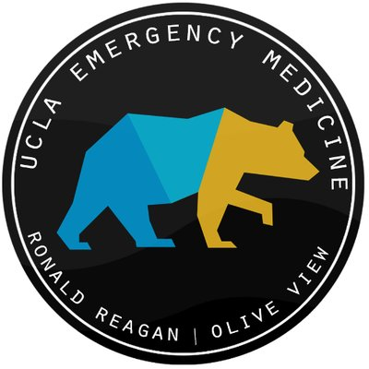
Infectious Disease, Chronic Disease & Minority Disparities
A Review of 2020 to Present Through a Social Medicine Lens
Christian Hernandez, MD
University of California - Los Angeles
Jamal Keyon Perry, MPH Candidate
University of Wisconsin Population Health Institute
Notes:
Better Title?

Slide 2
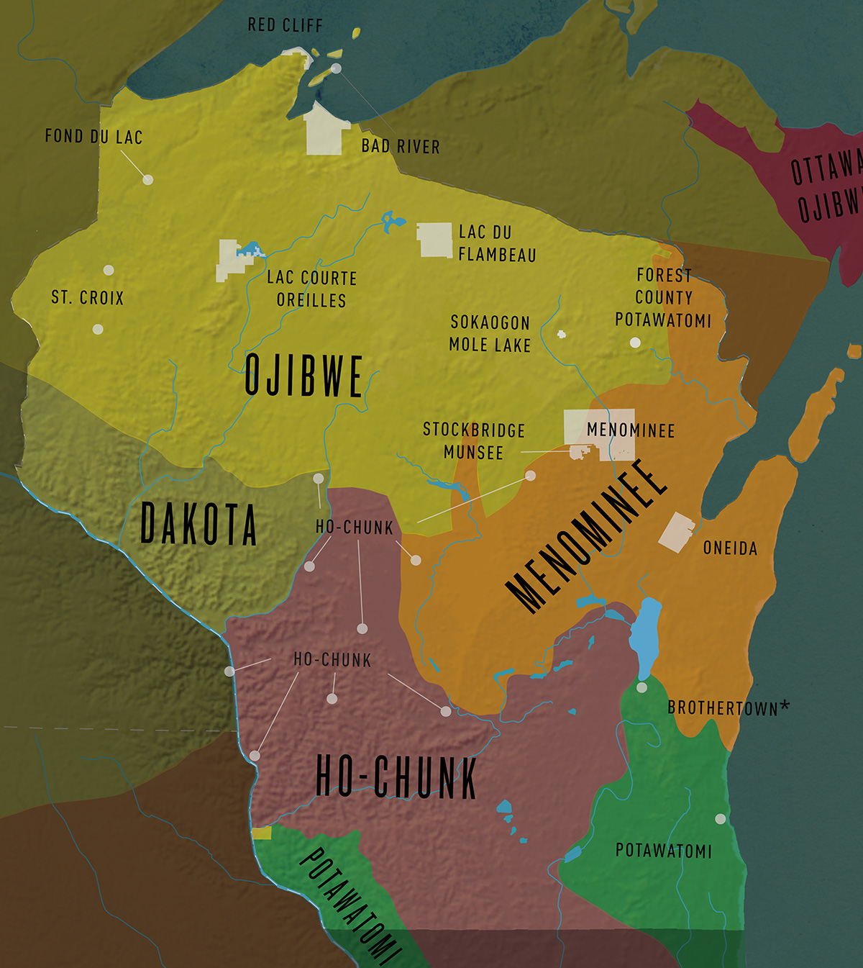
Land acknowledgement
In Wisconsin, we are on the ancestral lands of the:
Ojibwe
Dakota
Menominee
Ho-Chunk
Potawatomi
Today, WI is home to 11 Federally recognized tribes and Brothertown Nation, who is not currently Federally or State recognized.
Resources:
Honor Native Land: A Guide and Call to Acknowledgement. PDF can be accessed here. Link: https://usdac.us/nativeland.
UW Land Recognition. Black Cultural Center and Multicultural Student Center. PDF can be accessed here.
Wisconsin First Nations Map: https://wisconsinfirstnations.org/map/
Notes:
(Revise)
Jamal
-Before we dive into our overview today, We’d like to start our time together by sharing a land acknowledgement. The purpose of these statements is to show respect for indigenous peoples and recognize their enduring relationship to this land.
-Our hope is for land acknowledgments to name and raise awareness about histories that are often suppressed, erased, or unspoken. Like declarations on racism, we need to move beyond simply acknowledging that we are on taken land and similarly commit to ongoing learning, continued action and collective transformation.
Every community owes its existence and vitality to generations from around the world who contributed their hopes, dreams, and energy to making the history that led to this moment. Some were brought here against their will, some were drawn to leave their distant homes in hope of a better life, and some have lived on this land for more generations than can be counted. Truth and acknowledgement are critical to building mutual respect and connection across all barriers of heritage and difference.
Today we acknowledge these communities. We are standing on the ancestral lands of the Ojibwe, Dakota, Menominee, Ho-Chunk and Potawatomi People. These First Nations are not monolithic, all with languages, cultures, traditions and histories. We pay respects to their elders past and present. Please take a moment to consider the many legacies of violence, displacement, migration, and settlement that bring us together here today.
This history of colonization informs our shared future of collaboration and innovation. (End Here)
-Today, WI is home to 11 Federally recognized tribes and Brothertown Nation, who is not currently Federally or State recognized.
If you would like to learn more about Land acknowledgements and/or Wisconsin’s first nations , we will drop some resources in the chat.

Slide 3
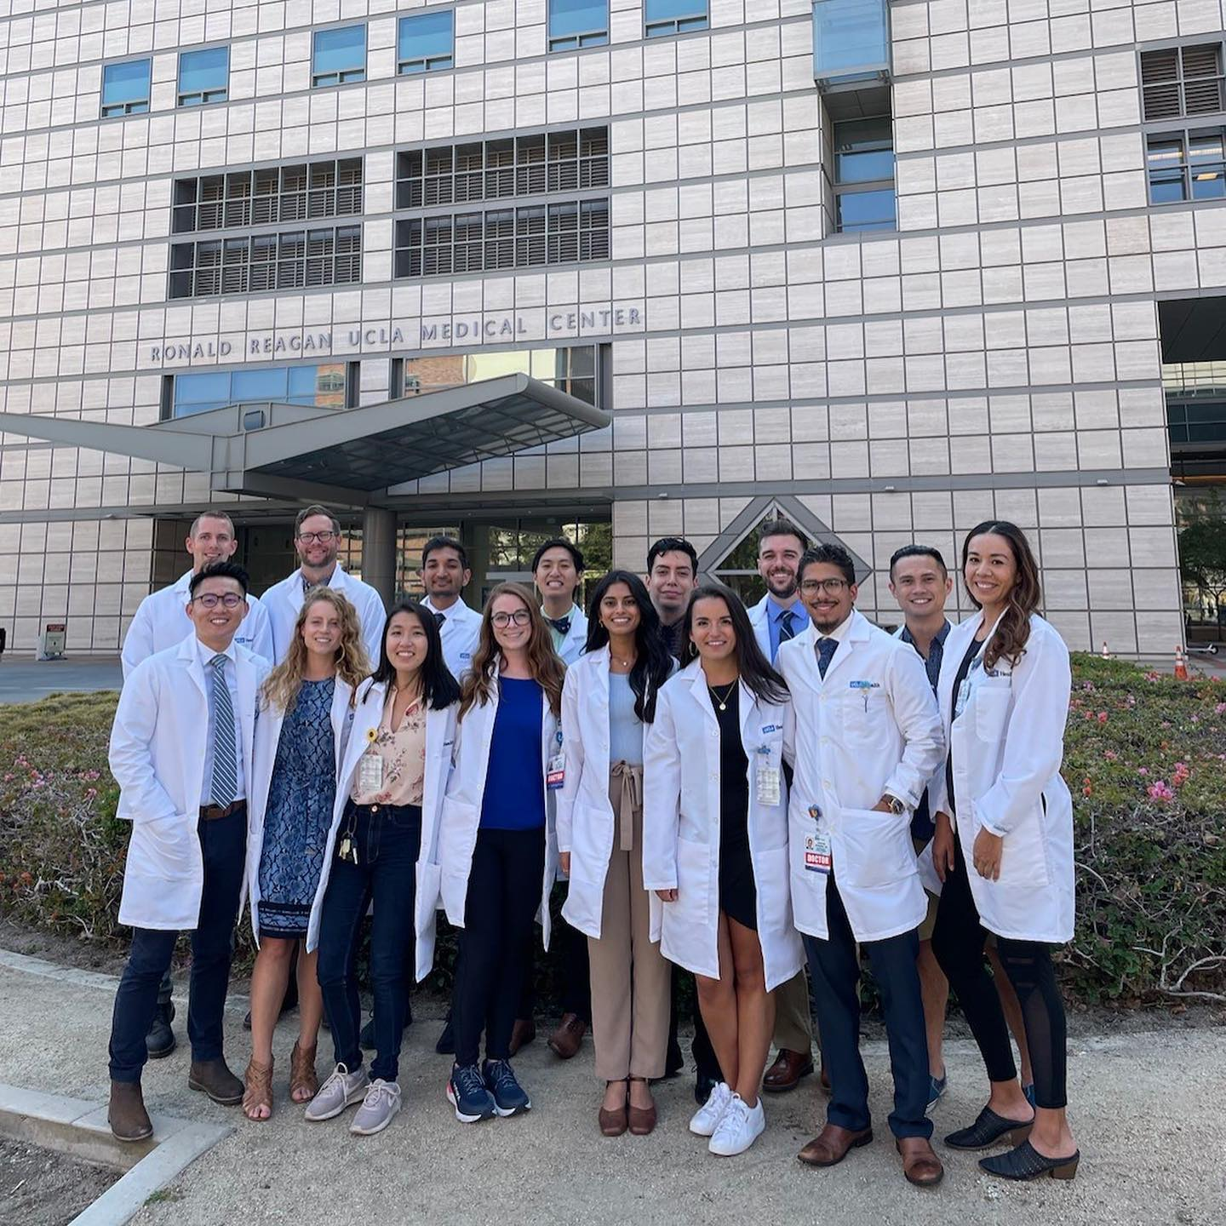
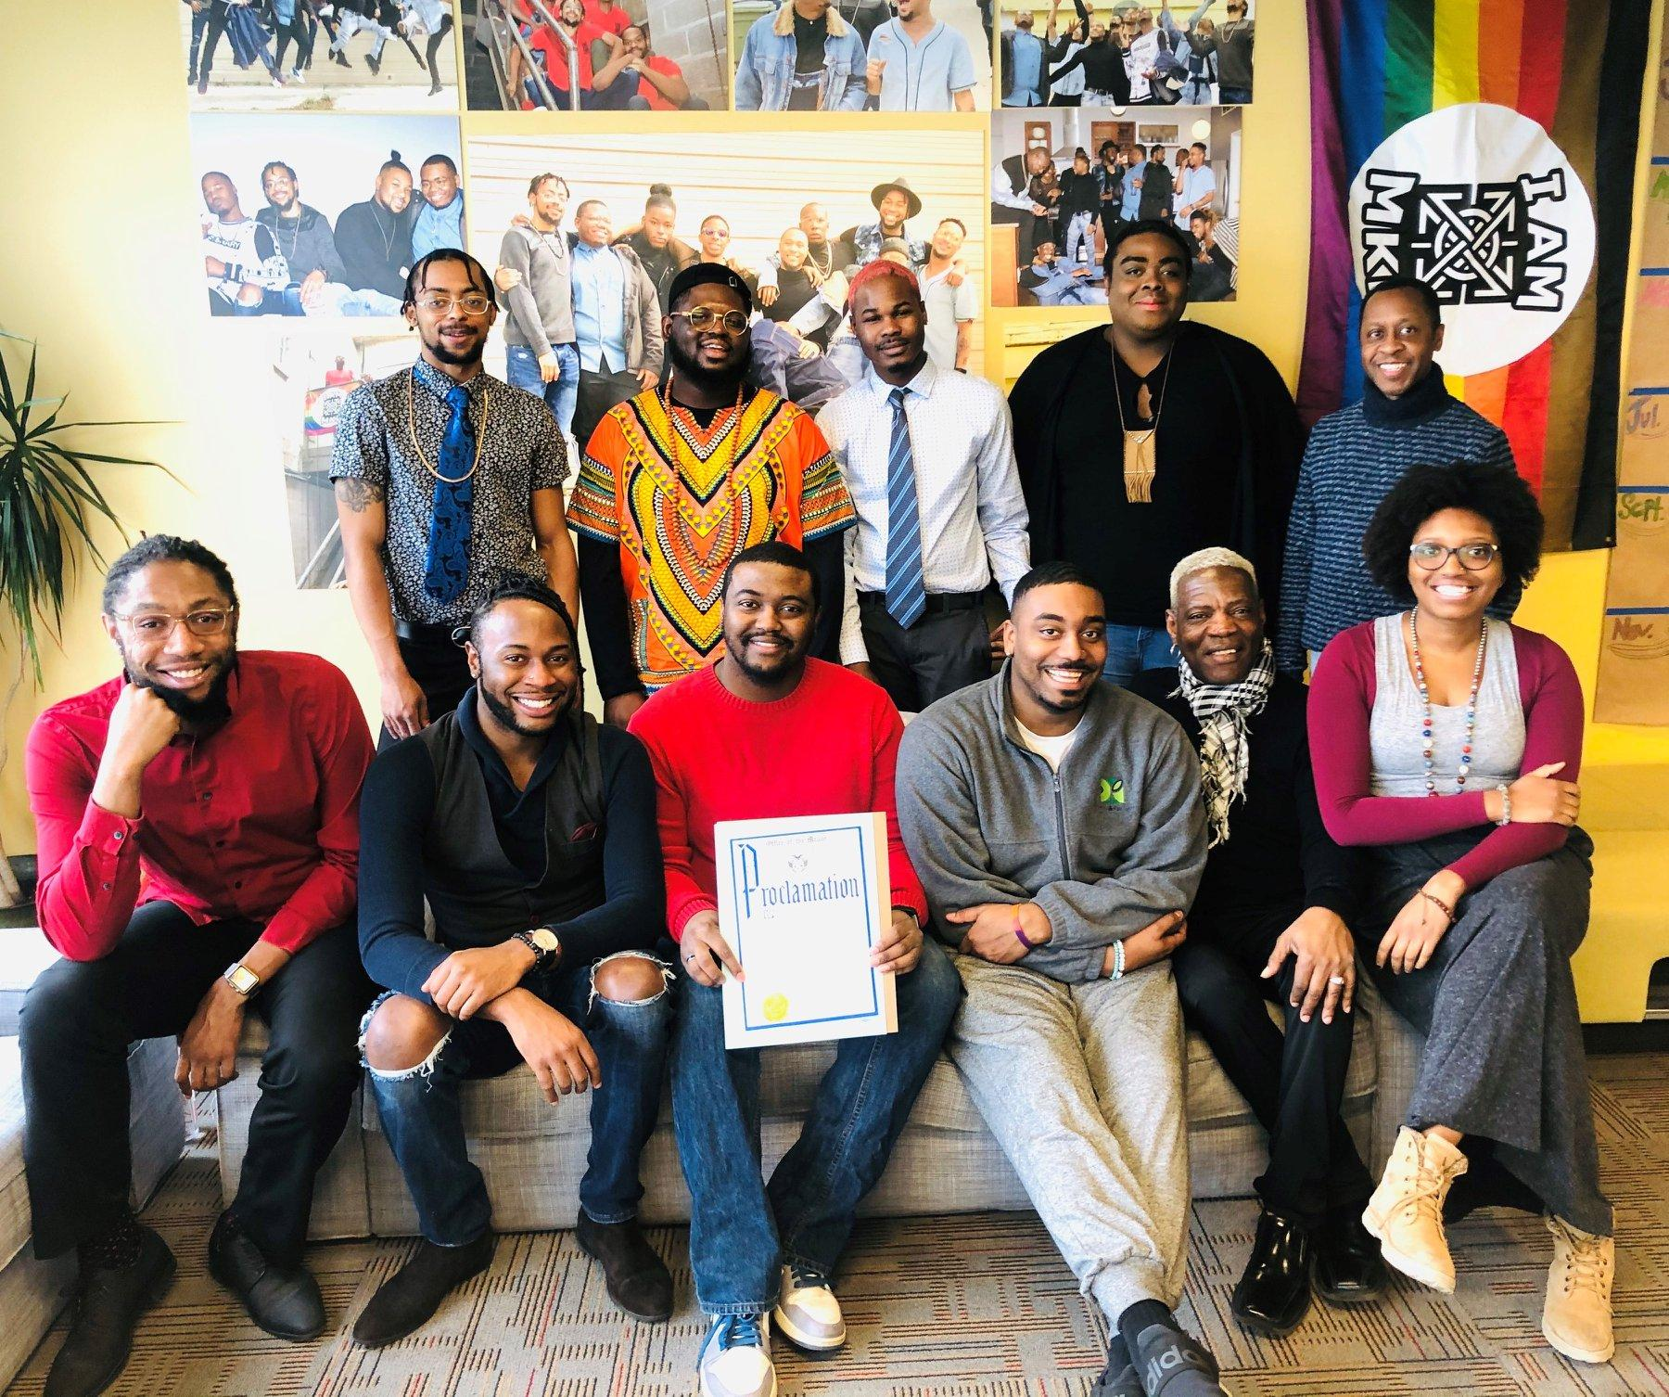
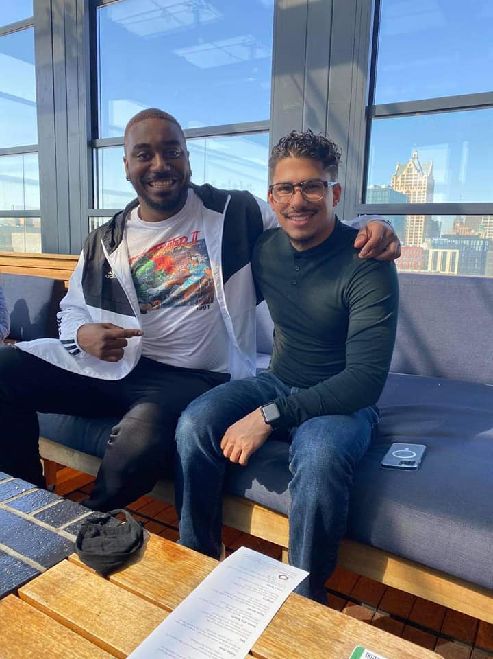
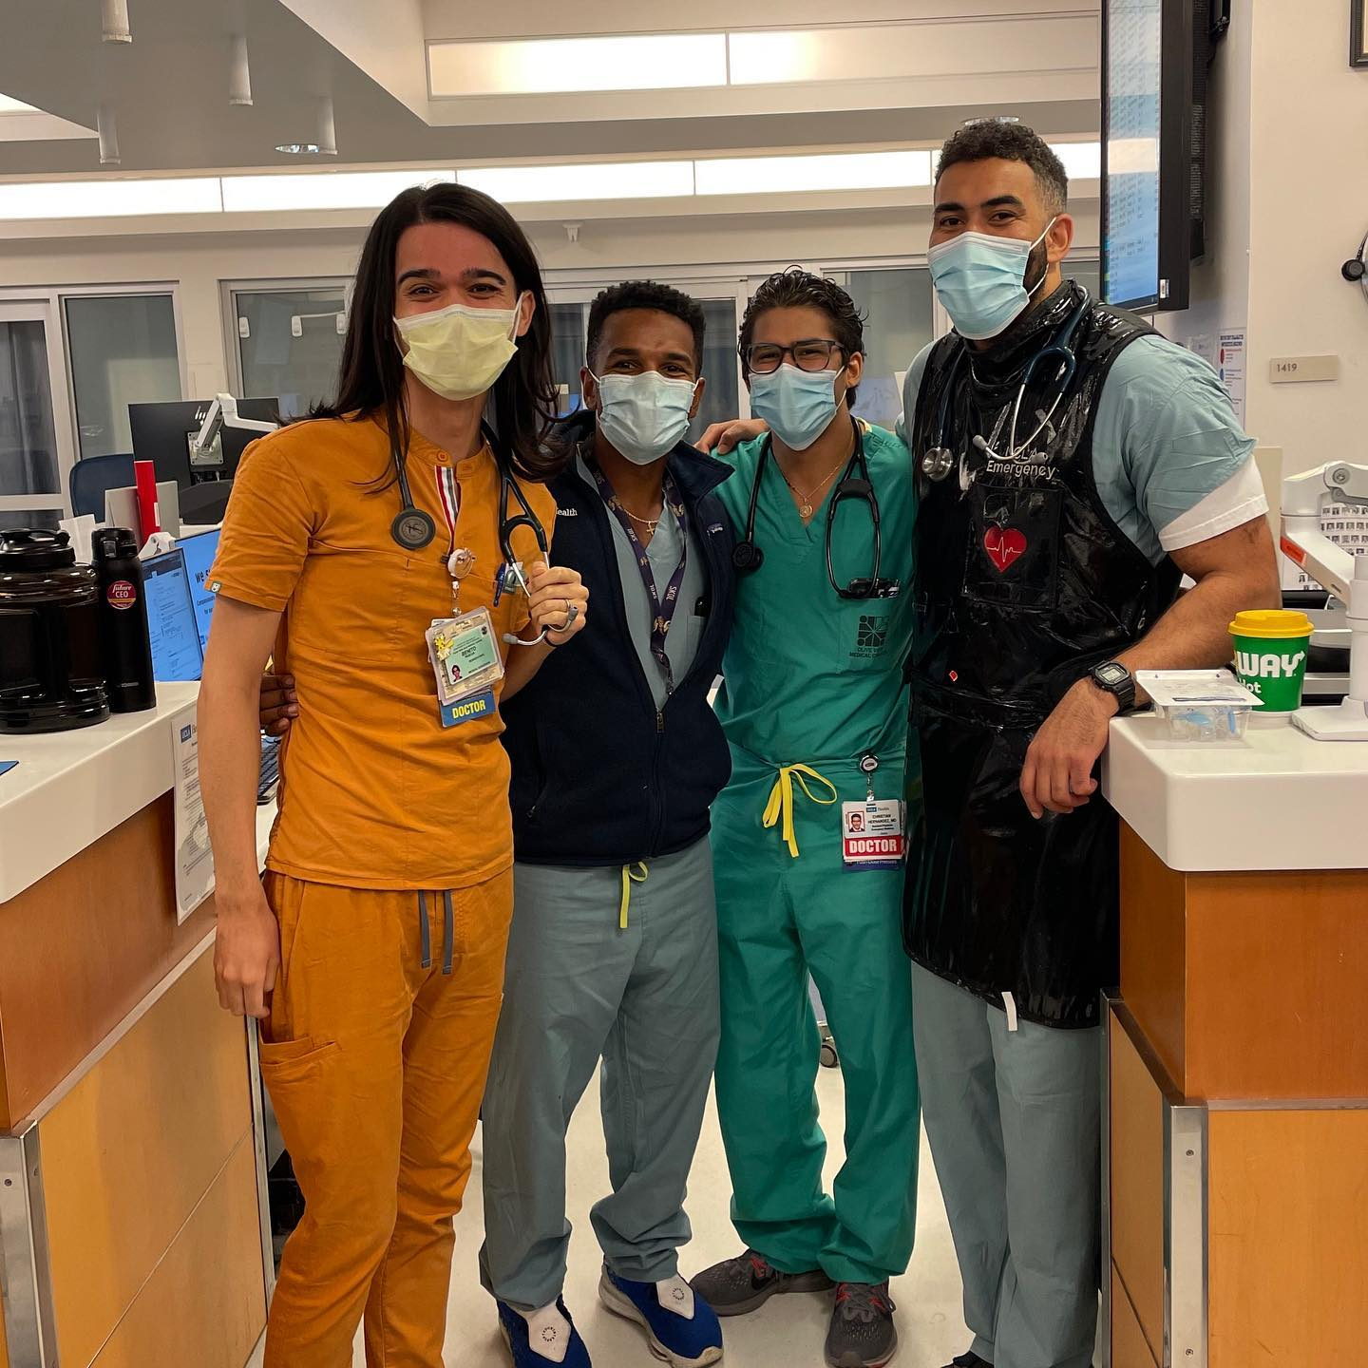
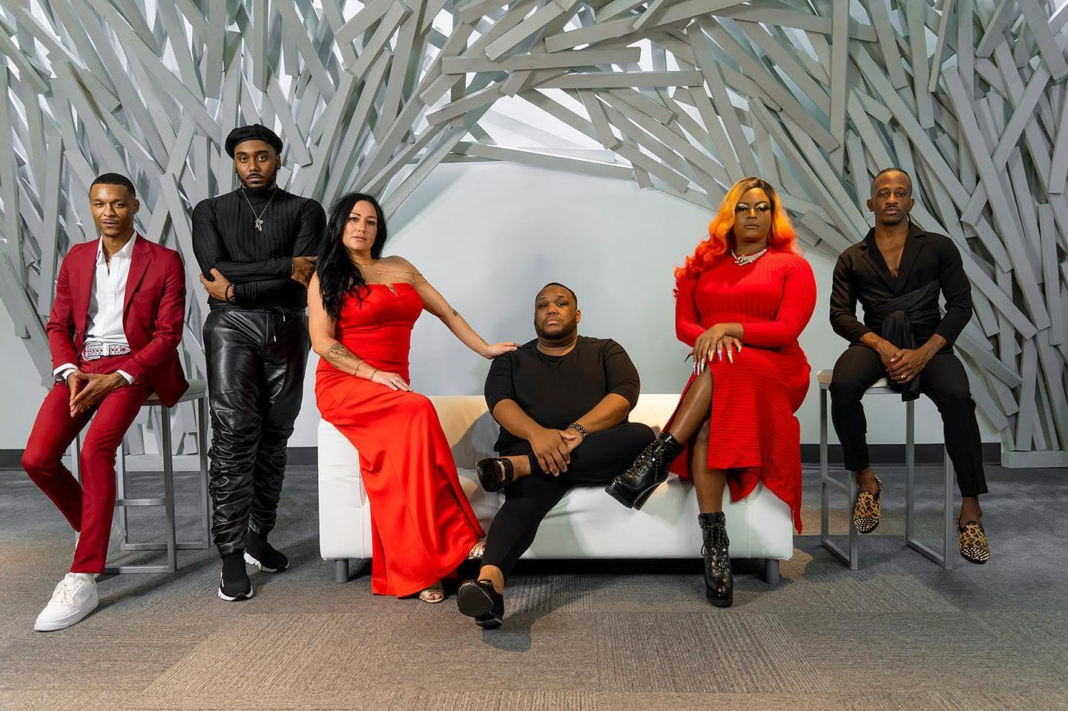
Notes:
Insert a pic to the right lol
I think this slide should be a introduction of us really quick
(picture of you and I who we are quick then presentations continues..)

Slide 4
OverView
Minority Health Month - “Give Your Community a Boost”
Health Literacy, COVID-19 Disaster Response, Health Systems
Missed Early Diagnosis, Loss of Preventative Care/ Chronic Disease Management
Access to Care, Telemedicine, New Hospital Policies
County Health, Medicare / Medi-Cal
Advanced ID Presentations, Delay of Care
Advocacy, Destigmatization, Health Promotion
Social Medicine’s Role in Addressing Chronic Disease
Notes:
Introduce lecture overview, give background about ourselves

Slide 5
“Give Your Community a Boost”
Focused on the continued importance of vaccinations, including boosters, as one of the strongest tools we can use to protect communities from infectious diseases.
https://www.minorityhealth.hhs.gov/nmhm/
Notes:
Celebrated every year in April, National Minority Health Month: Builds awareness about the disproportionate burden of premature death and illness in people from racial and ethnic minority groups. Encourages action through health education, early detection and control of disease complications. You all are helping celebrate the month by spending your morning with us today.
“Give your Community a Boost” - a broad interpretation, reflecting on what factors motivate or inhibit individuals to want to obtain vaccines, how those behaviors were established, what influenced the development of those beliefs, how to best integrate new science into public discussions

Slide 6
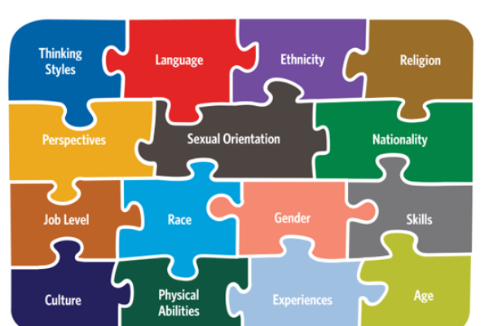
Diversity, Equity, Inclusion
https://www.thecloroxcompany.com/blog/our-refreshed-global-inclusion-diversity-strategy/ - Graphic Accessed 04/12/2022
Notes:
Jamal
-diversity can’t thrive without inclusion.
identity influences the way we perceive and process information
How we communicate messages across various spectrums
The way we describe what we’re feeling or the symptoms we have
How we articulate our understanding of topics
Identity, is central in thought processing and expression also t our ability to manage our chronic diseases

Slide 7
Health Literacy
Individual
Community Gathering Spaces
Community
Health Care Complex
Notes:
How identity influences health literacy

Slide 8
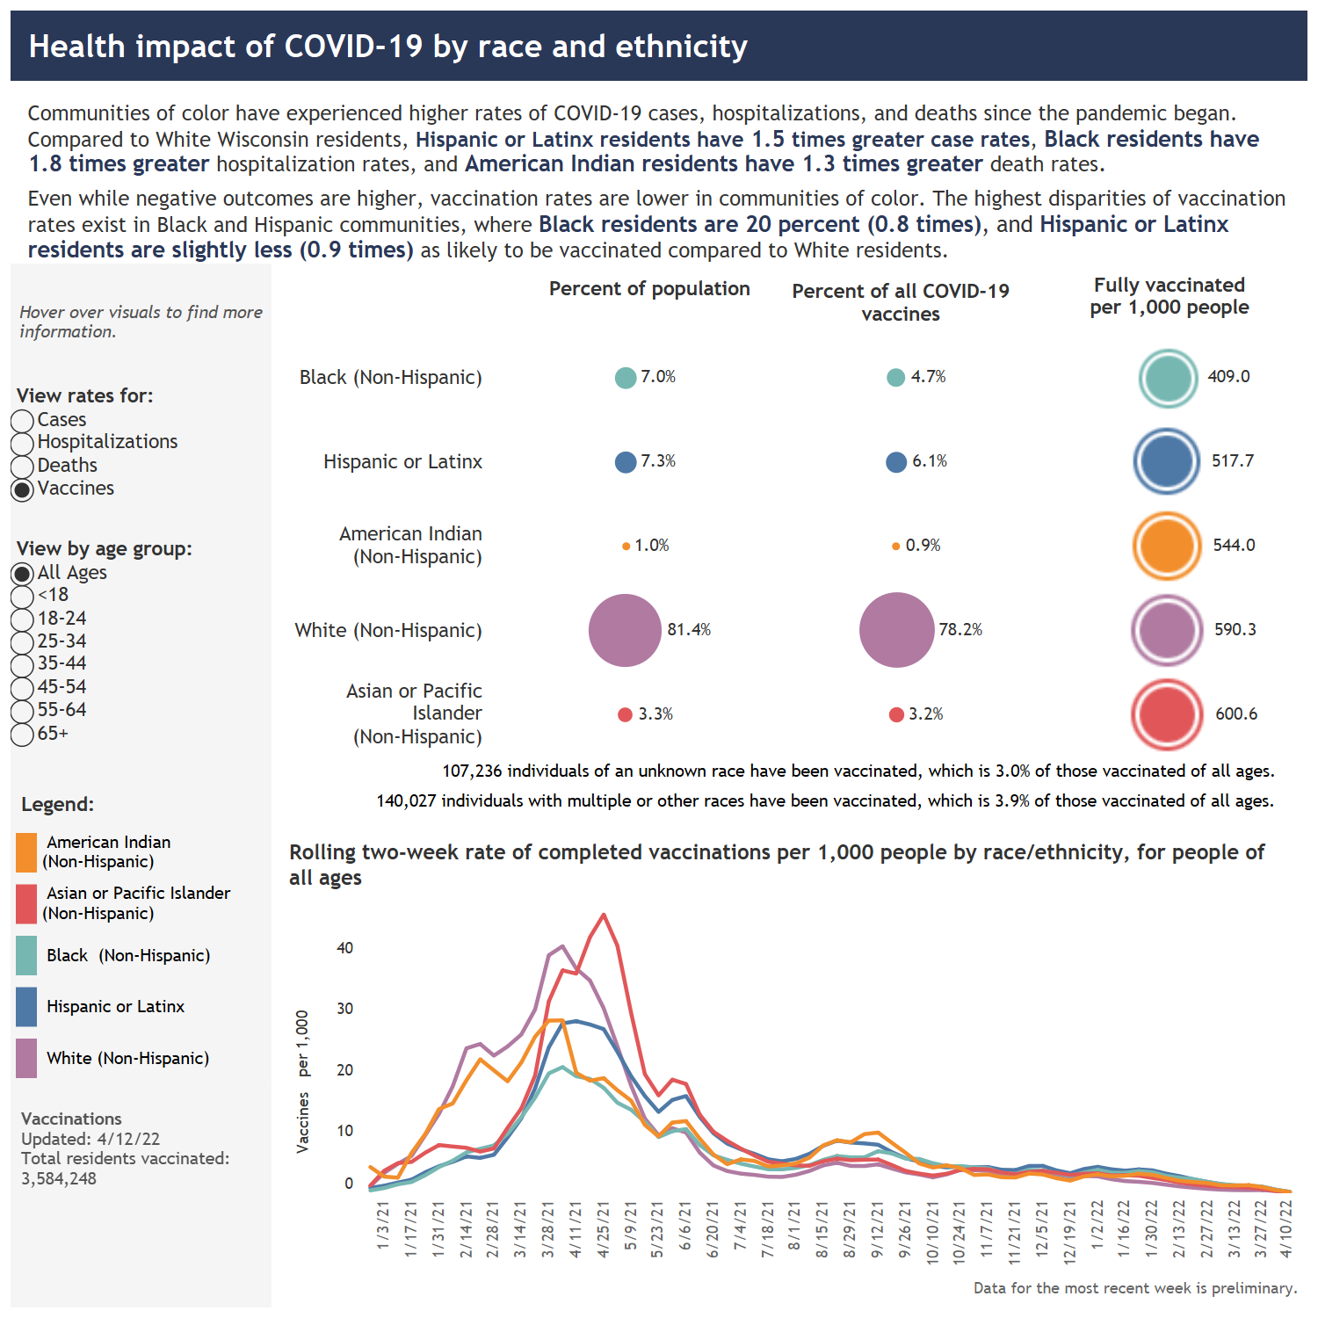
Structural Racism
Patients Unable to follow with providers for management of their Chronic Diseases
Disaster Response and Supply Chain
Misinformation in Communities and Lack of Health Literacy
Abenoza N, Hernandez C, Martinez E, Mora J, Siker M. 'Knowing What's Best': Community Partnerships Against COVID-19. WMJ. 2020 Jun;119(2):76. PMID: 32659055.
Wisconsin Department of Health Services COVID-19 Racial and Ethnic Disparities, 2021 - Retrieved 04/12/2022
Zeno Franco, Chris Davis, Adina Kalet, Michelle Horng, Johnathan Horng, Christian Hernandez, et al. (2021). Augmenting Google Sheets to Improvise Community COVID-19 Mask Distribution. In Anouck Adrot, Rob Grace, Kathleen Moore, & Christopher W. Zobel (Eds.), ISCRAM 2021 Conference Proceedings – 18th International Conference on Information Systems for Crisis Response and Management (pp. 359–375). Blacksburg, VA (USA): Virginia Tech.
Notes:
Talk about Structural Racism: For decades, African Americans in Milwaukee have dealt with devastating rates of poverty, intense segregation in housing and education, a criminal justice system that arrests, incarcerates, and devours communities of color at vastly disproportionate rates, as well as a myriad of other hardships rooted in our history of racism.
-Discuss hypothesis as to why less vaccination in POC communities (trauma from medical institutions, research studies i.e. tuskegee, conspiracy theories via other info platforms [whatsapp, youtube], early pandemic theories that poison was being injected into ppls veins [hispanics])
-Briefly allude to the Latinx Paradox and it being flipped in the instance of COVID
Discus early work during pandemic, disaster response, materials production and distribution, partnerships - Ayuda Mutua, Sixteenth Street Community Health Centers, United Migrant Opportunity Services, and United Community Center, Sherman Phoenix, etc.
If asked about it can discuss the interesting transition of the Hispanic Paradox and the opposite observed outcomes with COVID

Slide 9
Where Are we now?
Increase in individuals engaging in risky health behaviors during the pandemic like overeating and sedentary lifestyles
Decreased elective procedures early in pandemic → Delayed Sequelae of Diseases
Transformation of Health Care Systems (limiting visitors)
Poor Chronic Disease Management and Delayed Diagnosis (i.e. HIV, Syphilis, Chlamydia)
Increased Social Isolation → Increase in Mental Health Concerns (Stress, Anxiety, Depression, Substance Use)
Projecting COVID-19 Disruption to Elective Surgery. Lancet. 2021; 399: 233:234
Czeisler M.É., Marynak K., Clarke K.E.N., et al. Delay or avoidance of medical care because of COVID-19-Related Concerns - United States, June. 2020. Morb Mortal Wkly Rep. 2020;69:1250–1257.
Notes:
Bullet point 3: Limiting patient clinic, ED, ICU patient visitors to none initially or 1-2 afterward. How giving birth has changed, how providing patient health care information has changed (reflecting on the impact of this in family’s that rely on values such as familismo and allocentrismo [the impact of social integration on health and well-being], i.e. teaching my grandfather about diabetes, or my cirrhosis patient about alcohol abstinence)
Diabetics coming in with gangrenous foot ulcers extending into necrotizing infections due to medication non-compliance 2/2 running out of medications not controlling conditions appropriately
HIV advancing to AIDS and having down stream opportunistic infections (i.e. Disseminated fungal infections such as valley fever [coccidiomycosis], tuberculosis, PJP, etc.)
Schools not having in person classes. Educators burnt out, sub-qualified individuals filling gaps,

Slide 10
NEJM: ON Isolation
Health care workers left to fill the gaps (isolation)
ICU Delirium & Depression
PTSD
February 25, 2021
N Engl J Med 2021; 384:690-691
DOI: 10.1056/NEJMp2029725
Notes:
Isolation during illness is not new, but its effects and inequities are magnified by this pandemic. Visitor restrictions are reasonable public health measures, but they are inherently inequitable. People with the means to care for loved ones at home do not suffer the consequences of these rules as severely.

Slide 11
TeleMedicine and The evolution of Virtual Health
Decrease in patient accessibility to primary care → Transition to more virtual health follow-up care in person
Goal: Decrease in Infectious Disease Transmission (COVID)
Loss of Continuity of Care → Patient with “Red Flag Symptoms” referred to Emergency Departments
Goal: Expedited work-ups, labs, imaging
Results: Overwhelmed Emergency Departments, Burnt out Health Care Worker’s, Supply Demand Problems with Nursing (Increased Travel Nursing Requests, early retirements).
Challenges: Insurance Coding, Patient Education, Technology
Notes:
Open this if anyone wants to share any experiences with telemedicine too.
Case Managers and Insurance Navigator’s many times are not as well informed as they should be in understanding how to best assist patients in navigating care
-Advocacy via unionization for health care providers
Lack of education amongst providers in understanding insurance

Slide 12
County Experience - COVID Era
Delayed Diagnosis of HIV → Patient presenting with AIDS + AIDS Defining Illnesses (Disseminated Fungal Infections, Pneumocystis Jirovecii, on Top of COVID Infections)
Increased Transmission of STI’s, More Syphilis (including tertiary manifestations [Neurosyphilis]
Chlamydia & Gonorrhea Infections with advanced presentations → Pelvic Inflammatory Disease / Perihepatitis
Inability to Acquire Disease Controlling Medications (Anti-virals, PREP)
Intimate Partner Violence → Changes in Criminal Justice System Reporting and Navigating Court systems
Notes:
Narrative Medicine

Slide 13
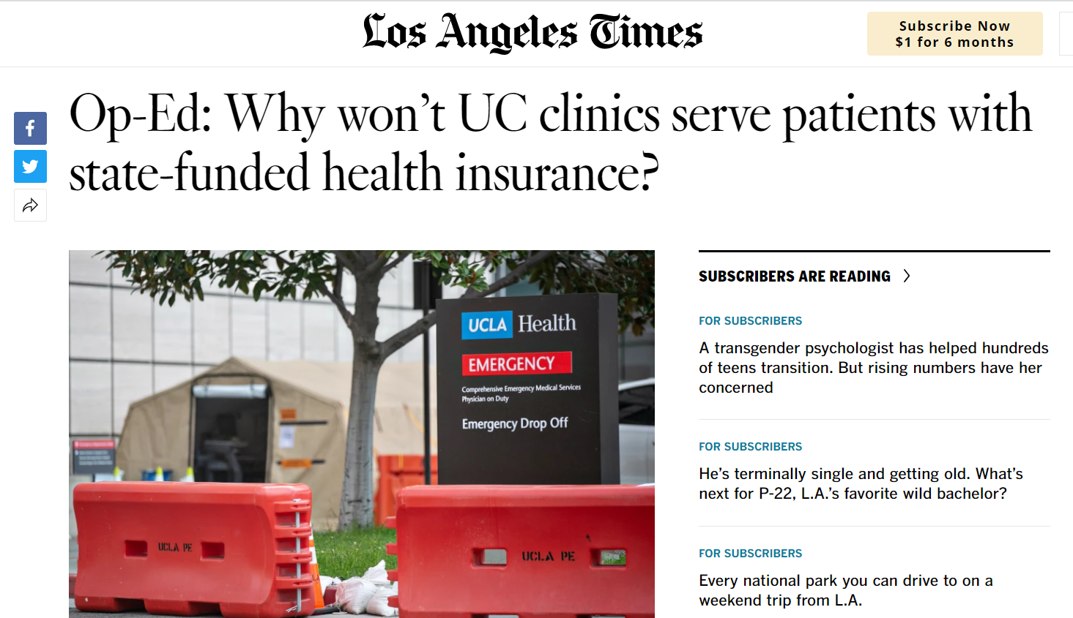
Disparities Magnified in the County System
Hospitals choosing the percentage of Medi-Cal, Uninsured, Emergency Authorized patients to take to not lose profit
The Patient Populations that UCLA clinics tend to serve is disproportionate to actual patient racial/ethnic composition in the county.
Notes:
Lack of PCP’s for patients to follow up with.

Slide 14
Evolution of Advocacy
Increased Isolation required creative strategies in helping spread information, to counter the misinformation movement.
How do you engage in conversations involving topics usually stigmatized in our communities?
Does the screen provide an additional safety net to “escape” shame/fear associated with discussing certain topics?
Notes:
Try to find a way to transition to your piece. (Jamal)

Slide 15
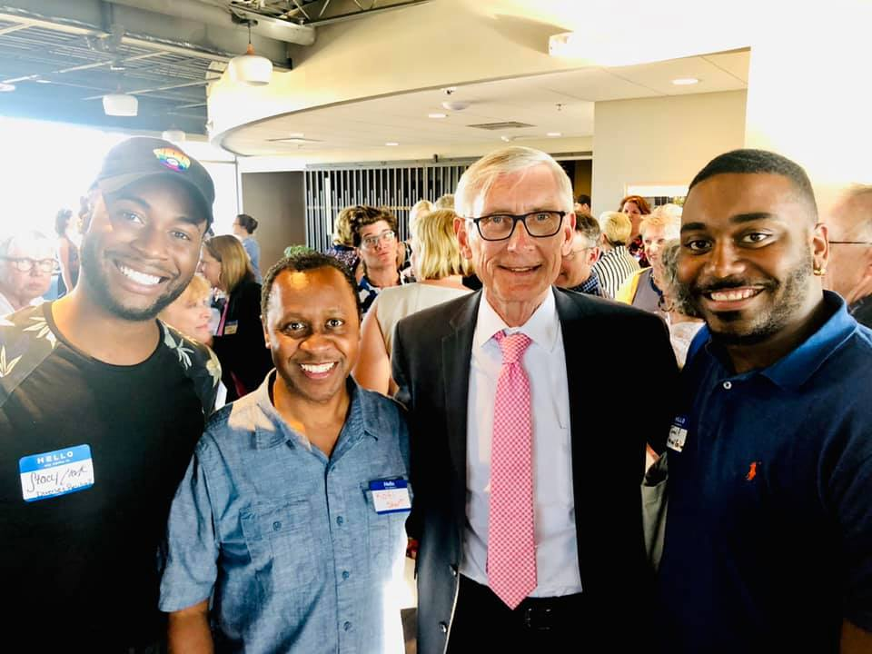
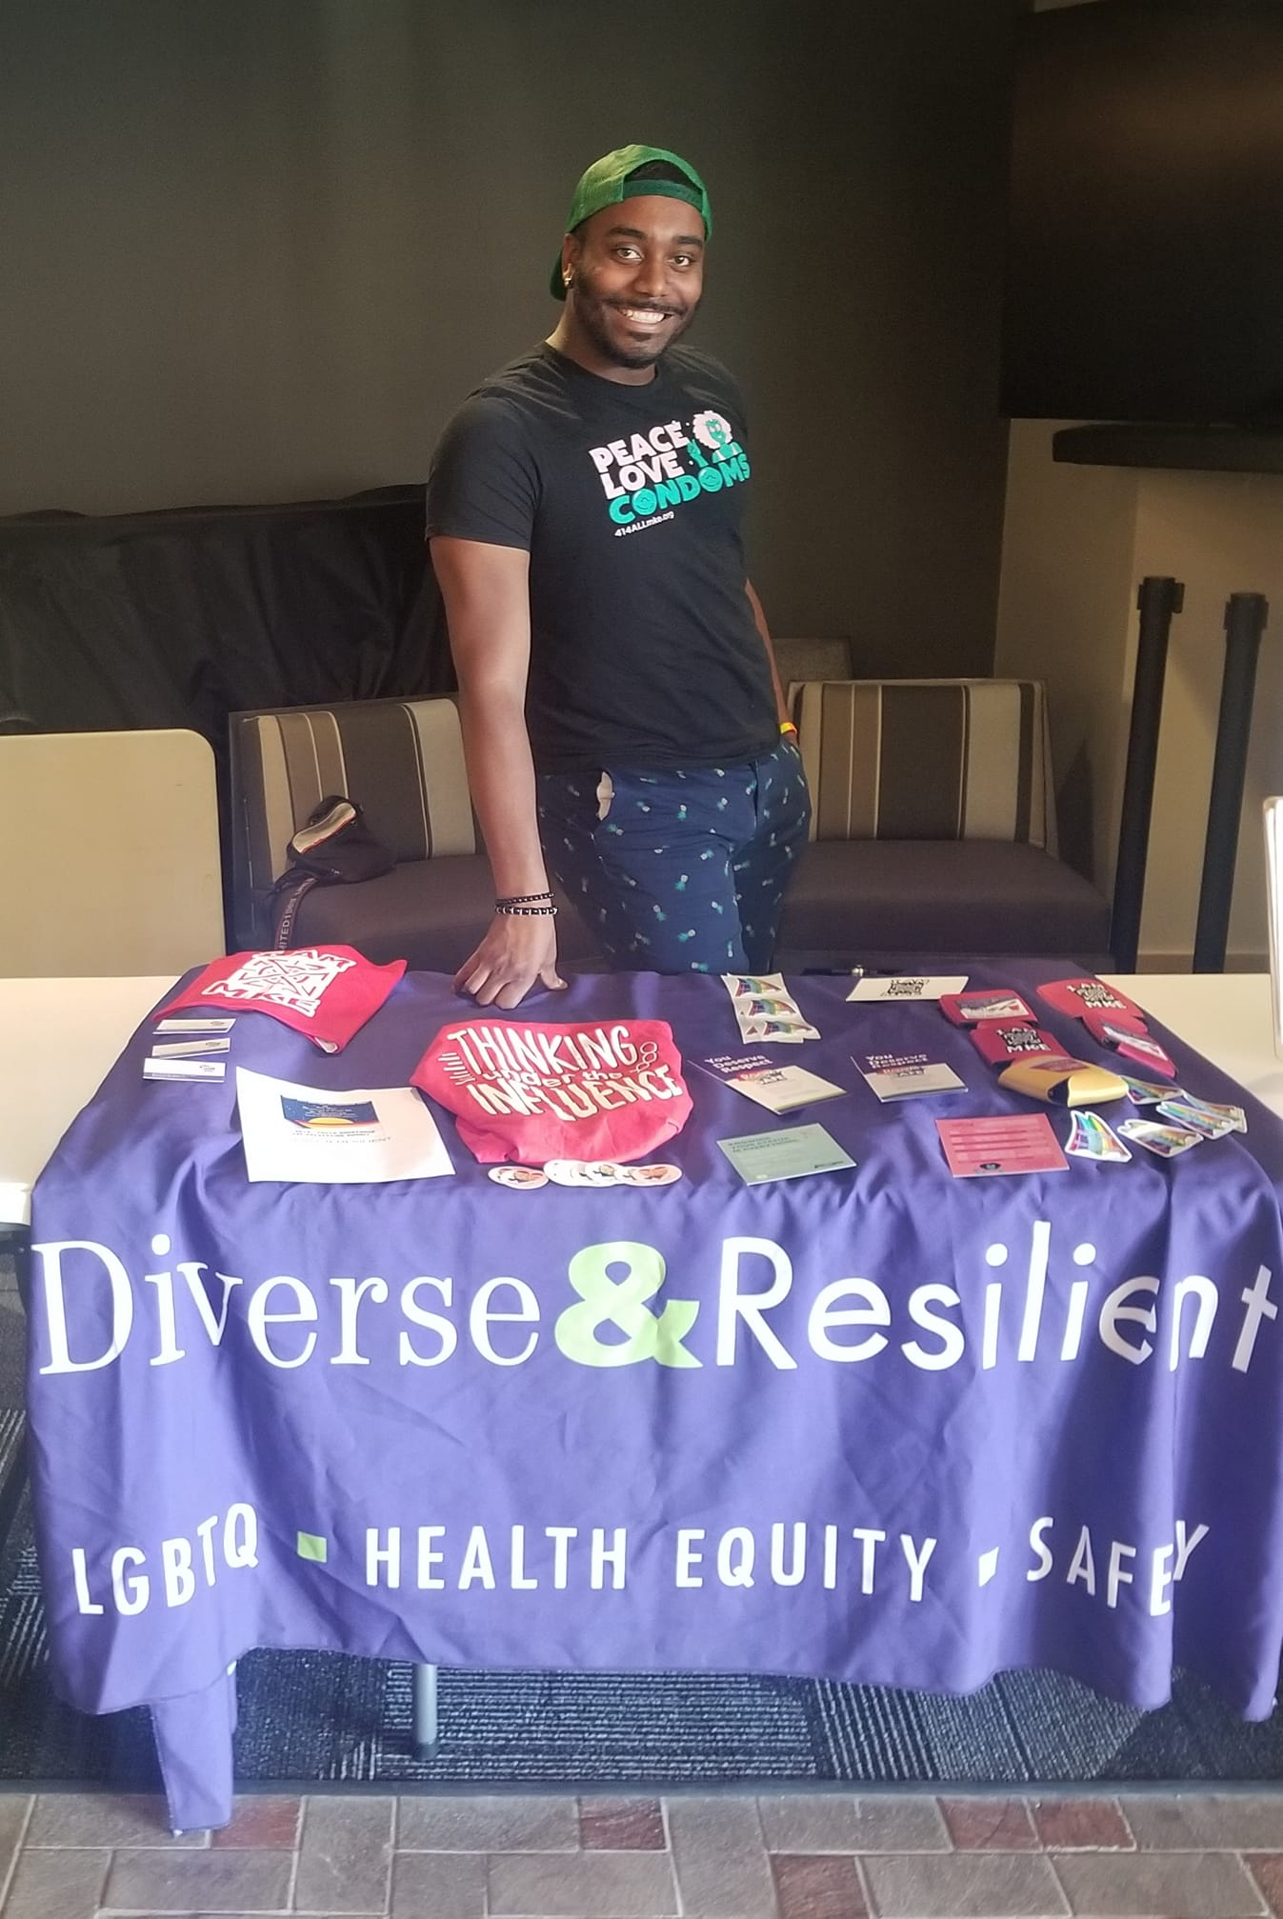
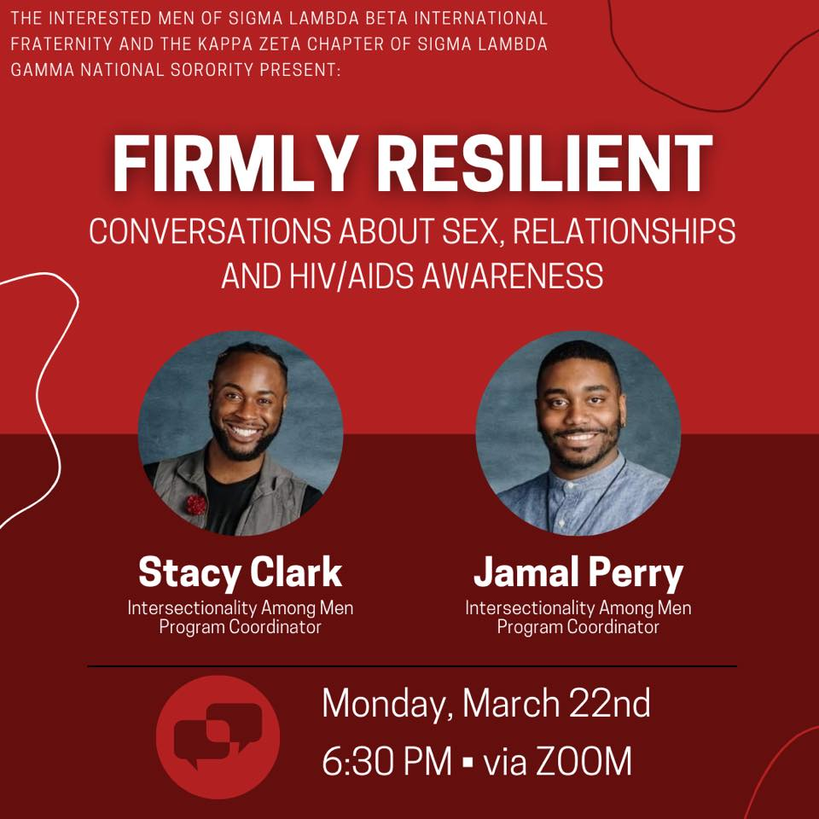
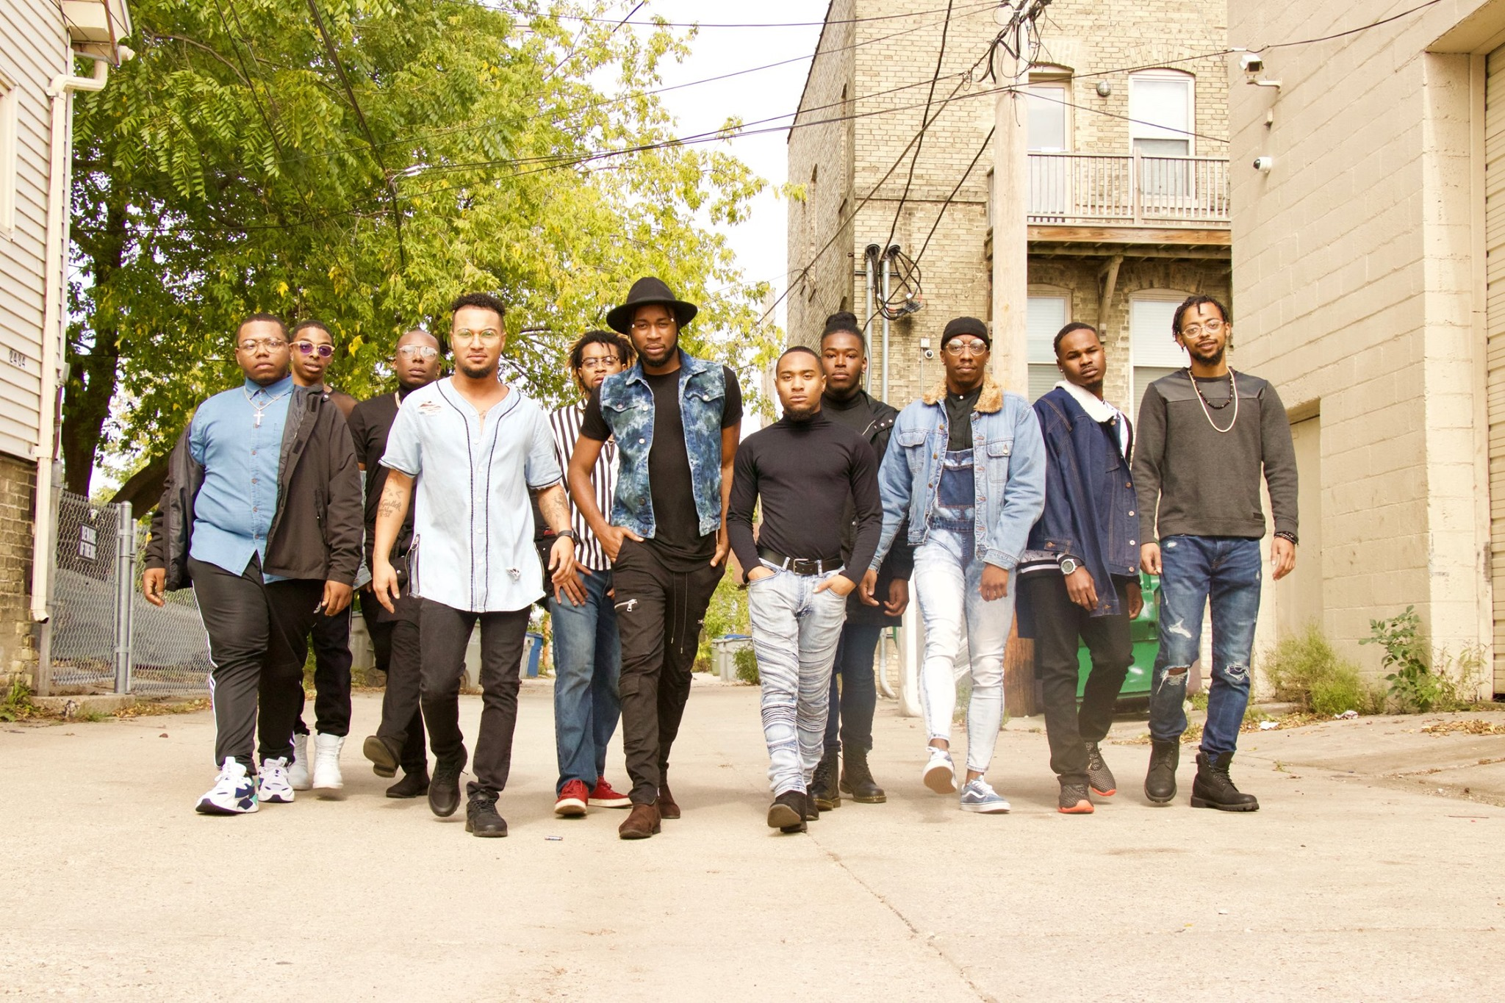
Notes:
-Before working with MATCH and UW’s Population Health Institute
-Much of my work and background was directly in community, doing work around LGBTQIA advocacy, equity, and HIV/STI prevention.
-As a Community Health Worker (CHW) I worked directly with Black and Brown LGBTQIA communities to help advance health literacy within my community.
-This work was done through Diverse & Resilient and various community partners
-Educating and destigmitizing HIV, and conversations around overall sexual health
-I’ll dive a little deeper into some of those programs and work

Slide 16
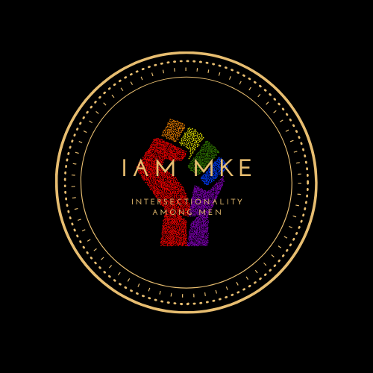
Notes:
-When I talk about de stigmatization, creating a safe space for Black and Brown same gender loving communities, bridging gaps between medical staff and community, and sexual health education/advocacy
-The Intersectionality Among Men project at D&R was a program for Black and Brown same gender loving Cis men 18-29 that was rooted in HIV prevention but grew into a community force for change. IAM promoted community Health by providing HIV/STI prevention through non traditional events and efforts. As one of the coordinators of this program we equip members of IAM with the tools and skills to go out into their own networks and community and educate and eliminate stigma around HIV, and HIV prevention efforts
-Talking about U=U, PrEP, and getting routine testing
-Overall normalized conversations around infectious diseases that are often left out of conversations in minority communities.
-But it’s important to realize these conversations aren’t just being left out for no reason
-Medical mistrust, minority stress,various social determinants of health also attribute to these conversations not being had and lead to unfavorable health outcomes.
-But the work IAM was and still is doing helped to address these various health disparities.

Slide 17
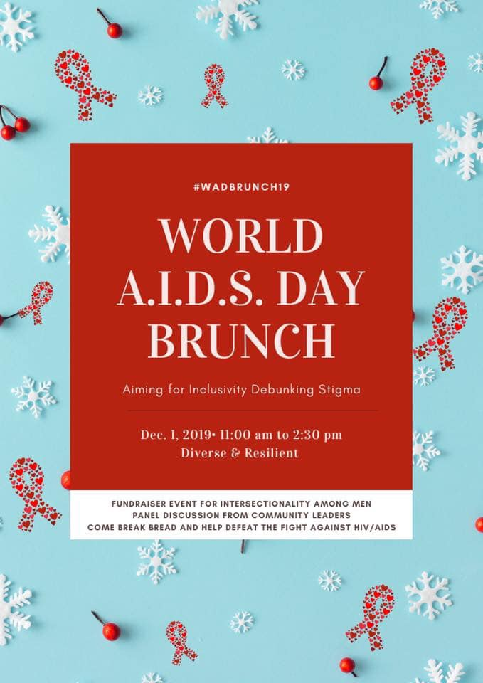
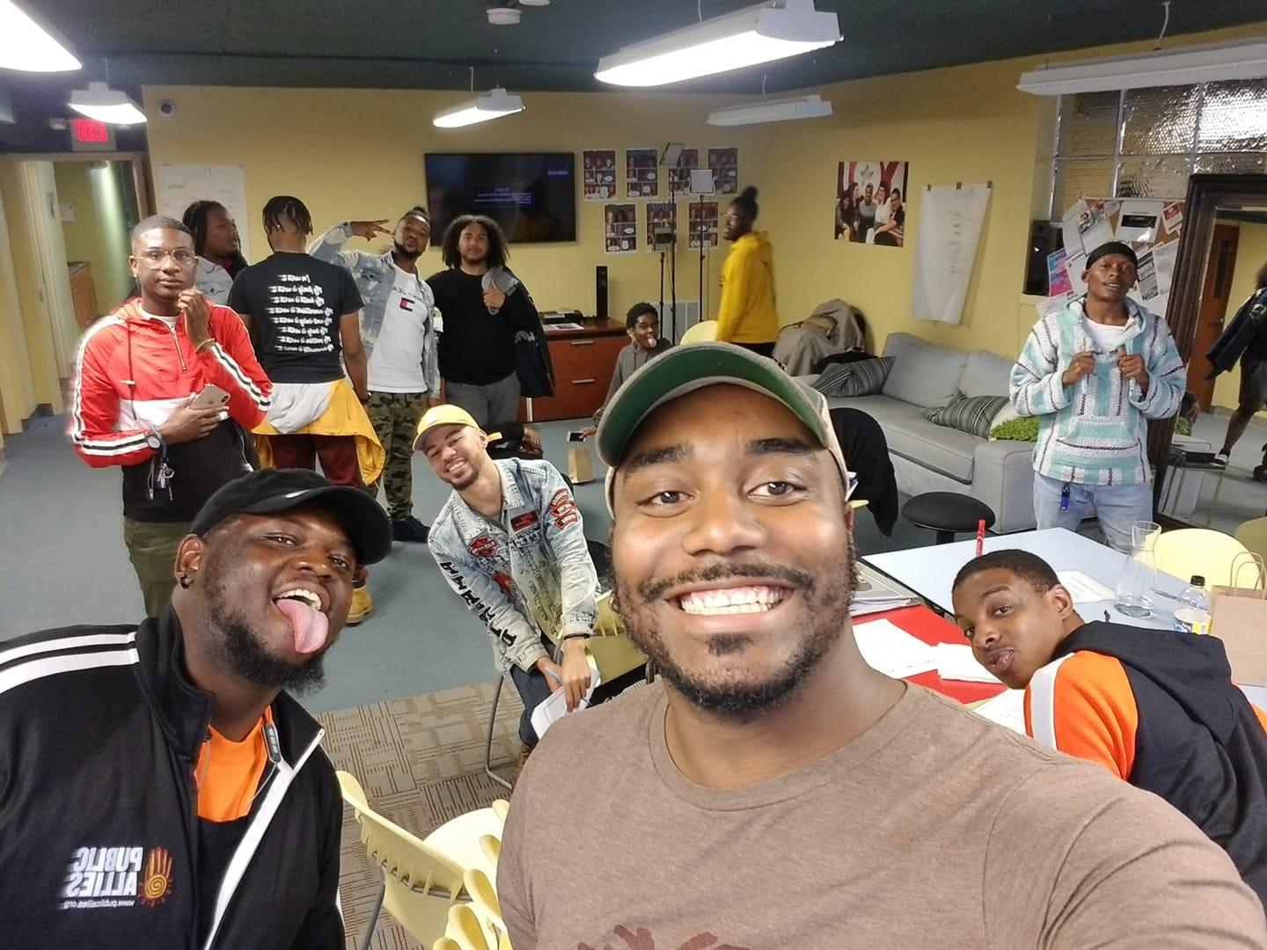
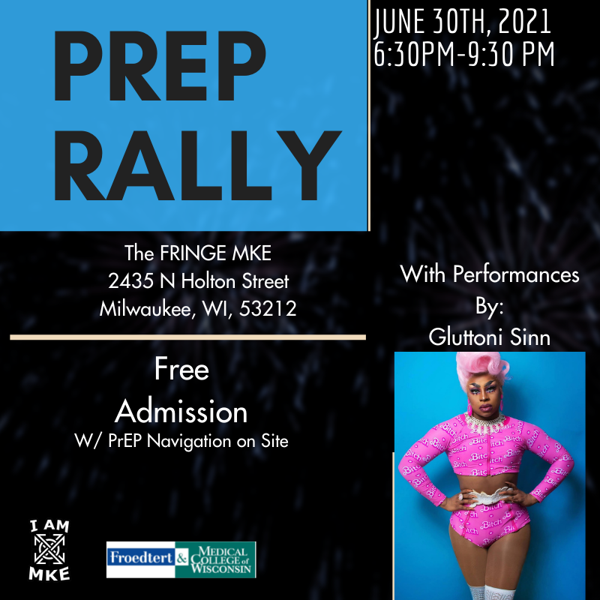
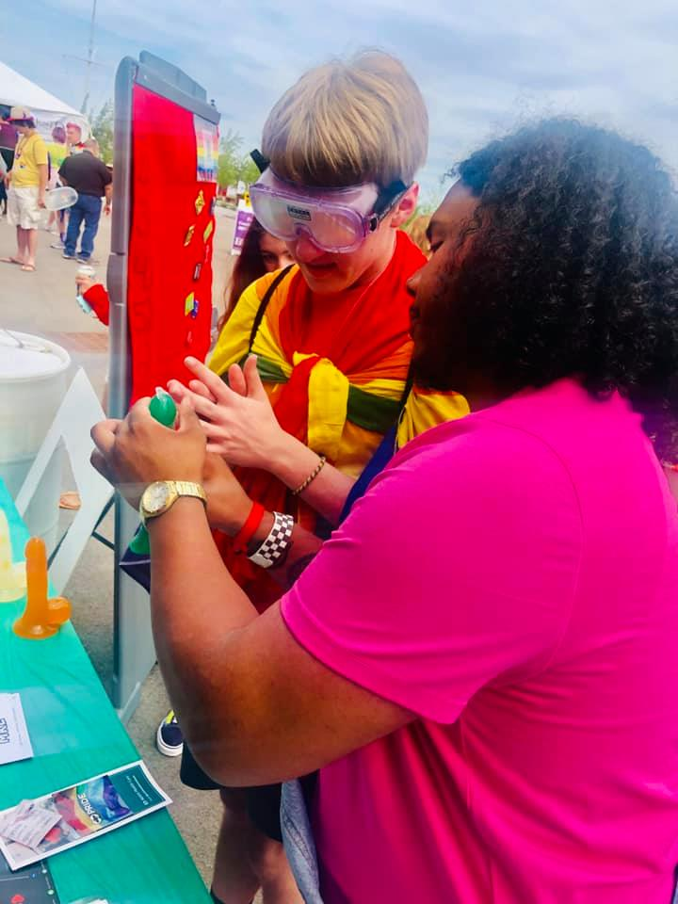
Notes:
-When it comes to vaccine Equity, Health equity, reaching community, increasing health literacy frontline staff, community voices, and CHW’s play such a pivotal role in increasing a community and populations health.
The rest of these images are just some of those nontraditional space we created to address HIV related health disparities in Black and Brown SGL communities in Southeast WI.

Slide 18
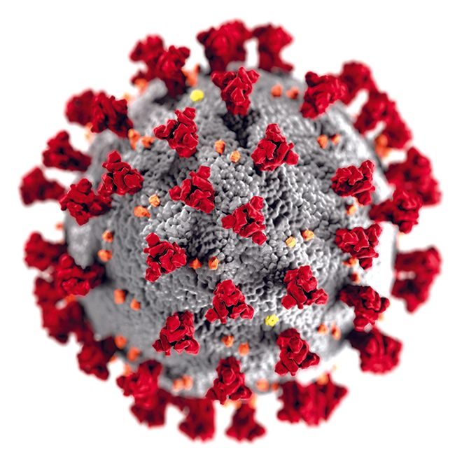
Social Medicine
I Hear You, I see you, Your Concerns are Valid
Patient-Centered Care
Infectious Disease Chronic Disease Management Minority Health
Notes:
Being Patient-Centered, Offering Validation. If we struggle navigating a complex health care system.
Care Centered around the Social Determinants of Health
Ending Argument: Infectious Disease has always influenced chronic disease management in recent history (think to HIV pandemic impact on LGBTQ community, COVID 19 in the present)
productivity based
Faculty promotions

