Slide 1
US Trans Survey
The U.S. Trans Survey (USTS) is the largest survey of trans people in the United States. The survey documents the lives and experiences of trans people in the U.S. and U.S. territories.
The USTS is the main source of data about trans people for the media, educators, policymakers, and the general public, covering health, employment, income, the criminal justice system, etc. The last survey in 2015 has been vital to understanding disparities in specific states as well as specific populations of focus, including people of color.
Please consider how you can get the word out to transgender and nonbinary folks aged 16+.
https://www.ustranssurvey.org

Slide 2
LGBTQIA2S+ Health Disparities
with Beneli Andert and Grayson Schultz

Slide 3
Beneli Andert
they/them
Grayson Schultz he/him

Slide 4
Introduction
We want to first acknowledge that much of the work being done around equity, both within and outside of Wisconsin, is being led by Black, Indigenous, and other people of color.
This is especially important to keep in mind during Pride Month, a month commemorating a riot against oppressors that was started by disabled trans women of color fighting for rights that are not distributed equitably - and that we know from this year alone are constantly in jeopardy.
Today is the anniversary of the Stonewall Riots, a day in 1969 that led to the LGBTQ+ rights movement as we know it now.

Slide 5
Land Acknowledgment
Notes:
The term “Two-spirit” is used by some Indigenous people to describe their sexual, gender, and/or spiritual identity. It's an umbrella term and may encompass same-sex attraction and a wide variety of gender variance, including people who might be described in Western culture as gay, lesbian, bisexual, transgender, gender queer, or who have multiple gender identities. The creation of the umbrella term “two-spirit” is attributed to Elder Myra Laramee, who proposed its use during the Third Annual Inter-tribal Native American, First Nations, Gay and Lesbian American Conference, held in Winnipeg in 1990. It was created to replace the offensive anthropological term berdache (pron. berdash). The word “two spirit” had not been previously used and was never intended to replace the traditional terms or concepts already in use in any Native cultures. Being Two Spirit is a spiritual role that is recognized and confirmed by a person’s community and Elders. It is important to note that if you don't have a tribe, you should not claim that role, because to do so is appropriative of Native and Indigenous culture.
Many tribes believe that Two Spirit people have both a male and female spirit within them and are blessed by their Creator to see life through the eyes of both genders. Two Spirit people held a meaningful place in the sacred hoop. In many tribes Two Spirits were balance keepers, thought to be the "dusk" between the male morning and the female evening. Although not all Native cultures conceptualize gender this way, research shows that more than 150 different pre-colonial Native American tribes acknowledged third genders in their communities.
The effects of colonialism in Native American communities resulted in both marginalization on the basis of racial/ethnic identity and also of gender and sexuality. Christian European colonizers condemned same-sex relationships and gender variance as sinful and used these beliefs to further dehumanize Indigenous people.
The land we are on is the ancestral home of the Ho-Chunk Nation, who have called this land Teejop (day-JOPE) since time immemorial.
In the first treaty following the Indian Removal Act in 1830, the state government forcibly removed the Ho-Chunk from their home in 1832. In the decades that followed, the federal and state government sought to completely remove the Ho-Chunk from Wisconsin. Despite these attempts, many Ho-Chunk people continued to return to their home in present-day Wisconsin.
We acknowledge the circumstances that led to the forced removal of the Ho-Chunk people, and honor their history of resistance and resilience. The Ho-Chunk Nation and the other eleven First Nations residing in the boundaries of present-day Wisconsin remain vibrant and strong.
We recognize and respect the inherent sovereignty of the twelve First Nations that reside in the boundaries of the state of Wisconsin. This history of colonization informs our work and vision for a collaborative future.

Slide 6
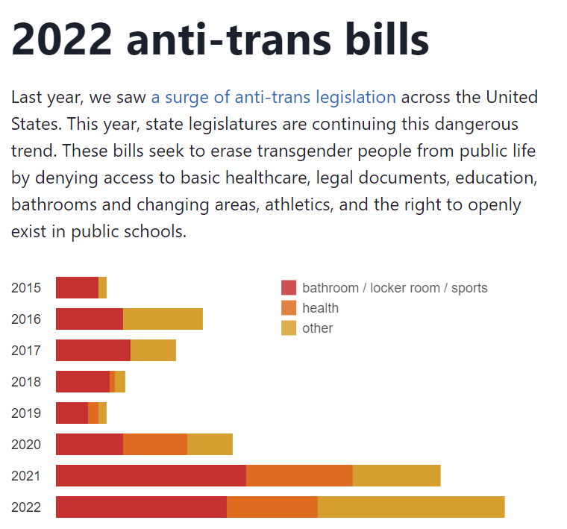
Perhaps the most well-known of the bills passed this year that harm transgender youth are those in Alabama, Florida, and Texas.
AL SB184 makes it a class C Felony for any healthcare provider to give transgender children any assistance in transition, including prescribing puberty blockers which help these kids not be forced to go through the wrong puberty.
FL H0007 + FL H1557 - the Anti-Wokeness bill and Don’t Say Gay bill, respectively. These bills give parents an unheard of level of oversight into what their children are being taught, including avoiding teaching about discrimination, racism, or any LGBTQ+ topics. Teachers have already been fired for having photos of them with their partners in the classroom.
Texas has been instructing CPS to investigate families with transgender children, asserting that puberty blockers are harmful.
Notes:
I wonder about moving the text to the speaker notes and making the graph the whole slide. It’s pretty impactful, and that way people won’t be distracted by the text and will focus on the holy crap aspect of the graph and listening to what is said.

Slide 7
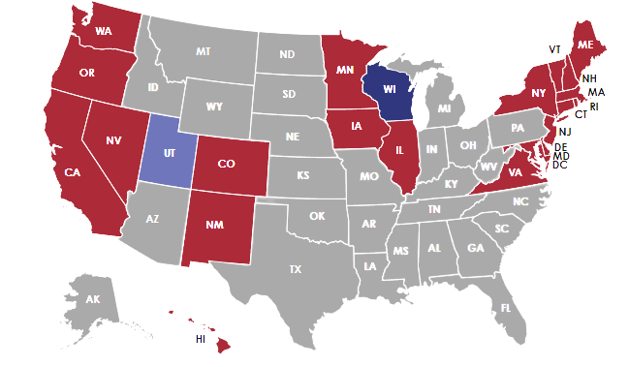
Protections
No LGBT Non-Discrimination Protections
Lacking Gender Identity Protections
Some LGBT Non-Discrimination Protections
Full LGBT Non-Discrimination Protections
Notes:
Nearly 30 states still lack clear laws to protect lesbian, gay, bisexual, and transgender, or LGBT, Americans from discrimination because of their sexual orientation or gender identity.
Wisconsin, for example, has no explicit protections from discrimination on the basis of gender identity.
Nationally, there remains no explicit federal law that prohibits LGBT Americans from being fired; being refused service; or, incredibly, even being denied access to medical care.
https://freedomforallamericans.org/states/
https://www.americanprogress.org/article/video-their-baby-was-denied-access-to-care-because-they-are-gay/

Slide 8
Wisconsin Legislation
Notes:
In 2018, after multiple lawsuits, Wisconsin’s Group Insurance Board agreed to cover gender affirming procedures.
This came after DHS at a federal level began to remove barriers to covering procedures for those on Medicare in 2014.
https://www.npr.org/sections/health-shots/2018/08/29/642965617/in-a-reversal-wisconsin-to-cover-state-workers-seeking-transgender-treatment
https://www.verywellhealth.com/medicare-coverage-for-transgender-surgery-5187791
https://transequality.org/know-your-rights/medicare

Slide 9
The Toll on Transgender Folks
A 16-year trans boy tried to kill himself after investigations of families supporting their trans kids were ordered in Texas. “[He] said that the political environment, including Abbott’s Letter, and being misgendered at school, led him to take these actions.”
He survived the attempt and was admitted to an outpatient psychiatric facility, where staff learned that he was undergoing hormone therapy. A week after he was discharged, an investigator from DFPS visited the family’s home and, according to the lawsuit, said that the psychiatric facility had reported the family for child abuse. The family remains under investigation.
This kid is not alone.

Slide 10
Recent Statistics
85%
Suicidality
Depression
52%
of transgender and nonbinary youth say that recent debates around anti-trans bills have negatively impacted their mental health
gender-affirming care for youth was linked to 73% lower odds of suicidality
gender-affirming care for youth was linked to 60% lower odds of moderate or severe depression
of transgender and nonbinary youth have seriously considered suicide in 2020-21
Notes:
“Transgender and nonbinary youth who were able to change their name and/or gender marker on legal documents, such as driver’s licenses and birth certificates, reported lower rates of attempting suicide.”

Slide 11
Recent Statistics
Athlete Bans
Outing Students
Care Bans
74% of transgender and nonbinary youth feel angry, 57% feel sad, 43% feel stressed, and nearly 1 in 3 feel scared.
56% of transgender and nonbinary youth feel angry, 47% feel nervous and/or scared, 45% feel stressed, and more than 1 in 3 feel sad
73% of transgender and nonbinary youth feel angry, 57% feel sad, 47% feel stressed, 40% feel scared, and more than 1 in 3 feel hopeless, helpless, and/or nervous.
Notes:
“Transgender and nonbinary youth who reported having pronouns respected by all of the people they lived with attempted suicide at half the rate of those who did not have their pronouns respected by anyone with whom they lived.”

Slide 12
94%
of LGBTQ+ youth
said that recent politics negatively impacted their mental health, according to the Trevor Project’s National Survey on LGBTQ Youth Mental Health in 2021

Slide 13
COVID-19-related Statistics
Future
Schooling
Mental health
Financial status
Amid the ongoing COVID-19 pandemic, 63% of LGBTQ youth, including 71% of transgender and nonbinary youth, feel scared about the future
anxiety about in-person learning (46%); feeling stressed (50%) and nervous (40%) about the 2021-2022 school year
Youth disproportionately reported (53%) having difficulty getting mental health care compared to cisgender LGBQ youth (28%) and the overall sample (39%)
More than 1 in 3 LGBTQ youth said they struggle to afford the things they need
Notes:
“Transgender and nonbinary youth who were able to change their name and/or gender marker on legal documents, such as driver’s licenses and birth certificates, reported lower rates of attempting suicide.”

Slide 14
Healthcare + Insurance
Higher rates of uninsurance, experience worse health outcomes, and often face discrimination in health care settings
Delays or denials of medically necessary care, including denying children care based on their LGBTQ+ parents
Religious exemptions from providing services puts another impediment in the way of LGBTQ people receiving medical care
Long waiting lists for decent providers, especially in areas with few of them
Alternatives may not be easily accessible, especially in specialties such as mental health or in rural areas
Notes:
LGBT individuals have higher rates of uninsurance than their heterosexual counterparts, experience worse health outcomes, and often face discrimination in health care settings.
Discrimination in health care settings endangers LGBTQ people’s lives through delays or denials of medically necessary care, including denying children care based on their LGBTQ+ parents.
There is a long waiting lists for decent providers, especially in areas with few of them. Between this and discrimination, quite often those within the community care for each other - with or without medical providers. It also leads to a lack of prevention screenings, early detection of cancers, and more.
https://nwlc.org/wp-content/uploads/2015/08/lgbt_refusals_factsheet_05-09-14.pdf
https://www.americanprogress.org/article/video-their-baby-was-denied-access-to-care-because-they-are-gay/

Slide 15
Healthcare + Insurance
Insurance dictates which providers we can see with little room for appeals.
Fertility preserving procedures are often not covered by insurance plans, especially without a diagnosis of infertility.
Insurers may have different hoops that transgender folks often need to jump through, from varying time periods of being on hormone replacement therapy (HRT) to letters of support required before approving surgery. These often go above and beyond the Standards of Care put out by the World Professional Association of Transgender Health (WPATH).
Notes:
Insurance dictates which providers we can see. For LGBTQ+ people, that can literally deny them care or even push them into environments that are harmful (such a religious institutions). While many can turn to LGBTQ+ care centers, there are 13 states without such centers.
Fertility preserving procedures are often not covered by insurance plans, especially without a diagnosis of infertility. This can mean LGBTQ+ have to choose between jumping through hoops, paying money they don’t have, or forgoing fertility-related procedures.
Insurers may have different hoops that transgender folks often need to jump through, from varying time periods of being on hormone replacement therapy (HRT) to letters of support required before approving surgery. These often go above and beyond the Standards of Care put out by the World Professional Association of Transgender Health (WPATH).
https://williamsinstitute.law.ucla.edu/publications/lgbt-health-services-us/
https://www.verywellhealth.com/insurance-requirements-for-gender-confirmation-surgery-4136743

Slide 16
Refusal of Care
8%
6%
7%
7%
said HCP refused to see them due to real or perceived sexual orientation
said HCP refused to provide care related to their real or perceived sexual orientation
said HCP refused to recognize their family, including a child or a same-sex spouse or partner
experienced unwanted physical and/or sexual contact from a doctor or other health care provider

Slide 17
Refusal of Care
29%
12%
29%
21%
23%
said HCP refused to see them due to real or perceived gender identity
said HCP refused to provide care related to gender transition
said they experienced unwanted physical and/or sexual contact
said HCP used harsh or abusive language
said HCP misgendered and/or deadnamed them

Slide 18
Refusal of Care
The 2015 U.S. Transgender Survey found that 23% of transgender people avoided seeking needed health care in the past year due to fear of discrimination or mistreatment due to their gender identity
In 2017, 14% of all LGBTQ+ folks and 22% of transgender folks reported avoiding any healthcare providers or institutions due to harm, discrimination, etc.
7% of LGBTQ respondents avoided or postponed care in the year prior to the survey
17 % of LGBTQ respondents who had experienced discrimination in the past year
19% of transgender people reporting avoidance during that period
Notes:
Statistics from 2017

Slide 19
Trans Healthcare
19%
28%
50%
reported refusal of care
were turned off of the healthcare system due to a lack of gender nonconforming providers
reported harassment
Notes:
16. Tabaac AR, Sutter ME, Wall CSJ, et al. Gender Identity Disparities in Cancer Screening Behaviors. Am J Prev Med 2018;54:385-93. 10.1016/j.amepre.2017.11.009
17. Grant J, Mottet L, Tanis J, et al. National transgender discrimination survey report on health and health care, 2010. Available online: https://cancer-network.org/wpcontent/uploads/2017/02/National_Transgender_Discrimination_Survey_Report_on_health_and_health_care.pdf

Slide 20
–Study Participant, NTDS
“Finding doctors who will treat, will prescribe, and will even look at you like a human being rather than a thing has been problematic. Have been denied care by doctors and major hospitals so much that I now use only urgent care physician assistants, and I never reveal my gender history.”
National Transgender Discrimination Survey: Full Report https://bit.ly/NTDS2012

Slide 21
LGBTQ+ Seniors
LGBTQ seniors are more likely to be single, poorer, childless than cishet peers
They rely on informal, non-traditional support networks that aren’t protected by governmental definitions of family causing issues with next-of-kin, emergency contacts, and who can visit in the hospital
Internalized homophobia & transphobia which can increase with age - esp if they are forced back into the closet for their own protection, to obtain housing, or even to secure assistance from family
Lack of sensitivity and education in caretakers
Notes:
Government defines family based on marriage and biological kin, but LGBT seniors often rely on informal, non-traditional support networks
“The Fair Housing Act prohibits the denial of housing based on race, religion, or sex but there is no federal law that explicitly protects people based on their sexual orientation or gender identity.”
“By the time LGBT individuals reach their senior years, they’ve already experienced a severe emotional toll due to years of ridicule, violence, and other abuse. In a 2000 study, 82% of LGBT seniors report having experienced abuse at least once in their life, and 64% at least three times.”
“Within LGBT seniors, 7% of participants in the study experienced abuse from a partner, family member, or close friend within the previous year, 3% of which suffered physical abuse.”
Ways abuse and denial of care can look in senior settings:
The denial of visits from friends without prior staff approval
A refusal to allow same-sex partners to live together
A refusal to allow non-biological families to take part in medical decision-making
Homophobic, biphobic, and transphobic remarks
Trans folks overall report the highest number of abusive interactions; Trans folks, bisexual women report the highest number of verbal abuse; bisexual men report the highest number of physical abuse
Increased hostility from staff members
Physical attacks from other residents and staff members
https://www.nursinghomeabusecenter.com/resources/lgbt/
https://www.usnews.com/news/health-news/articles/2021-08-10/a-second-closet-for-some-lgbtq-seniors-entering-nursing-homes
https://www.lgbtmap.org/effective-messaging/nursing-home-ad
https://www.lgbtagingcenter.org/resources/pdfs/NSCLC_LGBT_report.pdf
https://www.pbs.org/newshour/show/lgbtq-seniors-fear-discrimination-when-searching-for-housing

Slide 22
Trauma + Chronic Disease
Multiple studies around ACEs, traumatic situations, and discrimination have shown a strong link between these events and developing chronic disease later in life. Diseases and events linked to trauma include:
Diabetes
Postural Orthostatic Tachycardia Syndrome (POTS)
Fibromyalgia
Heart, lung, and liver disease
Autoimmune conditions
Notes:
https://vimeo.com/showcase/8639995/video/545980942
https://www.chcs.org/understanding-trauma-affects-health-health-care/
https://www.ajpmonline.org/article/S0749-3797(98)00017-8/fulltext
https://www.ncbi.nlm.nih.gov/pmc/articles/PMC4126411/
https://www.clinexprheumatol.org/article.asp?a=622&a=622
https://www.healthline.com/health/chronic-illness/childhood-trauma-connected-chronic-illness
https://www.lgbtqiahealtheducation.org/courses/diabetes-heart-disease-and-lgbtqia-populations/
https://diabetesjournals.org/care/article/41/10/2120/36656/Adverse-Childhood-Experiences-and-the-Risk-of
https://academic.oup.com/aje/article/186/4/445/3603583?login=true
https://jamanetwork.com/journals/jamapsychiatry/fullarticle/2088152
https://time.com/3656362/the-link-between-mental-trauma-and-diabetes/

Slide 23
Diabetes
The ‘Providers’ page on Prediabetes has many links around health equity and diabetes, including information on LGBTQ+ health and how to provide culturally sensitive care to the community.
People with diabetes are known to have a higher risk of cardiovascular disease (CVD), osteoporosis, and depression. Discrimination and other stressors can increase these risks and we don’t fully understand how HRT adjusts insulin resistance.
We need more research, but it isn’t a stretch to say that we need more culturally sensitive providers around diabetes and heightened screening of LGBTQ+ folks where applicable.
Notes:
“People with diabetes are known to have a higher risk of cardiovascular disease (CVD), osteoporosis, and depression. An important part of diabetes management is reducing other CVD risk factors like high blood pressure and high cholesterol. Although gender affirming hormone treatment is known to have effects on lipid profiles, blood pressure, weight, and blood glucose, the hormones' effect on diabetes risk or disease course is unclear. Furthermore, the management of diabetes in transgender patients has not been specifically studied.”
https://www.dhs.wisconsin.gov/prediabetes/providers.htm
https://transcare.ucsf.edu/guidelines/diabetes
https://www.lgbtqiahealtheducation.org/wp-content/uploads/2019/07/TFIE-35_LGBT-Diabetes-Brief_final2_pages.pdf
https://www.ncbi.nlm.nih.gov/pmc/articles/PMC7061235/
https://diabetesjournals.org/spectrum/article/23/3/178/32004/Providing-Culturally-Sensitive-Diabetes-Care-and
https://www.eurekalert.org/news-releases/902149

Slide 24
Cancer
“If you have it, get it checked.”
There are no reliable guidelines for people who have undergone mastectomy, so patients and providers should continue to discuss screening as the patient may still have breast tissue remaining.
There are currently very few transgender-specific cancer screening recommendations, especially as we don’t have much research data on cancer within the community. This has to change.
Notes:
https://www.ncbi.nlm.nih.gov/pmc/articles/PMC7807311/
https://www.verywellhealth.com/cancer-screening-for-transgender-people-5192495
https://26health.org/mammogram-trans-nonbinary/
“WPATH Standards of care version 7 states, “In the absence of large-scale prospective studies, providers are unlikely to have enough evidence to determine the appropriate type and frequency of screening…Patients may find cancer screening gender affirming, or both physically and emotionally painful” (7).”
“Large databases in the United States, like the Surveillance, Epidemiology and End Result (SEER) and the National Cancer Database (NCDB), do not capture non-binary genders, thus it is difficult to postulate if the cancer risk of transgender individuals is different from the general population.”
“A UK study found gay and bisexual men had increased odds of a cancer diagnosis compared to heterosexual males; although main driver of this difference was the higher rates of viral-related cancers: Kaposi’s sarcoma, anal cancer, and penile cancer (8).”
“The differences in cancer rates seen in the LGBT community is often attributed to high risk behaviors: smoking, alcohol and drug use, obesity, and significantly higher HIV rates (11-13).”
7. World Professional Association for Transgender Health EMRWG. Standards of care for health of transsexual, transgender, and gender nonconforming people, 7th version. 2011. Available online: https://www.wpath.org/media/cms/Documents/SOC%20v7/SOC%20V7_English.pdf
8. Saunders CL, Meads C, Abel GA, et al. Associations Between Sexual Orientation and Overall and Site-Specific Diagnosis of Cancer: Evidence From Two National Patient Surveys in England. J Clin Oncol 2017;35:3654-61. 10.1200/JCO.2017.72.5465
11. Kamen C, Blosnich JR, Lytle M, et al. Cigarette Smoking Disparities among Sexual Minority Cancer Survivors. Prev Med Rep 2015;2:283-6. 10.1016/j.pmedr.2015.04.004 12. Case P, Austin SB, Hunter DJ, et al. Sexual orientation, health risk factors, and physical functioning in the Nurses' Health Study II. J Womens Health (Larchmt) 2004;13:1033-47. 10.1089/jwh.2004.13.1033
13. Cathcart-Rake EJ. Cancer in Sexual and Gender Minority Patients: Are We Addressing Their Needs? Curr Oncol Rep 2018;20:85. 10.1007/s11912-018-0737-3

Slide 25
Additional Chronic Disease
Free osteoporosis screenings are often held from transgender folks. This can all be complicated by additional health issues, legal gender marker, insurance, and more.
Eating disorders and body dysmorphia
PrEP, HIV, and AIDS
Many specialists often have not received training or explored continuing education credits around the LGBTQ+ community. Unfortunately, that shows in how patients struggle to find affirming providers.
Notes:
Free osteoporosis screenings are often held from transgender folks. AFAB folks only receive free screenings if transitioning socially. AMAB folks are denied these screenings unless they were on puberty blockers in their youth. This can all be complicated by additional health issues, legal gender marker, insurance, and more.
Transgender students self-reported higher rates of an eating disorder diagnosis as well as higher rates of using compensatory behaviors such as diet pills, vomiting, and laxatives. Due to limited contact with HCPs - and additional pressure to be as ‘normal’ as possible to access gender affirming care - we hide these issues and they are often overlooked.
Despite their risk levels, transgender men and nonbinary people are often not spoken to about PrEP or HIV prevention measures at the same level as transgender women. Data on PrEP use, HIV, and AIDS can also often be hard to discern as researchers haven’t caught up with gender identity related language.
Many specialists often have not received training or explored continuing education credits around the LGBTQ+ community. Unfortunately, that shows in how patients struggle to find affirming providers. Often, patients are told “tell your doctor if something offends you, point out if there’s a pronoun/name you prefer, and offer to educate if your doctor isn’t knowledgeable” with no acknowledgment of the power differentials, access issues, cultural differences, emotional labor, and more.
https://www.verywellhealth.com/osteoporosis-screening-for-transgender-people-5192493
https://www.verywellhealth.com/prep-for-transgender-men-4797370
https://www.verywellmind.com/eating-disorders-in-transgender-people-4582520
https://rheumatoidarthritis.net/news/lesbian-gay-bisexual-transgender-and-queer-conversations

Slide 26
What You Can Do
Diversity your social media feeds and media you consume. Follow more LGBTQ+ people and organizations, especially those at intersections (e.g., BIPOC and LGBTQ+).
Use inclusive language, especially when talking about reproductive rights.
Learn about LGBTQ+ history and share that knowledge.
Correct misinformation when you encounter it, regardless of who is sharing it.
Figure out how to get involved in movements for justice based on your interests, skill set(s), and connections.
Do self-care.
Notes:
“Progress is possible, but it is fragile—and across our country, the battles for our most basic civil rights rage on.”
https://graysongoal.substack.com/p/talk-inclusively-about-abortion

Slide 27
Thank you!

