Slide 1
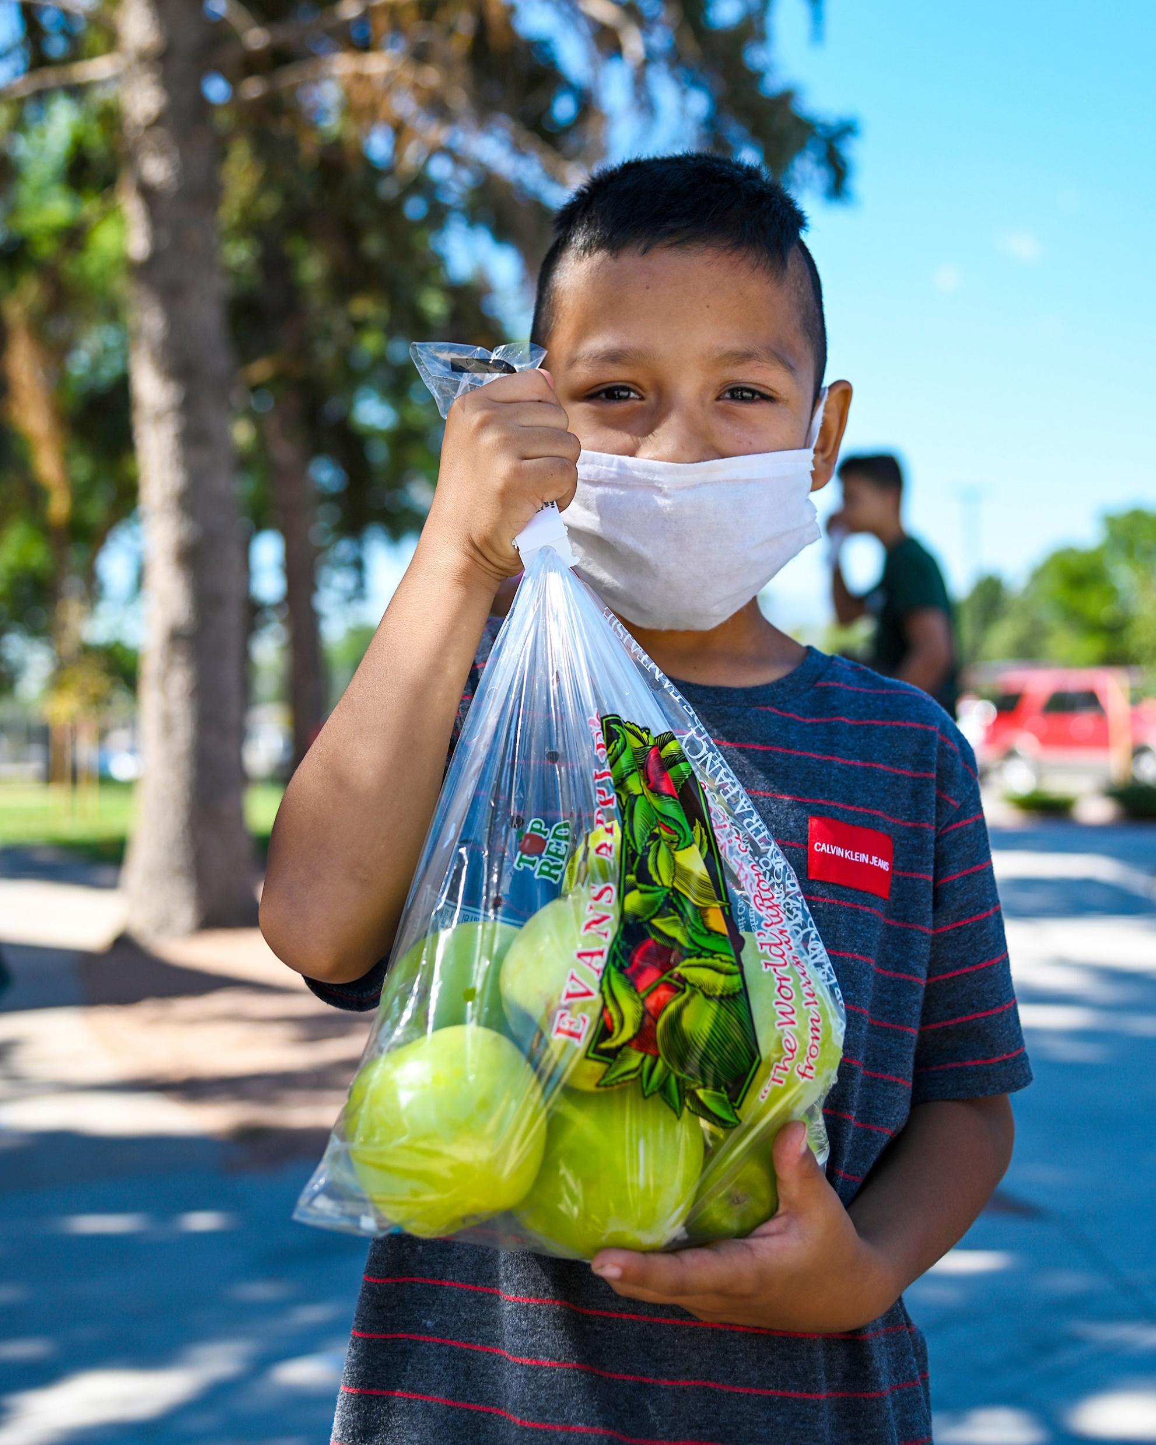
health programs:
HungerCare Screen & Intervene
HungerCare Wellness Boxes
Clinic-Based Food Distribution
Food Card Benefit Program
(Solutran)
Nutrition & Wellness Education

Slide 2
capacity-building grant:
Up to $200,000 in community-directed capacity building grants to area groups or organizations
Minimum grant of $2,500 up to a maximum of $75,000
Goals:
Learn from and build long-term nutrition distribution strategies with racially diverse communities to address health disparities and advance food equity
Increase the distribution of food to racially marginalized communities through new methods, increased product availability, and deeper collaborations

Slide 3
capacity-building grant:
To be considered for a capacity grant:
Applicants must be a current 501c3 organization, or be financially sponsored by a 501c3
Projects must be within our 16-county service area (Adams, Columbia, Crawford, Dane, Dodge, Grant, Green, Iowa, Jefferson, Juneau, Lafayette, Monroe, Richland, Rock, Sauk, Vernon)
Projects should be led by, or conducted in partnership with, racially diverse communities impacted by food insecurity
Application deadline is March 14, 2022
For more information, visit SecondHarvestMadison.org/Grant

