Slide 1
Civil Rights Training for
USDA Food Nutrition and Distribution Programs
Notes:
Hello, today, we are going to discuss the civil rights requirements for USDA Food Nutrition and Distribution Programs.
We will begin with a look at civil rights goals, define some essential terms, provide a few examples, and consider the essentials of civil rights compliance.
We will address information that must be posted at USDA Food Nutrition and Distribution Program sites. We will look at how to serve households with limited English proficiency. We will review the right anyone has to file a civil rights complaint.
Finally, we will discuss the need for annual training of this content and the documentation that should be retained for your records.

Slide 2
Why Do Civil Rights Matter?
It’s the law, and it is the right thing to do.
Walk with people during this time.
We care.
Notes:
Why do civil rights matter?
There are several good reasons...
Number 1, we care.
Anyone can need support; we can be there to advocate for others especially underserved or vulnerable individuals. People may find themselves in critical need through no fault of their own.
It is an important time to walk with the people in need of these services.
It is the right thing to do.
Your civil rights are there to protect you from unfair treatment and discrimination in all facets of life. Everyone has the right to use public services, they are meant to serve everyone.
It is the law, and the law is there to protect everyone. Civil rights ensure that everyone is protected from unequal treatment, therefore governments have an immense responsibility to maintain and protect civil rights.
Organizations that receive federal funding are obligated to comply with federal civil rights, equal opportunity, and nondiscrimination laws in their employment services and programming. USDA Food Nutrition and Distribution Programs receive financial assistance and funding through the United States Department of Agriculture (USDA).
We are committed to providing equal opportunity and equal access in compliance with all applicable federal and state laws and regulations and nondiscrimination policies and procedures.

Slide 3

Civil Rights Goals
Equal treatment for applicants and beneficiaries.
Knowledge of rights and responsibilities.
Elimination of illegal barriers.
Dignity and respect for all.
Notes:
As we begin to discuss Civil Rights, we want to remember a few key points and the Essentials that we must practice when we consider our customer’s Civil Rights.
We want to apply equal treatment for all people accessing USDA Food Nutrition and Distribution Program resources.
We want to be knowledgeable about the rights and responsibilities of our customers.
We want to consider the elimination of illegal barriers that prevent or deter people from receiving benefits.
And finally, we want to be sure that we serve everyone with Dignity and respect for all.

Slide 4

What is Discrimination?
Discrimination is the different treatment of one person or group from others by actions or lack of actions based on a protected class.
https://www.doi.gov/employees/anti-harassment/definitions
Notes:
What do we mean when we use the word, DISCRIMINATION?
Discrimination is the intentional or negligent act of treating an individual or a group of people differently than others because of their actual or perceived membership in a protected class.
Original statement from https://www.doi.gov/employees/anti-harassment/definitions
“Discrimination is the differential treatment of an individual or group of people based on their race, color, national origin, religion, sex (including pregnancy and gender identity), age, marital and parental status, disability, sexual orientation, or genetic information.”

Slide 5
What is a Protected Class?
USDA Food Nutrition and Distribution Programs prohibit discrimination for these protected classes
Race
Color
National Origin (includes limited English proficiency)
Disability
Age
Gender identity & sexual orientation
Filed a complaint previously
Religion
Notes:
What do we mean when we talk about a protected class?
A protected class is any person or group of people who have characteristics for which discrimination is prohibited based on a law, regulation, or executive order.
USDA Food Nutrition and Distribution Programs specifically prohibits discrimination for these protected classes:
Race
Color
National Origin (includes limited English proficiency)
Disability
Age
Religion
Gender identity and sexual orientation
And prior civil rights complainant

Slide 6
Discussion
Consider the following. . .
Notes:
At this point, let’s consider a few things about what you have learned so far.

Slide 7
The protected classes for USDA Food Nutrition and Distribution Programs include any person or group of people who are protected from discrimination based on which of the following:
Sex
Age
Gender
Race
Disability
National Origin
All of the above
Notes:
The protected classes include any person or group of people who are protected from discrimination based on which of the following:
Sex
Age
Gender
Race
Disability
National Origin or
All of the above
Can you recall what the protected classes are for discrimination?
Yes, ‘G’ is the correct answer to this question, all of the above.

Slide 8

Civil Rights
Compliance Essentials
Public notice of program availability and eligibility.
Requirements for language assistance.
Reasonable accommodations.
Civil Rights training for serving customers.
Conflict resolution methods and skills.
Notes:
We want to discuss the essentials of what Civil Rights Compliance is. Consider the following compliance actions that you must provide.
Public notice that USDA Food Nutrition and Distribution Program food, is available to people who qualify.
Language assistance for individuals with limited English proficiency.
Reasonable accommodations for people who have disabilities.
Training for people serving customers.
Solid customer service training.
And Conflict resolution methods and skills.

Slide 9
Civil Rights Public
Information Requirements
Provide program information to the public.
Display “And Justice for All’ poster in visible, customer location.
Provide USDA non-discrimination statement on program webpage, in public information, application forms, and program literature.
Notes:
It is important that you provide Civil Rights information for USDA Food Nutrition and Distribution Programs.
Provide details about the program to the public. This should include location, dates and times of distributions, eligibility criteria and basic program information.
Display the “And Justice for All” Poster in a location where participants can easily view.
It is important that the USDA non-discrimination statement is provided on the program webpage, in public information that is shared, on application forms and any literature that is created about the program.

Slide 10
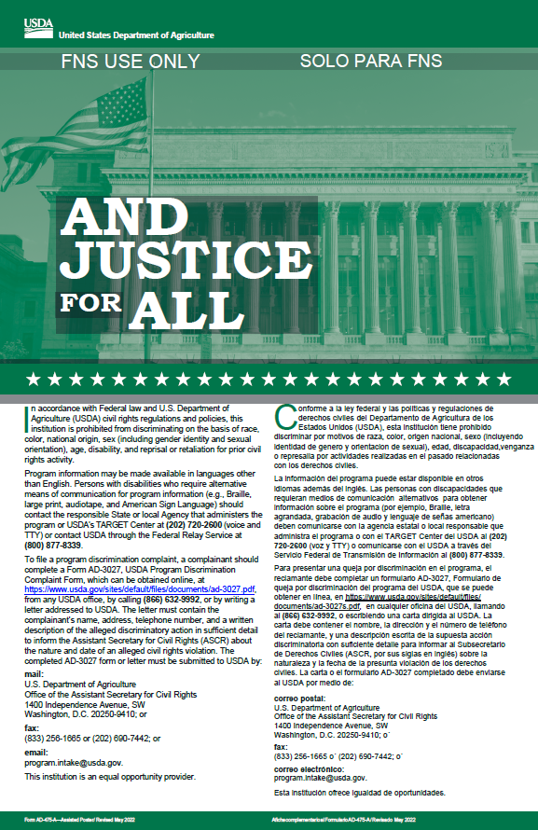
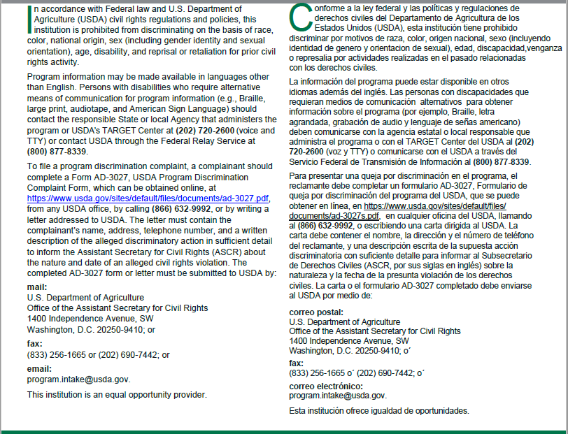
Required “And Justice For All” Poster
Notes:
This slide provides a visual of the And Justice For All poster that must be displayed at USDA Food Nutrition and Distribution Programs.
It should be displayed in a visible location for all to see.
Make sure to update it when the new And Justice For All posters come out, you can check the current version online at the USDA Food Nutrition Service website.

Slide 11

Program Information
Make program information available to public.
Inform potentially eligible person, applicants and participants of:
  Program rights and steps for participation.
  Changes in programs.
Notes:
Make sure you spread the word about your program, have methods in place to make the program information, and eligibility criteria available to the public and notify them of changes in the program such as changes to distribution days or times.

Slide 12
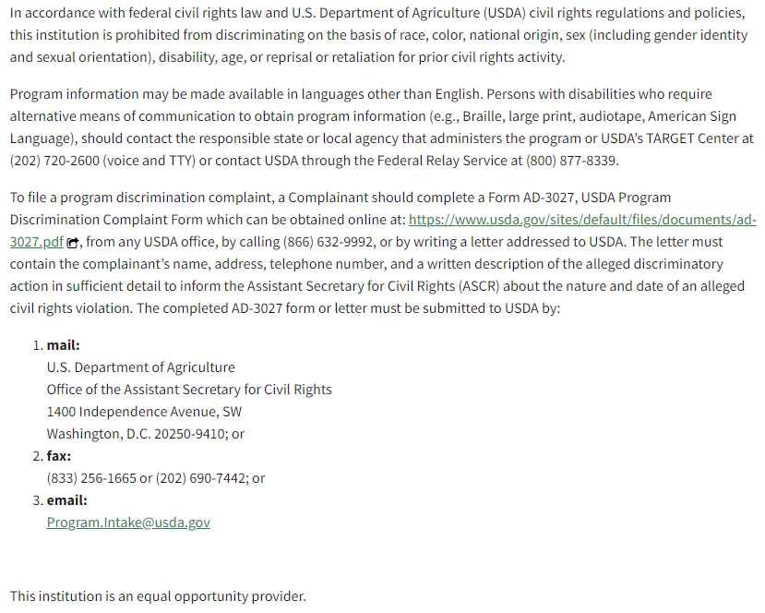
Nondiscrimination Statement
It is important to convey a message of equal opportunity in all materials used to provide program information:
Webpage
Program literature
Eligibility form
Notes:
The longer non-discrimination statement version is displayed here. It is important that this information is visible for customers that you serve. This can be achieved by displaying the And Justice for all poster.

Slide 13
Discussion
Consider the following. . .
Notes:
Let’s take a few moments again to consider a few of the points that we have addressed in the material.

Slide 14
The pantry distribution site must display the “And Justice for All” poster in a publicly visible location.
True
False
Notes:
In a previous slide the ‘And Justice for All’ poster was displayed.
The display of the poster is important.
Do you think that the poster must be displayed in a publicly, visible location or is it okay to be displayed in a closed office area where few people have access?
The answer to this question is true. The poster must be displayed in a visible location. It is fine if the poster is in the office area, but it must also be displayed where customers, staff and volunteers can readily view the poster.

Slide 15

Limited English Proficiency
Required for participants when English is not primary language.
Language assistance must be accurate, timely, effective.
No cost to the limited English proficient person.
Notes:
When serving customers at distribution sites, always remember Title VI of the Civil Rights Act says,
“No person in the United States shall, on the ground of race, color, or national origin, be excluded from participation in, be denied the benefits of, or be subjected to discrimination under any program or activity receiving Federal financial assistance.”
This is important. We want to remember that USDA Food Nutrition and Distribution Programs are federally funded programs. We want to be sensitive and aware when a participant has limited English proficiency. There are translation and/or interpretation services available to help participants in these programs.
USDA Food Nutrition and Distribution Programs must have language assistance that results in accurate, timely and effective communication at no cost to the person with Limited English proficiency.

Slide 16
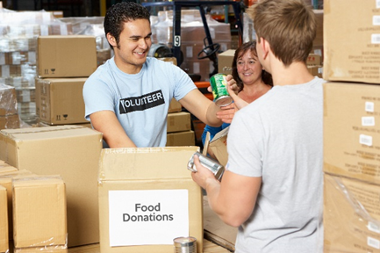
Language Assistance Serving
Limited English Proficiency Households
Bilingual volunteers.
Public service interpreter.
Language line or use app.
Notes:
Let’s consider a few practices for serving customers with limited English proficiency.
When choosing your reasonable accommodation method, you should consider the number of limited English proficiency people eligible to be served by your program and the frequency that individuals will encounter the program.
Be sure that you have language assistance service available to your community customers.
Support can be provided by bilingual volunteers from community-based organizations or other sources such as public service interpreters or bilingual staff on-site. Please note: a confidentiality agreement and Civil Rights training are required for these individuals.
There are language lines you can call in using a telephone or interpretation apps you can use on your smart phone or tablet.
Participants may also use a family member or friend, but USDA Food Nutrition and Distribution Programs who receive USDA foods should not rely on this as a strategy; the USDA Food Nutrition and Distribution Programs must offer an interpreter free of cost to the person with limited English proficiency.

Slide 17

Reasonable Accommodation
Make “reasonable modifications” to accommodate people with disabilities.
Disabilities can be physical or mental.
Notes:
Providing reasonable modifications to serve the needs of people with disabilities is important.
Be sensitive that someone’s request may be for a disability that is not visible.

Slide 18

Right to File a Complaint
Can be filed verbally or in writing; anonymous or not.
Complaints can be made within 180 days of the alleged discriminatory action.
Should notify local DHS USDA Food Nutrition and Distribution program coordinator.
Can refer complaints directly to U.S. Dept of Agriculture (USDA) using online form.
Notes:
Please note,
There are no “magic words.” A complaint may be verbal or written. It may be anonymous or self-identified.
Any person who believes they (or someone they know) has been discriminated against may file a complaint within 180 days of the alleged discriminatory action.
Document Civil Rights complaints and notify your local and DHS USDA Food and Nutrition program coordinators of such a complaint. Complaints filed with DHS will be forwarded to the USDA.
Distribution Sites must provide complainants a Civil Rights Complaint Form to complete (available on-line on USDA website) but it is not required to be used, a verbal statement can be given, and the complaint should then be recorded.
You might wonder what happens when a complaint is filed.
When a complaint is filed the following actions occur: Complaints alleging discrimination because of membership in a protected class must be forwarded to: USDA Director Office of Civil Rights, 1400 Independence Avenue, SW Washington, DC 20250.
The customer may also call to report at the federal level at 1-800-368-1019 or there is a web portal on the US Dept. of Health and Human Service Office for Civil Rights hhs.gov or report to the state level at Department of Health Services Civil Rights Compliance 608-267-1434.

Slide 19

Racial and Ethnic Data Collection
TEFAP has no ethnic or racial data collection requirement.
CSFP has an annual ethnic/racial data collection requirement.
By collecting racial and ethnic data we can help ensure that everyone in our community is being served.
First and foremost, any and all information collected from applicants and participants must be kept secure and confidential.

Slide 20
Race and Ethnicity Data Collection
For CSFP, the annual report is the FNS-191, this data is used in conjunction with the April distribution.
The Wisconsin Department of Health Services, provides separate, specific guidance for this reporting.
Agencies must collect ethnic and racial data on the CSFP application.
When collecting this data participants should be asked to self-identify.
If a participant refuses to provide data, you must tell him/her/them that the information will be collected based on your own visual identification.
Notes:
Please note,
There are no “magic words.” A complaint may be verbal or written. It may be anonymous or self-identified.
Any person who believes they (or someone they know) has been discriminated against may file a complaint within 180 days of the alleged discriminatory action.
Document Civil Rights complaints and notify your local and DHS USDA Food and Nutrition program coordinators of such a complaint. Complaints filed with DHS will be forwarded to the USDA.
Distribution Sites must provide complainants a Civil Rights Complaint Form to complete (available on-line on USDA website) but it is not required to be used, a verbal statement can be given, and the complaint should then be recorded.
You might wonder what happens when a complaint is filed.
When a complaint is filed the following actions occur: Complaints alleging discrimination because of membership in a protected class must be forwarded to: USDA Director Office of Civil Rights, 1400 Independence Avenue, SW Washington, DC 20250.
The customer may also call to report at the federal level at 1-800-368-1019 or there is a web portal on the US Dept. of Health and Human Service Office for Civil Rights hhs.gov or report to the state level at Department of Health Services Civil Rights Compliance 608-267-1434.

Slide 21
Compliance Reviews
Civil Rights compliance reviews are part of the regularly scheduled WI DHS agency review process.
The USDA and WI DHS may review an agency at anytime due to complaints, consistent errors in reporting, or other factors deemed appropriate.
Agencies must self-monitor each distribution site and include Civil Rights compliance.

Slide 22
Resolution of Non-Compliance
When there are areas of Civil Rights non-compliance, corrective action will be issued by the reviewer.
Agencies with findings as a result of a compliance review will be required to cease inappropriate action and institute correct procedures.
Action plans and written assurance are common documentation that the agency is now in compliance.
It may be necessary for a follow up review if the agency has several findings.

Slide 23

Civil Rights Training for Personnel
Training should be provided if staff have direct contact with USDA Food and Nutrition program applicants/participants.
Training required for new staff; then annually.
This presentation meets volunteer training requirement.
Maintain record of presentation dates, participants.
Notes:
In addition to the topics that we have addressed in this presentation thus far, an important requirement for USDA Food Nutrition and Distribution program participants is that:
ALL persons with direct contact with applicants or participants of USDA Food Nutrition and Distribution programs MUST receive annual training on all aspects of Civil Rights compliance.
The content of this presentation meets the volunteer training requirement.
And you will want to be sure that you:
Retain a dated record of the people who receive Civil Rights training, and a copy of your training materials.

Slide 24
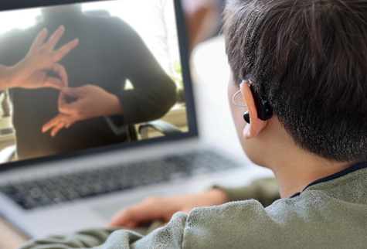
Each time you interact with participants:
Ask yourself, am I...
Treating people, the way I want to be treated?
Treating the same way, I treat other people?
Explaining rules, policies, expectations.
Notes:
Consider that each time that you interact with USDA Food Nutrition and Distribution program participants, you will want to ask yourself the following questions:
Am I treating this person the way I want to be treated?
Am I treating this person the same way that I treat other people?
Have I explained the distribution rules or customer service policy, so the participant knows what to expect?

Slide 25
Scenarios
What would you do?
Notes:
In the next section, we will present a few scenarios for you to think about and consider what you would do and how you would respond.

Slide 26
A participant tries to speak with a volunteer at a distribution site in a language other than English, but the volunteer cannot understand the participant. The participant leaves without being served.
How should this situation have been handled?
Notes:
Let’s consider how this situation might be handled at your distribution site.
A participant tries to speak with a volunteer at a distribution site in a language other than English, but the volunteer cannot understand the participant. The participant leaves without being served.
If there was no one present able to translate for the participant, what might have been one of the options for communicating with the individual?
Could a call to an interpretation service line have been possible for someone to access?
Might the volunteer have tried to communicate with the participant through any other means such as a phone interpretation app?
Remember you must have a plan in place for limited English proficient participants.

Slide 27
A person in a wheelchair complains that the site where he was told to pick up his food package is not accessible because it does not have a wheelchair ramp.
What steps should be taken to accommodate this participant?
Notes:
In this scenario:
A person in a wheelchair complains that the site where he was told to pick up his food package is not accessible because it does not have a wheelchair ramp.
What steps should be taken to accommodate this participant?
Would it be possible to add a pick-up spot outside the building where a participant might call a staff member or volunteer to bring food items?
Is it possible for someone to deliver food items to a person who is home bound and unable to access a building that does not accommodate a person in a wheelchair?
Might another option be for a client/customer to assign a proxy to pick up their food?
Consider other creative ways that you think you might be able to accommodate this participant.

Slide 28
A reviewer from the State visits a distribution site and views the And Justice for All poster displayed in the manager’s office, which is in an area that is usually off limit to program applicants and participants.
Is this a Civil Rights violation? Why or why not?
Notes:
A reviewer from the State visits a distribution site and views the And Justice for All poster displayed in the manager’s office, which is in an area that is usually off limits to program applicants and participants.
Is this a Civil Rights violation? Why or why not?
Yes. This is a Civil Rights violation that can be rectified by moving the poster to a location that is visible to the public.

Slide 29
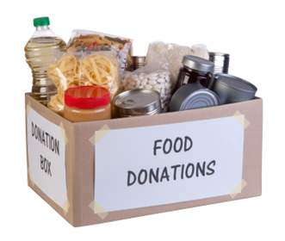
Additional Resources
Wisconsin Department of Health Services: Civil Rights Compliance.
https://www.dhs.wisconsin.gov/civil-rights/index.htm
U.S. Department of Agriculture, Food and Nutrition Service: Civil Rights.
Civil Rights | Food and Nutrition Service (usda.gov)
Notes:
Additional state and federal civil rights resource information and links are provided to you on this slide.

Slide 30

Thank you for your commitment and service to your community!
This information has been provided by the Wisconsin Department of Health Services.
The Emergency Food Assistance Program (TEFAP)
dhstefap@dhs.Wisconsin.gov
Commodity Supplemental Food Program(CSFP)
dhscsfpmain@dhs.Wisconsin.gov
Farmers Market Nutrition Program(FNMP)
dhswicfmnp@wisconsin.gov
2023 version
Notes:
We sincerely thank you for your time and efforts to serve your community and to follow Civil Rights laws and practices in your work.
For program specific questions please email the program coordinators listed on this slide.

