Slide 1
State of Wisconsin Department of Health Services (DHS) Division of Public Health Healthcare Coalitions July 7, 2014

Slide 2
Presenters
Jenny Ullsvik, Emergency Health Care and Preparedness Section Chief
Commander Duane Wagner, Assistant Secretary for Preparedness and Response (ASPR)
Jason Liu, M.D., M.P.H., Medical Advisor Health Emergency Preparedness
Carolyn Strubel, Hospital Emergency Preparedness Program Manager
Joe Cordova, Public Health Preparedness Program Manager

Slide 3
Outline
Introductions
Healthcare Coalition Federal Initiative
Background
Healthcare Coalition Concept
Regional Medical Coordination
Current Activities
Next Steps

Slide 4
Healthcare Coalitions Commander Duane Wagner - ASPR
Nationally, Healthcare Coalitions are an important federal initiative
Healthcare Coalitions are proven effective for large emergencies and events
Wisconsin is programmatically accountable to transition to Healthcare Coalitions (ASPR Program Measures) for grant compliance

Slide 5
Healthcare Coalitions (HCC)
Group of healthcare organizations, public safety and public health partners that join forces for the common goal of making their communities safer, healthier and more resilient
Support communities before, during and after disasters and other health-related crises
Development is required by ASPR as condition of continued funding

Slide 6
HCC Purpose
Coordinate how public health, healthcare institutions, and first responder agencies will manage their efforts to enact a uniform and unified response to an emergency, specifically the medical surge aspect of an event (ESF-8)
Shift from planning to include response and recovery
Does not replace day to day functioning of individual disciplines

Slide 7
Healthcare Coalitions in WI
Development is being lead by Health Emergency Preparedness Leadership at state level
Regions have been defined by the Department of Health Services
Intention is to have regional HCC’s established with basic functionality by July 1, 2015
Healthcare Coalition Program Measures (ASPR)
Guidance provided to Regions

Slide 8
Health Emergency Regions
Seven regions in state
Based on WHEPP regions, which were developed based on referral patterns
Will be Regional Trauma Advisory Council (RTAC) regions going forward
Public Health participates in planning and coordination

Slide 9
Health Emergency Response Regions
Douglas
Bayfield
Iron
Ashland
Vilas
Washburn
Florence
Burnett
Sawyer
Price
Oneida
Forest
Polk
Barron
Rusk
Lincoln
Marinette
Taylor
Langlade
St. Croix
Chippewa
Menomonee
Oconto
Dunn
Marathon
Oconto
Pierce
Eau Claire
Clark
Shawano
Door
Pepin
Portage
Waupaca
Kewaunee
Buffalo
Outagamie
Trempealeau
Wood
Outagamie
Brown
Jackson
Winnebago
Manitowoc
Adams
Waushara
Calumet
La Crosse
Monroe
Green
Lake
Juneau
Marquette
Fond du Lac
Sheboygan
Vernon
Dodge
Richland
Sauk
Columbia
Washington
Crawford
Ozaukee
Iowa
Dane
Jefferson
Waukesha
Grant
Milwaukee
La Fayette
Green
Rock
Walworth
Racine
Kenosha

Slide 10
Wisconsin Health Emergency Preparedness Structure
Wisconsin Department of Health Services
Division of Public Health
Bureau of Communicable Diseases and Emergency Response
Emergency Health Care and Preparedness Section
Health Emergency Preparedness Unit
Public Health
Hospital Emergency Preparedness Programs
EMS Unit
Trauma Program

Slide 11
Wisconsin Hospital Emergency Preparedness Program
Has supported hospital emergency preparedness planning and response to mass casualty incidents or pandemic events
Funded by the Office of the Assistant Secretary for Preparedness and Response (ASPR) in the U.S. Department of Health and Human Services (DHHS)

Slide 12
Hospital Response Capabilities
Healthcare Preparedness
Healthcare Recovery
Emergency Operations Center
Information Sharing
Medical Surge
Mass Fatality Management
Responder Safety and Health
Volunteer Management
Notes:
Some background

Slide 13
Wisconsin Public Health Emergency Preparedness Program
Has supported state, local and tribal public health departments
Wisconsin State Laboratory of Hygiene
2-1-1 Wisconsin
Funded by the Centers for Disease Control and Prevention (CDC) in the U.S. Department of Health and Human Services (DHHS)

Slide 14
Public Health Capabilities
Community Preparedness
Community Recovery
Emergency Operations Coordination
Emergency Public Information and Warning
Fatality Management
Information Sharing
Mass Care
Medical Counter Measure Dispensing

Slide 15
Time of Transition
Guidance from ASPR based on recent events such as Joplin Tornado and Hurricane Sandy now focuses on the development of Healthcare Coalitions
Shift from funding specific agencies/entities for preparedness to focusing on strengthening a regional response and recovery system using an Healthcare Coalitions

Slide 16
Wisconsin Successes
Developed partnerships
Developed plans
Stockpiled medical resources
Trained and exercised staff
Equipped hospitals and health departments
Communicated risks
Built communications infrastructure
Notes:
Stockpiles of medical supplies and medicines.
Incident Command System training and exercises.
Mass vaccination.
Hospital backup generators and wells.
Pediatric evacuation sleds.
Wisconsin Tracking, Resources, Alerts and Communication.
Wisconsin Interoperable System for Communications.
211 Wisconsin.
Medical Reserve Corps.
Disaster Medical Assistance Team.
Yes, Wisconsin’s built a lot already, but systems have been built in silos.

Slide 17
Wisconsin Gaps
Coordinated health plans for large scale disasters
Formal regional medical coordination structure
Regional system for “off-loading” and “on-loading” patients in mass-casualty incidents
Established indicators for crisis standards of care when resources are exhausted and systems are overwhelmed
Evacuation and patient tracking capability
Notes:
What’s Missing

Slide 18
Health Emergency Priorities
Improved system for medical surge
Patient transport and evacuation plans in disasters
Health surveillance and information sharing
Ability to mobilize and coordinate medical resources
Build situational awareness of medical resources
Improve alerting and communication coordination
Bed availability and patient tracking

Slide 19
Healthcare Coalition Partners
Emergency Medical Services
Hospitals and Clinics
Trauma
Emergency Management
Public Health
Long Term Care
Mental and Behavioral Health
Community and Faith Based Organizations
Volunteer Organizations
Businesses
Human Services
Medical Examiners and Coroners
And many, many more

Slide 20
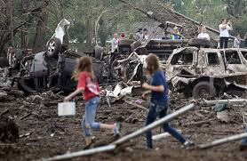
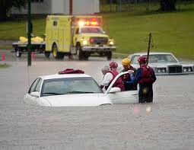
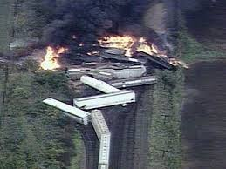
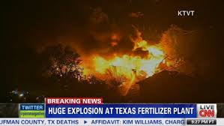
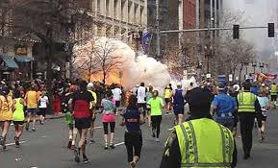
From Wisconsin Emergency Management
Natural
Disasters
Technological Accidents
Human-caused
Events

Slide 21
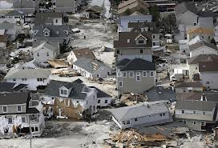
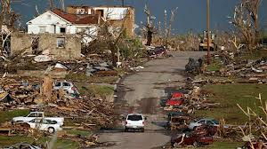
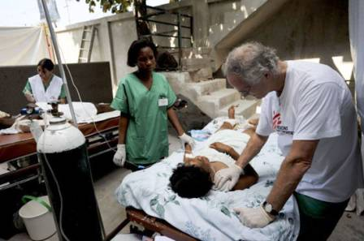
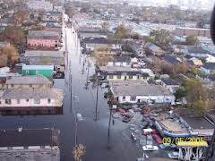
Comprehensive Response System
From Wisconsin Emergency Management
Priorities:
Focus – first 72 hours
Healthcare Coalitions – ESF 6 & 8
Enable response
Survivor needs
Begin restoration

Slide 22
Emergency Support Functions (ESF’s)
From Wisconsin Emergency Management
Healthcare Coalitions are critical to:
ESF 6 – Mass Evacuation, Sheltering and Care Services
ESF 8 – Health and Medical

Slide 23
Catastrophic Event Priorities
From Wisconsin Emergency Management
Focus: First 72 hours
Enable Response
Survivor Needs
Restoration Started
Situational Assessment
Cmd, Cntrl & Coord
Critical Communications
Critical Transportation
Environmental H&S
Public Messaging
Fire Control
Mass SAR
Health & Medical Treatment
Scene Security & Protection
Mass Evacuation-Sheltering/Feed
Fatality Management
Stabilize/Repair Essn Infrastr
Pub/Pri Services-Resources
Essn Service Facilities
Infrastructure/Utilities
Transportation Routes
Volunteers/Donations
Debris Removal
Health and Social Services
Structural/Housing Eval.
Schools and Gov’t Bldgs
Economic Recovery
Cultural/Natural resources

Slide 24
Mass Medical Treatment
Conduct triage, transportation and provide emergency-level heath and medical treatment to severely injured people within the impacted area.
Health & Medical Treatment
Fatality Management Services
Conduct operations to recover, identify, and properly handle the remains of 75 fatalities within 48 hours of an incident.
Requirements:
Hospital surge/decontamination
Develop healthcare coalitions to surge EMS and hospitals (tiered system)
Hospital out of service/relocation
Crisis Standard of Care
Family unification
Regional patient transportation
Patient tracking
Requesting DMAT – NDMS
From Wisconsin Emergency Management

Slide 25
Mass Care Services
Provide essential mass care services to include life-sustainment, with a focus on basic nourishment and temporary shelter to the impacted population. Shelter 25% of the impacted population.
Mass Evacuation, Sheltering & Care Services
Volunteers and
Donations
Manage unaffiliated volunteers and unsolicited donated goods cooperatively with local and voluntary and community based organizations and businesses during disaster response & recovery.
Health and
Social Services
Restore health and social services networks to support the health (including behavioral health) and well-being of the whole community following a disaster.
Requirements:
Counties need to establish threshold for assistance
Establish a tiered response and contingency plans
Reception centers – standardized approach
Temporary shelters/canteens
Donations Management Teams
Private sector resource integration
Social services delivery
Establish executive team – high level coordination
From Wisconsin Emergency Management

Slide 26
Medical Coordination
Purpose: Help to close critical gaps in medical surge capacity, continuity of operations and coordination
Components include:
Collection and collation of regional health intelligence
Situational awareness
Monitoring of health care system surge capacity
Support for healthcare system logistic requests in coordination with state and local agencies during a disaster

Slide 27
Medical Coordination Centers
Serve as the “response” arm of the healthcare coalition
Designated entity serving a coalition to collate medical and health information and provide coordination during a disaster
Virtual or physical depending on coalition needs and funding

Slide 28
Regional Medical Coordination Pilot
WHEPP is currently funding two pilots on Medical Coordination development: Rural and Urban
Medical directors for each pilot serve as WHEPP medical advisors
Rural: Michael Clark, M.D.; Ministry Health Care and Ministry St. Clare’s Hospital
Urban: Jason Liu, M.D.; Medical College of Wisconsin
Three phases

Slide 29
Pilot Objective One
Development of an outline for a statewide database of inpatient bed capacity and medical capabilities
Development of a hospital and inpatient facility profile template
Creation of a draft privacy and use-of-information policy and rules for database
Collection of data

Slide 30
Pilot Objective Two
Development of a disaster and special incident medical consultation expert panel
Identification of needed medical specialties
Identification of individuals to serve on panel to determine the feasibility of providing medical consultation in a disaster
Create sample operating procedures

Slide 31
Pilot Objective Three
Assistance and technical consultation to DHS and WHEPP leadership as needed
Medical technical consultation with emergency preparedness and response issues
Serve as a liaison and advocate to healthcare coalition partners statewide for disaster medical planning and response

Slide 32
Pilot Objective Four
Assistance and technical consultation to DHS and WHEPP in ongoing preparedness projects such as:
Medical surge planning expert panel
Crisis standard of care development
Formalization of Healthcare Coalition model
Preparedness meetings and trainings

Slide 33
Phases
Phase One
Ongoing communications and planning of HCC development, etc.
Phase Two
July 1, 2014–June 30, 2015
Phase Three
July 1, 2015–June 30, 2016

Slide 34
Phase Two
July 1, 2014–June 30, 2015
Begin to establish processes and procedures for:
Regional situational awareness and communication, alerting, and notification
Immediate Bed Availability (IBA)
Development of a database and process for coordination of resources

Slide 35
Phase Two, Continued
Will test the feasibility of regional medical coordination and provide data, outcomes and best practices that will lay the foundation for HCC’s
These projects will provide baseline data for an Medical Coordination model that will be shared statewide

Slide 36
Phase Three
Develop a comprehensive regional medical coordination template:
Use template to implement a standard medical coordination model
Adapt the model throughout the regional HCCs in Wisconsin

Slide 37
HCC Year One Timeline
Fiscal Year One (July 1, 2014–June 30, 2015)
Develop HCC strategic plans
Identify and develop regional HCC board of directors
Deadline: January 1, 2015
Develop governance structure, bylaws and procedures
Identify HCC partners and members
Identify a fiscal agent
Hire HCC coordinator, trauma coordinator and medical advisor by July 1, 2015

Slide 38
HCC Year Two Timeline
Fiscal Year Two (July 1, 2015–June 30, 2016)
Demonstrate or have detailed plan to address ASPR program measures
Demonstrate functionality of regional medical coordination

Slide 39
Next Steps
Strategic Planning: July 10, 2014
Transition Year: July 1, 2014–June 30, 2015
Regions establish HCC proposals
Transition committees convene
Led by DHS - all partners encouraged to participate
Vision and structure
Partner communications
Personnel
Fiscal

Slide 40
Next Steps
Build regional medical coordination capability via HCCs
Pilot models for regional medical coordination with physician medical advisors
Crisis standards of care
Allocation of scarce resources
ASPR program measures

Slide 41
The Bottom Line
Ability to respond to large-scale disasters that overwhelm and exhaust our health systems and resources
Save lives—get the right patient to the right place at the right time—and improve patient outcomes in disasters and significant emergency events
At the regional level, coordinate public health and medical response to disasters and large scale events
Notes:
From

Slide 42
Questions?
DHSHCC@wisconsin.gov

Slide 43
Resources
Healthcare Preparedness Capabilities http://www.phe.gov/preparedness/planning/hpp/reports/documents/capabilities.pdf
Hospital Preparedness Program (HPP) Measure Manual: Implementation Guidance for the HPP Program Measures Healthcare coalition Developmental Assessment Factors: http://www.phe.gov/Preparedness/planning/evaluation/Documents/hpp-bp2-measuresguide-2013.pdf
Medical Surge Capacity and Capability: The Healthcare Coalition in Emergency Response and Recovery http://www.phe.gov/Preparedness/planning/mscc/healthcarecoalition/Pages/default.aspx
Medical Surge Capacity and Capability: A Management System for Integrating Medical and Health Resources During Large-Scale Emergencies https://www.phe.gov/preparedness/support/mscc/pages/default.aspx
Developing the Health Care Coalition http://www.phe.gov/Preparedness/planning/mscc/healthcarecoalition/chapter5/Pages/developing.aspx
From Hospitals to Health Care Coalitions: Transforming the System http://www.phe.gov/Preparedness/planning/hpp/Documents/hpp-healthcare-coalitions.pdf

