Slide 1
Wisconsin STI (Sexually Transmitted Infections) Surveillance Data
Reported Cases in 2020
Reported Cases
in
2020
Division of Public Health
Bureau of Communicable Diseases
STI Unit
P-00415 (08/21)

Slide 2
Introduction
Reportable STIs in Wisconsin:
Chlamydia trachomatis (Chlamydia) - Includes disease classifications such as urethritis, cervicitis and conjunctivitis.
Neisseria gonorrhoeae (Gonorrhea) - Includes disease classifications such as urethritis, cervicitis, and resistant strains. Resistant or reduced susceptibility to antibiotic treatment are confirmed by antibiotic susceptibility testing (AST).
Treponema pallidum (Syphilis ) - Wisconsin data includes all stages and CDC data includes primary and secondary stages of syphilis.

Slide 3
Introduction
Sexually Transmitted Infections (STI) surveillance data is collected systematically for the purpose of monitoring the frequency and distribution of STIs in the Wisconsin population.
This analysis examines the trends in reportable STIs in Wisconsin to identify problem areas and allocate resources for effective STI interventions.
Out of state, cases from the Department of Corrections, and unknown states are not included.

Slide 4
STI Surveillance Data Should be Interpreted with Caution
STI data may be underreported, unevenly reported, and incomplete.
Elements that impact the completeness and accuracy of STI data include:
Practice and capacity of STI screening by health care providers.
Health care providers’ compliance with case reporting.
Completeness and promptness of case reporting.
COVID-19 may have influenced the number of cases diagnosed and reported in 2020.

Slide 5
How does Wisconsin compare nationally?

Slide 6
Chlamydia Rates* by State, 2019, CDC Data**
IL
WI (33rd)
USA
IA
MN
*Cases per 100,000 population.
**Centers for Disease Control and Prevention. Sexually Transmitted Disease Surveillance 2019. Atlanta: U.S. Department of Health and Human Services; 2021; https://www.cdc.gov/std/statistics/2019/default.htm.

Slide 7
Gonorrhea Rates* by State, 2019, CDC Data**
IL
MI
USA
IA
WI (34th)
MN
*Cases per 100,000 population.
**Centers for Disease Control and Prevention. Sexually Transmitted Disease Surveillance 2019. Atlanta: U.S. Department of Health and Human Services; 2021; https://www.cdc.gov/std/statistics/2019/default.htm.

Slide 8
Primary and Secondary Syphilis Rates* by State, 2019, CDC Data
USA
IL
MI
MN
WI (46th)
IA
*Cases per 100,000 population.
**Centers for Disease Control and Prevention. Sexually Transmitted Disease Surveillance 2019. Atlanta: U.S. Department of Health and Human Services; 2021; https://www.cdc.gov/std/statistics/2019/default.htm.

Slide 9
Number of STI Cases Reported in Wisconsin, 2020

Slide 10
STI Rates* in Wisconsin, 2020
* Rate per 100, 000 population

Slide 11
STIs are in Increasing Trends, Wisconsin, 2014-2020

Slide 12
STI Rate* Trends, Wisconsin, 2011-2020
Chlamydia
Gonorrhea
Syphilis
* Rate per 100, 000 population

Slide 13
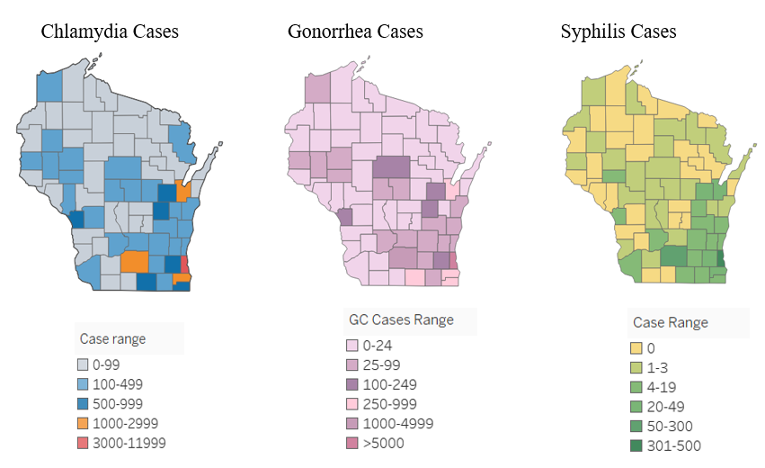
Reported STI Cases by County, Wisconsin, 2020
* Rate per 100, 000 population

Slide 14
Chlamydia

Slide 15
Trends of Chlamydia Rates* by Sex, Wisconsin, 2016-2020
Female
Male
* Rate per 100, 000 population

Slide 16
Trends of Chlamydia Rates* by Age, Wisconsin, 2016-2020
Age 20-24
Age 15-19
Age 25-29
Age 30-39
Age 30-39

Slide 17
Chlamydia Rates* by Race, Wisconsin, 2016-2020
Black
Native American
White
Asian
* Rate per 100, 000 population

Slide 18
Gonorrhea

Slide 19
Trends of Gonorrhea Rates* by Sex, Wisconsin, 2016-2020
Male
Female
* Rate per 100, 000 population

Slide 20
Gonorrhea Rates* by Age, Wisconsin, 2016-2020
Age 20-24
Age 30-39
Age 25-29
Age 15-19
Age 40-49
* Rate per 100, 000 population
Notes:
There is increase in all age group but steady increase is seen at age group 30-39

Slide 21
Gonorrhea Rates* by Race, Wisconsin, 2016-2020
1,415
Black
Native American Asian
White
198
* Rate per 100, 000 population

Slide 22
Closer look into Syphilis Data

Slide 23
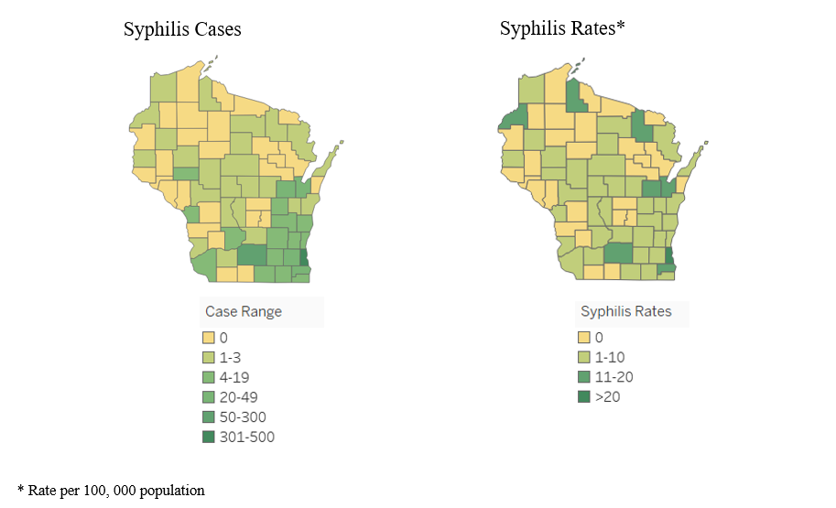
Syphilis Cases and Rates* by County, Wisconsin, 2020

Slide 24
Syphilis Cases and Percent Difference from Previous Year, Wisconsin, 2011-2020

Slide 25
Trends of Syphilis Cases and Rates*, Wisconsin, 2011-2020
Number of Cases
Syphilis Rates
* Rate per 100, 000 population

Slide 26
Milwaukee County vs. Rest of Wisconsin, Syphilis Cases by Stage, 2020

Slide 27
Milwaukee County vs. Rest of Wisconsin, Syphilis Rates* by Stage, 2020
* Rate per 100, 000 population

Slide 28
Primary & Secondary Syphilis Rates*, Wisconsin, 2016-2020
Primary
Secondary
*Rate per 100,000 population

Slide 29
Primary & Secondary Syphilis Cases and Rates* in Milwaukee County vs. Rest of Wisconsin, 2020
* Rate per 100, 000 population

Slide 30
Trends of Primary & Secondary Syphilis Rates* by Sex, Wisconsin, 2016-2020
Male
* Rate per 100, 000 population

Slide 31
Trends of Primary and Secondary Syphilis Rates* by Age, Wisconsin, 2016-2020
Age 25-29
Age 30-39
Age 20-24
Age 40-49
Age 15-19
* Rate per 100, 000 population

Slide 32
Trends of Primary and Secondary Syphilis Rates* by Race, Wisconsin, 2020
Black
Native
American
Asian
White
* Rate per 100, 000 population

Slide 33
Milwaukee County
Sexually Transmitted Infections by Zip Code
22

Slide 34
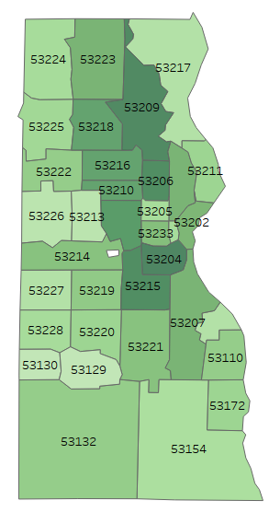
Reported Syphilis Cases by Zip Code, Milwaukee County, 2020

Slide 35
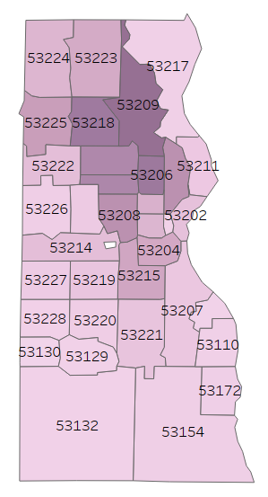
Reported Gonorrhea Cases by Zip Code, Milwaukee County, 2020

Slide 36
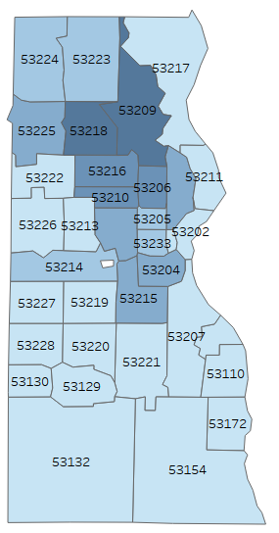
Reported Chlamydia Cases by Zip Code, Milwaukee County, 2020

