Slide 1
Wisconsin Sexually Transmitted Infections
Surveillance Data
Reported Cases in 2021
Division of Public Health
Bureau of Communicable Diseases
STI Unit
P-00415 (12/2022)

Slide 2
Introduction
Reportable Sexually Transmitted Infections (STIs) in Wisconsin:
Chlamydia trachomatis (Chlamydia): Includes disease classifications such as urethritis, cervicitis and conjunctivitis.
Neisseria gonorrhoeae (Gonorrhea): Includes disease classifications such as urethritis, cervicitis, and resistant strains. Resistant or reduced susceptibility to antibiotic treatment are confirmed by antibiotic susceptibility testing (AST).
Treponema pallidum (Syphilis ): Wisconsin data includes all stages and CDC data includes primary and secondary stages of syphilis.

Slide 3
Introduction
Sexually transmitted infections surveillance data is collected systematically for the purpose of monitoring the frequency and distribution of STIs in the Wisconsin population.
This analysis examines the trends in reportable STIs in Wisconsin to identify problem areas and allocate resources for effective STI interventions.
Out of state, cases from the Department of Corrections, and unknown states are not included.

Slide 4
STI surveillance data should be interpreted with caution
STI data may be underreported, unevenly reported, and incomplete.
Elements that impact the completeness and accuracy of STI data include:
Practice and capacity of STI screening by health care providers.
Health care providers’ compliance with case reporting.
Completeness and promptness of case reporting.
COVID-19 may have influenced the number of cases diagnosed and reported in 2020 and 2021.

Slide 5
How Does Wisconsin Compare with Neighboring States?
Division of Public Health
Bureau of Communicable Diseases
STI Unit
P-00415 (11/2022)

Slide 6
Chlamydia rates of reported cases in Wisconsin and neighboring states: 2021

Slide 7
Gonorrhea rates of reported cases in Wisconsin and neighboring states: 2021

Slide 8
Primary and secondary syphilis rates of reported cases in Wisconsin and neighboring states: 2021

Slide 9
Wisconsin STI Trends
Division of Public Health
Bureau of Communicable Diseases
STI Unit
P-00415 (11/2022)

Slide 10
The number of reported STI cases have increased 47% in Wisconsin from 2014-2021.

Slide 11
STI rates (per 100,000 people) of reported cases, Wisconsin: 2021

Slide 12
Number of STI cases reported in Wisconsin 2021

Slide 13
Syphilis rate of reported cases in Wisconsin increased 100% from 2020–2021. Rate of new STI diagnoses per 100,000 people, Wisconsin, 2012–2021
Chlamydia
Gonorrhea
Syphilis

Slide 14
Syphilis rate of reported cases increased 71.4% from 2020–2021 in the Northeastern Region. Rate of new STI diagnoses per 100,000 people, Northeastern Region of Wisconsin 2017–2021
Chlamydia
Gonorrhea
Syphilis

Slide 15
Syphilis rate of reported cases increased 200% from 2020–2021 in the Northern Region. Rate of new STI diagnoses per 100,000 people, Northern Region of Wisconsin, 2017–2021
Chlamydia
Gonorrhea
Syphilis

Slide 16
Syphilis rate of reported cases increased 115% from 2020–2021 in the Southeastern Region. Rate of new STI diagnoses per 100,000 people, Southeastern Region of Wisconsin, 2017–2021
Chlamydia
Gonorrhea
Syphilis

Slide 17
Syphilis rate of reported cases increased 15% from 2020–2021 in the Southern Region. Rate of new STI diagnoses per 100,000 people, Southern Region of Wisconsin, 2017–2021
Chlamydia
Gonorrhea
Syphilis

Slide 18
Syphilis rate of reported cases increased 75% from 2020–2021 in the Western Region. Rate of new STI diagnoses per 100,000 people, Western Region of Wisconsin, 2017–2021
Chlamydia
Gonorrhea
Syphilis

Slide 19
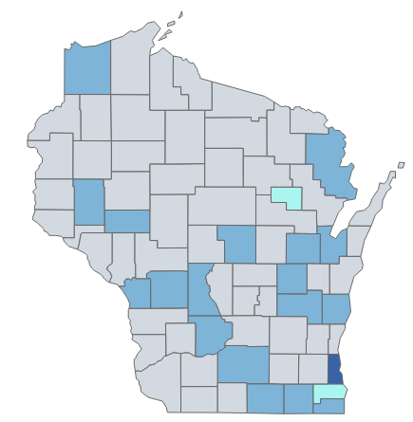
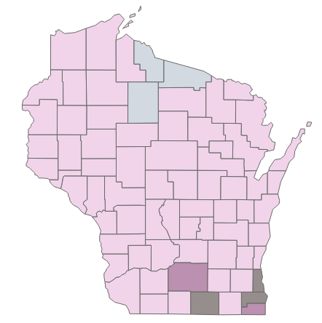
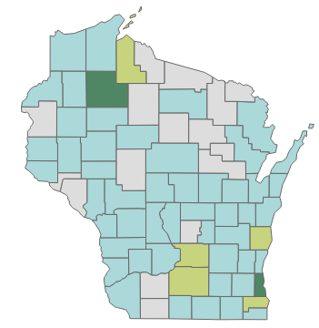
Reported STI rates of reported cases by Wisconsin county: 2021
Chlamydia rate range
Gonorrhea rate range
Syphilis rate range

Slide 20
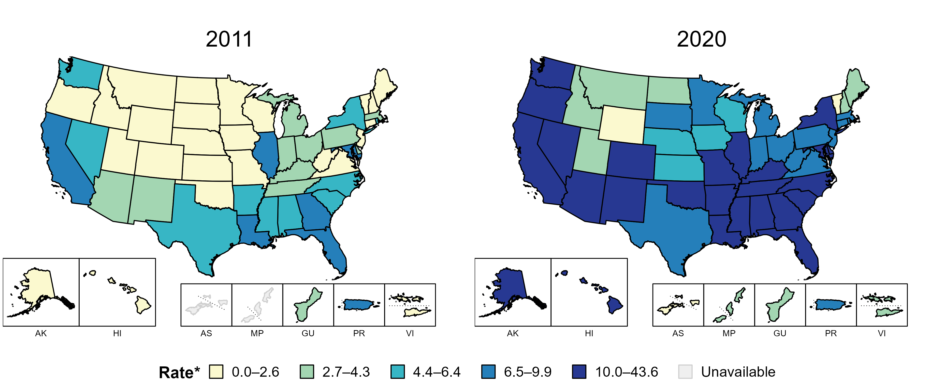
Primary and secondary syphilis—rates of reported cases by state, United States and territories, 2011 and 2020
* Per 100,000
Notes:
In 2011, six states, the District of Columbia (DC), and one US territory (14.3% of available areas) had a rate of reported primary and secondary syphilis greater than or equal to 6.5 cases per 100,000 population. This increased to 38 states, DC, and one US territory (71.4% of available areas) in 2020.
American Samoa and the Commonwealth of the Northern Mariana Islands began reporting data on primary and secondary syphilis cases to CDC in 2018; data are not available for those areas prior to that year.
The COVID-19 pandemic has introduced uncertainty and difficulty in interpreting 2020 case data. See Impact of COVID-19 on STDs (https://www.cdc.gov/std/statistics/2020/impact.htm) for more information.
See Technical Notes (https://www.cdc.gov/std/statistics/2020/technical-notes.htm) for information on syphilis case reporting and on interpreting reported rates in US territories.
Data points are available at: https://www.cdc.gov/std/statistics/2020/data.zip

Slide 21
Syphilis in Wisconsin
Division of Public Health
Bureau of Communicable Diseases
STI Unit
P-00415 (11/2022)

Slide 22
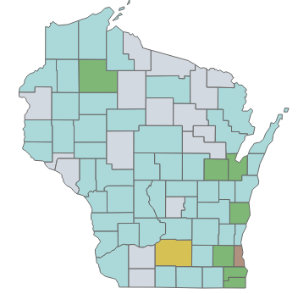
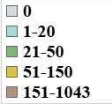
Syphilis cases and rates range by Wisconsin county: 2021
Cases
Rates
Syphilis case range
Syphilis rate range

Slide 23
Sawyer County had a higher syphilis diagnosis rate than Milwaukee County in 2021. Number of syphilis diagnoses per 100,000 people by county of residence, Wisconsin: 2021
Counties with Zero Syphilis Case Reported in 2021
Polk | 0
Pepin | 0
Clark | 0
Buffalo | 0
Lafayette | 0
Iowa | 0
Vilas | 0
Price | 0
Lincoln | 0
Langlade | 0
Iron | 0
Forest | 0
Florence | 0
Shawano | 0
Menominee | 0
Marquette | 0

Slide 24
Syphilis rate doubled in 2021 in Wisconsin. Trends of Syphilis Cases and Rates (per 100,000 population) Wisconsin 2012–2021
98.5% increase in 2021
Syphilis cases rate doubled in 2021

Slide 25
The Southeastern Region has the highest syphilis rate in Wisconsin. Number of syphilis diagnoses per 100,000 people by region of residence, Wisconsin: 2021

Slide 26
People aged 25–29 have the highest primary and secondary syphilis rate in 2021. Number of primary and secondary syphilis rates per 100,000 people by age Wisconsin: 2017–2021
Age 25-29
Age 30-39
Age 20-24
Age 40-49
Age 15-19

Slide 27
Black people have the highest primary and secondary syphilis rate in 2021. Number of primary and secondary syphilis rates per 100,000 people by race and ethnicity, Wisconsin: 2017–2021
Black
Native American
Asian
White

Slide 28
While men have a higher syphilis rate, the rate increased more for women from 2020–2021. Number of primary and secondary syphilis rates per 100,000 people by sex at birth, Wisconsin: 2017–2021
Male
Female

Slide 29
Syphilis in Milwaukee County
Division of Public Health
Bureau of Communicable Diseases
STI Unit
P-00415 (11/2022)

Slide 30
Milwaukee County accounts for 64% of all syphilis cases reported in Wisconsin in 2021. Proportion of syphilis cases reported in Wisconsin, 2021
Other Counties
Milwaukee County

Slide 31
Syphilis diagnosis rate in Milwaukee County increased 129% from 2020–2021. Number of syphilis diagnoses per 100,000 people, Milwaukee County 2012–2021

Slide 32
While men have a higher syphilis rate, the rate increased more for women from 2020 to 2021. Number of primary and secondary syphilis rates per 100,000 people by sex at birth Wisconsin, 2017–2021
(95% increase)
Male
Female
(220% increase)

Slide 33
People aged 20–29 have the highest primary and secondary syphilis diagnosis rate in 2021. Number of primary and secondary syphilis rates per 100,000 people by age Wisconsin, 2017–2021
Age 20–29
Age 30–39
Age 40–49
Age 15–19

Slide 34
Black people have the highest primary and secondary syphilis diagnosis rate in 2021. Number of primary and secondary syphilis rates per 100,000 people by race and ethnicity, Wisconsin: 2017–2021
(246% increase)
Black
Additional race
White

Slide 35
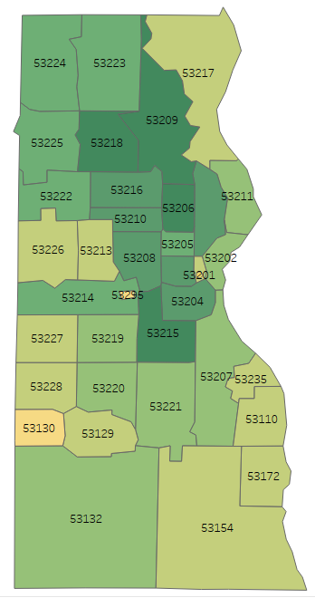
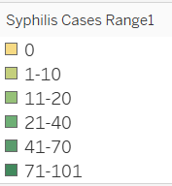
Most new syphilis diagnoses were identified in six zip codes in Milwaukee County (53206, 53208, 53209, 53210, 53215, 53218). Reported syphilis cases by Zip code, Milwaukee County: 2021 (n=1,043)

Slide 36
Syphilis cases increased 129% in Milwaukee in 2021 from 2020. Trends of syphilis cases, Milwaukee and Non-Milwaukee County: 2012–2021
(129% Increase)
(60%
Increase)

Slide 37
Milwaukee County vs. rest of Wisconsin, syphilis cases by stage: 2021

Slide 38
Gonorrhea

Slide 39
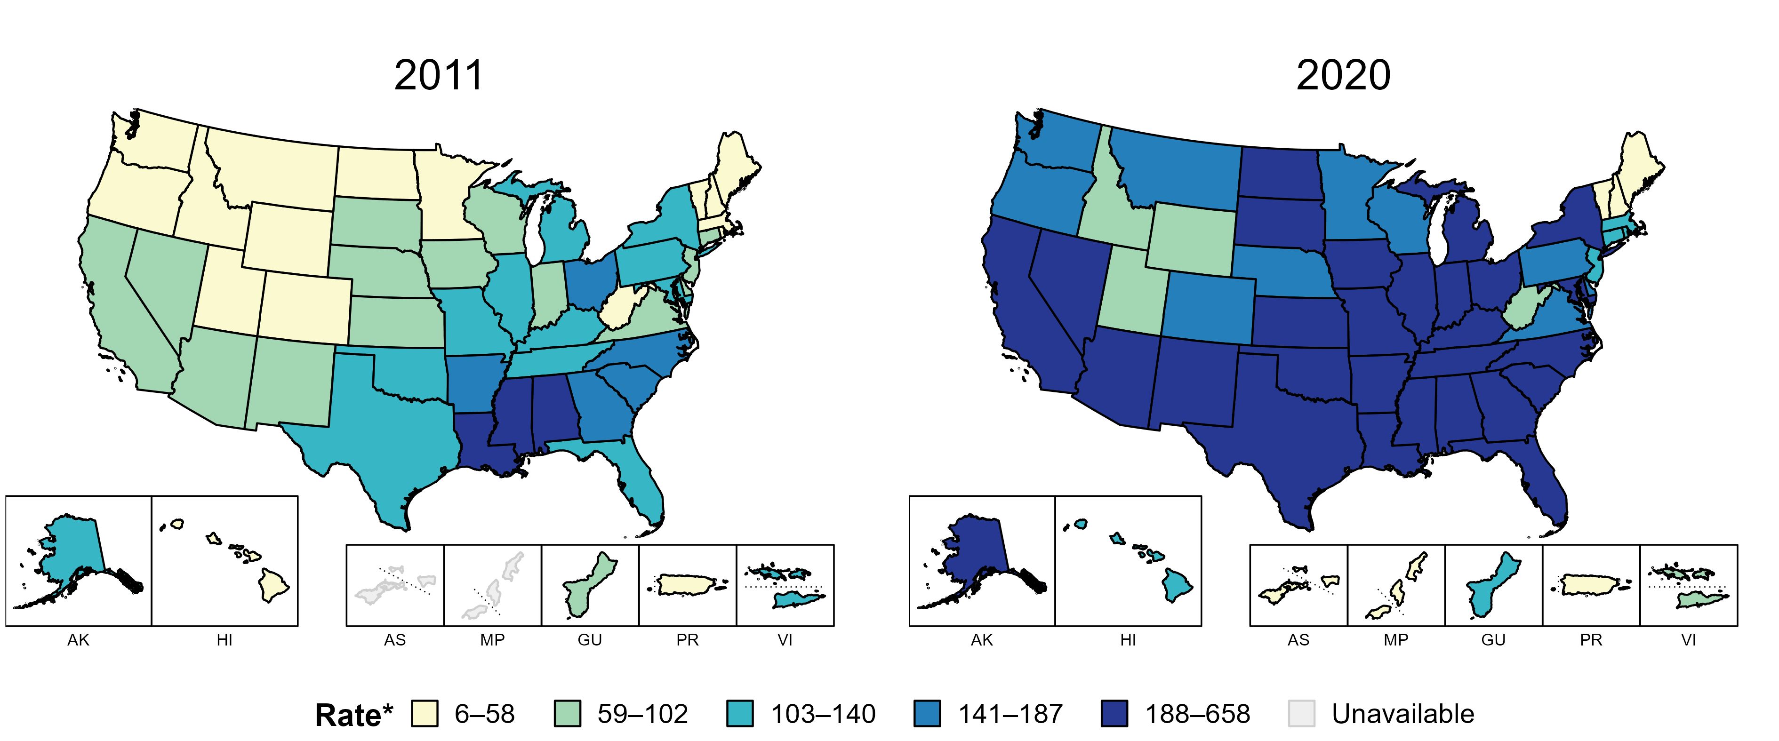
Gonorrhea—rates of reported cases by state, United States and territories, 2011 and 2020
* Per 100,000
Notes:
In 2011, eight states and the District of Columbia (DC; 16.1% of available areas) had a rate of reported gonorrhea greater than or equal to 141 cases per 100,000 population. This increased to 38 states and DC (69.6% of available areas) in 2020.
American Samoa and the Commonwealth of the Northern Mariana Islands began reporting data on gonorrhea cases to CDC in 2018; data are not available for those areas prior to that year.
The COVID-19 pandemic has introduced uncertainty and difficulty in interpreting 2020 case data. See Impact of COVID-19 on STDs (https://www.cdc.gov/std/statistics/2020/impact.htm) for more information.
See Technical Notes (https://www.cdc.gov/std/statistics/2020/technical-notes.htm) for information on gonorrhea case reporting and on interpreting reported rates in US territories.
Data points are available at: https://www.cdc.gov/std/statistics/2020/data.zip

Slide 40
While the gonorrhea rate is highest in those 20–24 years, those age groups saw a decrease in the number of case from 2020–2021. Number of gonorrhea diagnoses per 100,000 people by age at diagnosis, Wisconsin, 2017–2021
Age 20-24
Age 15-19
Age 25-29
Age 30-39
Age 40-49

Slide 41
The gonorrhea rate of reported cases in men is 1.5 times more than in women in Wisconsin. Number of gonorrhea diagnoses per 100,000 people by sex at birth, Wisconsin: 2017–2021
Male
Female

Slide 42
While Black people have a higher rate of gonorrhea in Wisconsin, the rate increased most (41%) in Native Americans from 2020– 2021. Number of gonorrhea diagnoses per 100,000 people by race and ethnicity Wisconsin, 2017–2021
Black
Native
American
White
Asian

Slide 43
The Southeastern Region has the highest rate of gonorrhea in the state although the Western region saw the highest increase . Number of gonorrhea diagnoses per 100,000 people by region of residence Wisconsin: 2017–2021
Southeastern
Southern
Northeastern
Western
Northern

Slide 44
Chlamydia

Slide 45
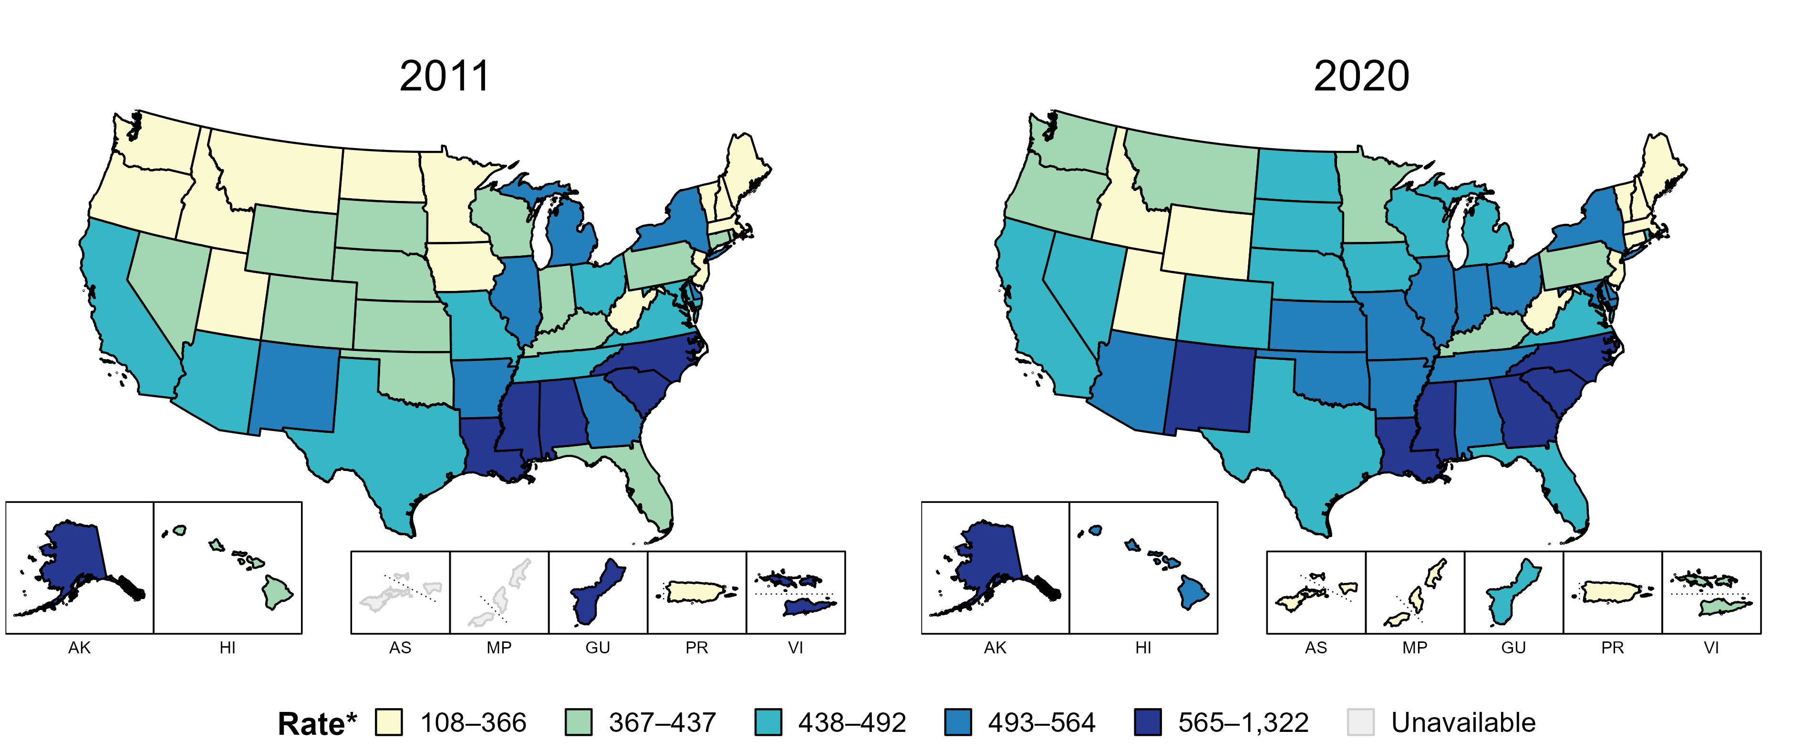
Chlamydia—rates of reported cases by state, United States and territories, 2011 and 2020
* Per 100,000
Notes:
In 2011, 13 states, the District of Columbia (DC), and two US territories (28.6% of available areas) had a rate of reported chlamydia greater than or equal to 493 cases per 100,000 population. This increased to 21 states and DC (39.3% of available areas) in 2020.
American Samoa and the Commonwealth of the Northern Mariana Islands began reporting data on chlamydia cases to CDC in 2018; data are not available for those areas prior to that year.
The COVID-19 pandemic has introduced uncertainty and difficulty in interpreting 2020 case data. See Impact of COVID-19 on STDs (https://www.cdc.gov/std/statistics/2020/impact.htm) for more information.
See Technical Notes (https://www.cdc.gov/std/statistics/2020/technical-notes.htm) for information on chlamydia case reporting and on interpreting reported rates in US territories.
Data points are available at: https://www.cdc.gov/std/statistics/2020/data.zip

Slide 46
Young people aged 20–24 have the highest chlamydia rate of reported cases in Wisconsin. Number of chlamydia diagnoses per 100,000 people by age at diagnosis, Wisconsin, 2017–2021
Age 20–24
Age 15–19
Age 25–29
Age 30–39
Age 40–49

Slide 47
While women have a higher rate of chlamydia in Wisconsin, the rate increased more in men from 2020–2021. Number of chlamydia diagnoses per 100,000 people by sex at birth Wisconsin, 2017–2021
Female
Male

Slide 48
While Black people have a higher rate of Chlamydia in Wisconsin, the rate increased most in Native Americans from 2020 to 2021. Number of Chlamydia diagnoses per 100,000 people by race and ethnicity, Wisconsin, 2017-2021
(+19%)
Black
(+52%)
Native American
(+24%)
Asian
(+12%)
White

Slide 49
Among all Regions, the Southern Region saw the rate of chlamydia increase the most from 2020–2021. Number of chlamydia rate per 100,000 people by region of residence Wisconsin, 2017–2021
Southeastern
Southern
Northeastern
Western
Northern

