Slide 1
Wisconsin Sexually Transmitted Infections (STIs) Surveillance Data
Reported Cases in 2022
Division of Public Health
Bureau of Communicable Diseases
STI Unit
P-00415 (07/2023)
Notes:
This slide set was prepared by the Sexually Transmitted Infection (STI) Intervention Unit, Bureau of Communicable Diseases, Division of Public Health Wisconsin Department of Health Services.
The slides display trends for STDs in Wisconsin in 2022, with data sourced from the Wisconsin Electronic Disease Surveillance System (WEDSS). WEDSS is a secure, web-based system designed to facilitate reporting, investigation, and surveillance of communicable diseases in Wisconsin.
WEDSS is a secure, web-based system designed to facilitate reporting, investigation, and surveillance of communicable diseases in Wisconsin. It is designed for public health staff, infection control practitioners, clinical laboratories, clinics, and
other disease reporters.

Slide 2
Introduction
Reportable Sexually Transmitted Infections (STIs) in Wisconsin:
  Chlamydia trachomatis (Chlamydia) - Includes disease classifications such as urethritis, cervicitis and conjunctivitis.
  Neisseria gonorrhoeae (Gonorrhea) - Includes disease classifications such as urethritis, cervicitis, and resistant strains. Resistant or reduced susceptibility to antibiotic treatment are confirmed by antibiotic susceptibility testing (AST).
  Treponema pallidum (Syphilis ) - Wisconsin data includes all stages and CDC data includes primary and secondary stages of syphilis.
Notes:
This set of slides focuses on three of the most prevalent STIs: Chlamydia, gonorrhea, and syphilis, examining the burden defined by age, sex, and race. National, state, and county-level trends will be discussed. Analyses related to syphilis differ from those of other STIs. Specifically, for age, sex, and race, only primary and secondary cases of syphilis were selected for analysis.

Slide 3
Introduction
Sexually transmitted infections (STIs) surveillance data are collected systematically through WEDSS* for the purpose of monitoring the frequency and distribution of STIs in the Wisconsin population.
This analysis examines trends in reportable STIs in Wisconsin to identify problem areas and allocate resources for effective STI interventions.
Out of state, cases from correctional facilities, and unknown states are not included.
Rates are calculated based on 2020 population data available in Wisconsin Interactive Statistics on Health (WISH) population module.
*WEDSS is a secure, web-based system designed to facilitate reporting, investigation, and surveillance of communicable diseases in Wisconsin. It is designed for public health staff, infection control practitioners, clinical laboratories, clinics, and other disease reporters.
Notes:
Our data are sourced from WEDSS and include all reported STIs within Wisconsin. The forthcoming analysis will encompass all cases among Wisconsin residents, excluding those from out-of-state or with unknown states of residence. For analyses, only confirmed cases of gonorrhea and chlamydia were included, while both probable and confirmed cases of syphilis were included."

Slide 4
STIs surveillance data should be interpreted with caution
STI data may be underreported, unevenly reported, and incomplete.
Elements that impact the completeness and accuracy of STI data include:
  Practices and capacity of STI screening by health care providers.
  Health care providers’ compliance with case reporting.
  Completeness and promptness of case reporting.
COVID-19 may have influenced the number of cases diagnosed and reported in 2020 and 2021.
Notes:
Data quality poses a significant concern when analyzing STI data, stemming from factors such as underreporting and incomplete patient records. Additionally, the emergence of COVID-19 has introduced new challenges, including disruptions to testing practices. The increased strain on the health system during the pandemic may have further exacerbated issues with data quality and access to testing services for the public. Considering these limitations, the Department of Health Services (DHS) recommends exercising caution when interpreting surveillance data.

Slide 5
How Does Wisconsin Compare with Neighboring States?
Notes:
The next three slides will compare STI rates among neighboring states and nationally.

Slide 6
Chlamydia cases per 100,000 people in Wisconsin and neighboring states: 2021
Notes:
In comparison to national rates, Wisconsin has a lower incidence of reported cases of chlamydia. Wisconsin's rate of chlamydia is comparable to that of other neighboring Midwestern states, with Illinois having the highest rate and Minnesota having the lowest rate

Slide 7
Gonorrhea cases per 100,000 people in Wisconsin and neighboring states: 2021
Notes:
In comparison to national rates, Wisconsin also has a lower incidence of reported cases of gonorrhea. The rate of gonorrhea in Wisconsin is lower than that observed in other neighboring Midwestern states.

Slide 8
Primary and secondary syphilis cases per 100,000 in Wisconsin and neighboring states: 2021
Notes:
Compared to national rates and those of neighboring Midwestern states, Wisconsin has a significantly lower incidence of reported cases of primary and secondary syphilis.

Slide 9
Reported Cases of Sexually Transmitted Infections (STIs)
2022
Notes:
The next part of these slides will quantify the burden of STIs in Wisconsin and examine how trends in STI incidence have changed over time.

Slide 10
The number of reported STI cases have increased by 23% in Wisconsin from 2015 to 2022.
Notes:
This slide includes the total number of reported cases of chlamydia, gonorrhea, and syphilis since 2015. While the number of reported cases of STIs increased by 23% during this time period (from 29,459 in 2015 to 36,299 in 2022), more recent data shows a 4% decrease from 2021 to 2022 (from 36,299 cases to 35,957 cases).

Slide 11
STI rates per 100,000 population of reported STI cases, Wisconsin - 2022
Notes:
The following slides will display rates of STIs per 100,000 persons, calculated by dividing the number of reported cases by the total population and multiplying by 100,000. This provides a measure of the number of cases of a certain STI observed for every 100,000 residents of Wisconsin, facilitating clearer comparisons between STIs or demographic groups and ensuring that figures are relative to the population size of Wisconsin.
From 2021 to 2022, the rate of reported syphilis (all stages including congenital) increased by 18% (from 28 to 33 cases per 100,000 persons).
From 2021 to 2022, the rate of Chlamydia decreased by 8% (from 477 to 440 cases per 100,000).
From 2021 to 2022, the rate of Gonorrhea decreased by 17% (from 180 to 150 cases per 100,000).

Slide 12
Syphilis (all stages) - rates of reported cases in Wisconsin 2013 – 2022
Rate of reported Syphilis cases increased 556% since 2013
Rate per 100,000 population
Notes:
While gonorrhea and chlamydia rates have declined recently, the rate of syphilis continues to rise. The rate of reported syphilis cases increased by 18% in 2022 compared to 2021. Wisconsin DHS is concerned about the rapidly increasing rate of syphilis throughout the state, with the rate of reported cases increasing by 556% since 2013.
Please note that different slides may show rates for only primary and secondary syphilis, and other slides may include primary, secondary, early, latent, and congenital forms of syphilis.

Slide 13
Chlamydia - rate of reported cases in Wisconsin
2013 – 2022
Rate per 100,000 population
Notes:
The rate of chlamydia reported in Wisconsin has remained somewhat consistent since 2014, with more recent declines in the observed rate.

Slide 14
Gonorrhea - rate of reported cases in Wisconsin
2013 – 2022
Gonorrhea rate decreased 17% in 2022 from 2021
Rate per 100,000 population
Notes:
The rate of gonorrhea in WI increased consistently from 2014 to 2020 and appears to have declined more recently. Further observation is necessary to understand whether this decline is due to changes in testing practices following the COVID-19 pandemic or changes in the number of infections throughout the state.

Slide 15
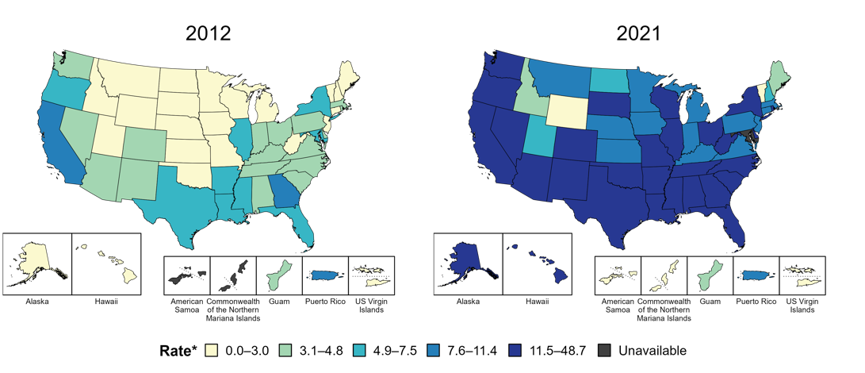
Primary and secondary syphilis—rates of reported cases by state, United States and territories, 2012 and 2021
Notes:
STIs have steadily increased throughout the USA overtime. This map displays the spread of primary and secondary syphilis rates across US states from 2012-2021. This trend is consistent with that of other STIs examined

Slide 16
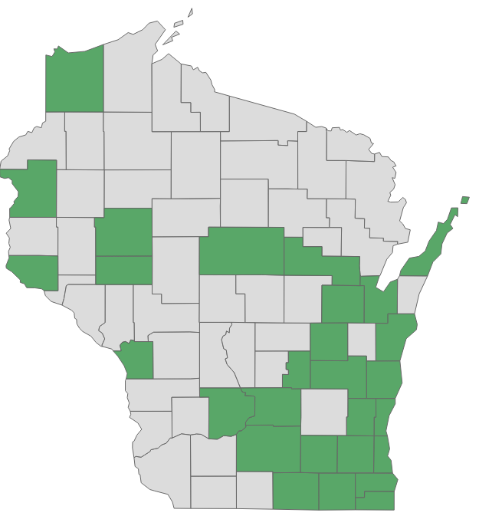
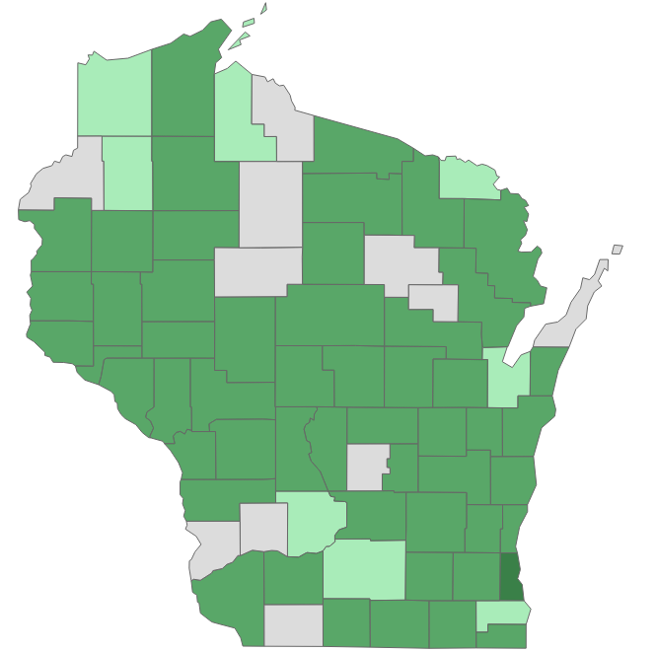

Syphilis (All stages) — rates of reported cases by county, Wisconsin, 2012 and 2021
2012
2022
Notes:
As observed nationally, the geographic spread of syphilis through Wisconsin counties has increased since 2012.

Slide 17
Syphilis (All stages) rate increased by 18% from 2021-2022 in Wisconsin.
Trends of Syphilis Cases and) Wisconsin 2014–2022
Rates (per 100,000 population
Notes:
As previously noted, there was a drastic increase in syphilis (all stages including congenital) rates from 2020 to 2021, with the rate doubling from 14 to 28 cases per 100,000 people. This represents a doubling in the rate of syphilis within a 1-year period.
In 2022, Syphilis increased by 18% compared to 2022.

Slide 18
People aged 30–39 have the highest primary and secondary syphilis rate reported - 2022.
Number of primary and secondary syphilis rates per 100,000 people by age Wisconsin: 2018–2022
Age 20-29
Age 30-39
Age 40-49
Age 15-19
Notes:
Unlike other STIs examined, syphilis tends to be more prevalent among older age groups than those most often diagnosed with chlamydia or gonorrhea, with the highest rate observed among those aged 30-39 in 2022.

Slide 19
Men have a higher rate of Syphilis, the rate remained same for women from 2021–2022.
Number of primary and secondary syphilis rates per 100,000 people by sex at birth, Wisconsin: 2018–2022
2.7 times higher than women
Male
Female
Notes:
Cis-gendered males tend to have a higher rate of diagnosed syphilis (all stages including congenital), compared compared to cis-gendered females. The rate among males increased from 2021-2022, while the rate among females has stayed steady more recently.

Slide 20
Black people have the highest primary and secondary syphilis rate in Wisconsin - 2022.
Number of primary and secondary syphilis rates per 100,000 people by race and ethnicity, Wisconsin: 2018–2022
Rate of primary and secondary syphilis in Black is 25 times the rate among White and 13 times the Asian and 4 times the Native American.
Black
Native American
Asian
White
Notes:
As in previous years, clear racial disparities in the rate of syphilis have been observed, with Black, Native American, and Asian groups experiencing rates disproportionate to their share of the Wisconsin population.

Slide 21
The Southeastern Region has the highest syphilis (All stages)rate in Wisconsin.
Number of syphilis diagnoses per 100,000 population by region of residence, Wisconsin: 2022
Note: Cases from corrections and unknown county are not included.
Notes:
This figure illustrates both the number of cases (shown in blue) and the rate of cases per 100,000 persons (shown in orange) in Wisconsin in 2022. The left axis corresponds to the blue bars on the graph, representing the number of cases while the right axis corresponds to the orange lines on the graph representing the rate per persons.
In 2022, the southeastern region of Wisconsin, which includes the city of Milwaukee observed the highest number of cases and the highest rate of syphilis.

Slide 22
Congenital Syphilis
Notes:
The following slides will focus on congenital syphilis, which refers to cases of syphilis diagnosed in newborns as a result of an untreated infection in the mother.

Slide 23
Trend of reported congenital Syphilis cases in Wisconsin 2013 - 2022
Congenital syphilis cases are in increasing trend in Wisconsin, and so is Nationally
480% increase from 2020 to 2022
Notes:
In conjunction with the rise in syphilis cases among the general population, cases of congenital syphilis drastically increased. In 2022, there was an 81% increase in the number of congenital syphilis cases observed, rising from 16 cases in 2021 to 29 cases in 2022.

Slide 24
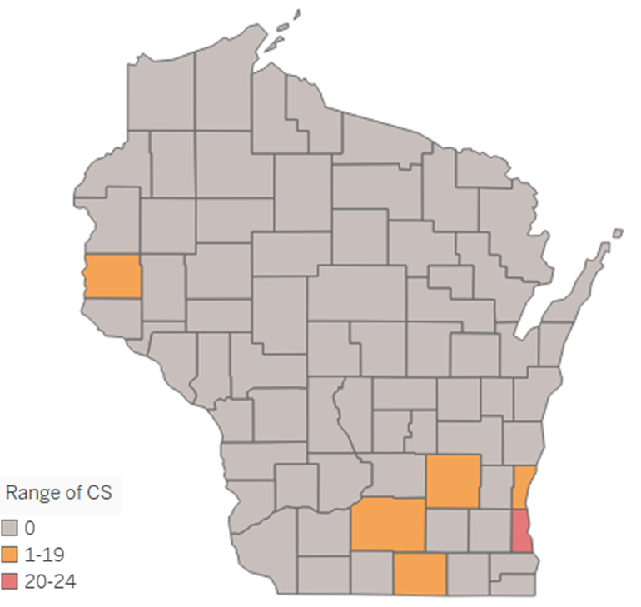

Distribution of congenital syphilis cases by county in Wisconsin – 2022 (n=29)
Milwaukee county accounts for 82% of reported congenital Syphilis cases in Wisconsin.
Count of cases
Notes:
The increase in the number of congenital syphilis cases was primarily concentrated in 6 Wisconsin counties with Milwaukee county alone accounted for 82% of reported cases.

Slide 25
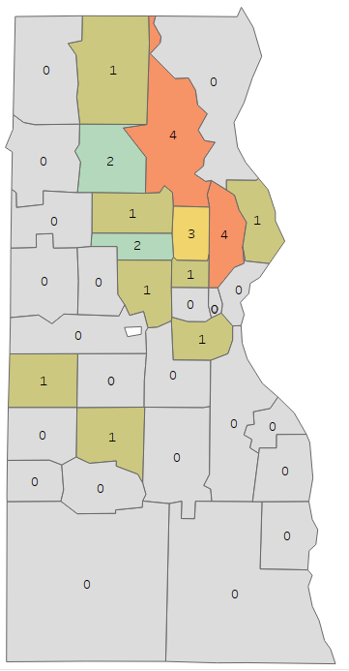
Distribution of congenital Syphilis cases in Milwaukee County by zip code - 2022
Notes:
Within Milwaukee County, three zip codes (53209, 53212, and 53206) accounted for 48% of reported congenital syphilis cases.

Slide 26
Chlamydia Trends:
Nationally and in Wisconsin
Notes:
The following slides describe trends in the incidence of Chlamydia, statewide and nationally.

Slide 27
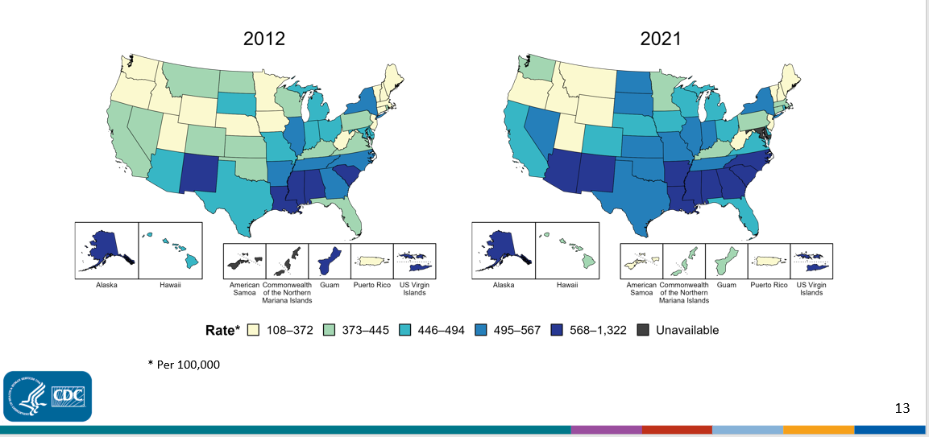
Chlamydia—rates of reported cases by state, United States and territories, 2012 and 2021
Notes:
The rate of chlamydia has increased among nearly all US states from 2012-2021.

Slide 28
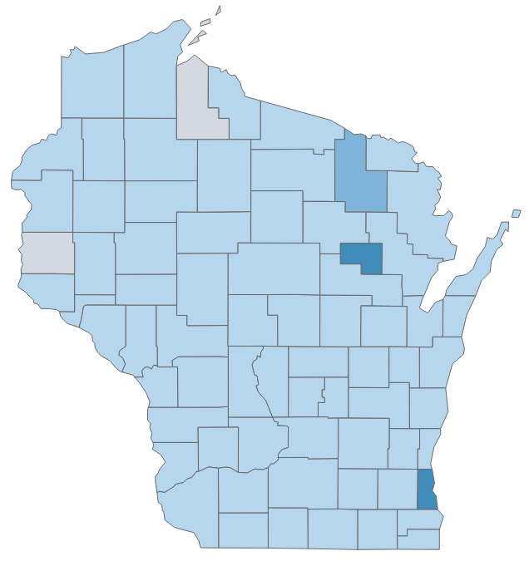
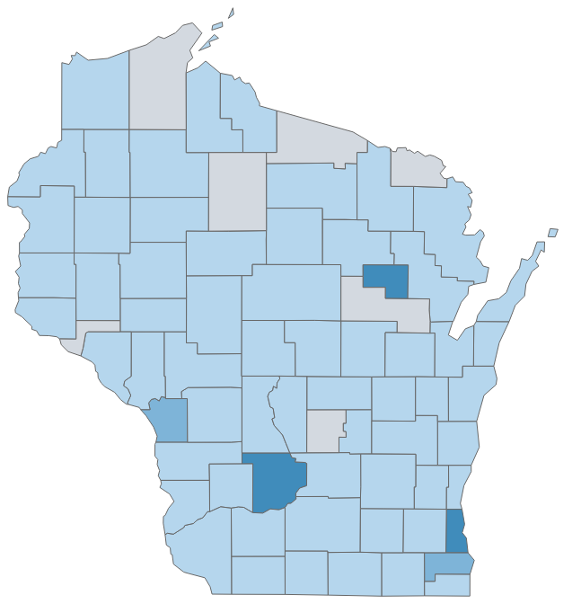


Chlamydia cases per 100,000 persons by county, Wisconsin, 2012 and 2022
2012
2022
Notes:
The trend of increasing chlamydia cases persists when looking at the county level within Wisconsin.

Slide 29
People aged 30–39 is the only age group that have increased chlamydia rates in Wisconsin.
Number of chlamydia diagnoses per 100,000 people by age at diagnosis, Wisconsin, 2018–2022
Age 20–24
Age 15–19
Age 25–29
Age 30–39
Age 40–49
Notes:
As in previous years, chlamydia is most prominent among younger age groups. In 2022, the rate of chlamydia decreased in all age groups except those aged 30-39.

Slide 30
While cis-women have a higher rate of chlamydia in Wisconsin, the rate decreased in both cis-men and cis-women from 2021–2022.
Number of chlamydia diagnoses per 100,000 people by sex at birth Wisconsin, 2018–2022
Female
Male
Notes:
Only data on biologically male and female persons are included due to low case counts among trans and non-binary persons in Wisconsin.
During 2022, the rate of chlamydia decreased in both sexes included for analyses. The rate of chlamydia among females was consistently higher than that of males from 2018-2022. More recently, the rate among both sexes examined decreased from 2018-2022, and decreased more among females than males.

Slide 31
While Black people have a higher rate of Chlamydia in Wisconsin, the rate increased most in Native Americans from 2021 to 2022.
Number of Chlamydia diagnoses per 100,000 people by race
Wisconsin, 2018-2022
Black
Native American
Asian
White
Notes:
Racial disparities persist in Wisconsin, with a greater rate of chlamydia being diagnosed among racial minorities within the state. In 2022 rates were highest among Black residents, with 2,327 cases of chlamydia per 100,000 population observed. Among other groups examined, there were 723 cases per 100,000 among Native Americans, 239 cases per 100,000 among Asians, and 205 cases per 100,000 among Whites.

Slide 32
While the Chlamydia rate decreased in all regions from 2021 to 2022, the Southern Region saw the highest decrease.
Number of chlamydia rate per 100,000 people by region of residence, Wisconsin, 2018–2022
Southeastern
Southern
Northeastern
Western
Northern
Notes:
While the burden of chlamydia is highest in the Southeastern region of Wisconsin, the rate of chlamydia is decreasing more rapidly than other regions also seeing a decline in cases.

Slide 33
Gonorrhea Trends:
Nationally and in Wisconsin
Notes:
The following slides describe trends in the incidence of Gonorrhea, statewide and nationally.

Slide 34
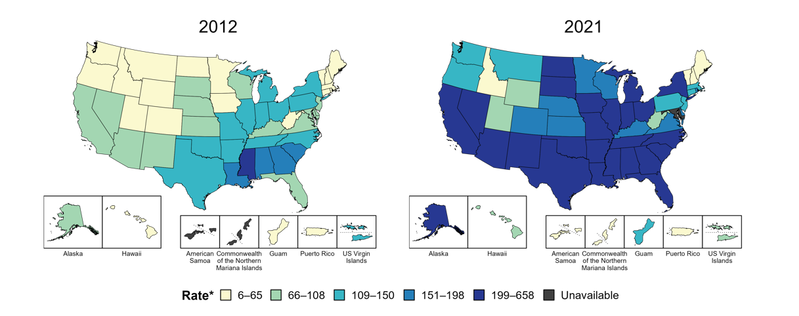
Gonorrhea—rates of reported cases by state, United States and territories, 2012 and 2021
* Per 100,000 population
Notes:
Gonorrhea has also increased nationally.

Slide 35
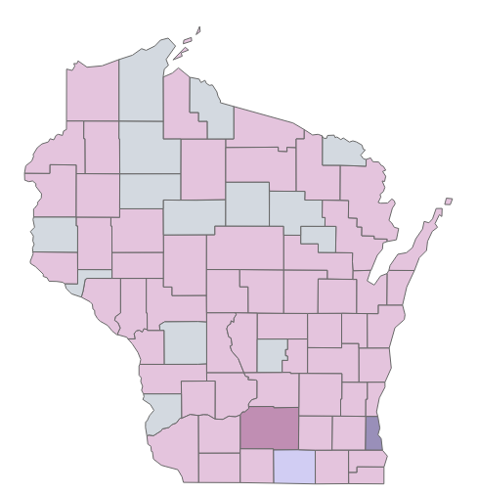
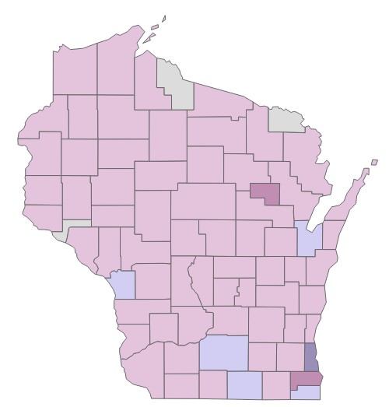


Gonorrhea—rates of reported cases by county, Wisconsin, 2012 and 2022
2012
2022
Notes:
This trend persists when looking at the county level within Wisconsin.

Slide 36
Gonorrhea rates of reported cases dropped among all age groups; the biggest drop was observed in those 30-39 years.
Number of gonorrhea diagnoses per 100,000 people by age at diagnosis, Wisconsin, 2018–2022
Age 20-24
Age 30-39
Age 15-19
Age 25-29
Age 40-49
Notes:
Gonorrhea tends to be diagnosed more frequently among younger age groups. From 2021-2022, the rate of gonorrhea decreased among all age groups and the biggest decrease was observed among those aged 30-39.

Slide 37
The gonorrhea rate of reported cases in men is 1.1 times more than in women in Wisconsin.
Number of gonorrhea diagnoses per 100,000 people by sex at birth, Wisconsin: 2018–2022
Male
Female
Notes:
As in previous years, the rate of gonorrhea was higher among men compared to women in 2022. From 2021-2022, the rate of gonorrhea decreased by 16% among both males and females.

Slide 38
While Black people have a higher rate of gonorrhea in Wisconsin, the rate increased only in Native Americans from 2021– 2022.
Number of gonorrhea diagnoses per 100,000 people by race and ethnicity Wisconsin, 2018–2022
Black
Native
American
White
Asian
Notes:
As in previous years, racial disparities in the rate of gonorrhea cases reported were observed in 2022. There were 1,323 cases of Gonorrhea per 100,000 persons among Black populations compared to 196 cases per 100,000 among Native Americans, 42 cases per 100,000 among Asians, and 39 cases per 100,000 among Whites.

Slide 39
While the Southeastern Region has the highest rate of gonorrhea in the state, the rate of gonorrhea decreased in all regions from 2021-2022.
Number of gonorrhea diagnoses per 100,000 people by region of residence Wisconsin: 2018–2022
Southeastern
Southern
Northeastern
Western
Northern
Notes:
The burden of gonorrhea is greatest in the southeastern region compared to other regions of Wisconsin. From 2021-2022, the rate of gonorrhea decreased in all regions. The greatest decreases were observed in the Northern and Southern regions.

Slide 40
Disseminated Gonococcal Infection (DGI)
Notes:
The following slides will discuss trends related to Disseminated Gonococcal Infections (DGI) observed in Wisconsin.

Slide 41

Definition of Disseminated Gonococcal Infection (DGI)
DGI is an uncommon, but severe, complication of untreated gonorrhea.
It is thought that DGI occurs in 0.5-3% of untreated gonorrhea cases. DGI occurs when the sexually transmitted pathogen Neisseria gonorrhoeae invades the blood stream and spreads to distant sites in the body, leading to clinical manifestations such as septic arthritis, polyarthralgia, tenosynovitis, petechial/pustular skin lesions, bacteremia, or, on rare occasions, endocarditis or meningitis.
Notes:
DGI is a rare but severe complication of untreated Gonorrhea.

Slide 42
Trends of confirmed disseminated gonococcal infection (DGI) reported, Wisconsin, 2019 - 2021
n=48
Notes:
Since 2019, 48 cases of DGI have been diagnosed in Wisconsin and nearly 38% were reported in Milwaukee County. The greatest number of cases was observed in 2021 and decreased from 2021-2022.

Slide 43
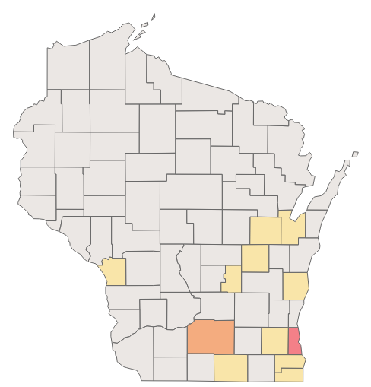
Distribution of confirmed disseminated gonococcal infection (DGI) by county, Wisconsin, 2019-2022 (n=48)
Milwaukee County accounted for 38% of reported DGI cases in Wisconsin
Notes:
Among counties in Wisconsin, Milwaukee has the highest burden of DGI in Wisconsin.

