Slide 1
Wisconsin Sexually Transmitted Infections (STIs) Surveillance Data Reported Cases in 2024
P-00415 (01/2026)
Notes:
This slide set is prepared by the Sexually Transmitted Infections (STIs) Intervention Unit, Bureau of Communicable Diseases, Division of Public Health Wisconsin Department of Health Services.
These slides display trends and burden of reported cases of STIs across different age groups, sexes, racial/ethnic groups and geographic regions in Wisconsin over the past five years (2020-2024).

Slide 2
Introduction
Reportable STIs in Wisconsin:
Chlamydia trachomatis (Chlamydia) — Includes disease classifications such as urethritis, cervicitis, and conjunctivitis.
Neisseria gonorrhoeae (Gonorrhea) — Includes disease classifications such as urethritis, cervicitis, and resistant strains.
Treponema pallidum (Syphilis) — Wisconsin data includes all stages and CDC data includes primary and secondary stages of syphilis.

Slide 3
Introduction
Sexually transmitted infections (STIs) surveillance data are collected systematically through Wisconsin Electronic Disease Surveillance System (WEDSS) for the purpose of monitoring the frequency and distribution of STIs in the Wisconsin population.
This analysis examines trends in reportable STIs in Wisconsin excluding those from out-of-state or with unknown states of residence to identify problem areas and allocate resources for effective STI interventions.
Rates are calculated based on 2023 population data available in Wisconsin Interactive Statistics on Health (WISH) population module. For analyses, only confirmed cases of gonorrhea and chlamydia were included, while both probable and confirmed cases of syphilis were included.
Notes:
Our data were sourced from WEDSS and included all reported STIs within Wisconsin. The forthcoming analysis incorporates all cases among Wisconsin residents, excluding those from out-of-state or with unknown states of residence. For analyses, only confirmed cases of gonorrhea and chlamydia were included, while both probable and confirmed cases of syphilis were included.

Slide 4
STIs Surveillance Data Interpretation
STI data may be underreported, unevenly reported, and incomplete.
Elements that impact the completeness and accuracy of STI data include:
Practices and capacity of STI screening by health care providers.
Health care providers’ compliance with case reporting.
Completeness and promptness of case reporting.
COVID-19 may have influenced the number of cases diagnosed and reported in 2020 and 2021.
Notes:
Our data were sourced from WEDSS and included all reported STIs within Wisconsin. The forthcoming analysis incorporates all cases among Wisconsin residents, excluding those from out-of-state or with unknown states of residence. For analyses, only confirmed cases of gonorrhea and chlamydia were included, while both probable and confirmed cases of syphilis were included.

Slide 5
Health Equity Considerations
STIs can affect anyone; however, some communities have much higher rates of infection than others. These disparities are not due to behavioral practices alone. There are many different social conditions, policies, and systemic practices that put some people at higher risk for STIs, such as:
Racism
Discrimination
Oppression
Poverty
Lack of access to sexual health education
Lack of access to health care
Stigma
Notes:
This report recognizes that there are many systemic barriers and social factors driving the inequities seen in the data throughout the report. Systemic conditions, for example, racism, discrimination, or oppression, can lead to higher prevalence of STIs in the community. In communities with higher STI rates, it is easier for a person to become infected with an STI because it is more likely that their sexual partner(s) have already been exposed.

Slide 6
How Does Wisconsin Compare with Neighboring States?
Notes:
The next three slides display the comparison of 2023 STI rates among neighboring states and the total for the US. 2024 STI rates from Centers for Disease Control and Prevention (CDC) are not yet available for all neighboring states, leading us to use 2023 rates instead.

Slide 7
Wisconsin Ranked Third Among Neighboring States for Primary and Secondary Syphilis Rates per 100,000 People in 2023
Note: The CDC’s 2024 Sexually Transmitted Infection (STI) data is not yet available.
Notes:
In 2023, Wisconsin had the third highest rate of primary and secondary syphilis among its neighboring states, with a rate of 9.1 cases per 100,000 people, but lower than national rate (15.8 cases per 100.000 people).

Slide 8
Wisconsin Ranked Fourth Among Neighboring States for Congenital Syphilis Rates per 100,000 People in 2023
Note: The CDC’s 2024 Sexually Transmitted Infection (STI) data is not yet available.
Notes:
In 2023, Wisconsin ranked fourth among its neighboring states for congenital syphilis, with a rate of 41.6 cases per 100,000 people, but lower than national rate (106 cases per 100.000 people).

Slide 9
Wisconsin Ranked Fourth Among Neighboring States for Gonorrhea Rates per 100,000 People in 2023
Note: The CDC’s 2024 Sexually Transmitted Infection (STI) data is not yet available.
Notes:
In 2023, Wisconsin ranked fourth among its neighboring states for congenital syphilis, with a rate of 41.6 cases per 100,000 people, but lower than national rate (106 cases per 100.000 people).

Slide 10
Wisconsin Ranked Third Among Neighboring States for Chlamydia Rates per 100,000 People in 2023
Note: The CDC’s 2024 Sexually Transmitted Infection (STI) data is not yet available.
Notes:
In 2023, Wisconsin ranked fourth among its neighboring states for congenital syphilis, with a rate of 41.6 cases per 100,000 people, but lower than national rate (106 cases per 100.000 people).

Slide 11
Reported Cases of Sexually Transmitted Infections (STIs)
2024
Notes:
The next part of these slides will quantify the burden of STIs in Wisconsin and examine how trends in STI incidence have changed over time.

Slide 12
STIs are Widespread in Wisconsin
A total of 31,576 cases of sexually transmitted infections were reported in 2024. Reportable STIs include gonorrhea, chlamydia, and syphilis.
Notes:
In 2024, a total of 31,576 cases of reportable STIs (syphilis, gonorrhea, and chlamydia) were reported in Wisconsin, which is 6.6% decrease compared to the total number of reportable STI cases in 2023 (33,791 cases in 2023 to 31,576 cases in 2024).

Slide 13
The Number of Reported Cases of STIs Continues to Decrease
Trend of reported STI cases, 2020–2024
Notes:
This slide presents the trend in reported sexually transmitted infections (STIs) case rates from 2020-2024, with a notable decline observed beginning in 2022.

Slide 14
The Rate of STIs Has Decreased Since 2021
Trend of STI rates per 100,000 people in Wisconsin, 2020–2024
Note: Excludes out of states cases.
Notes:
This slide presents the trend in reported sexually transmitted infections (STIs) case rates from 2020-2024, with a notable decline observed beginning in 2022.

Slide 15
Reported Sexually Transmitted Infections in 2024
Of the 31,576 STI cases reported in 2024, chlamydia accounted for 73.8%, followed by gonorrhea at 21.7% and syphilis at 4.5%.
Note: Includes all (Wisconsin, out of jurisdiction cases and correctional cases) reported cases.
Notes:
This slide presents the trend in reported sexually transmitted infections (STIs) case rates from 2020-2024, with a notable decline observed beginning in 2022.

Slide 16
Syphilis
Notes:
The next 16 slides discuss about the trend and burden of syphilis (all stages plus congenital) by age, sex, racial/ethnic groups and geographic regions.

Slide 17
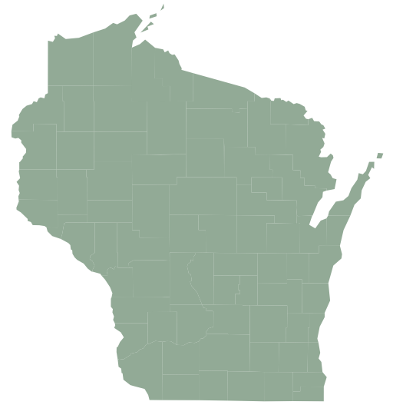
Syphilis was the Least Reported STI in 2024
A total of 1,416 cases of syphilis were reported in Wisconsin.
Notes:
In 2024, congenital syphilis was reported in only 7 out of 72 counties, indicating that 65 (90% of total counties) counties had no reported cases. Milwaukee County alone accounted for almost three quarter of the total reported cases. Most congenital syphilis cases were concentrated in the southeastern region of Wisconsin.

Slide 18
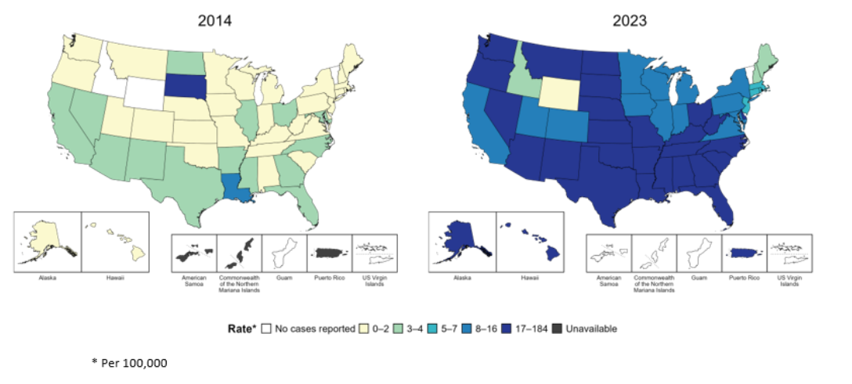
Primary and Secondary Syphilis—Rates of Reported Cases by Jurisdiction, United States and Territories, 2014 and 2023

Slide 19
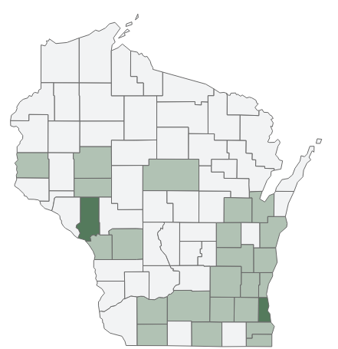
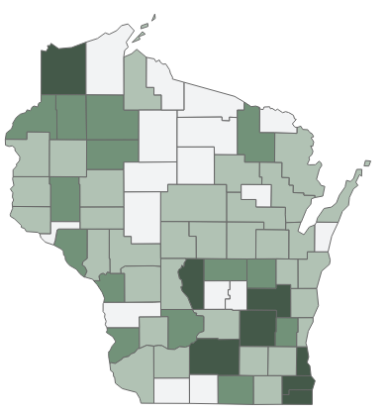
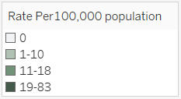
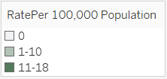
Syphilis Rates Increased in More Wisconsin Counties in 2024 Compared to 2014 Syphilis rates of reported cases by County, 2014–2024
2014
2024

Slide 20
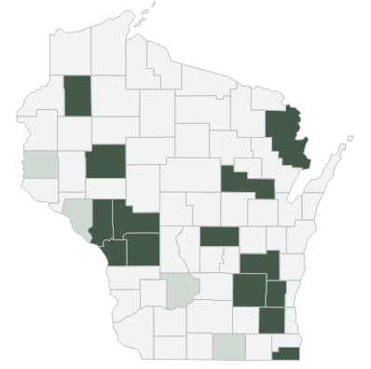
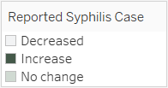
Compared to 2023, the number of syphilis cases in 54 counties decreased, increased in 14 counties, and remained unchanged in four Wisconsin counties in 2024.
Notes:
In 2024, congenital syphilis was reported in only 7 out of 72 counties, indicating that 65 (90% of total counties) counties had no reported cases. Milwaukee County alone accounted for almost three quarter of the total reported cases. Most congenital syphilis cases were concentrated in the southeastern region of Wisconsin.

Slide 21
Rate of Syphilis Cases has Decreased for the Last Two Years Syphilis cases and rates per 100,000 people, Wisconsin, 2014–2024

Slide 22
Rates of Syphilis Decreased Significantly among Males from 2023 to 2024 Rate of primary and secondary syphilis diagnoses per 100,000 people, Wisconsin, 2020–2024
Male
Female

Slide 23
The Rate of Primary and Secondary Syphilis Continues to Decrease in 2024 Rate of primary and secondary syphilis diagnoses per 100,000 people, Wisconsin, 2020–2024
Unknown Duration
Primary & secondary

Slide 24
All Age Groups Experienced a Decline in Primary and Secondary Syphilis Rates in 2024 Rates of syphilis per 100,000 people by age in Wisconsin, 2020–2024
15–19
years
20–29
years
30–39
years
40–49
years

Slide 25
The Syphilis Rate Has Been Higher Among Black People Rate of syphilis diagnoses per 100,000 people by race, Wisconsin, 2020–2024
Black
Native American
Hispanic
White,
Asian

Slide 26
Black and Hispanic People are Disproportionately Impacted by Syphilis

Slide 27
Southeastern Region Continues to Have Higher Rates of Syphilis in Wisconsin Rates of reported cases of syphilis by regions, 2020–2024
Southeastern
Southern
Northeastern
Northern
Western

Slide 28
Congenital Syphilis
Notes:
Congenital syphilis cases in Wisconsin is on the rise.

Slide 29
In 2024, 31 cases of congenital syphilis were reported in Wisconsin.
Notes:
In 2024, congenital syphilis was reported in only 7 out of 72 counties, indicating that 65 (90% of total counties) counties had no reported cases. Milwaukee County alone accounted for almost three quarter of the total reported cases. Most congenital syphilis cases were concentrated in the southeastern region of Wisconsin.

Slide 30
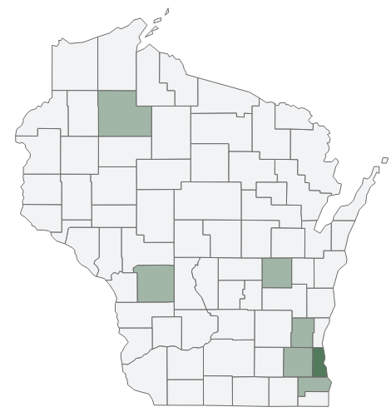

Milwaukee County accounted for 74% of reported congenital syphilis cases in Wisconsin in 2024.
n=31
Notes:
In 2024, congenital syphilis was reported in only 7 out of 72 counties, indicating that 65 (90% of total counties) counties had no reported cases. Milwaukee County alone accounted for almost three quarter of the total reported cases. Most congenital syphilis cases were concentrated in the southeastern region of Wisconsin.

Slide 31
More than half of the reported congenital syphilis cases were Black.
Reported cases of congenital syphilis in Wisconsin, 2024 (n=31)
Notes:
In 2024, congenital syphilis was reported in only 7 out of 72 counties, indicating that 65 (90% of total counties) counties had no reported cases. Milwaukee County alone accounted for almost three quarter of the total reported cases. Most congenital syphilis cases were concentrated in the southeastern region of Wisconsin.

Slide 32
Congenital Syphilis Cases Reached All-Time High in 2024 Since last 20 Years Reported cases of congenital syphilis in Wisconsin, 2020–2024
520% increase from 2020

Slide 33
Gonorrhea
Notes:
Gonorrhea is the second most reported sexually transmitted infection in the state.

Slide 34
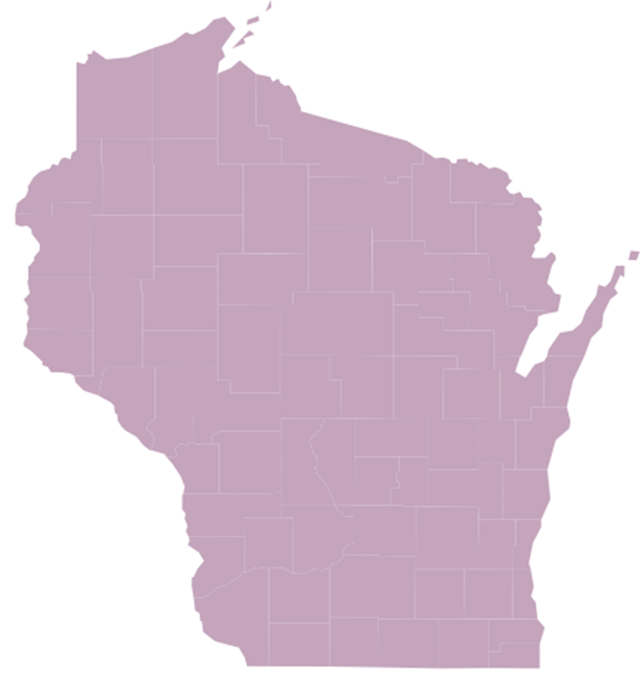
Gonorrhea is the Second Most Common Reported STI
A total of 6,852 cases of gonorrhea were reported in Wisconsin.
Notes:
In 2024, congenital syphilis was reported in only 7 out of 72 counties, indicating that 65 (90% of total counties) counties had no reported cases. Milwaukee County alone accounted for almost three quarter of the total reported cases. Most congenital syphilis cases were concentrated in the southeastern region of Wisconsin.

Slide 35
Reported Cases of Gonorrhea Decreased for the Third Consecutive Year in Wisconsin Five-year trend of reported cases of gonorrhea infection in Wisconsin.

Slide 36
The Gonorrhea Rate has also Decreased for the Third Consecutive Year in Wisconsin Five-year rate trend of gonorrhea cases per 100,000 people in Wisconsin, 2020–2024

Slide 37
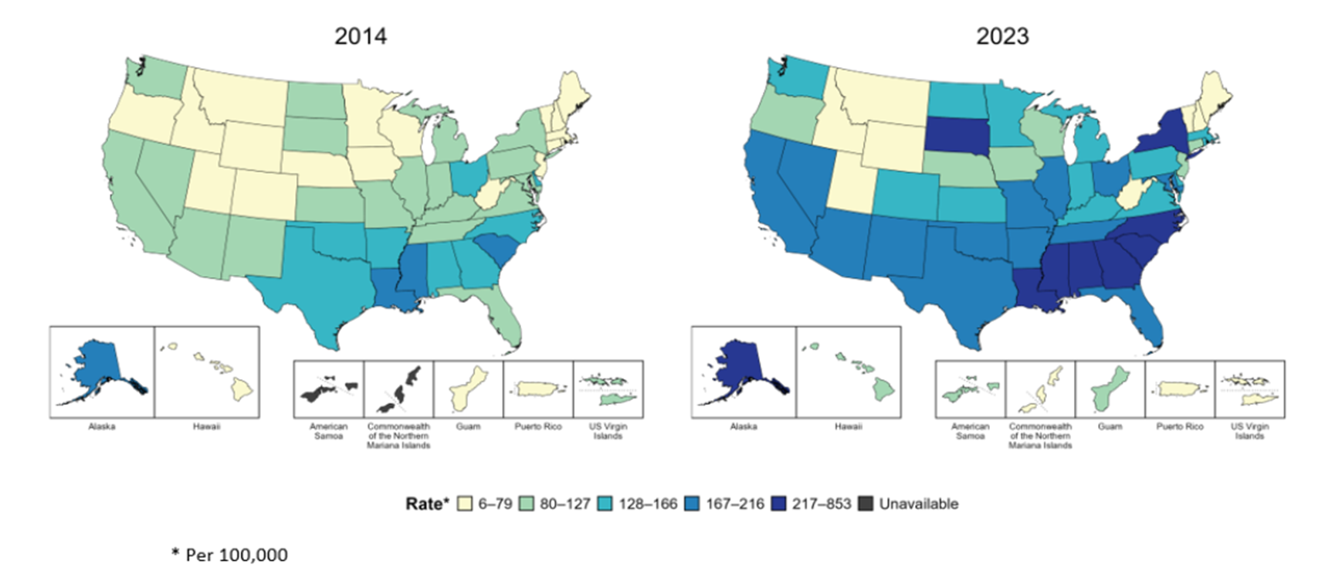
Rates of Reported Gonorrhea Cases by Jurisdiction, United States and Territories, 2014 and 2023

Slide 38
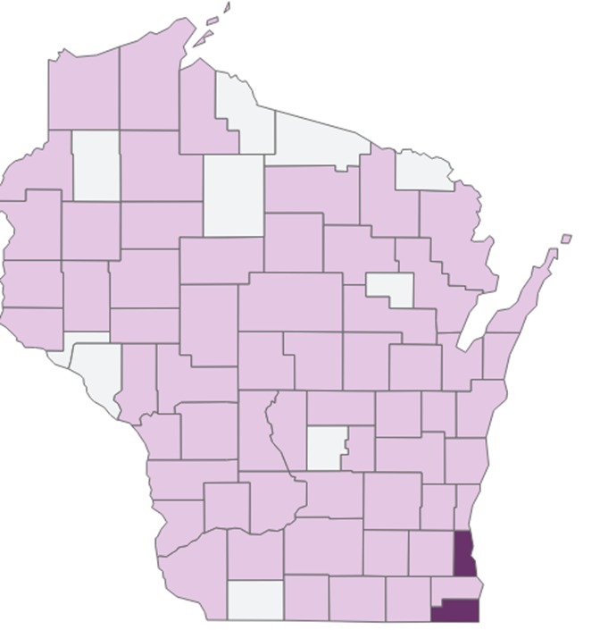
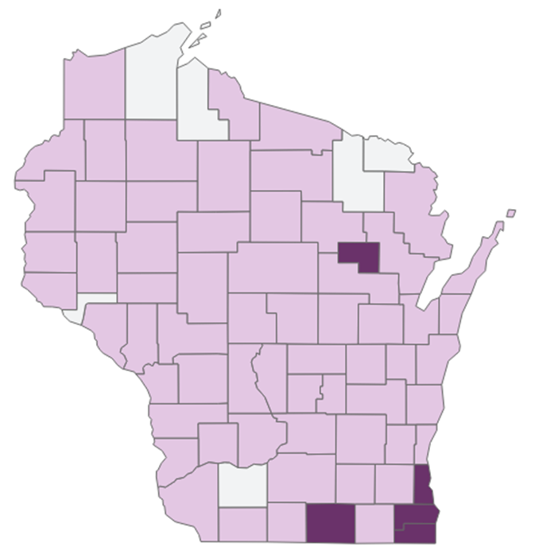
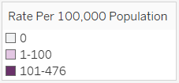
Gonorrhea Rates Increased in more Wisconsin Counties in 2024 from 2014 Gonorrhea rates of reported cases by County, 2014–2024
2014
2024

Slide 39
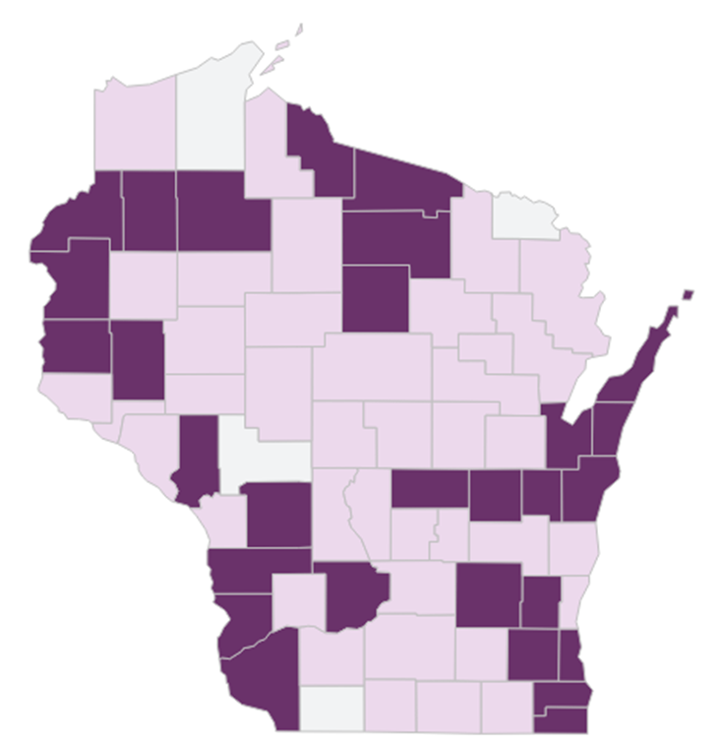
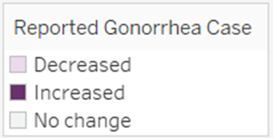
Compared to 2023, the number of gonorrhea cases decreased in 39 counties, increased in 29 counties, and remained unchanged in four Wisconsin counties.
Notes:
In 2024, congenital syphilis was reported in only 7 out of 72 counties, indicating that 65 (90% of total counties) counties had no reported cases. Milwaukee County alone accounted for almost three quarter of the total reported cases. Most congenital syphilis cases were concentrated in the southeastern region of Wisconsin.

Slide 40
Gonorrhea Rate Among Both Males and Females has Been Decreasing Since 2021 Number of gonorrhea diagnoses per 100,000 people by sex at birth, Wisconsin 2020–2024
Male
Female

Slide 41
Overall Trend of Gonorrhea by Age Groups Trend of gonorrhea diagnoses per 100,000 people by age at diagnosis in Wisconsin, 2020–2024
15–19
years
20–24
years
25–29
years
30–39
years

Slide 42
Rate of gonorrhea by sex and age in 2024 Rates of gonorrhea are slightly higher among males ages 15–19 years than same aged females
Male
Age
Female

Slide 43
Gonorrhea Rates Have Been Declining Across all Races and Ethnicities since 2019 Rates of gonorrhea diagnoses per 100,000 people by race/ethnicity, 2020–2024
Black
Hispanic
White

Slide 44
Gonorrhea Does Not Impact People of All Races and Ethnicities Equally

Slide 45
Chlamydia
Notes:
Chlamydia is the most reported sexually transmitted infection in the state.

Slide 46
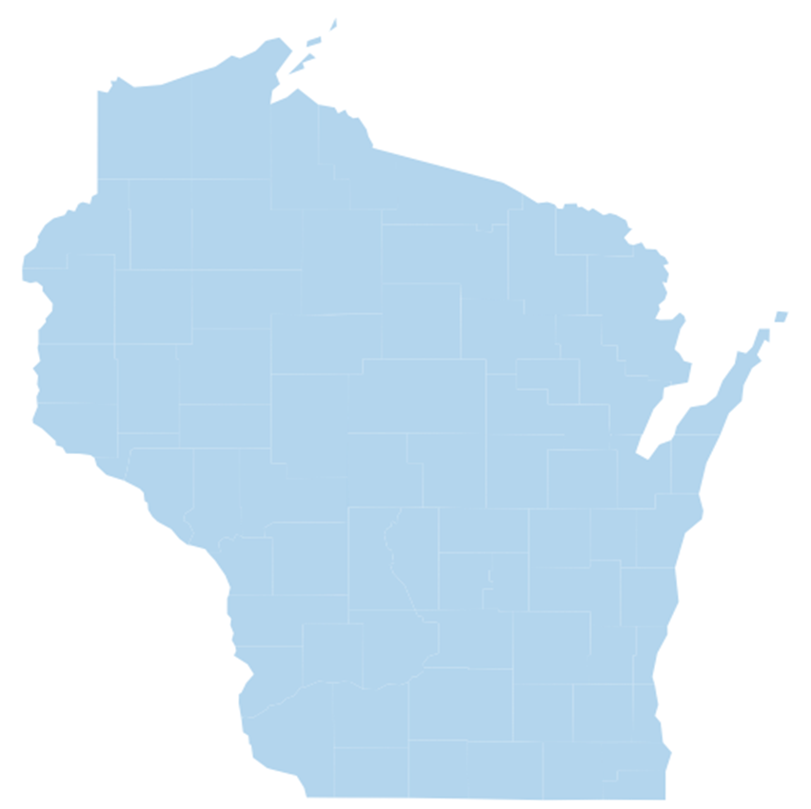
Chlamydia is the Most Common Reported STI
A total of 23,308 cases of chlamydia were reported in Wisconsin.
Notes:
In 2024, congenital syphilis was reported in only 7 out of 72 counties, indicating that 65 (90% of total counties) counties had no reported cases. Milwaukee County alone accounted for almost three quarter of the total reported cases. Most congenital syphilis cases were concentrated in the southeastern region of Wisconsin.

Slide 47
The Reported Number of Chlamydia Cases Decreased for the Third Consecutive Year Five-year trend of reported cases of chlamydia infection in Wisconsin, 2020–2024

Slide 48
Rate of Reported Chlamydia Cases Have Been Decreasing for the Last Three Years Five-year rate (per 100,000 people) trends of reported cases of chlamydia in Wisconsin, 2020–2024

Slide 49
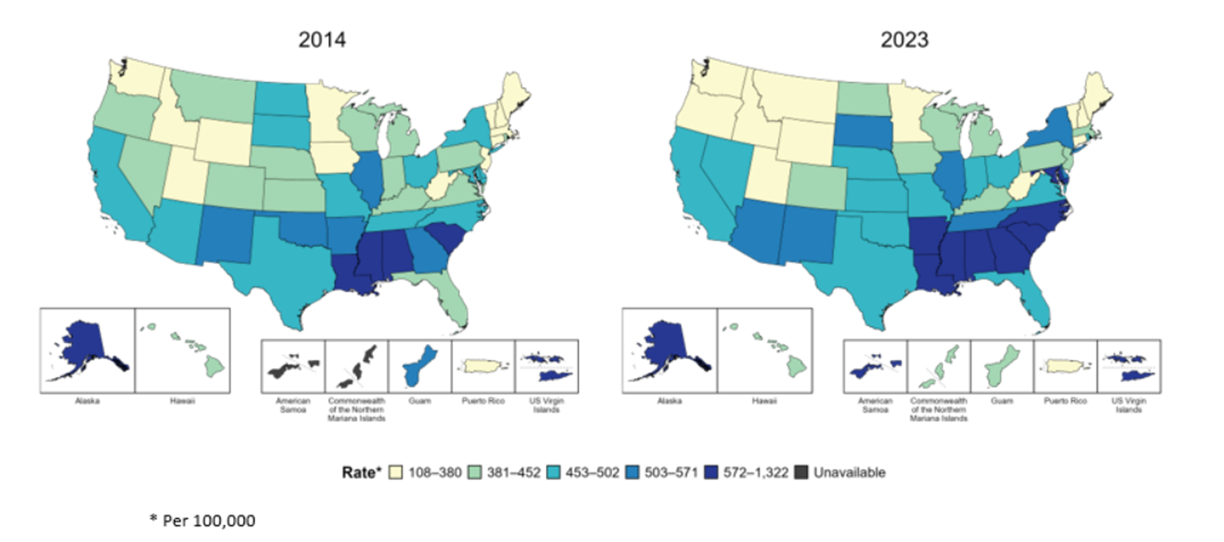
Rates of Reported Chlamydia Cases by Jurisdiction, United States and Territories, 2014 and 2023

Slide 50
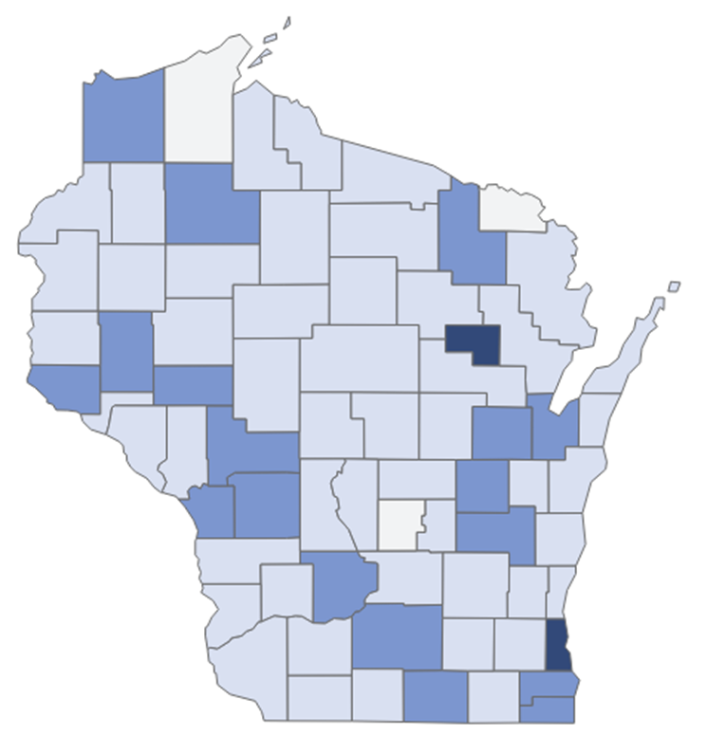
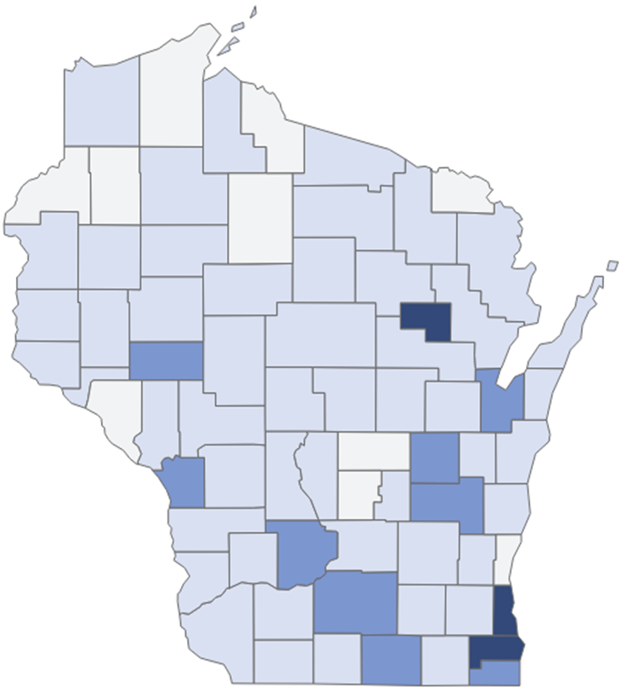
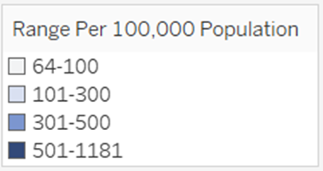
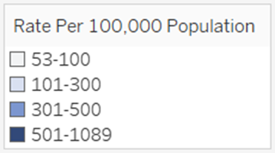
Chlamydia Rates Decreased in Several Counties in Wisconsin Since 2014 Chlamydia rates of reported cases by County, 2014–2024
2014
2024

Slide 51
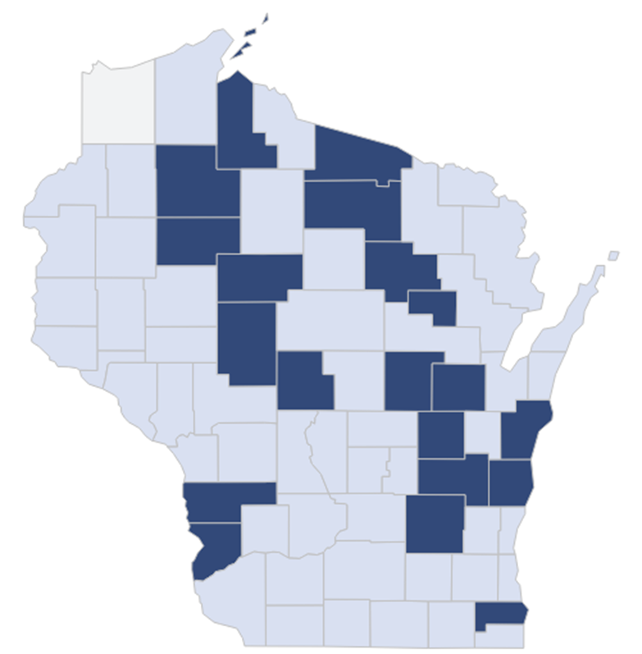
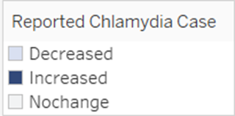
In Wisconsin, the number of reported chlamydia cases in 2024 compared to 2023 decreased in 51 counties, increased in 20 counties, and remained unchanged in one county.
Notes:
In 2024, congenital syphilis was reported in only 7 out of 72 counties, indicating that 65 (90% of total counties) counties had no reported cases. Milwaukee County alone accounted for almost three quarter of the total reported cases. Most congenital syphilis cases were concentrated in the southeastern region of Wisconsin.

Slide 52
Chlamydia Rates have Historically Been Higher Among Females Compared to Males Rates of chlamydia diagnoses per 100,000 people by sex, 2020—2024
Female
Male

Slide 53
Overall Trend of Chlamydia by Age Groups Trend of chlamydia diagnoses per 100,000 people by age at diagnosis in Wisconsin, 2020–2024
15–19
years
20–29
years
30–39
years
40–49
years

Slide 54
The Incidence of Chlamydia was Higher Among Females Than Males Aged 20–29 years in 2024 Chlamydia case distribution by age and sex in Wisconsin, 2024

Slide 55
The Rate of Chlamydia Infections Increased Among Black People from 2023–2024 Rates of chlamydia diagnoses per 100,000 people by race/ethnicity, 2020–2024
Black
Hispanic
White

Slide 56
Chlamydia Does Not Impact People of All Races and Ethnicities Equally

Slide 57
Key Takeaways From 2024 Data:
The number of reported cases of STIs decreased by 6.6% from 2023 to 2024.
Of the three STIs, syphilis cases decreased the most at 21%.
However, the number of congenital syphilis cases rose last year by 24%.

