Slide 1
The Story of Childhood Lead Poisoning
Presenter Name
Job Title
Date of Presentation
Division of Public Health, Bureau of Environmental and Occupational Health
P-01245 (04/2016)
Protecting and promoting the health and safety of the people of Wisconsin
Notes:
Group Leader Script:
Welcome.
In front of you is a folder with a lot of good information on lead and lead poisoning.
At certain points in this presentation I will refer to a particular handout in the folder.
Please wait until I tell you to pull out the handout.
Then we can look at it together.

Slide 2

Lead Poisoning – The Invisible Disease
Notes:
Group Leader Script:
Tonight we are going to talk about the story of Lead Poisoning—the Invisible Disease.
Let’s get started. What do you know about lead? Have you ever heard about lead or lead poisoning before? Do you know anyone who was lead poisoned?
Did you know that lead is toxic? It’s a poison and a child gets poisoned if lead gets into the body.
Lead hurts kids! Lead can damage a child’s brain and body.
It can make it hard for a child to learn to read. It can make a child antsy and act out in class.
But, lead poisoning is an invisible disease.
Now let’s learn more about lead and why it’s called the invisible disease.

Slide 3
The Story of Lead Poisoning
❒ WHO?
❒ WHAT?
❒ WHEN?
❒ WHY?
❒ WHERE?
❒ HOW?
Notes:
Group Leader Script:
When a reporter writes a story for the newspaper, he or she must get all the basic facts right. They call that the WHO, WHAT, WHEN, WHY, WHERE and HOW of the story.
We’ll begin with WHO is most affected by lead…

Slide 4
The Story of Lead Poisoning
❒ WHO?
❒ WHAT?
❒ WHEN?
❒ WHY?
❒ WHERE?
❒ HOW?
Notes:
Group Leader Script:
Next, we’ll talk about WHAT young children do that puts them at risk for lead exposure…

Slide 5
The Story of Lead Poisoning
❒ WHO?
❒ WHAT?
❒ WHEN?
❒ WHY?
❒ WHERE?
❒ HOW?
Notes:
Group Leader Script:
We’ll discuss WHEN children should be tested for lead…

Slide 6
The Story of Lead Poisoning
❒ WHO?
❒ WHAT?
❒ WHEN?
❒ WHY?
❒ WHERE?
❒ HOW?
Notes:
Group Leader Script:
We’ll discuss WHY children should be tested for lead…

Slide 7
The Story of Lead Poisoning
❒ WHO?
❒ WHAT?
❒ WHEN?
❒ WHY?
❒ WHERE?
❒ HOW?
Notes:
Group Leader Script:
We’ll discuss WHERE lead can be found…

Slide 8
The Story of Lead Poisoning
❒ WHO?
❒ WHAT?
❒ WHEN?
❒ WHY?
❒ WHERE?
❒ HOW?
Notes:
Group Leader Script:
And finally, HOW to protect your children from lead.

Slide 9
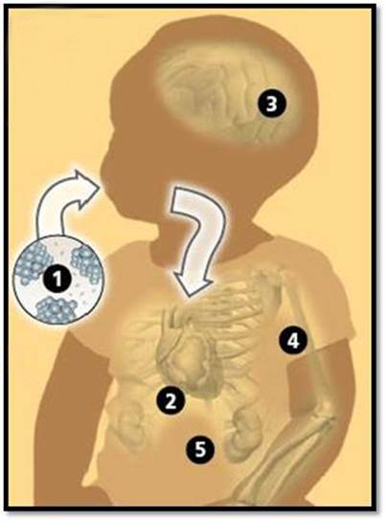
Young Child – Greater Risk
Children under six years
of age are at risk
because…
their brains are growing
quickly.
❒ WHO?  WHAT?  WHEN?  WHY?  WHERE?  HOW?
Notes:
Group Leader Script:
WHO is most affected by lead?
The focus of preventing lead poisoning is primarily on young children under age 6.
A child’s brain is growing very quickly at this age.
Lead can affect how the brain develops.
The body thinks lead is calcium. Calcium is needed to build the brain. So if the body sees lead, it latches onto it, thinking it is calcium.
Then the lead damages the brain and other parts of the body as well.
Key to Diagram
◆ Dust particles ingested through the mouth
❖ Travels to the stomach  Absorbed into the brain
 Absorbed into the bones  Absorbed into kidneys and other organs

Slide 10

Young Child - Greater Risk
Children under six years
of age are at risk
because…
their bodies absorb
lead more quickly.
Six times faster than adults
❒ WHO?  WHAT?  WHEN?  WHY?  WHERE?  HOW?
Notes:
Group Leader Script:
At this age, a child’s body absorbs whatever lead they put into their mouth.
Their bodies absorb lead six times faster than an adult’s body does.

Slide 11
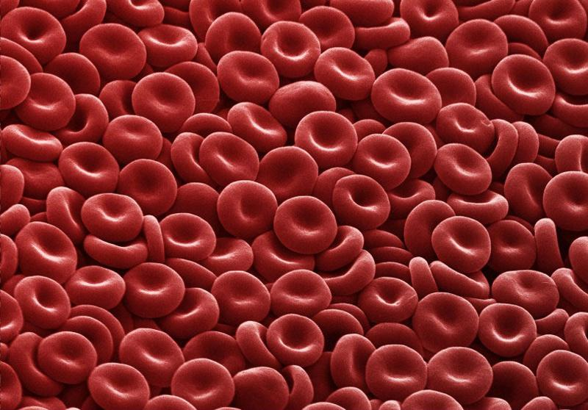
Young Child – Greater Risk
Children are at risk
if their bodies have
low iron because…
they may absorb more
lead.
❒ WHO?  WHAT?  WHEN?  WHY?  WHERE?  HOW?
Notes:
Group Leader Script:
This is a picture of red blood cells. The red in red blood cells is from iron. Iron is a mineral that our bodies need to stay healthy.
So iron, like calcium, is also something that is needed for building the brain and the body.
If a child has low iron in their body, the child can absorb more lead.

Slide 12

What Do Young Children Do?
Children under six years of age are at risk because…
they put everything
in their mouths.
❒ WHO?  WHAT?  WHEN?  WHY?  WHERE?  HOW?
Notes:
Group Leader script:
The primary source of lead for young children is lead dust. Lead dust is created when chipping and peeling lead paint gets ground up and spread around the house and yard.
So, WHAT are the things children do at these young ages that cause them to get exposed to lead more easily?
Young children put everything in their mouths.
So the lead dust on their hands, toys, etc., will get into their mouths and they swallow it.

Slide 13

What Do Young Children Do?
They crawl on the floor where lead dust settles.
❒ WHO?  WHAT?  WHEN?  WHY?  WHERE?  HOW?
Notes:
Group Leader Script:
Also, ordinary things they do can put them at greater risk:
Crawling on the floor where lead dust settles…

Slide 14
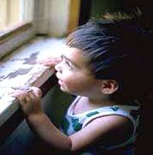
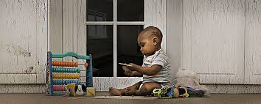
What Do Young Children Do?
They play by windows or on a porch with chipping paint.
❒ WHO?  WHAT?  WHEN?  WHY?  WHERE?  HOW?
Notes:
Group Leader Script:
Playing by an old window with chipping paint…
Or playing on a porch with chipping paint…

Slide 15
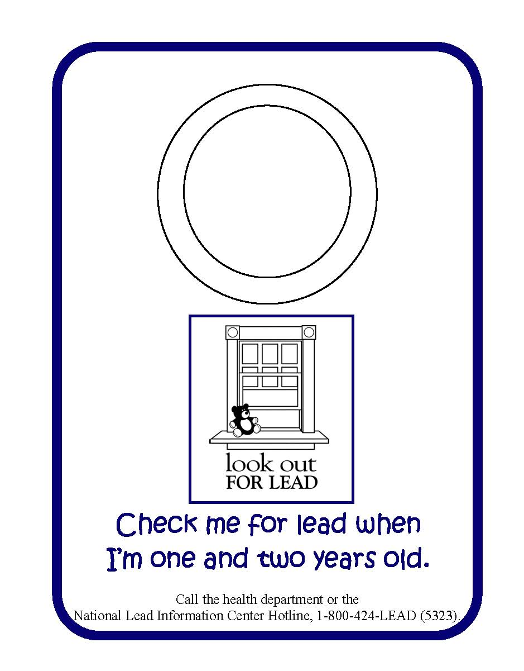
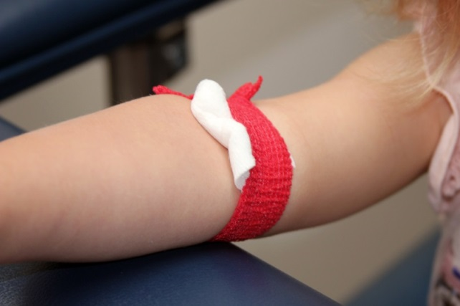
Young Children Should Have Their Blood Tested for Lead
❒ WHO?  WHAT?  WHEN?  WHY?  WHERE?  HOW?
Notes:
Group Leader Script:
WHEN should a young child be tested for lead?
Lead poisoning can be invisible in a child.
Children with lead poisoning often don’t look or act sick but they may be irritable, complain of tummy aches, or seem tired—much like the flu.
We measure how much lead is in a child’s body through a blood test. Getting a child tested for lead is the only way to know if a child is lead poisoned. The clinic staff may take a few drops of blood from the child’s finger or take blood from the child’s arm.
It’s important to test at age one to catch any lead exposure early on. It’s also important to test again at age two when children are at greater risk for lead poisoning. A two-year-old child is more able to explore on their own and may have easier access to lead hazards.

Slide 16
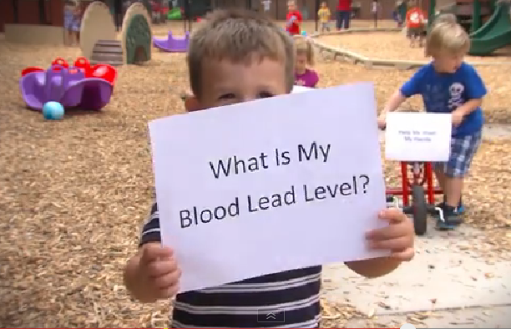
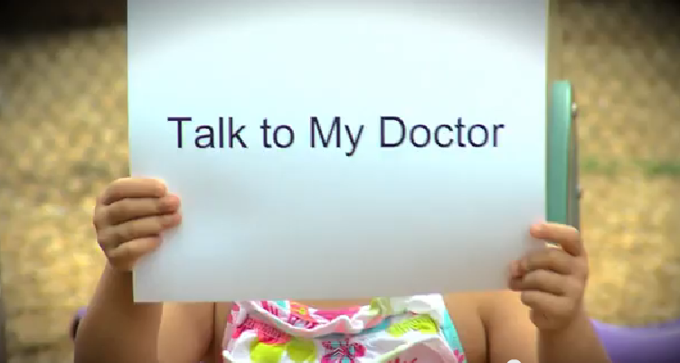
Young Children Should Have Their Blood Tested for Lead
❒ WHO?  WHAT?  WHEN?  WHY?  WHERE?  HOW?
Notes:
Group Leader Script:
When your child is tested for lead, the test result will be a number. That number will tell you how much lead is in your child’s blood. No amount of lead is safe, but we are more concerned the higher the number is, because it might mean the child has been exposed to more lead for a longer time.
Ask your doctor if your child has been tested, what your child’s lead level is, and if it’s time for another test. If your child hasn’t been tested, ask your doctor to do the test. Then be sure to ask for the test result.
If your child was tested at age one, it might be time for the two-year-old test.
There is a story book in your folder about getting a lead test, Elmo’s Trip to the Doctor. You can read it to your child later.

Slide 17




Lifelong Effects of Lead Poisoning
Misbehaving
As children:
Inattentive
Aggressive
Trouble Learning
Inattentive
❒ WHO?  WHAT?  WHEN?  WHY?  WHERE?  HOW?
Notes:
Group Leader Script:
WHY is it important to know what happens to a child exposed to lead?
Lead poisoning can mean a child will have problems with hearing, learning to talk, learning to read, and learning to complete a project from beginning to end.
Sometimes lead poisoning can result in negative behaviors—being antsy or wiggly, acting out and bullying, or being depressed, anxious, and panicky.
Not all children will have the same effects if they are lead poisoned.
It can depend on a number of things. Like how much lead the child was exposed to and how long the child was exposed to the lead. Say a child is exposed to lead on a daily basis over a long period of time. That child is more likely to have the problems we are discussing here.

Slide 18


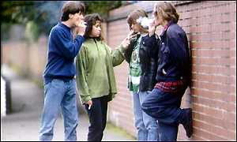
Lifelong Effects of Lead Poisoning
As teenagers:
Skipping School
Teen Pregnancy
Smoking
❒ WHO?  WHAT?  WHEN?  WHY?  WHERE?  HOW?
Notes:
Group Leader Script:
Sometimes lead poisoning can result in bad outcomes later in life—getting in trouble in school, teen pregnancy, smoking and crime.
Why is lead connected with these things?
Some researchers did a study that showed there were missing parts of the brain in adults who had been lead poisoned as children.
The places in the brain where the tissue was missing are the same areas of the brain people use when they make decisions, control their emotions, control their impulses.
So if that brain matter is missing, those people are less likely to make good decisions, control their emotions, and control their impulses.
Also, if those people have been struggling in school, they could be suspended or fail school, and that could increase the chance that they might get pregnant or get into trouble with the law.

Slide 19



Lifelong Effects of Lead Poisoning
As adults:
Memory Loss
High Blood Pressure
Heart Attack
❒ WHO?  WHAT?  WHEN?  WHY?  WHERE?  HOW?
Notes:
Group Leader Script:
Being exposed to lead as a child can mean health problems later on, like high blood pressure, heart attack, stroke, and memory loss.
Because lead affects the development of every part of the body, it can affect the major organs of the body like the heart, veins, kidneys, as well as the brain.

Slide 20
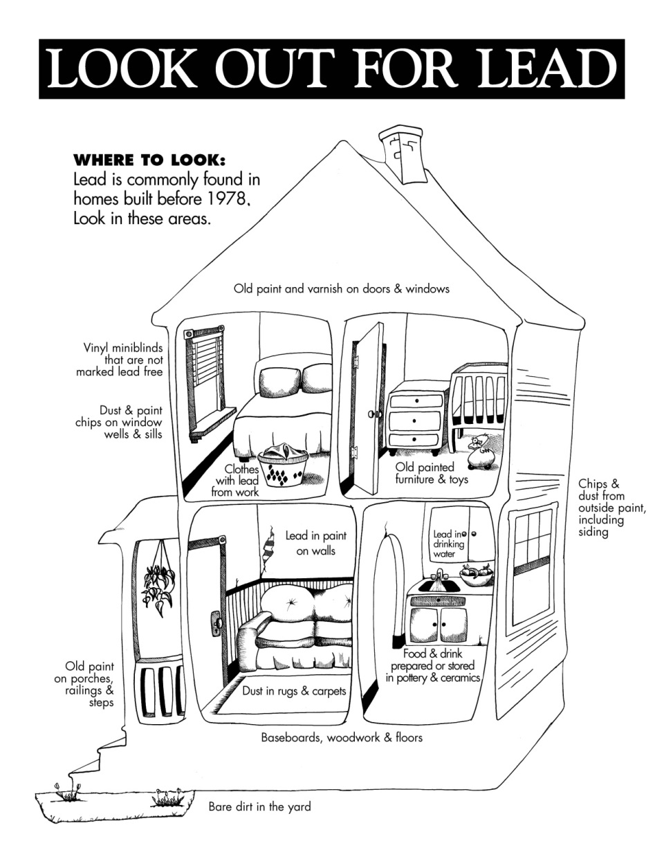
Older homes are more likely to have lead paint hazards.
Where can you find lead in a home?
❒ WHO?  WHAT?  WHEN?  WHY?  WHERE?  HOW?
Notes:
Group Leader Script:
So WHERE is lead found?
Now we are going to look at some places where lead might be found in homes.
Knowing where and what things could expose your child to lead is important.
Paint in older homes—those built before 1978—may contain lead. Paint that is not in good condition—peeling, flaking, chipping, or is on a friction surface like a window or door—may be a lead hazard.
Old painted surfaces and small children do not mix.
You have a handout in your folder showing this house and where the lead hazards are, but don’t look at it just yet.
Let’s take a look and point out the places where lead might be found inside and outside this house.

Slide 21

Where is lead found?
❒ WHO?  WHAT?  WHEN?  WHY?  WHERE?  HOW?
Notes:
Group Leader Script
[Read out any of the ones that were not brought up in the discussion.]
You can use this handout with your child and point out where the lead hazards might be. Then your child can color the house.

Slide 22

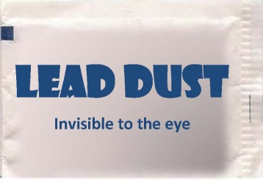
How Much Lead Does it Take to Poison a Child?
Less than the size of a sugar packet spread around a two-bedroom house.
Lead Poisoned Child
❒ WHO?  WHAT?  WHEN?  WHY?  WHERE?  HOW?
Notes:
Group Leader Script
So WHERE is lead found?
Remember when I said that the primary way young children get lead poisoned is from lead dust?
In front of each of you is a sugar packet. Pretend we’re in a two-bedroom home like this one.
I am going to demonstrate another way lead poisoning is an invisible disease. I am going to open my packet of sugar, pour it into my hand and now watch (blows from hand). Can you see it? No, you can’t.
If that sugar were lead dust, that would be enough to poison a child, and it’s invisible.
There is a handout in your folder that explains this. It’s right behind another handout that shows you where to look for lead in your home.
Now I hope every time you see a packet of sugar, you’ll think of this.

Slide 23

Sources of Lead in Homes
❒ WHO?  WHAT?  WHEN?  WHY?  WHERE?  HOW?
Notes:
Group Leader Script:
We’re going to look at some pictures of lead inside and outside the home.
This is a door with lead-based paint and the pattern is what we call alligatoring.

Slide 24
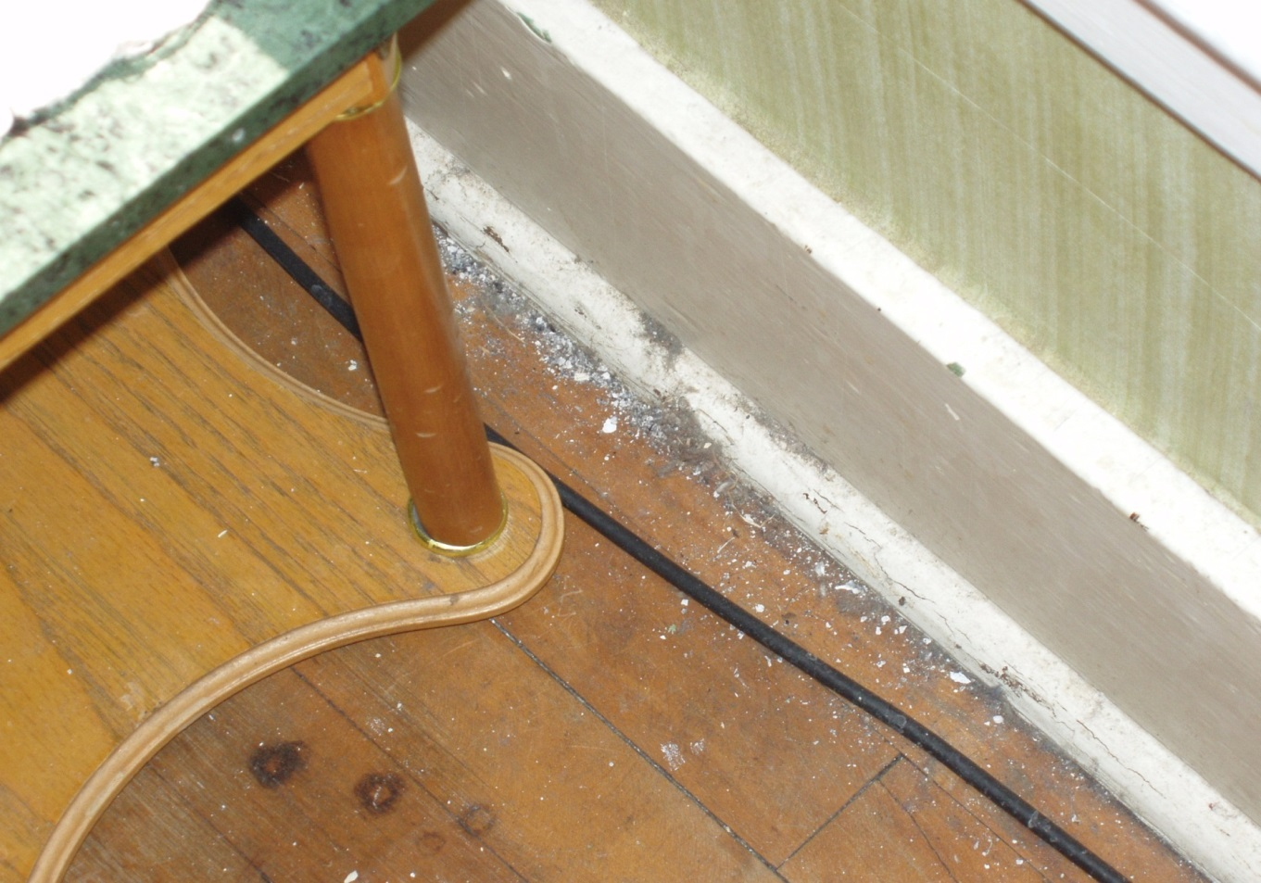
Sources of Lead in Homes
❒ WHO?  WHAT?  WHEN?  WHY?  WHERE?  HOW?
Notes:
Group Leader Script:
See the lead dust on the floor.
Normally you would not be able to see the dust. But here there are also larger pieces of dust and some chips of paint.

Slide 25
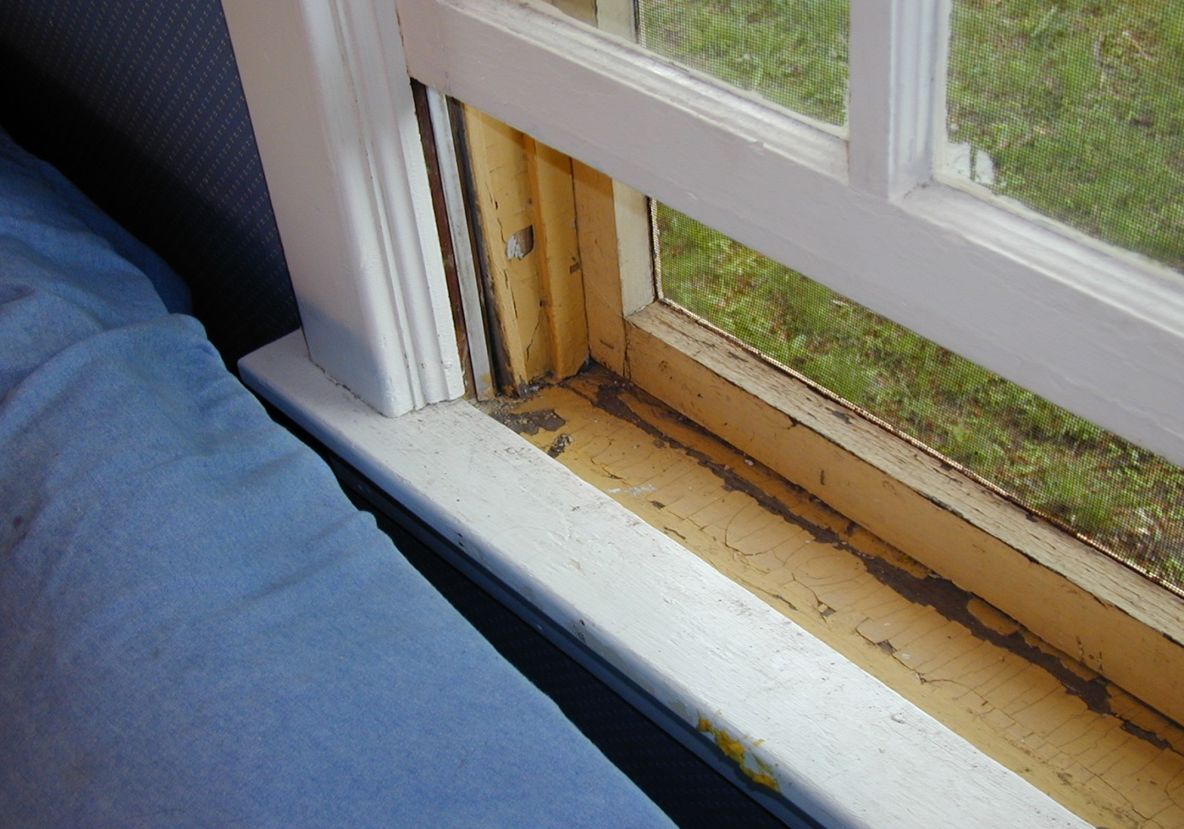
Sources of Lead in Homes
❒ WHO?  WHAT?  WHEN?  WHY?  WHERE?  HOW?
Notes:
Group Leader Script:
Chipping paint in the window wells and on the window sill…

Slide 26

Sources of Lead in Homes
❒ WHO?  WHAT?  WHEN?  WHY?  WHERE?  HOW?
Notes:
Group Leader Script:
Chipping paint on the exterior…

Slide 27

Sources of Lead in Homes
❒ WHO?  WHAT?  WHEN?  WHY?  WHERE?  HOW?
Notes:
Group Leader Script:
Lead in water can also be a source of a child’s poisoning.
Homes built before 1984 may have plumbing that includes materials made from lead. These plumbing materials can be a source of lead in your water.
People can find out how much lead is in their water by getting it tested for lead.
If you think your water might have lead, you can take steps:
Flush your pipes for two minutes before using the water.
Never use hot water for cooking or drinking.
Install a water filter for removing lead.
Get your water another way, such as bottled water.
There is a pamphlet in your folder with more information about lead in drinking water. You can look at that later.

Slide 28
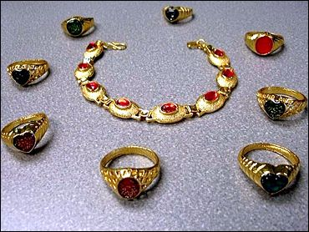
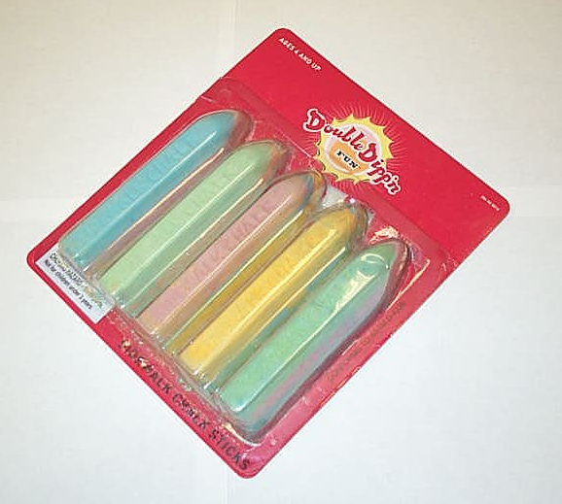

Lead in Other Products
Jewelry
Sidewalk chalk
Candies
❒ WHO?  WHAT?  WHEN?  WHY?  WHERE?  HOW?
Notes:
Group Leader Script:
And lead can be found in other products that children are exposed to.
Lead may be in jewelry, art supplies such as sidewalk chalk, and imported candies.

Slide 29
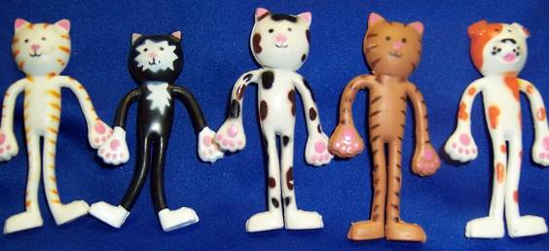
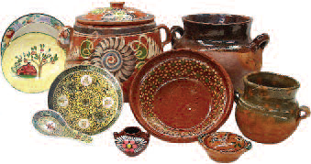
Lead in Other Products
Toys
Ceramic Dishes
❒ WHO?  WHAT?  WHEN?  WHY?  WHERE?  HOW?
Notes:
Group Leader Script:
Lead may be in imported toys, and other products you use, such as ceramic dishes.

Slide 30
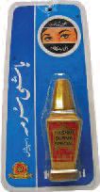
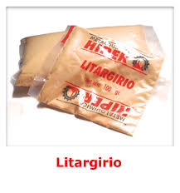

Lead in Other Products
Home Remedies
Imported Make-up
❒ WHO?  WHAT?  WHEN?  WHY?  WHERE?  HOW?
Notes:
Group Leader Script:
Lead may be in imported make-up and home remedies.

Slide 31
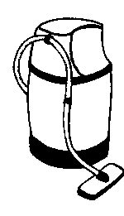
How to Prevent Lead Poisoning
High Efficiency Particulate Air (HEPA) Vacuum
Wet Washing
❒ WHO?  WHAT?  WHEN?  WHY?  WHERE?  HOW?
Notes:
Group Leader Script:
[For the HEPA filter instructions, find out ahead of time if your health department or housing agency has a HEPA-filter vacuum for rent or loan. Otherwise you can discuss it as a best practice if a similar vacuum is available to them.]
And finally HOW do you protect your children from lead?
There are some things you can do right now if you find chipping and peeling paint in your home. Instructions for some of what we are going to talk about are in your folder.
On windows and carpets, the best way to clean is to use a vacuum with a HEPA air filter to get rid of the lead dust. Don’t use a shop vacuum, regular home vacuum, or broom to clean up lead dust. It just spreads the dust around the room. A HEPA vacuum has an air filter that traps all of the dust it collects. If your vacuum cleaner has a high-efficiency air filter, you can use that on carpeted areas, and on window surfaces.
Use the HEPA vacuum on floors, especially below windows. Use it all around the windows and inside the window wells. Move slowly and make sure the hose has good suction on the surface.
If you have bare wood floors, a Swiffer or other wet mop works well.
After you vacuum the lead dust, it’s important to wet clean the window surfaces and other flat surfaces where lead dust might collect, like a bookshelf under a window. It’s best to use a wet method for cleaning. If you use a dry dust cloth, the dust will blow around.

Slide 32
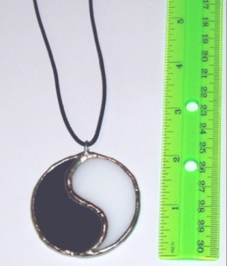
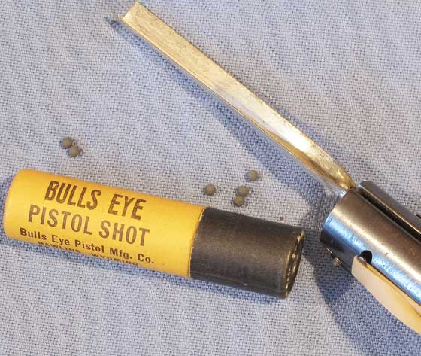
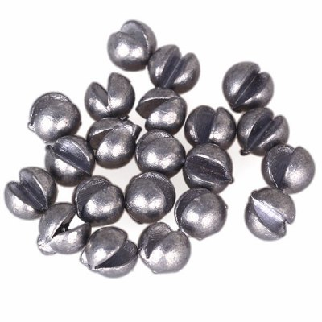
How to Prevent Lead Poisoning
From Work
From Hobbies
❒ WHO?  WHAT?  WHEN?  WHY?  WHERE?  HOW?
Notes:
Group Leader Script:
Some adults work with lead on their job, such as floor sanding, battery manufacturing, remodeling, etc. If someone in your home works with lead:
have them shower and change into clean clothes and different shoes before entering the car or your home. If they don’t, they could expose your child to lead dust.
Wash these clothes separately from the rest of the family’s clothes.
In addition, any items used on the jobsite, such as lunch coolers or tool boxes, should be kept in the trunk of the car.
Lead is also in some products used in certain hobbies, such as leaded stained glass, loading shot, and fishing weights. The following practices should be followed:
Children should be kept away from any work areas.
Adults should not eat or smoke while handling the lead product.
Adults should wash their hands frequently.

Slide 33


How to Prevent Lead Poisoning
Cover Peeling Paint
Wash Hands Often
Block Access/Lock Door
❒ WHO?  WHAT?  WHEN?  WHY?  WHERE?  HOW?
Notes:
Group Leader Script:
Cover up chipping paint with duct tape or contact paper.
Put something in front of a window with chipping and peeling paint that blocks your child’s access to it.
Wash your child’s hands after play and before eating, napping or bedtime. Also, wash your child’s toys frequently.
Lock the door to a room with lead hazards.

Slide 34




How to Prevent Lead Poisoning
Seek out funding to fix lead hazards
Northwoods Region
Barbara Gabrielson, Grant Funding Manager
GAI Consultants, Inc.
313 Prospect Street
Bear Creek, WI 54922
Phone: 715-752-4620
Fax: 715-752-4595
E-mail: b.gabrielson@gaiconsultants.com
Northeastern Region
Todd D. Mead
Brown County Planning Commission
305 E. Walnut Street
Green Bay, WI 54305-3600
Phone: 920-448-6480
Fax: 920-448-4487
www.co.brown.wi.us
Southern Region
Kari Justmann
MSA Professional Services
201 Corporate Drive
Beaver Dam, WI 53916
Phone: 1-800-552-6330
Email: kjustmann@mpa-ps.com
Central Region
Julie A. Oleson, Executive Director
Juneau County Housing Authority717 E. State Street
Mauston, WI 53948
Phone: 608-847-7309
Fax: 608-847-2278
E-mail: juncoha@frontier.com
❒ WHO?  WHAT?  WHEN?  WHY?  WHERE?  HOW?
Notes:
Group Leader Script:
And we can contact the housing agency to see if your family or landlord might be able to get some money to fix some of the hazards.
Your landlord will have to fill in some forms, but we can work together on that.
There is a handout in your folder with this information.

Slide 35

For More Information
Lead-Safe Wisconsin
www.dhs.wisconsin.gov/lead
Product Recall Searchable Database
http://www.saferproducts.gov/Search/Result.aspx?dm=0&q=lead&srt=0
Notes:
Group Leader Script:
These are a couple of websites that have good information.
Do you have any final questions? I hope that you will be able to use this information at home.
Before we finish the session, please take a few minutes to fill out the evaluation form in your folder and turn it in to me. Thank you for your attention and your questions. I really enjoyed meeting with you today.

