Slide 1
HIV in Wisconsin Integrated Epidemiology Profile, 2016-2020
Wisconsin Department of Health Services | Division of Public Health | HIV Program P-01294 (12/2023)
Notes:
For more information, contact:
Wisconsin HIV Program
Surveillance Unit
Email: DHSHIVSurveillance@dhs.wisconsin.gov

Slide 2
Suggested citation:
Wisconsin Department of Health Services, Division of Public Health, HIV Program. Wisconsin HIV Integrated Epidemiology Profile, 2016-2020 (P-01294). December 2023.

Slide 3
Acknowledgements
The Communicable Disease Harm Reduction Section, HIV Program would like to thank the following Wisconsin Division of Public Health staff for their contributions in writing, providing data, and reviewing this epidemiology profile:
Authors:
Jennifer Mark
Yi Ou
Abby Winkler
Reviewers:
Natalie Bachmeier
Molly Bieber
Connie Bell
Bethany Horvath
Brandon Kufalk
Justin Martin
Kailynn Mitchell
Caroline Mohr
Heidi Olson-Streed
Scott Stokes
Reiauna Taylor
Jordan Veek
Rachel Welsh
Ricardo Wynn
Data contributors:
Dhana Shrestha
Vipul Shukla
Philip Wegner

Slide 4
Table of Contents Interactive—Click to navigate
Sexually transmitted infections
Technical notes
Hepatitis C
Abbreviations
Tuberculosis
Mental health and substance use
Male-Male sex
Male-Female sex
Care services –
Ryan White Program
Injection drug use
Perinatal exposure
AIDS Drug Assistance Program (ADAP)
Sex work
Medicaid services
Gender: M / F / Trans
Peer Navigator Program
Race
Age: youth/ 55+
HIV care continuum
Late diagnosis
Testing
Incarcerated persons
Partner Services
Metropolitan grouping
Harm reduction
Notes:
This Document is divided into eight sections as the following:
Introduction and Technical Notes
Wisconsin Demographics
Overview of HIV in Wisconsin
People Living with HIV
HIV Cluster Detection and Response in Wisconsin
Co-Occurring Conditions
Social Determinants of Health and HIV
Program Outcomes
Using the interactive Table of Contents
This Table of Contents allows you to navigate to each section of this PowerPoint document. It is best used when the PowerPoint is in “presentation view” (slide show mode) by clicking on the box buttons of this slide.
In “normal view”, you can navigate using [Right Click]/”Go To Slide” option, or CTRL + click.
Returning to the Table of Contents
A “home” button icon is located at each section-header slide. At the right-hand corner, click the home icon to navigate back to this Table of Contents.
Printing Tips
This PowerPoint presentation can be viewed or printed to include slides and Notes corresponding to each slide as “Notes Pages.”
To view: (1) In the Task Ribbon at top of PowerPoint Program, click [VIEW] and (2) select “Notes Page.”
To Print: (1) In the Task Ribbon at top of PowerPoint Program, click [FILE] and (2) select [Print]. (3) Select the option for your Print Layout to “Notes Page” – do not print “Full Slides.”

Slide 5
Introduction and Technical Notes

Slide 6
Introduction
The purpose of the Wisconsin HIV Integrated Epidemiology Profile, 2016–2020 is to describe HIV among various populations in terms of socio-demographic, geographic, behavioral, and clinical characteristics.
This profile can serve as a tool at the state and local levels for:
Prioritizing the delivery of HIV prevention and care services.
Determining or projecting future needs.
Discussing HIV with affected communities.
Framing research and evaluating questions.
Applying for funding.
Responding to public information requests.
Notes:
The Wisconsin HIV Integrated Epidemiology Profile, 2016–2020, is a comprehensive summary of the HIV-related data and outcomes from programs administered within the Wisconsin Department of Health Services (DHS), Division of Public Health (DPH), Communicable Diseases Harm Reduction Section (CDHRS), HIV Program. It is an update to the first profile that covered 2010–2014.
The purpose of this epidemiology profile is to describe HIV among various populations in terms of socio-demographic, geographic, behavioral, and clinical characteristics. Therefore, this profile offers:
A more comprehensive description of HIV in Wisconsin than the annual HIV surveillance report.
A summary of HIV in Wisconsin from 2016–2020 and population-specific summaries that can be used as stand-alone fact sheets.
A summary of commonly co-occurring HIV conditions such as syphilis, tuberculosis, and hepatitis C.
Service utilization and outcomes from programs administered by the CDHRS.
Annual HIV surveillance reports Each year, the comprehensive Wisconsin HIV Surveillance Annual Report is released, which describes the previous calendar year’s new diagnoses and prevalent cases and analyzes trends over time among various subpopulations. This report is limited in scope to a summary of surveillance data among people reported with HIV in Wisconsin. Similarly, Wisconsin HIV Surveillance Annual Report: Milwaukee Addendum describes City of Milwaukee data. The HIV Surveillance Annual Report and Milwaukee Addendum can be found at: https://www.dhs.wisconsin.gov/hiv/data.htm.

Slide 7
Technical Notes
More information on the Wisconsin HIV Program can be found at https://www.dhs.Wisconsin.gov/hiv/index.html
Details of the following topics are detailed below, in the PowerPoint notes section below this slide:
Other Department of Health Services Programs
Wisconsin Reporting Requirements
Definitions
Data Sources
Notes:
Other Department of Health Services Programs
In addition to data from within the Communicable Diseases Harm Reduction Section (CDHRS), this epidemiology profile also includes data from other Wisconsin DHS programs. The DPH, Bureau of Communicable Diseases houses the HIV Program, Hepatitis C Program, Sexually Transmitted Infections Program, and Tuberculosis Program. The Department of Health Services also administers the Wisconsin Medicaid Program.
Wisconsin reporting requirements
Wisconsin Stat. § 252 requires that providers and laboratories report suspect or confirmed cases of specified communicable diseases to the local health departments (LHD) or, in the case of HIV, directly to the state. The following disease-specific reporting requirements also apply:
HIV: In addition to suspect and confirmed cases of HIV, all CD4 counts, all viral load test results, and Stage 3 (AIDS)-defining conditions are also reportable directly to the state epidemiologist.
HCV: Evidence of hepatitis C virus is reportable to the local health department. HCV has been a reportable communicable disease in Wisconsin since 2000.
Syphilis: In addition to suspect, probable and confirmed cases of syphilis, the stage of syphilis infection (congenital; primary; secondary; early non-primary non secondary; and late, unknown duration), symptoms and treatment information are also reportable to the local health department officer.
Tuberculosis: In addition to smear, nucleic acid testing (NAT), and culture test results, chest X-ray results and medication treatment information are also reportable to the local health department.
Definitions
Newly diagnosed HIV cases
Individuals included in analyses of new diagnoses are those whose first verifiable HIV diagnosis was made at the time they were living in Wisconsin. Also included are individuals who report being first diagnosed with HIV in another country but for whom Wisconsin is unable to verify the non-U.S. diagnosis. These practices conform to CDC’s guidelines for case residency assignment. New diagnoses are counted by the year of diagnosis, regardless of when the case was reported to the HIV Surveillance Program. In this report, new diagnoses are reported over a five-year period (2016–2020) to allow for more robust estimates, especially among population groups with small numbers of cases. Trends in new diagnoses are analyzed across a 10-year period (2011–2020) to reduce the impact of normal, annual fluctuations.
Prevalent HIV cases
Individuals are included in the prevalence count for a given year if they were presumed to be alive at the end of the calendar year (i.e., no documentation of death has been received and the individuals did not match any records in local or national death data) and their last known address is in Wisconsin. Because of delays in reporting of deaths, the number of cases presumed alive should be considered provisional.
HIV disease status
In this report, the term HIV refers to all persons confirmed to be living with HIV, regardless of whether their disease has progressed to Stage 3—also called AIDS, which is defined as a CD4 count of less than 200, or a diagnosis of a Stage 3 (AIDS)-defining opportunistic infection.
HIV transmission mode
Transmission mode is self-reported by the individual. For surveillance purposes, cases are counted only once in a hierarchy of transmission categories. Persons with more than one reported mode of transmission to HIV are classified in the first category in the hierarchy as defined by CDC. The transmission categories, in order of their position in the hierarchy, are:
Male-male sexual contact (MMSC): This refers to sex at birth males who report sexual contact with another person born male and with no history of injection drug use. This includes males who report sexual contact with both males and females.
MMSC/IDU: This refers to a reported history of male-male sexual contact and a history of injection drug use.
IDU: This refers to a history of injection drug use for females and males without a reported history of MMSC.
Male-female sexual contact (MFSC): This refers to sex at birth persons who report a history of sexual contact with a partner of the opposite sex including a person who injects drugs, a person who identifies as a bisexual male, a person with hemophilia, or a person living with HIV.
Additional: This refers to having hemophilia, being exposed to HIV through a blood transfusion or tissue/organ transplant and being born to people living with HIV.
No identified/Unknown: These are cases currently under investigation; cases with incomplete exposure history; cases with exposure history but no transmission mode was identified.
Unless otherwise noted, the transmission mode data in the Wisconsin HIV Epidemiology Profile have been statistically adjusted to account for individuals with unknown risk using a CDC-supplied multiple imputation program.
Co-occurring conditions
People living with HIV (PLWH) in Wisconsin as of December 31, 2020, were identified as prevalent HIV cases in the Enhance HIV/AIDS Reporting System (eHARS) and matched by last name, first name, and date of birth against people diagnosed with syphilis, gonorrhea, or chlamydia during 2016–2020, or hepatitis C virus (acute or chronic disease, probable, and confirmed status) through 2020. Co-occurring condition was defined as an STI or HCV report within 30 days of or any time after the date of HIV diagnosis.
Sex at birth
Sex at birth is collected by health care providers. CDC classifications for male and female are based on sex at birth, which may include both cisgender and transgender individuals.
Age
For new diagnoses, age refers to the age at time of HIV diagnosis. For prevalent HIV cases, age refers to the age on December 31 of the year of analysis.
Race/Ethnicity
This report presents data using the following race categories: Black, Asian, Native American, Native Hawaiian or other Pacific Islander, and White. People categorized by race were not Hispanic or Latino. This report also presents data for whom multiple race categories are reported. People who identify their origin as Hispanic, Latino, or Spanish may be of any race and they are referred to as “Hispanic” ethnicity in this report.
Rates
In this report, rates are presented as the estimated number of diagnoses per 100,000 or 1,000 population. A one-year rate is based on the population denominator for the year of analysis. Five-year rates, covering 2016–2020, are based on the total number of cases during the period and the mid-point population estimate, in this case 2018. The resulting rate is annualized by dividing by five.
Data Sources
Socio-demographic data The socio-demographic section of this profile pulls from a variety of datasets, including the Wisconsin Interactive Statistics on Health website for population, birth, and death information; the American Community Survey for income, poverty, housing, education, Gini Index, and country of birth; and the Wisconsin Youth Risk Behavior Survey (YRBS). Specific data sources and years are listed within each section.
HIV diagnoses Analyses of HIV diagnoses are based on HIV case surveillance and laboratory data collected by the HIV Program. These data are stored in the Enhances HIV/AIDS Reporting System (eHARS), the CDC-mandated HIV surveillance database used by all states and territories. Data reported here are based on the information available in eHARS on the date the surveillance and laboratory data were frozen for analysis. Therefore, all data are provisional and subject to change as additional case information becomes available. The analyses of HIV diagnoses do not include individuals who are unaware of their HIV status.
Co-occurring conditions Data on sexually transmitted infections, tuberculosis, and hepatitis C virus are housed in the Wisconsin Electronic Disease Surveillance System (WEDSS). Similar to HIV diagnoses, data reported here are based on the information in WEDSS on the date the data were frozen for analysis.
HIV testing HIV testing data included in this epidemiology profile are restricted to tests performed at state-funded CTR sites. Unless otherwise noted, the number of tests may include multiple tests for the same person. All CTR tests are reported and managed within EvaluationWeb, a web-based data system designed and hosted by Luther Consulting, LLC.
Care utilization Care utilization data come from a number of sources, consisting of HIV surveillance data, the federally required Ryan White Services Report (RSR), the Wisconsin AIDS Drug Assistance Program (ADAP), and the Wisconsin Medicaid program. The HIV care continuum is based on HIV surveillance data. A detailed description of the methodology and definitions can be found at https://www.dhs.wisconsin.gov/hiv/notes.htm.
Ryan White service utilization data are from the RSR, which the HIV Program submits to Health Resources and Services Administration (HRSA) annually in March. The de-identified, client-level data files are submitted simultaneously to the HIV Program, and contain client demographics, Ryan White-funded service utilization, and laboratory and medical visit dates. The RSR data in this profile are from clients served during 2016–2020. Data on Wisconsin ADAP include individuals who received services from the program in the form of payment towards medications or insurance premiums. Individuals who enrolled in but never used the program are excluded from the analyses.
Wisconsin Medicaid data
The HIV Program contracts with Gainwell Technologies and the DPH Office of Health Informatics to conduct analysis of data regarding Wisconsin residents living with HIV receiving services and medications billed to Medicaid. Data are also provided for HIV-negative residents who have filled prescriptions for pre-exposure prophylaxis (PrEP).
HIV Partner Services (PS) HIV PS are coordinated centrally within the HIV Program. All PS case assignments and PS provider notes are managed within EvaluationWeb, a web-based data system designed and hosted by Luther Consulting, LLC and within the Wisconsin Electronic Disease Surveillance System (WEDSS). PS outcomes in this document are based on cases assigned and partners named during 2016–February 2020.

Slide 8
Abbreviations (more below in Notes section)
Commonly used
IDU Injection drug use
MSM Male persons (by birth sex) who have sex with males
MMSC Male-male sexual contact
MFSC Male-female sexual contact
PLWH People living with HIV
PWID People who inject drugs
Programs
CT Chlamydia
GC Gonorrhea
HCV Hepatitis C
STI Sexually transmitted infections
TB Tuberculosis
Notes:
Data source
ACS American Community Survey
BRFSS Behavioral Risk Factor Surveillance System
DOC Department of Corrections
WEDSS Wisconsin Electronic Disease Surveillance Systems
WISH Wisconsin Interactive Statistics on Health
YRBS Youth Risk Behavior Surveillance System
Other abbreviations
ADAP AIDS Drug Assistance Program
AIDS Acquired Immune Deficiency Syndrome
ART Antiretroviral therapy CD4 Cluster of differentiation 4 CDC US Centers for Disease Control and Prevention
CDHRS Communicable Disease Harm Reduction Section CTR Counseling, testing, and referral sites DHS Department of Health Services DPH Division of Public Health eHARS Enhanced HIV and AIDS Reporting System FPL Federal poverty level HIV Human Immunodeficiency Virus HRSA Health Resources and Services Administration
IAP Insurance Assistance Program LHD Local health department LTBI Latent tuberculosis infection PrEP Pre-exposure prophylaxis PS Partner Services RSR Ryan White Services Report RW Ryan White HIV/AIDS Program

Slide 9
Wisconsin Demographics
Who are the people residing in Wisconsin

Slide 10
Demographic Highlights
Wisconsin has 5.8 million residents living in 72 counties.
Milwaukee County’s population is nearly 1 million while several counties have fewer than 5,000 residents each.
Approximately 81.3% of Wisconsin residents are non-Hispanic White. Black and Hispanic people each comprise 7.1%–7.3% of the population, Asians, 3.3%, and Native Americans, 1.0%.
The median age among White people is 43.4; all other racial and ethnic groups have a median age between 28 and 33.
Recent population growth is greatest in Asian and Hispanic people and people ages 50 and older.
1 in 20 residents is foreign-born.
11% of residents live in poverty.

Slide 11
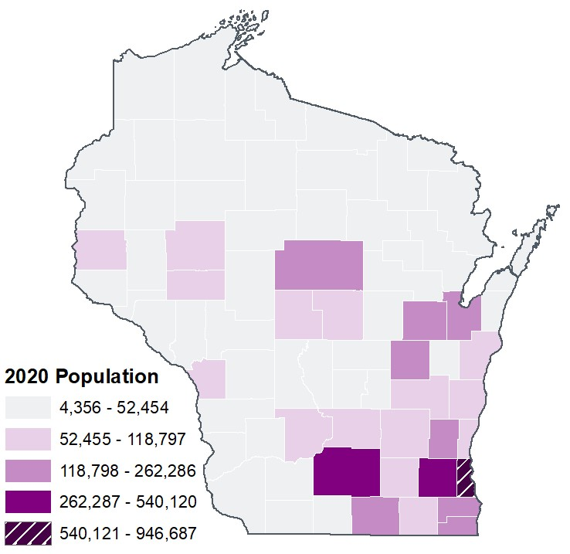
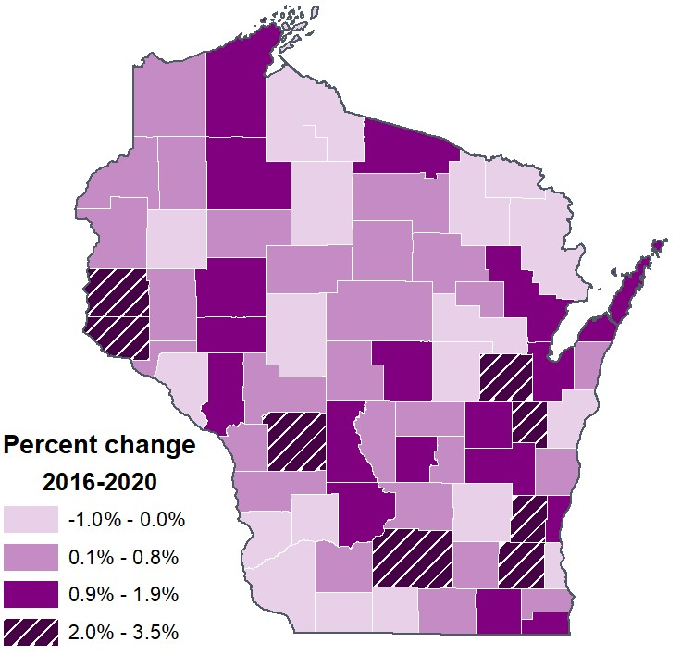
Population
Most of Wisconsin’s population lived in the south and southeastern part of the state.
Counties throughout Wisconsin experienced varying levels of population change, particularly in the southeast.
Notes:
Wisconsin population
Wisconsin’s population in 2020 was estimated to be 5.8 million, 1.8% of the nation’s estimated 329.5 million residents. The state’s 72 counties range in population from fewer than 5,000 in several rural counties to nearly 1 million in Milwaukee County. The population change from 2016–2020 ranges from a decline of 1.0% in Florence County and Crawford County to an increase of 3.5% in Dane County.
Source: Wisconsin Interactive Statistics on Health (WISH), U.S. Census, 2020.

Slide 12
Population: Demographics
Category | Sub-group | Percent of population | Percent change, 2011–2020
Ethnicity | Hispanic | 7.3% | 23.7%
Race (non-Hispanic) | White | 81.3% | -0.7%
 | Black | 7.1% | 8.1%
 | Asian | 3.3% | 33.6%
 | Native American | 1.0% | 5.6%
Sex | Female | 49.8% | 2.1%
 | Male | 50.2% | 2.6%
Age group (years) | 0–14 | 18.0% | -4.2%
 | 15–24 | 13.2% | -1.8%
 | 25–34 | 12.8% | 1.9%
 | 35–44 | 12.3% | 1.0%
 | 45–54 | 12.3% | -17.0%
 | 55–64 | 14.1% | 12.7%
 | 65+ | 17.4% | 28.5%
Notes:
Race and ethnicity, sex, age, and region
2020 population data for Wisconsin are shown in the table above. Four in five Wisconsin residents are non-Hispanic White. About 18% of the state’s population is under age 15, while 17% are ages 65 and older.
Trends in population growth
Between 2011 and 2020, Wisconsin’s total estimated population increased by 2.3% but the change was variable by sub-group, as shown in the table above. Population growth was greatest in Asians (33%), Hispanics (24%), and those ages 65 and older (29%).
Source: Wisconsin Interactive Statistics on Health (WISH), U.S. Census, 2020.

Slide 13
Population: Demographics by region
Category | Sub-group | Percent of population | Percent change, 2011–2020
Region | Northeastern | 21.6% | 2.4%
 | Northern | 8.4% | 0.6%
 | Southeastern | 36.6% | 1.2%
 | Southern | 19.8% | 4.8%
 | Western | 13.7% | 2.6%
Notes:
Trends in population growth
Between 2011 and 2020, Wisconsin’s total estimated population increased by 2.3% but the change was variable by sub-group, as shown in the table above. Population growth was greatest in the Southern region.
Source: Wisconsin Interactive Statistics on Health (WISH), U.S. Census, 2020. Wisconsin Department of Health Services Regions by County, https://www.dhs.wisconsin.gov/aboutdhs/regions.htm

Slide 14
Wisconsin experienced a notable increase in reported net migration in 2019, with more people entering than leaving the state. Births, deaths, and net migration, Wisconsin, 2011–2020
Notes:
Births
Between 2011 and 2020, Wisconsin’s birth rate declined by 13% while the U.S birth rate also declined by 13%. Wisconsin’s 2020 birth rate was 5.6% lower than that of the nation.
Deaths
Between 2011 and 2020, the Wisconsin age-adjusted death rate increased by 17.8% in males and by 14.0% in females due to the COVID-19 pandemic. Between 2011 and 2019, the Wisconsin age-adjusted death rate increased by 0.4% in males and declined by 0.7% in females. Wisconsin’s age-adjusted 2020 death rate was 0.1% higher than the national rate.
Net migration
Net migration reflects the number of people entering and leaving the state. Between 2011 and 2020, except for 2014, 2015, and 2019, net migration was negative, meaning more people moved out of the state than moved into the state. In 2014, 2015, and 2019, more people moved into the state than out of the state.
Wisconsin experienced a notable increase in reported net migrations in 2019, with more people entering than leaving the state. This contributed to 16,000 people net migration into Wisconsin, between 2011 and 2020.
Source: Wisconsin Interactive Statistics on Health (WISH), U.S. Census, 2020; National Center for Health Statistics Data Brief. https://www.cdc.gov/nchs/data/nvsr/nvsr70/nvsr70-17.pdf; National Center for Health Statistics Data Brief. https://www.cdc.gov/nchs/data/databriefs/db427.pdf

Slide 15
Age by sex at birth and race, Wisconsin, 2020
Wisconsin’s age distribution by sex at birth is representative of national trends.
Non-white persons are younger than white persons.
Notes:
Age and sex distribution
In 2020, Wisconsin’s age and sex distribution closely resembled that of the nation. In most age groups, males and females each accounted for half the population. However, among those ages 65 and older, female residents were 54.2% of this age group.
Median age by race/ethnicity
The median age in Wisconsin (39.7) was older than that of the nation (38.1) and has increased in the state since 2002, indicating an aging population. Median age varies by race/ethnicity. In 2020, the median age of persons of color in Wisconsin tend to be 10–18 years younger than White persons.
Source: Wisconsin Interactive Statistics on Health (WISH), U.S. Census, 2020.

Slide 16
Median age varies by county with Milwaukee County having the youngest population. Median age by county, Wisconsin, 2020
Milwaukee
County
34.8
55.8
Bayfield
County
Notes:
Median age by county
Median age also varies by geographic area in Wisconsin. Milwaukee county has the lowest median age at 34.8 years while Bayfield county has the highest median age at 55.8 years.
Source: Wisconsin Interactive Statistics on Health (WISH), U.S. Census, 2020.

Slide 17
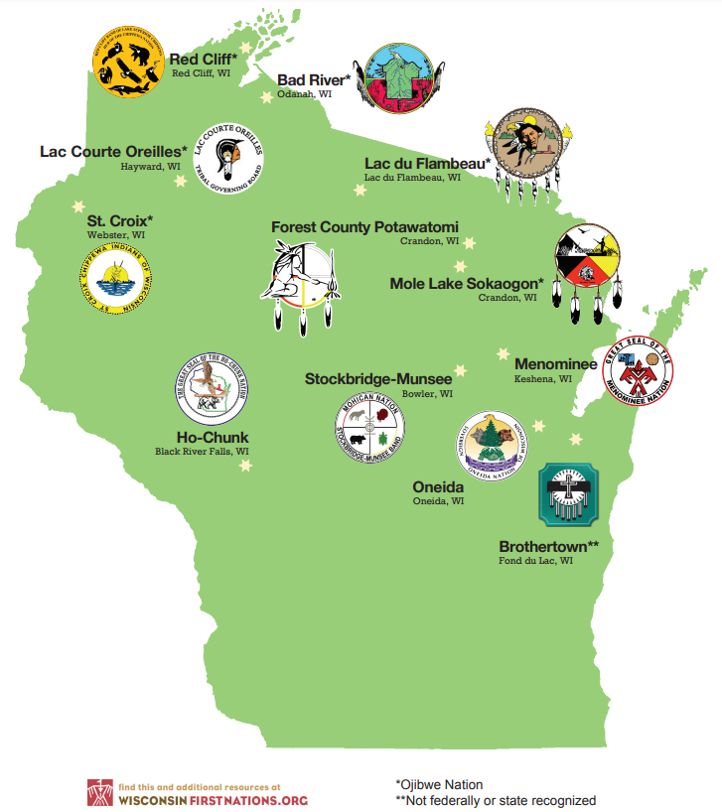
Wisconsin is home to 11 federally recognized Native American communities.
Milwaukee and Brown county have the largest proportions of Native American persons among the top 9 counties.
Percentage of the Native American population, Wisconsin, 2020
79,000
Native Americans
living in Wisconsin
(2020)
Hispanic
origin
1 in 4
Notes:
Socio-demographic highlights, 2020:
Wisconsin has 11 federally recognized Native American Tribal governments, including six bands of Lake Superior Chippewas (sometimes referred to as Ojibwe).¹
Over 79,000 Native Americans lived in Wisconsin in 2020: 27% were of Hispanic origin.²
Wisconsin counties with the largest Native American populations include Milwaukee (15% of the total Native American population); Brown (13%); Shawano, Menominee and Outagamie (5% each); Sawyer and Dane (4% each); and Vilas and Ashland (3% each).²
1 in 4 (28.5%) Native Americans in Wisconsin live in poverty, compared to 1 in 12 (8.7%) of Whites.³
Median household income for Native Americans in 2020 was $45,003, compared to $66,073 for Whites.³
Sources:
¹Wisconsin State Tribal Relations Initiative, http://witribes.wi.gov/section.asp?linkid=731&locid=57; Wisconsin First Nations, https://wisconsinfirstnations.org/seats-of-government/
²Wisconsin Interactive Statistics on Health (WISH), U.S. Census, 2020.
³American Community Survey, U.S. Census, 2020.

Slide 18
In 2020, foreign-born people constituted 5% of all Wisconsin residents but about 3 in 10 Asians and 4 in 10 Hispanics. Percent of the population that is foreign-born, by race/ethnicity, Wisconsin, 2020
Notes:
Foreign-born people
In 2020, foreign-born people constituted 5% of all Wisconsin residents, but about 3 in 10 Asians and 4 in 10 Hispanics/Latinos.
In 2020, 39% of foreign-born residents in Wisconsin had come from Latin America; 37% had emigrated from Asia; and 16% had been born in Europe. In 2020, 77% of Hispanic/Latino foreign-born Wisconsin residents reported Mexico as their country of origin; 11% were born in South America, 8% in Central America, and 5% in the Caribbean. People born in Puerto Rico are U.S. citizens. Of foreign-born Asians in Wisconsin, 44% are from Southeast Asia (Laos, Thailand, the Philippines, and other countries); 28% were born in India, Pakistan, and other South Asian nations; and 24% are from China, Korea, and other East Asian countries. 1 in 12 Wisconsin residents speaks a language other than English at home compared to 1 in 5 nationally.
Source: American Community Survey, 2016–2020.

Slide 19
Lesbian, gay, bisexual populations
Youth
9% of students in Wisconsin public high schools and 16% of students in Milwaukee Public Schools identify as lesbian, gay, or bisexual (LGB).
Demographic and health data on transgender youth and adults are very limited.
Adults
7% of Wisconsin adults identify as LGB.
1 in 200 Wisconsin households resides a same-sex couple.
Notes:
Source: Youth Risk Behavior Survey (YRBS), 2019, Wisconsin Department of Public Instruction; YRBS, 2018, Milwaukee Public Schools; Wisconsin Behavior Risk Factor Surveillance System (BRFSS), 2019; American Community Survey, 2020.
Note: YRBS survey categories for gender identity included lesbian, gay, and bisexual. Gender identity did not include a transgender category.

Slide 20
The counties with the largest percent of residents living in poverty are found primarily in the Western and Northern regions of Wisconsin. Percent living in poverty, Wisconsin 2020
Notes:
Income
Wisconsin’s median household income in 2020 was estimated at $63,293, closely behind the median income of the rest of the nation ($64,994). Median household income by county in 2020 varied from about $45,000 in some counties to more than twice that in the wealthiest counties.
Poverty
During 2016–2020, 11.0% of Wisconsin residents were living in poverty compared to 12.8% nationally. With the exception of Milwaukee, Menominee and Grant counties, the counties with the largest percent (>15%) of residents living in poverty are found in the Western and Northern regions of the state.
Source: American Community Survey, 2016–2020

Slide 21
Educational attainment of adults ages 25 and older, by race/ethnicity, Wisconsin, 2020
31% > bachelor degree
93% completed high school
Notes:
Education
Of Wisconsin residents ages 25 and older during 2016–2020, 93% had completed high school and 31% had a bachelor’s degree or higher compared to 88% and 32% respectively in the U.S. Educational attainment is variable by race/ethnicity. Asians and Whites have the highest levels of educational attainment.
Source: American Community Survey, 2016–2020

Slide 22
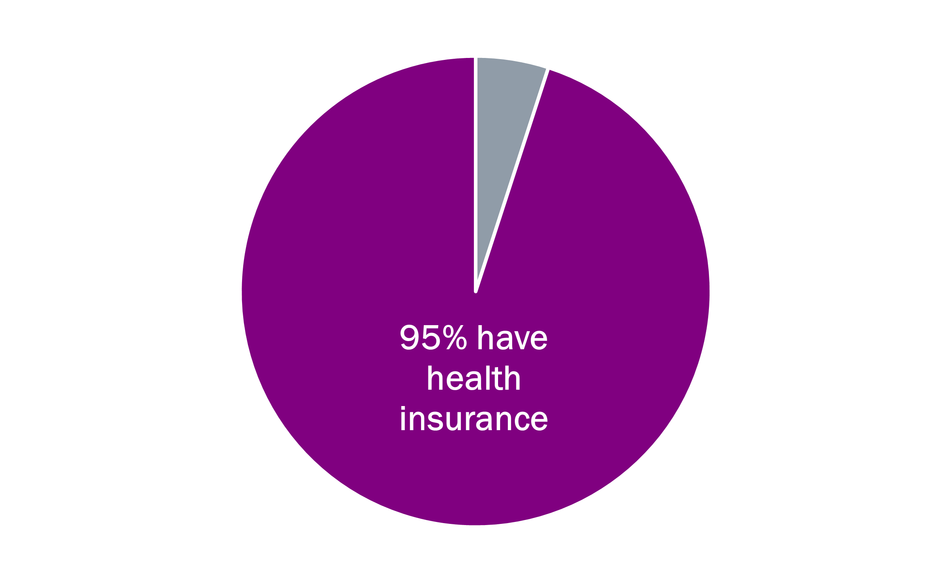
During 2007–2020, about 5,600 people were without housing each night, about 1 in 1,000 Wisconsin residents. Housing, Wisconsin, 2020
Most Wisconsin residents had health insurance in 2020. Health insurance coverage, Wisconsin, 2020
Among every 10 people
without housing…
Have temporary shelter
Have a family/
dependents
Veteran
Experience chronic
housing instability
9
4
1
1
Notes:
Housing
During 2007–2020, about 5,600 people were without housing each night, about 1 in 1,000 Wisconsin residents.
In 2020, of every 10 people without housing:
9 were sheltered and 1 was unsheltered.
4 were people in families and 6 were individuals.
1 was a veteran.
1 experienced chronic housing instability.
Insurance coverage
In 2020, an estimated 95% of the Wisconsin population was insured by either private or public institutions compared to 91% of the U.S. population.
Source: Housing and Urban Development Point in Time Estimates, 2007–2020; American Community Survey, 2016–2020.

Slide 23
Overview of HIV in Wisconsin
Notes:
The first case of HIV in Wisconsin was confirmed in 1979. The number of new HIV diagnoses steadily increased every year, reaching a peak in 1990. Since that time, Wisconsin has experienced a significant reduction in the number of new diagnoses and deaths but has also observed increased diagnoses in some subpopulations and a growing population of individuals requiring access to high-quality HIV medical care and supporting services.

Slide 24
Overview
See the 2020 annual report of HIV in Wisconsin found at the following link: https://www.dhs.wisconsin.gov/publications/p00484-20.pdf
See the 2020 annual supplemental report of HIV in the city of Milwaukee found at the following link: https://www.dhs.wisconsin.gov/publications/p0/p00484a-2020.pdf

Slide 25
People Living with HIV
HIV transmission mode: Male-male sexual contact (MMSC)
Notes:
This section addresses HIV in individuals who were born male, who were ages 13 or older at the time of diagnosis, and whose transmission of HIV is attributed to male-male sexual contact (MMSC), also noted as males who have sex with males (MSM). This section includes people who report both MMSC and injection drug use (MMSC/IDU).

Slide 26
Male-male sexual contact continued to be the most common HIV transmission mode. New HIV diagnoses among males who report MMSC by selected demographics, Wisconsin, 2016–2020
72%
new diagnoses attributed to males who reported MMSC
2 in 5
new diagnoses among Black males who reported MMSC
Hispanic and Black males who reported MMSC
Were diagnosed younger
Over half
of new diagnoses in Milwaukee County
52% 11% 37%
Milwaukee Dane All other counties
‡Median age is based on reported transmission mode for counts ≥5.
Notes:
New diagnoses
Consistent with national trends, male-male sexual contact (MMSC) continues to be the most common behavior associated with HIV transmission in Wisconsin. Approximately 813 (72%) of the 1,126 new HIV diagnoses in Wisconsin during 2016–2020 were among males reporting MMSC, including 47 people who also injected drugs. The annual number of new HIV diagnoses among males who report MMSC was stable from 2011 to 2020. However, the trends varied by population.
Age at diagnosis
In Wisconsin, 2 in 7 (28%) people, who report MMSC and were diagnosed with HIV during 2016–2020, were under age 25 at the time of their diagnosis, with 2 in 5 (37%) between the ages of 25 and 34.
Males who have sex with males (MSM) ages 15–24 accounted for 1 in 4 (21%) new HIV diagnoses in Wisconsin during 2016–2020. The median age at HIV diagnosis for MSM during 2016–2020 was 29 years. White MSM were generally older at the time of HIV diagnosis compared to MSM of other racial and ethnic groups.
Between 2011 and 2020, the annual number of new HIV diagnoses declined among MSMs ages 45–54 and remained stable among MSM of other ages.
Race and ethnicity
Among people who reported MMSC and were newly diagnosed with HIV in Wisconsin during 2016–2020, 37% were White and 63% were people of color. Trends among Black, White, and Hispanic people who report MMSC were stable during 2011 to 2020. The number of cases in other racial and ethnic groups was too small to evaluate trends.
Geography
Over half (52%) of all diagnoses among people who reported MMSC were from Milwaukee County. Milwaukee County accounted for one in 12 diagnoses among White and Hispanic MSM and one in three diagnoses among Black MSM during 2016–2020. Dane County residents made up 11% of new diagnoses among people who reported MMSC; all other counties accounted for less than 4% of new diagnoses.

Slide 27
Age distribution of males who report MMSC and are living with HIV in Wisconsin (prevalent cases) compared to ages of newly diagnosed males who report MMSC during 2020.
4,726
people who engage in MMSC were living
with HIV in Wisconsin
at the end of 2020.
Notes:
Prevalence
As of December 31, 2020, approximately 69% (n=4,726) of all people living with HIV in Wisconsin had an estimated HIV transmission category of male-male sexual contact. An additional 690 males who have sex with males (MSM) are estimated to be living with HIV in Wisconsin but are unaware of their status.¹
Source: Centers for Disease Control and Prevention. Estimated HIV incidence and prevalence in the United States, 2015–2019. HIV Surveillance Supplemental Report 2021;26(No. 1). http://www.cdc.gov/ hiv/library/reports/hiv-surveillance.html. Published May 2021. Accessed June 2022.

Slide 28
People Living with HIV
HIV transmission mode: Male-female sexual contact (MFSC)
Notes:
This section addresses HIV in individuals whose transmission of HIV is attributed to male-female sexual contact, defined as males and females who report a history of heterosexual contact with a person behaviorally vulnerable to HIV such as a person who injects drugs, a bisexual male, or a person living with HIV.

Slide 29
While the number of new diagnoses attributed to male-female sexual contact has remained stable in recent years, it still accounted for 17% of recent HIV transmission in Wisconsin. New HIV diagnoses (MFSC) by selected demographics, Wisconsin, 2016–2020
17%
new diagnoses attributed to MFSC
People of color
who reported MFSC are
diagnosed younger
‡Median age is based on reported transmission mode for counts ≥5.
^Estimate is statistically unreliable due to case count <12.
Notes:
New diagnoses
Approximately 191 (17%) of the 1,126 HIV diagnoses in Wisconsin during 2016–2020 were among individuals identifying as heterosexual. The annual number of new HIV diagnoses due to male-female sexual contact (MFSC) remained stable from 2011 to 2020.
Among MFSC cases of HIV, 4 of 5 new diagnoses were female and one out of five was male during 2016–2020.
Age at diagnosis
Fifty-eight percent of individuals diagnosed with HIV associated with MFSC during 2016–2020 were ages 35 and older at the time of diagnosis. The median age at HIV diagnosis for individuals diagnosed with HIV associated with MFSC during 2016–2020 was 39 years. This median age was similar for all racial and ethnic groups.
Race and ethnicity
Among individuals diagnosed with HIV associated with MFSC during 2016–2020, 55% were Black, 24% were White, and 13% were Hispanic. Black cis-gender women accounted for almost half of all new HIV diagnoses associated to MFSC between 2016 and 2020.
Geography
Half (52%) of all diagnoses attributed to MFSC were from Milwaukee County. Dane County residents made up 10% of new diagnoses, Kenosha County made up 5% of new diagnoses, and all other counties account for less than 3% of new diagnoses.

Slide 30
Age distribution of people living with HIV attributed to MFSC in Wisconsin (prevalent cases) compared to ages of people newly diagnosed with HIV attributed to MFSC during 2020.
940
people were living
with HIV attributed to MFSC in Wisconsin
at the end of 2020.
Notes:
Prevalence
As of December 31, 2020, approximately 14% (n=940) of all people living with HIV in Wisconsin had an estimated HIV transmission category of male-female sexual contact (MFSC). An additional 121 people are estimated to be living with HIV attributed to MFSC in Wisconsin but are unaware of their status.¹
Source: Centers for Disease Control and Prevention. Estimated HIV incidence and prevalence in the United States, 2015–2019. HIV Surveillance Supplemental Report 2021;26(No. 1). http://www.cdc.gov/ hiv/library/reports/hiv-surveillance.html. Published May 2021. Accessed June 2022.

Slide 31
People Living with HIV
HIV transmission mode: Injection drug use (IDU)
Notes:
This section addresses HIV in individuals whose transmission of HIV is attributed to injection drug use (IDU), also noted in this report as people who inject drugs (PWID). People who inject drugs and who report male-male sexual contact (MMSC) are excluded from this section and are instead covered in the MMSC section.

Slide 32
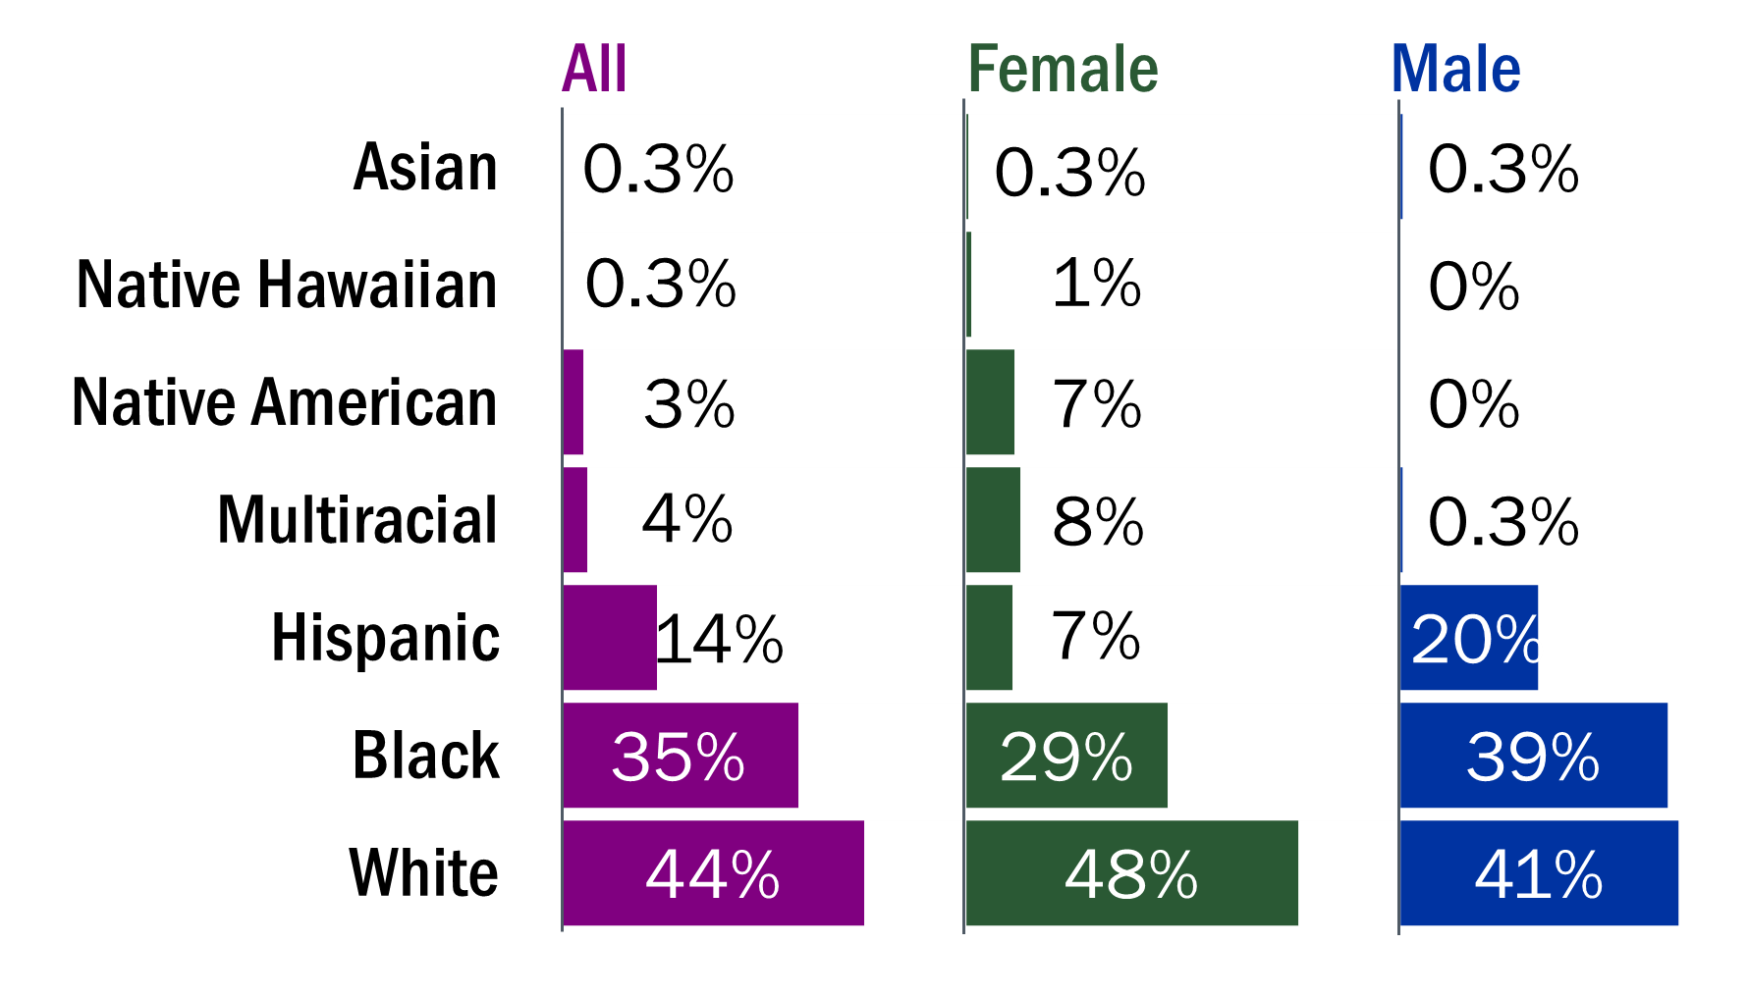
Injection drug use accounted for 6% of recent HIV diagnoses in Wisconsin and remained steady in the past ten years. New HIV diagnoses among PWID by selected demographics, Wisconsin, 2016–2020
6%
new diagnoses attributed to IDU
Almost half
new IDU-attributable diagnoses in non-large metro areas
54% 27% 19%
Milwaukee Small/medium Non-
metro metro
White PWID
are diagnosed younger
44%
of new diagnoses among White PWID
‡Median age is based on reported transmission mode for counts ≥5.
^Estimate is statistically unreliable due to case count <12.
Notes:
New diagnoses
Approximately 73 (6%) of the 1,126 HIV diagnoses in Wisconsin during 2016–2020 were among people who inject drugs (PWID). The annual number of new HIV diagnoses attributed to injection drug use (IDU) remained stable from 2011 to 2020.
Sex
Males and females were equally represented among PWID diagnoses during 2016–2020.
Age at diagnosis
Two-thirds of PWID diagnosed with HIV in Wisconsin during 2016–2020 were ages 35 and older. The median age at HIV diagnosis for PWID diagnosed during 2010–2016 was 35 years. White PWID were generally younger at the time of HIV diagnosis (age 31.5) compared to Black and Hispanic PWID. The median age at diagnosis for other racial and ethnic groups is not shown due to small numbers.
Race and ethnicity
Among PWID newly diagnosed with HIV in Wisconsin during 2016–2020, 35% were Black, 44% were White, and 14% were Hispanic. White females accounted for 1 in 5 diagnoses among PWID between 2016 and 2020. The annual number of new diagnoses from 2011 to 2020 remained steady among all racial and ethnic groups.
Geography
Half (54%) of all diagnoses among PWID were from Milwaukee County. The remainder of diagnoses among PWID were from small metropolitan counties (27%), non-metropolitan counties (19%) and Dane County (4%). While efforts to reach MSM would benefit from being focused in large metro areas, efforts to reach PWID should be delivered more broadly.

Slide 33
Age distribution of people living with HIV attributed to IDU in Wisconsin (prevalent cases) compared to ages of people newly diagnosed with HIV attributed to IDU during 2020.
644
people were living
with HIV attributed to IDU in Wisconsin
at the end of 2020.
Notes:
Prevalence
As of December 31, 2020, approximately 9% (n=644) of all people living with HIV in Wisconsin had an estimated HIV transmission category of injection drug use. According to CDC, an estimated 6.8% of people living with HIV attributed to injection drug use are undiagnosed, meaning an additional 44 people are estimated to be living with HIV due to injection drugs in Wisconsin but are unaware of their status.¹
¹Centers for Disease Control and Prevention. Estimated HIV incidence and prevalence in the United States, 2015–2019. HIV Surveillance Supplemental Report 2021;26(No. 1). http://www.cdc.gov/ hiv/library/reports/hiv-surveillance.html. Published May 2021. Accessed June 2022.

Slide 34
People Living with HIV
HIV transmission mode: Perinatal exposure
Notes:
Infants and HIV
This section is on the outcomes of infants who were born to people living with HIV in Wisconsin. These data only include information on pregnancies that were reported to the HIV Program. There are several contributing factors that could lead to an underestimation of the number of pregnant people living with HIV in Wisconsin: (1) Wisconsin does not mandate HIV testing for all pregnant people, so some people might not be tested during pregnancy; (2) there are demonstrated uneven testing rates throughout Wisconsin: people in non-urban counties are less likely to be tested; and (3) reporting of pregnancies among people living with HIV is not required in Wisconsin, so even if local providers know of a pregnancy in a person with HIV, it may not be reported.
HIV transmission from pregnant person to child can occur during pregnancy, labor and delivery, or breastfeeding. With antiretroviral treatment during pregnancy, perinatal transmission is rare. Infants born to people living with HIV are eventually classified into two outcomes categories: (1) perinatal seroreverter means the exposed infant has been confirmed to be not diagnosed with HIV and (2) pediatric HIV means that the infant has a confirmed HIV diagnosis.
Infant testing is different from adults as infants generally have birthing parent antibodies for HIV. As a result, HIV antigen/antibody tests cannot be used to accurately diagnose HIV in infants.
The tests used to diagnose HIV in children less than18 months of age are either the HIV RNA or HIV DNA nucleic acid test. Some providers perform a nucleic acid test at birth to rule perinatal transmission through pregnancy. Some providers provide a fourth-generation HIV antigen/antibody screen between 12 and 18 months of age to document the loss of birthing parent antibodies.
CDC recommends testing infants born to people with HIV at 14–21 days, again at 1–2 months, and at 4–6 months.
In Wisconsin, it is recommended that providers perform HIV RNA or DNA PCR at birth, 2 weeks, 4 weeks, and 4 months.
If the full testing algorithm is not documented, the status in the HIV surveillance system remains classified as a “perinatal HIV exposure” rather than a seroreverter or pediatric HIV.
Please see the Wisconsin HIV Surveillance Annual Report, 2020 (https://www.dhs.wisconsin.gov/publications/p00484-20.pdf) on page 8 for information on outcomes.

Slide 35
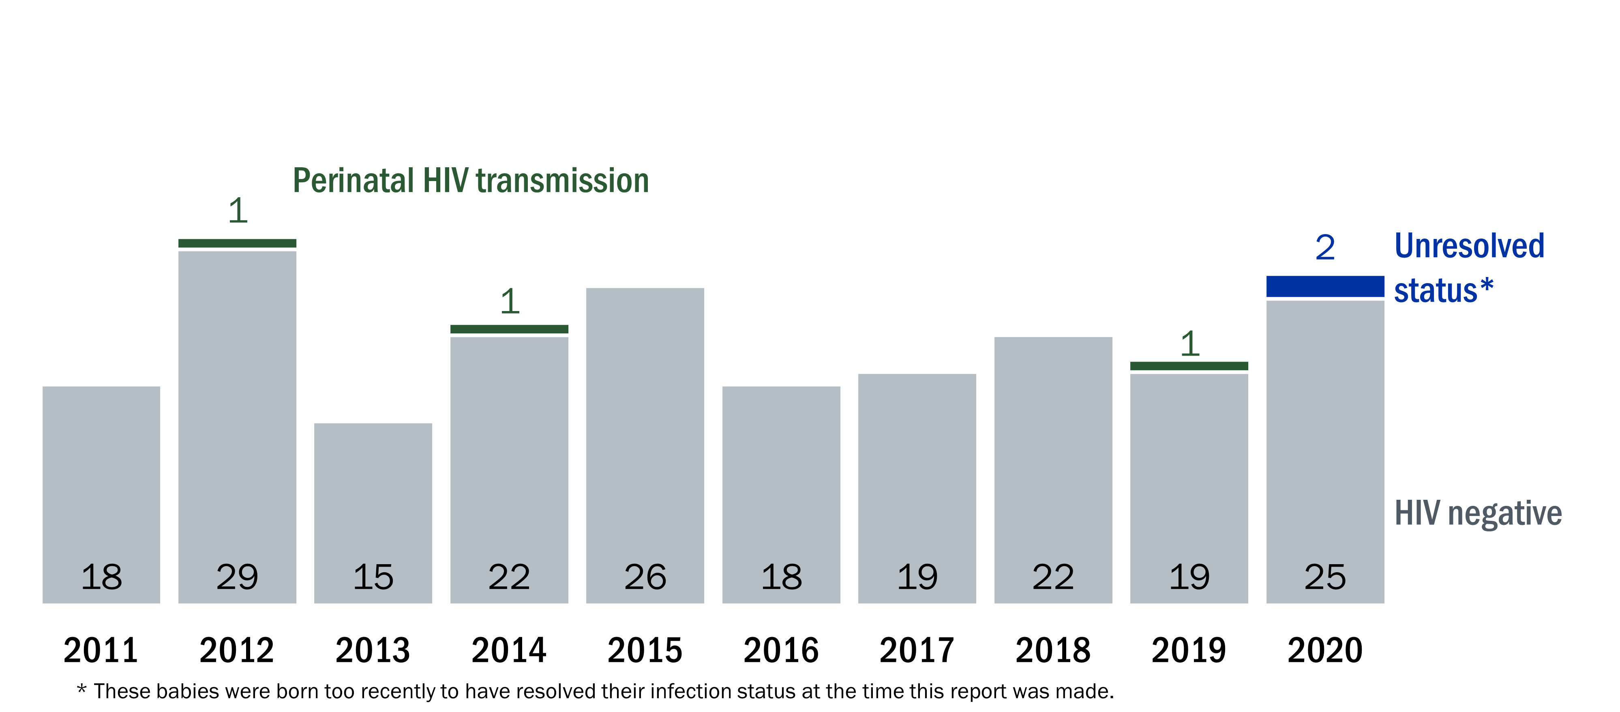
Perinatal transmission of HIV to babies is rare in Wisconsin due to strong partnerships for providing care to pregnant people living with HIV. Diagnostic status of children born to people of childbearing potential living with HIV, Wisconsin, 2011–2020
Notes:
In Wisconsin, perinatal transmission of HIV to babies born to people living with HIV is rare.

Slide 36
People Living with HIV
HIV transmission mode: Sex work
Notes:
This section addresses HIV in individuals whose HIV diagnosis is attributed to sexual activity for income, employment, or non-monetary items like food, drugs, or shelter. These individuals are denoted in this report as sex workers. The term “sex” will be used to denote any sexual activity provided in exchange for monetary or non-monetary items.

Slide 37
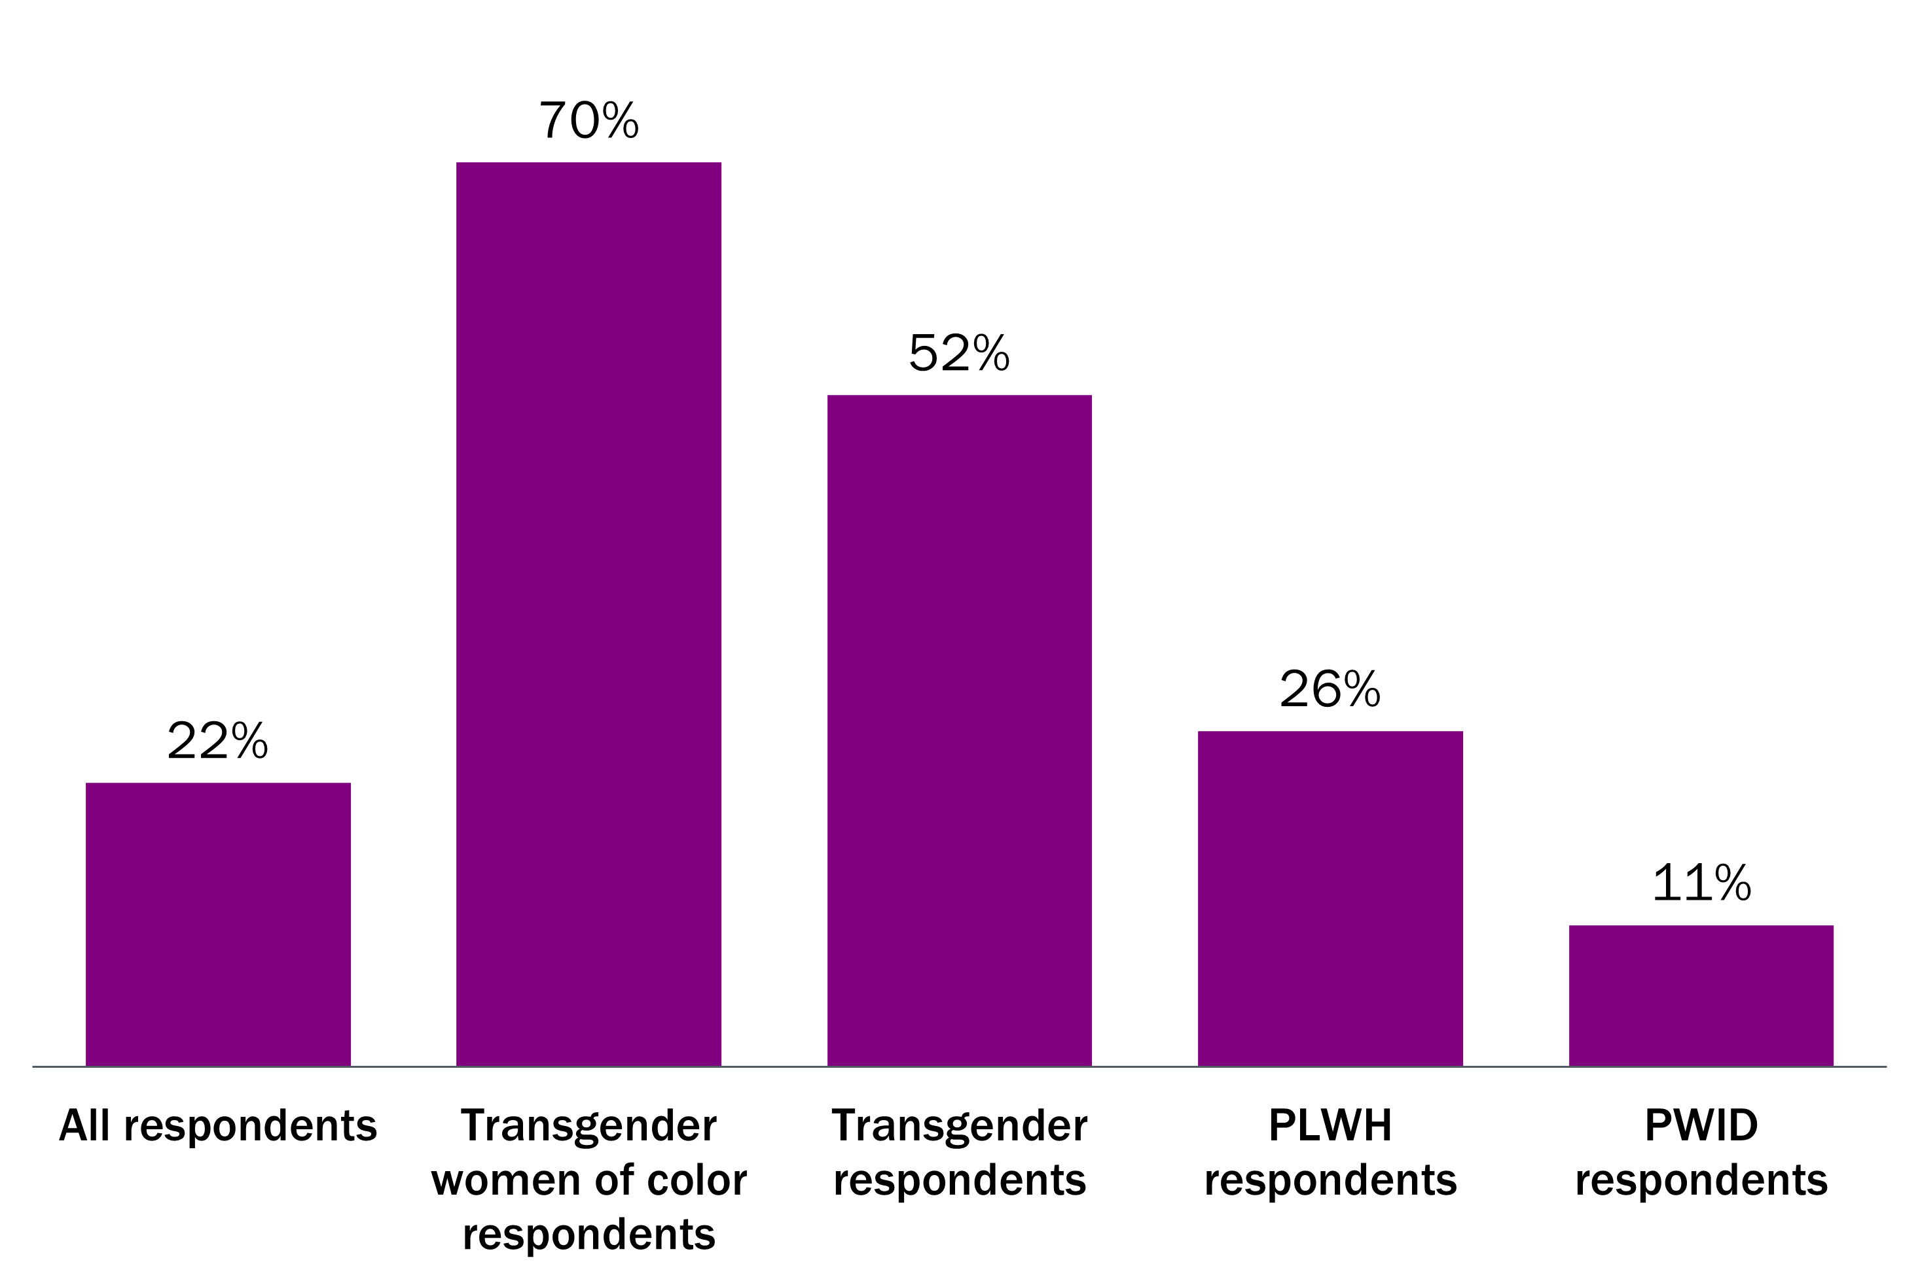
2 in 9 community respondents of the needs assessment were currently or previously engaged in sex work. Respondents to the question “are you now, or have you ever been a sex worker?”, Wisconsin Needs Assessment, 2022
Notes:
Sex work and HIV
Data on sex workers’ chance of HIV are limited. Furthermore, individuals living with HIV who participate in sex work have their diagnosis attributed elsewhere, namely male-male sexual contact, injection drug use, or male-female sexual contact.
Federal and Wisconsin laws state that sex trafficking includes the engagement of minors in sexual activity for financial gain. For simplicity, this section considers sex-trafficked individuals to be sex workers.
For more information, please see CDC’s webpage on sex work and HIV at https://www.cdc.gov/hiv/group/sexworkers.html.

Slide 38
People Living with HIV
Birth sex: Male
Notes:
This section addresses HIV in individuals whose birth sex was reported as male. This section is limited to individuals ages 13 or older at the time of diagnosis.

Slide 39
Black males were 14 times and Hispanic males were 5 times more likely to be diagnosed with HIV than White males. New HIV diagnoses among birth sex of male by selected demographics, Wisconsin, 2016–2020
MMSC
accounted for most new diagnoses in males
83%
new diagnoses among males
White and Asian
males are
diagnosed older
Black and Hispanic
males are diagnosed at higher rate*
‡Median age is based on reported birth sex for counts ≥5.
*Rate is per 100,000 people. Rates based on counts less than five have been suppressed.
Therefore, not all racial groups are included in this figure.
Notes:
New diagnoses
Of the 1,126 HIV diagnoses in Wisconsin during 2016–2020, 940 (83%) were among males, with an HIV diagnosis rate of 6.5 per 100,000. The annual number of new HIV diagnoses among males was stable from 2011 to 2020.
Age at diagnosis
The median age at diagnosis for males diagnosed during 2016–2020 was 30 years. White and Asian males were generally older at the time of HIV diagnosis compared to males of other racial and ethnic groups.
Race and ethnicity
While the number of HIV diagnoses in White (n=343) and Black (n=391) males during 2016–2020 was similar, the Black population in Wisconsin is much smaller than the White population, indicating a significant racial disparity in HIV diagnoses. Black males were 14 times more likely, and Hispanic males five times more likely, to be diagnosed with HIV compared to White males.
The HIV diagnosis rate from 2011 to 2020 remained stable among all racial and ethnic groups for people born male.
Transmission mode
Male-male sexual contact (MMSC) accounted for most new HIV diagnoses among people born male in Wisconsin. Native American males had the highest proportion of MMSC attributed diagnoses (100%) and Hispanic males had the lowest (89%). From 2011 to 2020, trends in HIV diagnoses was stable among all transmission modes: MMSC (including males who report both MMSC and who also injected drugs), injection drug use (IDU), and those with male-female sexual contact (MFSC).
While the annual number of new HIV diagnoses among males who report MMSC remained stable, diagnoses among MSM ages 25–34 increased between 2011 and 2020. Diagnoses declined among MSM ages 45–54 over the same time period and remained stable among other age groups.

Slide 40
Age distribution of men living with HIV in Wisconsin (prevalent cases) compared to ages of men newly diagnosed with HIV during 2020.
5,538
people who were born male were living
with HIV in Wisconsin
at the end of 2020.
Notes:
Prevalence
As of December 31, 2020, approximately 80% (n=5,538) of all people living with HIV in WI were born male. According to CDC, an estimated 14.2% of people born male living with HIV are undiagnosed, meaning an additional 786 people may be living with HIV in Wisconsin but are unaware of their status.¹
¹Centers for Disease Control and Prevention. Estimated HIV incidence and prevalence in the United States, 2015–2019. HIV Surveillance Supplemental Report 2021;26(No. 1). http://www.cdc.gov/ hiv/library/reports/hiv-surveillance.html. Published May 2021. Accessed June 2022.

Slide 41
People Living with HIV
Birth sex: Female
Notes:
This section addresses HIV in individuals whose birth sex was reported as female. This section is limited to individuals ages 13 or older at the time of diagnosis.

Slide 42
Black females are 21 times and Hispanic females were 4 times more likely to be diagnosed with HIV than White females. New HIV diagnoses among birth sex of female by selected demographics, Wisconsin, 2016–2020
17%
new diagnoses among females
MFSC
accounted for most new diagnoses in females
Black and Hispanic
females are diagnosed at higher rate*
White
females are
diagnosed younger
‡Median age is based on reported birth sex for counts ≥5.
*Rate is per 100,000 people. Rates based on counts less than five have been suppressed.
Therefore, not all racial groups are included in this figure.
Notes:
New diagnoses
Of the 1,126 HIV diagnoses in Wisconsin during 2016–2020, 186 (17%) were among people born female, with an HIV diagnosis rate of 1.3 per 100,000. The annual number of new HIV diagnoses among females was stable from 2011 to 2020.
Age at diagnosis
Most (86%) females diagnosed with HIV in Wisconsin during 2016–2020 were ages 25 and older at the time of diagnosis.
The median age at diagnosis for all people born female living with HIV in Wisconsin was 39. White and multiracial women tended to be younger than other racial and ethnic groups.
Race and ethnicity
Among people born female diagnosed with HIV in Wisconsin during 2016–2020, 52% were Black, 28% were White, and 10% were Hispanic. Black females were 21 times more likely, and Hispanic females more than 4 times more likely, to be diagnosed with HIV compared to White females. The HIV diagnosis rate for all racial and ethnic groups among people born female remained stable or fluctuated from 2011 to 2020.
Transmission mode
During 2016–2020, 4 in 5 new HIV diagnoses among people born female in Wisconsin were attributed to male-female sexual contact. The other 18% of new diagnoses were attributed to injection drug use. The diagnosis rate of all transmission modes remained stable from 2011 to 2020.

Slide 43
Age distribution of women living with HIV in Wisconsin (prevalent cases) compared to ages of women newly diagnosed with HIV during 2020.
1,385
people who were born female were living
with HIV in Wisconsin
at the end of 2020.
Notes:
Prevalence
As of December 31, 2020, 20% (n=1,385) of all people living with HIV in Wisconsin were born female. According to CDC, an estimated 10.2% of people born female are living with HIV and undiagnosed. This means that an additional 141 females are estimated to be living with HIV in Wisconsin but are unaware of their status.¹
Source: Centers for Disease Control and Prevention. Estimated HIV incidence and prevalence in the United States, 2015–2019. HIV Surveillance Supplemental Report 2021;26(No. 1). http://www.cdc.gov/ hiv/library/reports/hiv-surveillance.html. Published May 2021. Accessed June 2022.

Slide 44
People Living with HIV
Current gender: Transgender individuals
Notes:
This section addresses HIV in individuals whose current gender is transgender, meaning people whose gender identity does not conform to their sex assigned at birth. This includes people who self-identify as transgender women, transgender men, and other gender nonconforming identities.
Data and transgender people
Data on HIV diagnoses among transgender people are very limited, both nationally and in Wisconsin. While collection of self-reported gender identity has improved over time, the number of diagnoses among transgender individuals in Wisconsin may be underreported.
Please see the HIV Annual Report on pages 6 and 7 for the most current information.

Slide 45
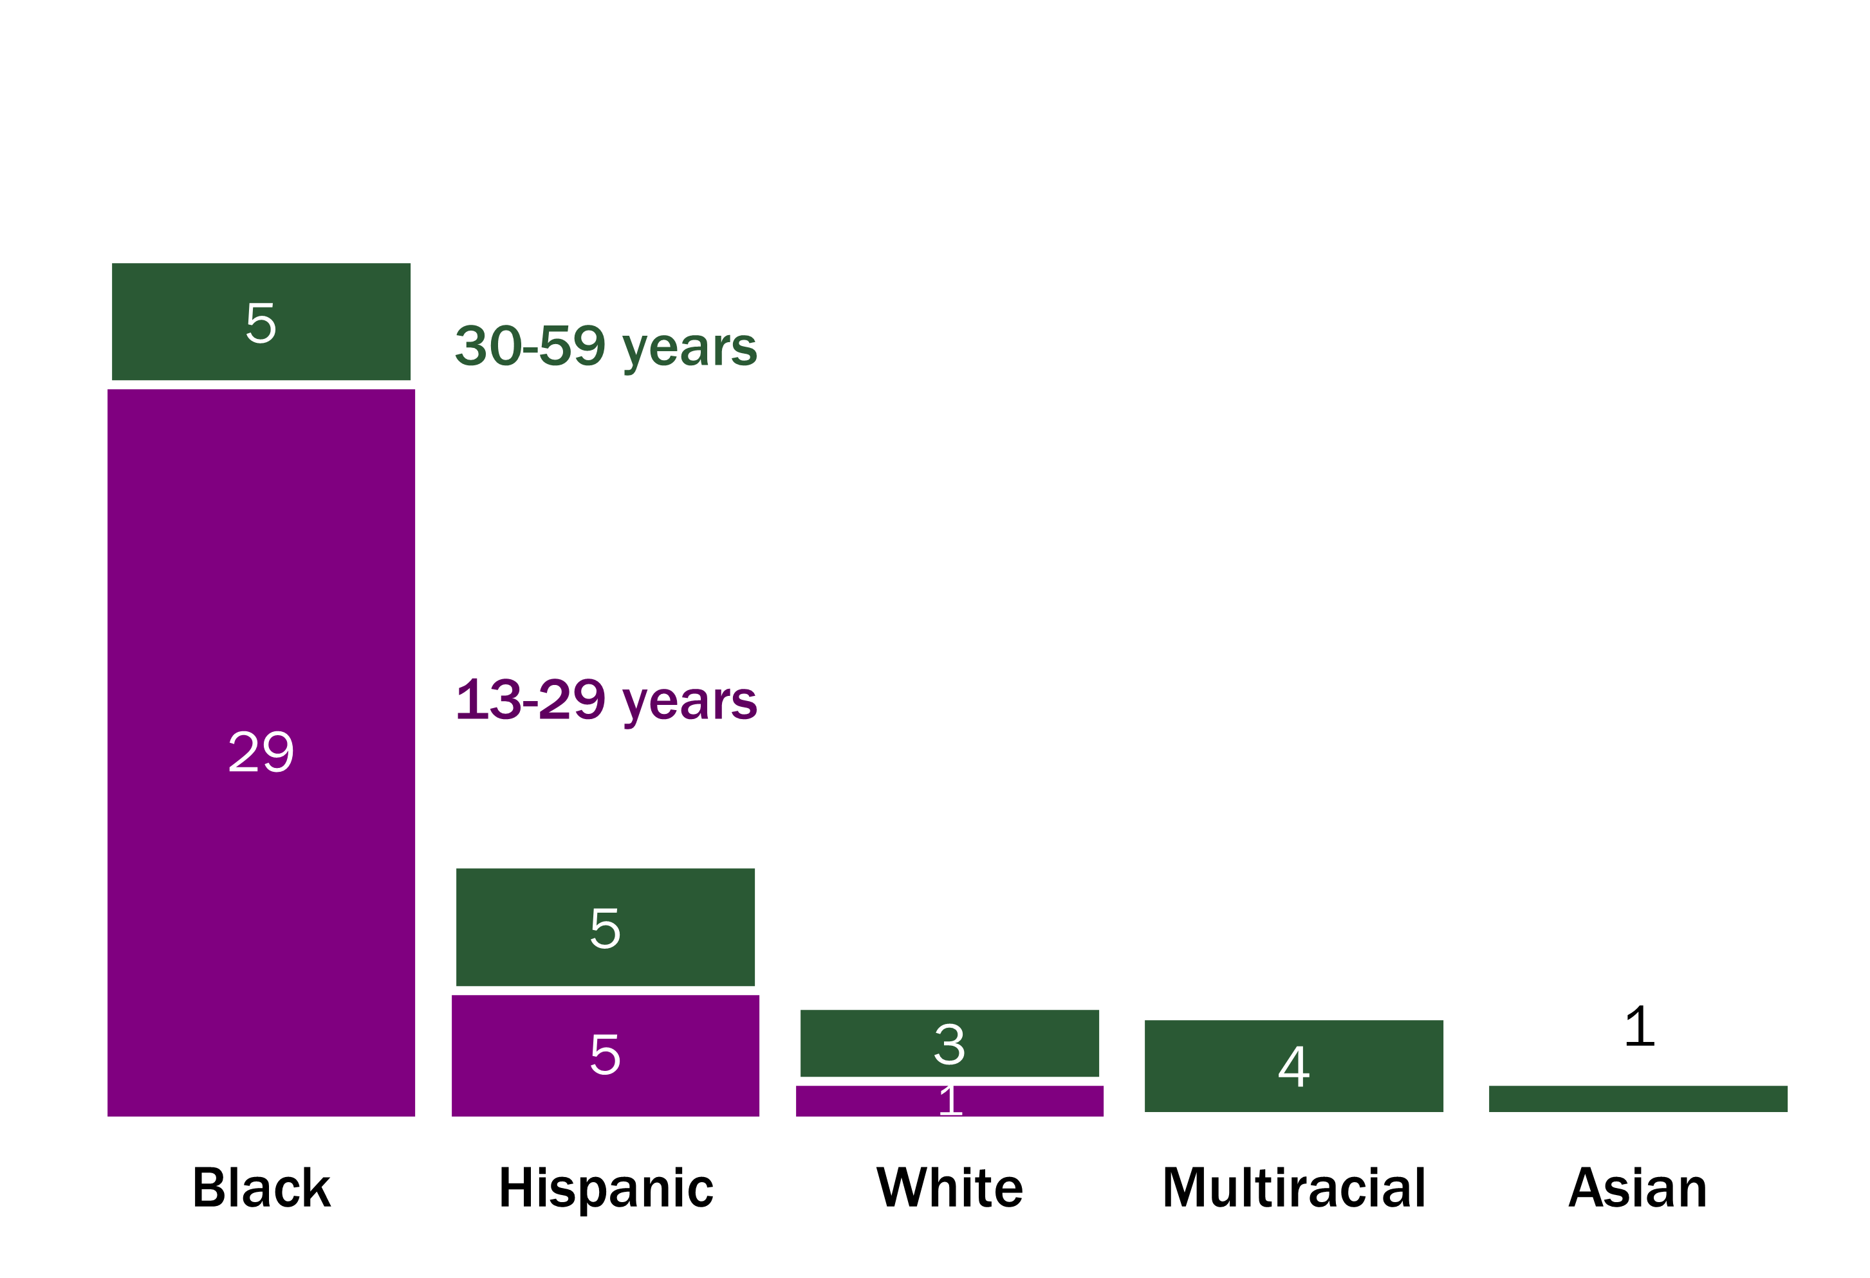
Over half of transgender people diagnosed with HIV in the last 10 years were young people of color. Number of HIV diagnoses among transgender people by age at diagnosis and race and ethnicity, 2011–2020
Notes:
Cisgender people have a gender identity that corresponds with their sex assigned at birth. Conversely, transgender people have a gender identity that does not conform to their sex assigned at birth. This includes people who self-identify as transgender women, transgender men, and other gender nonconforming identities.
Gender identity and sexual orientation are separate, distinct concepts, with gender identity referring to an individual’s sense of themselves and sexual orientation referring to an individual’s attractions and partnering.
Transgender people face an increased risk of HIV due to stigma, discrimination, social rejection and exclusion, violence, and barriers in health care settings, such as lack of provider training on transgender people’s unique needs.¹ Since 1982, 95 transgender individuals have been diagnosed with HIV in Wisconsin (eight transgender men and 87 transgender women). While collection of self-reported gender identity has improved over time, the number of diagnoses among transgender individuals in Wisconsin may be underreported.
Of the 95 HIV diagnoses among transgender individuals, 53 occurred between 2011 and 2020:
The majority were from a racial or ethnic minority group (92%).
Two out of three individuals were under age 30 (66%).
89% of recent diagnoses were attributed to sexual contact (47 of 53).
¹Centers for Disease Control and Prevention. HIV Among Transgender People. https://www.cdc.gov/hiv/group/gender/transgender/. Published April 2017.

Slide 46
People Living with HIV
Race: Non-Hispanic Black individuals
Notes:
This section addresses HIV in non-Hispanic Black people or African Americans.

Slide 47
Black people accounted for 43% of recent HIV diagnoses in Wisconsin and the HIV diagnosis rate in Black people was more than 14 times higher than in White people. New HIV diagnoses among Black people by selected demographics, Wisconsin, 2016–2020
MFSC
accounted for most new diagnoses in Black females
81%
male among new Black diagnoses
†
†
Black people
diagnosed younger than most other racial and ethnic groups
Diagnoses decreased
among Black MSM
†
†Median age is based on reported race/ethnicity for counts ≥5.
‡Estimate is statistically unreliable due to case count <12.
Notes:
New diagnoses
Black people accounted for 487 (43%) of the 1,126 HIV diagnoses in Wisconsin during 2016–2020 but make up only 7% of the state’s population. The HIV diagnosis rate in Black people were more than 14 times higher than in White people and nearly 3 times higher than in Hispanic people. The HIV diagnosis rate remained level among all racial and ethnic groups from 2011 to 2020.
Birth sex
During 2016–2020, 4 in 5 Black people diagnosed with HIV in Wisconsin were male.
Current gender
Of the 53 known transgender individuals diagnosed with HIV during 2011–2020, 34 are Black, and 29 of these were diagnosed before the age of 30.
Age at diagnosis
Black males were diagnosed at a much younger age than both Black females and males of other racial and ethnic groups except multiracial males.
Transmission mode
Male-male sexual contact (MMSC), including males who report both MMSC and injection drug use, accounted for 90% of new HIV diagnoses among Black males in Wisconsin between 2016 and 2020. Among Black women, 87% of HIV diagnoses were attributed to male-female sexual contact.
HIV diagnoses in Wisconsin during 2011–2020:
Decreased in young Black males who report MMSC.
Increased in Black males who report MMSC ages 25 and older.
Declined in Black people who inject drugs and those with male-female sexual contact.

Slide 48
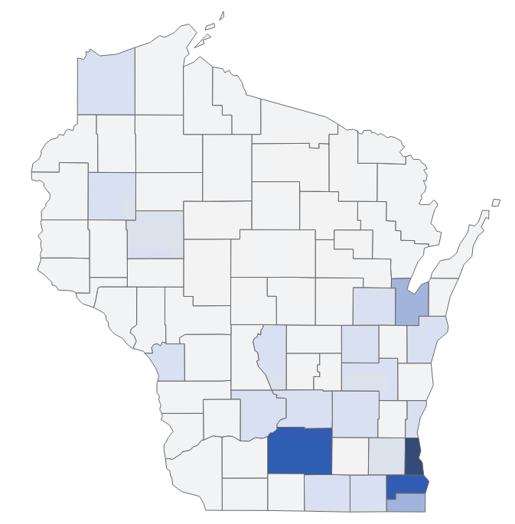
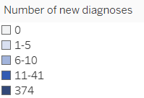
Milwaukee County residents accounted for over 3 in 4 new diagnoses among Black people in Wisconsin. HIV diagnoses among Black people by county, Wisconsin 2016–2020
2,611
Black people were living
with HIV in Wisconsin
at the end of 2020.
Notes:
Geography
Milwaukee County residents account for over three in four diagnoses among Black people in Wisconsin.
Prevalence
As of December 31, 2020, 38% (n=2,611) of all people living with HIV were Black. According to CDC, an estimated 8 13.4% of Black people living with HIV are undiagnosed, meaning an additional 350 people may be living with HIV in Wisconsin but are unaware of their status.¹
1 in 3 Black MSM is estimated to be living with HIV compared to 12% of Hispanic and 3% of White MSM.
¹Centers for Disease Control and Prevention. Estimated HIV incidence and prevalence in the United States, 2015–2019. HIV Surveillance Supplemental Report 2021;26(No. 1). http://www.cdc.gov/ hiv/library/reports/hiv-surveillance.html. Published May 2021. Accessed June 2022.

Slide 49
People Living with HIV
Race: Hispanic individuals
Notes:
This section addresses HIV in Hispanic or Latino people. The federal Office of Management and Budget (OMB) defines Hispanic or Latino as “a person of Cuban, Mexican, Puerto Rican, South or Central American, or other Spanish culture or origin, regardless of race.”

Slide 50
Hispanics accounted for 15% of recent HIV diagnoses in Wisconsin and the HIV diagnosis rate in Hispanics was more than five times higher than in Whites. New HIV diagnoses among Hispanic people by selected demographics, Wisconsin, 2016–2020
89%
male among new Hispanic diagnoses
MFSC
accounted for most new diagnoses in Hispanic females
Hispanic women
diagnosed older than all other racial groups
†
†
Diagnoses increased
in Hispanic MSM
†
†Median age is based on reported race/ethnicity for counts ≥5.
‡Estimate is statistically unreliable due to case count <12.
Notes:
New diagnoses
Hispanic people accounted for 170 (15%) of the 1,126 new HIV diagnoses in Wisconsin during 2016–2020 but make up only 7% of the state’s population. The HIV diagnosis rate in Hispanics was five times higher than in Whites during 2016–2020. The HIV diagnosis rate remained level among all racial and ethnic groups from 2011 to 2020.
Birth sex
Males accounted for nine out of ten Hispanic people diagnosed with HIV in Wisconsin during 2016–2020.
Current gender
Of the 53 known transgender individuals diagnosed with HIV during 2011–2020, 10 are Hispanic, and five of these were diagnosed before the age of 30.
Age at diagnosis
Hispanic females had a median age at diagnosis that was older than all other racial and ethnic groups while Hispanic males had a median age at diagnosis that was younger than White and Asian people but older than Black and multiracial people.
Transmission mode
Male-male sexual contact (MMSC), including males who report both MMSC and injected drugs, accounted for 89% of new HIV diagnoses among Hispanic males in Wisconsin. Among Hispanic women, 88% of HIV diagnoses were attributed to male-female sexual contact.
HIV diagnoses in Wisconsin during 2011–2020:
Increased in Hispanic males who report MMSC.
Declined in Hispanic people with HIV attributed to injection drug use and male-female sexual contact.

Slide 51
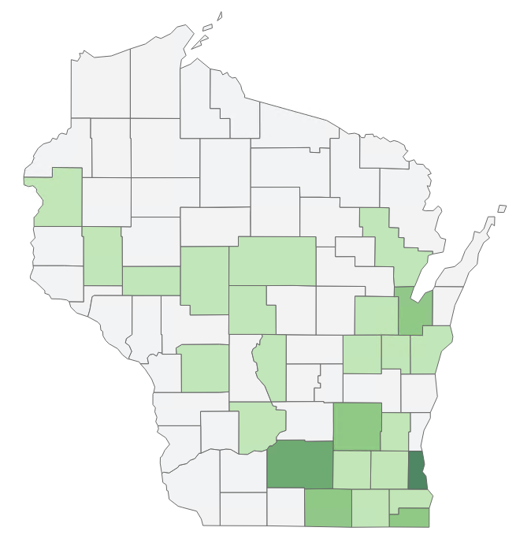
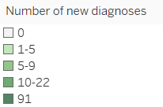
Milwaukee County residents account for over half of new diagnoses among Hispanic people in Wisconsin. HIV diagnoses among Hispanic people by county, Wisconsin 2016-2020
1,001
Hispanic people were living with HIV in Wisconsin
at the end of 2020.
Notes:
Geography
Milwaukee County residents account for over half of diagnoses among Hispanic people in Wisconsin from 2016–2020.
Prevalence
As of December 31, 2020, 14% (n=1,001) of all people living with HIV in Wisconsin were of Hispanic ethnicity. According to CDC, an estimated 16.4% of Hispanic people are living with HIV and undiagnosed. This means that an additional 164 Hispanic people are estimated to be living with HIV in Wisconsin but are unaware of their status.¹
The prevalence of HIV in Hispanic people is almost four times higher than in White people. An estimated 12% of Hispanic MSM are living with HIV compared to 3% of White MSM.
Source: Centers for Disease Control and Prevention. Estimated HIV incidence and prevalence in the United States, 2015–2019. HIV Surveillance Supplemental Report 2021;26(No. 1). http://www.cdc.gov/ hiv/library/reports/hiv-surveillance.html. Published May 2021. Accessed June 2022.

Slide 52
People Living with HIV
Race: Native American individuals
Notes:
This section addresses HIV in Native American people (formerly referred to as American Indian and Alaskan Native). The federal Office of Management and Budget (OMB) defines Native American as “a person having origins in any of the original peoples of North and South America (including Central America), and who maintains tribal affiliation or community attachment.”
This report bases classifications of race and ethnicity according to CDC standard classifications, which may lead to underreporting of certain racial and ethnic groups. When classified in a more inclusive way, the number of new HIV diagnoses among Native American people during 2011–2020 increases from 16 to 52. This section will use the more inclusive way of defining race and ethnicity (ever reported as Native American, alone or in combination with other racial or ethnic groups).

Slide 53
Injection drug use accounted for a higher percentage of new diagnoses in Native Americans compared to other racial and ethnic groups. New HIV diagnoses among Native Americans by selected demographics, Wisconsin, 1979–2020
70%
male among new Native American diagnoses
IDU
accounts for 1 in 6 new HIV diagnoses
*Includes transmission associated with perinatal exposure and receiving clotting factors.
Diagnosed younger
than White people
63%
of new Native American diagnoses under age 35
†
†Median age is based on reported race/ethnicity for counts ≥5.
‡Estimate is statistically unreliable due to case count <12.
Notes:
New diagnoses
Native Americans accounted for 24 (2%) of the 1,126 new HIV diagnoses in Wisconsin during 2016–2020. The diagnosis rate among Native Americans is higher (6.1 per 100,000 people) than that of White people (1.7 per 100,000 people).
Because of relatively small numbers of diagnoses in recent years, the rest of this section will focus on the 174 Native Americans ever diagnosed with HIV in Wisconsin from 1979 to 2020.
Birth sex
Males accounted for seven out of ten Native Americans diagnosed with HIV in Wisconsin during 1979–2020. In other racial and ethnic groups, males accounted for at least three in four diagnoses.
Age at diagnosis
The median age at diagnosis for Native Americans diagnosed with HIV in Wisconsin is 30.5 for people born female and 31 for people born male which is similar to all racial and ethnic groups except White and Asian people.
Transmission mode
Male-male sexual contact (MMSC), including males who report both MMSC and injected drugs, accounted for 85% of new diagnoses among Native American males in Wisconsin from 1979 to 2020. Injection drug use accounted for 34% and 9% of diagnoses in females and males respectively, a higher percentage than in other racial and ethnic groups. Male-female sexual contact (MFSC) accounted for 59% of diagnoses in Native American women.

Slide 54
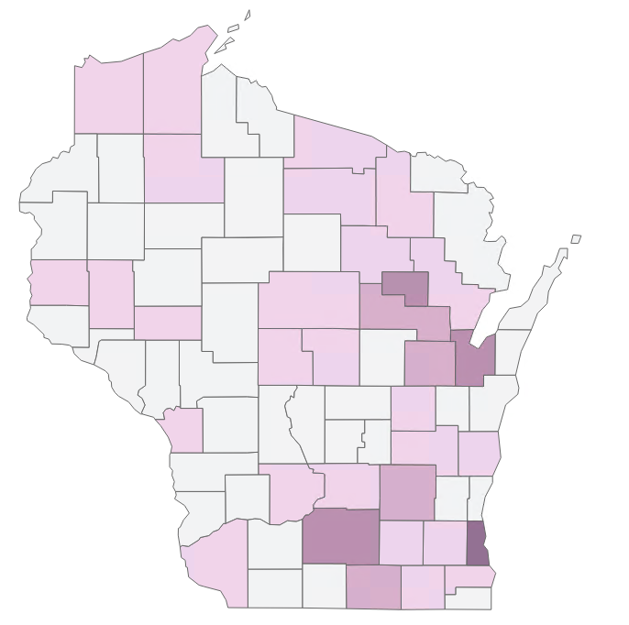
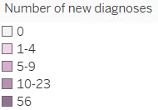
Milwaukee County residents account for 1 in 3 new diagnoses among Native people in Wisconsin. HIV diagnoses among Black people by county, Wisconsin 1979-2020
142
Native American people were living
with HIV in Wisconsin
at the end of 2020.
Notes:
Geography
HIV diagnoses among Native Americans have been distributed across the state, with 32% from Milwaukee County, 13% from Dane County, 8% from Menominee County, 37% from north or northeastern counties, and 22% from southern Wisconsin counties.
Prevalence
As of December 31, 2020, 2% (n=142) of all people living with HIV in Wisconsin were Native American. According to CDC, an estimated 20.5% of Native American people are living with HIV and undiagnosed. This means that an additional 29 Native Americans are estimated to be living with HIV in Wisconsin but are unaware of their status.¹
Source: Centers for Disease Control and Prevention. Estimated HIV incidence and prevalence in the United States, 2015–2019. HIV Surveillance Supplemental Report 2021;26(No. 1). http://www.cdc.gov/ hiv/library/reports/hiv-surveillance.html. Published May 2021. Accessed June 2022.

Slide 55
People Living with HIV
Race: Asian individuals
Notes:
This section addresses HIV in Asian people, Native Hawaiians, and Pacific Islanders. The U.S. census in 2010 defines Asian as a “person having origins in any of the original peoples of the Far East, Southeast Asia, or the Indian subcontinent” and Native Hawaiian or Other Pacific Islander as a “person with origins in any of the original peoples of Hawaii, Guam, Samoa, or other Pacific Islands.” This section will use the term “Asians” for brevity.

Slide 56
115 Asian people were diagnosed with HIV in Wisconsin during 1987–2020. New HIV diagnoses among Asian people by selected demographics, Wisconsin, 1987–2020
MFSC
accounts for highest percentage in males of any racial/ethnic group
78%
male among new Asian diagnoses
*Includes transmission associated with perinatal exposure and unknown factors.
†
†
Diagnosed younger
than White people
58%
of new Asian diagnoses under age 35
†Median age is based on reported race/ethnicity for counts ≥5.
‡Estimate is statistically unreliable due to case count <12.
Notes:
New diagnoses
Asians accounted for 20 (2%) of the 1,126 people newly diagnosed with HIV in Wisconsin during 2016–2020. The diagnosis rate among Asians (2.2 per 100,000 people) was 1.3 times the rate for Whites (1.7 per 100,000 people).
Because of the relatively small number of diagnoses in the recent period, the rest of this summary is based on the 115 Asians diagnosed with HIV in Wisconsin from 1987 to 2020.
Birth sex
Males accounted for almost four in five of the 115 Asians diagnosed with HIV in Wisconsin during 1987–2020.
Age at diagnosis
The median age at diagnosis for all Asians diagnosed with HIV in Wisconsin is 32 for females and 31 for males–similar to that of other people of color.
Transmission mode
Male-male sexual contact (MMSC), including males who report both MMSC and injection drug use, accounted for 79% of new HIV diagnoses among Asian males in Wisconsin. An additional 20% were due to male-female sexual contact (MFSC), which is the largest percentage among males of the other racial and ethnic groups. Injection drug use accounted for 1% and 7% among Asian males and females, respectively. Male-female sexual contact accounted for 85% of HIV diagnoses among Asian women.

Slide 57
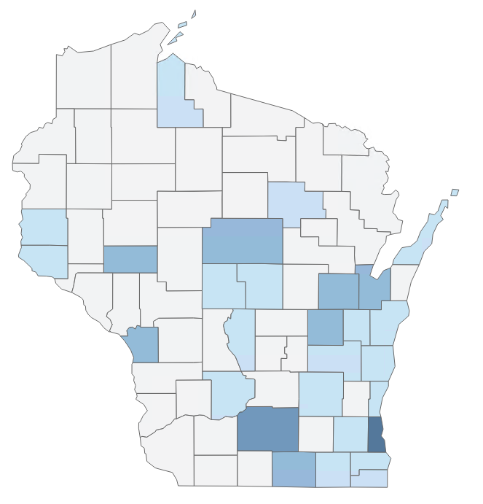
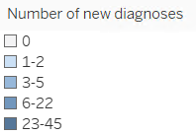
Milwaukee County residents account for over 3 in 4 new diagnoses among Asian people in Wisconsin. HIV diagnoses among Asian people by county, Wisconsin 1987-2020
98
Asian people were living
with HIV in Wisconsin
at the end of 2020.
Notes:
Geography
Seven out of ten (70%) diagnoses among Asians were made in Southern and Southeastern Wisconsin, including 39% from Milwaukee County, followed by 14% in the northeast, 10% in the west, and 6% in the north.
Prevalence
As of December 31, 2020 1% (n=98) of all people living with HIV in Wisconsin were Asian. According to CDC, an estimated 13.6% of Asian people are living with HIV and undiagnosed. This means that an additional 13 Asians are estimated to be living with HIV in Wisconsin but are unaware of their status.¹
Source: Centers for Disease Control and Prevention. Estimated HIV incidence and prevalence in the United States, 2015–2019. HIV Surveillance Supplemental Report 2021;26(No. 1). http://www.cdc.gov/hiv/library/reports/hiv-surveillance.html. Published May 2021. Accessed June 2022.

Slide 58
People Living with HIV
Age: Youth ages 13–24
Notes:
This section addresses HIV in youth, defined as individuals ages 13–24 years old at the time of diagnosis (new diagnosis section) or were ages 13–24 as of December 31, 2020 (prevalence section).

Slide 59
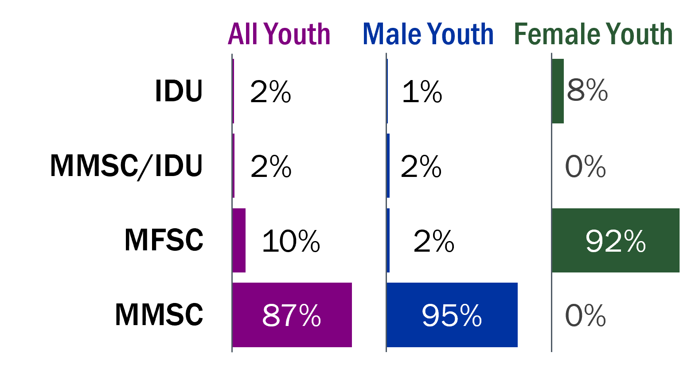
Youth accounted for 1 in 4 new HIV diagnoses in Wisconsin during 2016–2020. New HIV diagnoses among youth ages 13–24 by selected demographics, Wisconsin, 2016–2020
Race/Ethnicity | Number | Rate per 100,000
Statewide | 271 | 7
Hispanic | 30 | 8
Native American† | 1 | -
Asian† | 4 | -
Black | 171 | 46
White | 55 | 2
Multiracial‡ | 10 | -
23 times
Black youth more
likely to be
diagnosed than
White youth
MMSC
accounts for most
of new diagnoses in youth
†Rates based on counts <5 are not shown.
‡Population denominator is unavailable for rate calculation.
213
youth were living with HIV in Wisconsin at the end of 2020
91%
new diagnoses among youth were male
Notes:
New diagnoses
Of the 1,126 people diagnosed with HIV in Wisconsin during 2016–2020, 271 (24%) were among youth. While the annual number of new HIV diagnoses among youth fluctuated from year to year, it was on a downward trend from 2011 to 2020.
Race and ethnicity
Among youth newly diagnosed with HIV in Wisconsin during 2016–2020, 20% were White and 80% were People of Color (POC). Black youth were 23 times more likely to be diagnosed with HIV than their White counterparts.
Birth Sex
Most (91%) youth diagnosed during 2016–2020 were male.
Transmission mode
Most (89%) of new diagnoses among youth in Wisconsin are among males who report MMSC, including males who report both MMSC and injection drug use. The remaining new diagnoses are attributed to male-female sexual contact (10%) and injection drug use (2%). Among young females diagnosed with HIV, 92% of diagnoses were attributed to male-female sexual contact and 8% to injection drug use. Among young males diagnosed with HIV, 97% of diagnoses were attributed to male-male sexual contact, including males who reported both MMSC and injection drug use. Diagnoses decreased among young Black males who report MMSC from 2011 to 2020, while remaining stable in young White and Hispanic males who report MMSC.
Geography
Youth were most likely to be diagnosed with HIV in Milwaukee (65%) and Dane (10%) counties. Small metropolitan counties make up 18% of diagnoses among youth while non-metro counties made up just 7% of diagnoses.
Prevalence
As of December 31, 2020, approximately 3% (n=213) of all people living with HIV in Wisconsin were ages 13-24. According to CDC, an estimated 45% of youth are living with HIV and undiagnosed. This means that an additional 94 youth are estimated to be living with HIV in Wisconsin but are unaware of their status.¹
Source: Centers for Disease Control and Prevention. Estimated HIV incidence and prevalence in the United States, 2015–2019. HIV Surveillance Supplemental Report 2021;26(No. 1). http://www.cdc.gov/ hiv/library/reports/hiv-surveillance.html. Published May 2021. Accessed June 2022.

Slide 60
People Living with HIV
Age: Adults ages 55 and over
Notes:
This section addresses HIV in adults who were ages 55 and older at the time of HIV diagnosis (new diagnoses section) or were ages 55 and older as of December 31, 2020 (prevalence section).

Slide 61
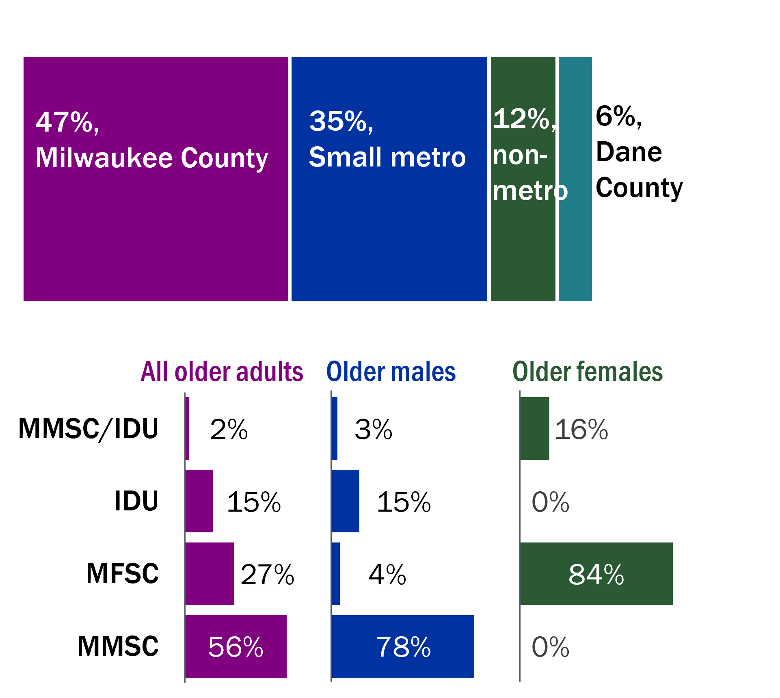
Adults aged 55 and older accounted for less than 1 in 10 new diagnoses during 2016–2020 but represent 2 in 5 people living with HIV in Wisconsin. New HIV diagnoses among adults aged >55 by selected demographics, Wisconsin, 2016–2020
Race/Ethnicity | Number | Rate per 100,000
Statewide | 109 | 1
Hispanic‡ | 8 | 4
Native American† | 1 | -
Asian† | 2 | -
Black | 31 | 9
White | 64 | 1
Multiracial‡ | 2 | -
12 times
older Black adults more likely
to be diagnosed than older White adults
Milwaukee
county accounts for almost half new diagnoses in older adults
†Rates based on counts <5 are not shown.
‡Population denominator is unavailable for rate calculation.
71%
new diagnoses among people over the age of 55 were male
MMSC
accounts for most of new diagnoses in older adults
Notes:
New diagnoses
Of the 1,126 new HIV diagnoses in Wisconsin during 2016–2020, 111 (10%) were among adults aged 55 and over. The annual number of new HIV diagnoses among older adults fluctuated between 2011 and 2020 with no clear trend.
Race and ethnicity
Among older adults newly diagnosed with HIV in Wisconsin during 2016–2020, 59% were White and 41% were people of color (POC). Despite a similar number of new diagnoses among White people and POC ages 55 and older, racial and ethnic minorities are still disproportionately impacted given the difference in population size. Older Black people are 9 times and older Hispanic people are 4 times more likely than Older White people to be diagnosed with HIV.
Birth sex
During 2016–2020, 5 in 7 new diagnoses among older adults were male.
Transmission mode
Over half (58%) of new diagnoses among adults ages 55 and older in Wisconsin during 2016–2020 were among males who report male-male sexual contact (MMSC), including those who also injected drugs. The remaining new diagnoses among older adults were attributed to male-female sexual contact (27%) and injection drug use (15%). Diagnoses were stable among adults aged 55 and older among all transmission modes between 2011 and 2020.
Geography
Milwaukee County accounts for almost half of all diagnoses among older adults in Wisconsin during 2016–2020. The HIV diagnosis rate among older adults in Milwaukee County is more than four times higher than in Dane County and small metropolitan counties, and more than 8 times higher than in non-metropolitan counties.
Prevalence
As of December 31, 2020, 39% (n=2,269) of all people living with HIV in Wisconsin were aged 55 and older. According to CDC, an estimated 5% of people aged 55 and older are living with HIV and undiagnosed. This means that an additional 133 people aged 55 and older are estimated to be living with HIV in Wisconsin but are unaware of their status.¹
Source: Centers for Disease Control and Prevention. Estimated HIV incidence and prevalence in the United States, 2015–2019. HIV Surveillance Supplemental Report 2021;26(No. 1). http://www.cdc.gov/hiv/library/reports/hiv-surveillance.html. Published May 2021. Accessed June 2022.

Slide 62
People Living with HIV
Late diagnosis
Notes:
The definition of a late diagnosis is individuals who progress to Stage 3 (AIDS) within one year of receiving their initial HIV diagnosis, including those who receive a concurrent HIV and Stage 3 diagnosis. A concurrent diagnosis is when Stage 3 is diagnosed within 30 days of the HIV diagnosis.
Please see the HIV Annual Report on pages 6 and 7 for the most current information.

Slide 63
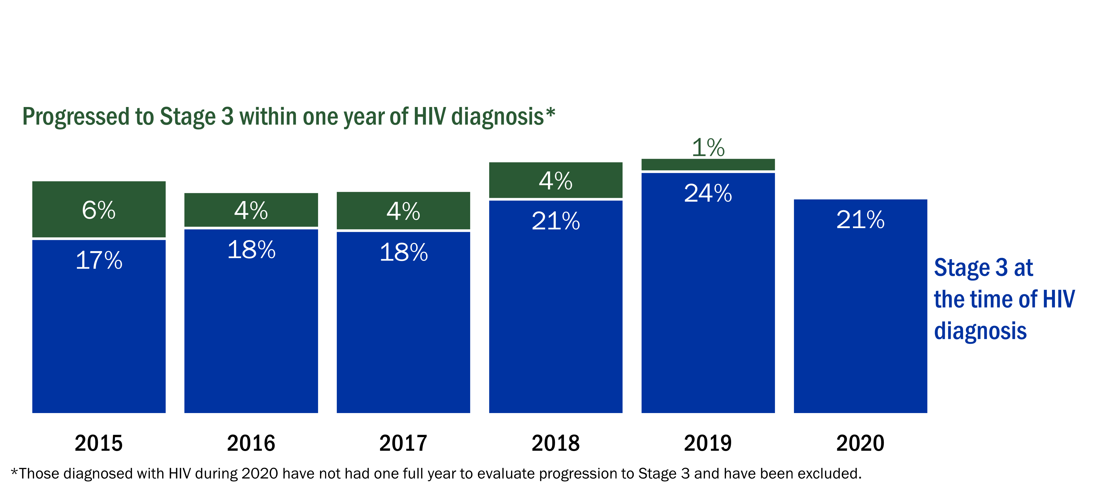
Indicators for HIV late diagnosis showed a small decrease of progressing to Stage 3 within 12 months and a small increase in Stage 3 at time of diagnosis from 2015–2019. Percentage of people who progressed to Stage 3 (AIDS) of HIV within one year of diagnosis, Wisconsin, 2015–2020
Notes:
A late diagnosis occurs when a person living with HIV progresses to Stage 3 (AIDS) within one year of receiving their initial diagnosis. Without treatment, progression to Stage 3 typically occurs eight to 10 years after HIV was acquired. Stage 3 status is clinically defined by having a very low CD4 white blood cell count or a Stage 3-defining opportunistic infection. Early diagnosis and access to HIV care can prevent progression to Stage 3 so that people living with HIV have longer and healthier lives.
The percentage of new HIV diagnoses that had progressed to Stage 3 by the time they were first identified increased from 2015 to 2020, with a low of 17% in 2015 and a high of 24% in 2019.
Of people who received a late HIV diagnosis during 2015–2020:
The majority (77%) were men.
Four out of five (79%) were over 30 at the time of diagnosis.
Thirty-nine percent were White, 38% were Black, and 17% were Hispanic.
About half (51%) had a transmission category of male-male sexual contact, 8% had a transmission category of male-female sexual (heterosexual) contact, and 3% had a transmission category of injection drug use.

Slide 64
People Living with HIV
Incarcerated persons
Notes:
This section addresses individuals who were diagnosed with HIV, or are living with HIV, in one of Wisconsin’s state or federal correctional facilities. However, individuals diagnosed or living with HIV in a county jail are excluded. In Wisconsin, Dodge Correctional Institution is the central reception center for adult males who are sentenced to prison. HIV testing at Dodge Correctional Institution is offered to all people who are incarcerated. HIV testing is similar at Taycheedah Correctional Institution, Wisconsin’s correctional facility for women.

Slide 65
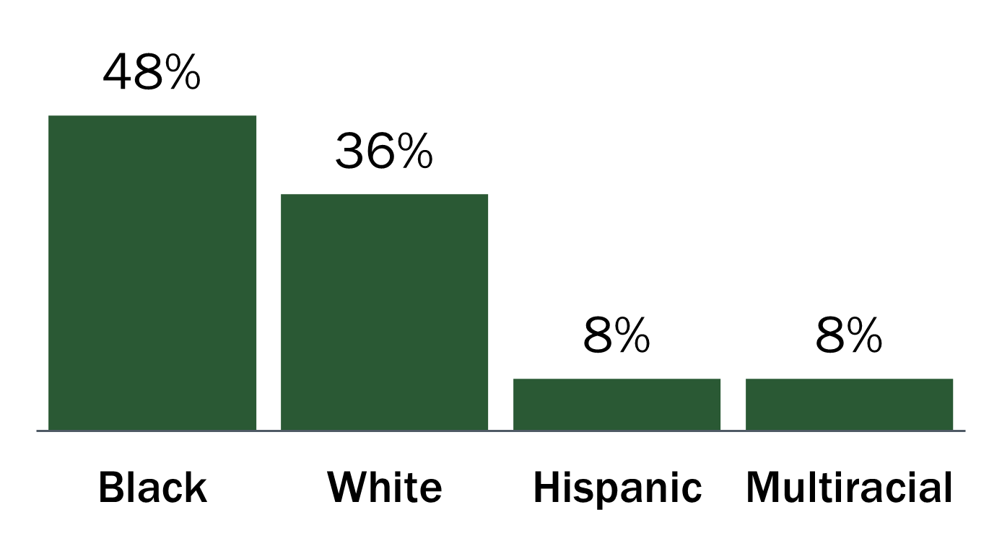
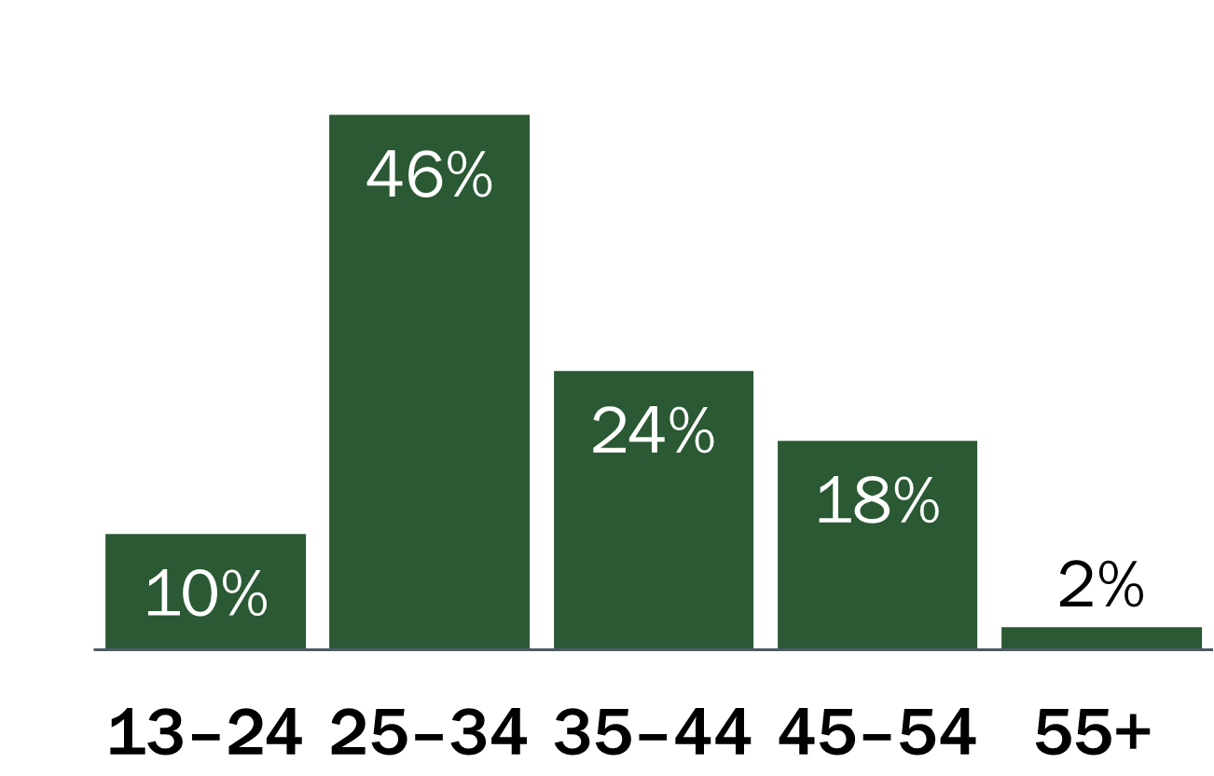
An average of 5 new diagnoses of HIV per year were diagnosed within the Wisconsin Department of Corrections (DOC) during 2011–2020. New HIV diagnoses among incarcerated people by selected demographics, Wisconsin, 2016–2020
88%
new diagnoses among males
Black people
accounted for almost half of new diagnoses among incarcerated persons
56%
of diagnoses in incarcerated
persons were under
the age of 35
IDU
accounted for 18% of new diagnoses among incarcerated persons
Notes:
New diagnoses
Between 1985 and 2020, 385 individuals were first diagnosed with HIV in the Wisconsin Department of Corrections (DOC). The number of people diagnosed with HIV in the DOC has decreased, from an average of 15 new diagnoses per year during 1985–1999, to an average of 10 new diagnoses per year during 2000–2010, to an average of 5 new diagnoses per year during 2011–2020.
Race and ethnicity
Black people accounted for almost half of new HIV diagnoses among incarcerated persons, followed by White people (36%), then Hispanic and multiracial people (8% each).
Birth sex
Eight out of nine new diagnoses among incarcerated people during this period were male.
Transmission mode
Individuals diagnosed with HIV within DOC were more likely to have a history of drug use compared to individuals diagnosed outside of DOC.
Prevalence¹
At any one time, there are approximately 105 incarcerated persons living with HIV within the DOC. With 20,191 incarcerated persons annually, the estimated HIV prevalence within the DOC is 5 per 1,000 inmates.
¹Wisconsin Department of Corrections. https://doc.wi.gov/Pages/DataResearch/PrisonPointInTime.aspx. Accessed July 12, 2022. University of Wisconsin HIV Program, Department of Corrections Case Management Program.

Slide 66
Individuals diagnosed within DOC were more likely to be Black, ages 25–34 and have a history of injection drug use compared to people diagnosed outside of DOC. New HIV diagnoses among incarcerated people and non-incarcerated people by selected demographics, Wisconsin, 2011–2020
Notes:
Individuals diagnosed with HIV from 2011 to 2020 within DOC were more likely to be Black, ages 25–34, and have a history of injection drug use compared to individuals diagnosed outside of DOC.

Slide 67
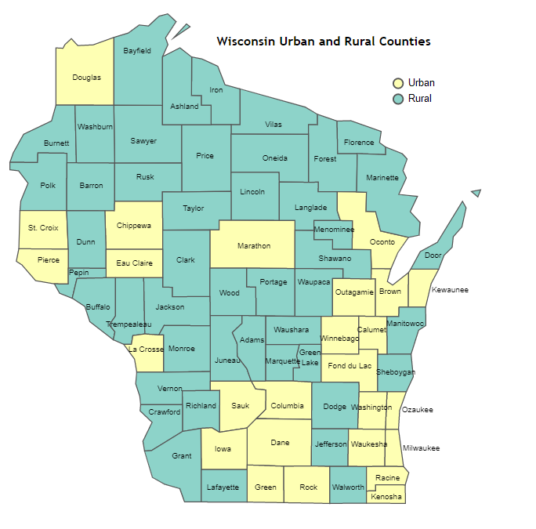
People Living with HIV
Metropolitan grouping
Notes:
Based on U.S. Census Bureau definitions¹, Wisconsin counties were grouped into four metropolitan, or “metro,” levels: Milwaukee County (large metropolitan), Dane County (medium-sized metro); small metro (25 counties); and non-metro (45 counties) as shown on the map. These groupings also match with the Wisconsin Office of Rural Health’s county urban and rural designations². Non-metro is rural and the metropolitan counties are urban.
¹Ingram DD, Franco SJ. 2013 NCHS urban–rural classification scheme for counties. National Center for Health Statistics. Vital Health Stat 2(166). 2014.
²WISH: Urban and Rural Counties. Accessed July 19, 2022: https://www.dhs.wisconsin.gov/wish/urban-rural.htm

Slide 68
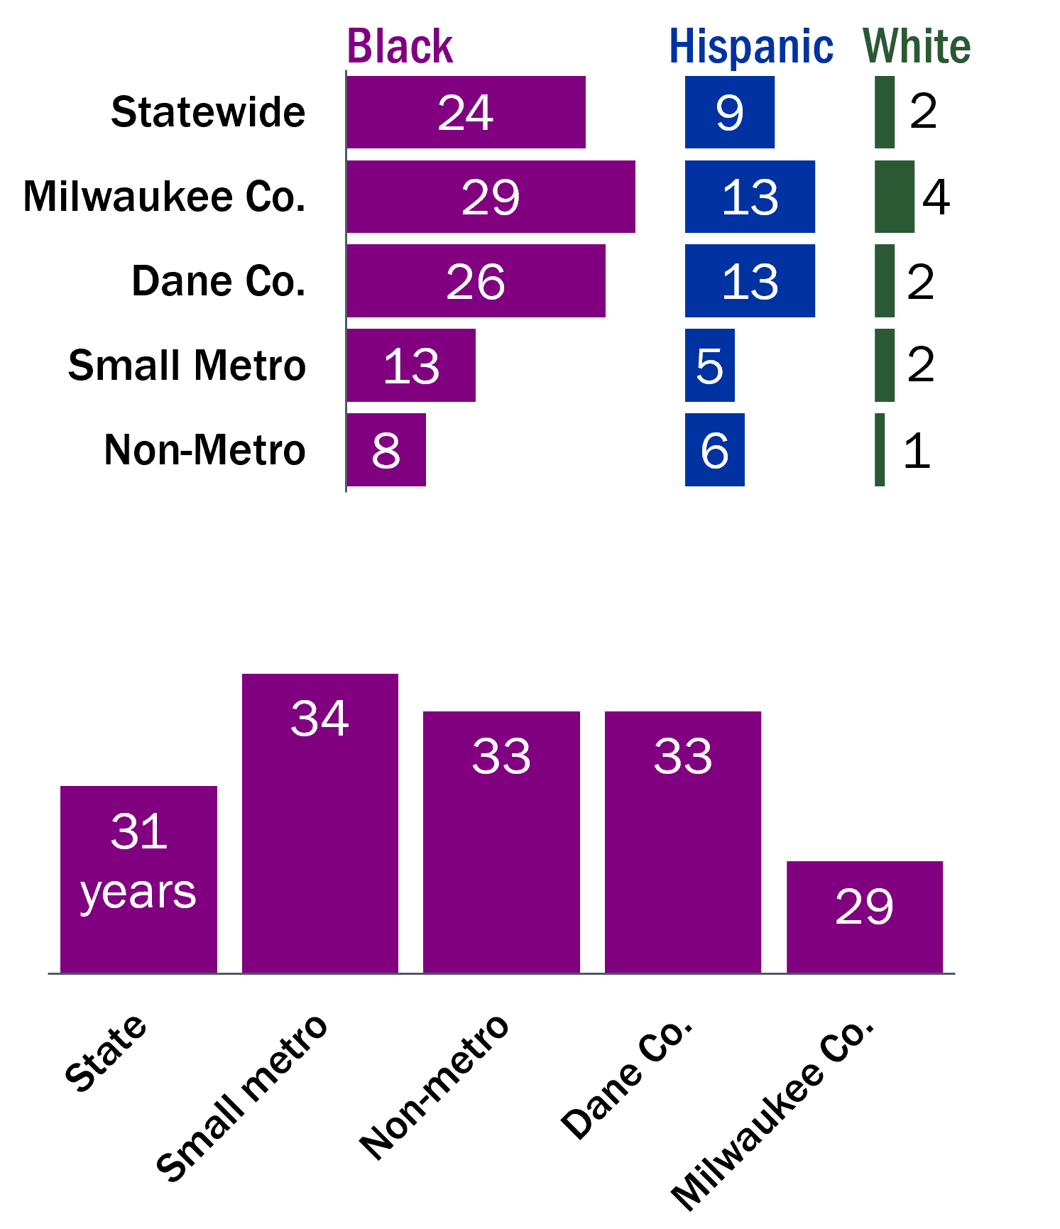
Compared to non-metropolitan counties, new diagnosis rates were 8 times higher in Milwaukee County, 3-fold higher in Dane County and 1.5 times higher in small metro counties. New HIV diagnoses by metropolitan grouping and selected demographics, Wisconsin, 2016–2020
Black and Hispanic
people in Milwaukee diagnosed at higher rate* than small and non-metro counties
Metro grouping | Number of diagnoses | Percent of diagnoses | Rate*
Statewide | 1,126 | 100% | 4
Milwaukee Co. | 586 | 52% | 12
Dane Co. | 115 | 10% | 4
Small metro | 315 | 28% | 2
Non-metro | 106 | 10% | 1
Milwaukee
higher HIV
rate than other Wisconsin counties
*Rate is per 100,000 people.
*Rate is per 100,000 people. Rates based on counts less than five have been suppressed.
Therefore, not all racial groups are included in this figure.
Non-metro
more new diagnoses
attributed to
injection drug use
Milwaukee
residents diagnosed younger than other areas
Notes:
New diagnoses
The HIV diagnosis rate is much higher in Milwaukee County than in other Wisconsin counties. HIV diagnosis rates remained steady for Dane County, small metro counties, and non-metro counties but there was a slight decline in Milwaukee County during 2011–2020.
Age at diagnosis
The median age at diagnosis during 2016–2020 was age 29 for Milwaukee County, but about age 33 in the other metro areas.
Race and ethnicity
HIV diagnosis rates among Black people and Hispanic people are more than twice as high in Milwaukee as in small and non-metro counties. White people have a lower rate in every metro grouping; even so, the rate in Milwaukee is four-fold higher than in small and non-metro counties.
Transmission mode
Each metro grouping had a similar proportion of diagnoses across reported risk groups, except for non-metro counties, which had fewer new diagnoses attributed to male-male sexual contact (MMSC) and more new diagnoses attributed to injection drug use.

Slide 69
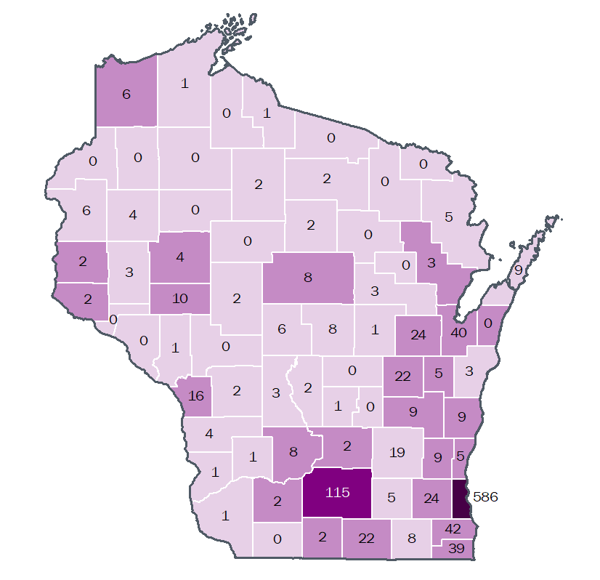
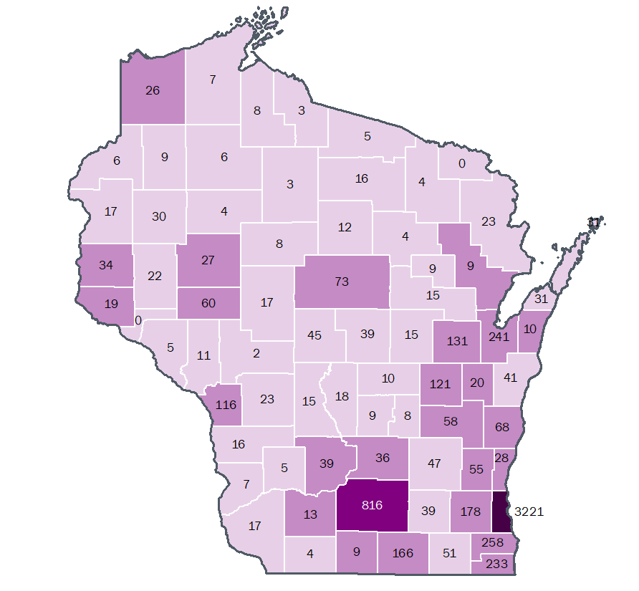
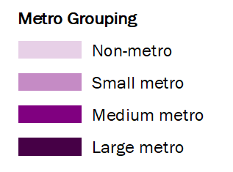
More people are diagnosed with HIV and living with HIV in metropolitan (metro) areas than non-metro areas.
New HIV diagnoses by metropolitan grouping, Wisconsin 2016–2020
People living with HIV by metropolitan grouping, Wisconsin, 2020
Notes:
Prevalence
HIV prevalence rates are highest in Milwaukee County and lowest in non-metro counties.

Slide 70
HIV Cluster Detection and Response in Wisconsin
Notes:
This section addresses HIV cluster detection and response in Wisconsin. The presence of an HIV cluster or outbreak is a sign of increased HIV transmission among a group of people in an area or in a sexual or social network. The Wisconsin Department of Health Services relies on analysis of surveillance data to detect HIV transmission events of potential concern, known as clusters and outbreaks. Clusters are smaller in case numbers and, in general, do not require a community-wide response. An outbreak is larger in case numbers and could require activating the Incident Command System (ICS) at the health department and involving external partners.
When an HIV cluster or outbreak is identified, public health agencies can engage a wide range of health care providers, advocates, and other community leaders who work together to design interventions that address the community’s specific needs. HIV responses seek to reach people in affected networks, including people with undiagnosed HIV, people with diagnosed HIV who might not be accessing HIV care or other services, and people who do not have HIV but would benefit from prevention services.

Slide 71
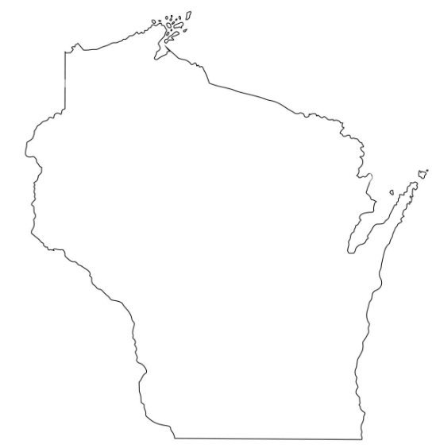
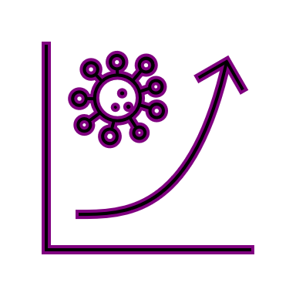
Cluster detection: HIV community partners observe and report increases in disease.
DIS or HIV PS at local health departments
Health care providers
Prevention outreach staff
Case managers / Linkage specialists
Information reported
Unusual patterns
HIV diagnoses
HIV / HCV co-infections
Surveillance Coordinator
Notes:
CDC and health departments can identify HIV clusters or outbreaks a few different ways. In some cases, public health agencies use multiple ways to understand HIV transmission in an area at the same time. One-way clusters or outbreaks can be identified is when frontline health workers (such as medical providers, public health staff, or others in the community) notice an increase in HIV diagnoses among a specific group of people in their community:
When disease intervention specialists (DIS) or HIV Partner Service providers (PS) at the local health departments notice an unexpected pattern (e.g., connections among social and/or sexual networks) or increased HIV diagnoses in their jurisdictional areas, they notify the HIV PS coordinator.
When health care providers at clinical settings observe an increase in HIV diagnoses, they directly report this information to the HIV Surveillance Unit staff.
When outreach staff at prevention grantee agencies identify a spike in HIV (and/or HIV/HCV coinfection) cases at their respective testing, syringe service program, or harm reduction sites, they notify the HIV prevention coordinator and the hepatitis prevention coordinator.
When case managers or linkage to care specialists at the care grantee agencies identify a spike in HIV (and/or coinfection) cases at their respective sites, they notify the HIV care services coordinator.
The roles listed above will report the notification from frontline staff to the HIV surveillance coordinator who will share them at the monthly cluster detection and response meeting. These observations of increases in HIV diagnoses or unusual patterns call for further investigation to determine if and how people are connected and the extent of other connections they may have in a community.

Slide 72
Prioritizing clusters is a dynamic and iterative process. Review of data and collaboration with partner agencies
Partner Services
Analysis
Review
Investigation
Plan
Response
Data to Care
Team
Peer Navigator
Program
1.
Surveillance analysis and report
2.
Review and division of exploratory tasks
3.
Seek more info from:
*Provider network
*Clients
*Partner services
*Medical chart
4.
Review and determine level of follow-up
5.
Direct /
re-direct
program activities
Linkage to care
specialist
Notes:
In the event an HIV cluster is detected, assessing the level of concern about a cluster is a dynamic process. Factors used for assessing concern can change as new information becomes available or new cases are added to a cluster. Most of the recent cluster alerts being reviewed are low priority or Level 1.
Step 1: The HIV surveillance coordinator conducts monthly analysis to detect unusual increases or patterns in case reports.
Step 2: All available data will be reviewed by the HIV surveillance coordinator, HIV PS coordinator, and HIV Data-to-Care team.
Step 3: If it is determined that more information is required, the HIV Program can investigate further and seek qualitative interviews with providers and case management staff, clients themselves, additional PS interview questions, and/or medical chart review.
Step 4: The surveillance team meets to plan by determining the level of follow-up appropriate and whether HIV Program response is appropriate.
Criteria to be considered when evaluating clusters of interest are the following:
Size of the cluster
Evidence of ongoing risk (for example, transmission communities of males who report MMSC, PWID)
Acute HIV or late diagnosis
Pregnancy status
Current Wisconsin residency
Care status and viral load suppression
HIV PS interview and enrollment status
Co-occurring conditions of HIV with HCV or STI
Step 5: In a potential fifth step, response efforts may include directing, or re-directing, routine program activities with the larger network of Partner Services providers, data-to-care teams, the Peer Navigation Program, and/or linkage to care specialists. Descriptions for each of these teams Is described below.
Partner Services (PS) assigns members of identified clusters to DIS/Public health nurses at the local health department who regularly conduct Partner Services within the jurisdiction of that cluster member’s residence. Partner Services process continues as usual. Previously interviewed clients will be considered for re-interview based on relevant data (for example, date of first interview, ability to locate). Clusters are prioritized based on several factors including viral load, HIV care history, transmission, known behavioral risk factors, co-occurring conditions, etc.
Data-to-Care (D2C) collaborates with the PS coordinator and assists with identifying the most up-to-date locating information for cases within a cluster. D2C also assists surveillance staff in conducting outreach to the client’s most recent health care provider as appropriate.
Peer Navigator Program is housed within Diverse and Resilient in Milwaukee. Peer navigators may be called upon to assist in case follow-up if the need is determined. Diverse and Resilient is also HIV Prevention-funded for HIV testing and could provide expanded HIV testing services in the event of a cluster.
Linkage to Care Specialists (LTCS) are integrated within Wisconsin Early Intervention Services (EIS) and is provided at 5 subrecipient agencies in southern Wisconsin. The goal of LTCS is to increase overall levels of client engagement in HIV medical care. Referrals are to be made for LTCS for identified cluster members. Staff may be called upon to assist in case follow-up, re-linkage to care, and linkage to additional services as needed.

Slide 73
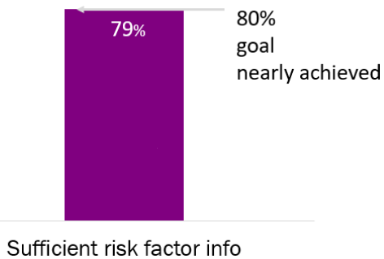
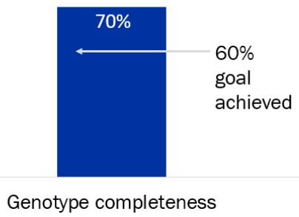
Routine HIV cluster detection activities
Time-space
analysis
Molecular cluster
detection
HCV-HIV
monitoring
Detects regional HIV cases
> normal values
Shared characteristics examined:
County specific
Sub-populations
Detects similarities in HIV virus sequence within a cluster of cases
Uses health care data of HIV drug resistance testing
* routine patient care
Detects transmission of co-occurring conditions of HCV and HIV within common social networks
HCV clusters examined as precursor to an HIV cluster or outbreak
Notes:
Another way clusters or outbreaks can be identified is when CDC and health departments analyze HIV surveillance data to identify areas where HIV diagnoses are increasing. Three methods used by the Wisconsin HIV Program are named below.
I. Time-space analysis
On a monthly basis, Wisconsin Health Services HIV Surveillance Unit analyzes the previous 12 month’s surveillance data using a CDC-provided statistical program. This tool alerts staff to regional increases in HIV cases that exceed normal county-specific values (referencing space, or geographical considerations), referencing a baseline of the previous 3 years of data (referencing time). In addition to county-level analysis, the analyses are also done by sub-populations of interest including persons who report injection drug use (IDU), males who report male-male sexual contact (MMSC), and males who report both MMSC and IDU. Clusters that appear to have related cases using the time-space analysis will be examined for available HIV nucleotide sequence data that could confirm the cases may be closely related by transmission (see “Molecular cluster detection” below for more details).
Our ability to detect and effectively respond to emergent HIV relies on the completeness and accuracy of surveillance data in order to detect patterns of accelerated disease occurrence. Our annual Standards Evaluation Report for year 2022 reported that all 2020 case records that met the surveillance case definition for HIV were complete with no missing required data by the end of December 2021. As shown here, 79% of new HIV cases reported to surveillance were accompanied by sufficient risk factor information to describe sub-populations of interest.
II. Molecular cluster detection
Health care providers routinely conduct drug resistance testing to find the best HIV medication for their patients. This process generates genetic sequences from the virus (not the person); these sequences are a small portion of the larger HIV genome. CDC and health departments can then analyze these sequences to identify groups, or clusters, of similar HIV sequences. Because HIV mutates quickly in each person’s body, similar genetic sequences in the virus indicate that rapid transmission is occurring.
Technical considerations regarding molecular cluster detection: Please note that similarity of HIV sequences does not imply direction of transmission or even direct transmission between two people. Molecular cluster information may not always be complete because DHS may lack drug resistance testing data for some PLWH in Wisconsin or people may not have had resistance tests completed. According to our annual Standards Evaluation Report for year 2022, 70.6% of HIV cases diagnosed in 2020 had an analyzable genotype sequence which could be utilized for molecular cluster detection, surpassing a 60% national standard.
III. HIV-HCV monitoring
People who inject drugs (PWID) are at high risk for Hepatitis C (HCV) through the sharing of needles and drug preparation equipment. HCV infections among PWID are examined as a potential precursor to an HIV cluster or outbreak. HIV Surveillance works with the Hepatitis Surveillance to conduct monthly monitoring of HIV/HCV co-occurring conditions using laboratory and case data from the Wisconsin Electronic Disease Surveillance System (WEDSS) and eHARS. They visualize data using Tableau dashboards.
Addressing public concerns about molecular surveillance
In 2018, CDC included molecular detection methods to enhance existing efforts of cluster detection. Any health data provided by health providers comes from routine patient care services and is strictly protected under HIPAA regulations (Health Insurance Portability and Accountability Act). Wisconsin works to ensure program partners are supported to assist in these statewide efforts. Please contact the Wisconsin HIV Surveillance Unit (DHSHIVSurveillance@dhs.wisconsin.gov) to discuss how additional cluster detection methods can support your work.

Slide 74
Co-Occurring Conditions
Sexually transmitted infections (STIs):
syphilis, gonorrhea, chlamydia
Notes:
There is substantial evidence that being diagnosed with a sexually transmitted infection (STI) increases the chances of getting or transmitting HIV (http://www.cdc.gov/std/hiv/stdfact-std-hiv.htm). People living with HIV and an STI are more likely to transmit HIV. This section describes trends in STI diagnosis among people living with HIV and is important for HIV and STI prevention efforts.
To determine the occurrence of an STI among people living with HIV (PLWH), people presumed alive and living with HIV in Wisconsin as of December 31, 2020, were identified in the Wisconsin HIV registry (eHARS) and matched against people diagnosed with syphilis (primary, secondary, early non-primary non secondary, and late, unknown duration), gonorrhea, or chlamydia during 2016–2020. Co-occurring condition was defined as an STI report within 30 days of, or any time after, the date of HIV diagnosis. The transmission category determined at the time of HIV diagnosis was used to describe transmission mode associated with STI and HIV diagnoses.

Slide 75
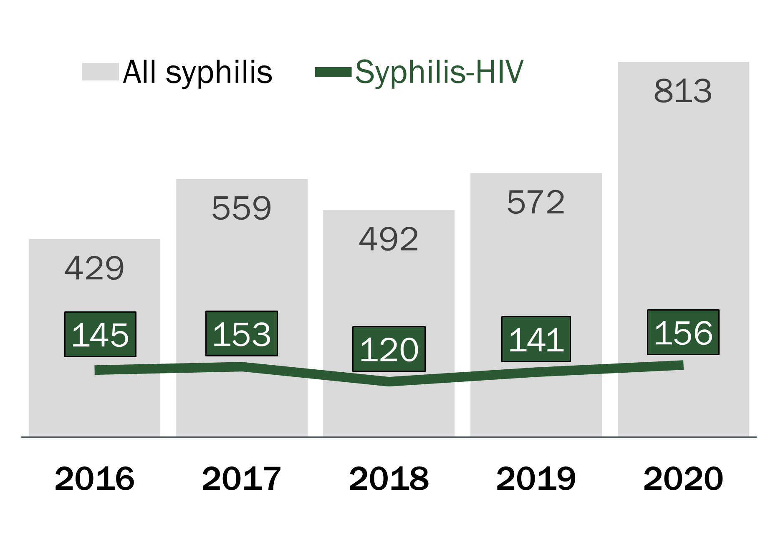
Syphilis-HIV co-occurring conditions were 25% of syphilis reports, primarily affecting people engaging in male-male sexual contact. People living with HIV and diagnosed with syphilis, Wisconsin, 2016–2020
Number of all syphilis (2,865) and syphilis-HIV (715) cases, 2016–2020.
Male-male sexual contact is the leading transmission mode for syphilis-HIV cases.
MMSC
MMSC/ IDU
Additional modes
Notes:
Syphilis
Syphilis is an STI that can cause long-term complications if not treated properly. Symptoms in adults are divided into stages. The stage of syphilis infection are primary, secondary, early non-primary non secondary, and late, unknown duration (http://www.cdc.gov/std/syphilis/stdfact-syphilis.htm).
Of syphilis, gonorrhea and chlamydia, the current epidemiology of syphilis overlaps most with that of HIV.
During 2016–2020, there were 2,865 syphilis cases reported to the Wisconsin Department of Health Services. Of these, 715 (25%) cases were syphilis-HIV co-occurring conditions.
Timing of diagnosis
Among the 2016–2020 cases of syphilis-HIV co-occurring conditions, 98 of 715 (14%) were concurrently diagnosed with syphilis and HIV, while the majority of cases (86%, n=617) had the second diagnosis more than 1 month later.
Transmission mode
There has been a notable increase in syphilis diagnoses among males who report male-male sexual contact (MMSC) in the United States, as well as in Wisconsin. For years 2016–2020, MMSC was the leading transmission mode reported for syphilis-HIV cases (87%), followed by people who report both MMSC and injection drug use (MMSC/IDU), and “additional modes” (8%). Additional transmission modes included the following modes: no reported or identified risk (5%), male-female sexual contact (2%), and injection drug use (1%).
Note: For syphilis-HIV co-occurring conditions, syphilis data included multiple syphilis types, including syphilis early non-primary non-secondary (31%, n=219); late, unknown duration syphilis (26%, n=185); secondary syphilis (17%, n=122); early-latent syphilis (16%, n=116); and primary syphilis (10%, n=73). There were no cases of congenital syphilis. The previous 2010–2014 Epi Profile reported primary, secondary, and early latent syphilis disease.

Slide 76
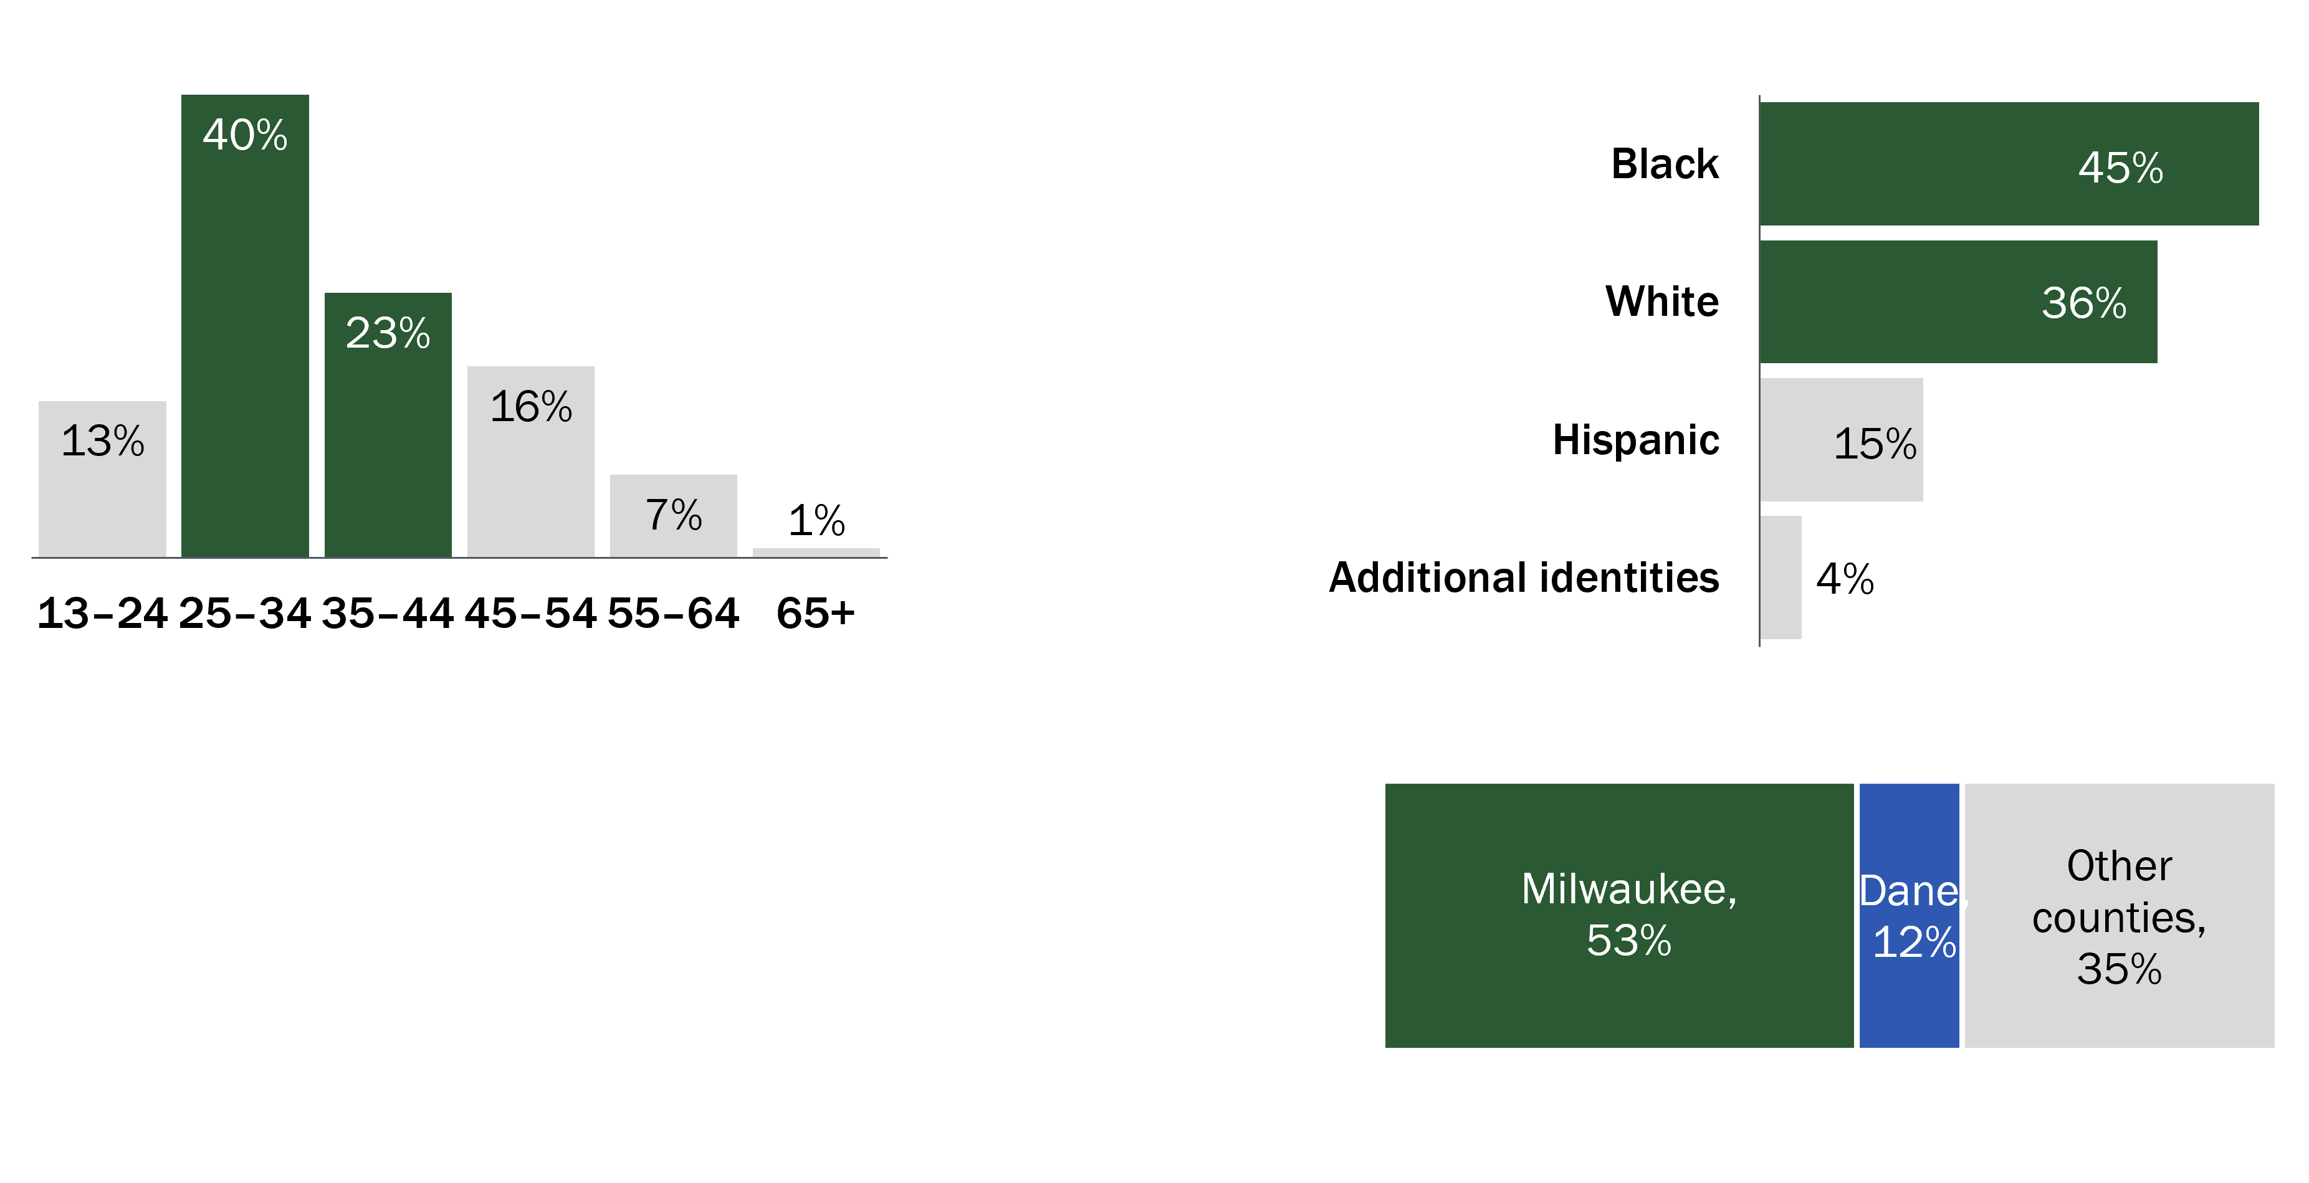
Syphilis-HIV co-occurring conditions affected mostly Black and White men of reproductive age living in Milwaukee County. People living with HIV diagnosed with syphilis by selected demographics, Wisconsin, 2016-2020
Ages
25–44
represent most
syphilis-HIV cases
Black and White
people represent 81% of syphilis-HIV cases
9 of 10
syphilis-HIV
cases are among males
Half
of WI syphilis-HIV cases reported by Milwaukee County
Notes:
Characteristics of people with syphilis and HIV co-occurring conditions
Among co-occurring conditions of syphilis and HIV in Wisconsin from 2016–2020, most cases occurred among people aged 25–34 years (40%) followed by people aged 35–44 years (23%). By gender, cisgender men accounted for 9 of 10 cases (92%) of people diagnosed with both syphilis and HIV, while cisgender women (2%) and transgender women (6%) accounted for less syphilis-HIV cases.
By race and ethnicity, Black people (45%) and White people (36%) represented 81% of syphilis-HIV co-occurring conditions. Hispanic people represented a smaller proportion (14%). The “additional identities” category included smaller categories of multiracial (2%), Asian (0.7%), Native American (0.4%), and Native Hawaiian/Pacific Islander people (0.4%).
By county region, more than half (53%) of syphilis-HIV co-occurring conditions were reported in Milwaukee County. Dane County was the next highest occurrence of syphilis-HIV cases at a lower 12%. The remaining third (35%) of syphilis-HIV cases were reported among other counties (single-digit percentages).

Slide 77
Gonorrhea-HIV co-occurring conditions were 3% of all GC infections primarily affecting people engaging in male-male sexual contact. People living with HIV and diagnosed with gonorrhea by selected demographics, Wisconsin, 2016–2020
Number of all gonorrhea (39,307) and gonorrhea-HIV (1,211) cases, 2016–2020.
Male-male sexual contact is the leading transmission mode for GC-HIV co-occurring conditions.
Notes:
Gonorrhea
Gonorrhea (GC) is an STI that can cause infections in the genitals, rectum, and throat and create an opportunity for HIV. It is a very common STI, especially among young people ages 15–24 years (www.cdc.gov/std/gonorrhea/stdfact-gonorrhea.htm).
During 2016–2020, there were 1,211 GC-HIV co-occurring conditions reported among Wisconsin residents, which represents 3% of all GC cases.
Timing of diagnosis
Among the 2016–2020 cases of GC-HIV co-occurring conditions, 70 of 1,211 (6%) were concurrently diagnosed with GC and HIV, whereas the majority of cases (n=1141, 94%) had the second diagnosis more than 1 month later.
Transmission Mode
Transmission notably occurred among males who report male-male sexual contact (MMSC), accounting for 81% of GC-HIV co-occurring conditions. Other transmission modes included male-female sexual contact (MFSC, 5%), males who report both male-male sexual contact and injection drug use (MMSC/IDU, 5%), as well as “additional modes”. These additional transmission modes included the following categories: no reported or identified risk (8%), and transfusion and perinatal transmission(<1%)

Slide 78
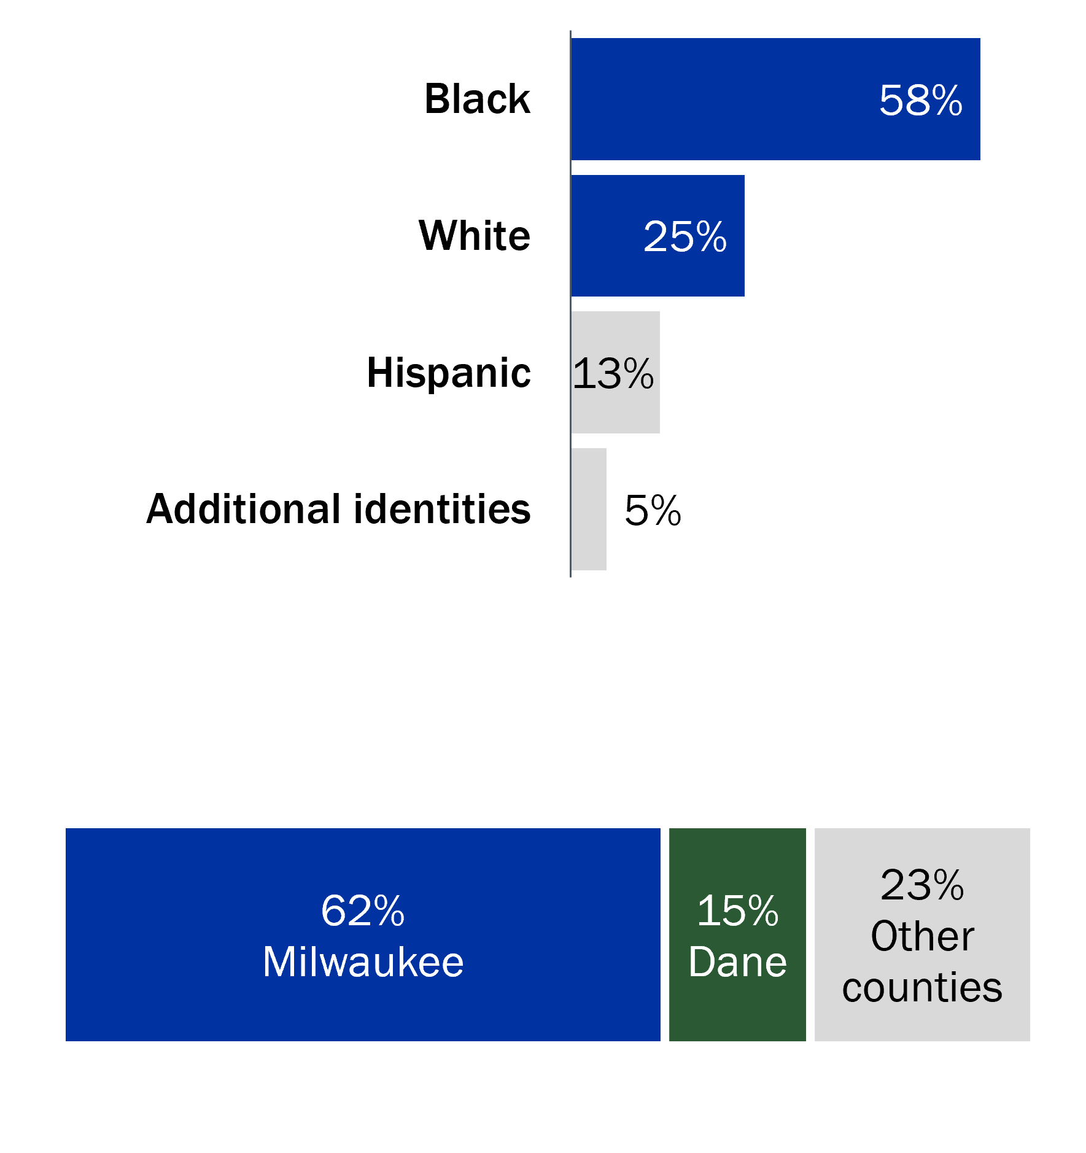
Gonorrhea-HIV co-occurring conditions affected Black men aged 25–34 in Milwaukee County. People living with HIV and diagnosed with gonorrhea by selected demographics, Wisconsin, 2016–2020
Black people
represent
>2 times
the number of GC-HIV cases compared to white people
Ages
25–34
Are nearly half
of GC-HIV cases
2 of 3
GC-HIV cases are reported in Milwaukee County
9 of 10
GC-HIV
cases are male
Notes:
Characteristics of people diagnosed with both gonorrhea and HIV
Among 1,211 gonorrhea-HIV co-occurring conditions in Wisconsin from 2016–2020, the majority were among young people, with nearly half of GC-HIV cases among the 25–34 age group (43%).
By race and ethnicity, Black people represented more than two-times the number of GC-HIV co-occurring conditions (58%) compared to White people (24%), with even smaller numbers for Hispanic (13%), and the “additional identities” categories (5%). Additional identities included the following: multiracial (3.6%), Asian (0.9%), Native American (0.5%), and Native Hawaiian/Pacific Islander (NHPI) (0.2%).
By gender, 92% of GC-HIV co-occurring conditions were reported among cisgender men, with the remaining cases among transgender women (6%) and cisgender women (2%).
By county region, nearly 2 of 3 GC-HIV co-occurring conditions (62%) were reported in Milwaukee county, with the last third of cases in Dane (15%) and all other counties (23%).

Slide 79
Chlamydia-HIV co-occurring conditions primarily affected males who reported male-male sexual contact. People living with HIV and diagnosed with chlamydia by selected demographics, Wisconsin, 2016–2020
Male-male sexual contact is the leading mode of transmission for chlamydia-HIV cases.
Number of all chlamydia (130,861) and chlamydia-HIV (1,155) cases, 2016–2020.
Notes:
Chlamydia
Chlamydia (CT) is the most commonly reported STI in Wisconsin and in the United States (https://www.cdc.gov/std/chlamydia/stdfact-chlamydia-detailed.htm).
During 2016–2020, there were 1,155 CT-HIV co-occurring conditions reported among Wisconsin residents.
The proportion of people reported with chlamydia and HIV in 2016–2020 ranged from 0.6%–1.0% (0.9% overall). This is an increased proportion compared to the previous 2010–2014 period, which ranged from 0.3%–0.5%.
Timing of diagnoses
Among the 2016–2020 cases of CT-HIV co-occurring conditions, 78 of 1,155 (7%) were concurrently diagnosed with CT and HIV, whereas the majority of cases (93%, n=1077) had the second diagnosis more than 1 month later.
Transmission mode
Male-male sexual contact (MMSC) was the leading transmission mode for CT-HIV co-occurring conditions (81%). The second and third modes were male-female sexual contact (MFSC, 6%) and both MMSC and injection drug use (MMSC/IDU, 4%). Additional transmission modes, which were reported in 9% of CT-HIV cases were the following: no reported or identified risk (7%), IDU only (1%), and perinatal transmission (0.5%).

Slide 80
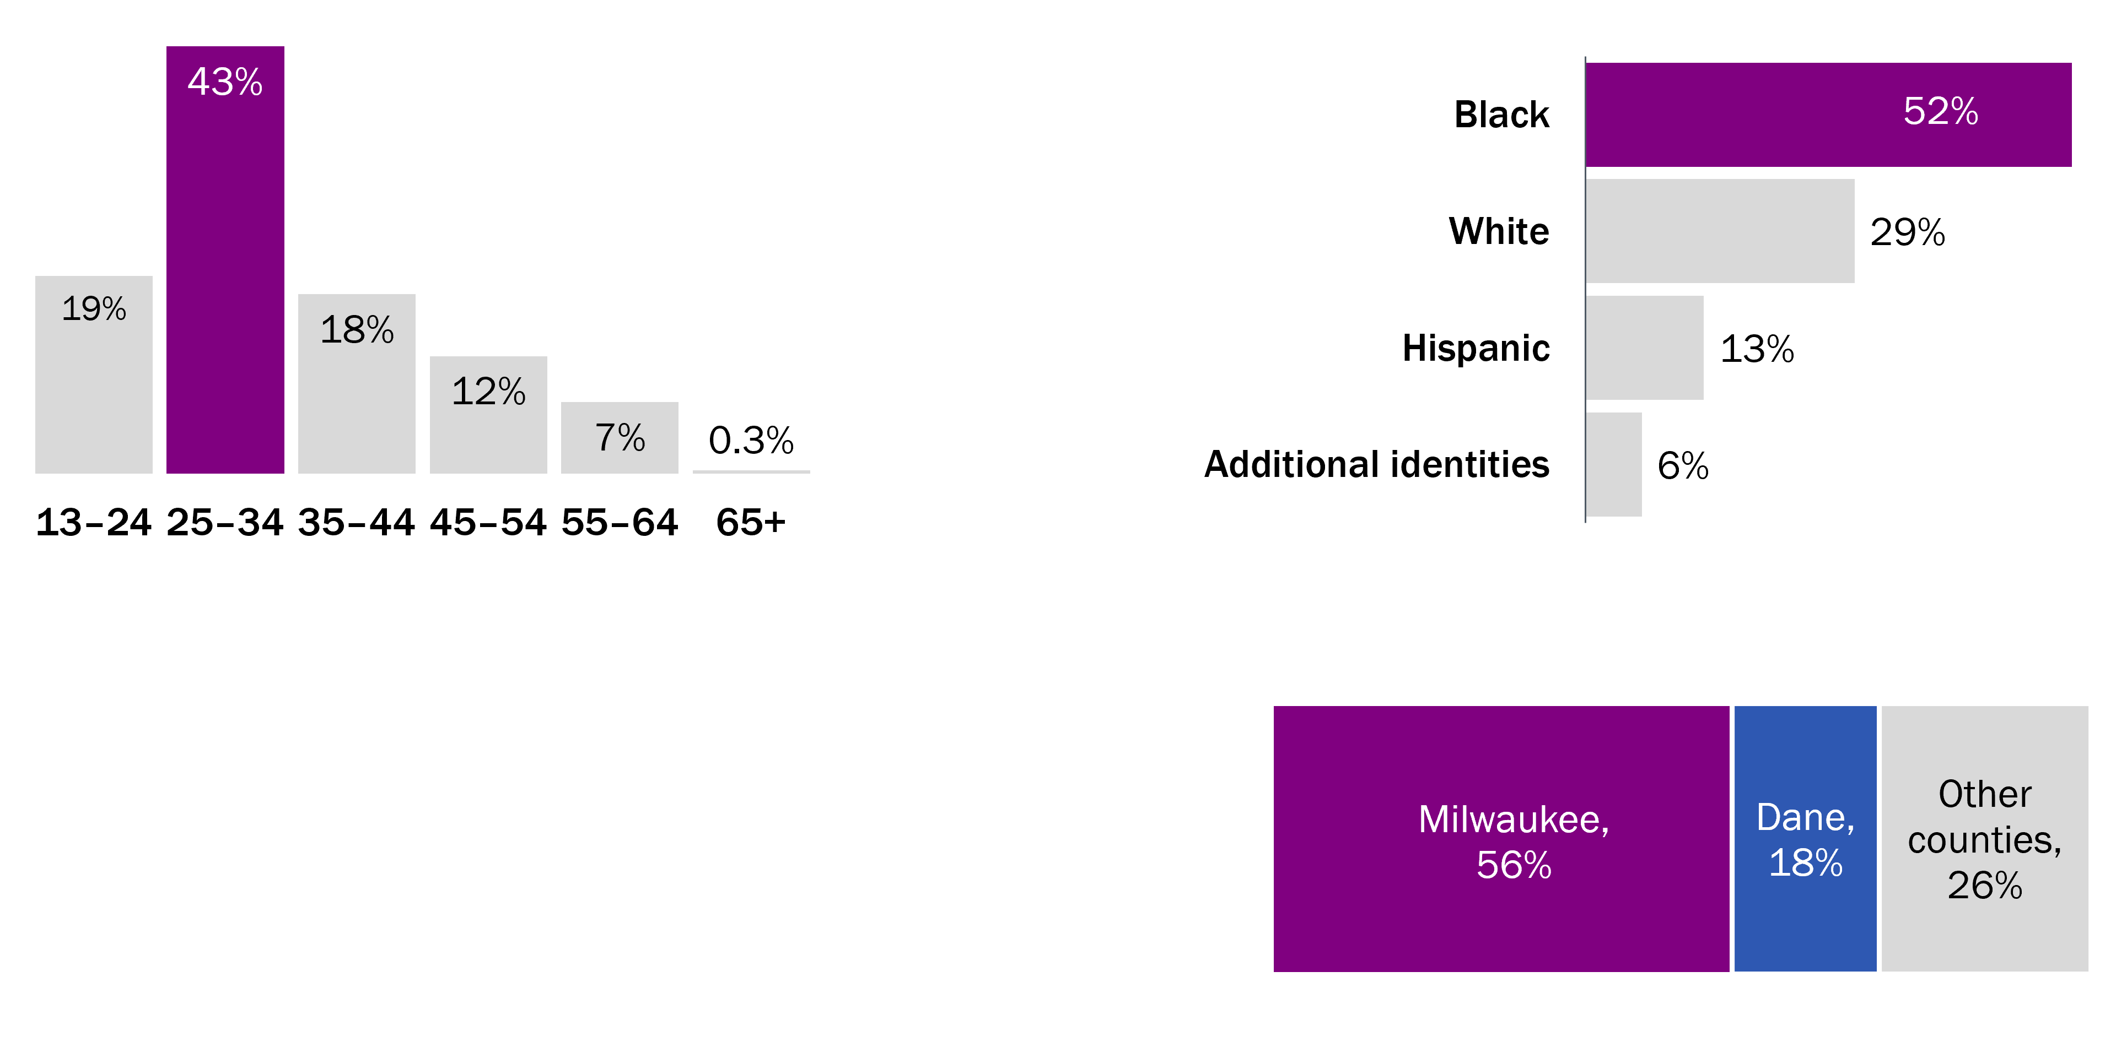
Chlamydia-HIV co-occurring conditions affected Black men ages 25–34 in Milwaukee County. People living with HIV and diagnosed with chlamydia by selected demographics, Wisconsin, 2016–2020
Ages
25–34
are nearly half of CT-HIV cases
Half
of CT-HIV cases are Black people
9 of 10
CT-HIV
cases are among
males
56%
of CT-HIV cases are reported by
Milwaukee County
Notes:
Characteristics of people diagnosed with both chlamydia and HIV
Chlamydia-HIV co-occurring conditions had a similar profile to gonorrhea-HIV co-occurring conditions. Among 1,155 chlamydia-HIV cases in Wisconsin from 2016–2020, most cases were among young people, with nearly half (43%) of CT-HIV cases among the 25–34 age group.
By race and ethnicity, Black people represented more than half (52%) of CT-HIV co-occurring conditions compared to White people (29%), with even smaller numbers for Hispanic (13%), and the “additional identities” categories (6%). Additional identities included the following: multiracial (3.5%), Asian (1.8%), Native American (0.5%), and Native Hawaiian/Pacific Islander (NHPI, 0.3%).
By gender, 89% of CT-HIV co-occurring conditions were reported among cisgender men, with the remaining cases among cisgender women (7%), transgender women (3.5%), and transgender men (0.1%).
By county, more than half (56%) of CT-HIV co-occurring conditions were reported in Milwaukee County, with 18% in Dane county and 26% in all other remaining counties.

Slide 81
While syphilis was more commonly diagnosed among people living with HIV compared to the general population, it increased from 2018–2020 for both populations. People living with HIV who received an STI diagnosis by selected demographics, Wisconsin, 2016–2020
People living with HIV:
Rate of STIs per 1,000 PLWH living in Wisconsin
General Population:
Rate of STIs per 100,000 people living in Wisconsin
Please note the scale difference in the rates of the graphs between 1,000 PLWH and 100,000 Wisconsin residents to account for the higher frequency of co-occurring sexually transmitted infection among PLWH.
Notes:
STI rates comparing PLWH vs. general population
In the graph above, at left, we report rates of sexually transmitted infections (STIs) per 1,000 people living with HIV (PLWH). In general, among PLWH from 2016 to 2020, rates of gonorrhea and chlamydia showed an increasing trend while rates of syphilis remained relatively constant. Further, STI rates among PLWH are two to three times higher than the prior 5 years rates of 2010–2014. In 2019, the rate of gonorrhea-HIV cases was the highest at 49 cases per 1,000 PLWH (compared to 15 per 1,000 in 2014), followed by chlamydia-HIV at 44 per 1,000 PLWH (compared to 16 per 1,000 in 2014), and finally syphilis-HIV at 23 per 1,000 PLWH (compared to 10 per 1,000 in 2014).
In the graph above, on the right, we display the general population rate of STIs per 100,000 people in Wisconsin. Please note the scale difference in the rates of the graphs between 1,000 PLWH and 100,000 Wisconsin residents to account for the higher frequency of co-occurring STIs among PLWH.
Between these graphs, we compare the rate of STIs among PLWH to rates of STIs among the general population in Wisconsin in 2020.
Syphilis diagnoses among PLWH were 210 times higher.
Gonorrhea diagnoses among PLWH were 30 times higher.
Chlamydia diagnoses among PLWH were 8 times higher.

Slide 82
Co-Occurring Conditions
Hepatitis C (HCV)
Notes:
In the United States, about 21% of people living with HIV (PLWH) are also diagnosed with HCV.¹ HCV progresses faster and causes more liver-related health programs among PLWH than those who do not have HIV. CDC recommends people get treated properly for both HIV and HCV. In Wisconsin, trends in HIV-HCV co-occurring conditions are closely monitored because it is known that monitoring co-occurring cases can help identify where communities might be more likely to get or transmit HIV and HCV through injection drug use (IDU) or male-male sexual contact. All people diagnosed with HCV and HIV are identified to assess transmission mode (for example, IDU) and if the person is in HIV care and virally suppressed. If not, efforts are made to link the person to care.
¹CDC. People Coinfected with HIV and Viral Hepatitis. Accessed July 18, 2022, at https://www.cdc.gov/hepatitis/populations/hiv.htm.

Slide 83
As of 2020, 8.3% of people living with HIV in Wisconsin had also been diagnosed with hepatitis C. People living with HIV and diagnosed with HCV by selected demographics, Wisconsin, 2020
IDU
most common mode of transmission among HCV-HIV
cases
75%
male among cases of HCV-HIV cases
41%
White among cases living with HCV-HIV
Older
HIV-HCV cases compared to all people living with HCV
Notes:
Characteristics of people with HCV and HIV co-occurring conditions
Among 573 individuals diagnosed with HCV and HIV that were still alive and residing in Wisconsin as of 2020, 62% were currently 55 years or older and the median age was 57 years (range 24–81 years); 75% were male; 41% were White, 38% were Black, and 18% were Hispanic. The most commonly reported county of current residence was Milwaukee County (47%), followed by Dane (10%), and Racine counties (6%). Over half of HCV-HIV cases were among people who reported injection drug use (IDU, 36%) at the time of HIV diagnosis as the only transmission mode or together with male-male sexual contact (MMSC & IDU, 15%). Other transmission modes included MMSC only (27%), male-female sexual contact (MFSC, 10%), and no reported or identified transmission mode (9%).
Timing of Diagnosis
In 1999, the U.S. Public Health Service and Infectious Disease Society of America recommended HCV screening for people living with HIV.¹ HCV diagnosis after HIV diagnosis may reflect HCV screening and does not necessarily indicate new HCV infection among PLWH. The majority (67%) of people with HCV and HIV were diagnosed with HIV at least one year or more before their HCV diagnosis. 11% received an HIV and HCV diagnosis concurrently (within 30 days) and 16% were diagnosed with HIV since their HCV diagnosis.

Slide 84
Co-Occurring Conditions
Tuberculosis (TB)
Notes:
Tuberculosis and HIV
People living with untreated HIV are more susceptible to opportunistic infections, like tuberculosis (TB). TB is a bacterial infection that usually affects the lungs. ¹ There are two conditions that are caused by these bacteria: TB disease and latent TB infection (LTBI). TB disease occurs when TB bacteria is actively multiplying in one’s body. Symptoms of TB disease include a long-lasting cough, pain in the chest, coughing up blood or sputum, and general fatigue. When someone with TB disease in the lungs or throat coughs, sneezes, or speaks, TB bacteria can be released into the air and expose people nearby. ² TB diagnosis has typically followed HIV diagnosis by one year or more.
LTBI occurs when TB bacteria is present in one’s body, but not actively replicating.² People with LTBI has no symptoms and do not spread TB bacteria to others; however, without treatment, they may develop TB disease.¹ In particular, if not treated, people living with HIV (PLWH) and LTBI are 30 to 100 times more likely to develop TB disease than people not living with HIV. ³ It is recommended that all persons diagnosed with HIV should be tested for TB and all persons with TB disease should be tested for HIV.
Globally, TB-HIV co-occurring conditions are common—of an estimated 10 million new cases of TB disease worldwide in 2019, 8.2% were among PLWH.⁴ In the United States, an estimated 7% (625) of those developing TB disease annually (~9500) occur among PLWH. ⁵ In this section, the term co-occurring conditions refers to individuals with TB disease and HIV.
LTBI and HIV
LTBI is not a reportable condition in Wisconsin, but data is collected when available.
1. CDC. Basic TB Facts. Accessed November 11, 2022, at http://www.cdc.gov/tb/topic/basics/default.htm.
2.CDC. LTBI and TB Disease. Accessed November 11, 2022, at https://www.cdc.gov/tb/topic/basics/tbinfectiondisease.htm.
3. Menzies D. 10 November, 2015. Treatment of latent tuberculosis infection in HIV-infected adults. Accessed November 11, 2022, at http://www.uptodate.com/contents/treatment-of-latent-tuberculosis-infection-in-hiv-infected-adults.
4. WHO. Global Tuberculosis Report 2020, 10 October, 2020. Accessed November 11, 2022, at https://www.who.int/publications/i/item/9789240013131.
5. Zanoni BC, Gandhi RT. 2014. Update on opportunistic infections in the era of effective antiretroviral therapy. Infect Dis Clin North Am. Sep;28 (3):501-18. Doi: 10.1016/j.idc.2014.05.002.

Slide 85
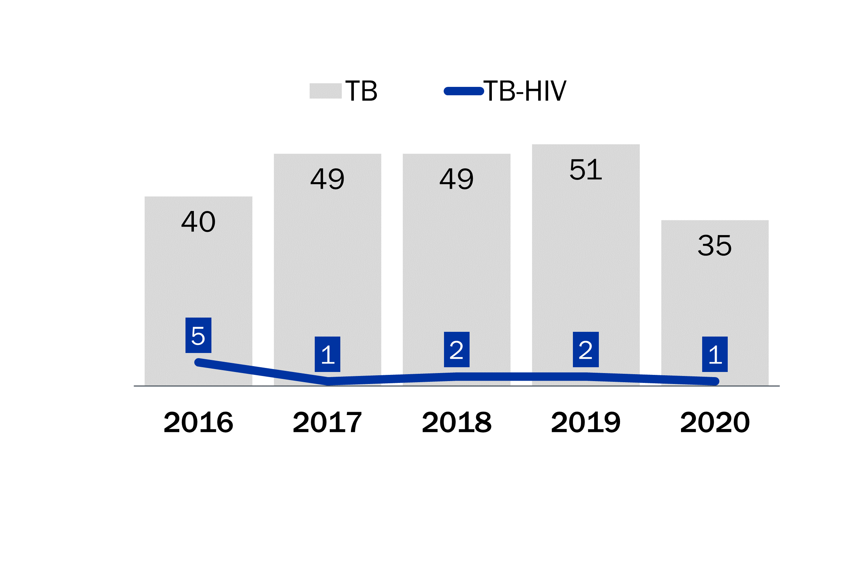
TB-HIV co-occurring conditions in Wisconsin (4.9%) was similar compared to the United States (4.6%). People living with HIV and diagnosed with tuberculosis by selected demographics, Wisconsin, 2016–2020
TB-HIV cases were a small proportion of all TB cases.
11 people with TB-HIV co-occurring conditions
5 people from Milwaukee County
County | TB-HIV | TB
Milwaukee | 5 | 111
Dane | 2 | 42
Rock | 1 | 3
Fond du Lac | 1 | 6
Waukesha | 1 | 22
Marathon | 1 | 11
 | 11 | 195
For more information on Tuberculosis go to https://www.dhs.wisconsin.gov/tb/index.htm
Notes:
Tuberculosis and HIV
In Wisconsin, the proportion of TB-HIV co-occurrence among all TB cases (4.9%) was similar to the national data for the years 2016-2020 (4.6%).¹
TB-HIV co-occurrence compared to TB-only diagnosis
In the 2016–2020 bar graph above, at left, Wisconsin reported 224 cases of TB (gray bars), with annual cases ranging from 35 to 51 cases. TB-HIV co-occurring conditions (dark blue line) represent a very small number of these infections from 2016–2020 (n=11), with the highest annual number of infections in 2016 (n=5).
Note: TB cases reported in Wisconsin during 2016–2020 (n=224) were matched against people presumed to be alive and living with HIV in Wisconsin as of the end of 2020 as identified in the Wisconsin HIV registry (eHARS). Individuals were matched based on date of birth, last name and first name.
Gender and county location of individuals with TB-HIV co-occurring conditions
The 11 persons with TB-HIV co-occurring conditions were all men. In the table above, at right, more than half of cases resided in Milwaukee County (5 of 11). The other 5 counties had 1 or 2 cases each (Dane, Rock, Fond du Lac, Waukesha, and Marathon).
Location of TB-HIV co-occurring conditions by Wisconsin regions from 2005–2021
Contextual data from 2005–2021 by Wisconsin regions show that half of TB-HIV cases resided in the SE region (51%), of which most (90%) were in the city of Milwaukee. Smaller proportions of cases were in the Southern and Northeastern regions (18% each), as well as Western (8%) and Northern regions (5%).
1. CDC. Reported Tuberculosis in the United States, 2021. Table 19 Tuberculosis Cases and Percentages Among Persons with HIV Test Results and with HIV Coinfection by Age Group: United States, 2011-2021. Updated July 8 2022. Accessed from https://www.cdc.gov/tb/statistics/reports/2021/table19.htm on December 2, 2022.

Slide 86
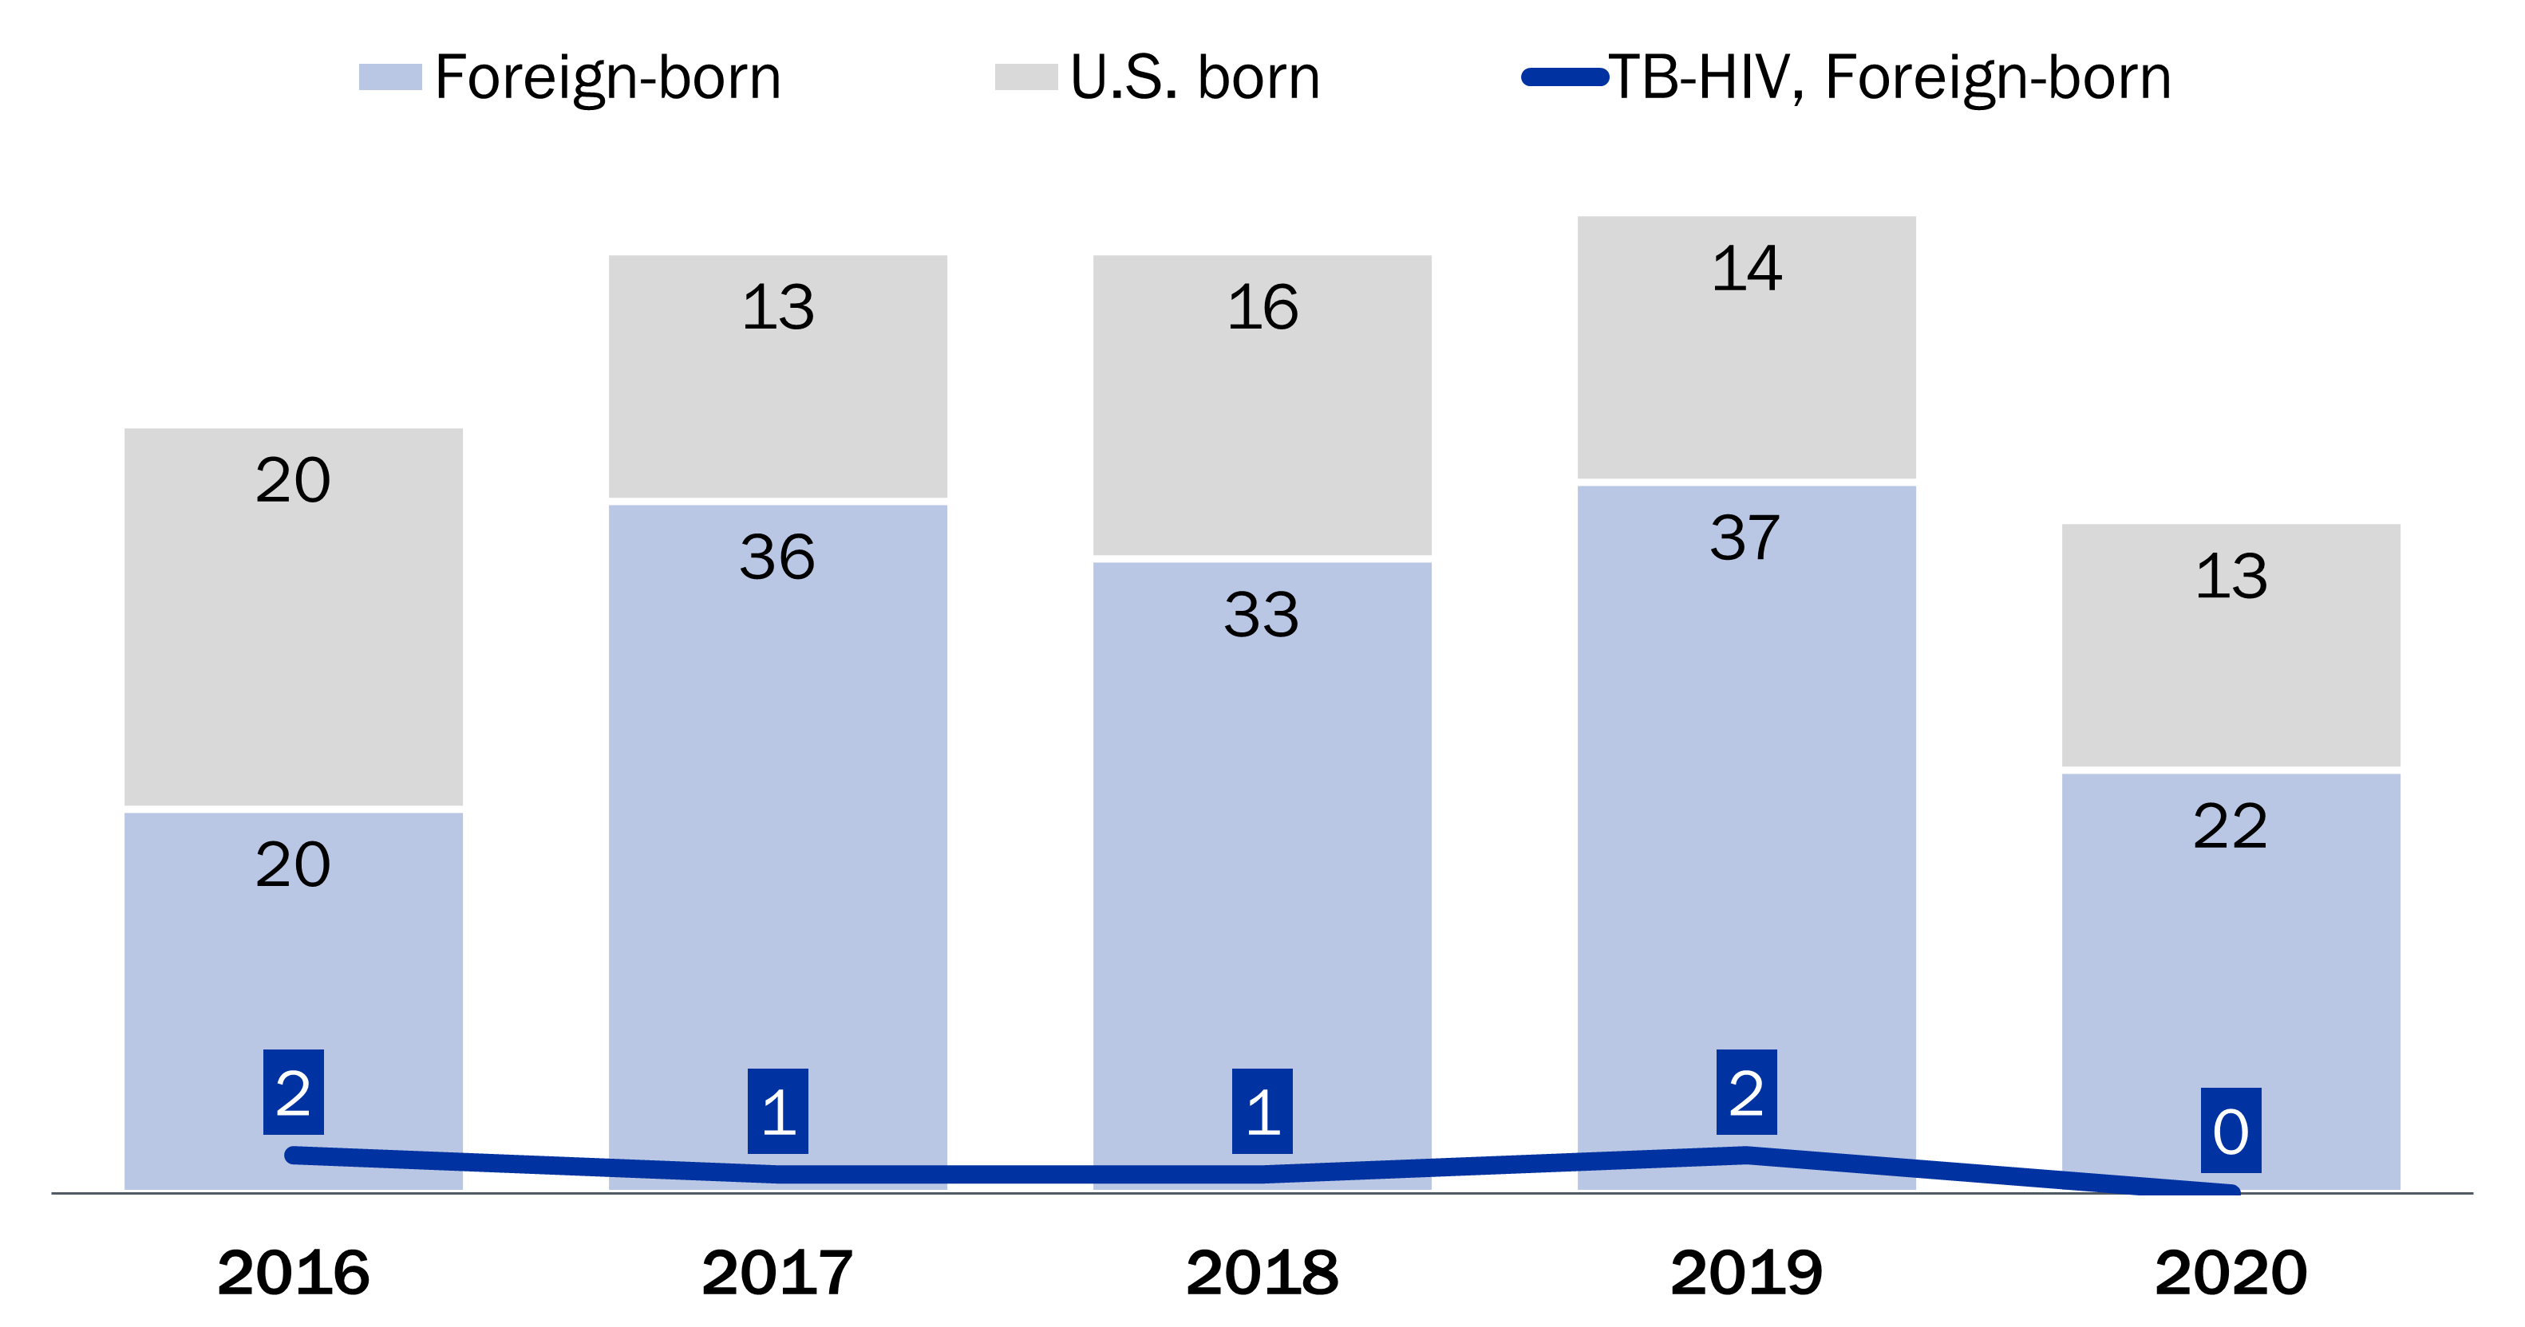
Foreign-born persons represent 66% of TB cases and half of the 11 TB-HIV cases. People living with HIV and a TB diagnosis by birth country, Wisconsin, 2016–2020
Notes:
TB cases by birthplace status: foreign-born
Among Wisconsin TB cases, foreign-born persons (light blue bar, at bottom) represented 66% (148 of 224, or 2 of every 3 TB cases) of the total people diagnosed with TB between 2016–2020, compared to TB cases who report a U.S. birthplace (grey bar, at top).
At the bottom of the graph (dark blue line), foreign-born persons with TB-HIV co-occurring conditions were six cases from 2016 to 2020. As a result, foreign-born persons represent just greater than half of the total TB-HIV cases from 2016 to 2020 (6 of 11 cases).
Characteristics of TB-HIV co-occurring conditions by foreign birthplace from 2005–2021
Contextual data from 2005–2021 shows that 39 cases of TB-HIV were reported with an average age of 39 years. Death occurred in 18% (n=7) of TB-HIV cases. Consistent with 2016–2020 data, the last 16 years of data showed that more than half (59%, n=23) were foreign-born, of which half (52%, n=12) were from Latin America (Predominantly Mexico, at 10 of 12 TB-HIV cases). A quarter were from Asia (26%, n=6) and included birthplaces of Burma, the Philippines, China, Laos, and India. A last quarter of foreign-born TB-HIV cases reported birthplaces from Africa (22%, n=5), including Liberia, Nigeria, Cameroon, and Kenya.
Note: reported birthplace does not indicate the location where TB infection was acquired (that is, imported or acquired in the United States).

Slide 87
People living with both HIV and TB are younger and have more racial/ethnic diversity than everyone living with TB. People living with HIV and a TB diagnosis by age and race, Wisconsin, 2016–2020
People with TB and HIV are younger than people with TB alone.
The race and ethnicity of the 11 TB-HIV cases compared to TB-only cases.
Notes:
Characteristics of people living with HIV and TB
The graph on the left, above, a comparison of age, shows that TB and HIV co-occurring conditions primarily affect younger age groups, including ages 15–24 (45%) and ages 25–44 (55%). This is a contrast to all TB cases, which occur in the older age groups ages 25 to 65 and older. This data is similar to previous data reported for Wisconsin from 2010 to 2014.
The graph on the right, above, provides the racial and ethnic demographics for the 11 cases of TB-HIV compared to all TB cases. By racial demographics, the 11 cases of TB-HIV were Black (n=3), Hispanic (n=3), Asian (n=2), White (n=2), and Native American (n=1). By comparison, the distribution of all TB cases in Wisconsin are predominantly Asian (43%) followed by Hispanic (20%), White (18%), Black (17%), and Native American (1%).
Note: All race categories of Black, Asian, White, and Native American are non-Hispanic.

Slide 88
Co-Occurring Conditions
Mental health and substance use
Notes:
This section addresses mental health, and alcohol and drug abuse disorders among people who are living with HIV or at increased risk for acquiring HIV.
Prevalence of mental health disorders among people living with HIV
Mental health disorders are more common among people living with HIV (PLWH) compared to the general population. In fact:¹
Three times as many PLWH experience depression during their lifetime compared to the general population.
PLWH who experience trauma have higher rates of mental health conditions than the general population.
Posttraumatic stress disorder (PTSD) is more than five time more likely in women living with HIV than in women in the general population.
There are several reasons why mental health issues are more common among PLWH, including: ^{1,2}
Experience with trauma and abuse.
Substance abuse.
Gender stereotypes.
Isolation due to loss of social support.
Loss of, or fear of losing, employment.
Financial instability.
Disclosure.
Management of, or effects of, HIV medication.
Entering or leaving the criminal justice system.
Dealing with loss of relationships or death.
Facing stigma and discrimination associated with HIV infection.
1. Health Resources and Services Administration. HRSA Care Action Newsletter. February 2018. Accessed June 27, 2023, at https://ryanwhite.hrsa.gov/sites/default/files/ryanwhite/resources/behavioral-health-2018.pdf.
2. AIDS.gov. Mental Health. Accessed June 27, 2023, at https://www.hiv.gov/hiv-basics/staying-in-hiv-care/other-related-health-issues/mental-health/.

Slide 89
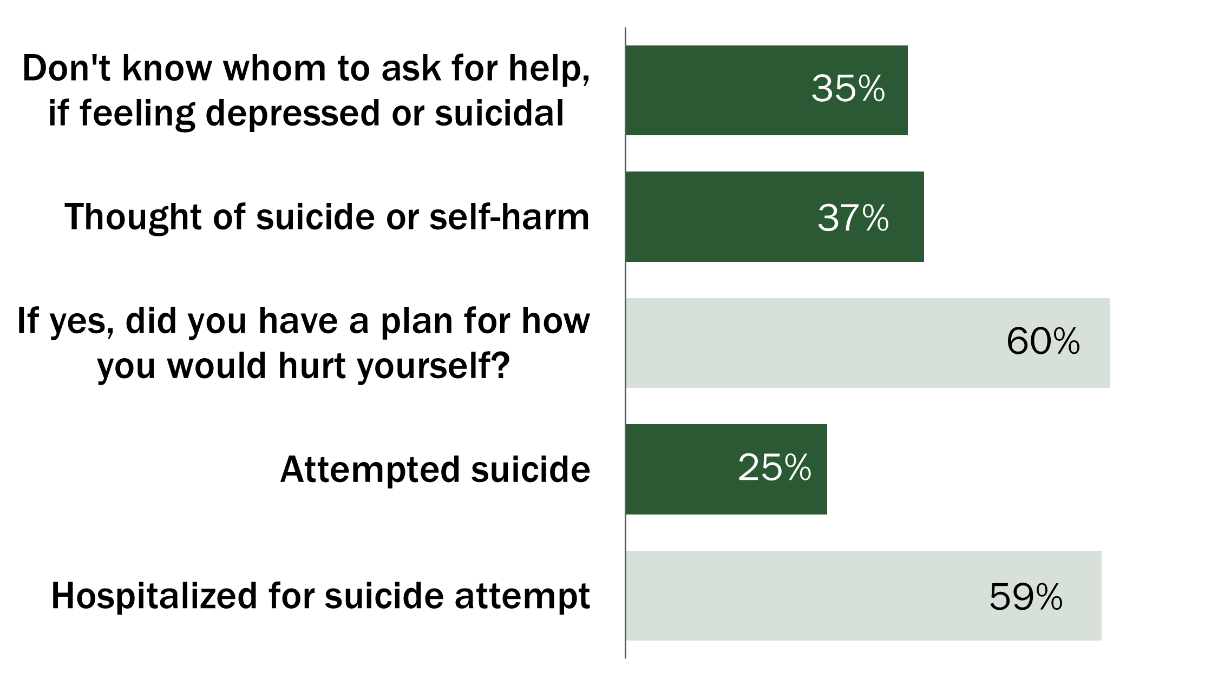
95% of HIV service providers said poor mental health is a barrier to health care. Clients reported prevalent anxiety, depression and self-harm behaviors. Questions about mental health, Wisconsin Needs Assessment, 2022
“Many clients have mental health issues and have experienced trauma.
Many are distrustful of institutions such as the medical system due to
feelings of powerlessness and negative past experiences.”
1 in 2
stress or anxiety at least every couple of days per week while…
… 1 in 3 report daily stress
1 in 2
felt down, depressed, or hopeless >2 weeks
Notes:
The 2022 HIV Prevention and Care integrated needs assessment
In early 2022, a statewide needs assessment survey was conducted to identify most needed services, service gaps, barriers to services, and potential areas for improvement. It was taken by 126 community members across the state who were living with HIV, impacted by HIV, or part of a priority population for HIV. These priority populations, as defined by the federal government, are gay, bisexual, and other men who have sex with men, in particular Black, Latino, and American Indian/Alaska Native men; Black women; transgender women; youth aged 13–24 years; and people who inject drugs.¹
Mental health disorders among PLWH
While data are not available on the prevalence of mental health disorders among all PLWH in Wisconsin, 70% of clients who completed a survey of barriers as part of the 2015 Linkage to Care pilot stated that they sometimes felt depressed, anxious, or had other mental health concerns (Wisconsin DHS, unpublished data). While these data may not represent all PLWH in Wisconsin, they do support the thought that the prevalence of mental health disorders is high among people with HIV, especially among those who are at risk of falling out of care.
From 2018 to 2022, between 16% and 18% of Ryan White clients utilized mental health services through Ryan White clinics (Wisconsin DHS, unpublished data). This is grossly under utilized when 95% of HIV service providers, who took the 2022 needs assessment, also commented on poor mental health as a barrier to seeking health care, citing past trauma, distrust of the medical system, and feelings of powerlessness or having a negative experience.
Mental health disorders as a risk factor for HIV
While mental health disorders alone is not a risk factor for HIV, it is associated with less consistent condom use or less perceived condom self-efficacy or injection drug use, which puts individuals at greater risk for HIV. For example:²
Depression: In one study, houseless males with depression who engaged in multiple female sexual partnerships, were less likely to use condoms.
Anxiety and childhood trauma: In another study, young men and transgender women who report having sex with men with anxiety or childhood trauma were more likely to have decreased PrEP adherence.
Sexual abuse: A study of gay and bisexual men found that those who had been abused were more likely to engage in condomless sex and injection drug use. In addition, women who have been abused may turn to drug use as a way of coping and may have trouble negotiating condom use.
Among people who took the 2022 needs assessment, stress and anxiety is highly prevalent. One in two (50%) people experiences stress at least every couple of days, and one in three (36%) experiences stress every day. More than half (53%) report feeling down, depressed, or hopeless for more than two weeks.
However, greater than one-third (35%) of people surveyed did not know of someone to ask for help if they were feeling depressed or having thoughts of self-harm. Thoughts of suicide or self-harm are relatively common (37%), among whom 60% had a plan for how they would hurt themselves and 25% attempted suicide. If they attempted suicide, 59% were hospitalized for a suicide attempt. These statistics indicate depression and self-harm as prevalent challenges.
Treatment for poor mental health is an important component of wellness for people living with or vulnerable to HIV. Among people who currently have a prescription for medication to help with feelings of stress, anxiety, or depression (37%), a further one-third (34%) of people have taken more than the prescribed dose to cope with these feelings.
For more information, please see the Wisconsin HIV Prevention & Care Integrated Needs Assessment 2022 Final Report.
1. The White House. 2021. National HIV/AIDS Strategy for the United States 2022–2025. Washington, DC.
2. Collins PY, Velloza J, Concepcion T, Oseso L, Chwastiak L, Kemp CG, Simoni J, Wagenaar BH. Intervening for HIV prevention and mental health: a review of global literature. J Int AIDS Soc. 2021 Jun;24 Suppl 2(Suppl 2):e25710.

Slide 90
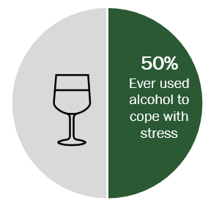
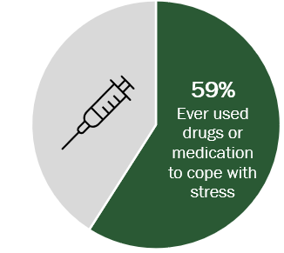
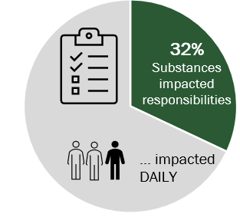
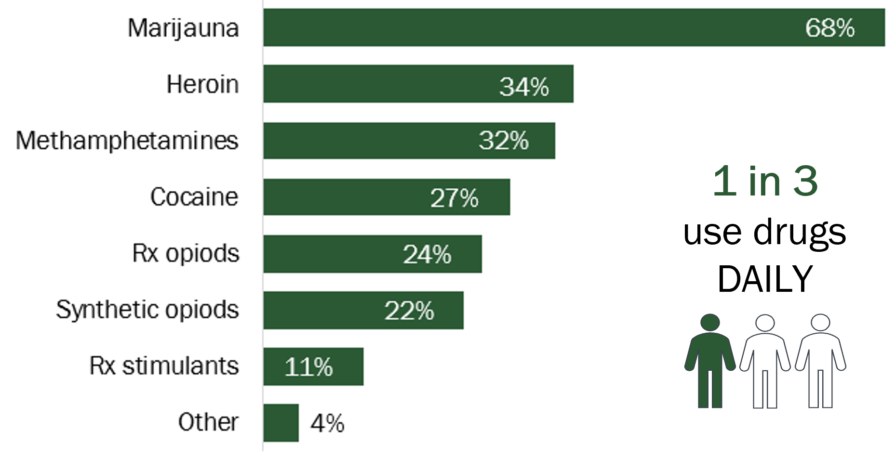
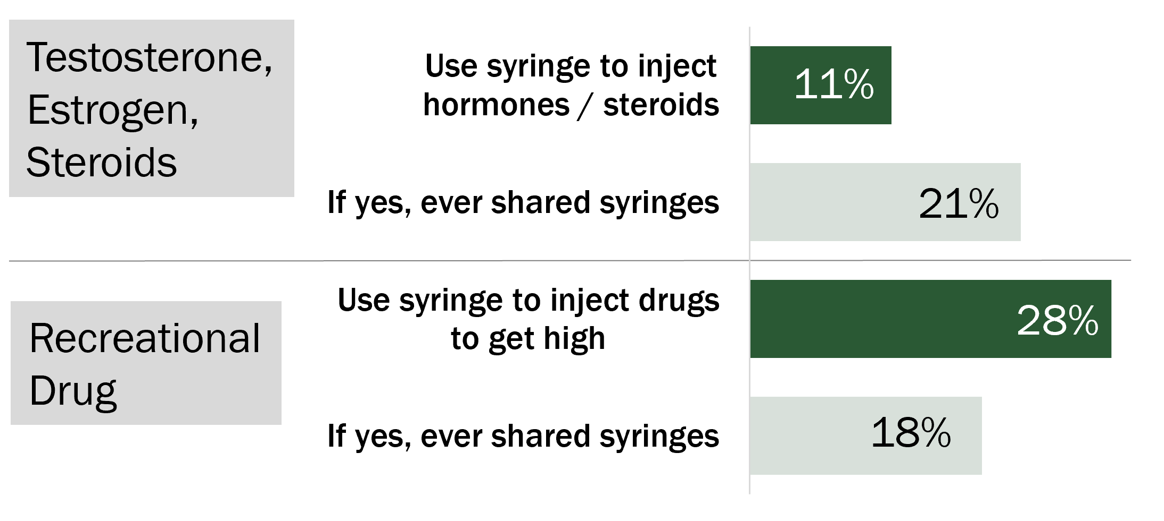
Use of substances to cope with frequent stress adversely impacted daily function and responsibilities. WI Needs Assessment, 2022
Drugs used the most to cope with stress / anxiety
Syringe use and sharing practices
Notes:
The 2022 HIV Prevention and Care integrated needs assessment
In early 2022, a statewide needs assessment survey was conducted to identify most needed services, service gaps, barriers to services, and potential areas for improvement. It was taken by 126 community members across the state who were living with HIV, impacted by HIV, or part of a priority population for HIV. These priority populations, as defined by the federal government, are gay, bisexual, and other men who have sex with men, in particular Black, Latino, and American Indian/Alaska Native men; Black women; transgender women; youth aged 13–24 years; and people who inject drugs.¹
Alcohol use
Half (50%) of the needs assessment respondents reported ever using alcohol to help cope with stress or feelings of anxiety. Nearly a fourth (23%) reported currently using alcohol to cope with stress. While the majority never use alcohol to cope with stress or anxiety (43%), about one-fifth (20%) of those surveyed use alcohol at least weekly to cope with stress, with 5% reporting daily alcohol use.
Drugs used the most to cope with stress or anxiety, non-prescribed
Use of drugs or medication without prescription was prevalent among survey respondents. More than half (59%) reported ever using drugs or medication (that was not prescribed to them) to help cope with stress or anxiety. Of these people, drugs that were used the most to cope with stress of anxiety were the following:
Marijuana (68%),
Heroin (34%),
Methamphetamines (32%),
Cocaine (27%),
Prescription opioids (24%)—codeine, oxycontin, morphine, Percocet, Vicodin
Synthetic opioids (22%)—fentanyl, methadone, meperidine, tramadol
Prescription stimulants (11%)—Adderall, Vyvanse
Other drugs (4%)—CBD (x3), benzies or mushrooms
Among those who reported ever using recreational drugs or medication (without prescription) to cope with stress and anxiety, just less than half (40%) used substances in the last seven days, and a third (35%) used these substances daily.
Syringe use and sharing practices
With regard to syringe use, 11% of respondents said they use syringes to inject hormones (that is, testosterone, estrogen) or steroids and 21% of them had ever shared syringes. When asked how frequently they shared syringes, most people “rarely or never” share (71%), while 29% “sometimes” share. When asked how frequently they use sterile syringes to inject hormones or steroids, 77% responded “every time,” 15% responded “most of the time,” and 7% responded “every other time or so.”
Further, 28% of respondents used syringes recreationally to “get high” with drugs or medications that were not prescribed to them and 18% of them had ever shared syringes. When asked how frequently they shared syringes, 43% “rarely or never” share, 43% “sometimes” share, and 14% share “most of the time.” When asked how frequently they use sterile syringes to inject drugs recreationally, 47% said “most of the time,” 44% said “every time,” a small 6% said “every other time or so,” and 3% said “sometimes.”
Substance use impact on daily activities or responsibilities
Use of alcohol or drugs as a coping mechanism for stress and anxiety can have adverse impact on completing daily activities or responsibilities. A third (32%) of respondents reported that substance use has ever impacted their ability to complete work, childcare, family or social responsibilities; if they reported yes to this question, a further one in three (35%) reported that drug or alcohol use impacted them daily.
1. The White House. 2021. National HIV/AIDS Strategy for the United States 2022–2025. Washington, DC.

Slide 91
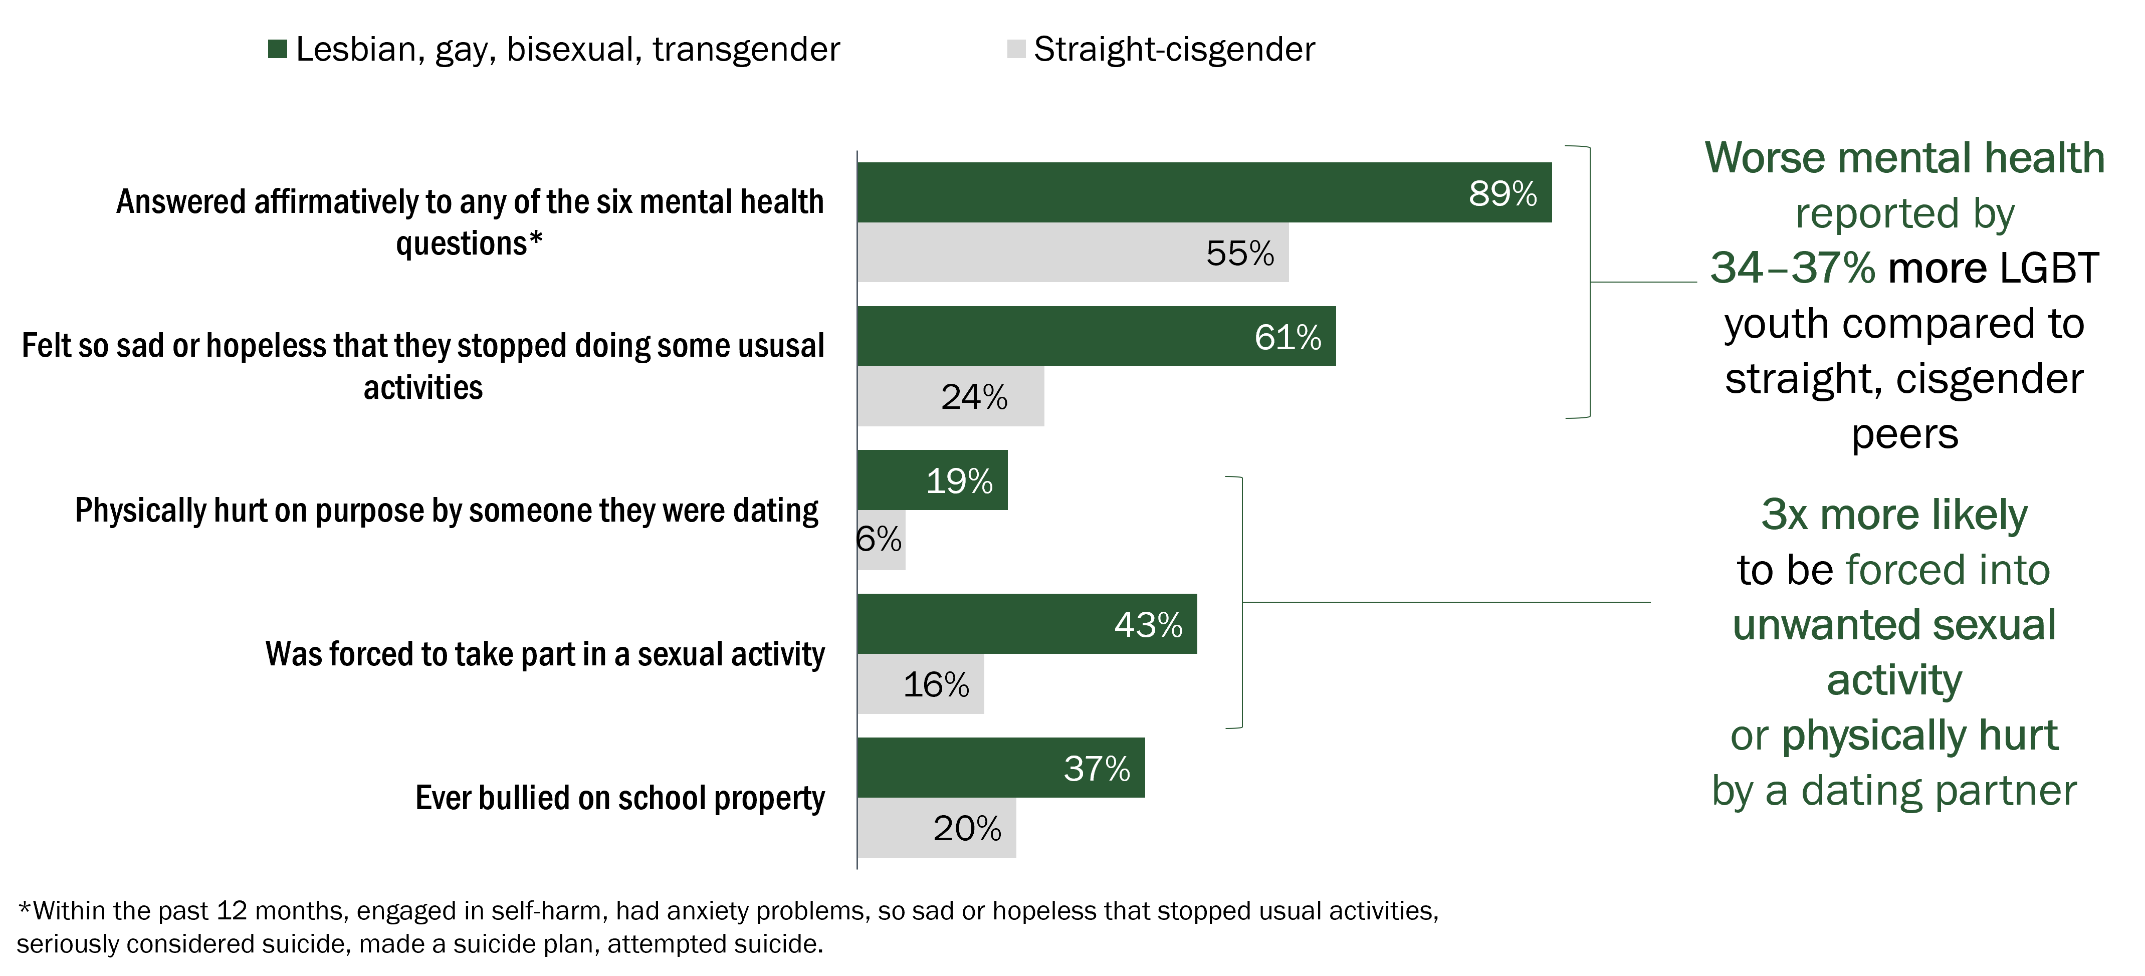
Wisconsin LGBT youth experience worse mental health than straight-cisgender youth. Youth Risk Behavior Surveillance System, 2019
Notes:
Youth mental health: LGBT youth
Although Wisconsin does not routinely collect surveillance data for mental health and substance abuse, data from the national Youth Risk Behavioral Surveillance Survey (YRBSS) may inform planning for HIV prevention interventions. The objective of YRBSS is to estimate the prevalence of behaviors that put youth at risk for unintentional injury or violence. The survey demographics include vulnerable youth communities, such as lesbian, gay, bisexual, and transgender (LGBT) youth, highlighting potential risk disparities that can impact HIV prevention success.
We display weighted data from the Youth Risk Behavior Survey (YRBS) 2019, as 2021 data was not yet available at the time this report was completed.
In Wisconsin, data from YRBS showed a higher prevalence of forced sex, depressed mental health, and lack of safety that could lead to increased risk of HIV among lesbian, gay, and bisexual youth (LGBT) compared to straight-cisgender (heterosexual) youth.¹ Risks assessed included reports of engaging in self-harm, anxiety problems, changes in behavior, and the ideation, planning and attempt of suicide.
In fact, with regard to intimacy and risk disparity, LGBT youth were nearly three-times more likely to be forced into unwanted sexual activity or physically hurt by a dating partner compared to similarly aged, straight-cisgender youth.
Additional information about the Wisconsin YRBSS can be viewed here at https://dpi.wi.gov/sspw/yrbs.
The 2019 Wisconsin YRBSS questionnaire can be viewed here at https://dpi.wi.gov/sites/default/files/imce/sspw/pdf/yrbs2019hsquestionnaire.pdf.
1. Department of Public Instruction. 2013 Youth Risk Behavior 2013 Sexual Identify Report. Accessed December 2, 2015, at http://dpi.wi.gov/sites/default/files/imce/sspw/pdf/yrbs13hssexualid.pdf.

Slide 92
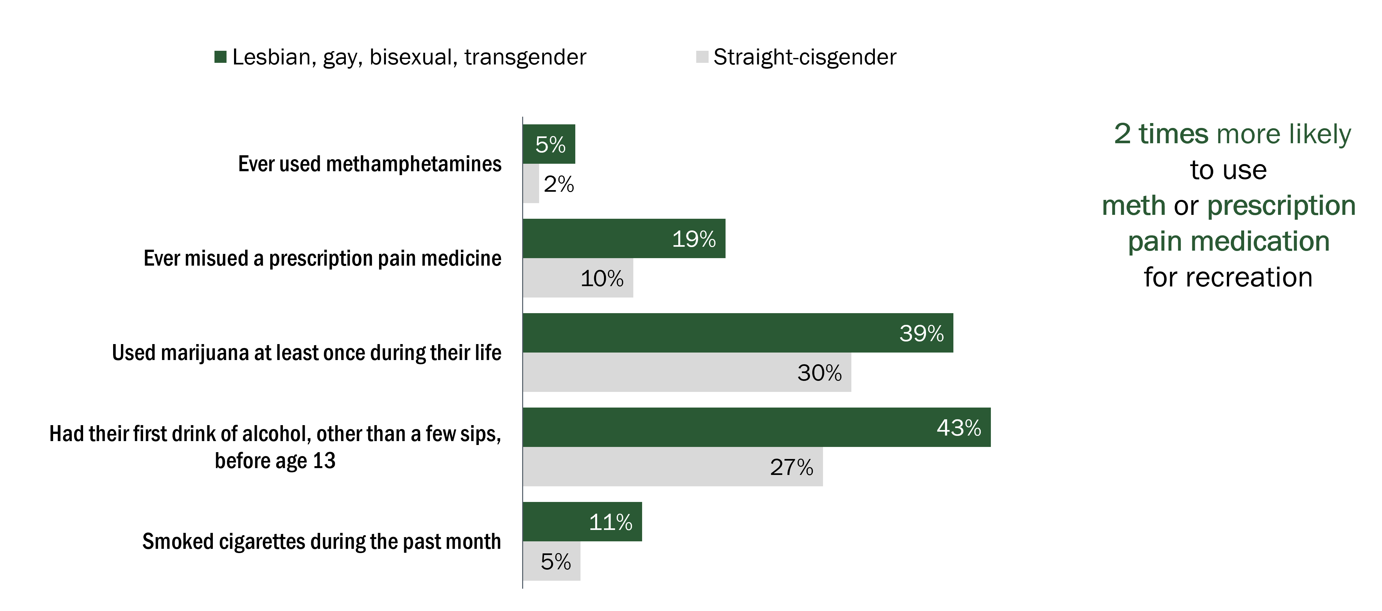
Wisconsin LGBT youth have greater substance use than straight-cisgender youth. Youth Risk Behavior Surveillance System, 2019
Notes:
Wisconsin youth LGBT and substance use
Similar to mental health disorders, data from the YRBS also show a higher prevalence of substance use among lesbian, gay and bisexual youth compared to heterosexual youth.¹ In fact, LGBT youth are two times more likely to use methamphetamines or prescription pain medicines for recreational use than their similarly-aged straight-cisgender peers.
Prevalence of substance use among people living with HIV
Nationally, people living with HIV are more likely to experience substance use than the general population:²
Alcohol: The lifetime prevalence of alcohol use disorders among PLWH is 2–3 times that of the general population.
Tobacco: The smoking rate among PLWH is 2–3 times that of the general population.³
Injection drugs: While the rate of ongoing injection drug use among PLWH is unknown, the estimated number of new diagnoses attributed to injection drug use has remained stabled. At the end of 2020, about 9% of all PLWH in Wisconsin were people who inject drugs.
In Wisconsin, the prevalence of substance use among PLWH is unknown. However, 22% of PLWH who completed a survey of barriers as part of a linkage and retention intervention stated that they were concerned about their use of drugs or alcohol (Wisconsin DHS, unpublished data). As with mental health, this number may overestimate the prevalence of substance use disorders due to the specific population surveyed, but is indicative of the need for treatment services and highlights the impact that substance use can have on adherence to care. According to the U.S. Department of Health and Human Services, ongoing substance use among PLWH can interfere with adherence to antiretroviral therapy, and can lead to other potential barriers to adherence, such as unstable housing, loss of relationships and social support, loss of employment, and involvement with the criminal justice system. In Wisconsin, PLWH whose HIV transmission was attributed to injection drug use were less likely than those with male-male or high-risk heterosexual contact to be in care, retained in care, or virally suppressed.⁴
Substance use as a risk factor for HIV
Injection drug use, through the sharing of needles and drug use or preparation equipment, is a direct route of HIV transmission, accounting for about 10% of annual new HIV diagnoses in the United States and 7% of new diagnoses during 2010–2014 in Wisconsin. However, use or abuse of alcohol, tobacco and other non-injection drugs is also associated with increased risk of HIV because these substances may reduce inhibitions and lead to more unsafe sexual behaviors.⁵ For example:
Males who have sex with males (MSM) and who use methamphetamine (“meth”) report using condoms less often, have more sex partners, and are more likely to inject meth (which adds an additional HIV risk) rather than smoke or snort it.⁶
Individuals who use crack cocaine report more sexual partners, infrequent condom use, using more than one substance, and being less responsive to HIV prevention.
MSM may use alcohol or drugs as a result of homophobia, discrimination or violence. MSM are more likely than the general population to use alcohol or drugs, continue heavy drinking later in life, and have higher rates of substance abuse. ⁵
People who have experienced abuse are more likely to overuse drugs and alcohol and practice unsafe sexual behaviors, such as sex without a condom, or trading sex for drugs, money, food, or shelter. ^{5, 6}
1. Department of Public Instruction. 2013 Youth Risk Behavior 2013 Sexual Identify Report. Accessed December 2, 2015, at http://dpi.wi.gov/sites/default/files/imce/sspw/pdf/yrbs13hssexualid.pdf.
2. Justice A, Sullivan L, Fiellin D; Veterans Aging Cohort Study Project Team. HIV/AIDS, comorbidity, and alcohol: can we make a difference? Alcohol Res Health. 2010;33(3):258-66.
3. Mdodo R, Frazier EL, Dube SR, Mattson CL, Sutton MY, Brooks JT, et al. Cigarette smoking prevalence among adults with HIV compared with the general adult population in the United States: cross-sectional surveys. Ann Intern Med. 2015;162(5):335–44.
4. Wisconsin AIDS/HIV Program. Wisconsin 2014 HIV Care Continuum: Statewide and Select Population Groups. Wisconsin AIDS/HIV Program Notes. November 2015. Available at: https://www.dhs.wisconsin.gov/publications/p0/p00792-14-february.pdf.
5. Centers for Disease Control and Prevention. HIV and Substance Use. Accessed June 27, 2023, at https://www.cdc.gov/hiv/basics/hiv-transmission/substance-use.html.
6. HIV.gov. Substance Use and HIV Risk. Accessed June 27, 2023, at https://www.hiv.gov/hiv-basics/hiv-prevention/reducing-risk-from-alcohol-and-drug-use/substance-use-and-hiv-risk/.

Slide 93
Social Determinants of Health and HIV
Notes:
HIV continues to disproportionately affect various populations in Wisconsin. Race or ethnicity alone does not make someone more or less likely to acquire HIV. Many social and economic factors contribute to disparities and may be partly explained through a better understanding of the social determinants that affect the health of populations. Social determinants of health (SDOH) are the conditions in the environments where people are born, live, learn, work, play, worship, and age that affect a wide range of health, functioning, and quality-of-life outcomes and risks.¹ Examples of SDOH include racism, poverty, limited access to health care, lack of education, stigma, homelessness, and oppression.
¹Healthy People 2030, U.S. Department of Health and Human Services, Office of Disease Prevention and Health Promotion. Retrieved August 2020, from https://health.gov/healthypeople/objectives-and-data/social-determinants-health.

Slide 94
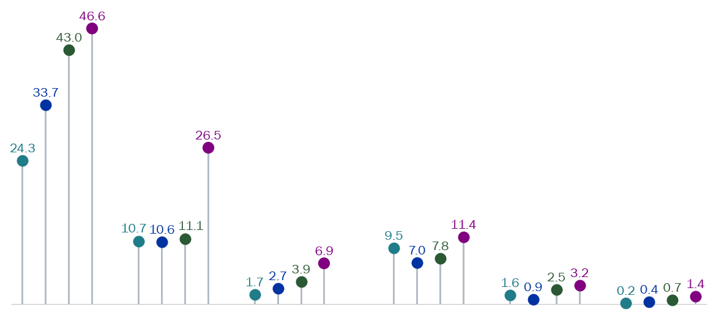
The rate of HIV diagnosis increased as the percentage of residents living below the federal poverty level increased. HIV diagnosis rate by federal poverty level at census tract level, race, and sex, Wisconsin, 2017–2020
Below federal poverty level (%)
<6
6.00–10.99
11.00–17.99
≥18
All new diagnoses,
2017–2020
Black Hispanic White
Male
Black Hispanic White
Female
Notes:
Federal poverty status
Sex at birth
The highest diagnosis rate for males (20.2) and for females (4.6) were among those who lived in census tracts where 18% or more of the residents lived below the federal poverty level. For both sexes, the rate of HIV diagnoses increased as the percentages of residents living below the federal poverty level increased.
Age at diagnosis
Persons who lived in census tracts where 18% or more of the residents lived below the federal poverty level accounted for the highest HIV diagnosis rates in all age groups.
Race and ethnicity
Persons who lived in census tracts where 18% or more of the residents lived below the federal poverty level accounted for the highest HIV diagnosis rates in Black, Hispanic, and White people. Additional racial and ethnic groups had too-small case counts.
Among males residing in census tracts with the lowest poverty, HIV diagnosis rates among Black (24.3) and Hispanic people (10.7) were 14.3 times and 6.3 times, respectively, as high as the rate for White people (1.7). Among males residing in census tracts with the highest poverty, Blacks (46.6) and Hispanics (26.5) were 6.8 times and 3.8 times, respectively, as high as the rate for White people (6.9). The Black-White race and Hispanic-White race absolute disparities (the difference between a group with the lowest rate and the group with the highest rate) were wider (or more disparate) in the highest poverty areas than in lowest poverty areas.

Slide 95
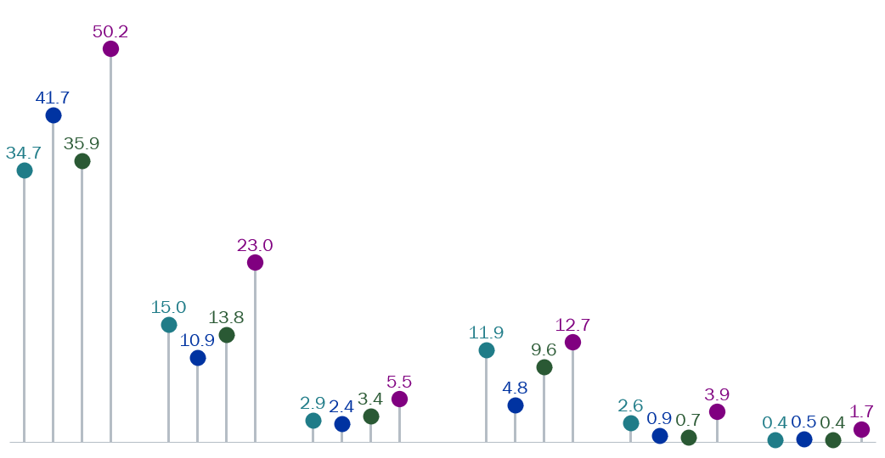
The rate of HIV diagnosis increased as the percentage of residents without a high school diploma increased. HIV diagnosis rate by education level at census tract level, race, and sex, Wisconsin, 2017–2020
Less than a high school diploma (%)
<6
6.00–10.99
11.00–17.99
≥18
All new diagnoses,
2017–2020
Black Hispanic White
Male
Black Hispanic White
Female
Notes:
Education level
Sex at birth
The highest diagnosis rate for males (22.4) and for females (5.5) were among those who lived in census tracts where 18% or more of the residents had less than a high school diploma. For both sexes, the rate of HIV diagnoses increased as the percentages of residents living below the federal poverty level increased.
Age at diagnosis
Persons who lived in census tracts where 18% or more of the residents had less than a high school diploma accounted for the highest HIV diagnosis rates in all age groups.
Race and ethnicity
Persons who lived in census tracts where 18% or more of the residents had less than a high school diploma accounted for the highest HIV diagnosis rates in Black, Hispanic, and White people. Additional racial and ethnic groups had too-small case counts.
Among males residing in census tracts with the highest education, HIV diagnosis rates among Black (34.7) and Hispanic people (15.0) were 12.0 times and 5.2 times, respectively, as high as the rate for White people (2.9). Among males residing in census tracts with the lowest education, Black (50.2) and Hispanic people (23.0) were 9.1 times and 4.2 times, respectively, as high as the rate for White people (5.5). The Black-White race and Hispanic-White race absolute disparities (the difference between a group with the lowest rate and the group with the highest rate) were wider (or more disparate) in the lowest education areas than in highest education areas.

Slide 96
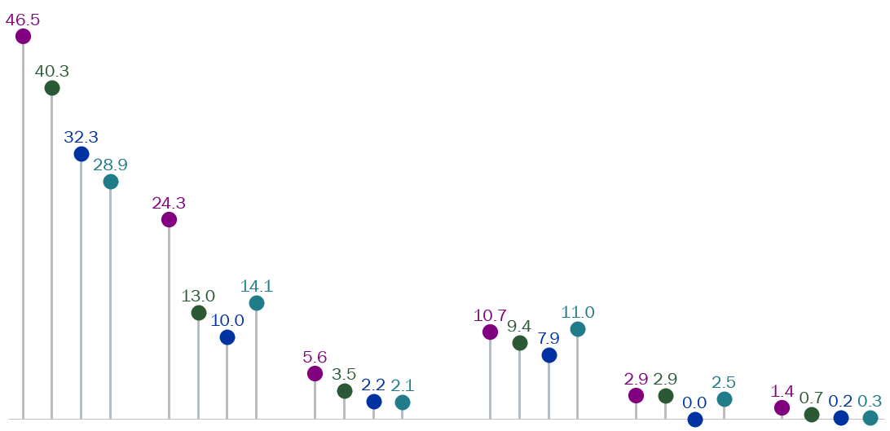
The rate of HIV diagnosis decreased as the median household income increased. HIV diagnosis rate by median household income at census tract level, race, and sex, Wisconsin, 2017–2020
Median household income (U.S. $)
<42,000
42,000–56,999
57,000–77,999
≥78,000
All new diagnoses,
2017–2020
Black Hispanic White
Male
Black Hispanic White
Female
Notes:
Median household income
Sex at birth
The highest diagnosis rate for males (18.4) and for females (4.2) were among those who lived in census tracts where the median household income was less than $42,000 a year. For both sexes, the rate of HIV diagnoses decreased as median household incomes increased.
Age at diagnosis
Persons who lived in census tracts where the median household income was less than $42,000 a year accounted for the highest HIV diagnosis rates in all age groups.
Race and ethnicity
Persons who lived in census tracts where the median household income was less than $42,000 a year accounted for the highest HIV diagnosis rates in Black, Hispanic, and White people. Additional racial and ethnic groups had too-small case counts.
Among males residing in census tracts with the lowest income, HIV diagnosis rates among Black (46.5) and Hispanic people (24.3) were 8.3 times and 4.3 times, respectively, as high as the rate for White people (5.6). Among males residing in census tracts with the highest income, Black (28.9) and Hispanic people (14.1) were 13.8 times and 6.7 times, respectively, as high as the rate for White people (2.1). The Black-White race and Hispanic-White race absolute disparities (the difference between a group with the lowest rate and the group with the highest rate) were wider (or more disparate) in the lowest income areas than in highest income areas.

Slide 97
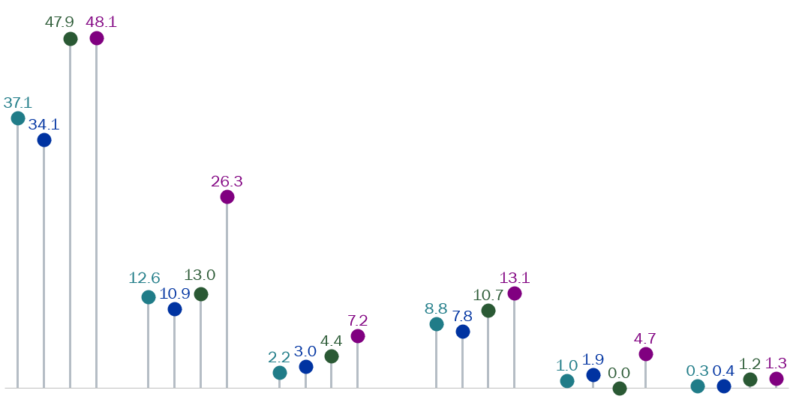
The rate of HIV diagnosis increased as the percentage of residents without health insurance coverage increased. HIV diagnosis rate by health insurance coverage at census tract level, race, and sex, Wisconsin, 2017–2020
Without health insurance (%)
<5
5.00–8.99
9.00–13.99
≥14
All new diagnoses,
2017–2020
Black Hispanic White
Male
Black Hispanic White
Female
Notes:
Health insurance coverage
Sex birth
The highest diagnosis rate for males (21.0) and for females (5.1) were among those who lived in census tracts where 14% or more of the residents did not have health insurance or a health coverage plan. For both sexes, the rate of HIV diagnoses increased as the percentages of residents without health insurance coverage increased.
Age at diagnosis
Persons who lived in census tracts where 14% or more of the residents did not have health insurance coverage accounted for the highest HIV diagnosis rates in all age groups.
Race and ethnicity
Persons who lived in census tracts where 14% or more of the residents did not have health insurance coverage accounted for the highest HIV diagnosis rates in Black, Hispanic, and White people. Additional racial and ethnic groups had too-small case counts.
Among males residing in census tracts with the highest health insurance coverage, HIV diagnosis rates among Black (37.1) and Hispanic people (12.6) were 16.9 times and 5.7 times, respectively, as high as the rate for White people (2.2). Among males residing in census tracts with the lowest education, Blacks (48.1) and Hispanic people (26.3) were 6.7 times and 3.7 times, respectively, as high as the rate for White people (7.2). The Black-White race and Hispanic-White race absolute disparities (the difference between a group with the lowest rate and the group with the highest rate) were wider (or more disparate) in the areas with the lowest health insurance coverage than in areas with the highest health insurance coverage.

Slide 98
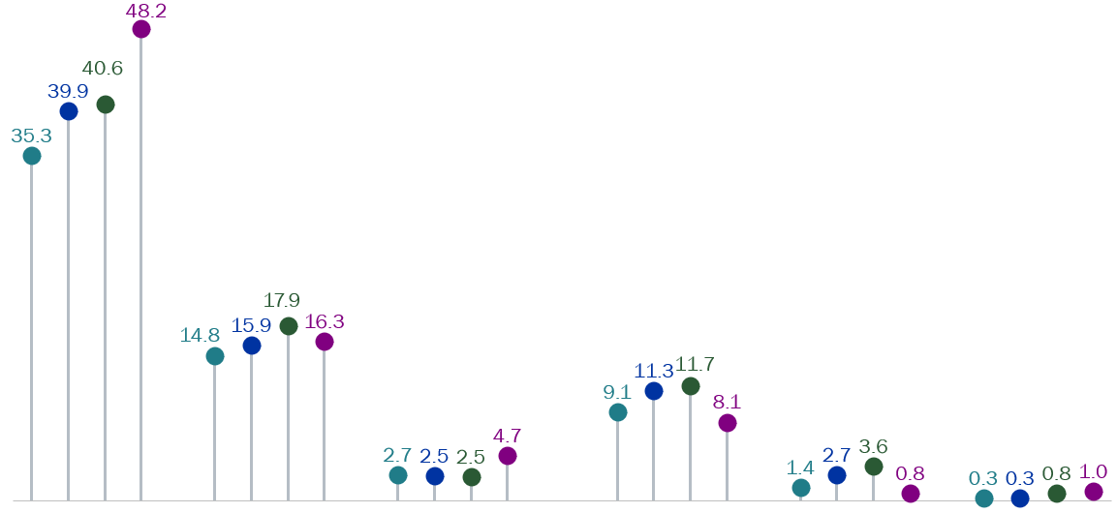
The rate of HIV diagnosis increased as the percentage of income inequality increased. HIV diagnosis rate by Gini Index at census tract level, race, and sex, Wisconsin, 2017–2020
Gini Index(%)
<38
38.00–41.99
42.00–45.99
≥46
All new diagnoses,
2017–2020
Black Hispanic White
Male
Black Hispanic White
Female
Notes:
Income inequality (Gini index)
Poor health and income inequality are closely linked. High levels of income inequality negatively affect the health of even the wealthy because income inequality reduces social cohesion which leads to more stress, fear, and insecurity.¹
This slide uses the Gini index to measure income inequality. The Gini index summarizes the scatterings of income across the entire income distribution. It ranges from 0, which means perfect equality (where all households have an equal share of income), to 1, perfect inequality (where only one household has all the income and the rest have none).
Sex at birth
The highest diagnosis rate for males (11.0) and for females (2.1) were among those who lived in census tracts where income inequality was 46% or more. For both sexes, the rate of HIV diagnoses increased as the percentages of income inequality increased.
Age at diagnosis
Persons who lived in census tracts where income inequality was 46% or more accounted for the highest HIV diagnosis rates in all age groups.
Race and ethnicity
Persons who lived in census tracts where income inequality was 46% or more accounted for the highest HIV diagnosis rates in Black, Hispanic, and White people. Additional racial and ethnic groups had too-small case counts.
Among males residing in census tracts with the highest income inequality, HIV diagnosis rates among Blacks (48.2) and Hispanics (16.3) were 10.3 times and 3.5 times, respectively, as high as the rate for Whites (4.7). Among males residing in census tracts with the lowest income inequality, Blacks (35.3) and Hispanics (14.8) were 13.1 times and 5.5 times, respectively, as high as the rate for Whites (2.7). The Black-White and Hispanic-White absolute disparities (the difference between a group with the lowest rate and the group with the highest rate) were slightly wider (or more disparate) among those residing in census tracts with the lowest income inequality compared to those with the highest income inequality.
¹Pickett KE, Wilkinson RG. Income inequality and health: a causal review. Soc Sci Med 2015;128:316-326. doi:10.1016/j.socscimed.2014.12.031

Slide 99
Program Outcomes
HIV Care Services—Ryan White Program
Notes:
This section covers the use of HIV medical and supportive services by people living with HIV (PLWH) in Wisconsin from 2016–2020.
The Ryan White HIV/AIDS Program is administered by the U.S. Department of Health and Human Services, Health Resources and Services Administration. Funding from this program allows states, cities, and local organizations to provide high-quality medical and supportive services to people living with HIV who do not have sufficient health care coverage or financial resources to manage their HIV care. It provides the public health infrastructure needed to ensure access to a wide range of core medical services (like medical care, medical case management, and mental health services) and support services (like non-medical case management, housing, transportation, and foodbank) aim at early diagnosis of HIV, linkage to care, retention in care, medically appropriate treatment, and continued viral load suppression. In addition, a large portion of Ryan White funding is used to cover the costs of medications, medication co-pays, and health insurance premiums through the AIDS Drug Assistance Program (ADAP) to ensure that PLWH have access to life-saving antiretroviral therapy.

Slide 100
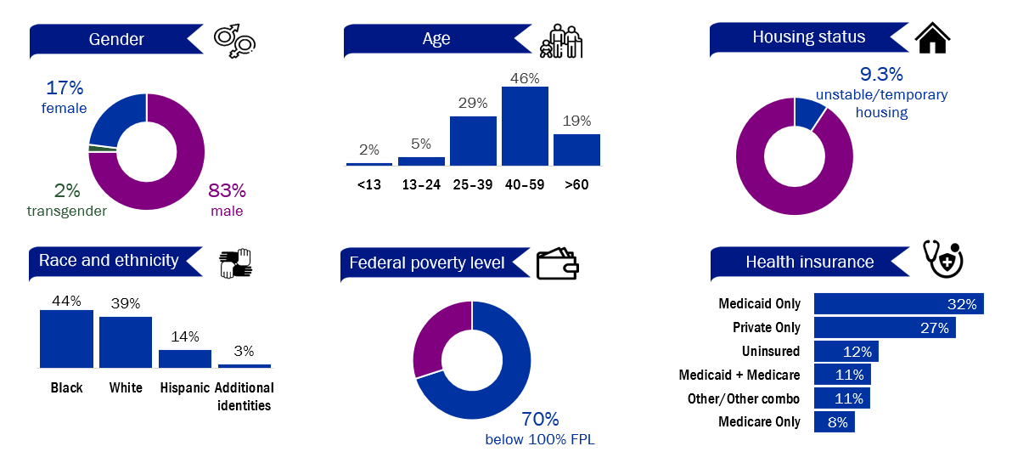
In 2020, 73% (n=5,206) of people living with HIV in Wisconsin were served by the Ryan White HIV/AIDS Program. People living with HIV receiving Ryan White services by selected demographics, Wisconsin, 2020
Notes:
Service utilization
During 2020, nine Wisconsin organizations received Ryan White funding through the Ryan White HIV/AIDS Program (RWHAP). Based on the annual Ryan White Services Report (RSR), these agencies served a total of 5,026 unique clients, which represents 73% of all PLWH in Wisconsin during 2020. This number remains relatively consistent from year to year.
Current age
The age distribution is shifting among RWHAP clients. From 2016–2020, the percentage of clients in the 40–59 age range decreased (54% of RWHAP clients in 2016 decreasing to 46% of clients in 2020), whereas the percentage of clients aged 60 years and older increased (12% in 2016 to 19% in 2020).
Race and ethnicity
Nearly two-thirds of RWHAP clients are from racial and ethnic minority populations. The percentage distribution of client racial and ethnic populations has remained consistent since 2016. In 2020, 44% of clients self-identified as Black, 39% as White, 14% as Hispanic, and less than 2% each as Native American, Asian, Native Hawaiian/Pacific Islander, and people of multiple races.
Gender
The majority of RWHAP clients are male. In 2020, 83% of clients were cisgender male, 17% were cisgender female, and 2% identified as transgender people. The gender distribution of RWHAP clients has remained steady since 2016.
Socioeconomic factors and health care coverage
In 2020, 7 out of 10 RWHAP were living at or below 100% of the federal poverty level (FPL), which is an increase from 64% in 2019 and probably a result of the COVID-19 pandemic. From 2016–2019, the percentage of RWHAP clients living at or below 100% FPL increased from 61% to 64%. Approximately 88% of RWHAP clients had some form of health care coverage in 2020 with 32% covered by Medicaid, 8% covered by Medicare, 27% had private health care coverage, and 22% had multiple forms of coverage. The percentage of clients uninsured remained steady from 2016–2018 at 9%, increased in 2019 to 14% and then decreased a little in 2020 to 12%. The distribution of RWHAP clients by housing status has remained relatively stable since 2016. In 2020, 9.3% of clients had temporary or unstable housing.

Slide 101
The percentage of clients accessing medical case management has increased in the past five years. People living with HIV receiving Ryan White core services, Wisconsin, 2016–2020
Notes:
Ryan White clients accessing core services
Overall, the percentage of clients receiving each core service has remained steady from 2016–2020 except for medical case management (MCM) which has increased due to changes made at the state-level about how case management is classified. Prior to 2016, clients accessed both MCM and non-medical case management (non-MCM). After the changes in 2016, clients only accessed MCM so the number of clients accessing non-MCM decreased and the number accessing MCM increased. Dental services declined in 2020 due to many of the dental clinics being closed because of the COVID-19 pandemic. Both Early Intervention Services and Health Insurance Premiums and Cost-Sharing Assistance began being funded in 2018.

Slide 102
The percentage of clients accessing non-medical case management services decreased over the last six years and the percentage accessing referral for services increased.
People living with HIV receiving Ryan White support services, Wisconsin, 2016–2020
Notes:
Ryan White clients accessing support services
Funding for support services hasn’t changed much except for beginning to fund Foodbank in 2018 (1% of clients utilizing Foodbank in 2016 to 34% in 2020). Emergency Financial Assistance (EFA) was utilized more in 2020 (9%) probably due to the pandemic.
A change to which service categories are funded for case management in 2016 resulted in huge decrease in the number of clients receiving non-medical case management (61% of clients utilizing non-MCM in 2016 to 5% in 2020) as non-MCM was no longer being funded for case management. Instead, Referral for Services was used for lower acuity clients resulting in more clients utilizing the service (33% in 2016 to 44% in 2020).

Slide 103
Program Outcomes
HIV Care Services—AIDS Drug Assistance Program (ADAP)
Notes:
The Wisconsin AIDS Drug Assistance Program (ADAP) and Insurance Assistance Program (IAP) help people with HIV get:
Health insurance help.
Medicine for:
HIV.
Hepatitis C, if they are living with both HIV and hepatitis C.
The prevention or treatment of other health conditions.
Additional information on ADAP can be found at https://www.dhs.wisconsin.gov/hiv/adap.htm.

Slide 104
The majority of PLWH accessing ADAP services are male between the ages of 25 and 65 and are virally suppressed. People living with HIV receiving ADAP services by selected demographics, Wisconsin, 2020
Notes:
Service utilization
While clients are characterized as AIDS Drug Assistance Program (ADAP) or Insurance Assistance Program (IAP) clients, there is a lot of overlap. In 2020, there were 731 clients who only utilized ADAP to fill medications, 278 clients who only used IAP for insurance premium payments, and 695 clients who utilized both programs to fill medications and pay insurance premiums.
These are the demographics for the 1,426 clients who filled prescription medications in 2020.
Clients on ADAP:
5 out of 6 were male.
Almost half were between the age of 45 and 65.
43% were white.
40% were between 100 and 200% FPL.
87% were virally suppressed in 2020.
1 in 3 were uninsured for the full year.

Slide 105
The majority of PLWH accessing IAP services are male between the ages of 45 and 65 and are virally suppressed. People living with HIV receiving IAP services by selected demographics, Wisconsin, 2020
Notes:
Service utilization
There were 974 clients that had their insurance covered by the Insurance Assistance Program (IAP) in 2020. These are their demographics.
Compared to clients who fill medications, clients who insurance was paid for tend to be a little older (over 50% between the ages of 45–65), White, and had a higher FPL (since lower FPL are eligible for BadgerCare).

Slide 106
The number of antiretroviral prescriptions decreased as clients hit their deductibles in 2020. Medication prescriptions filled per month by type of medication, Wisconsin ADAP 2020
Notes:
Medications provided by ADAP
This is the number of prescriptions for the main drug classes provided by ADAP per month in 2020. There were 13,009 prescriptions filled for 1,426 clients.
The number of ARVs filled decreased as the year goes on because once insured clients hit their out-of-pocket max for the year, the deductible goes to $0 and no data is collected on medications ADAP does not pay for.
The side effect, mental health, and prophylaxis fills decreased too but not as much as ARVs.
In 2020, ADAP also filled two hepatitis C medication prescriptions, seven H1N1 medication prescriptions, and three opioid dependency medication prescriptions.

Slide 107
Program Outcomes
HIV Care Services—Medicaid Services

Slide 108
While the make-up of Medicaid members largely matches that of prevalent HIV cases, several populations have a lower rate of Medicaid claims: White people, men, and Northeastern Wisconsin residents. Characteristics of 2020 Medicaid members with HIV claims and prevalent cases of HIV as of 2020, Wisconsin
Notes:
Medicaid services for people living with HIV
In 2020, 2,411 individuals with HIV received medical services or prescription drugs covered by Wisconsin Medicaid/BadgerCare. This accounts for about 0.3% (3 in 1,000) of the approximately 860,000 total annual Medicaid members, and 35% of people reported and living with HIV in Wisconsin in 2020.
Demographic characteristics
The figure above compares demographic characteristics of Medicaid members with HIV claims in 2020 to people presumed to be alive and living in Wisconsin at the end of 2020. While the make-up of Medicaid members largely matches that of prevalent HIV cases, several populations have a lower rate of Medicaid claims: White people, men, and residents of the Northeastern Region.

Slide 109
Most people living with HIV who are on Medicaid had an evaluation and management office visit in 2020. Claims by service category among Medicaid members with HIV claims, Wisconsin, 2020
Although young Black men have the highest rate of new HIV diagnoses, almost half of Medicaid PrEP clients were White. Characteristics of Medicaid members with PrEP prescriptions, Wisconsin, 2020
2 of 3
Male
Half
White
2 of 5
in Milwaukee County
Half
young
adults
Notes:
Service categories
More than 74% of Medicaid members with HIV claims had an evaluation and management office visit and 34% filled prescriptions for HIV medications. Other service categories used by more than 10% of Medicaid members living with HIV are shown in the slide above, on the left.
Medicaid members receiving PrEP
Pre-exposure prophylaxis (PrEP) is a medicine that reduces individuals’ chances of getting HIV from sex or injection drug use. When taken as prescribed, PrEP reduces the risk of getting HIV by about 99%.¹
During 2020, 550 Wisconsin Medicaid members filled one or more prescriptions for PrEP. Geographic and demographic characteristics of the members are:
Region: Milwaukee County, 42%; Dane County, 16%; Western Region, 12%; Northern Region, 9%; South Region excluding Dane County, 8%; Southeastern Region excluding Milwaukee County, 8%; Northeastern Region, 6%.
Sex: Male, 68%; Female, 32%.
Race and ethnicity: White, 49%; Black, 24%; Hispanic, 12%; Asian or Hawaiian, 3%; Native American, 2%; Other identities, 12%.
Age: 0–14, 2%; 15–29, 47%; 30–44, 34%; 45–59, 14%; 60 and older, 3%.
¹Center for Disease Control and Prevention. PrEP (Pre-Exposure Prophylaxis). Accessed June 30, 2023, at https://www.cdc.gov/hiv/basics/prep.html.

Slide 110
Program Outcomes
HIV Care Services—Evidence-based Interventions:
Peer Navigator Program (PNP)
Notes:
Peer Navigators, people living with HIV (PLWH) who are trained to mentor other PLWH to increase treatment adherence, community connection and provide them with resources, have been growing in numbers all over the United States. The Wisconsin Department of Health Services (DHS) funded its first ever Peer Navigator program (PNP) in 2020.

Slide 111
Notes:
The PNP has five primary goals with individual objectives that were monitored throughout the pilot period. Some of the objectives, as written, were not measurable or attainable.
Goal 1: Increase viral load suppression.
Goal 2: Decrease barriers to achieving viral load suppression.
Goal 3: Decrease the number of participants who are lost to care.
Overall, most goals were met or trending in the right direction and those that were not, were due to how the objectives were written.

Slide 112
Notes:
Goal 4: Reduce HIV-related disparities and health inequalities.
Goal 5: Increase community awareness of the Peer Navigator Program.

Slide 113
Program Outcomes
HIV Care Services—HIV Care Continuum
Notes:
The HIV care continuum is a useful tool for visualizing health outcomes, identifying health disparities, and prioritizing programmatic efforts. Using the definitions described by the CDC¹, Wisconsin’s 2020 diagnosis-based HIV care continuum is presented on the next slide.
¹Centers for Disease Control and Prevention. Understanding the HIV Care Continuum. https://www.cdc.gov/hiv/pdf/library/factsheets/cdc-hiv-care-continuum.pdf. Published July 2019. Accessed August 2022.

Slide 114
Most people living with HIV who are engaged in care are virally suppressed.
HIV Care Continuum, Wisconsin, 2020
Notes:
The HIV Care Continuum
The HIV Care Continuum continues to be an important framework for understanding and assessing the status of HIV care and treatment in the United States. Additionally, the HIV Care Continuum helps drive prevention efforts directed at early detection and prevention of transmission (treatment as prevention). The HIV care continuum illustrates the stages through which PLWH can progress in their HIV management.
Estimated values
Living with HIV: The U.S. Centers for Disease Control estimates that 13.8% of individuals living with HIV in the U.S. are unaware of their status. This bar shows both those aware and diagnosed (green) and those unaware of their HIV diagnosis (grey).
Values based on surveillance data
During 2020:
86% of people newly diagnosed with HIV were linked to care within three months of diagnosis.
77% of people living with HIV (PLWH) had at least one medical visit.
48% of PLWH had at last two medical visits, at least 90 days apart.
71% of PLWH were virally suppressed at their last test during 2020.
93% of PLWH who had at least one viral load test (indicating some care) were virally suppressed.
The following differences in these important health indicators were observed:
Males and females had equal success across the whole care continuum except for linkage to care where males linked to care faster than females.
Hispanic PLWH were the most likely to be linked to care within three months but were less likely to be in care or to be virally suppressed. Outcomes for both Hispanic and Black PLWH were worse than White PLWH.
Younger PLWH (ages 13–29) were more likely than PLWH ages 30 and older to be in care but were less likely to be virally suppressed.
Individuals with a history of injection drug use had among the lowest proportion at each stage of the continuum, except for linkage to care.

Slide 115
Program Outcomes
HIV Prevention—HIV Testing at funded Counseling, Testing, and Referral (CTR) Sites
Notes:
This section discusses HIV testing data from the HIV counseling, testing, and referral (CTR) sites publicly funded by the Wisconsin HIV Program during 2018–2019 to provide HIV CTR services; however, we are excluding 2020 data because the COVID-19 pandemic disrupted both in-person HIV testing services and outreach activities at these sites. The HIV testing data is from EvaluationWeb reported by the CTR sites including some local public health departments and community-based organizations (CBOs).
The data presented in this section only contain the valid tests events, excluding those with invalid or indeterminate test results or declined HIV testing, per CDC's analyzable valid test event definition. There were 7 invalid tests in 2018 and 10 in valid tests in 2019. This 2018–2019 HIV testing data at the publicly-funded HIV CTR sites do not reflect a comprehensive, statewide HIV testing outcome.

Slide 116
State-funded HIV CTR sites diagnosed 1 in 5 of Wisconsin’s new HIV positive cases in 2018–2019.
2018–2019
State-funded
HIV CTR sites…
Point-of-care tests:
Finger-stick
Laboratory-based tests:
Blood draw
29,302 HIV tests
83 New diagnoses
…detect 1 of 5, or
19% of Wisconsin’s
total HIV diagnoses
432 WI new HIV diagnoses
* This 2018–2019 HIV testing data at the publicly-funded HIV CTR sites do not reflect a comprehensive, statewide HIV testing outcome.
Notes:
HIV testing at counseling, testing and referral (CTR) sites
In 2018–2019, these Wisconsin publicly funded HIV CTR sites performed 29,302 HIV tests, of which 83 tests were reported as new HIV diagnoses. These CTR sites detected 19%, or one-fifth of Wisconsin’s total HIV positive diagnoses (n=432).
The CTR sites used the Abbott Determine HIV-1/2 Ag/Ab test and/or laboratory-based HIV tests for HIV testing.
NOTE: The testing data is at test-level and not duplicated by person, except for the new diagnoses. Because some individuals who tested positive at these sites were previously diagnosed with HIV, this section focuses only on new positives for the individuals who were newly diagnosed at these sites. The 2018–2019 HIV testing data at the HIV CTR sites do not reflect a comprehensive, statewide HIV testing outcome.
Image credit:
Testing image by CDC: https://www.cdc.gov/hiv/basics/hiv-testing/test-types.html

Slide 117
Men and people who report male-female sexual contact received the most HIV testing at HIV CTR sites. Most new diagnoses were among males who report male-male sexual contact. Proportion of total HIV tests performed by demographics, Wisconsin 2018–2019
% of HIV tests done % of new HIV diagnoses
Men and people who report MMSC make up most HIV diagnoses at CTR sites. They continue to be important populations of focus for HIV testing and prevention services.
Gender
Cisgender men
Cisgender women
Transgender individuals*
No gender data
MFSC
MMSC
MMSC and IDU
Additional exposures
Exposure
People who report MMSC may have unmet HIV testing need relative to people reporting MFSC, which has very high testing.
*Transgender includes transmen (0.3%), transwomen (4.7%), or transgender unspecified (0.1%).
Notes:
Characteristics of people who used CTR sites for testing
We examined characteristics of people who received HIV testing at the publicly funded HIV CTR test sites in Wisconsin from 2018–2019.
NOTE: The effect of testing goals and objectives on testing data, by CTR site
Depending on the funding source and communities served, some CTR sites that are community-based organizations (CBOs) have testing goals and objectives to ensure their HIV prevention programs are reaching out and serving the populations of focus. These objectives may include focusing on high inclusivity in health service delivery or achieving the desired coverage and quality of services. The CTR sites with testing objectives tended to test a higher percentage of people within their populations of focus compared to the sites without testing objectives.
General
From 2018–2019, CTR sites reported the proportion of demographic groups relative to the total HIV tests done (n=29,302), as well as proportion of all new HIV diagnoses (n=83). We can examine trends in the uptake of HIV testing services, including through different modalities, and their effectiveness at identifying people living with HIV. Testing volume and data on positivity are useful for program monitoring. When breaking down by age, sex, testing modality, and HIV status, these data are useful in assessing the effectiveness of delivering HIV testing and prevention services and addressing gaps in various settings, contexts, and populations.
Gender
In the image above, top left, we examine the proportion of HIV tests done at CTR sites (purple data point) by gender. Cisgender men represent the greatest proportion of HIV tests done at 72%. Cisgender women (26%) is second highest group receiving HIV testing services, with testing levels reflective of goals established at the CTR sites in Wisconsin. Transgender persons (5%) includes transmen (0.3%), transwomen (4.7%) and transgender unspecified (0.1%). Of all HIV tests done among publicly-funded CTR sites, a small proportion of tests (0.2%, n=47 of 29,302) did not collect gender data.
In general, HIV testing demographics appear aligned with the demographics of people newly diagnosed with HIV (grey data point). HIV diagnoses among cisgender men are the leading group (94%) of new HIV cases detected at CTR sites, in addition to being the leading group receiving HIV testing (72%). Cisgender women (6%) are the second ranking group receiving HIV testing (26%). There were no new HIV diagnoses among transgender people (n=0). No new HIV diagnoses at CTR were missing gender data.
Exposure
Testing by risk exposure shows that people reporting male-female sexual contact (MFSC, 47%) are the leading group to receive HIV testing at the HIV CTR sites. They are followed by people who report MMSC (31%), and MMSC with injection drug use (MMSC/IDU, 1%). Additional transmission categories (20%) include the following: IDU only (14%) and other risk not specified (6%).
However, the proportion of HIV new diagnoses indicates that people who report MMSC represent the highest proportion of new HIV cases (84%), followed by MFSC (22%), MMSC/IDU (5%), and additional categories (that is, IDU, 1%). This data indicates that (1) Male-female sexual contact has sufficient HIV testing, and (2) People who report MMSC behavior may have unmet need for HIV testing relative to other groups in publicly-funded HIV test sites.

Slide 118
Black people accounted for most new HIV diagnoses identified, but most HIV testing occurred among White people at HIV CTR sites. Proportion of total HIV tests performed by demographics, Wisconsin 2018–2019
% of HIV tests done % of new HIV diagnoses
Race
Black people accounted for 45% of HIV diagnoses, followed by White people (27%), and Hispanic people (20%).
White
Black
Hispanic
Additional identities
Unknown
White people had high testing (40%) relative to the proportion of White people diagnosed as a new HIV case.
Notes:
Race
Testing uptake (purple data point) was represented mostly by White people (40%), followed by Black people (37%), Hispanic people (12%), and people of additional identities (5%). These additional identities included Asian (2%), Native Hawaiian/Pacific Islander (0.1%), Native American (1%), and multiracial (2%).
Data on HIV new diagnoses (grey data point) by race suggests that greater discussion may be helpful. Black people accounted for most new HIV diagnoses (45%), in line with the leading HIV testing proportion for Black people (37%). However, the next racial/ethnic groups ranked for HIV new diagnoses, White (27%) and Hispanic (20%) people, while of similar proportion, have shown notably different rates of testing (White 40% and Hispanic 12%). This is visualized in the inverse of color dots between White people (HIV testing was greater than new HIV diagnoses) compared to Hispanic and other races (new HIV diagnoses was greater than HIV testing). This may indicate (1) sufficient testing of White people, and (2) potential unmet testing need among Hispanic communities. In depth review of community-specific data may be helpful to determine whether these differences indicate true unmet need that can be addressed through greater HIV prevention service outreach to Hispanic communities.
Race data was unable to be collected for 6% of tests done at CTR sites. No cases of new HIV diagnoses at CTR sites are missing race data.
Note: All races are non-Hispanic, unless otherwise noted.

Slide 119
Program Outcomes
HIV Prevention—HIV Partner Services
Notes:
HIV Partner Services (PS) consists of a broad array of services that are offered to any persons living with HIV and their sexual and substance-use sharing partners. These services are voluntary, confidential, and provided by staff at tribal and local health departments.
Services offered by HIV PS providers include:
HIV testing, counseling, and referral services.
HIV prevention education and harm reduction counseling.
Assistance in notifying sexual and substance-use sharing partners.
Referral and linkage to health care services.

Slide 120
Only half (49%) of clients assigned to Partner Services from 2016–2019 were interviewed. HIV Partner Services outcomes, Wisconsin, January 2016–February 2020
Notes:
Index case interviews
Of 2,000 index clients assigned, 970 (49%) had completed interviews.
Of 970 completed interviews, 867 (89%) named one or more partners.
Of 867 index cases who name one or more partners, 897 (average = 1.0 partners per index case) partners were named.
Partners
Of 897 partners identified, 107 (12%) were notified.
Of the 107 partners notified, 24 (22%) were previously identified as living with HIV.
Of the 83 partners whose status was not known to be positive, 64 (77%) were tested.
Of the 64 partners tested, 1 partners (2%) were newly diagnosed with HIV.
Of the partners who tested negative, 8 (14%) were currently taking PrEP and 14 (24%) were referred to a PrEP provider.

Slide 121
Program Outcomes
HIV Prevention—Harm Reduction
Notes:
Harm reduction strategies aim to lessen harms associated with drug use and related behaviors that increase the transmission of HIV. Harm reduction is key in the prevention of HIV among people who inject drugs and their sexual partners.

Slide 122
In Wisconsin there are 16 primary syringe service programs (SSPs) and 13 satellite locations. Location of primary and satellite SSPs, Wisconsin, 2020
Primary SSP location
Satellite location
Notes:
Syringe service programs (SSPs)
Syringe service programs are community-based prevention programs. In Wisconsin there are 16 primary SSPs: Vivent Health locations (Appleton, Beloit, Eau Claire, Green Bay, Kenosha, La Crosse, Madison, Milwaukee, Superior, and Wausau), Sixteenth Street Community Health Center, United Migrant Opportunity Services (UMOS), Public Health Madison and Dane County (East Washington Ave, Park Street, and MLK in Madison), and the Bad River Band of Lake Superior Chippewa. There are also 13 satellite locations.
The HIV and HCV Programs have a determination of need (DON) for SSPs from the CDC. Utilizing non-CDC funds, these programs provide harm reduction services for people who inject drugs. Wisconsin grants GPR funds to Vivent Health, the statewide HIV/AIDS service organization, to conduct harm reduction outreach with people who inject drugs who are not currently in treatment programs. GPR funds cannot be used to purchase syringes, so Vivent Health uses private donation funding to support the purchase of syringes in their SSPs. Additionally, the program funds services such as HIV and HCV rapid testing, laboratory testing, and condom distribution which are frequently co-located with harm reduction outreach services. These programs are not exclusive to people who inject drugs, are considered separate interventions from harm reduction outreach, and are prioritized as stand-alone services.

Slide 123
Areas of concern located outside of a 30-minute driving time of a syringe service program (SSP) are important areas to target for increased access to SSPs. Location of primary and satellite SSPs compared to areas of concern for the opioid crisis, Wisconsin, 2017–2018
Accessibility to syringe service programs are worse in northern and western areas of the state. Driving time (minutes) to SSPs, average by census tract in Wisconsin
Notes:
An assessment to identify geographic gaps in harm reduction services
In 2020, the HCV Program with the Division of Care and Treatment Services, published an assessment to identify geographic gaps in services, and a plan to address these gaps¹. Areas of concern were identified using data routinely reported to the Wisconsin Department of Health Services (DHS) for the year 2017 and 2018 combined. Areas of concern were defined as ZIP codes that had rates in the highest 20% of any of four health outcomes (opioid overdose deaths, opioid overdose hospitalizations, suspected opioid overdose ambulance runs, newly reported cases of hepatitis C among people aged 15–39) and had more than five events of that outcome during the 2-year period. This method identified 169 ZIP codes (22% of all Wisconsin ZIP codes) as areas of concern. Areas of concern are located in rural and urban areas of Wisconsin, overlap with several tribal boundaries, and border several interstate highways. These areas of concern were overlayed with the locations of primary and satellite syringe services programs along with the 30-minute driving time around the SSPs.
In addition to the SSPs shown on the map above, mobile van syringe services programs are available, at different frequencies, in the following counties: Adams, Columbia, Dane, Grant, Juneau, Milwaukee, Ozaukee, Richland, Sauk, Washington, and Waukesha.
Gaps in syringe services programs
DHS will continue to work to expand capacity to provide harm reduction services in Wisconsin. During 2018 and 2019, DHS sponsored trainings by the Harm Reduction Coalition to teach local health department, tribal health clinic, and syringe service program staff members about the principles of harm reduction.
DHS will work with existing syringe service programs to determine whether their mobile van services provide resources to the gap areas, and if these services can be expanded or intensified.
DHS will continue to support HIV and hepatitis C testing at syringe services programs.
¹Preventing and Treating Harms of the Opioid Crisis: an Assessment to Identify Geographic Gaps in Services, and a Plan to Address these Gaps. https://www.dhs.wisconsin.gov/publications/p02605.pdf

