Slide 1
WELCOME!
[Name]
[Title]
[Organization]
[Insert image here]
Notes:
Hello, everyone. My name is [ FULL NAME] and I am a [ JOB TITLE] with the [ORGANIZATION NAME].

Slide 2
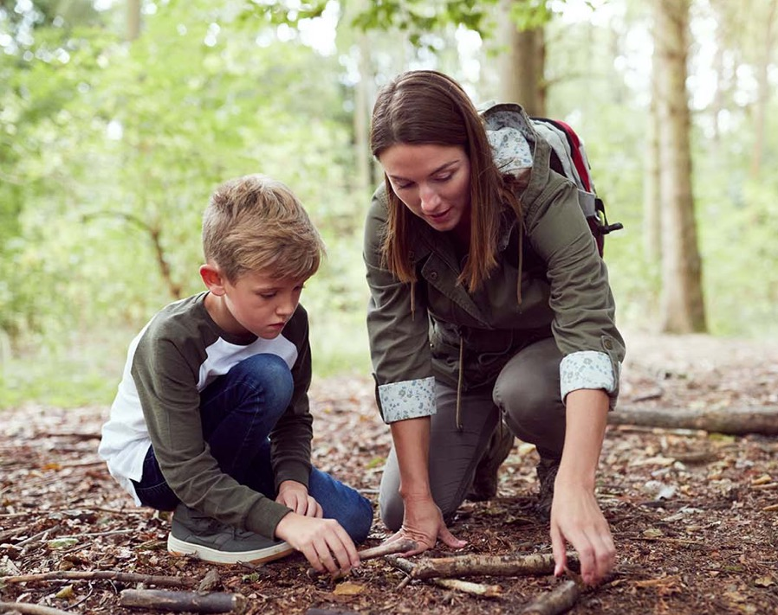
Small Talks
How Wisconsin Prevents Underage Drinking
Month X, 2021
Notes:
I’m here to talk to you about what we can do to reduce underage drinking in Wisconsin. Specifically…

Slide 3
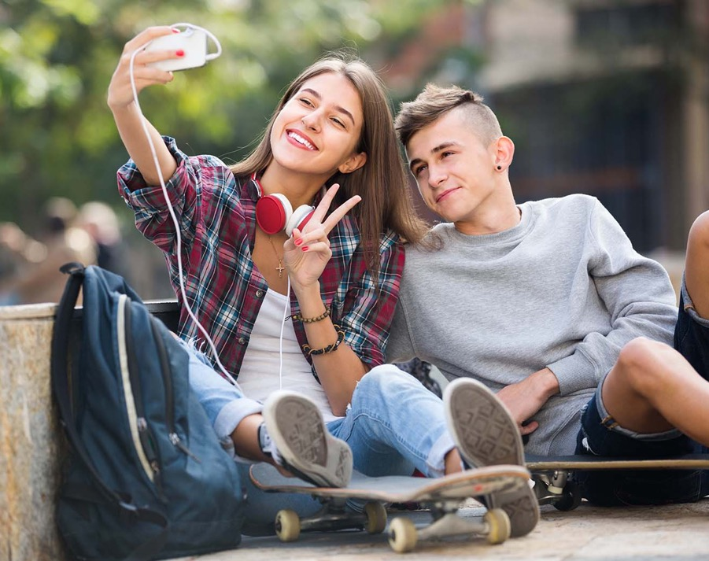
Small Talks
Agenda
Why underage drinking matters
Talking to your kids about alcohol
Taking action to prevent underage drinking
Getting help and learning more
Notes:
So, before getting into the presentation, let's take a quick look at what we'll be discussing today and what we hope to learn. (Speaker reads through slide)

Slide 4
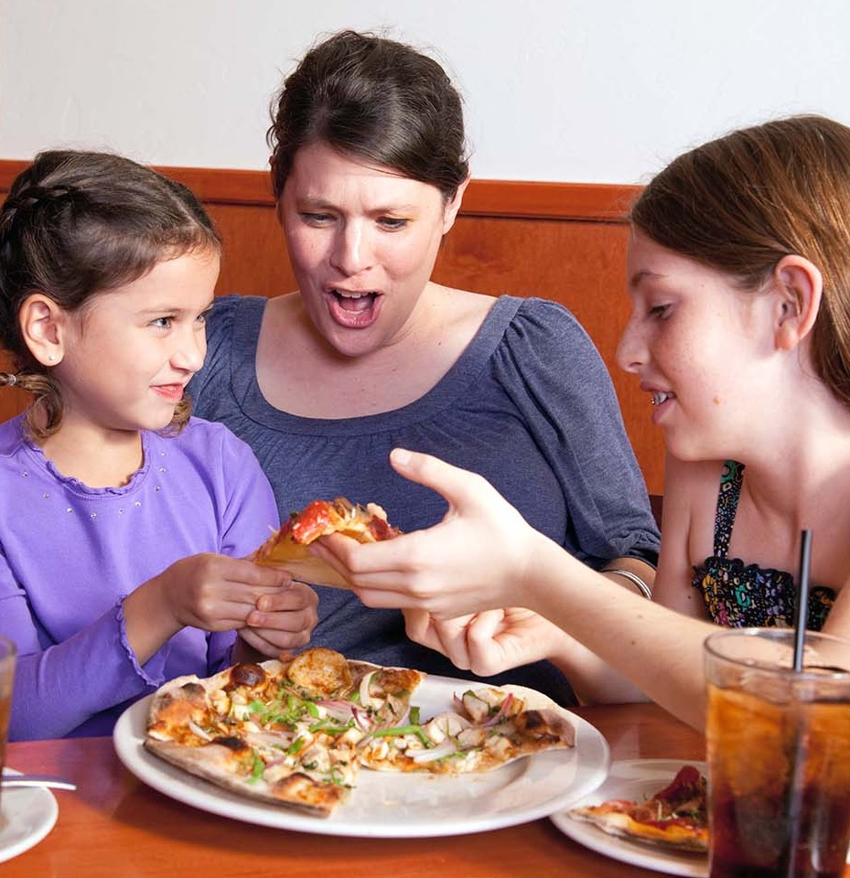
Are Wisconsin
laws encouraging underage drinking?
Notes:
Alright, so to begin, let's see a show of hands…
… How many people know that it is currently legal to drink with your kids in a bar in Wisconsin—at any age?
[PAUSE FOR GROUP INTERACTION]
That says a lot about the drinking culture in Wisconsin, right?

Slide 5
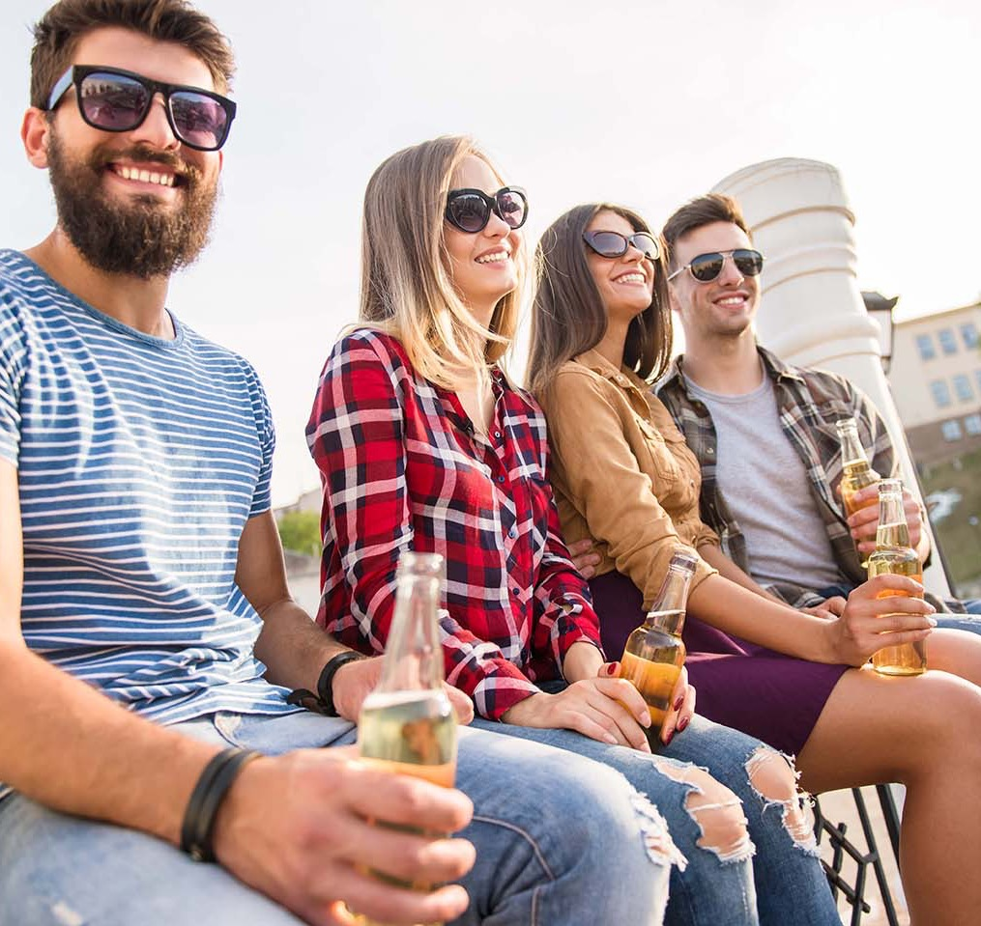
The dangers of Wisconsin’s drinking culture.
Notes:
As you know, Wisconsin has always had a culture of drinking—excessively. Our state leads the nation in heavy drinking and binge drinking. We drink to celebrate, connect, unwind, and sometimes deal with stress. And our kids notice this behavior at a very impressionable time in their lives. A time when they are starting to establish their views on alcohol. So, it's important that we do our best to show kids that drinking can be done responsibly—and show them early.

Slide 6
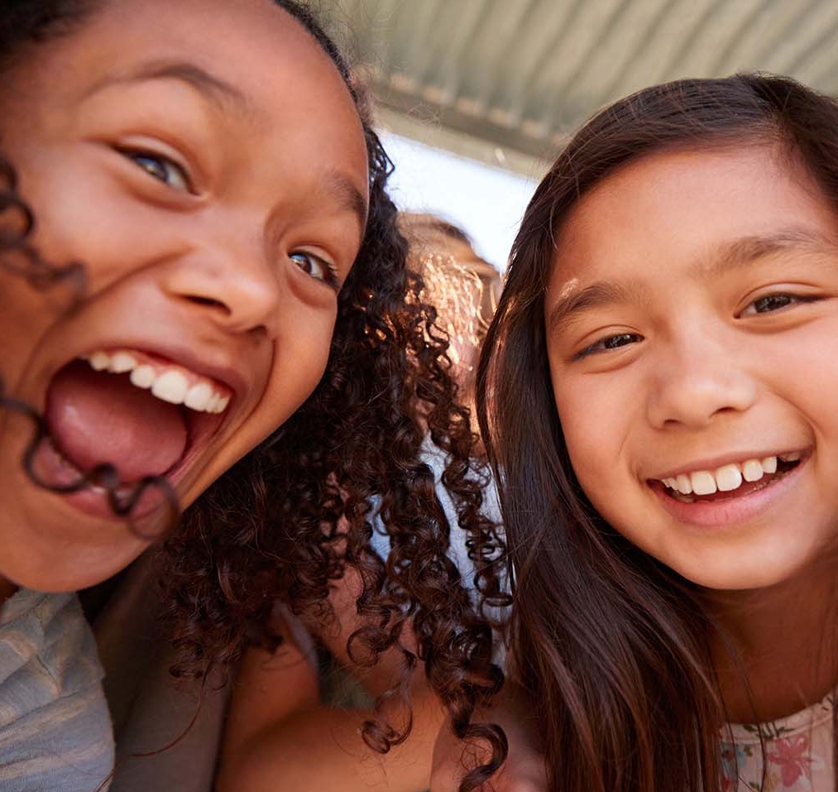
I drank when I was underage, and I turned out ok.
Notes:
Given Wisconsin's history of being an alcohol-friendly environment, the damaging effects of underage drinking can be overlooked. Drinking at a young age has often been viewed as a rite of passage that everyone does. But the dangers and consequences are real. Now, you may be thinking… (Speaker reads slide)

Slide 7
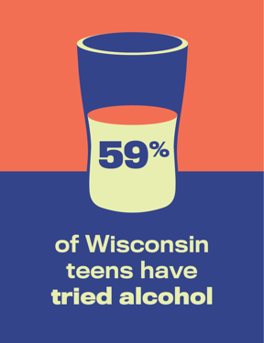
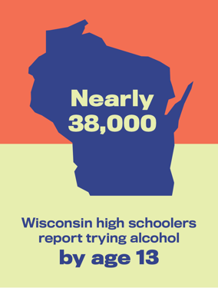
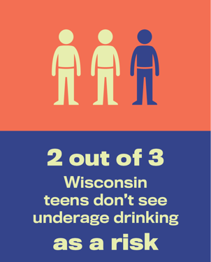
Wisconsin kids are drinking.
Notes:
Well, times have changed. We know a lot more about the risks of underage drinking and kids’ habits with alcohol. Kids are trying alcohol earlier, and in larger amounts. And while underage drinking has dropped nationally, as you can see—Wisconsin isn’t keeping up with the trend.

Slide 8
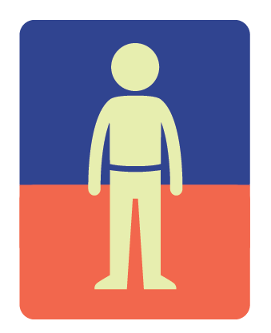
The impacts of underage drinking
Underage drinking affects developing brains.
Underage drinking affects developing brains.
Underage drinking affects developing brains.
Underage drinking affects the body.
Underage drinking affects the body.
Underage drinking can cause cancer.
Notes:
Because the brain continues to develop until the age of 25, drinking when young can damage the parts of the brain responsible for learning, memory, and self-control.
[NEXT]
High levels of alcohol in the body can shut down those parts of the brain that control breathing, heart rate, and body temperature.
[NEXT]
We now know that drinking alcohol can increase a person’s risk for at least seven different types of cancer. Scary, right?
Beyond the physical implications that underage drinking can cause, we know that alcohol can affect kids emotionally—during an already challenging time in their development.

Slide 9
The impact of alcohol on mental health
The emotional impact
The emotional impact
The sad truth
The emotional impact
The sad truth
The long-term
Notes:
Underage drinking goes hand in hand with higher rates of depression and anxiety.
[NEXT]
Each year, 300 young people nationwide die in alcohol-related suicides where consuming alcohol led them to commit self-harm.
[NEXT]
Underage drinking increases the risks of developing a substance use disorder later in life.

Slide 10
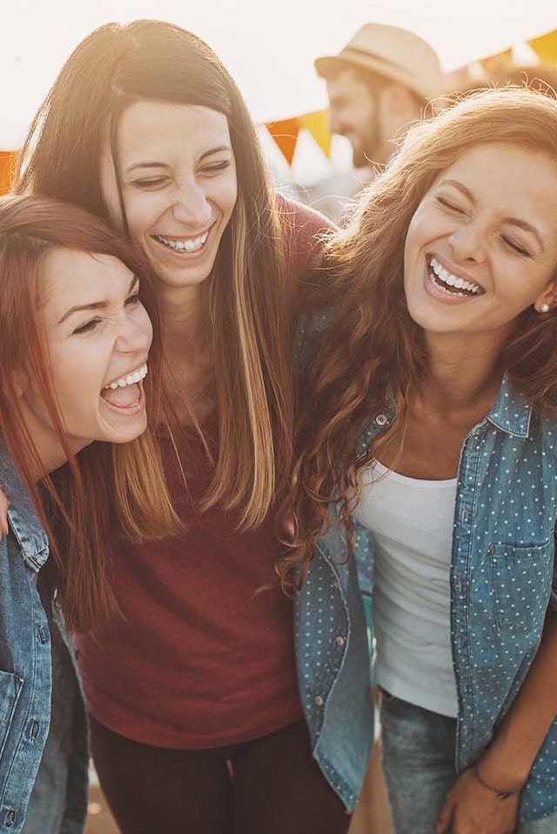
Alcohol leads to risky behavior
Kids who drink are:
more likely to get in a car with someone who’s been drinking.
more likely to have issues with the law.
at a higher risk of physical and sexual assault.
more likely to end up in the emergency room.
Notes:
Lastly, kids are naturally inclined to try new things and take risks, and this is especially dangerous with alcohol, as we can see here.

Slide 11
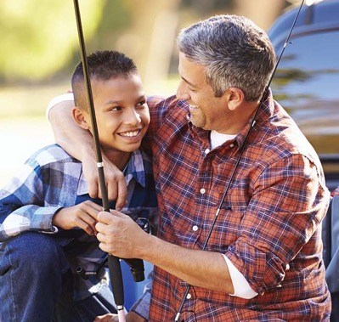
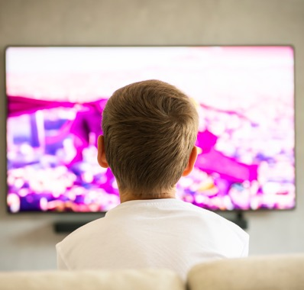
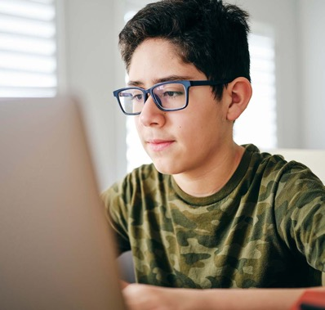
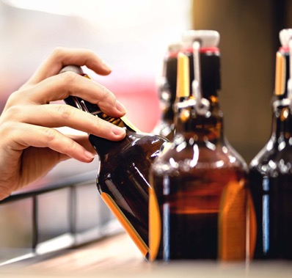
What can influence kids’ choices about alcohol?
Notes:
So, with all the dangers that come from underage drinking, the big question is—why do kids drink? Let’s look at a few key influences on kids’ perceptions of alcohol.

Slide 12
The Media Effect
Advertising
Social Media
Movies
Magazines
Video Games
Television
Videos
Radio
Music
Notes:
Advertising and media play a huge role in kids' opinions about alcohol. Alcohol companies spend $2 billion per year on advertising. Because of this, kids are constantly exposed to messages about alcohol and other substances through ads, social media, television, music, magazines, and more. In fact, the average kid is exposed to three alcohol ads per day, leading to a more positive view of drinking among youth. Why? Because the people often featured in these ads are celebrities or other influencers that kids admire or identify with. That is no accident!

Slide 13
Kids mimic the behavior they see.
Sporting Events
Holidays
Vacations
Family Gatherings
Festivals
Birthday Parties
Music Events
Dinner
Notes:
However, kids also form their opinions about alcohol from those around them, like their parents, extended family, friends, and others in the community. Try to think about some of your common behaviors with drinking. Do you turn to a drink after a long stressful day? Have a few drinks with friends during the big game? Or pop the cork on a bottle of wine or two when the friends are over? These are all pretty common examples, right?
Now, I'm not telling you that drinking is wrong—responsible drinking is ok for adults. But it's important to remember that our behavior with alcohol impacts kids' attitudes toward drinking.

Slide 14
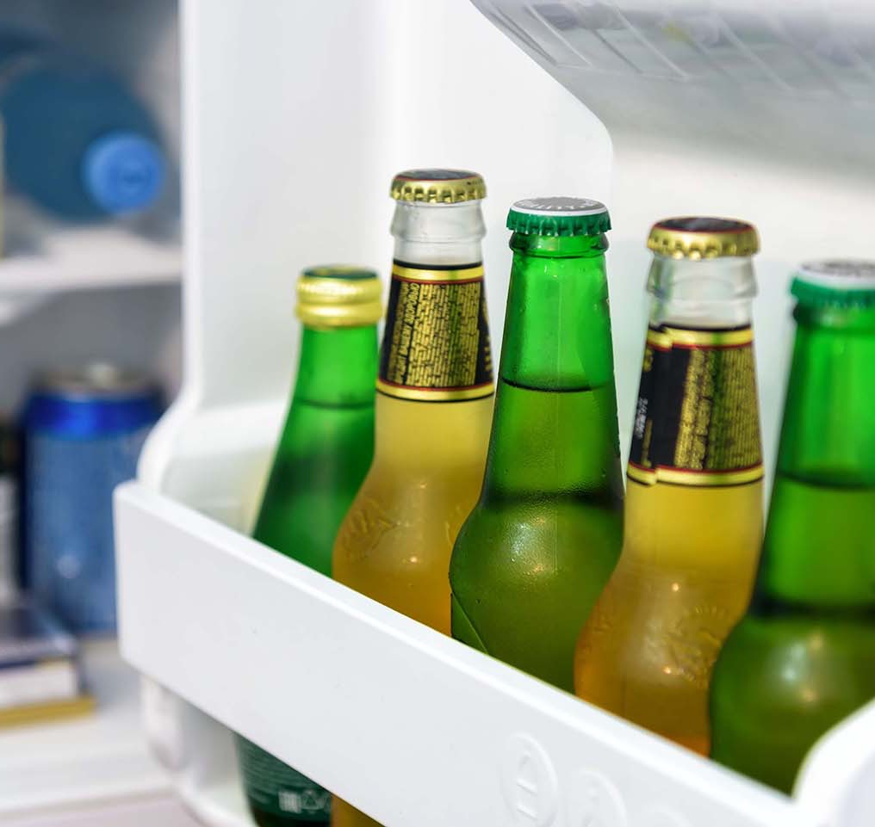
Kids often drink because they have access.
Notes:
We also know that kids drink when they have access to alcohol. Kids commonly get alcohol from unsecured liquor in their homes, from older friends and siblings, or even purchasing it from local retailers.

Slide 15
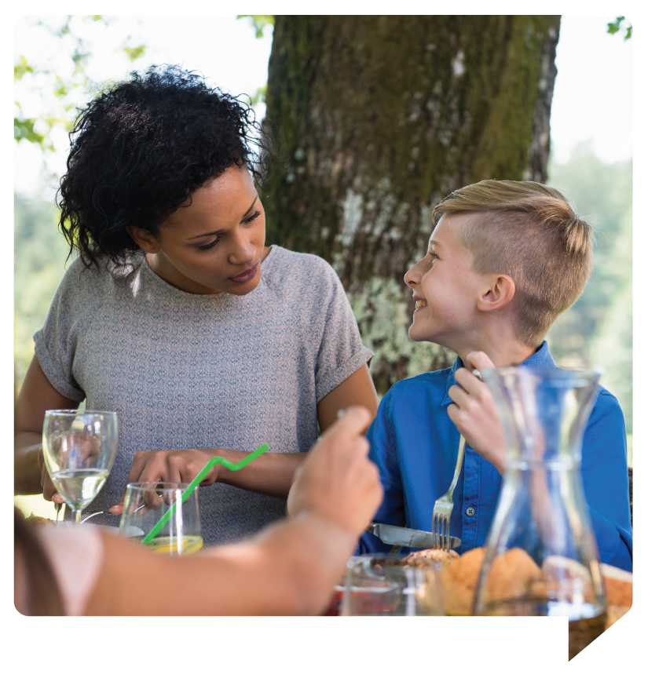
The COVID-19 Pandemic Effect
1 in 6 parents of younger adolescents allowed them to drink with their family—kids as young as 11.
Notes:
Recently, with the impact of the COVID-19 pandemic, we've seen a new trend emerging with underage drinking. Given all the new stressors we've all faced during this challenging time, there has been an increase in parents drinking with their kids. Social hosting has become more common as well. Parents may think that if kids are going to drink, it's safer for them and their friends to do so in a home where an adult is present. But that's not the case. First off, it's illegal to provide underage kids with alcohol and a place to drink. Secondly, social hosting can have dangerous consequences. It often opens the door to future drinking, raises the chances of alcohol poisoning, and increases the risk of physical harm if a kid leaves intoxicated.

Slide 16
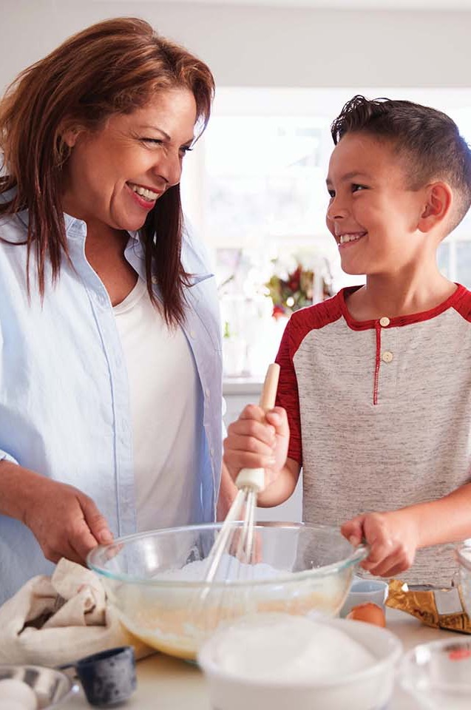
Engage your kids in small talks about underage drinking!
Small talks are short, casual, and frequent conversations with kids about alcohol.
Notes:
So, this brings us to the whole point of why we’re here. What can we do to prevent underage drinking? The answer may be simpler than you think! Have small talks. (Speaker reads slide)

Slide 17
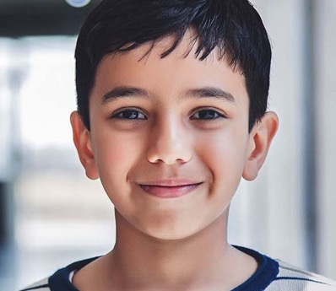
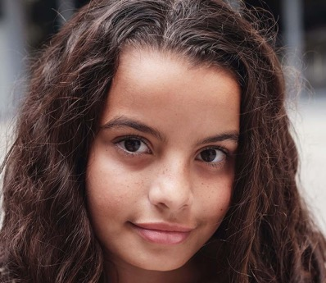
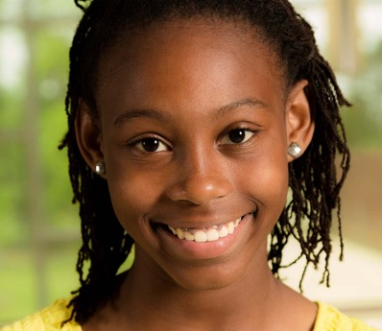
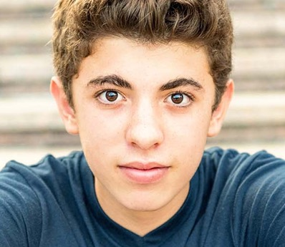
When should the conversation start?
Small talks are short, casual, and frequent conversations with kids about alcohol.
Age 8
Age 10
Age 12
Age 14
Notes:
It may be shocking to some of you here, but kids listen. Research shows that parents and other caring adults are the most powerful influence on children’s choices about underage drinking. But most people aren’t sure when to begin the conversations about alcohol. So, let’s ask the obvious question.
When do you think small talks about alcohol with children should begin? Look at the age groups on the slide; let's hear what a few of you think.
[PAUSE FOR GROUP INTERACTION]
Thanks for sharing.

Slide 18
Small talks about alcohol should begin around age 8.
Notes:
Well, while small talks make a difference at any age, research shows that conversations about alcohol should begin around the age of 8.

Slide 19
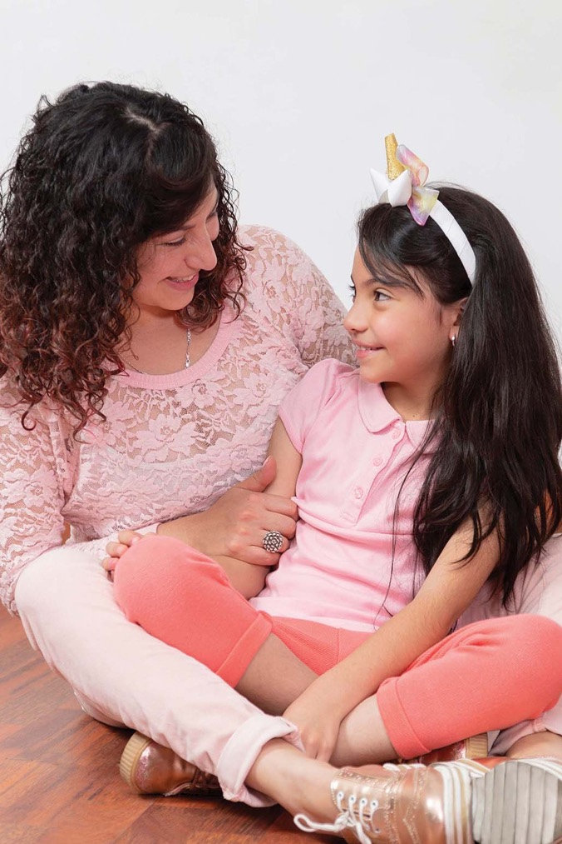
Why start talking early?
Kids start forming their opinions of alcohol around age 8.
Kids are starting to drink earlier than they used to.
It’s important to lead the conversation—not follow it!
Notes:
This might seem early to some of you, but here’s why it’s important to start the conversations when they’re young: (Speaker reads through slide)

Slide 20
Nervous?
It’s normal.
Small talks are short, casual, and frequent conversations with kids about alcohol.
Notes:
Now I know it’s a bit scary for parents to have these talks with their kids. But it really doesn’t have to be. Let’s see how some of your fellow Wisconsin parents were feeling:

Slide 21
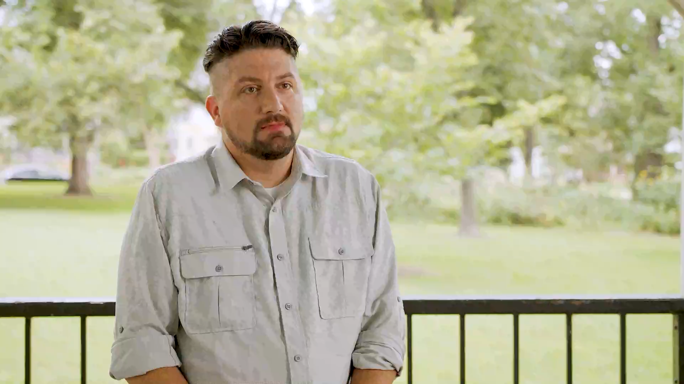
Notes:
So, as you may have learned from the video, it's completely normal to be nervous about having talks about alcohol with kids. But the most important thing to remember is just to get the conversation started…

Slide 22
Small talks can happen anywhere, and at any time.
While watching television
While watching television
While watching television
While watching television
While listening to music
While listening to music
While listening to music
While gaming
While gaming
At the store
Notes:
…Let’s look at a few opportunities for parents and caregivers to begin a small talk.
You could ask: “Why do you think that character drinks?”
[NEXT]
Ask: “Do your favorite artists sing about alcohol?”
[NEXT]
You could ask: “How do you and your friends have fun?”
[NEXT]
Ask: “What’s a good reason to buy alcohol?”

Slide 23
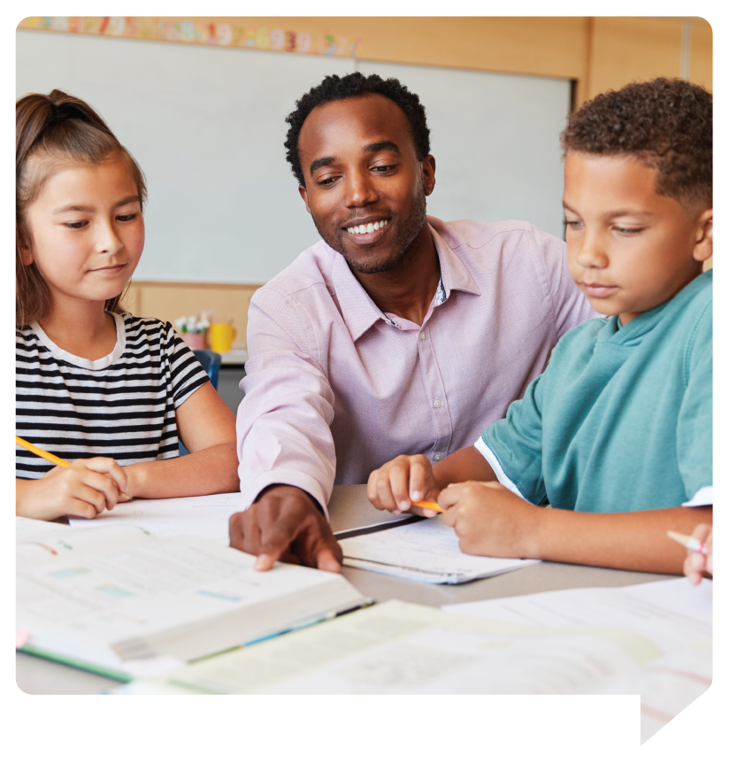
Here’s how certain role models can engage kids.
Teachers
Notes:
…Parents and caregivers are kids' number one influence when preventing underage drinking. But small talks can come from anyone. Role models like teachers, coaches, law enforcement, and other community leaders also play an important role in conversations about alcohol. Let's look at a few opportunities for role models to begin a small talk.
Look for ways to incorporate alcohol education into your lessons and how it can affect learning and their grades.

Slide 24
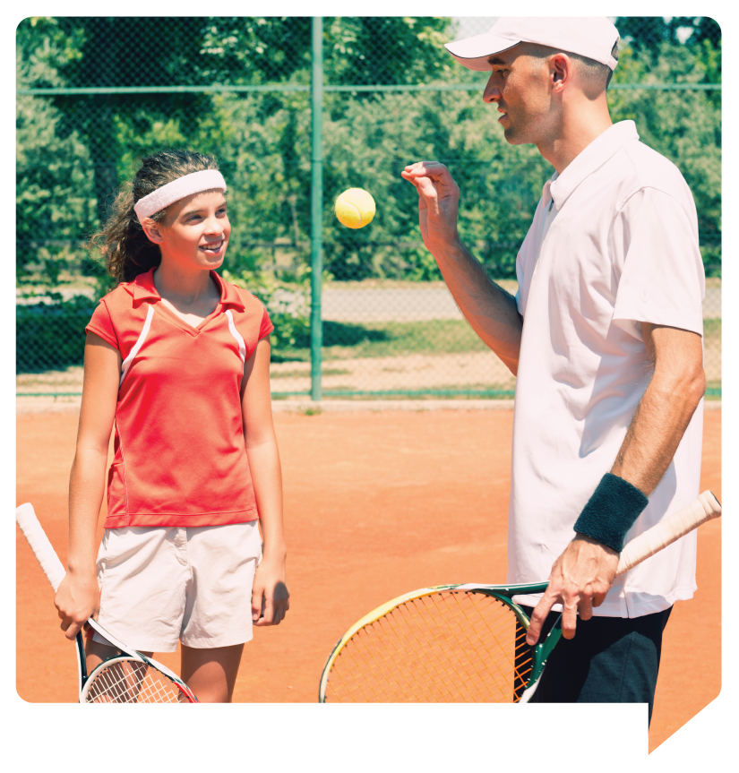
Here’s how certain role models can engage kids.
Teachers
Coaches
Notes:
Take time after practice to let kids know how alcohol can affect their body and performance.

Slide 25
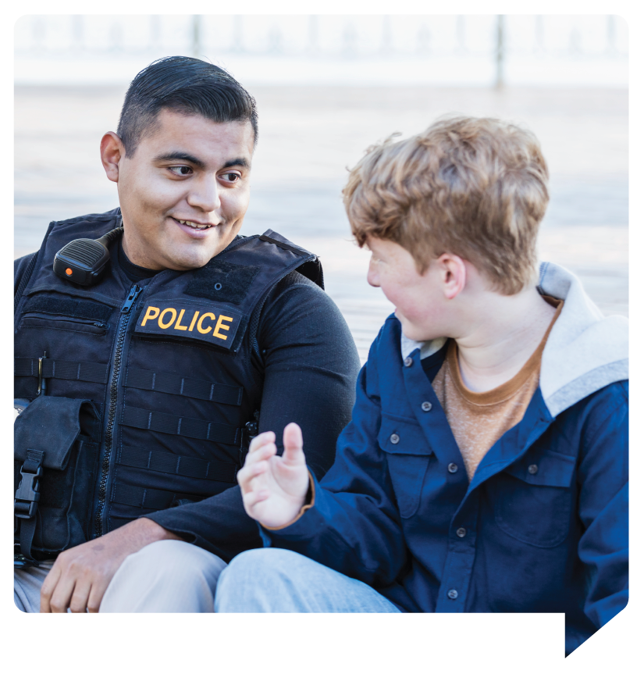
Here’s how certain role models can engage kids.
Teachers
Coaches
Law enforcement
Notes:
Interact with kids at school and in their neighborhoods and talk to them about how alcohol can lead to risky behavior.

Slide 26
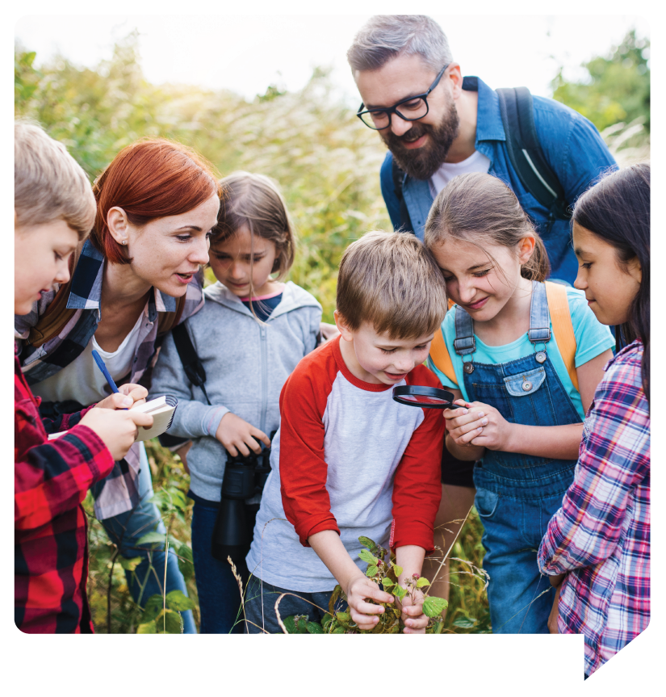
Here’s how certain role models can engage kids.
Teachers
Coaches
Law enforcement
Community leaders
Notes:
Look for ways to integrate underage drinking education into community events and focus on how alcohol can affect their mental health.

Slide 27
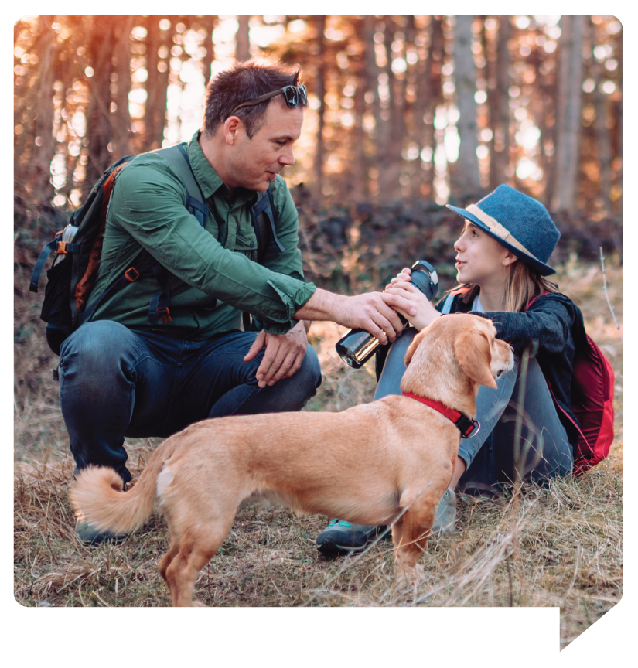
Here’s what to do for a successful small talk:
Keep it casual
Notes:
So, as you can see, there’s always an opportunity to talk with kids about alcohol. But once we get the conversations started, we want to make it as successful as possible by knowing what to do and what we can say.
No need for a fancy script or setting. Just think about what you want to share with your kid before diving in.

Slide 28
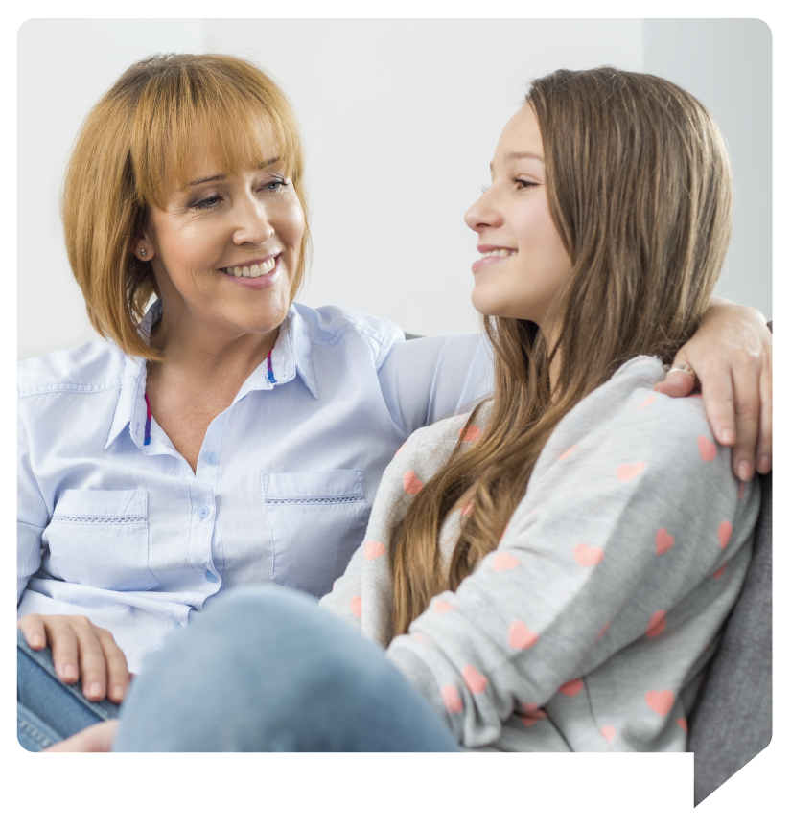
Here’s what to do for a successful small talk:
Keep it casual
Control your emotions
Notes:
Be prepared to hear things you may not expect or like. If this happens, just make sure to relax and only talk about your feelings when you’re calm.

Slide 29
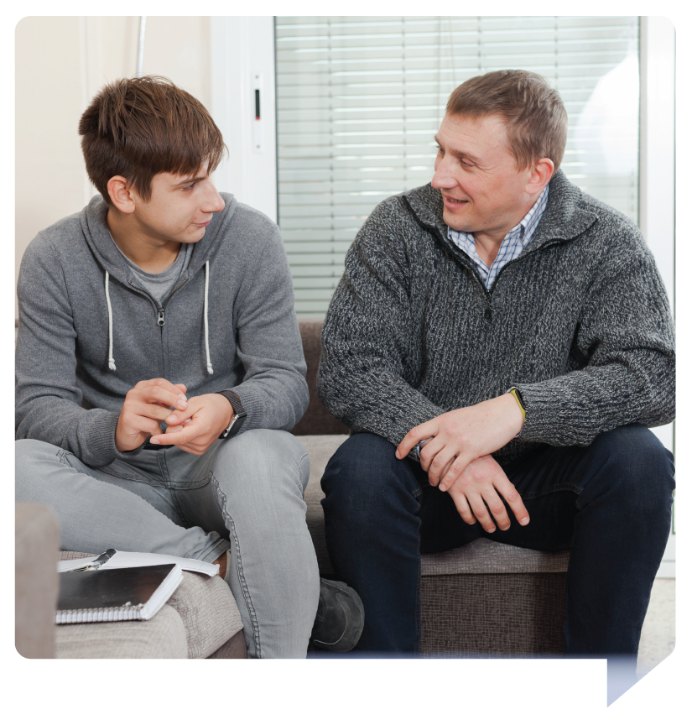
Here’s what to do for a successful small talk:
Keep it casual
Control your emotions
No answer? Don’t panic
Notes:
It’s ok to admit when you need to learn more. Remember, you don’t have to discuss everything all at once.

Slide 30
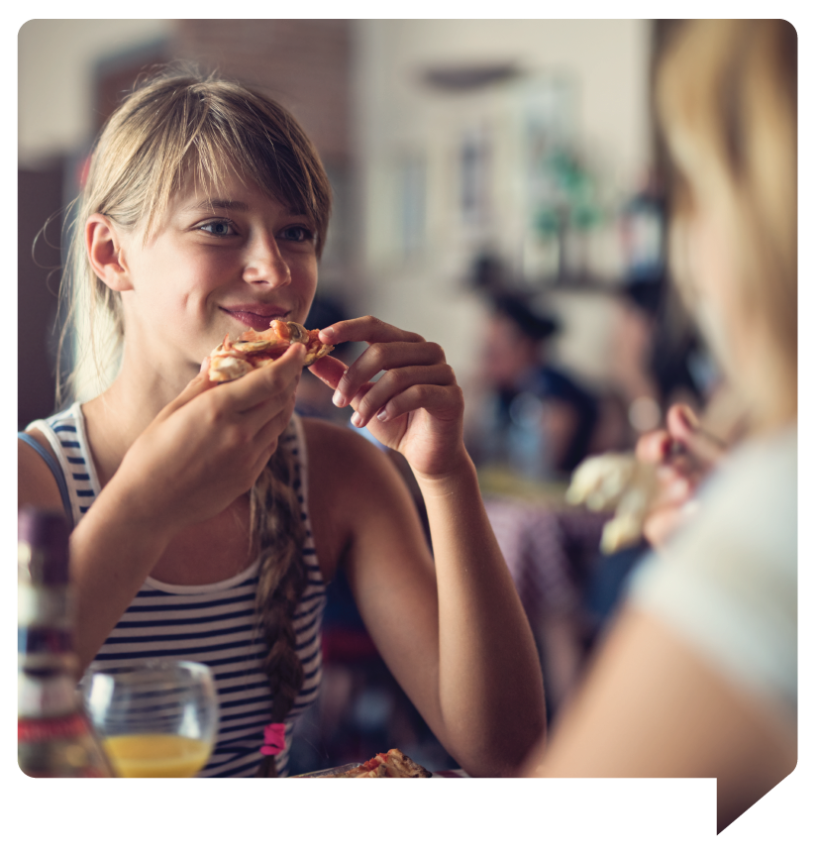
Here’s what to do for a successful small talk:
Keep it casual
Control your emotions
No answer? Don’t panic
Set clear behavior expectations
Notes:
Make it known that underage drinking is illegal and unacceptable and enforce your house rules consistently.

Slide 31
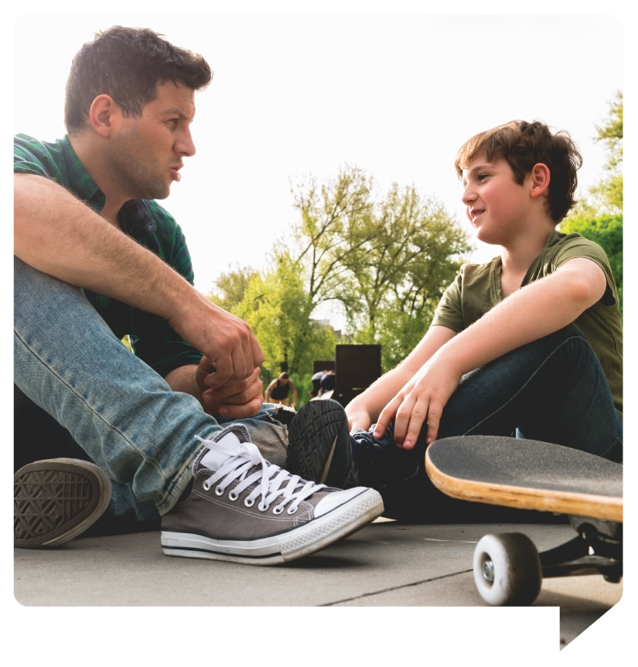
Here’s what to do for a successful small talk:
Keep it casual
Control your emotions
No answer? Don’t panic
Set clear behavior expectations
Be a nonjudgmental resource
Notes:
Become your kid’s go-to for information and support. Take all their questions seriously and provide calm, nonjudgmental answers.
So now that we know how to approach a small talk, let’s look at some things we can say for a successful small talk.

Slide 32
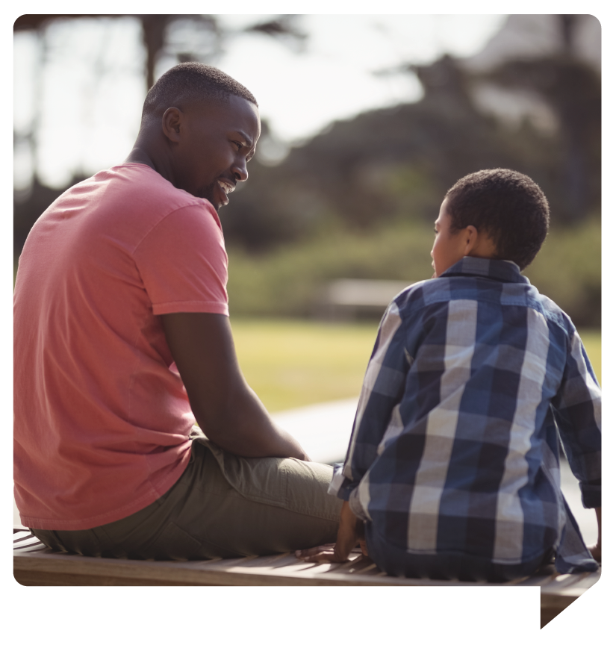
What to say for a successful small talk:
Ask open-ended questions
Notes:
Get them talking by avoiding yes or no questions. Ask about their friends' choices, school experiences, or perceptions about alcohol use in games, TV, and social media.

Slide 33
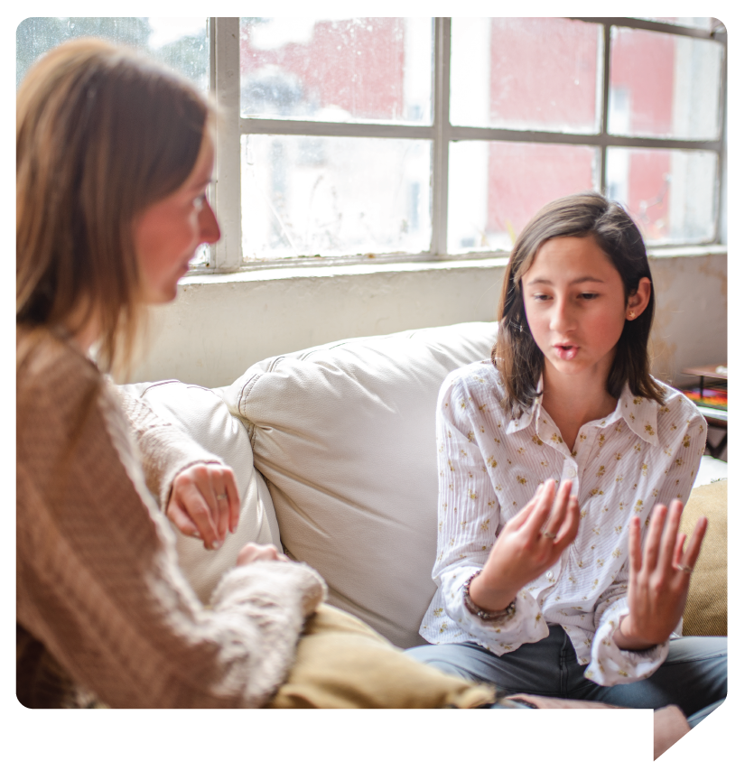
What to say for a successful small talk:
Ask open-ended questions
Listen, listen, listen
Notes:
Show them you are interested in what they have to say. Ask questions and let their responses guide the discussion.

Slide 34
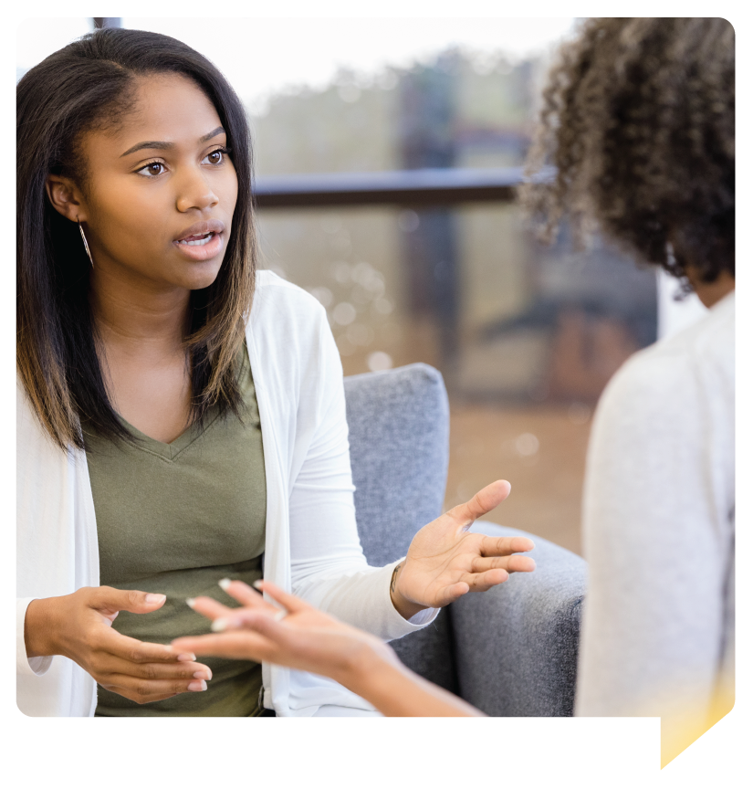
What to say for a successful small talk:
Ask open-ended questions
Listen, listen, listen
Talk about the tough stuff
Notes:
Kids can sometimes think of alcohol as a way to cope with stress or trauma. Give them a safe place to talk about those feelings instead.

Slide 35
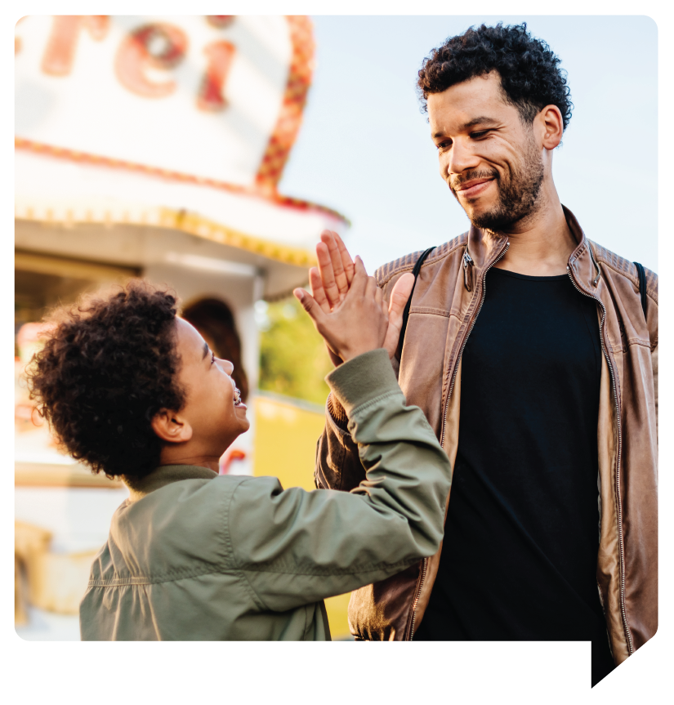
What to say for a successful small talk:
Ask open-ended questions
Listen, listen, listen
Talk about the tough stuff
Don’t keep score
Notes:
If your kid’s info or opinion differs from yours, avoid correcting them. It’s important not to lecture them, use scare tactics, or shut them down with facts.

Slide 36
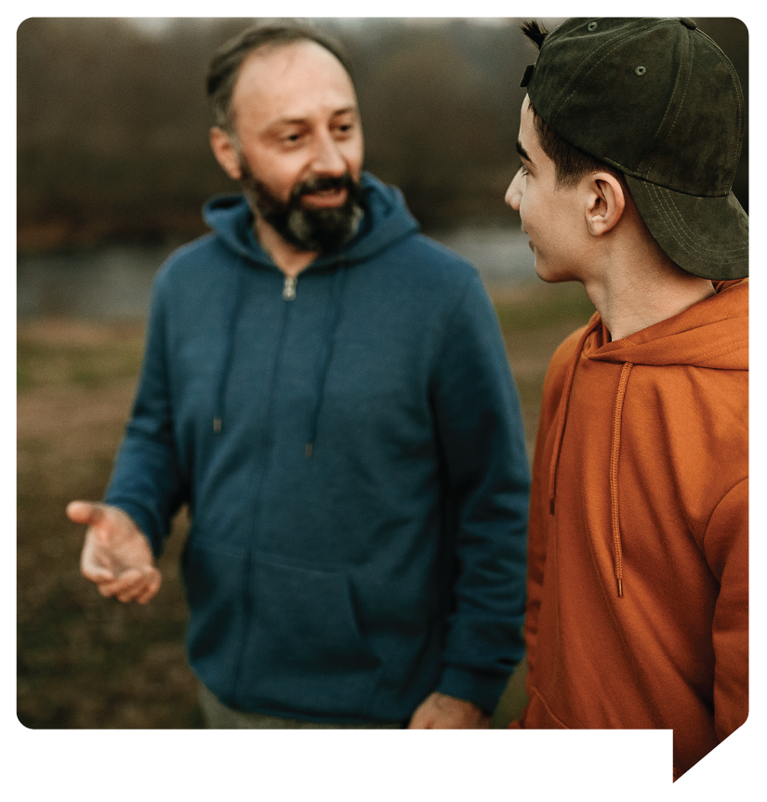
What to say for a successful small talk:
Ask open-ended questions
Listen, listen, listen
Talk about the tough stuff
Don’t keep score
Consider sharing your own story
Notes:
What you share is up to you. But revealing your own choices, regrets, or family history may help kids understand what’s at stake.
Now, no matter how many talks we have with kids about alcohol, the reality is—they will find themselves in a situation where there’s pressure to drink. Beyond educating them about all the risks of underage drinking, it’s important to give them the tools to make the right choice when faced with peer pressure. So, what can we do?

Slide 37
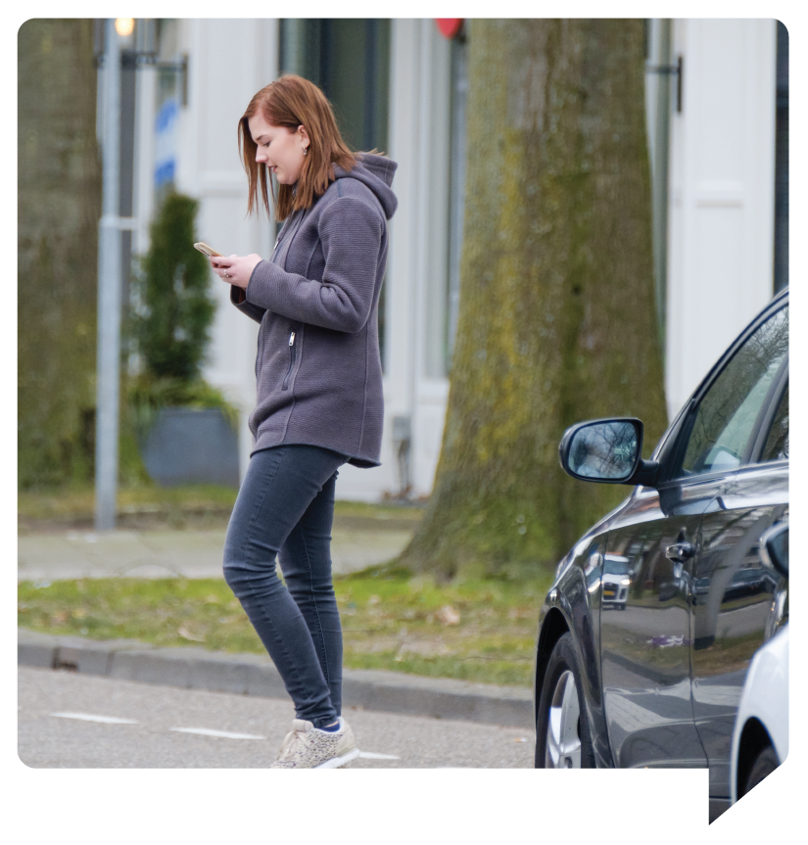
Help kids plan an exit strategy
Pick a code word
Pick a code word
Provide a safe space
Pick a code word
Provide a safe space
Practice “no thanks” responses
Notes:
Come up with a code word that your child can text to you if they need a ride home or an excuse to leave a sticky situation.
[NEXT]
Let your child know that your home is a safe space for them and their friends when they want to leave a situation with alcohol or other peer pressures.
[NEXT]
Before your kids go out, practice ways they can say no to alcohol like, “No thanks, I have a big day tomorrow.” or “No way! My parents are very strict and find out everything.”
Alright, now that we’ve given you some tips and tricks for managing small talks, you may be asking yourself…

Slide 38
What if I mess up?
What if I mess up?
You can’t.
Notes:
What if I mess it up? It’s always tough having serious conversations with your kids, but the fact is…
[NEXT]
…you can’t. Having a lot of talks (even do-overs) is the point. Every attempt shows kids you care and are paying attention.

Slide 39
Bouncing back
Notes:
Remember, mistakes are ok, and you won't always have the right answers, but practice makes perfect, and there's always a way to bounce back. Let's look at how some Wisconsin parents deal with difficult situations during small talks.
PLAY VIDEO

Slide 40
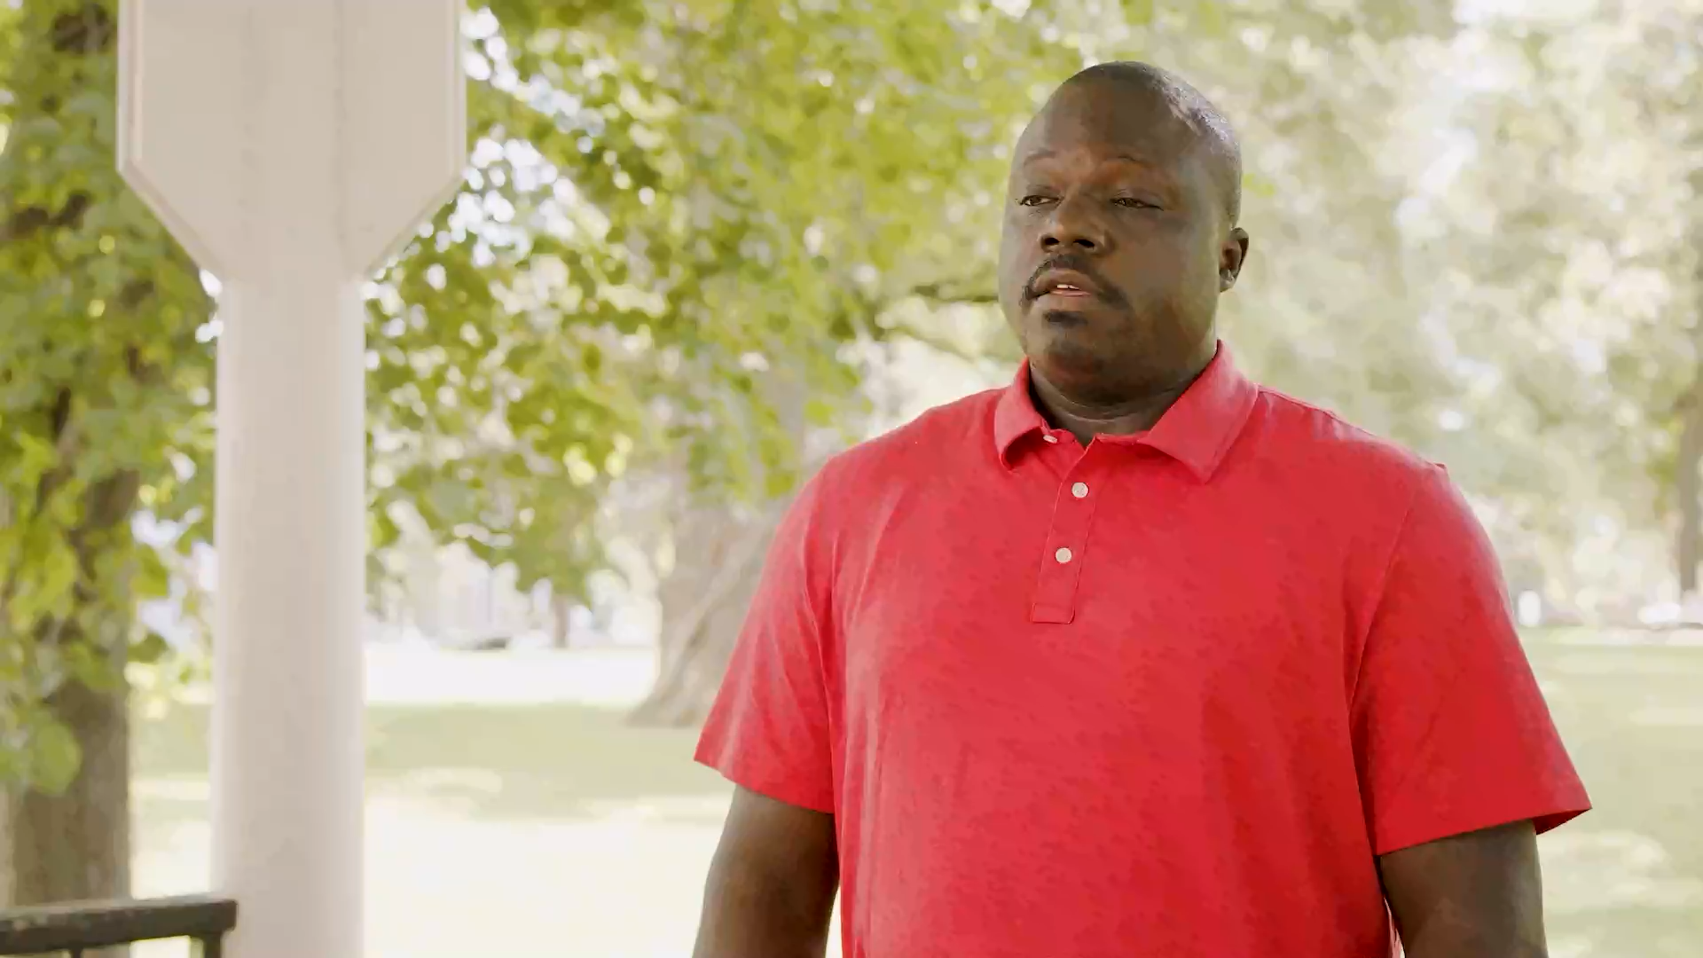
Notes:
As you can see, small talks aren't always going to be easy or the most comfortable. Kids are very perceptive, and they're going to ask some tough questions—questions you may not have the answers to. But when kids start asking questions, that means they are engaged and listening—and that's a great sign. So, before we look at a few tough questions kids might ask, and how you can answer them, I want to do a little practice run. Let's hear how a few of you might answer this question.

Slide 41
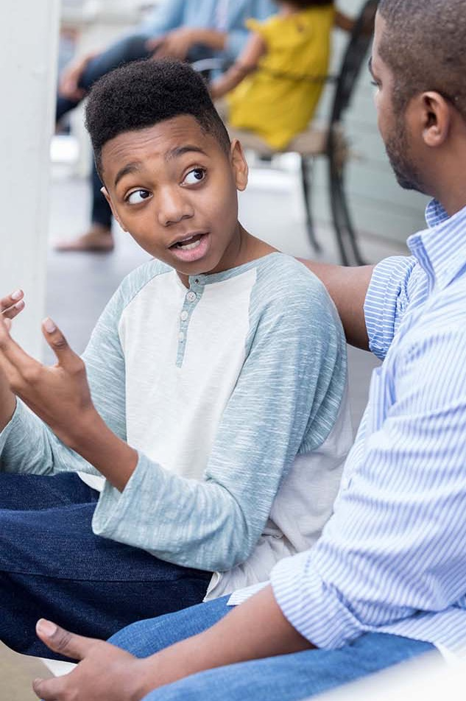
How are you going to answer the tough questions?
Notes:
If drinking is bad, why do you do it?
That's a tough one, right? Think about it for a second, and let's hear how some of you might answer this.
[PAUSE FOR GROUP INTERACTION]
Thanks for sharing.

Slide 42
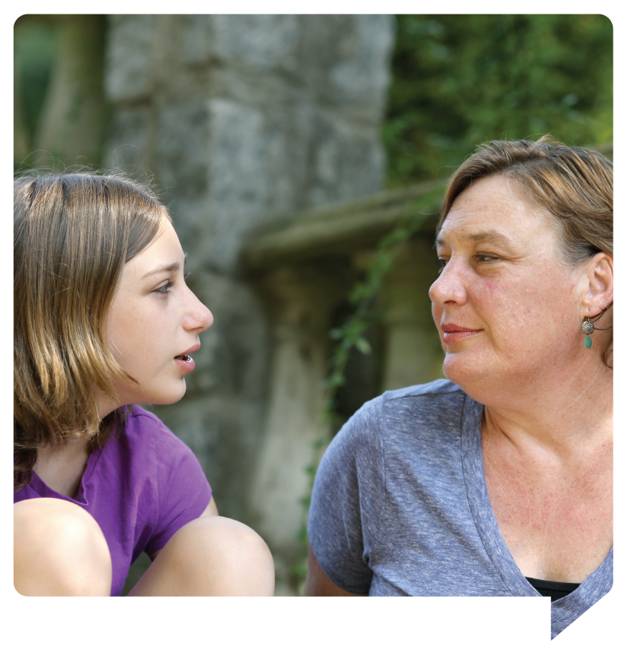
Some tough questions and how you can answer them
Why do people get drunk?
Why do people get drunk?
Did you drink when you were a kid?
Why do people get drunk?
Did you drink when you were a kid?
Why do I need to wait until I’m 21 to drink?
Notes:
Now let's look at some other tough questions you might face and ways you can answer them.
Try saying, “Sometimes adults don’t mean to get drunk, but they aren’t careful when they’re drinking, and they have too much.”
[NEXT]
If you did, be honest. Say something like, “I did try alcohol when I was a kid, but looking back, I realize how risky it was and how it could have affected my health.”
[NEXT]
Tell them, “Your body and brain are still developing and drinking alcohol can affect the way you grow and how your brain develops. Also, it’s the law.”
Now as important as small talks are—that's just the beginning. We can do many actions every day in our homes and our communities to prevent underage drinking. Let's look at a few ways we can make a difference.

Slide 43
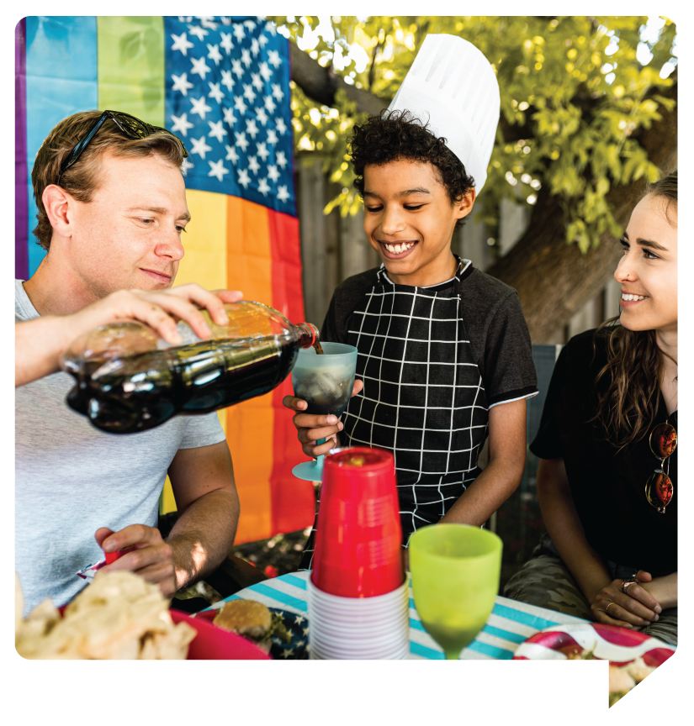
What can we do beyond talking to make an impact?
Model responsible drinking
Model responsible drinking
Obey Wisconsin laws
Model responsible drinking
Obey Wisconsin laws
Set clear boundaries
Model responsible drinking
Obey Wisconsin laws
Set clear boundaries
Lock up your alcohol
Notes:
Taking a stand against underage drinking doesn’t mean you have to give up alcohol. But, if you drink in front of your child, drink in moderation. Also, don’t talk about drinking as a way to manage stress.
[NEXT]
Familiarize yourself with all of Wisconsin’s drinking laws and let your kids know they are non-negotiable. Remember, it’s illegal for anyone under 21 to drink, and it’s illegal to provide minors with alcohol or a place to drink.
[NEXT]
Make it clear that you have a zero-tolerance policy with alcohol and there are consequences if rules are broken.
[NEXT]
As we mentioned earlier, most kids get their alcohol at home. If you keep alcohol in your house—the easiest thing you can do is lock it up. You can always contact your local coalition and ask where you can get fridge locks.

Slide 44
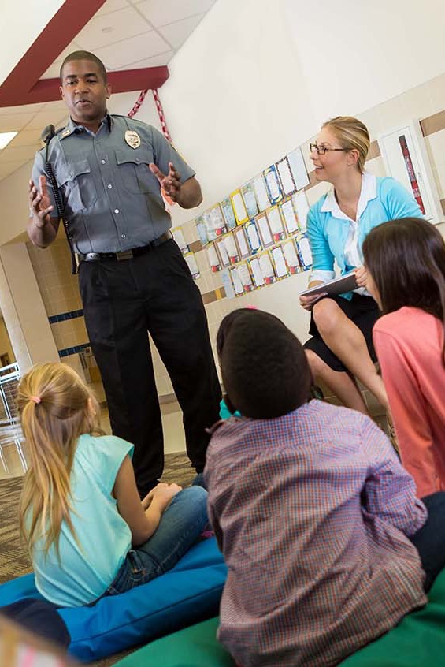
Make an impact outside your home
Join a coalition or become a volunteer
Support alcohol-free events in your community
Promote policies that can help limit alcohol access
Provide alcohol education for children and families
Notes:
One of the best things we can do to help reduce the underage drinking statistics in Wisconsin is to get involved on a community level. This means engaging schools, health care systems, employers, government agencies, and prevention coalitions. Together, here’s how we can make an impact.

Slide 45
Signs of a child who may be struggling with alcohol
Mood swings and/or a defensive attitude
Problems at school, like failing grades or poor attendance
Breaking family rules
A lack of interest in their appearance or favorite activities
Notes:
As we finish up, I'd like to touch on one last subject briefly. The reality is, as much as we do to help our kids make the right choices about alcohol, it's important to recognize when kids may be struggling and in need of help. Take some time to talk with your kids if you notice: (Speaker reads through the slide)

Slide 46
Here’s how to get help
Call: 211
Text: Your ZIP code to 898211
Online search: addictionhelpwi.org
Notes:
If you are concerned about a child who is struggling with alcohol, here’s where to find help.
<SHORT PAUSE FOR VIEWERS TO READ INFORMATION>

Slide 47
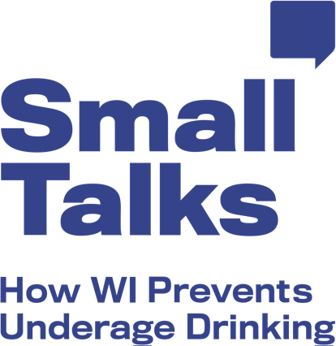
smalltalkswi.org
Notes:
If you'd like more information on underage drinking facts, talking tips, advice from other parents, or how to take action, visit the Small Talks website. You can also sign up for the Small Talks email list to receive quarterly newsletters, and information on steps to receive free Small Talks merchandise.
<SHORT PAUSE FOR VIEWERS TO READ INFORMATION>

Slide 48
QUESTIONS?
Notes:
Before we go, I’d like to open the floor for some discussion and answer any questions you may have.

Slide 49
Here’s how you can reach
[Insert image here]
[Name]
Notes:
If you'd like to learn more, please don't hesitate to contact me and, again, you can find more information on the small talks website.

Slide 50
THANK YOU!
Notes:
Thank you!

